Slide 1

B Meson Decays
Kirby Hermansen - Julia Cline

Slide 2
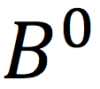
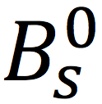


Motivation
We want to measure the ratio of the lifetime of
and mesons.
Only a difference of quarks between the two
Several other decays present (Julia)

Slide 3
Goal
Create a method of measuring the decay times from the decay times or vice versa.
Why is this useful?
We can use lifetimes to tune models that predict the occurrences of certain decays. If observed rates are different than the prediction, we have found certain decays that could be part of non-standard model physics!

Slide 4
So what can we do?
Reconstruct the visible part of the decays (no neutrino)
Although the neutrino biases the decay times, a ratio of decay times partially corrects this bias
But reconstruction efficiencies select decays based on their kinematics (momenta and lifetime-related observables), and different physical properties introduce differences in detector acceptances vs. decay time, which is problematic
Goal: We try to mitigate these differences

Slide 5
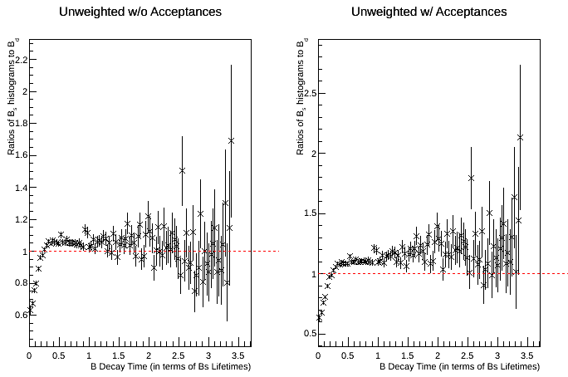
ACCEPTANCES

Slide 6
How?
Eliminate kinematic dependencies across the two decays by reweighting
But we do not have enough events to reweight all the variables, so we identify a subset of relevant variables
Distributions such as Z-Momentum, Transverse-Momentum, decay angles, decay times, etc. for particles involved in the decay
Compare these many options and pick the best one (or two or three)

Slide 7
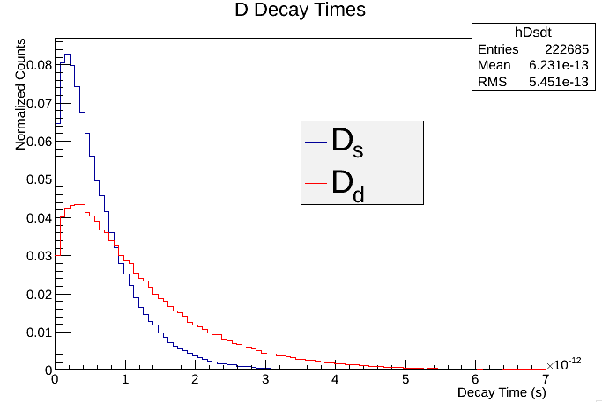
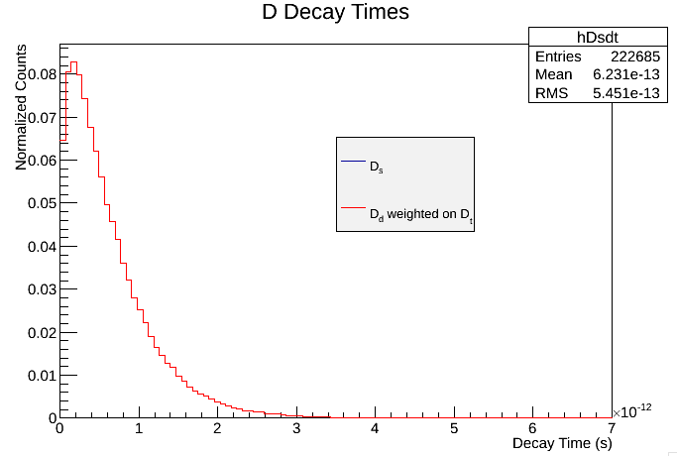
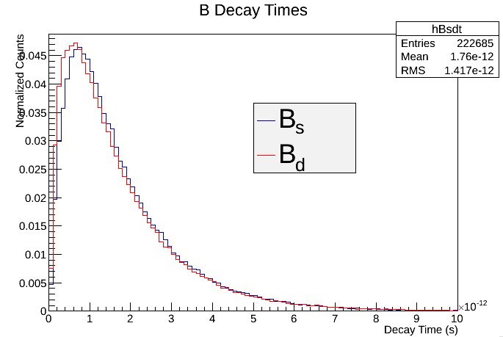
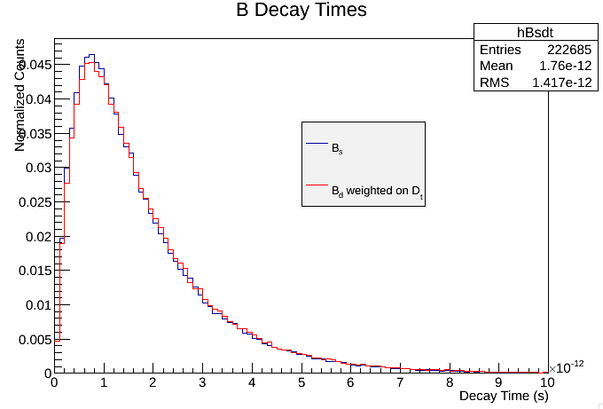
THE WEIGHTING (IS THE HARDEST PART)

Slide 8
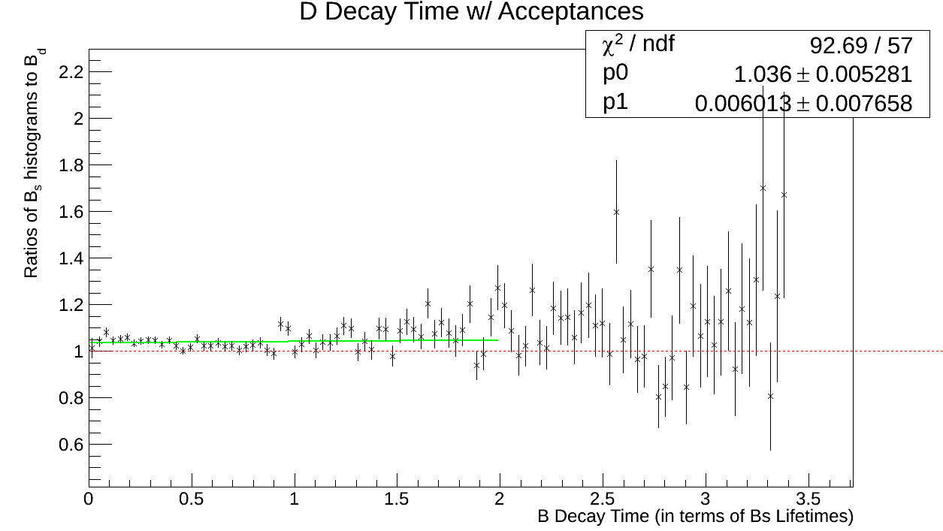
A Good start

Slide 9
Other Kinematic Distributions
Muon Transverse and Z momentums
B Transverse and Z momentums
Opening angles of the B and D decays
Invariant masses
WHY THESE?
Decay time and momentum are obvious (differences will clearly bias results)
Angle and mass differences implicitly bias results

Slide 10
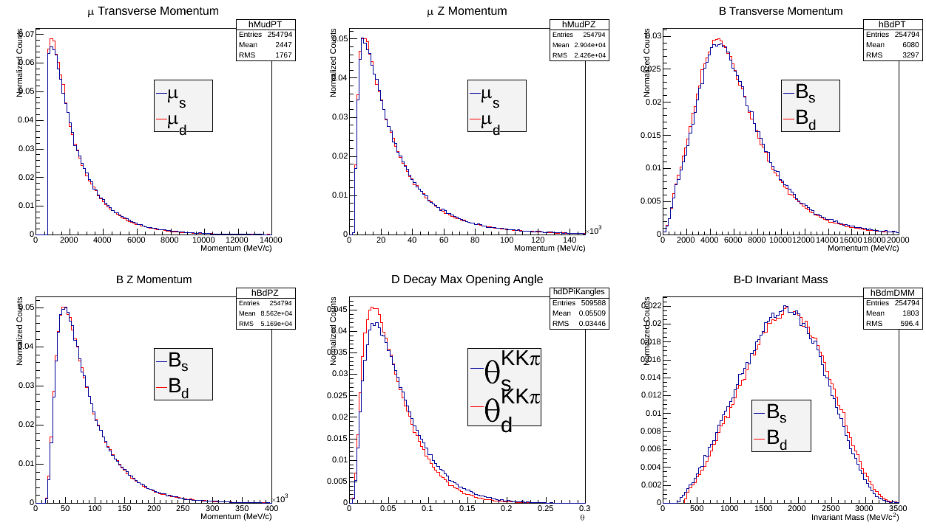
Best options

Slide 11
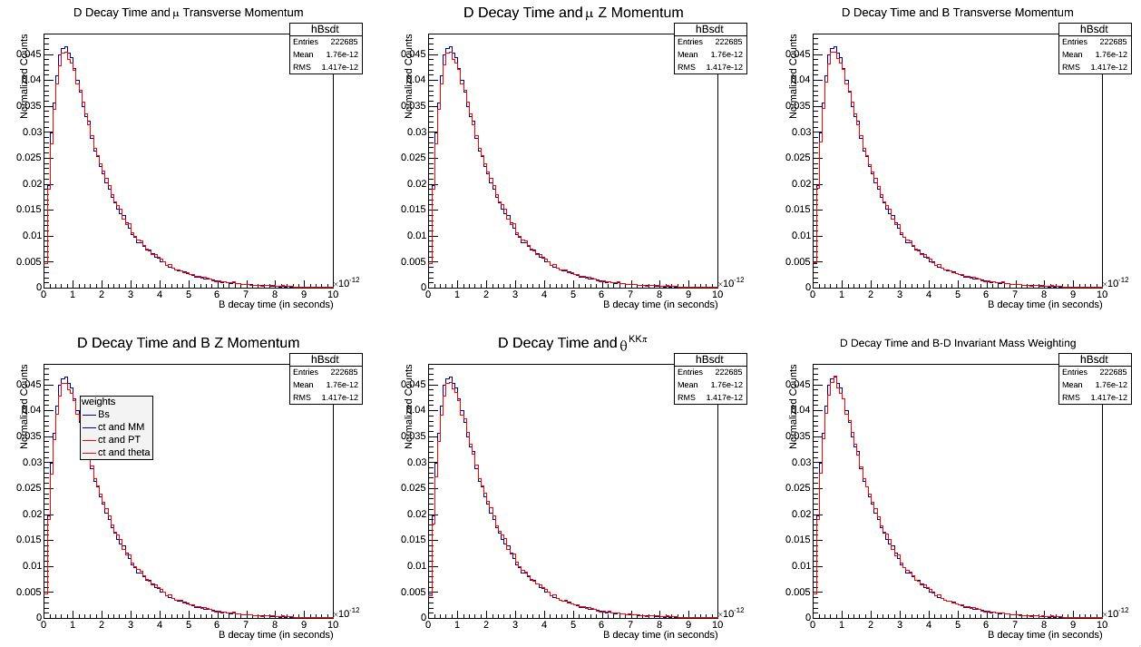
A first glimpse

Slide 12
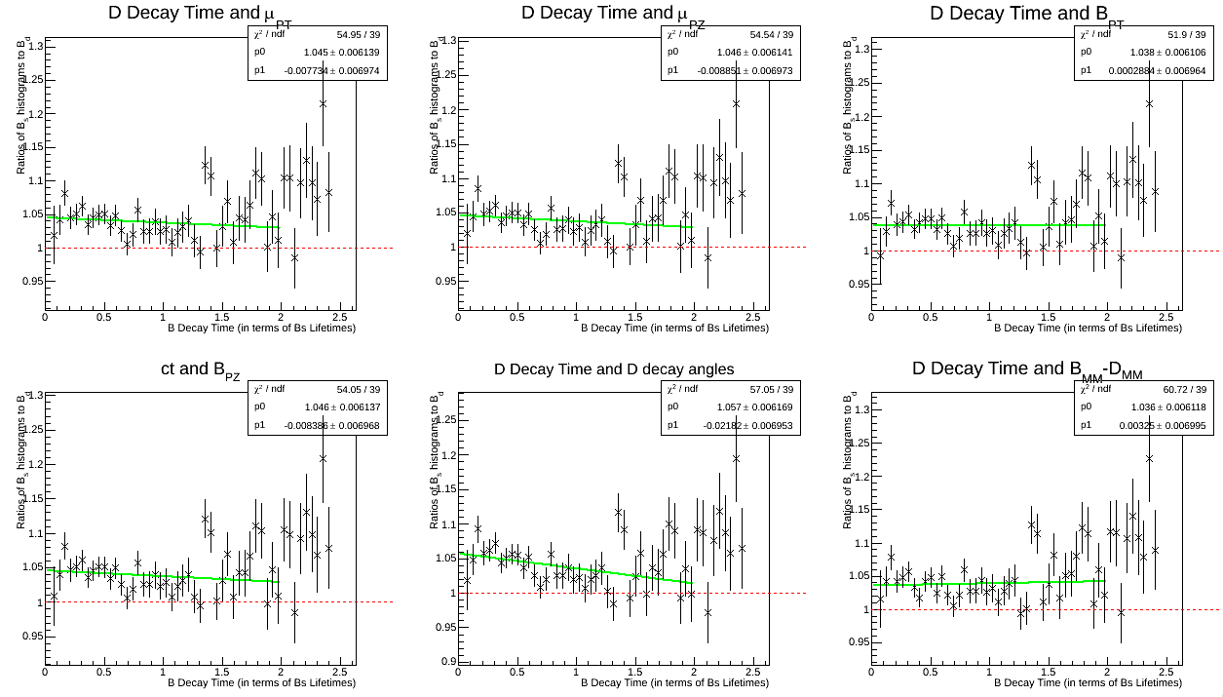
Ratio of visible decay-time acceptances

Slide 13
Conclusions/future
SUMMARY
We now have a procedure to resolve the kinematic differences between decays through reweighting
An extensive revision of the possible weighting options reveals two or three candidates that flatten the acceptances towards 1/1
WHAT’S NEXT?
Apply these weights to new MC Ntuples (more events)
Include various selection techniques to eliminate background (Julia)
Look at possible 3-D weighting
Apply weights to ACTUAL DATA!

Slide 14

Beauty Meson Sample Composition
The core of my project is to assess the sample composition, but I also work with Kirby on weighting and acceptances.
Previously, I was working on detector acceptances.
Now, I am working on
  Isolating decays from the mixture of and decays
  Then, within the decays, isolating the particular decay mode.

Slide 15

Isolating Decay Modes of
Our desired decay mode:
But there are many other decay modes that generate the products we observe!
Why does this matter?
We are finding the ratio of lifetimes of the and the to try to achieve a cancellation of instrumental effects. But this only works if the and decay dynamics and topology are the same. It doesn’t work if other decay modes are contaminating our and samples in a way we don’t control.
Notes:
B0 composed of a bottom antiquark and a down quark. (B0s is anti bottom and strange, B+ is anti bottom and up).
Mesons are subatomic particles composed of one quark and one antiquark, bound together by the strong force. They have the radius of about one femtometer, which is roughly 2/3 the size of a proton or neutron. They appear as short-lived products of very high-energy interactions in matter, between particles made of quarks.

Slide 16
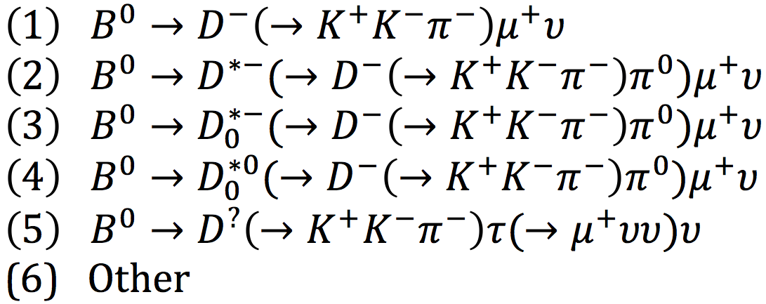
Decay Modes and Intermediate Resonances of
Decay Mode | Percent of Total Decays (that generate ΚΚπμν)
(1) | 52.6
(2) | 38.1
(3)+(4) | 1.7
(5) | 1.3
(6) | 6.3
Notes:
B0 composed of a bottom antiquark and a down quark. (B0s is anti bottom and strange, B+ is anti bottom and up).
Mesons are subatomic particles composed of one quark and one antiquark, bound together by the strong force. They have the radius of about one femtometer, which is roughly 2/3 the size of a proton or neutron. They appear as short-lived products of very high-energy interactions in matter, between particles made of quarks.

Slide 17
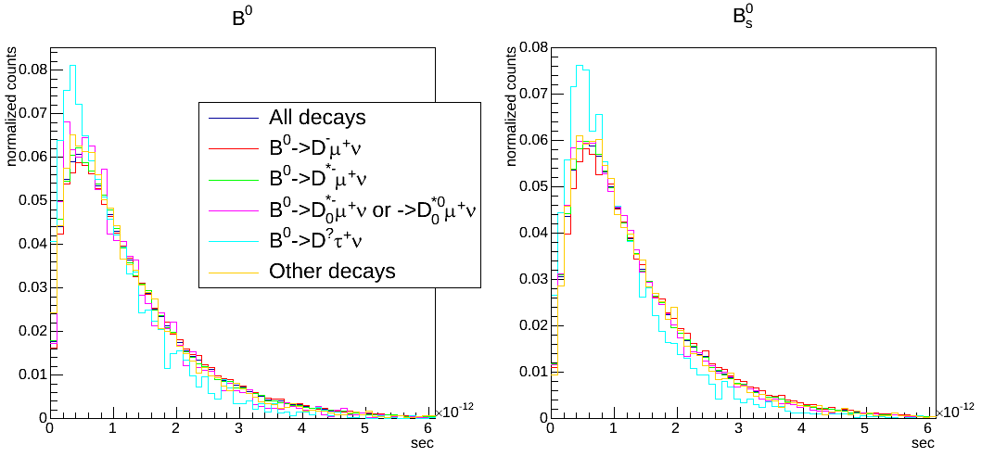
Observed Decay Times for Different Decays (normalized)
Notes:
All labels are the same for Bs if you add an s subscript. The only difference is pink, which doesn’t have the second decay.

Slide 18
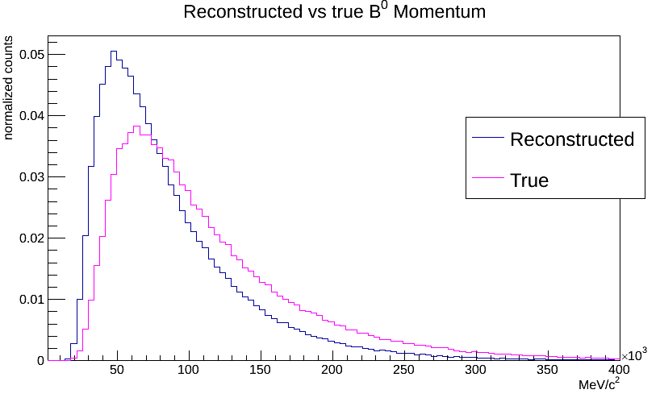
Missing Neutrino

Slide 19
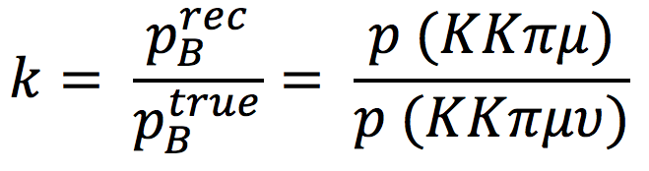
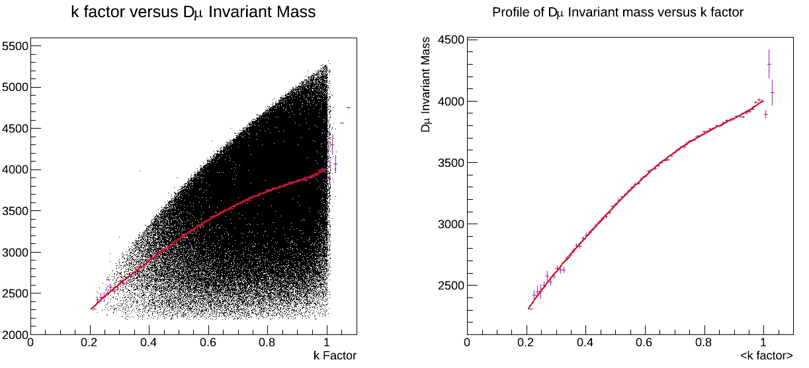
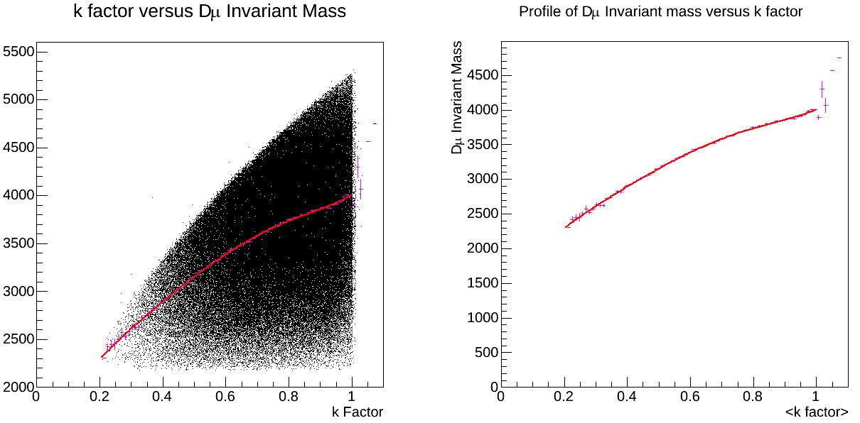
K-Factor Correction

Slide 20
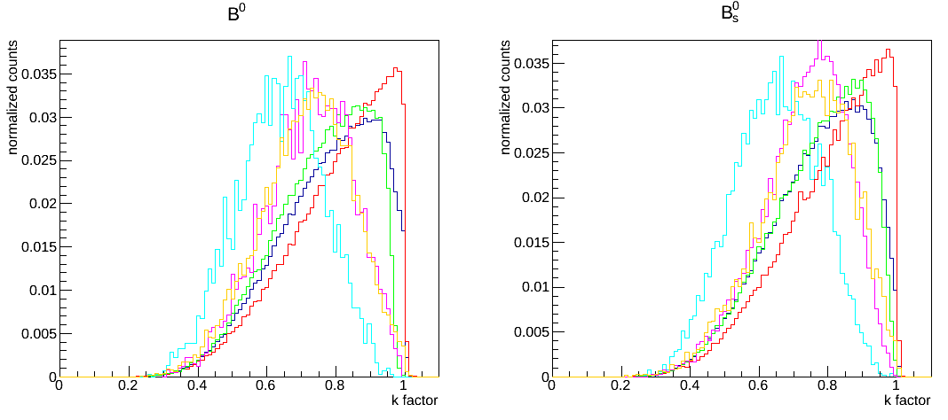
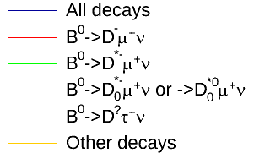
K-factors for Different Decays (normalized)
For the future: need to estimate the effect of differing k-factors on the final lifetime measurement
Notes:
Also, computed statistics and did this for each of the three B mesons.

Slide 21
Distinguishing Between and
The can decay to a final state similar to the one we are interested in. This decay is about 1/10th as frequent as that of the , so it provides a significant background.

Slide 22
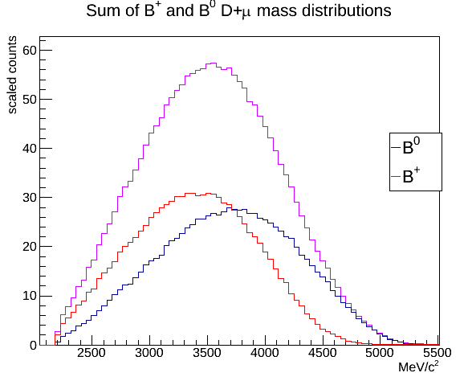
Distinguishing Between and
Notes:
For equal amounts of B+ and B0 entries

Slide 23
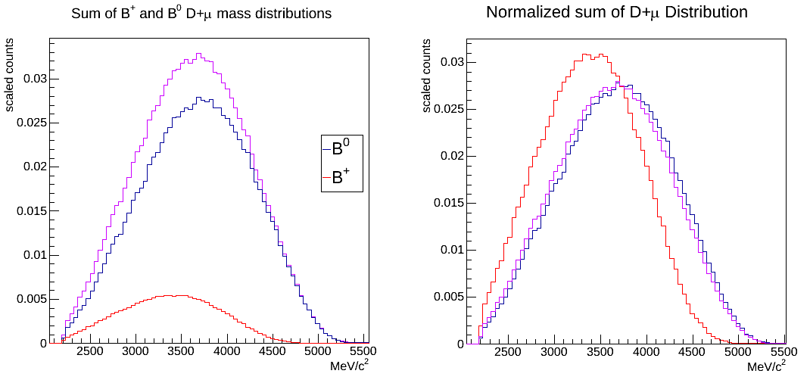
An Additional Complication
So far, we have had equal amounts of and entries. What if the amount of entries are not equal?
For 15% entries:

Slide 24
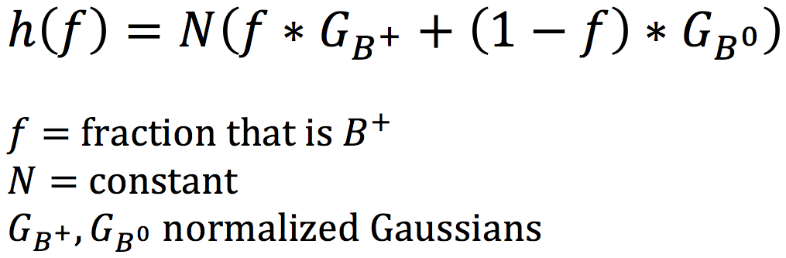
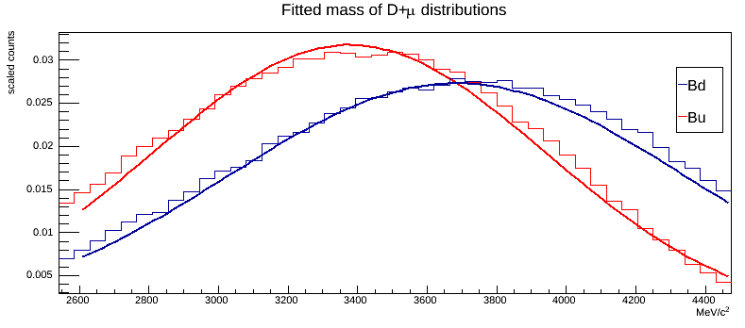
Solution: Fitting
Idea: fit Gaussians to the and mass distributions, call them
Then fit the following function to the unknown distribution:

Slide 25
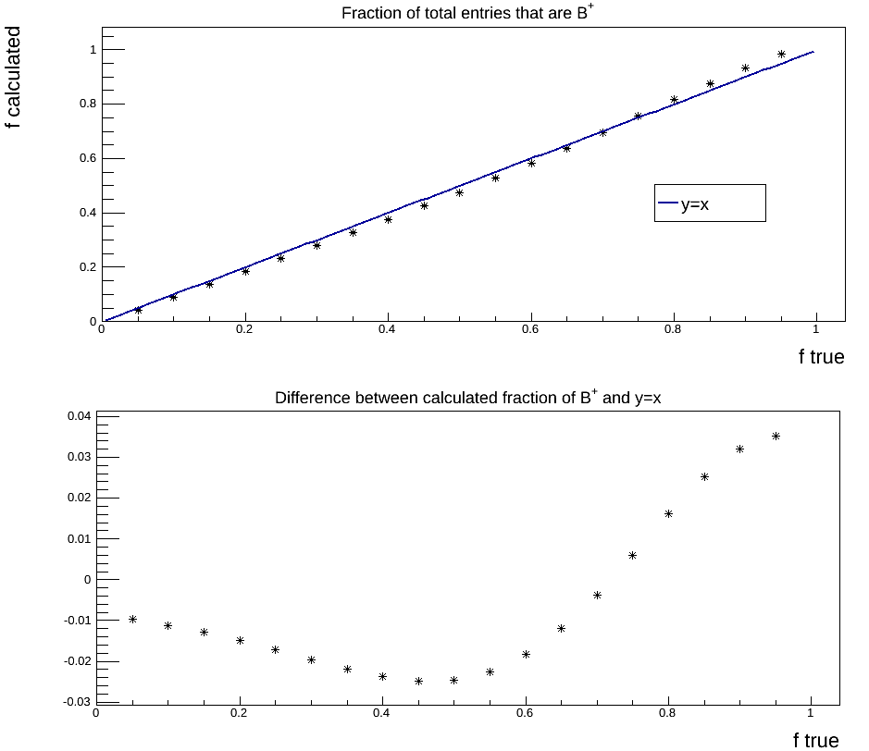
How Accurately can we Reconstruct the Composition of the Simulation?

Slide 26
Summary
Decay modes
    The shape of the lifetime distribution is dependent on the decay mode. The k-factor distribution significantly varies with decay mode.
Differentiating between and
    The fit I developed can determine the percent of background fairly well.

Slide 27
Acknowledgements – Special thanks
Diego Tonelli (CERN)
Angelo Di Canto (CERN)

