Slide 1
NA62: The LKr Electronics
Matt Huszagh

Slide 2
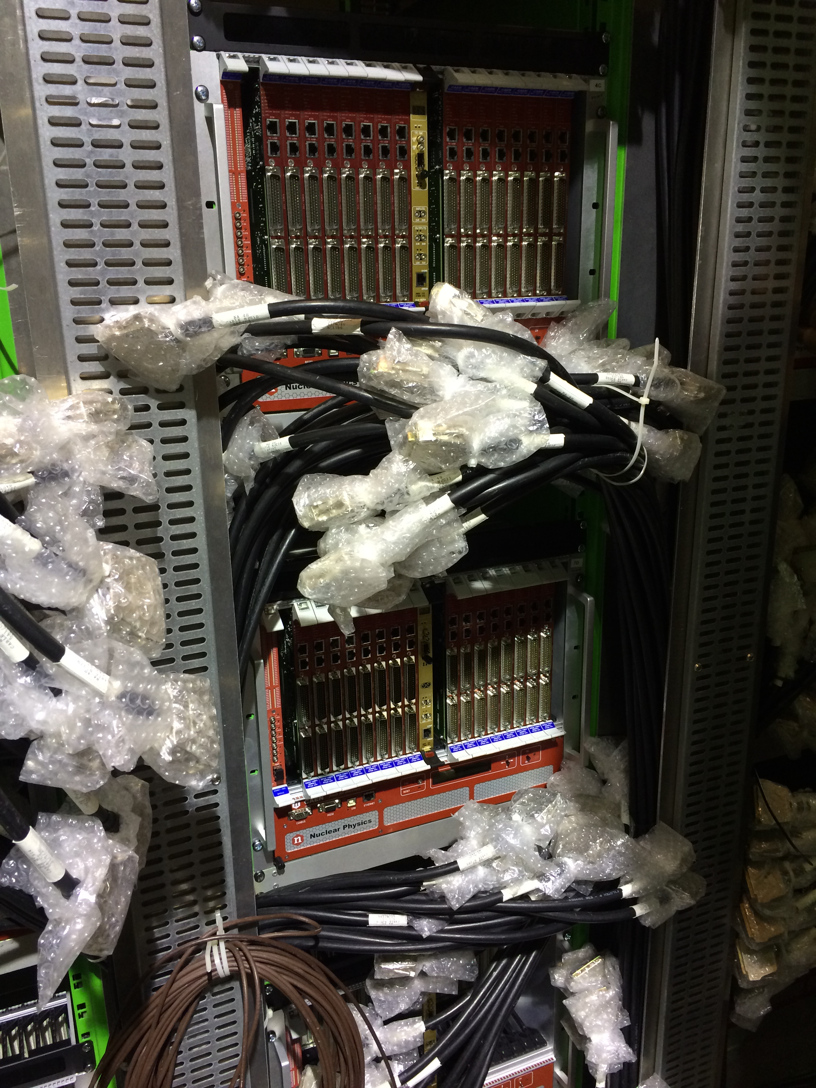
Installation & Setup (1/5)
Crate Setup
8 vertical columns of 4 crates
Almost all installed

Slide 3
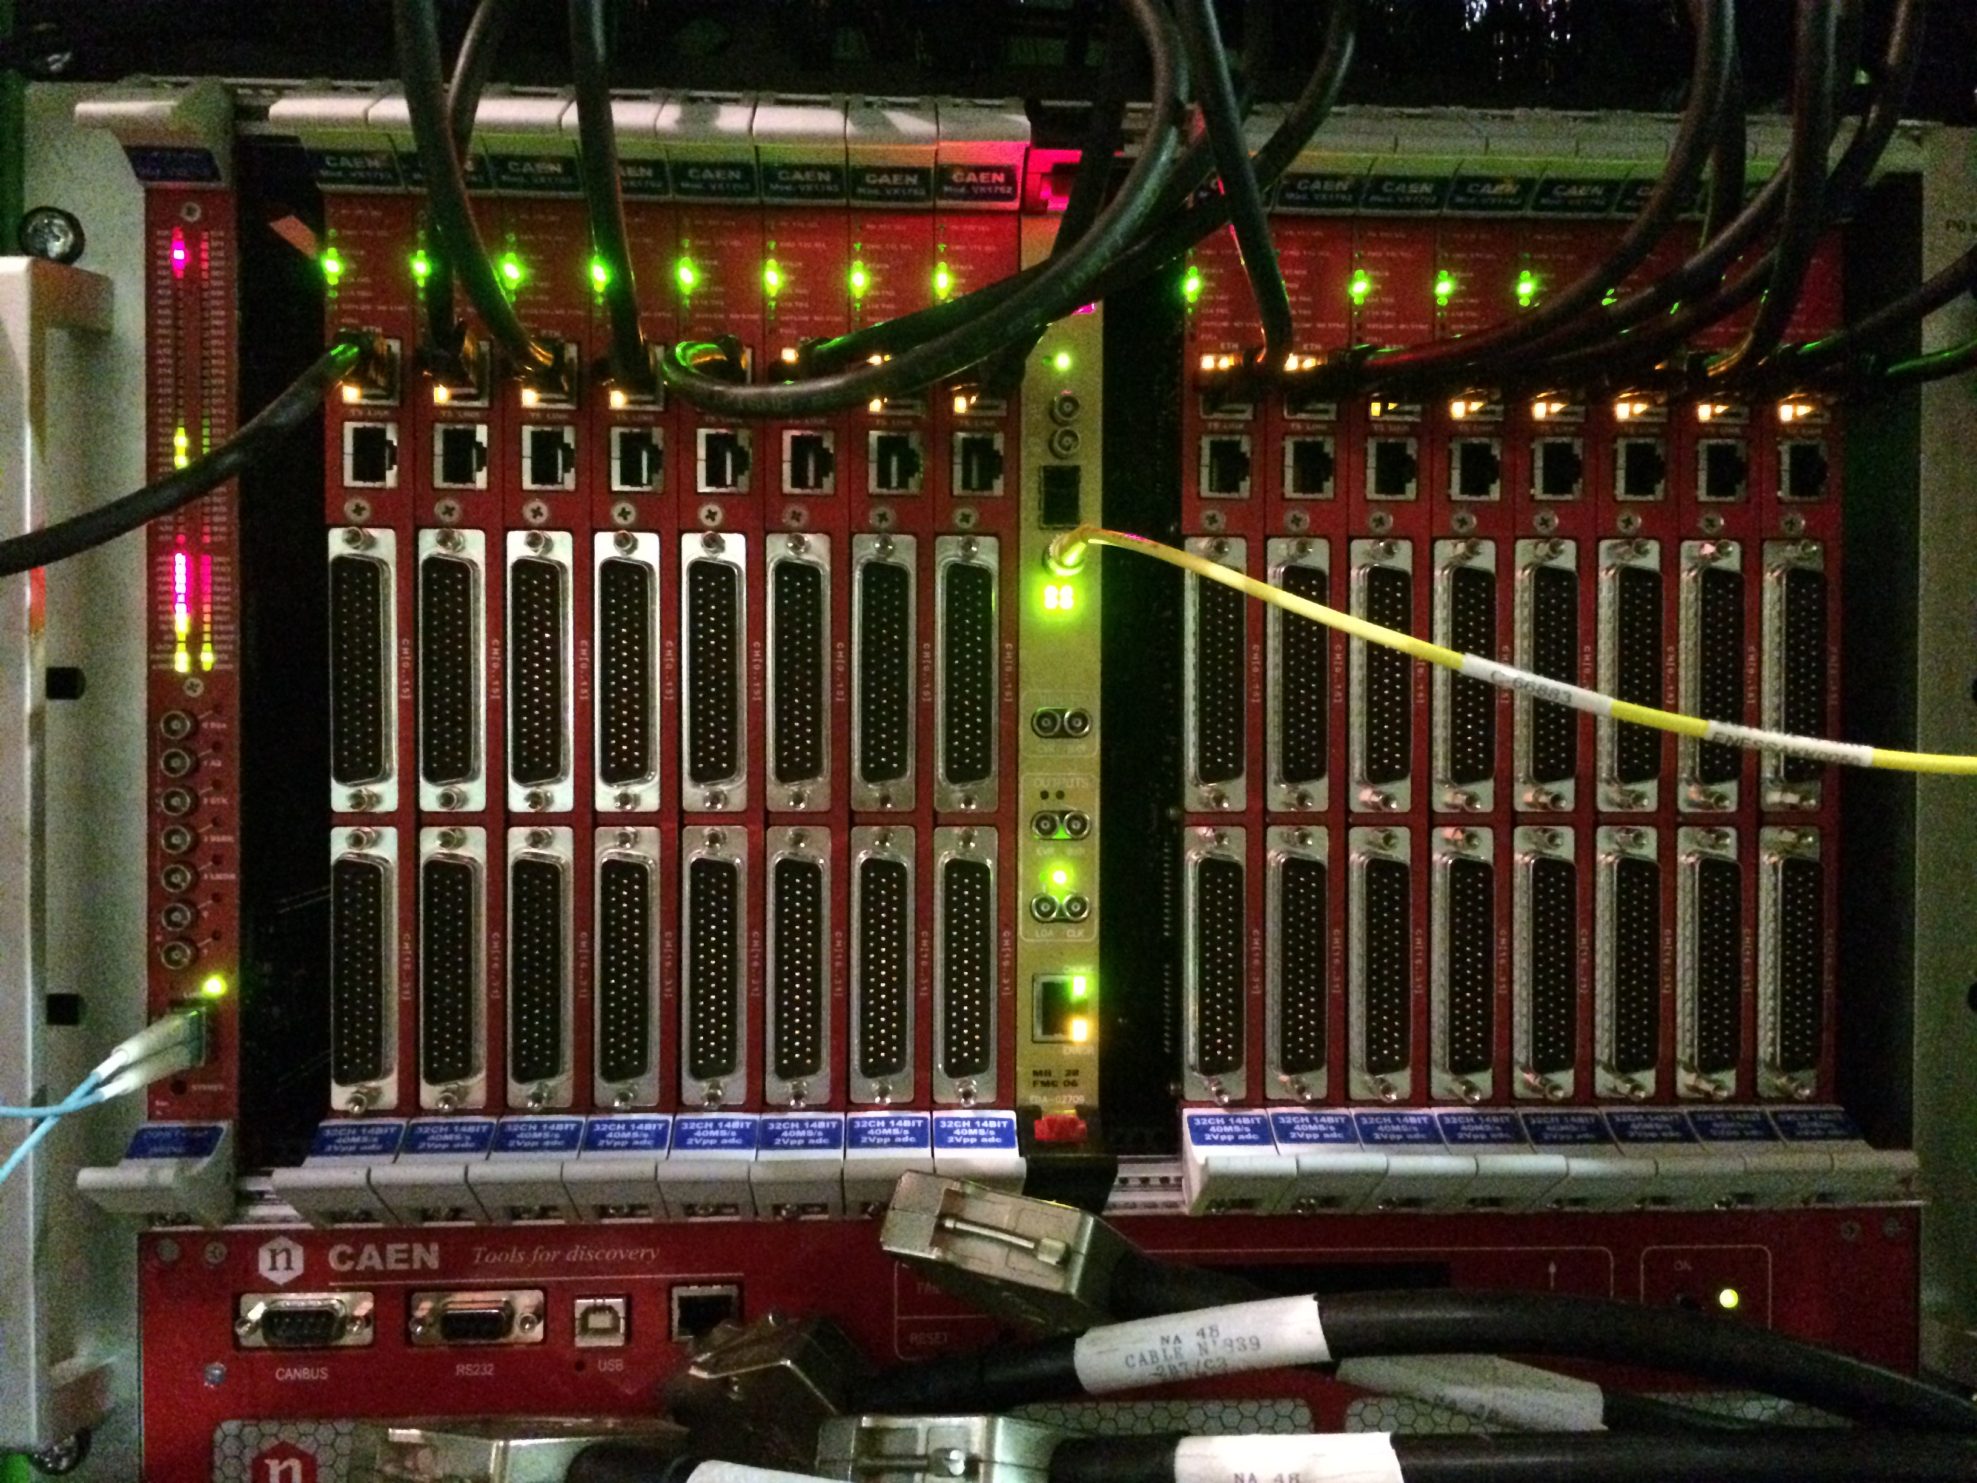
Installation & Setup (2/5)
Calorimeter Readout Module Setup
CREAMS: each crate contains 16 readout modules, one bridge and one motherboard (about half installed)
Bridge: allows communication with the PC farm
Motherboard: receives the L1 trigger from the PC farm and administers it to the CREAMs
Ethernet connection: the creams send data via Ethernet ports to the switch, which then sends that data to the PC farm

Slide 4
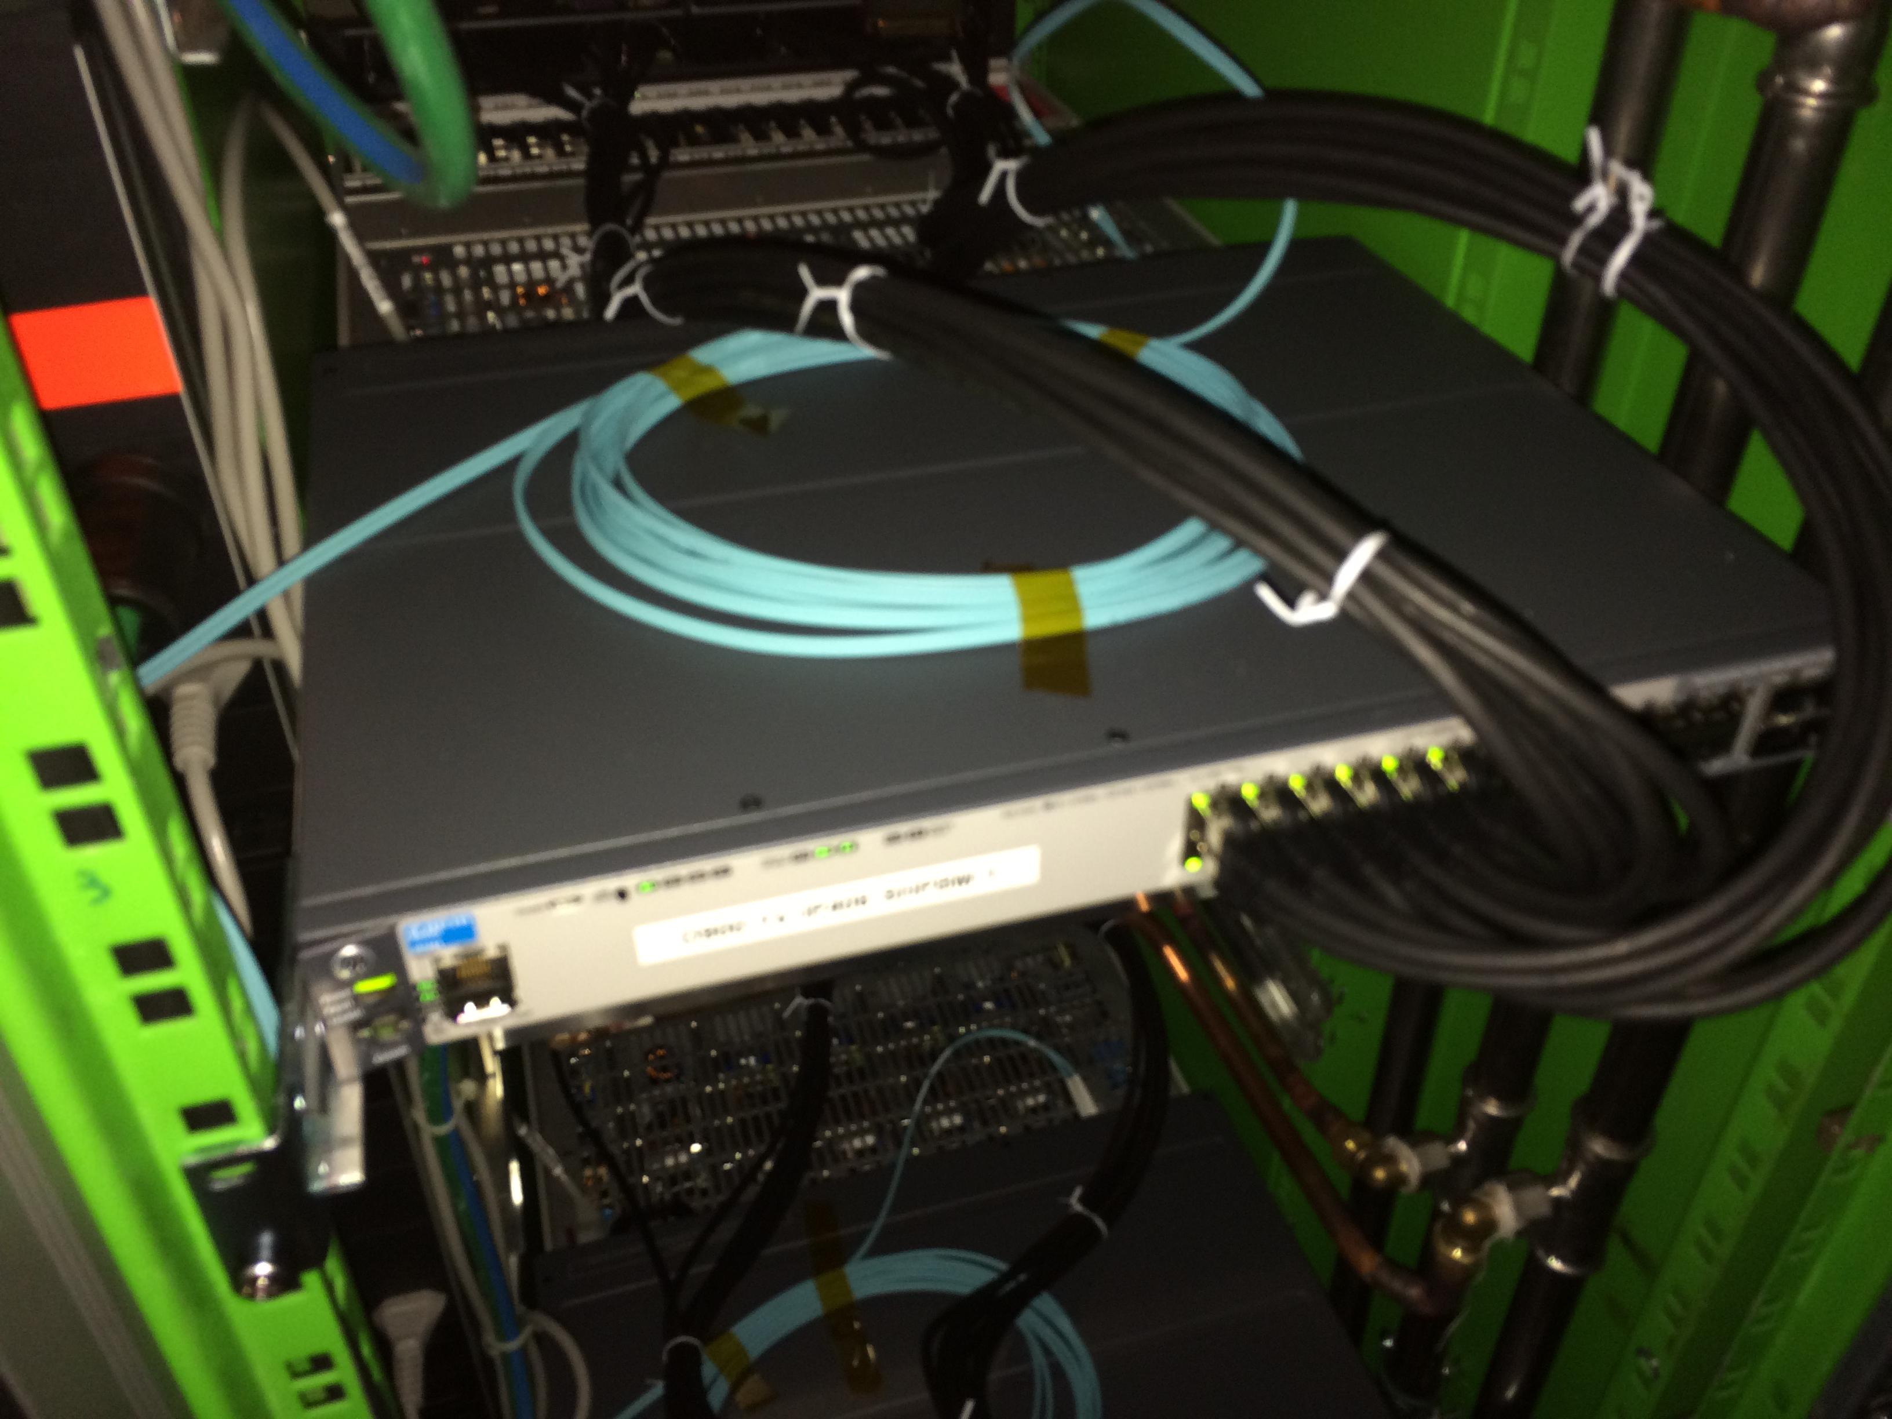
Installation & Setup (3/5)
The Switch
Collects data from the CREAMs via Ethernet cables
Combines data from all 16 CREAMS into a single 10Gb/s Ethernet connection, which is then sent up to the PC farm
We have all of these installed but only 4 are currently configured
There is also a problem with fitting the backplane behind the switches

Slide 5
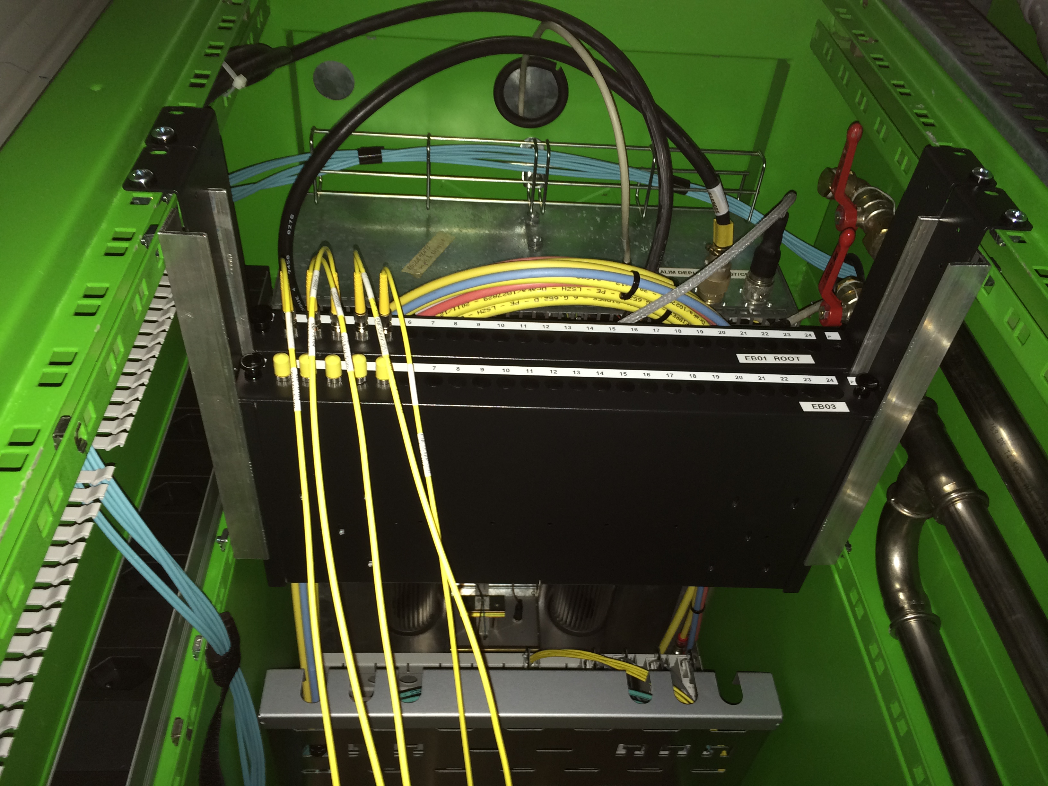
Installation & Setup (4/5)
The Trigger
Administers the L1 trigger from the PC farm to each motherboard, which in turn administers the trigger to each individual CREAM

Slide 6
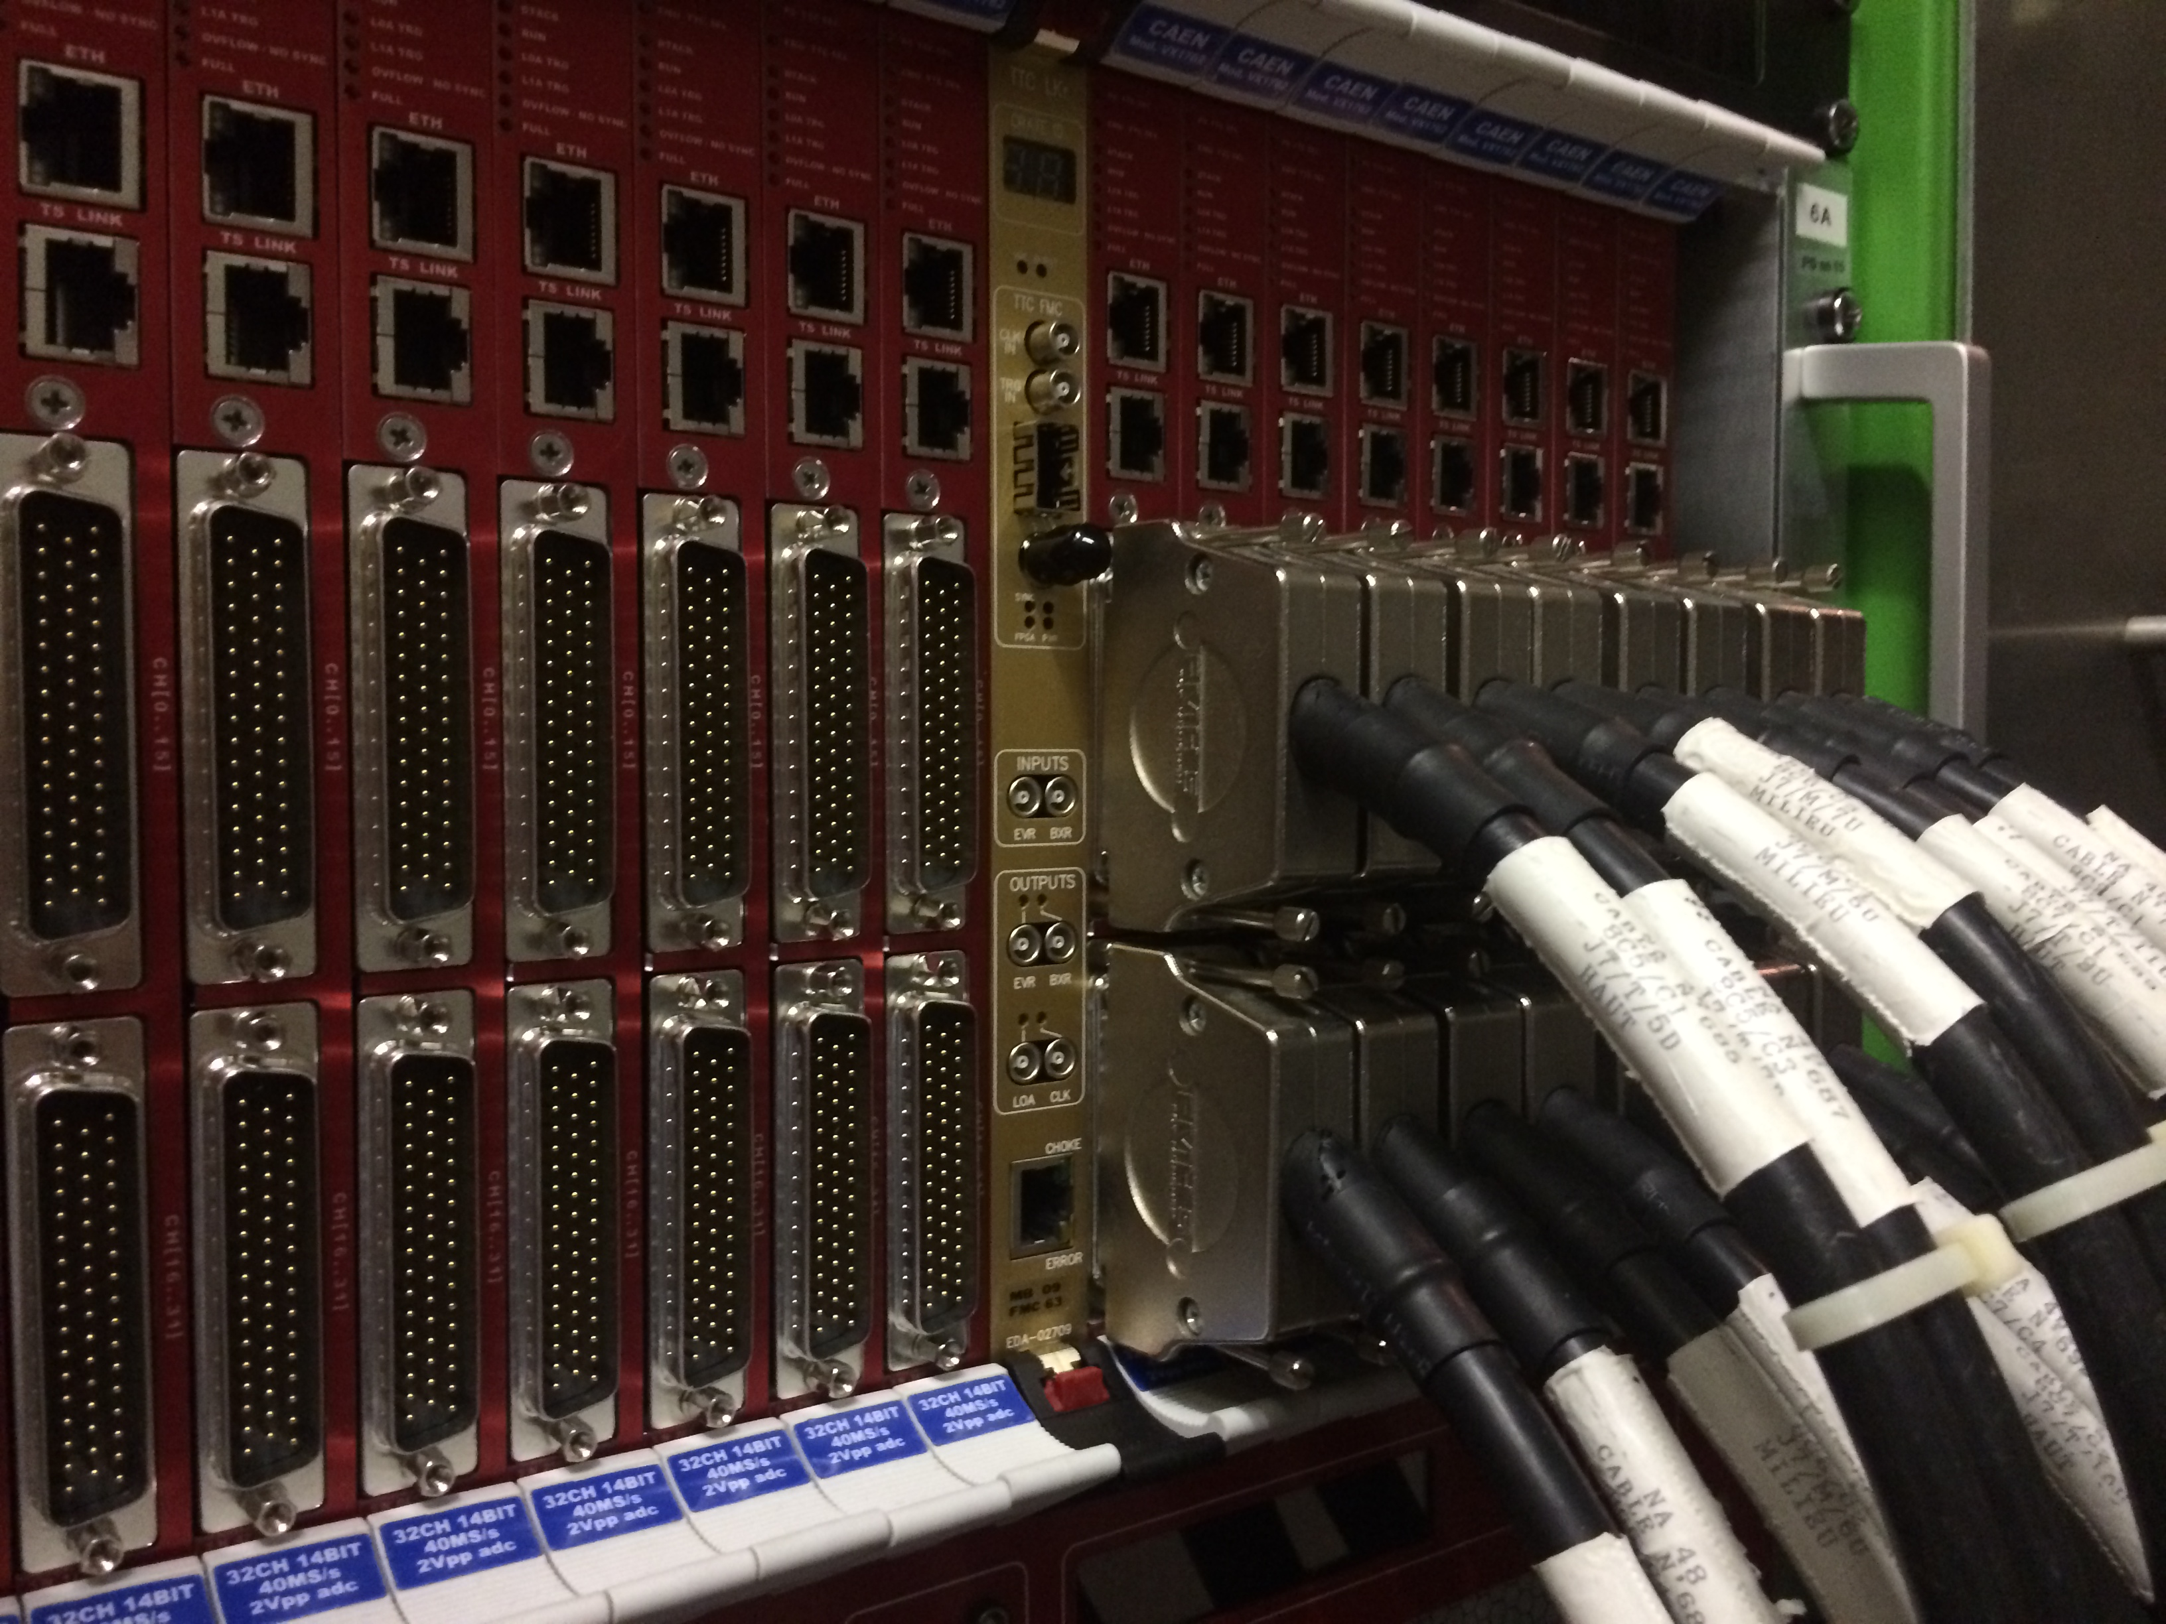
Installation & Setup (5/5)
LKr Channels
These channels send an analog signal from the LKr tank to each CREAM
These are all in place, but few are actually connected
I have not had any role in connecting these

Slide 7
Real Data / Equipment Testing (1/2)
First real data!
Data was acquired from 4 crates (64 CREAMS; 2048 channels) during a short period of time
We can only take data for a short time currently because the cooling system is not yet installed
I wrote and implemented a code which plotted a histogram of each channel and extracted the mean and sigma values
I then plotted two histograms of all mean and all sigma values and fit them with a Gaussian
I included the underflow and overflow to make sure no data was outside the range of each histogram
Good result!

Slide 8
Real Data / Equipment Testing (2/2)
This code is time-sensitive because it extracts the fit parameters of 2048 histograms currently and will eventually need to do so for 16,384 histograms
I implemented two different methods for the same desired output
Method 1:
  creates a temporary array of 32 histograms (corresponding to all channels of a single CREAM)
  The two final histograms (mean and sigma) are filled with the Gaussian fits of all 32 histograms
  The array of histograms is emptied and refilled when the data from a different CREAM is being analyzed.
Method 2:
  creates an array of all 2048 histograms and iterates through to fill them with data
  fits all 2048 histograms iteratively and extracts the mean and sigma values, which are then passed to the final histograms
Method 1: ~3 minutes
Method 2: >1hour

