Slide 1


ALIGNMENT OF Q2 LOW BETA QUADRUPOLES
D. Missiaen, On behalf of the EN-MEF-SU/MTI team

Slide 2
OUTLINE
Short reminders of the low beta quad alignment system
Issues with Q2 low beta quads : follow up and status of
Repartition of the weight of the Q2s on their jacks
Longitudinal misalignment of the Q2R5

Slide 3
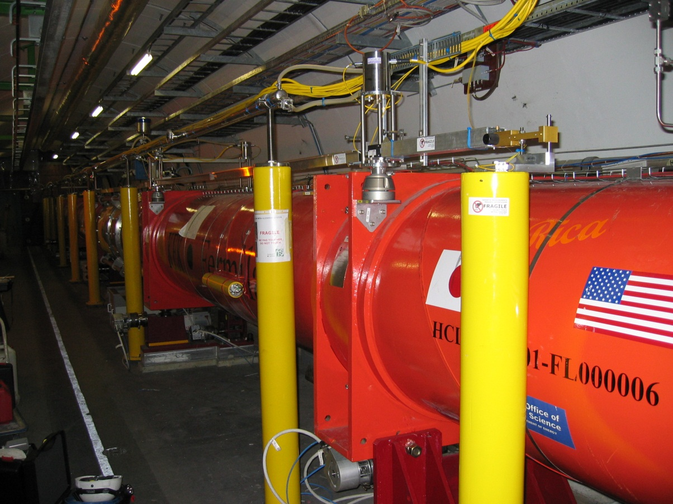
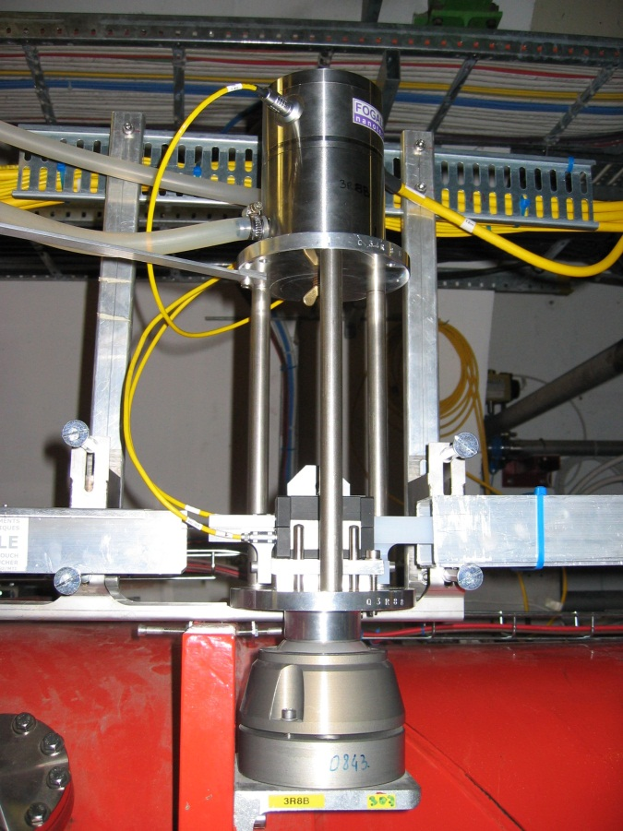
Small reminders concerning the low beta triplets (1)
All cryostats equipped with alignment sensors allowing to perform the continuous monitoring of the position of triplets according to 5DOF (not in longitudinal)

Slide 4
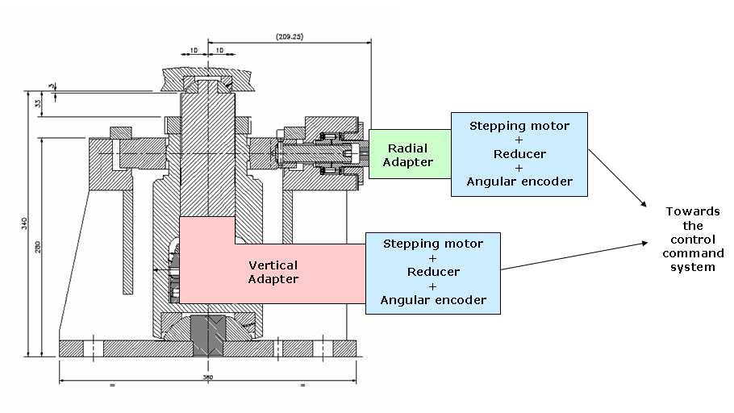
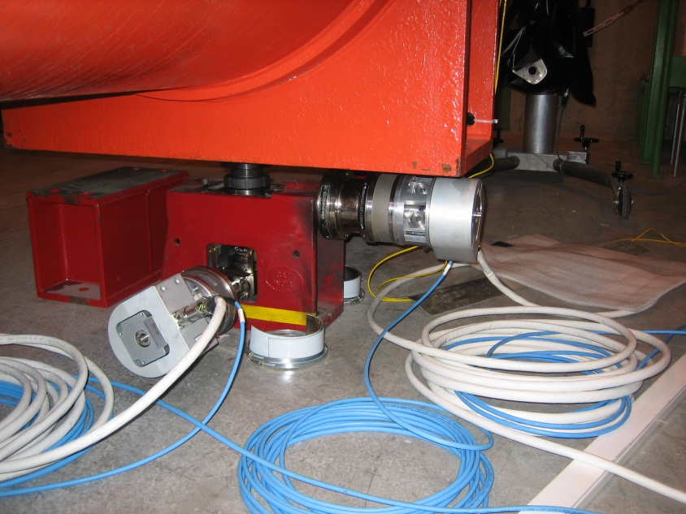
Small reminders concerning the low beta triplets (2)
All cryostats supported by modified indian jacks, where actuators have been plugged to perform remote radial / vertical adjustments (a few µm resolution)

Slide 5
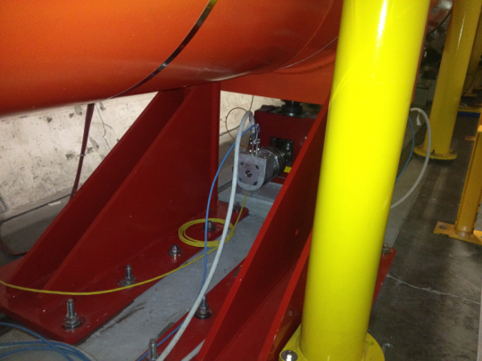
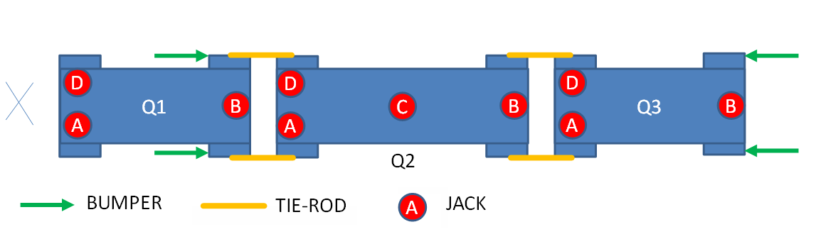
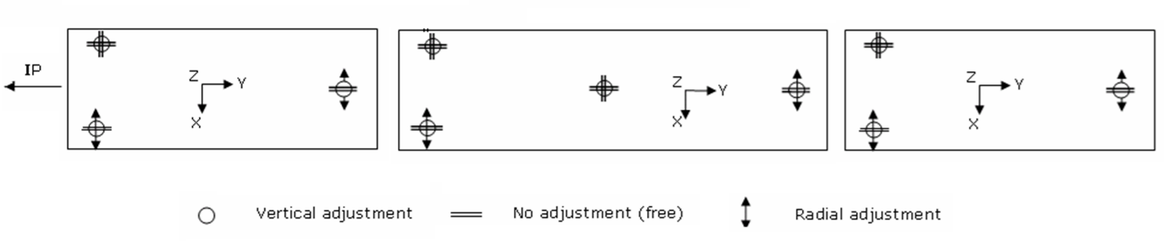
Small reminders concerning the low beta triplets (3)
Other particularities:
  Tie-rods
  Bumpers
  Jacks free in longitudinal direction
13 tons
17 tons
13 tons

Slide 6
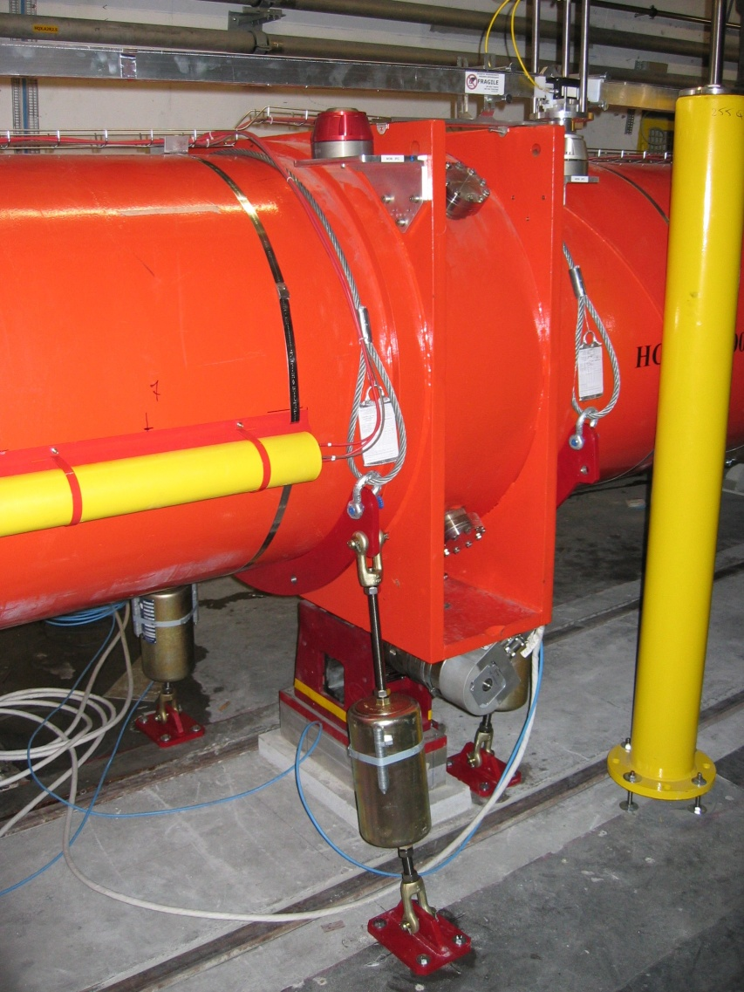
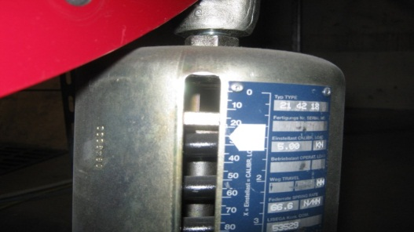
Small reminders : a bit of history… (1)
Bad distribution of load on the central jack of Q2
  This issue was raised for the first time in 2008 (ICC, 01/08/2008)
Decision to install a “spring system” to add 2 tons on each external support
➔ 4 springs, each set at 500 kg
Triplet | Load (t)
1L | 14
1R | 13
2L | < 1
2R | 14
5L | 10
5R | 4
8L | 3
8R | 8
Load on the central jack

Slide 7
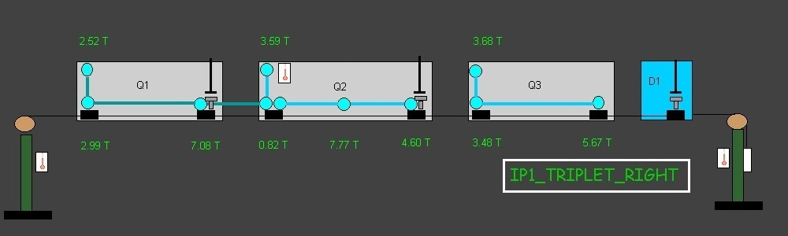
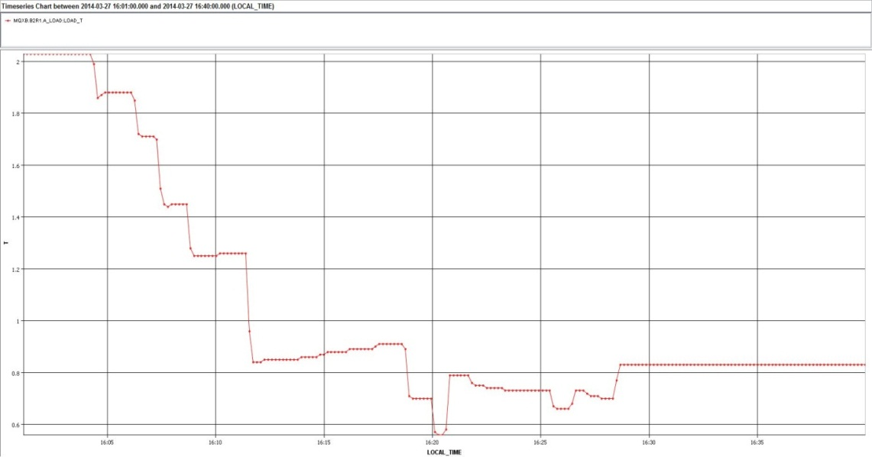
Non distributed loads on the jacks
the issue re-appeared during a remote repositioning beginning in April 2014. Thanks to load sensors, we saw that we were losing the contact between the head of the jack and the cryostat.
2 t
1 t
Loads applied on jack Q2A along time

Slide 8
Non distributed loads on the jacks
Situation of triangle could be very unstable
Contact plane between cryostat and jacks
Stable
Very unstable!
In April 2014 the springs are no more at the nominal tension value (only 60%).

Slide 9
Non distributed loads on the jacks: our proposal
Proposal of the meeting held on the 14h of April 2014 : Andreas Herty, Hervé Prin, Mateusz Sosin, Hélène Mainaud Durand
  First step: establish the contact safely:
    Dismantling of the springs at the extremities of Q2 (MSC/MME)
    If the load on the external jacks is very low, Go up with all the external jacks, in order to get a minimum load of 3t on each jack to guarantee the contact head of the jack – cryostat (SU)
    Go down with the central jack, in order to get a maximum load of 1 t (SU)
  Second step: re-position Q2 correctly:
    Perform all the displacements necessary, keeping an eye on the central jack that has to remain very low (SU)
    Go up with the central jack in such a way that the sum of the loads on the external jacks is around ~12 t (SU)
    Determine the new sag of Q2 and check if it is acceptable on the beam side (SU/ABP)
Do we still need the springs system (MSC/MME) at the end ?

Slide 10
Non distributed loads on the jacks: our proposal (cont’d)
Meeting held on the 12 may 2014 with ABP
  They are concerned by the change of sag for aperture reasons
  As no values of the sag without any central jack are available (it has never been measured at CERN and no values from FNAL), it is proposed to make a test in situ in the tunnel
    Go down with the central jack by a max. of 2 mm in order not to exceed a movement of 1mm in the interconnects (limit given by JP Tock and C. Garion) and measure the load on all the jacks
    The problem is that we don’t know the transfer function between a mvt of the cryostat and the cold mass (should be smaller as more rigid JP Tock). This can be measured on a spare Q2 at a later stage
    The test can be done next week on Q2R1
  According to the results of the test, ABP will do a simulation and a compromise has to be found between the acceptable change of sag and the load on the central jack

Slide 11
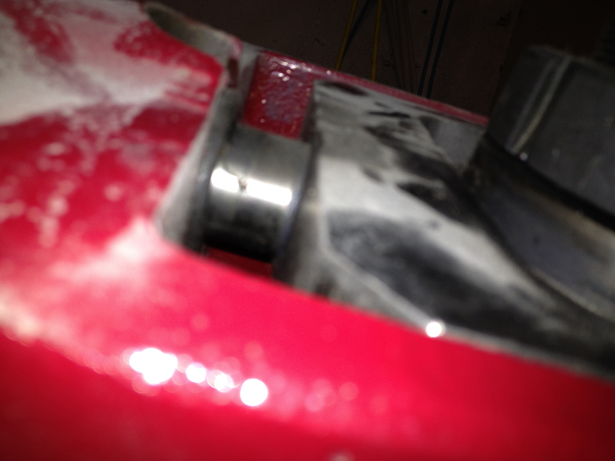
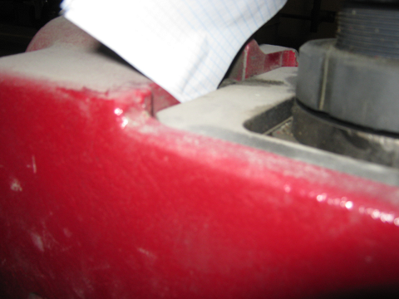
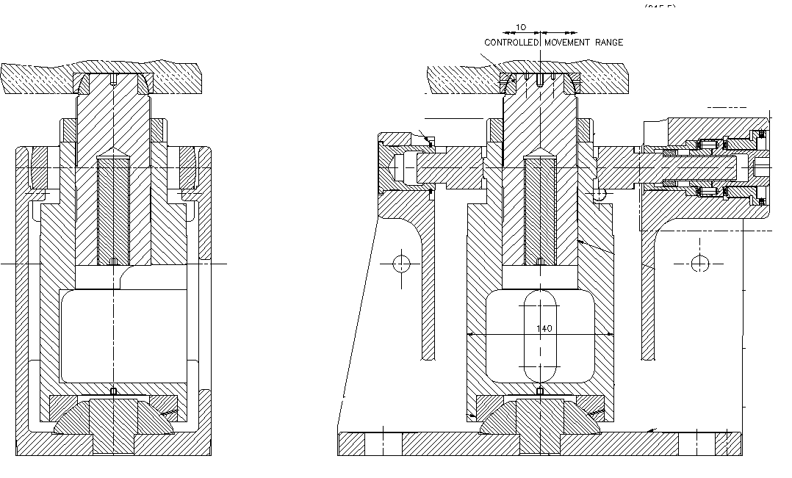
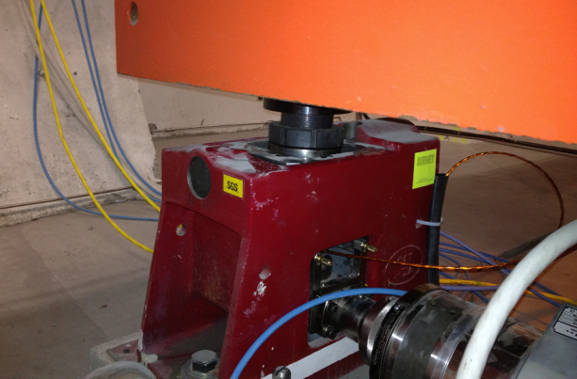
Longitudinal misalignment of the jack Q2 5R
Q2
D
C
B
A
IP
IP
Jack reached the limit
position
IP
IP

Slide 12
Longitudinal misalignment of the jack Q2 5R
    this situation prevents to realign Q2R5 using this jack in the vertical and transversal direction
    All the jacks of this magnet are misaligned towards the Non_Ip side, the D is the worse case. The reason is that a shift of +7mm has been applied on this magnet at the installation to take into account the non-conformities of the interconnect which was too short between Q1 and Q2
    The position of the triplet under vacuum measured in April 2013 is the following
Q1 dl = 0 Q2 dl = +10 mm Q3 dl = -5 mm

Slide 13
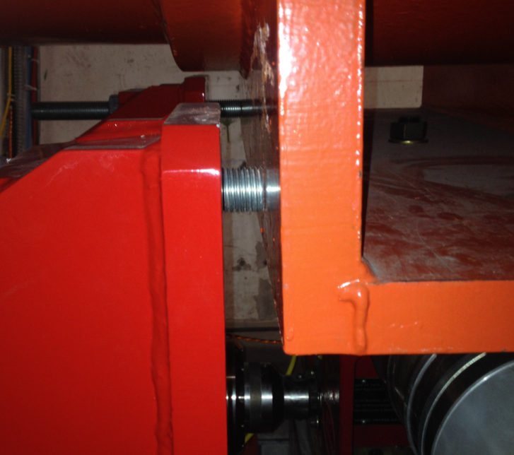
Longitudinal misalignment of the jack Q2 5R
On top of that the Q1 was completely blocked against its bumper
First meeting on the subject in December 2013 where it was decided to perform tests with/without vacuum on the triplet (V. Parma, H. Prin, M. Sosin, H. Mainaud Durand)
Test done in March 2014 showed that a displacement of 1.5 mm was applied at the level of the Q1 bumper to remove the contact bumper/cryostat
  Such a situation with contact between bumper (screw) and cryostat has been observed on other triplets and should be solved (action MSC)
The situation of the jack Q2R5D didn’t improve

Slide 14
Longitudinal misalignment of the jack Q2 5R
Proposal of the meeting held on the 14h of April 2014 :
  Relax the longitudinal position of the triplet 5R acting on the tie- rods located between Q2 and Q3:
    Triplet would be set at atmospheric pressure to ease the process (VSC)
    Monitoring by longitudinal sensors (SU)
  Sequence of the operation :
    Relax of the screw at the level of the Q1 bumper in order to allow such a displacement (MSC)
    Longitudinal displacement of 3 mm on Q1 and Q2 acting on the tie-rods (4 persons in parallel) (MSC)
    Adjustment of the screw at the level of the Q1 bumper (MSC)
    2 cycles of pumping in order to check the position w.r.t bumper (MSC)

Slide 15
This solution was proposed at the TETM of May 6th
  M. Jimenez asked the situation of the PIM in the interconnect Q2-Q3 to be reviewed by the VSC team
  MSC proposed to make a tomography (rather difficult in terms of logistics) or an X ray(easier) in this interconnect in order to have a better knowledge of the PIM situation. This will be done next monday
  No objection from ABP for such a displacement as long as it goes in the right direction, i.e. towards to the nominal position

Slide 16
Conclusion
Some triplets have an unstable distribution of loads : at least half of the total load of Q2 is applied on the central jack
Our proposal is to remove a large part of the load applied on this central jack, following a procedure that has been described previously. This will lead to an increase of the sag of Q2. Verification of the value is on-going. Operation to be performed under the supervision of MSC
Contact between bumpers and cryostats to be checked and modified (MSC)
There is an additional problem on the triplet 5R, where the jack Q2D is constrained
Our proposal is to displace longitudinally the triplet towards the IP, by acting on the tie-rods between Q2 and Q3. Displacement proposed : 3mm. The procedure described previously includes actions from MSC, SU and VSC.
If it is decided to go ahead with both proposals, they have to be endorsed by the LMC

Slide 17
Conclusion
With all the constraints in the triplets added by new systems for resolving a new issue, triplets will become more and more difficult to align remotely.
  The triplets at point 1 and 5 will be exchanged during LS3.
  But a long term solution has to be found for 2 and 8. Studies to be started asap.

