Slide 1
Physics at Future Colliders
Lecture 1
  An historical perspective (1964-2014): The need for precision and energy
  A strategy for the future: Towards the precision and energy frontier
  The short-term perspectives (2020-2030)
Lecture 2
  The quest for precision (2030-2045): Linear or Circular ?
  The energy frontier (2045-2060): Leptons or Hadrons ?

Slide 2
Lecture 1
An historical perspective (1964-2014):
The need for precision and energy

Slide 3
1964-1974: The rise of the standard model
Very little was known experimentally
Mostly theoretical advances
  1964: Spontaneous symmetry breaking mechanism (Brout-Englert, Higgs)
  1967: Unification of electroweak interactions (Glashow, Weinberg, Salam)
    With m_{γ} = 0, m_{W} = m_{Z} cosθ_{W} and a Higgs boson
  1970: Prediction of the c quark (Glashow, Illiopoulos, Maiani)
  1971: Elucidate quantum structure of electroweak interactions (t’Hooft, Veltman)
    Predicts and computes quantum corrections
  1973: Six quarks needed for CP violation (Kobayashi, Maskawa)
  1974: Complete formulation of the standard model ! (Illiopoulos)
  + Discovery of CP violation in the K⁰_{L} → ππ decays
    (Kronin, Finch: 1964)
  + Discovery of neutral currents ν_{μ}e → ν_{μ}e
    (Gargamelle: 1973)

Slide 4
1974-1984: The rise of centre-of-mass energy
Collisions at large √s: A-priori obvious way to discover heavier particles
  Standard model particle spectrum is filling up quickly
    Three families, but top quark missing
    Higgs boson missing but m_{W} ~ m_{Z} cosθ_{W} : smoking gun for the Higgs mechanism
  Quantum structure not tested: requires precision measurements
Year | Discovery | Experiment | √s (GeV) | Observation
1974 | c quark (m~1.5 GeV) | e⁺e⁻ ring (SLAC) Fixed target (BNL) | 3.1 8 | σ(e⁺e⁻ →J/Ψ) J/Ψ→μ⁺μ⁻
1975 | τ lepton (m=1.777 GeV) | e⁺e⁻ ring (SLAC) | 8 | e⁺e⁻ → τ+τ− e⁺μ⁻ events
1977 | b quark (m~4.5 GeV) | Fixed target (FNAL) | 25 | ϒ→μ⁺μ⁻
1979 | gluon (m = 0) | e⁺e⁻ ring (DESY) | 30 | e⁺e⁻ → qqg Three-jet events
1983 | W, Z (m ~ 80, 91 GeV) | pp ring (CERN) | 900 | W → lν Z → l⁺l⁻
-
-

Slide 5
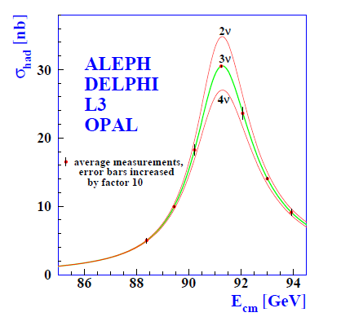
1987-2011: The rise of precision (1)
1987/1989: Start of SLC (linear e⁺e⁻ collider) and LEP (e⁺e⁻ collider ring)
  Much larger luminosity at LEP, much faster commissioning
  1989/LEP: Only three species of light, active, neutrinos – ν_{e} , ν_{μ} , and ν_{τ} .
    e⁺e⁻ → Z → hadrons at LEP1, measurement of the line shape
  After 5 years at LEP1: per-mil precision
    N_{ν} = 2.984 ± 0.008
    (Note the 2σ deficit)
    Γ_{Z} = 2495.2 ± 2.3 MeV
    m_{Z} = 91187.5 ± 2.1 MeV
    α_{S} = 0.1190 ± 0.0025
√s ~ 91 GeV

Slide 6
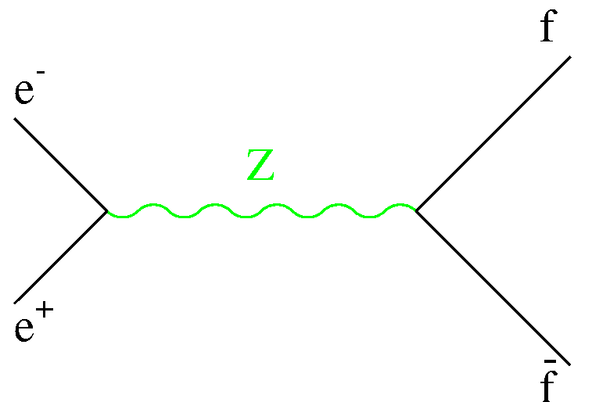
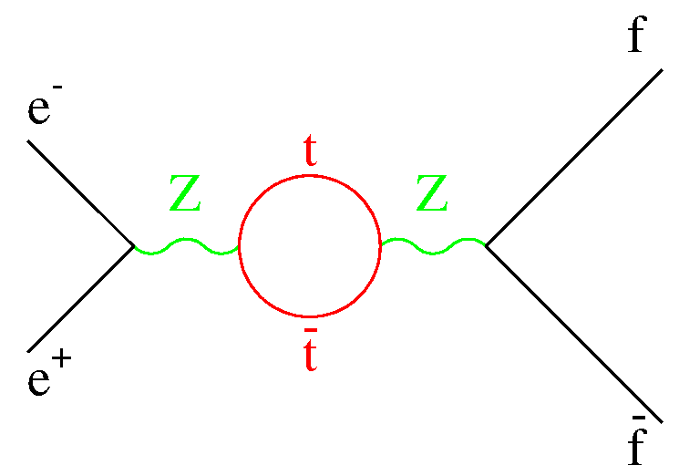
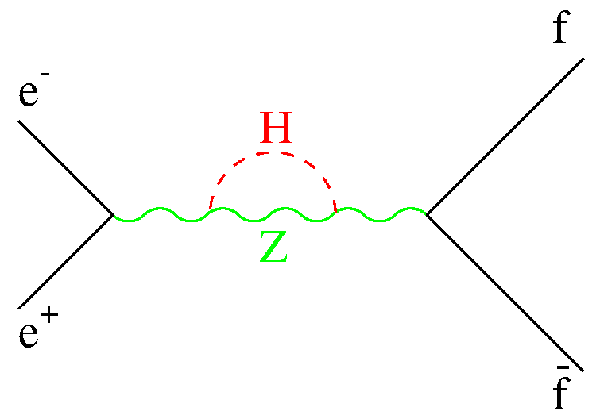
1987-2011: The rise of precision (2)
What’s the use of such a precision anyway ?
  1994 : Prediction of the top quark mass
    Remember quantum corrections from t’Hooft and Veltman work (1971) ?
    Tree level
  Example: Γ_{Z} → Γ_{Z} × (1+Δρ)
  Similarly, m²_{W} = m²_{Z} cos²θ_{W}^{eff} (1+Δρ)
    (sin²θ_{W}^{eff} from Zff couplings)
  Predict m_{W} and m_{top} from Z measurements
[small correction]

Slide 7
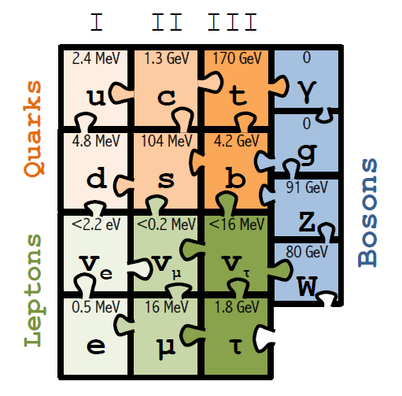
1987-2011: The rise of precision (3)
1995-2011: Testing the quantum structure of the standard model
  1995: Discovery of the top quark at the Tevatron (D0, CDF)
  1995-2011: Measurement of m_{top} (Tevatron)
    m_{top}(Obs.) = 173.2 ± 0.9 GeV
    m_{top}(Pred.) = 178.0 ± 4.3 GeV [LEP/SLD/m_{W} , for mH = 150 GeV]
  1997-2011: Measurement of m_{W} (LEP2, Tevatron)
    m_{W}(Obs.) = 80385 ± 15 MeV
    m_{W}(Pred.) = 80363 ± 20 MeV [LEP/SLD/m_{top}]
  1999: Nobel Prize for t’Hooft and Veltman
  Standard Model almost complete
    Only the Higgs boson is missing, but …
    Prediction from Higgs mechanism
      m²_{W} = m²_{Z} cos²θ_{W} (1+Δρ)
        Verified !

Slide 8
1987-2011: The rise of precision (4)
1989-2011: Looking for the Higgs boson’s imprint
  1999-2011: The Higgs boson is cornered by all precision measurements
    Remember (for example)
      m²_{W} = m²_{Z} cos²θ_{W} (1+Δρ)
  m_{Z}, m_{top} and m_{W} are known with precision
    The standard model has nowhere to go !
    114 GeV < m_{H} < 152 GeV
  [LEP/SLD/m_{W}/m_{top}]
  at 95% CL
Direct searches @ LEP
Just 10 GeV below the target …
(important for the future!)
Fit to precision measurements

Slide 9
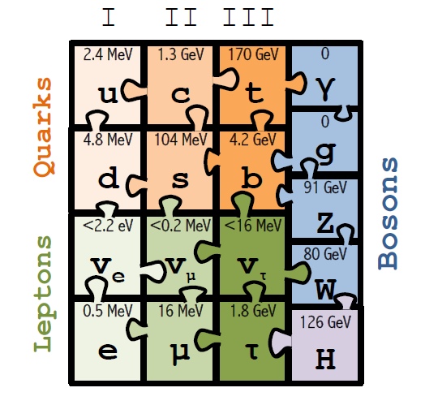
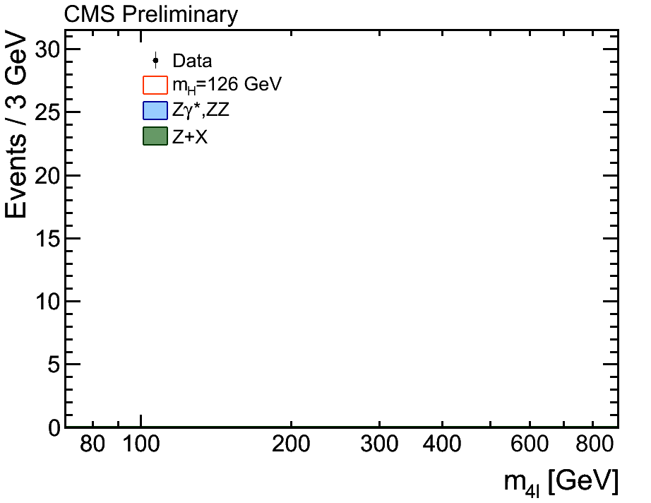
2012-14: The SM becomes the standard theory
2012-2014: The Higgs boson era
  2012: Discovery of the standard model Higgs boson at the LHC (ATLAS, CMS)
    m_{H} = 125.4 ± 0.5 GeV (ATLAS), 125.0 ± 0.3 GeV (CMS)
    Mass, couplings, spin, width in agreement with Standard Theory predictions
  2010-2013: No new physics found at the LHC Run1 at the TeV scale
  2014: Nobel Prize to Englert and Higgs

Slide 10
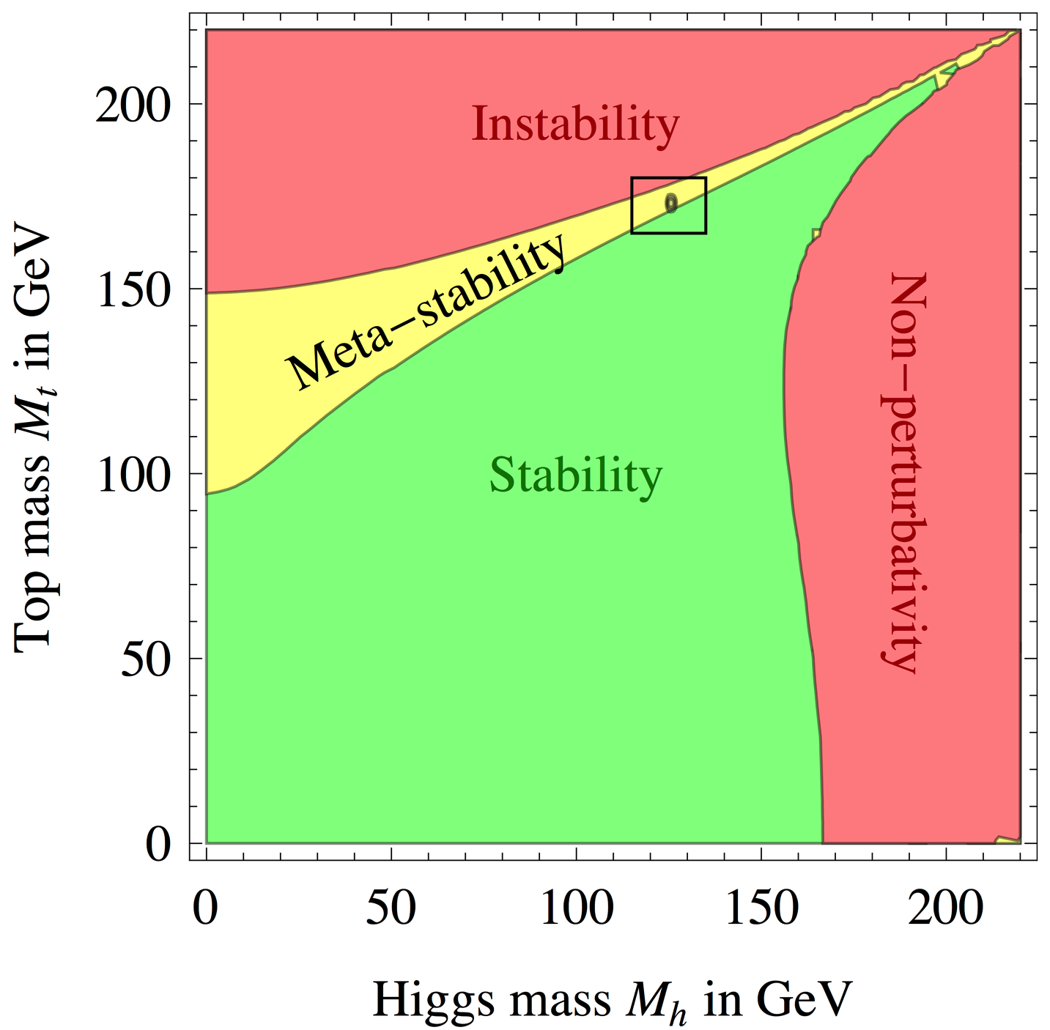
And now, what ?
The standard model has become the Standard Theory
  It explains/describes all observations and measurements from high-energy colliders
    It is also able, in principle, to predict all measurements at future colliders
      As well as the fate of the Universe …
  On the theory side, no new physics is needed beyond this Standard Theory
Is it the end ?
Nima ARKANI-HAMED

Slide 11

It is not the end !
There is something beyond the standard theory
  Many experimental proofs, e.g.,
    Cosmological dark matter (DM)
    Baryon asymmetry of the Universe (BAU)
    Non-zero, but very small, neutrino masses
  A mathematical hint : the small Higgs boson mass.
Often heard: New physics must be “around the corner”
  Problem: there is no corner (so far) … and not much of theoretical guidance
  Is new physics at larger masses ? Or at smaller couplings ? Or both ?
    Only way to find out: go look, following the historical approach:
      Direct searches for new heavy particles
        Need colliders with larger energies
      Searches for the imprint of new physics on W, Z, top quark, Higgs boson
        Need colliders / measurements with unprecedented accuracy

Slide 12
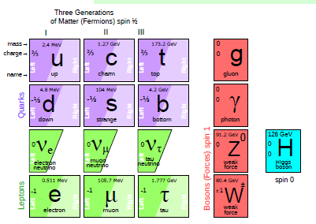
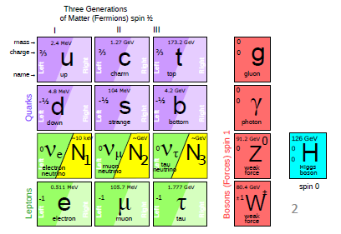
Precision vs Energy (1)
Three pieces are obviously missing in the standard theory
  Three sterile right-handed neutrinos ?
    Extremely small couplings, nearly impossible to find, but could explain it all !
      Small m_{ν} (see-saw), DM (light N₁), and B.A.U. (leptogenesis)
  Need very-high-precision experiments to unveil
    Could cause a slight reduction (increase) of the Z (H) invisible decay width
    Could open exotic Z and Higgs decays: Z,H → ν_{i} N_{i}
      Possibly measurable / detectable in precision e⁺e⁻ colliders
      Almost certainly out of reach for hadron colliders (small couplings)

Slide 13
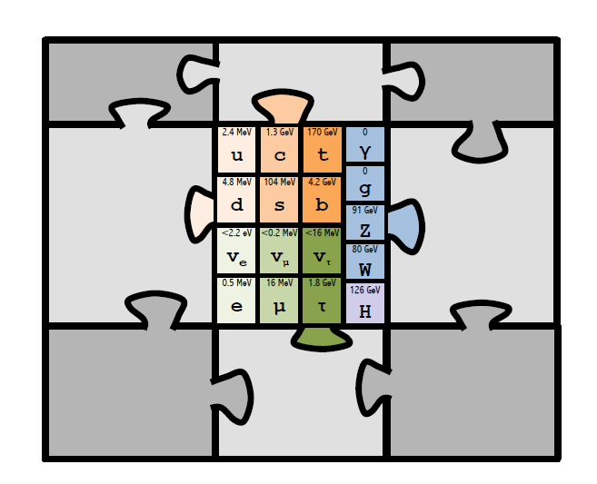
Precision vs Energy (2)
Others lean towards higher-energy replicas of the standard theory
  Direct searches at larger energies may be the key – but how much larger ?
    Rare decays and precise measurements may unveil these extension’s imprints
Extra-
dimen-
-sions
You
Super
Symmetry
Funny
Higgses
name
it

Slide 14
Lecture 1 (cont’d)
A Strategy for the future:
Towards the precision and energy frontiers

Slide 15
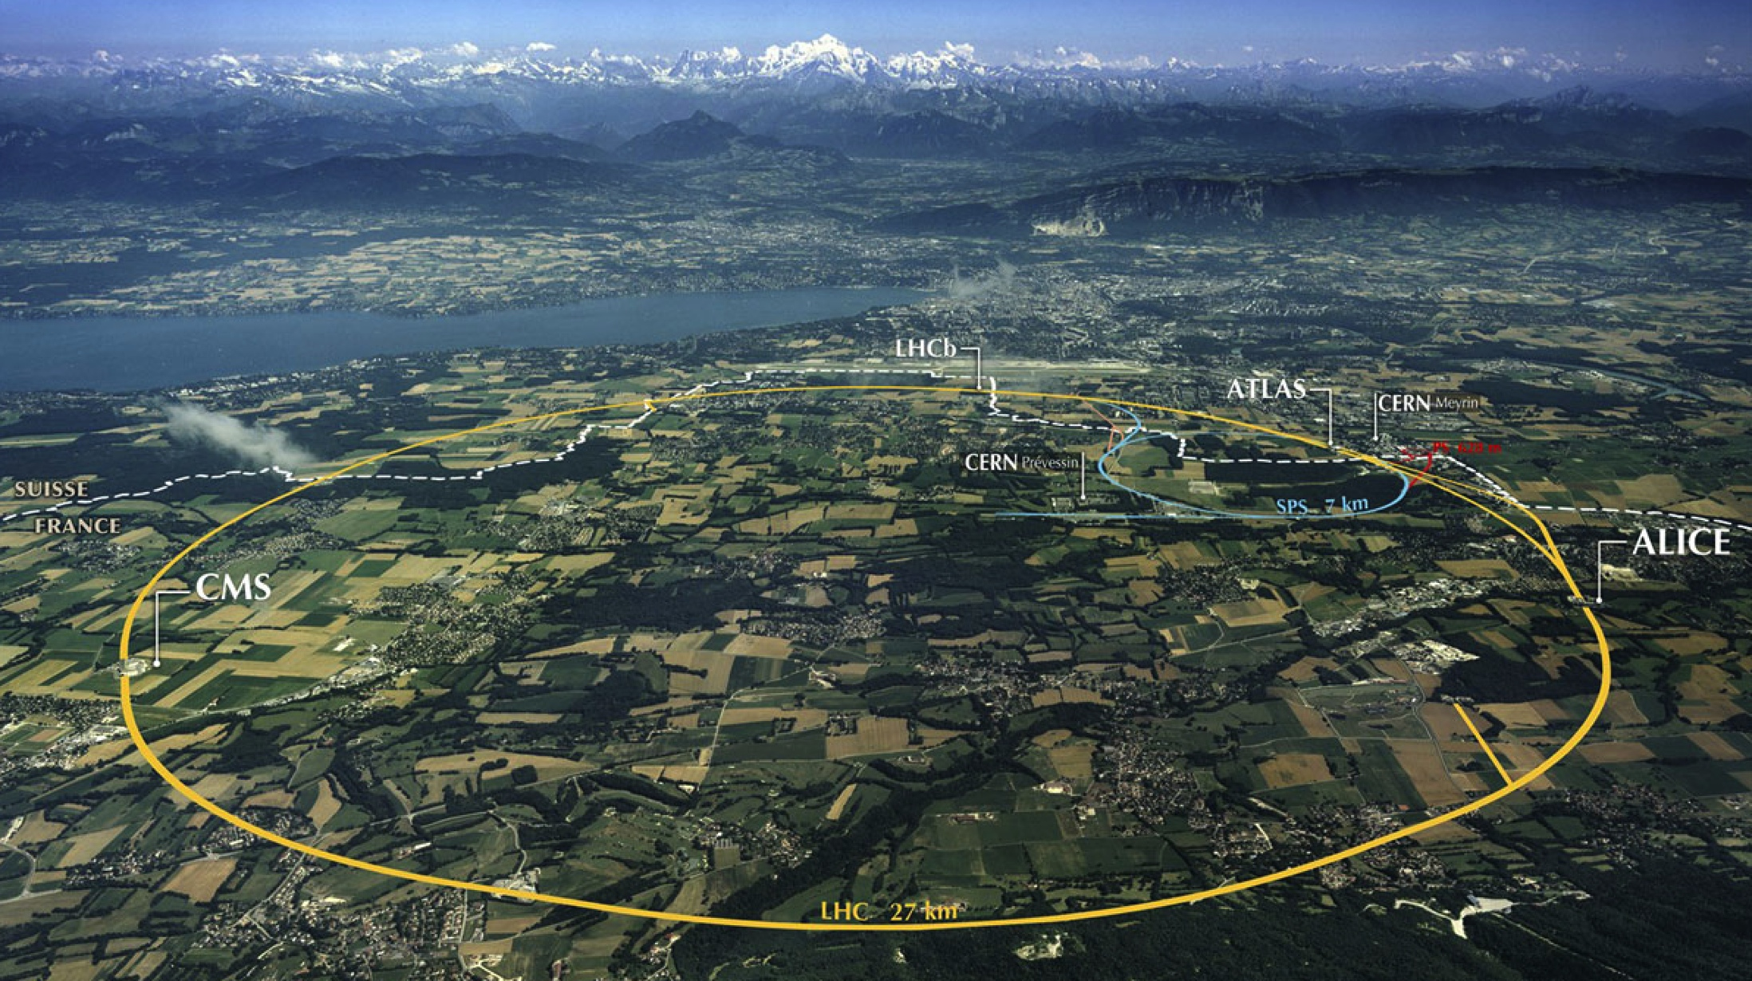
Short-term perspectives (2020-2030)
In May 2013, European Strategy said (very similar statements from US)
  Thou shalt exploit the full potential of the LHC until ~2030 as the highest priority
    Get 75-100 fb⁻¹ at 13-14 TeV by 2017 (LHC Run2: approved)
    Get ~350 fb⁻¹ at 14 TeV by 2022 (LHC Run3: approved)
    Upgrade machine and detectors to get 3 ab⁻¹ at 14 TeV by 2035 (HL-LHC: project)
      Addresses both energy and precision frontier

Slide 16
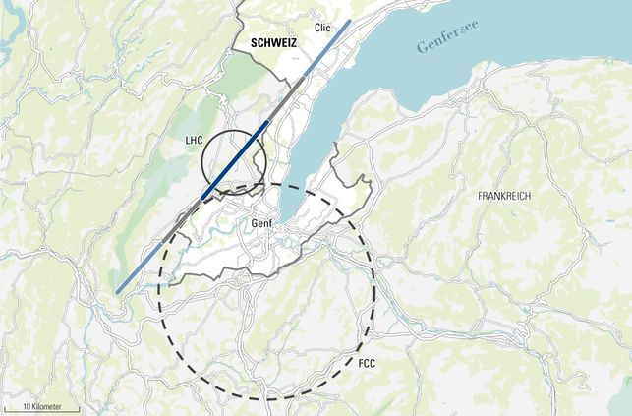
Long-term perspectives (2045-2060)
In May 2013, European Strategy said (very similar statements from US)
  Thou shalt perform R&D and design studies for high-energy frontier machines at CERN
    HE-LHC, a programme for an energy increase to 33 TeV in the LHC tunnel
    FCC, a 100-km circular ring with a pp collider long-term project at √s = 100 TeV
    CLIC, an e⁺e⁻ collider project up to √s = 3 TeV
Similar circular projects
(50 or 70km) in China
pp collisions at √s ~ 50 or 70 TeV
HE-LHC (27 km)
pp collisions at 33 TeV)
CLIC (50km)
e⁺e⁻ at 3 TeV
FCC (100 km)
[Future Circular Colliders]
Ultimate goal: FCC-hh (100 TeV)
[Access to highest energies]

Slide 17

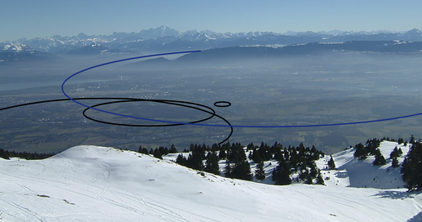
Mid-term perspectives (2030-2045)
In May 2013, European Strategy said (very similar statements from US)
  Thou shalt acknowledge the strong physics case of e⁺e⁻ colliders with intermediate √s
    Participate in ILC if Japan government moves forward with the project
    In the context of the FCC, perform accelerator R&D and design studies
      Towards a high-luminosity, high-energy, circular e⁺e⁻ collider as a first step
FCC (100 km)
First step: FCC-ee (91-400GeV)
[Use the tunnel ultimately aimed at FCC-hh]
ILC (31 km)
e⁺e⁻ : 250-500 GeV
Note: CLIC can also run at √s ~ 250-500 GeV in 2030-2045

Slide 18
Can / should we do everything ? (1)
The cost (10’s B$) and challenges of these projects are paramount
  A choice will have to be made at one point, but it would be too early to make it now
    The LHC, indeed, is still in its early infancy
  The 14 TeV Run2 data might bring a whole new light on the process
    Next check point after LHC Run2 for the next European strategy update in 2018
You are here
Run 2
Run 3

Slide 19
Can / should we do everything ? (2)
Hand-waving anticipation: With the 14 TeV LHC Run2 data, we may
  Find a new heavy particle (or new heavy particles)
    The (HL-) LHC will study this (these) particles to some extent
    If m < 1 TeV, CLIC become interesting (if copiously produced in e⁺e⁻ collisions)
    Larger energies might be needed to find & study the whole new spectrum (FCC-hh)
    An e⁺e⁻ Z factory (FCC-ee) might be useful to study the underlying quantum structure
  Find no new particle, but finds a hint for non-standard Higgs properties
    The (HL-) LHC will improve the precision on these measurements to some extent
    e⁺e⁻ factories for Higgs (ILC, FCC-ee) and Z (FCC-ee) become very interesting machines
    Push the energy frontier to its limits (FCC-hh)
  Find no new particle, standard Higgs properties
    Push precision measurements to their limits (FCC-ee)
    Possibly push energy frontier to its limits (FCC-hh)
Let’s now try to quantify the respective merits of all options.

Slide 20
Lecture 1 (cont’d)
The short-term perspectives (2020-2030)
The (HL)-LHC: Physics prospects

Slide 21
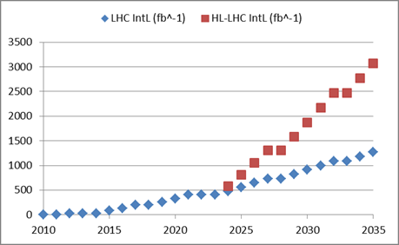
Note on integrated luminosity
The High Lumi upgrade of the LHC is an ambitious project
  Target is to deliver ~10 times more luminosity (3 ab⁻¹) than the first 10 LHC years
    Without the luminosity upgrade, the LHC could reach ~1.3 ab⁻¹ in 2035
      It could also deliver 1 ab⁻¹ in 2030
  The results of the LHC Run2 in 2018 might argue in one direction or the other
    e.g., what do we do if there is no hint for new physics by then ?
3000 fb⁻¹
By implementing HL-LHC
A factor ~2.3
350 fb⁻¹
By continuous performance improvement and consolidation
100 fb⁻¹
30 fb⁻¹

Slide 22
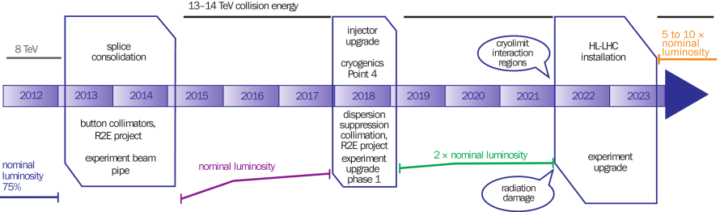
Note on pile-up interactions (1)
Two very distinct stages of operation, indeed
  LHC Run 2 (and, to a lesser extent, Run 3)
    Conditions similar to those of LHC Run 1 for “in-time” pile-up
      Increase of “out-of-time” pile-up from the 50 → 25 ns bunch separation
  HL-LHC
    Tremendous increase of “in-time” and “out-of-time” pile-up
25 ns
50 ns
25 ns
25 ns
Run 1
Run 2
Run 3
5×10³³ cm⁻²s⁻¹
<PU> ~ 25
1×10³⁴ cm⁻²s⁻¹
<PU> ~ 25
2×10³⁴ cm⁻²s⁻¹
<PU> ~ 50
5×10³⁴ cm⁻²s⁻¹
<PU> ~ 140
LS1: 2013-2014
LS2: 2018
LS3: 2022-2023
Data: 2015-2017
Data: 2019-2022
Data

Slide 23
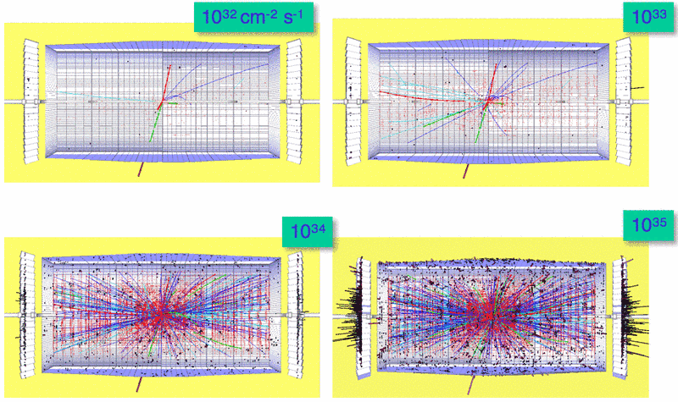
Note on pile-up interactions (2)
CMS real event with 78 reconstructed vertices
Why do we care ?
  A simulated H → ZZ → eeμμ with 0, 2, 20 and 200 in-time PU events (p_{T}^{cut} = 1 GeV)

Slide 24
Note on pile-up interactions (3)
Why do we care ? (cont’d)
  Interesting physics can be identified with
    Isolated leptons (e, μ, τ) and photons
    Missing transverse energy (neutrinos, DM, …)
    High-p_{T} b-quark jets
      Sign the presence of high-p_{T} Z, W, H, and top – or DM particles –, which heavy new physics like to decay to
  If nothing is done, intense pile-up degrades
    The reconstruction of charged particle tracks
      CPU, Fakes, Efficiency, b tagging
    The separation of calorimetric clusters
      Particle flow reconstruction performance
    The effectiveness of isolation cuts
      Lepton selection
    The missing transverse energy resolution
      Dominated by pile-up + all the above
    The trigger capabilities – a killer !
  Vigorous detector/trigger/software/algorithmic upgrades required at HL-LHC

Slide 25
Physics prospects with HL-LHC (1)
Disclaimer
  The HL-LHC is not funded yet (~0.8 BCHF), and neither are the upgraded detectors
    Core cost estimated to be 250-300 MCHF for each detector
  The final design choices for the upgraded detectors are yet to be made
  As a consequence, full simulation of the upgraded detectors is not yet available
    Event reconstruction will need significant developments
      Future performance for physics studies can only be inferred
  The projections presented in the coming slides
    Are based on either parametric or fast simulations (or even extrapolations)
    Rely on a number of assumptions (may be realistic … or not)
      On the effect of pile-up on detector and reconstruction performance
      On the improvement of systematic uncertainties
      On the improvement of theory calculations
    Use simplified models, for simplified conclusions
    But give a reasonably optimistic idea of the HL-LHC physics prospects
  A lot of work remain to be done (BY YOU!) from detector R&D to physics analyses

Slide 26
Physics prospects with HL-LHC (2)
Physics programme at the (HL-)LHC in a nutshell
  Electroweak physics
    Measure top (and W?) masses, rare top decays
    Measure triple and quartic gauge couplings
    Study vector boson scattering
  Higgs physics
    Measure Higgs couplings to other particles, rare Higgs decays
    Measure Higgs self-coupling
    Measure Higgs mass, width, CP, …
  Search for new heavy physics
    Supersymmetry
    Extra-dimensions (new resonances, black holes)
    Quark substructure (compositeness)
    Fourth generation
    New gauge bosons
    …
  Only a few highlights are given here. Details in P. Mättig’s and P. Sphicas’ lectures.
P. Mättig
P. Mättig
P. Sphicas

Slide 27
Physics prospects with HL-LHC (3)
Physics programme at the LHC in a nutshell (cont’d)
  The energy increase (7/8 → 13/14 TeV) in LHC Run2 will be very (as in very) exciting
  More energy buys a lot, both for precision and new physics reach
    Cross sections multiplied by 3, 5, 10, 100 at m = 0.1, 0.35, 1 and 3 TeV
    Mass reach for new physics roughly doubled
SUSY
Squarks/Gluinos
~1.5 TeV
Or
Z’
~3.0 TeV
SUSY
3rd gen
~500 GeV
Top quark
~175 GeV
Higgs
~100 GeV

Slide 28
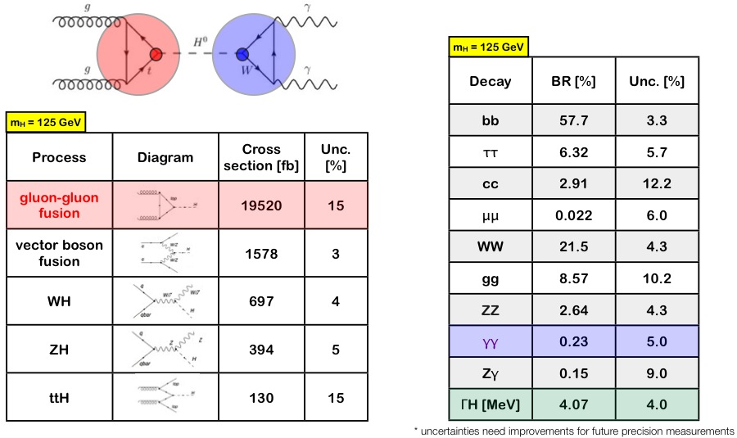
Precision Higgs physics (1)
Reminder: production and decays
  Want to test if the Higgs particle couples as predicted by the Standard Model

Slide 29
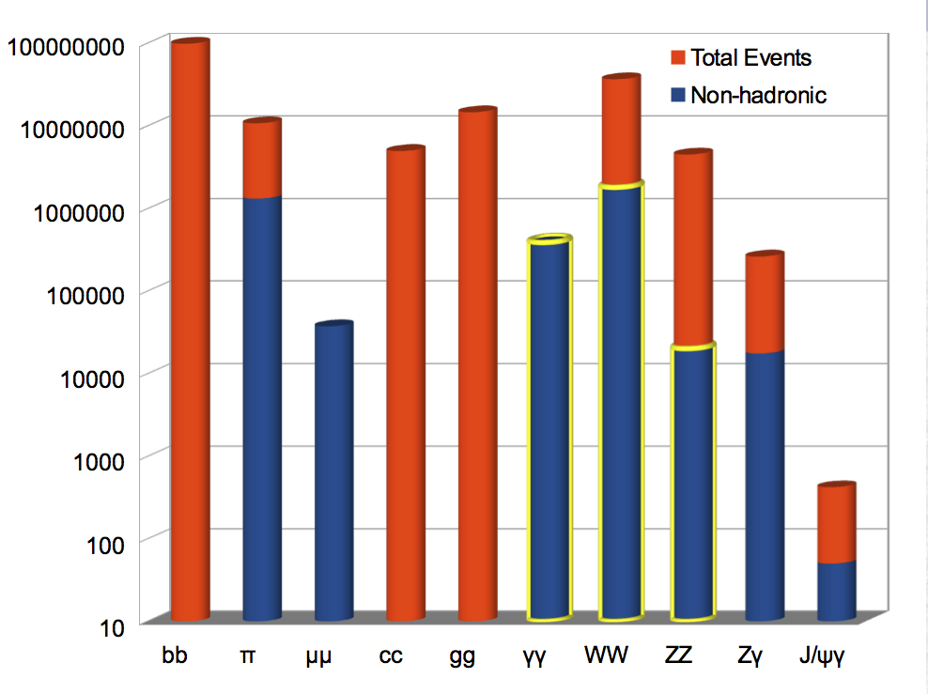
Precision Higgs physics (2)
Higgs couplings today
  1400 Higgs events after selection
  Measured coupling so far:
    W, Z, g, γ, b, τ and top (from ttH)
  Typical precision: 15 to 50%
HL-LHC (3 ab⁻¹)
  17 M Higgs produced in each experiment
    ~ 2 million events after selection
  HL-LHC would be the first Higgs factory
    With access to rare decays
      H → μμ, Zγ …
  Typical precision: 2 to 10%

Slide 30
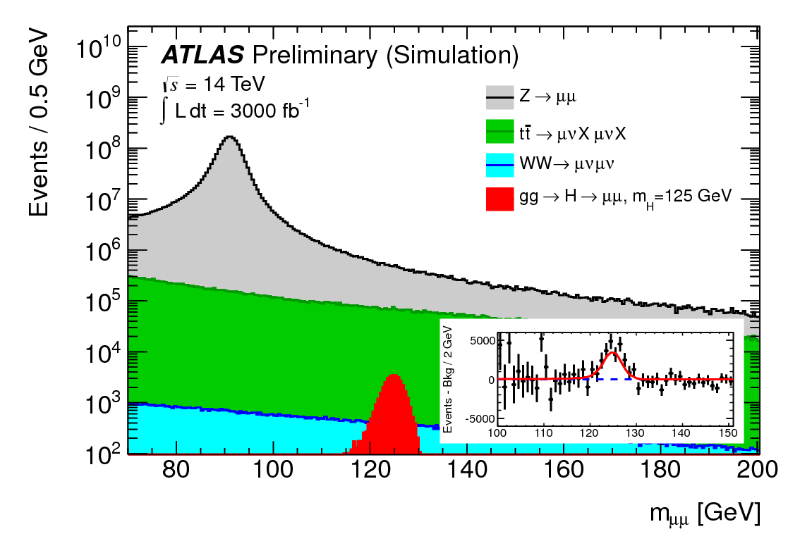
Precision Higgs physics (3)
Higgs couplings projections (cont’d)
  HL-LHC would bring a factor 1.5 to 2 on top of 300 fb⁻¹ (and 20-50% on top of 1 ab⁻¹)
    Limited by systematic uncertainties
  Becomes sensitive to, e.g., H → μμ
    Expect 35K signal events with 3 ab⁻¹
      S/B ~ 0.3% → 10σ significance
    Coupling measured to ~10%
      20-30% with 300 fb⁻¹
Coupling | LHC Run1 | LHC (300 fb⁻¹) | LHC (1 ab⁻¹) | HL-LHC
κ_{W} | 15% | 4-6% | 3-5% | 2-5%
κ_{Z} | 20% | 4-6% | 3-5% | 2-4%
κ_{t} | 50% | 14-15% | 10-12% | 7-10%
κ_{b} | 40% | 10-13% | 6-10% | 4-7%
κ_{τ} | 25% | 6-8% | 4-6% | 2-5%

Slide 31
Precision Higgs physics (4)
Is the precision good enough to make a “discovery” ?
  Example of expected deviations if new physics scale is at 1 TeV
    Need 1% precision on couplings for a 5σ discovery if Λ = 1 TeV
      And much better for heavier new physics
  HL-LHC might be good enough for some new physics models
    IF the new physics scale is below 1 TeV
      The air is getting thin …
Typically, expect deviations:
Δκ/κ < ~5 % / Λ²
(with Λ in TeV)

Slide 32
Precision Higgs physics (5)
Higgs self coupling
  Measurable through double Higgs production
    Negative interference reduces the sensitivity to g_{HHH}
  Experiments are still working on projections for the precision on the coupling
    Small cross section, large backgrounds
      First attempts show that the full HL-LHC luminosity will be needed
      A precision of 30% might be achievable with bbγγ
        Other channels are also investigated
  Is this precision enough ?
    Not really: new physics models do not predict deviations larger than 20%
With 3 ab⁻¹
g_{HHH} = 3 m_{H}²/v

Slide 33
Precision Higgs physics (6)
Invisible Higgs decays (complementary to direct DM search)
  Expected 95% CL upper limit
  Improves DM search at low mass
q
q
 | BR_{inv} (95% CL)
LHC Run1 | 40-50%
LHC 300 fb⁻¹ | 20-30%
HL-LHC | 10-15%

Slide 34
Top quark mass (1)
The top quark mass today
  Standard method: final state with one lepton
    Kinematic fit with mass constraints
≥4 jets
2 b jets
1 lepton
MET

Slide 35
Top quark mass (2)
The top quark mass tomorrow
  There is still much more to come: systematic uncertainties are statistically limited
    And there are more methods out there to try
Projected uncertainties
  Reduction by a factor 2
    After the first data of LHC Run2
      One year
    Then after the LHC Run3
      Five more years
    Then after 3 ab⁻¹
      Ten more years
Ultimate reach: ~ 200 MeV (exp.)
  Theory uncertainties ~ 500 MeV
    What is the quantity that is measured ? MC top mass ?
  Must answer this very question
    Otherwise 3 ab⁻¹ won’t do much better than 0.3 or 1 ab⁻¹
7 TeV

Slide 36
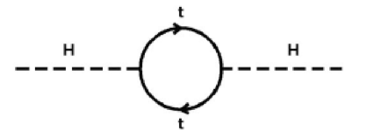
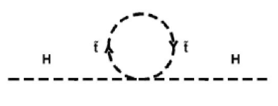
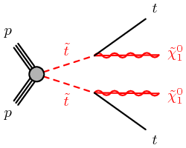
Supersymmetry (1)
Search for third generation squarks (stop)
  Original motivation: make a small Higgs boson mass “natural”
  To serve its purpose, the lighter stop should not be much heavier than 1 TeV
    Search for light stop production, e.g.,
      Final state similar to top pair production, with larger missing energy
−

Slide 37
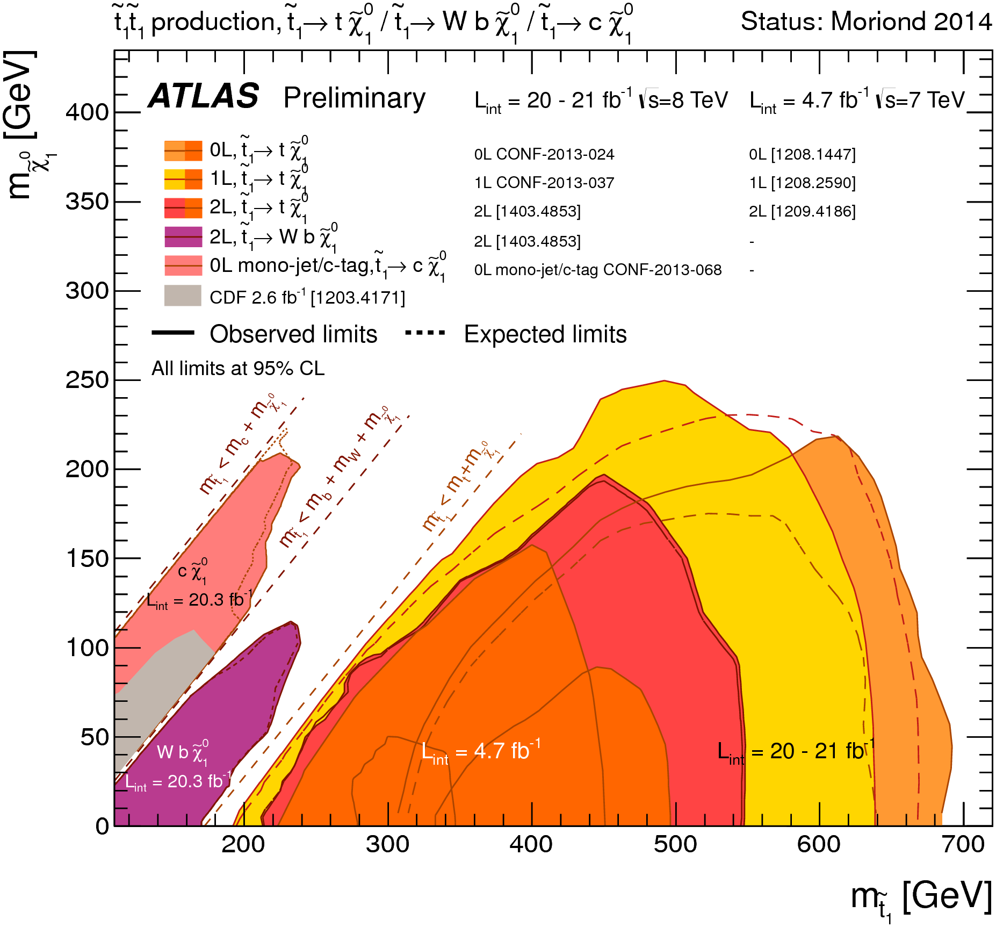
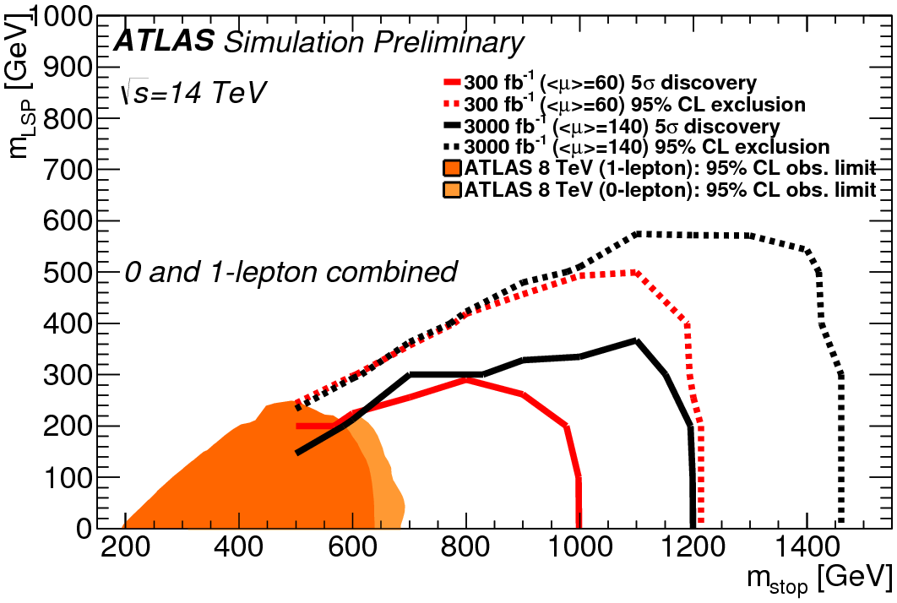
Supersymmetry (2)
Search for third generation squark (cont’d)
  Today : Projections with 300 and 3000 fb⁻¹
  Mass reach extended by a factor 2 with LHC at 14 TeV (300 fb⁻¹): covers the 1 TeV region
    Further 20% extension with HL-LHC
  If no excess is seen with 300 fb⁻¹
    The HL-LHC discovery potential vanishes entirely

Slide 38
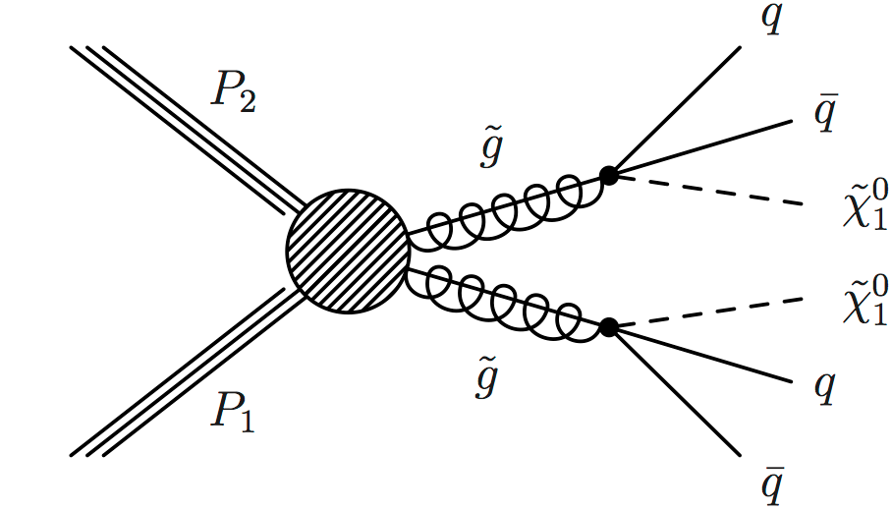
Supersymmetry (3)
Search for other squarks and gluinos
  Can be heavier than the lighter stop – already excluded up to 1 TeV in Run 1
  Mass reach extended by a factor 2 with LHC at 14 TeV (300 fb⁻¹)
    Further extended by 20% with HL-LHC
  Discovery potential of HL-LHC vanishes if no excess is seen with 300 fb⁻¹
q
~
q
~
q
q

Slide 39
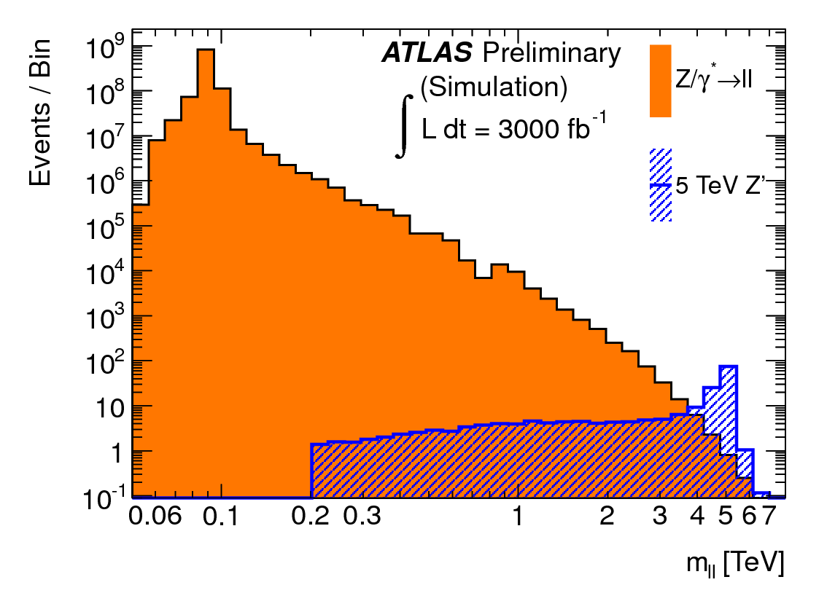
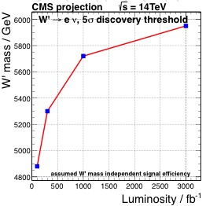
New gauge bosons: W’, Z’
Look for heavy di-lepton resonance: Z’ → e⁺e⁻, μ⁺μ⁻, or W’ → e⁺ν_{e} , μ⁺ν_{μ}
  Z’ and W’ masses up to 2-3 TeV excluded at LHC Run 1
  Mass reach extended by a factor 2 with LHC at 14 TeV (300 fb⁻¹)
    Further extended by 20% with HL-LHC
  Discovery potential of HL-LHC vanishes if no excess is seen with 300 fb⁻¹
    (Not visible in the graphs above)

Slide 40
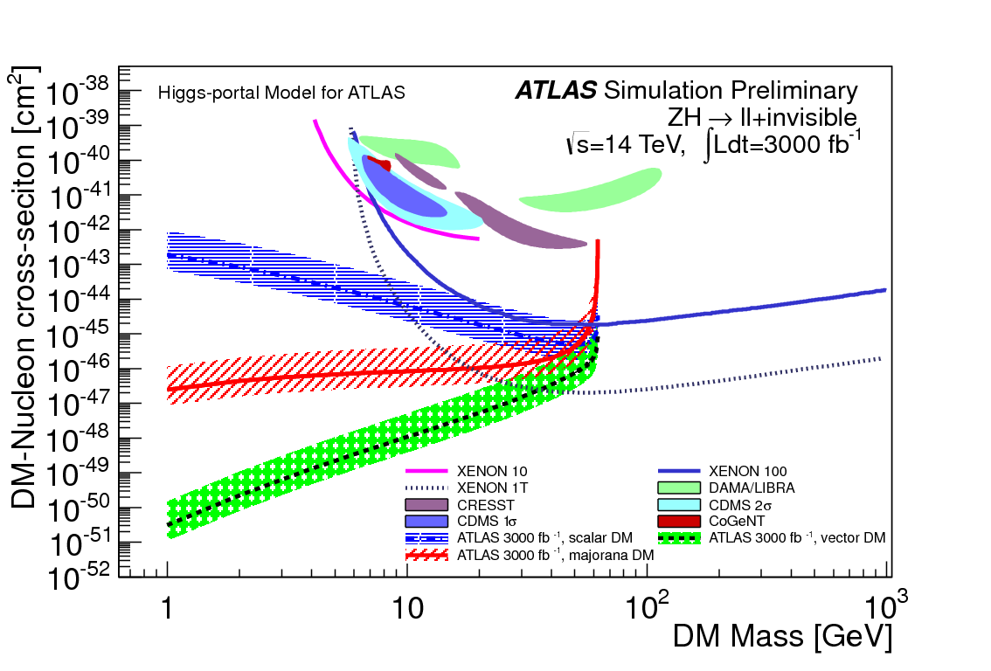
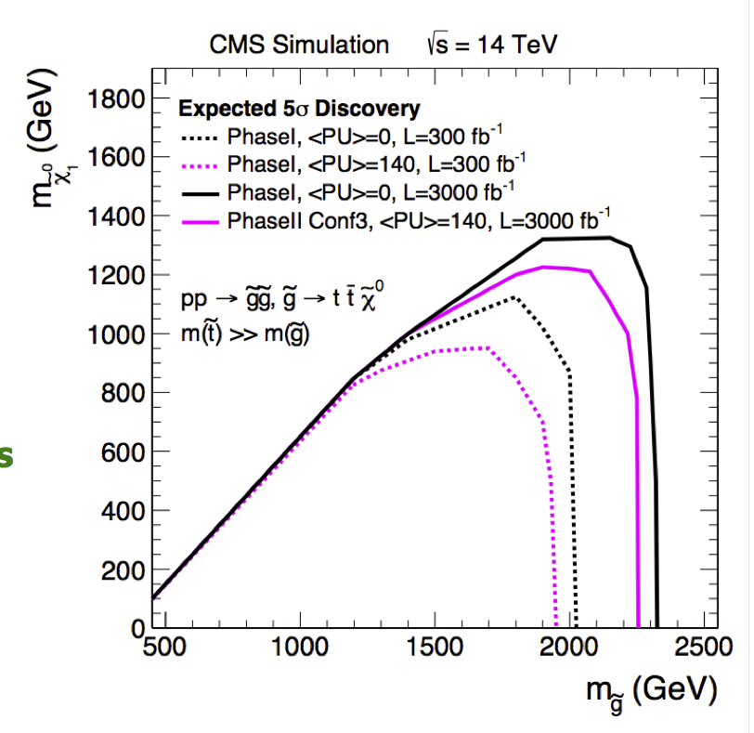
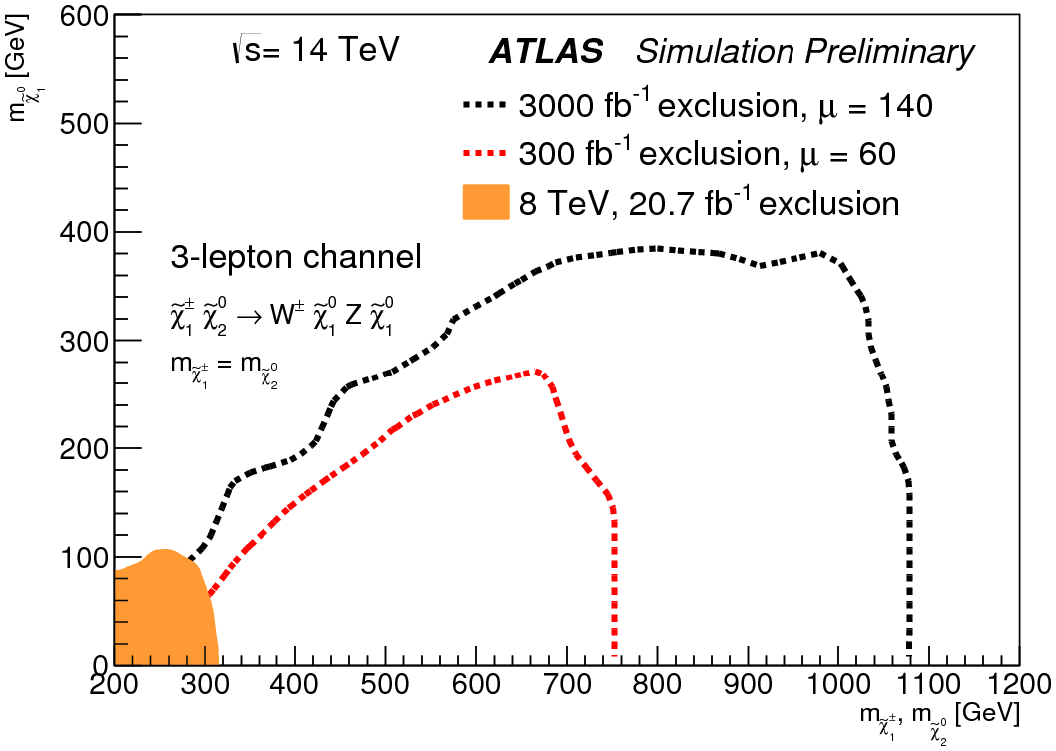
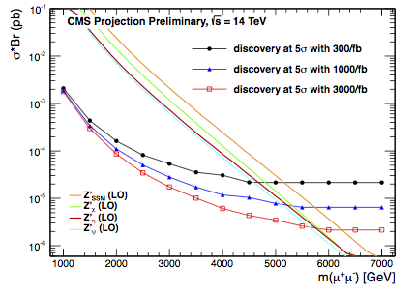
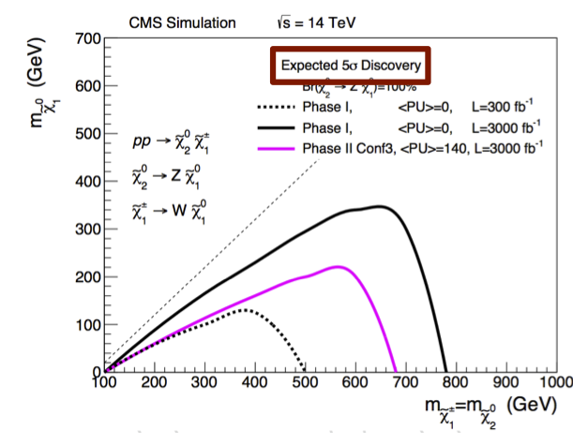
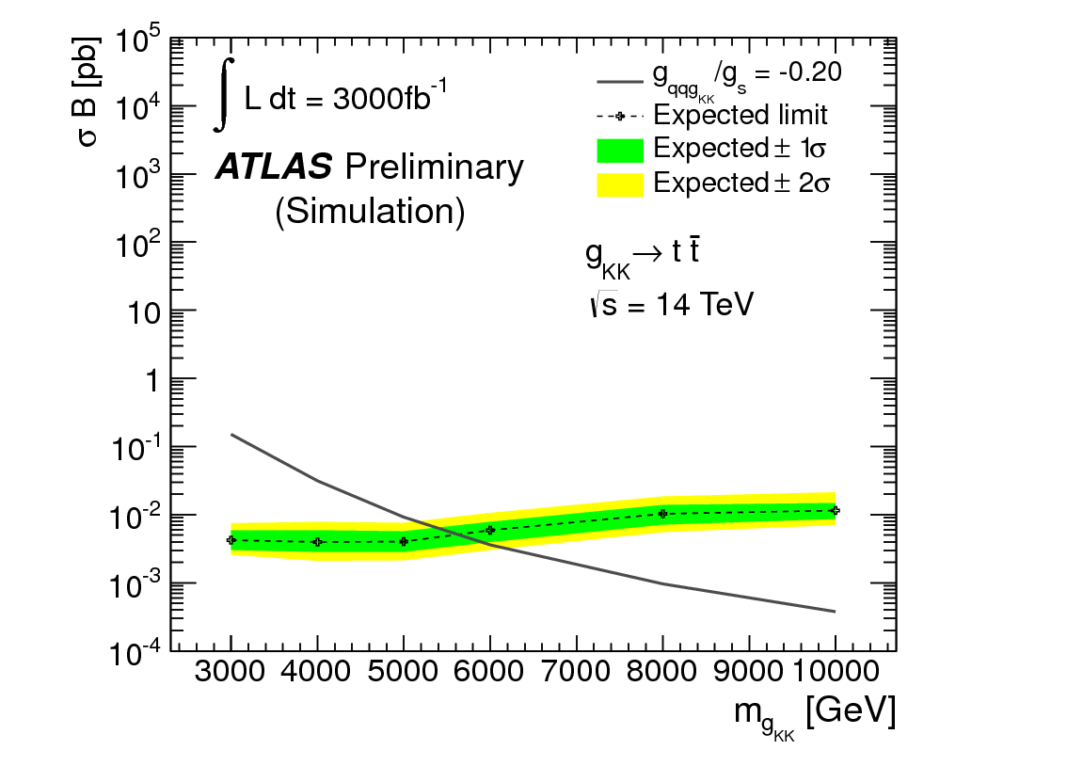
… and many others …
All with a similar pattern

Slide 41
Conclusions of the first lecture (1)
The LHC Run 1 brought the last experimental proof of the Standard Theory
  The Standard Theory of Particle Physics was already complete 40 years ago !
    New physics with a scale below 1 TeV has become quite unlikely
With the 8 → 14 TeV increase, the LHC Run 2 and Run 3 promise to be thrilling
  The mass reach for new physics will increase by a factor 2
    Stop: 1.2 TeV; Squarks/Gluinos: 2.5 TeV; Z’: 6 TeV; etc.
  The measurement precision will improve by a factor ~4-5
    Top mass: 300-400 MeV; Higgs couplings: 3-10%; etc.
  The lighter particle of the new physics spectrum may even be discovered
The HL-LHC will allow the first studies of any discovered new particle
  But it is unlikely to allow the exploration of the heavier part of the spectrum
    Only 20% mass reach increase from the tenfold increase of the luminosity

Slide 42
Conclusions of the first lecture (2)
If no hint of a new particle is found in the LHC Run2 (even via a modest excess)
  The HL-LHC is unlikely to make any discovery in 10 years of running
The HL-LHC will allow precision measurements to improve
  By a factor up to 2 (1.5) with respect to LHC 300 fb⁻¹ (1000 fb⁻¹)
    The ultimate precision is unlikely to unveil new physics effects
      Because deviations from BSM physics are not expected to be large enough
Whether a new particle is discovered at the LHC Run2 or not
  Very significantly more energy will be eventually needed
    Either to explore the heavier part of the spectrum
    Or to extend the search for new physics towards significantly higher masses
  Very significantly more precision will be eventually needed
    To extend the search for new physics towards significantly smaller couplings
    To see indirect effects of heavy new physics in precision measurements
      And possibly compare with observations made at higher energy
See 2nd lecture for the pertaining perspectives

Slide 43
Conclusions of the first lecture (3)
You are going to be running the LHC until 2030 – and maybe more
  With significant upgrades to the machine and the detectors for the HL-LHC
    In extreme running conditions (with an average of 140 PU collisions)
It will be necessary to re-assess the strategy in depth in 2018/19
  In view of the results of the LHC Run2
    Will 300 fb⁻¹ be enough ? Or 1000 fb⁻¹ ?
    Will the physics prospects compelling enough to justify the need of 3 ab⁻¹ ?
      with a luminosity increment of 10% / year, until 2030-2035
TODAY, WHAT DO YOU THINK ?

