Slide 1

Helix Nebula The Science Cloud
CERN – 13 June 2014
Alberto Di MEGLIO on behalf of Bob Jones (CERN)
This document produced by Members of the Helix Nebula consortium is licensed under a Creative Commons Attribution 3.0 Unported License.
Permissions beyond the scope of this license may be available at http://helix-nebula.eu/. The Helix Nebula project is co-funded by the European Community Seventh Framework Programme (FP7/2007-2013) under Grant Agreement no 312301

Slide 2


Why do we need Helix Nebula?
Paradigm shift – scientific innovation dependent on large-scale data collection, processing and access enabling interdisciplinary science
Vision 2030 - identifies the benefits and costs of accelerating the development of a fully functional e-infrastructure for scientific data
Realisation that no single provider could address all the needs of the European Research Area and that a simple customer-supplier model will be unable to support the full scientific lifecycle

Slide 3
Establish a sustainable multi-tenant cloud computing infrastructure in Europe
Initially based on the needs for the European Research Area & space agencies
Based on commercial services from multiple IT industry providers
Adhere to internationally recognised policies and quality standards
Governance structure involving all stakeholders
http://cdsweb.cern.ch/record/1374172/files/CERN-OPEN-2011-036.pdf

Slide 4
Timeline
2011
2014 …
2012-2013
Endorse the Common Strategy
Agree on the Partnership
Select flagships use cases
Define governance model
Pilot Phase
Deploy flagships,
Analysis of functionality,
performance & financial
model
Towards an open market
for Science

Slide 5
Long Term Goal
To create a multi-tenant ‘Open Marketplace for Science’, where data, scientists, funding bodies, SMEs and downstream industry meet to work towards common interests
An ecosystem to transform
data into valuable information

Slide 6
Partnership – Who & How?
IT Providers
-commit resources
-share investments
-agree on standards
& interoperability
Scientific and Space
Organizations
-commit resources
-access to data & user
communities
SME’s
Bring expertise
& agility to innovate
new services
EC supports with
-Policy & Strategy

Slide 7
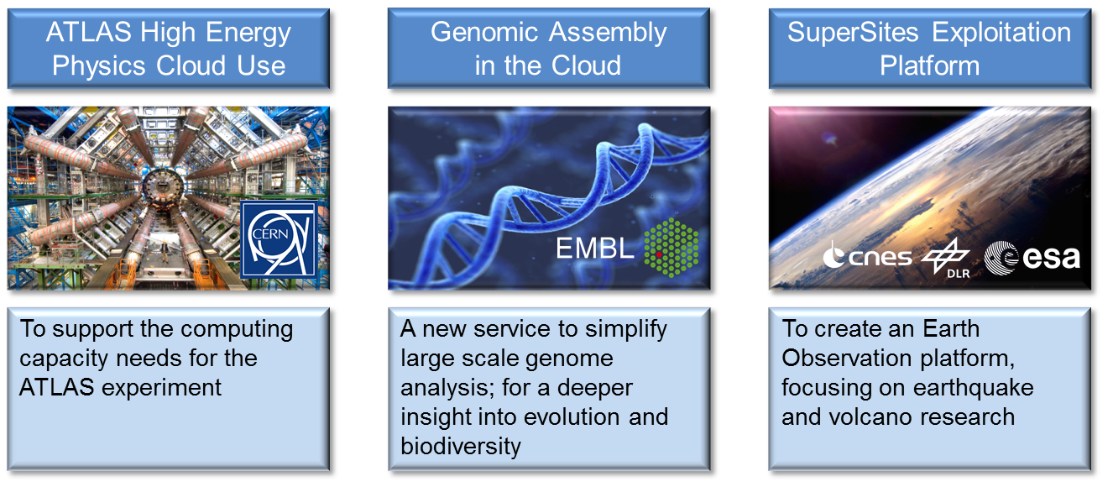
Initial Flagship Use Cases
Scientific challenges with societal impact
Sponsored by user organisations
Stretch what is possible with the cloud today

Slide 8
Flagship use cases
 | ATLAS H.E.P. Cloud Use (CERN) | Genomic Assembly in the Cloud (EMBL) | SuperSites Exploitation Platform (ESA/CNES/DLR)
Scientific goal/society impact/photogenic | • | • | •
Scale of resources used | • | •
Federation/Aggregation of datasets |  | • | •
Long-term archiving of data |  |  | •
On-demand processing | • | • | •
Impact on community & benefits | • | • | •
Potential increase of users | • | • | •
Interoperability | • | • | •
Data security | • | • | •
Maturity | • | • | •
Access to license-controlled sw |  |  | •

Slide 9

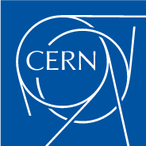
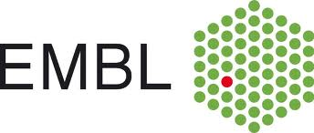

































May 2014: A European cloud computing partnership: big science teams up with big business
Strategic Plan
Establish multi-tenant, multi-provider cloud infrastructure
Identify and adopt policies for trust, security and privacy
Create governance structure
Define funding schemes
To support the computing capacity needs for the ATLAS experiment
Setting up a new service to simplify analysis of large genomes, for a deeper insight into evolution and biodiversity
To create an Earth Observation platform, focusing on earthquake and volcano research
To improve the speed and quality of research for finding surrogate biomarkers based on brain images
Suppliers
Adopters

Slide 10
There is a broad range of (competing) suppliers involved
Added
value/
people
Niche
offerings
Data and
information
Commodity
infrastructure
Small
Large

Slide 11

Many-to-many relationship matrix
Customers,
users
Suppliers,
providers
Front-end
Front-end
Front-end
Front-end
Each supplier has a working cloud service, but they are all different

Slide 12
Helix Nebula Blue Box services
REST API,
command line,
web app,
EC2 interface
SlipStream
Atos Canopy
CloudSigma
Interoute
T-Systems
Front-end
Front-end
Front-end
Front-end
They still are, but we have been working to make that irrelevant/transparent to users

Slide 13
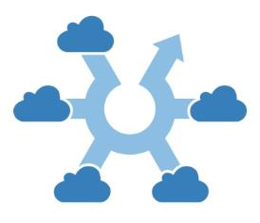







Helix Nebula Marketplace
Builds upon the work undertaken as part of the EC funding project and overall initiative
Support by European cloud providers and integration with existing e-Infrastructures, a hybrid cloud Computing Market Place and open for new Cloud Providers
Trusted cloud services through compliance with EU regulations and legislation
Simplified procurement process for multiple cloud services
Offered to the global scientific community, for both publicly-funded and commercial Research and Technology Organizations, offering large-scale and HPC-type deployments from the start.
A focus on transparency and impartiality of the brokerage function. Trust is important.

Slide 14
HNX Platform
Initial four commercial cloud providers integrated
Amazon EC2 Bridge for compatibility with third party tools, such as StarCluster or any EC2-compatible tool
Integration with the EGI FedCloud on our roadmap for 2014
EC2 Bridge
IaaS
Broker
Marketplace
Operator
Atos
CloudSigma
Interoute
T-Systems
EGI
FedCloud
GÉANT / Internet

Slide 15
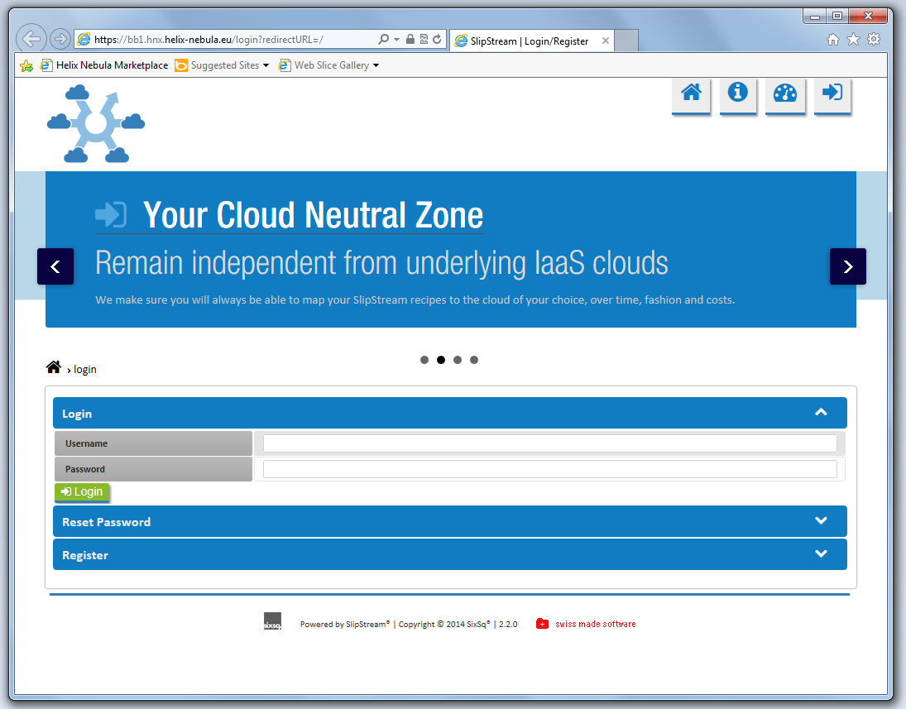
Brokerage Platform

Slide 16
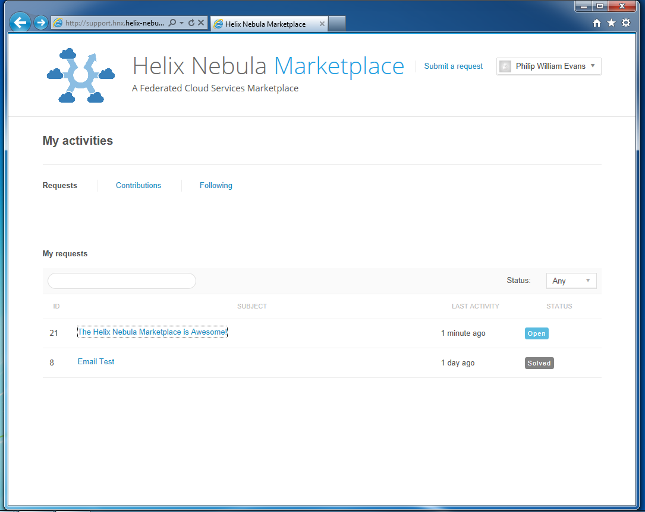
Support Desk

Slide 17
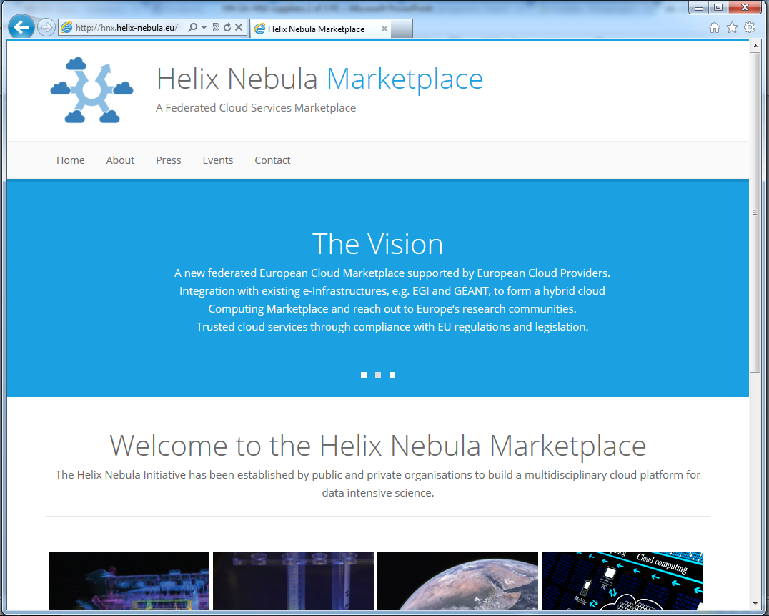
http://hnx.helix-nebula.eu

