Slide 1

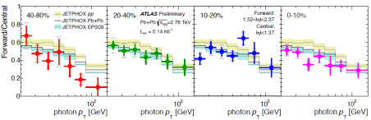
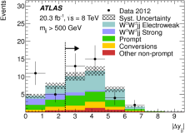
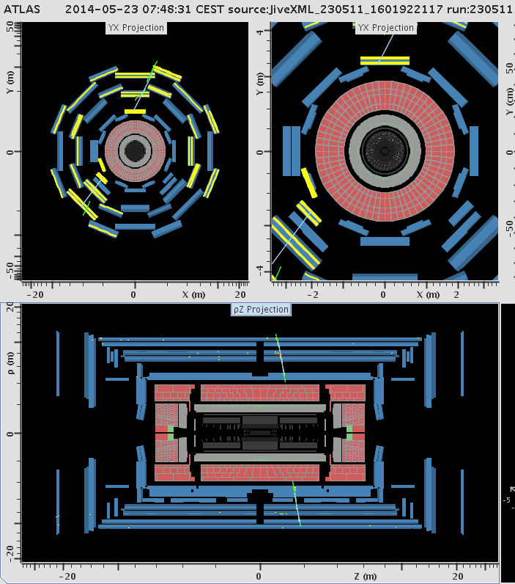
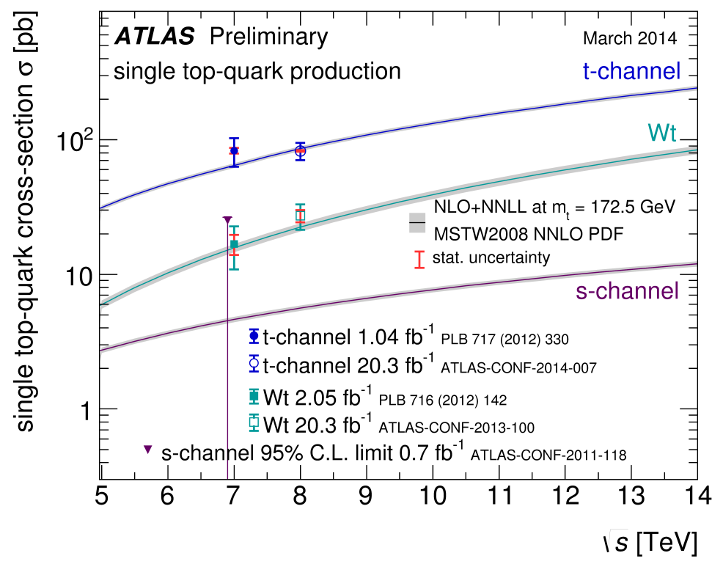
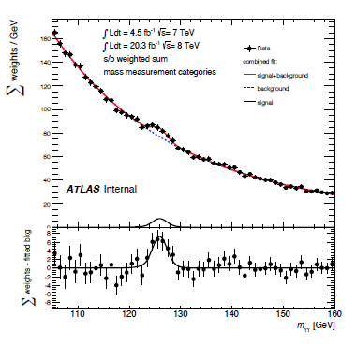
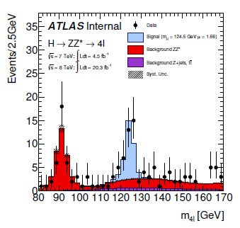
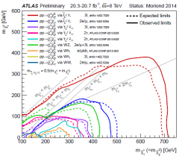
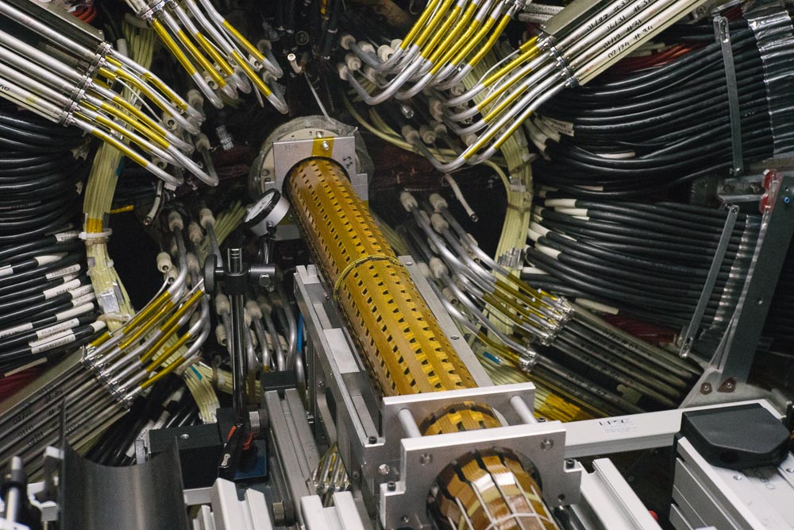
ATLAS Status Report
118th OPEN LHCC Session, 4th of June 2014
Monica D’Onofrio (University of Liverpool)
On behalf of the ATLAS Collaboration
Physics Highlights: many new results!
IBL Insertion and ID cooling tests
Milestone Week 3: cosmics in ATLAS!

Slide 2
Recent Physics Highlights

Slide 3
Papers since last LHCC meetings
Finalizing Run 1 data analysis (7 and 8 TeV)
Measurement of the underlying event in jet events from 7 TeV proton-proton collisions with the ATLAS detector | EPJC
Jet energy measurement and its systematic uncertainty in proton-proton collisions at √s = 7 TeV with the ATLAS detector | EPJC
Search for squarks and gluinos with the ATLAS detector in final states with jets and missing transverse momentum using 20.3 fb−1 of √s=8 TeV proton-proton collision data | JHEP
Light-quark and gluon jet discrimination in pp collisions at √s =7 TeV with the ATLAS detector | PRD
Evidence of electroweak production of WWjj in pp collisions at sqrs{s}=8 TeV with the ATLAS detector | PRL
Search for supersymmetry in events with four or more leptons in √s = 8 TeV pp collisions with the ATLAS detector | PRD
Search for microscopic black holes and string balls in final states with leptons and jets with the ATLAS detector at √s = 8 TeV | JHEP
Search for High-Mass Dilepton Resonances in pp Collisions at √s = 8 TeV with the ATLAS Detector | PRD
Measurement of the centrality and pseudorapidity dependence of the integrated elliptic flow in lead-lead collisions at √s_{NN} = 2.76 TeV with the ATLAS detector | EPJC
The monitoring and data quality assessment of the ATLAS liquid argon calorimeter | JINST
Operation and Performance of the ATLAS Semiconductor Tracker | JINST
Measurement of chi_c1 and chi_c2 production with √s = 7 TeV pp collisions at ATLAS | JHEP
Observation of Boosted Z-→bb Production in Proton-Proton Collisions at √s = 8 TeV and Measurement of the Production Cross-Section | PLB
Muon Reconstruction Efficiency and Momentum Resolution of the ATLAS Experiment in Proton-Proton Collisions at √s = 7 TeV in 2010 | EPJC
Search for supersymmetry at √s = 8 TeV in final states with jets and two same-sign leptons or three leptons with the ATLAS detector | JHEP
Electron reconstruction and identification efficiency measurements with the ATLAS detector using the 2011 LHC proton-proton collision data | EPJC
Measurement of the low mass Drell-Yan differential cross section at √s = 7 TeV using the ATLAS detector | JHEP
Measurement of the parity violating asymmetry parameter α_{b} and the helicity amplitudes for the decay ΛB → J/ψ Λ0 with the ATLAS detector | PRD
Search for dark Matter in events with single Z and missing transverse Energy using pp collisions at √s = 8 TeV with the ATLAS detector | PRD
Search for top quark decays t→ qH with H→γγ using the ATLAS detector | JHEP
Searches for direct production of charginos, neutralinos and sleptons in final states with two leptons and missing transverse momentum in pp collisions at √s = 8TeV with the ATLAS detector | JHEP
Measurement of the 4l Cross Section at the Z Resonance and Determination of the Branching Fraction of Z→4l in pp Collisions at √s = 7 and 8 TeV with ATLAS | PRL
Search for direct stop pair production in events with a Z boson, b-jets and missing transverse energy with the ATLAS detector using 21 fb⁻¹ from proton-proton collision at √s =8 TeV | EPJC
Search for direct top squark pair production in final states with two leptons in √s = 8 TeV pp collisions with the ATLAS detector | JHEP
Measurement of event-plane correlations in √s_{NN} = 2.76 TeV lead-lead collisions with the ATLAS detector | PRC
Since the last LHCC meeting:
25 new papers
27 CONF notes
Paper shown in this talk
Paper in back-up

Slide 4
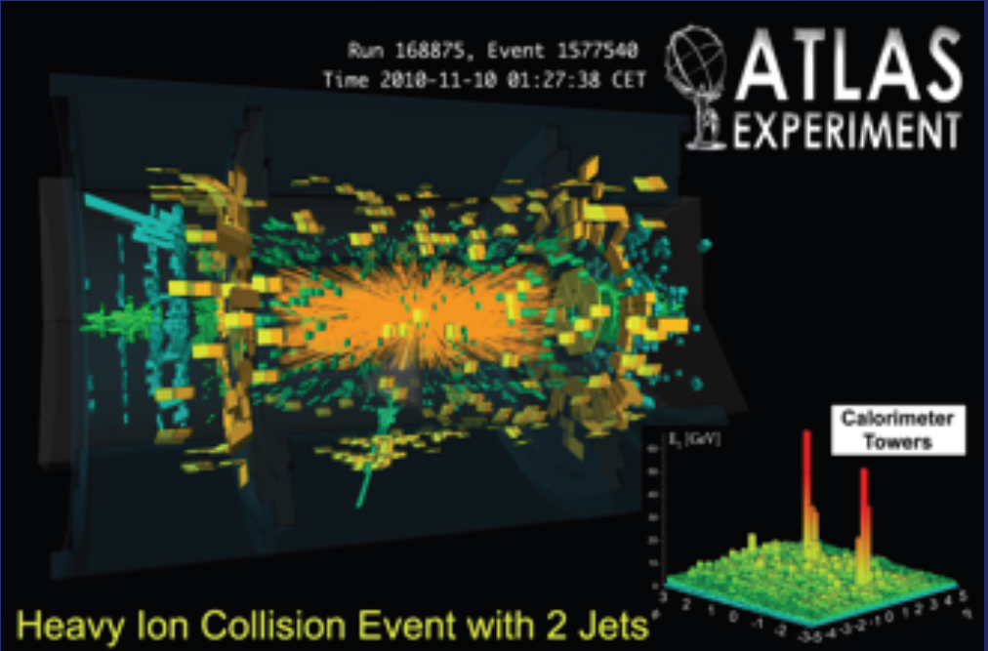
Heavy Ions
10 new results released since last LHCC meeting!
  Cover a variety of topics aiming to study quark gluon plasma using soft and hard probes (in p-Pb and Pb-Pb)
  Presented at QuarkMatter 2014 Conference
May
2014
Charged hadron production in p+Pb collisions at √s_{NN}=~5.02~TeV measured at high transverse momentum | ATLAS-CONF-2014-029
Measurement of the production of neighbouring jets in lead-lead collisions at √s_{NN}= 2.76 TeV | ATLAS-CONF-2014-028
Collective flow with higher-order cumulants in lead-lead collisions at √s_{NN}=2.76 TeV | ATLAS-CONF-2014-027
Centrality, rapidity and pT dependence of isolated prompt photon production in Pb-Pb collisions at √s_{NN} = 2.76 TeV | ATLAS-CONF-2014-026
Measurements of the nuclear modification factor for jets in Pb+Pb collisions at sqrt{NN}=2.76 TeV | ATLAS-CONF-2014-025
Centrality and rapidity dependence of inclusive jet production in √s_{NN}=~5.02~TeV proton—lead collisions | ATLAS-CONF-2014-024
Measurement of W boson production and lepton charge asymmetry in Pb+Pb collisions at √s_{NN} = 2.76 TeV | ATLAS-CONF-2014-023
Elucidating the event-shape fluctuations via flow correlations and jet tomography studies in 2.76 TeV Pb+Pb collisions | ATLAS-CONF-2014-022
Measurement of the long-range pseudorapidity correlations and associated Fourier harmonics in √s_{NN}=5.02 TeV proton-lead collisions | ATLAS-CONF-2014-021
Measurement of the Z-boson production in pPb collisions at √s_{NN}=5.02TeV | ATLAS-CONF-2014-020

Slide 5
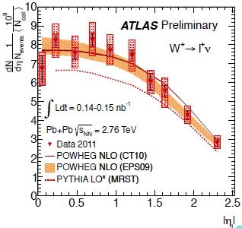
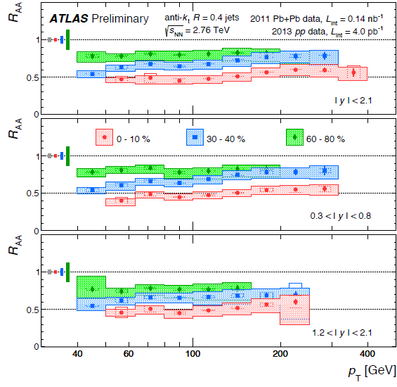
HI highlights: Hard Probes and jets
EWK Boson measurements → additional way to study partonic energy loss in HI collisions (standard candles).
  E.g.: W (→e,μ)
Jet production in p-p and Pb-Pb:
Measure absolute jet suppression: R_{AA} (=nuclear modification factor) vs rapidity and in ranges of centrality
  0-10% Centr: R_{AA}= 0.47 (0.56) for p_{T} = 55 (355) GeV consistent with central-to-peripheral ratio

Slide 6
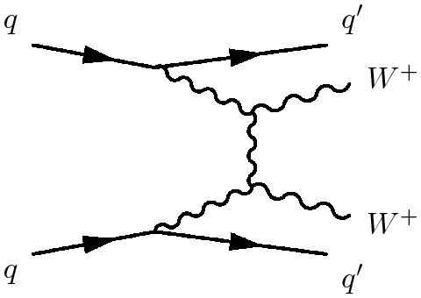
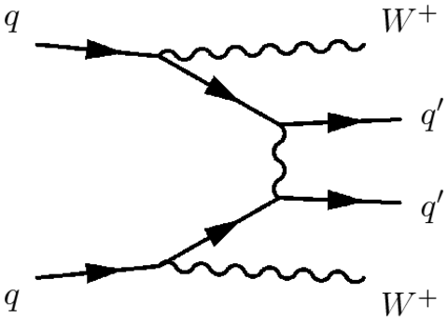
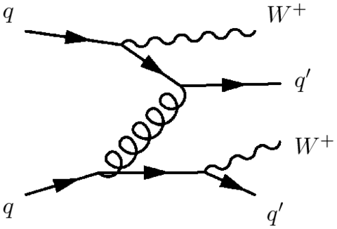

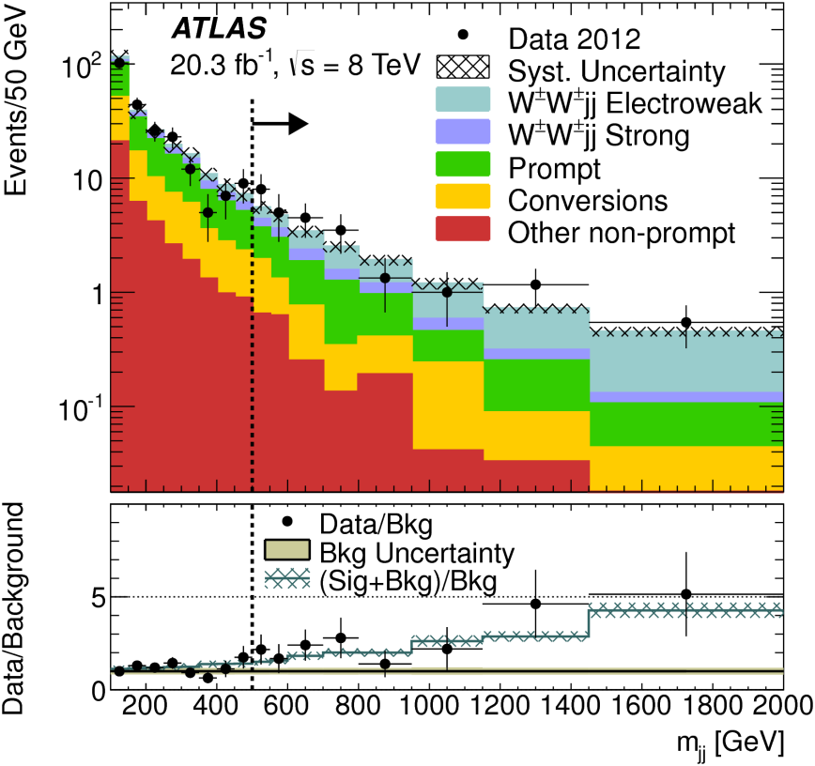
Evidence for Electroweak Production of W±W±jj
arXiv:1405.6241
Key process to probe the nature of EWK symmetry breaking
Use 8 TeV full dataset in e±e±, e±μ±, and μ±μ± final state (+2jets)
EWK: VBS non-VBS Strong
‘Inclusive’ and ‘VBS’ fiducial regions
M_{jj}>500 GeV
M_{jj}>500 GeV
|Δy_{jj}| > 2.4
Combined significance:
4.5 (3.6) σ in the inclusive (VBS) region
Fiducial cross section in VBS region:
SM:
Set also limits on anomalous quartic gauge boson couplings (a4, a5)

Slide 7
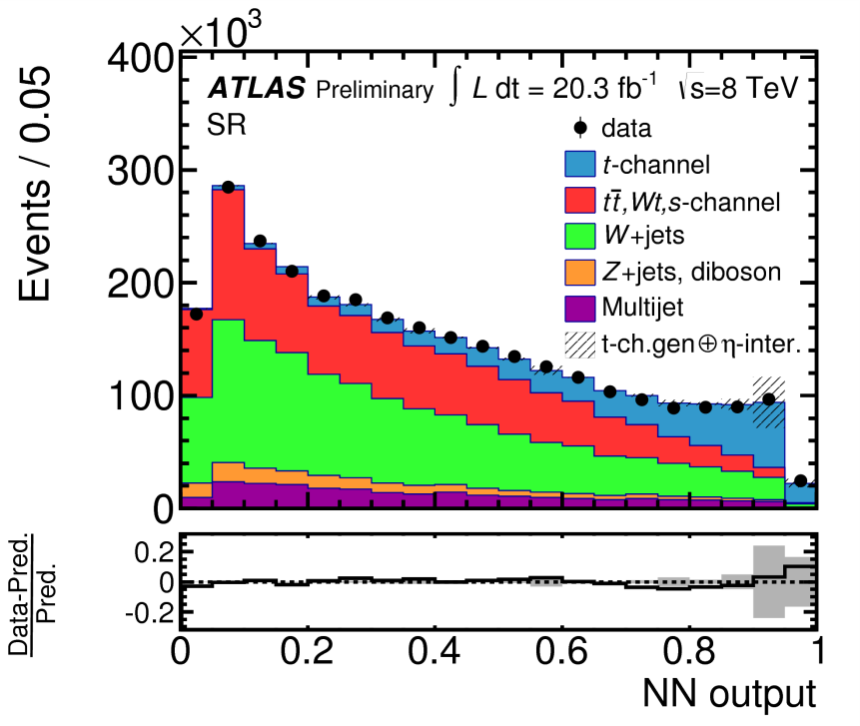
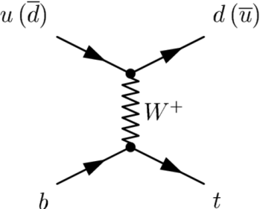
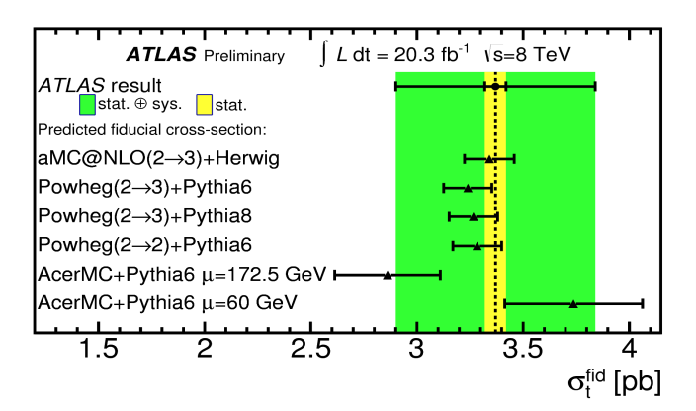
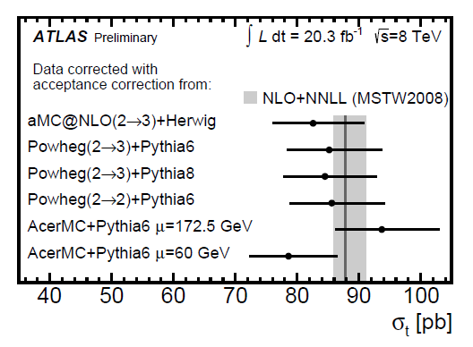
Top production
Single top t-channel inclusive and fiducial cross section
ATLAS-CONF-2014-007
Summary of single top production
Translate fiducial σ to total σ
arXiv:1403.6293
Also:
Search for FCNC top → Hq, H→ γγ
BR < 0.79% and limits on tqH (q=u,c) coupling

Slide 8

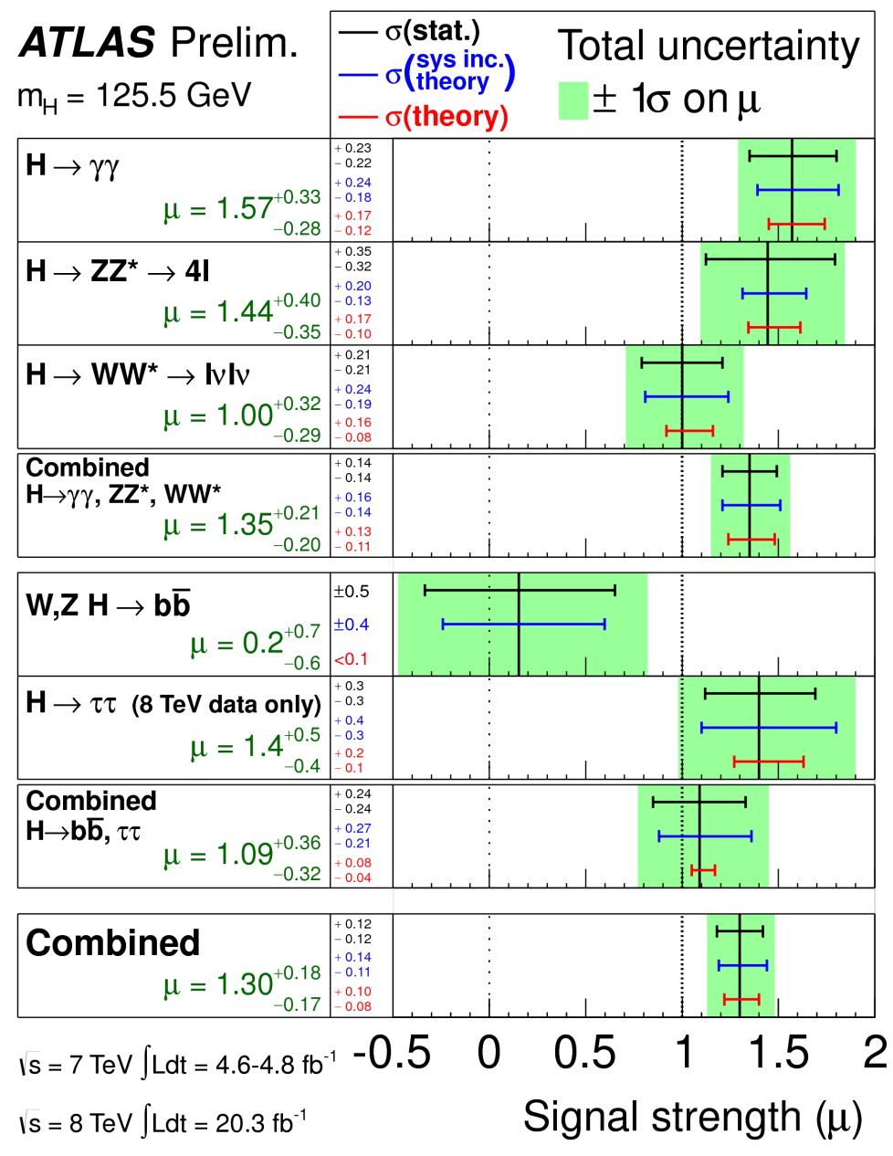



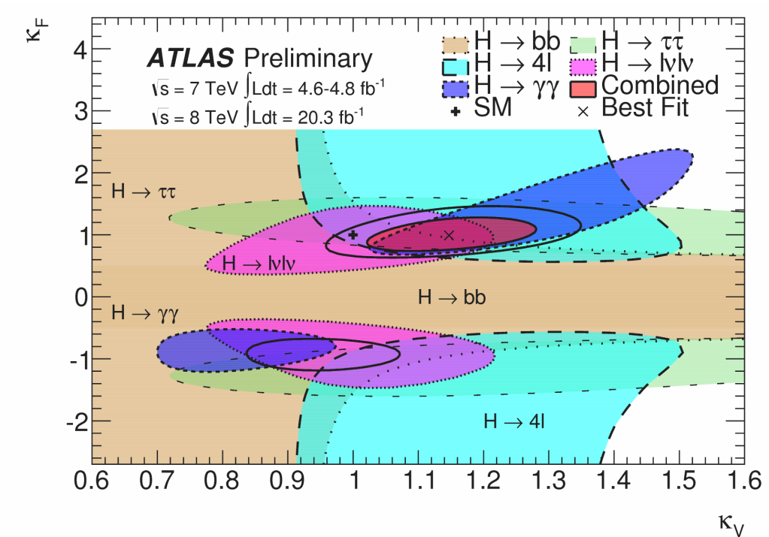
Higgs highlights
Shortly after last LHCC meeting: update on higgs couplings
  Inclusion of fermion results (H to ττ and VH, H → bb)
ATLAS-CONF-2014-009
Fermionic:
Total:
Coupling fits assuming only SM
Illustration on how channels contribute
Notes:
Higgs to tautau, VH and bb do not improve mu

Slide 9

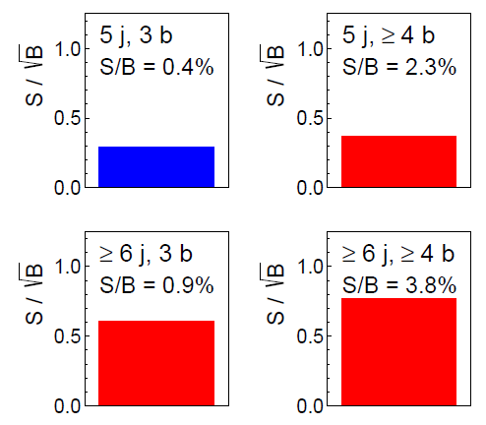
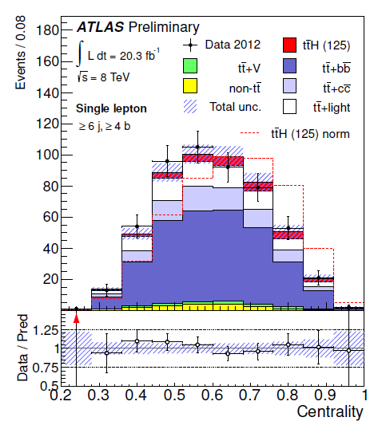
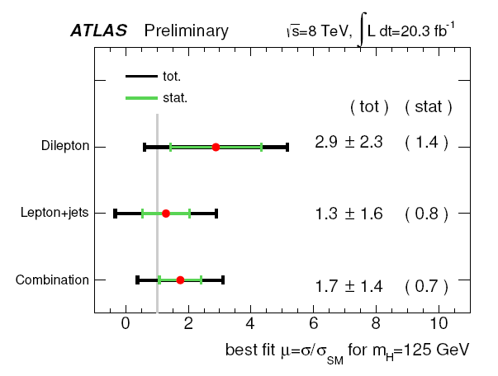
ttbar+Higgs
ATLAS-CONF-2014-011
Direct access to top-Higgs Yukawa coupling
Consider H→bb: single and dilepton channels, categorized in N jets, N b-jets.
Use Neural Network based on several discriminating variables
E.g.: single lepton
6j, 4b
Signal strength assuming m_{H}=125 GeV
Constrain background in suitable Control Regions → help reducing systematic uncertainties
Centrality=Sum pT / Sum E (all jets and lepton)

Slide 10


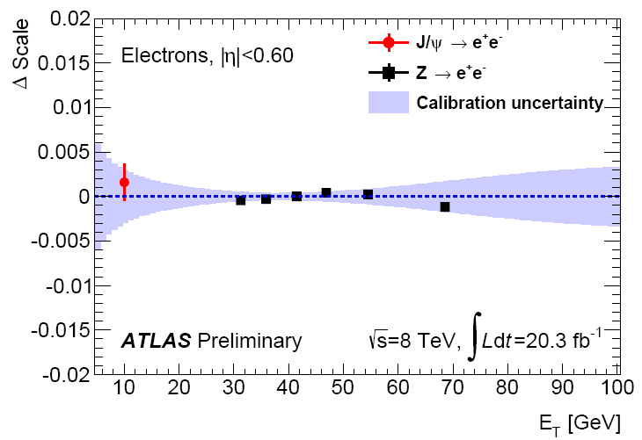
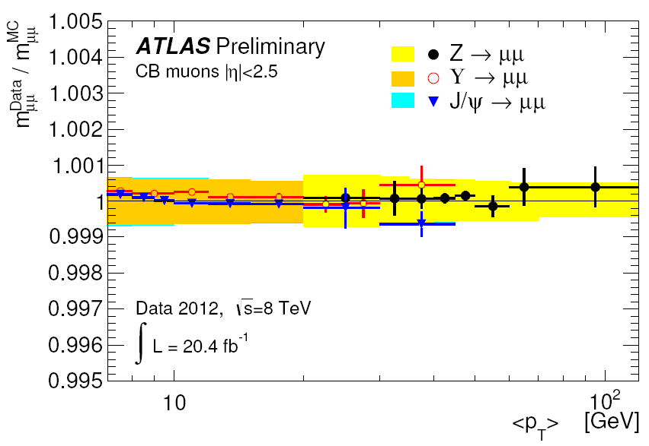
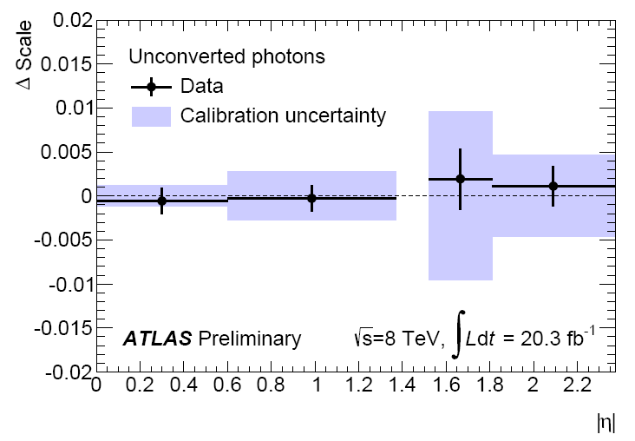
Improved measurement of Higgs boson mass
Last Mass measurement (July 2013)
Since then: improvements in energy-scale calibrations for e , γ and μ
Ele/photon in 2012 data
6.6M Z to ee used to derive in-situ energy scales for e and γ
0.3M J/ψ to ee and 0.2M Z to llγ for cross checks
Z → llγ
Muon in 2012 data:
9M Z to μμ, 6M J/ψ used to set the muon p scale and resolution.
5M Υ to μμ used to verify results and systematics
Comparison of measured and nominal scale
Total uncertainty on e energy scale: 0.03%-0.3% for E^{e}_{T} ~ 40 GeV
Total uncertainty on γ energy scale: 0.2%-0.6% for E^{γ}_{T}~ 60 GeV
Total uncertainty on μ: from 0.04% for η ~ 0 to 0.2% for |η| > 2.0
Notes:
9M Z to μμ, 6M J/ψ used to set the muon p scale and resolution (accounting for residual effects related to alignment, material and magnetic field).

Slide 11
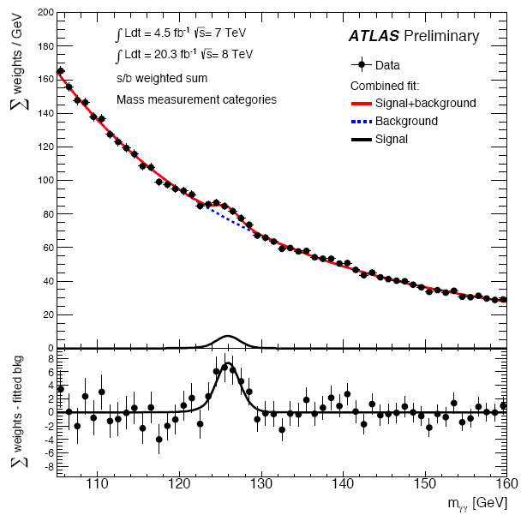
Improved measurement of Higgs boson mass
Last Mass measurement (July 2013)
Mass measurement in H→ γγ
Unbinned likelihood fit with mH as parameter of interest
10 mutually orthogonal categories (converted/ unconverted γ, η of γ) with different S/B, optimized to minimize the expected uncertainty on the mass measurement
Reduction by 10% of expected signal resolution
  Reduce systematics on m_{γγ} from 0.7 GeV (Summer 2013) to 0.24 GeV (now!)

Slide 12
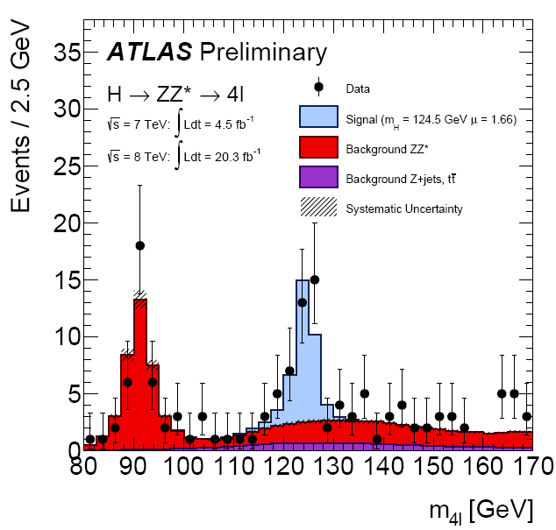
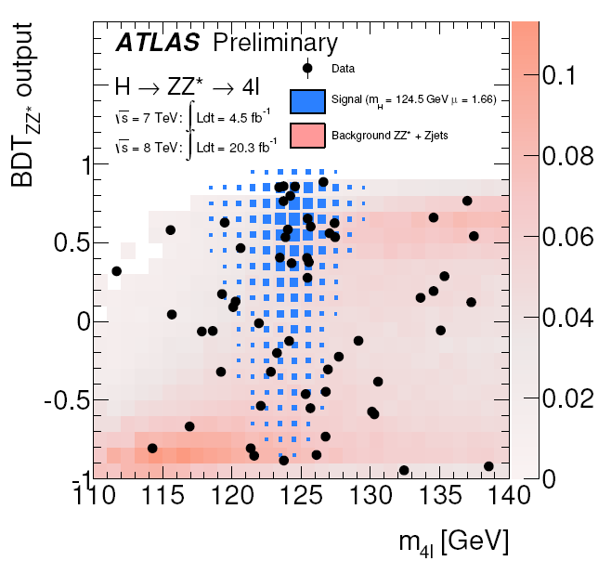
Improved measurement of Higgs boson mass
Last Mass measurement (July 2013)
Mass measurement in H→4l
  Improvements in analysis techniques
  Use new multivariate discriminant
  2D fit (m4l,BDT) with 4 categories (4μ,4e,2μ2e,2e2μ)
  Factor of 2 to 10 reduction of uncertainties related to energy calibration
  Increase S/B
  Reduction of the statistical uncertainties

Slide 13

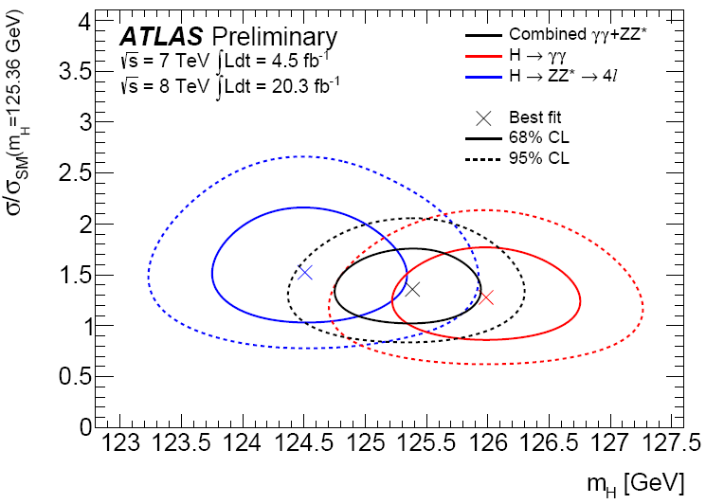
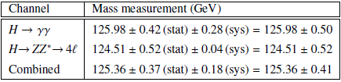
Improved measurement of Higgs boson mass
Last Mass measurement (July 2013)
Syse
Combination
  Use profile likelihood ratio defined in terms of m_{H} and treating μ_{γγ} and μ_{4l} as independent nuisance parameters
Considerable reduction of systematic uncertainties on individual measurements
Compatibility: 2.0σ (was 2.5σ) corresponding to a probability of 4.8%
Shown at LHCP this week for first time; paper to be submitted shortly

Slide 14
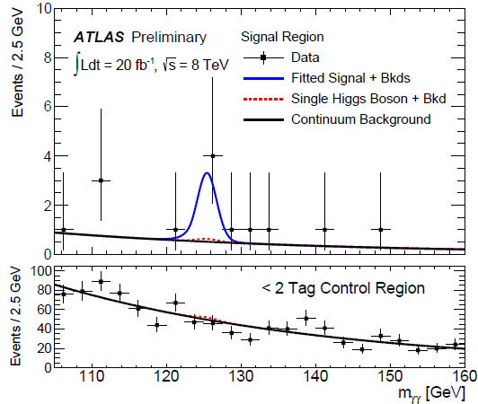
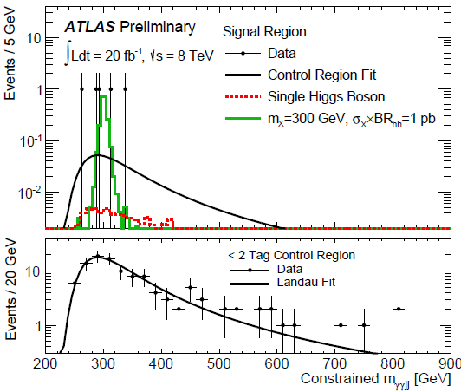
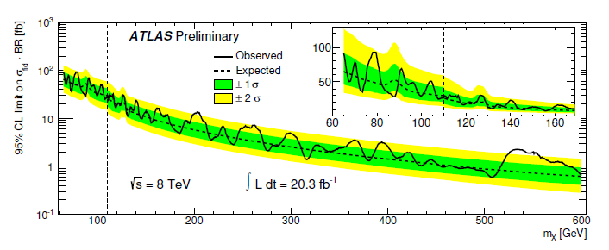
Beyond SM Higgs searches
Shown at LHCP this week for first time; paper to be submitted shortly
Search for resonant (X→hh) and non-resonant Higgs pair production in γγbb
  X could be heavy Higgs in 2HD Models
  Non resonant: SM hh production NLO xsect = 9.22 fb (includes interference between trilinear Higgs couplings and box diagrams)
95% CL upper limit on σxBR of non-resonant production:
Obs: 2.2pb
(Exp: 1.0^{+0.6}_{-0.3}pb)
Limit for narrow resonance:
0.8 – 3.5 pb as function of its mass
Search in low/high γγ mass
  Explore region between 65 and 600 GeV
  SM Higgs production treated as background
  Model-independent limit at the 95% CL on the production cross-section x BR(→ γγ) in a ﬁducial volume
Notes:
For the non resonant search, the invariant mass of the two photons is considered, performing a fit of mgg for all events passing the dijet and diphoton selections and considering 3 components: double higgs, single higgs and continuum background, dominated by diphoton, photon+jets and ttbar dileptonic events (latter 10%), and constrainted using a CR with less than 2 btags (CR and SR simultaneous fit).
For the resonant search, an additional selection on the 4-object invariant mass is applied, with a sliding cut depending on the mass of the X resonance . The acceptance on the background is extracted from data in a region with less than 2 btags and the mggjj slope is fitted with a landau function – integrated in the signal window to obtain the eff. The choice of the window is such that it contains 95% of the signal events for production of X.
For the non resonant analysis, a window 2 sigma mgg is considered: 1.5 events are expected, 1.3 from continuum bkg, 0.2 from single higgs production (0.04 for SM hh). 5 events are found, corresponding to 2.4 standard deviations. For the resonance search, the global probability to have such an excess is 2%, corresponding to 2.1 st dev.

Slide 15
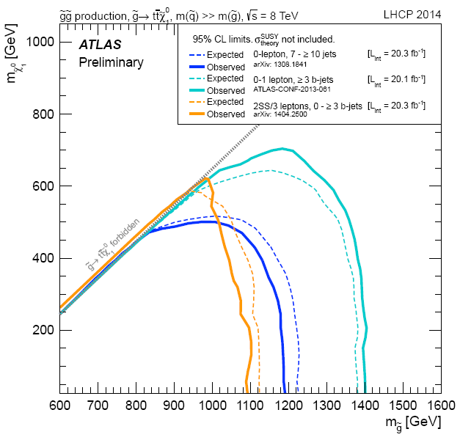
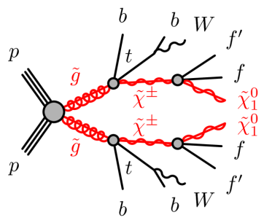
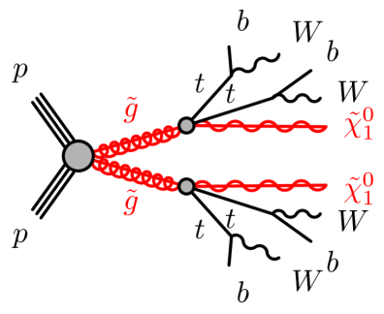
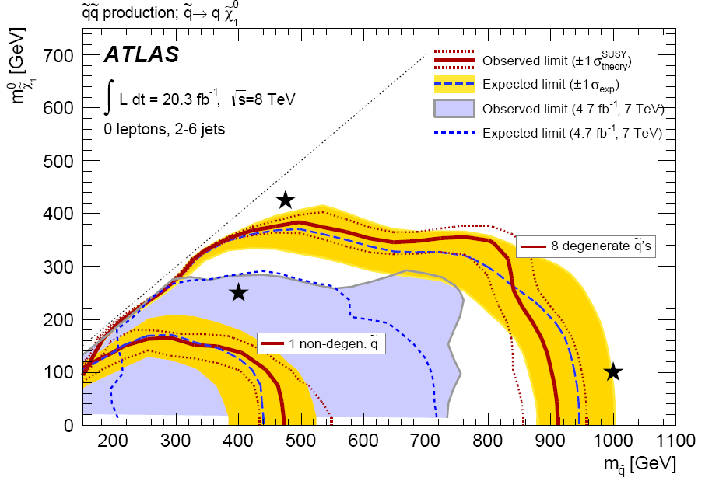
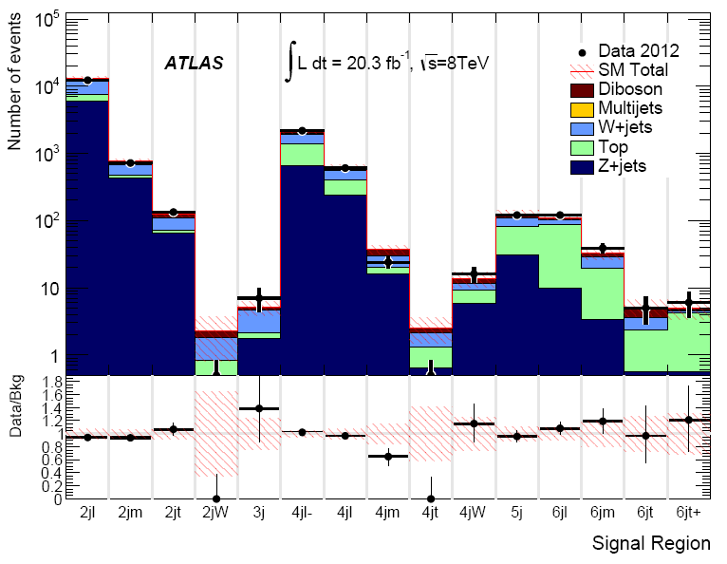
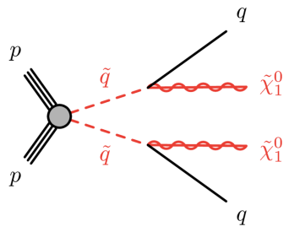
SUSY searches: strong production
Several new results on searches for SUSY strong production: gluinos, squarks including top squarks
arXiv:1404.2500
2 same sign leptons (e/mu) + (b-) jets (/ 3-leptons + (b-)jets).
Background estimate mostly data-driven
Several interpretations
→ gluino pair production
0 leptons, 2-6 jets +Missing E_{T} → several SR
targeting many strong production scenarios.
arXiv:1405.7875
Example: squark pair production
Background estimate from control regions.

Slide 16
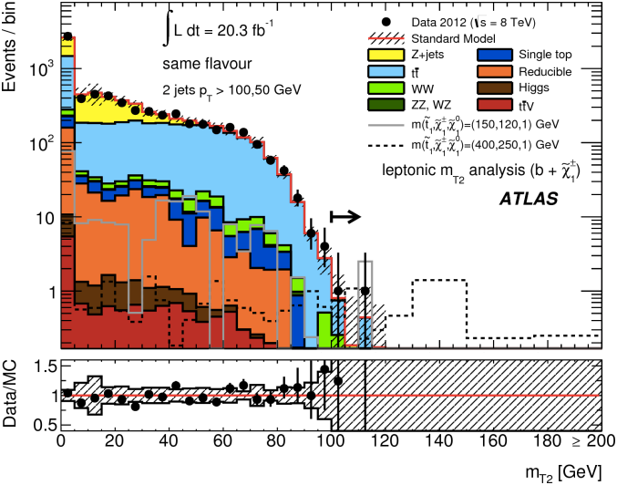
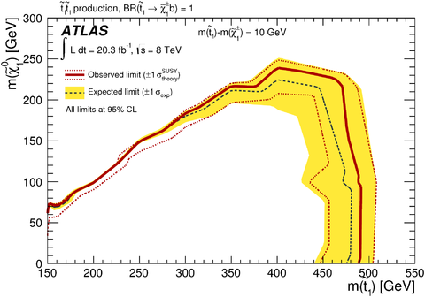
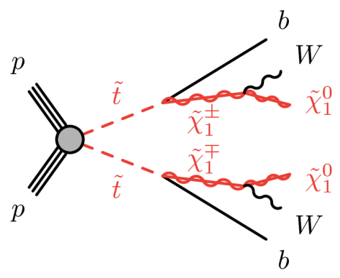
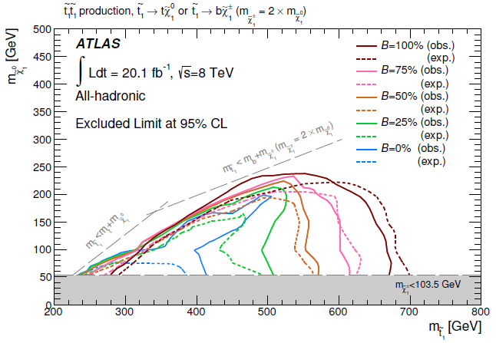
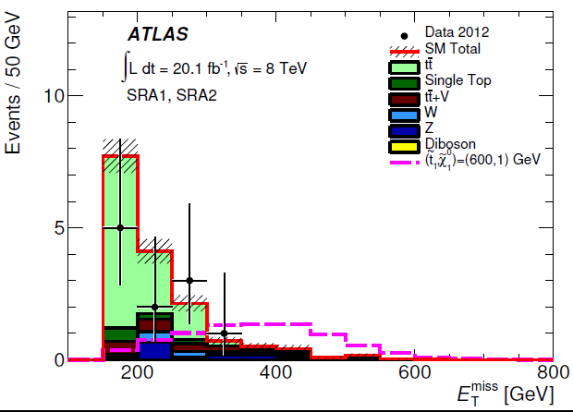
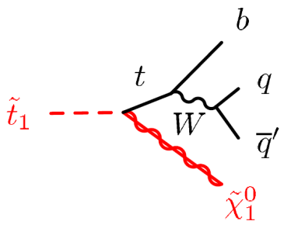
SUSY searches: top squarks
2-lepton (e/μ) + b-jet: targets different mass hierarchies.
Uses M_{T2} variable to suppress the background
arXiv:1403.4853
OR decay via stau
ATLAS-CONF-2014-014
0 leptons + 4/5/6 jets + Missing E_{T} : sensitive to various scenarios
Shown TODAY for first time; paper to be submitted shortly

Slide 17
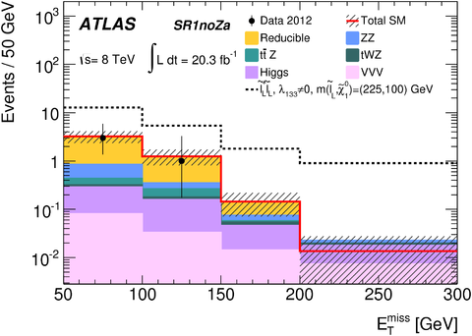
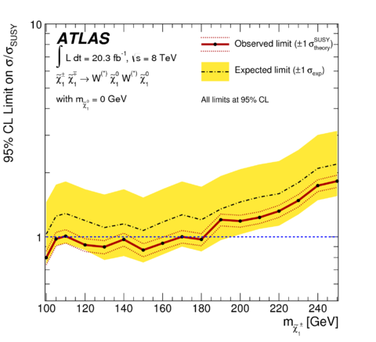
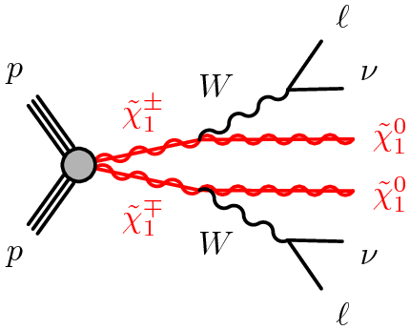




SUSY Searches: Electroweak production
1405.5086
1403.4853
4-lepton (e,μ,τ) – many interpretations (R-parity violating and EWK scenarios).
2-lepton (e,μ) – many interpretations.
(a) Exclusion of chargino pair production decaying via W’s (b)combined chargino-neutralino exclusion in WZ final states
Example of SR with 1τ
(a)
(b)

Slide 18




Searches in dilepton final states
arXiv:1405.4123
Resonant dilepton production
  ee,μμ
Non resonant dilepton production
ATLAS-CONF-2014-030
Lower limits on:
Scale for Contact Interaction: Λ>26.3 TeV
Large Extra Dimension: Ms>6.1 TeV for n=3 ADD
  Use also the ll decay angle, cosθ*

Slide 19
Towards Run 2

Slide 20


IBL insertion and Pixel status
IBL (new inner pixel layer being added during LS1) completely inserted on Wednesday May 7!
  Smooth operations, followed by installation of N₂ lines and flushing in IBL sealed volume
In addition:
Pixel detector reconnected and cooling restarted
  All 82 Pixel loops operated successfully
On-going:
IBL service connections
Further extensive cooling trials in July for IBL, Pixel and SCT systems

Slide 21

M-weeks
Milestone weeks:
  get all sub detectors up and running for Run-2
  6 milestone weeks foreseen until October 2014
Since last LHCC meeting: two more M-weeks completed
M3 (just two weeks ago):
Huge progress on all systems!
Could run with combined system at 100+ kHz level-1 rate using random triggers
Overnight Cosmic Trigger Run TRT Fast OR + RPC + MDT (HV nominal) and CSC (~side A HV nominal)
Cosmic run Nov 24-Dec 5

Slide 22


A busy ATLAS Control Room

Slide 23

M3 Participating Components and Runs
Include BCM, TRT, CSC, MDT , TGC and RPC (new in M3!):
  Tested with 100+ kHz level-1 rate
  Sector 5 A RPC providing trigger
Also include HLT (New in M3!):
  For the first time in ATLAS partition since Run 1!
M3 Menu:
LVL1: latest Run 1 Physics menu
HLT: basic L1 streamers (e.g. L1_TRT)
Basic algorithms expected in M4
Event Display and Monitoring working at Point1.
Tier0 processing of the data streamlined
Data Quality Web-displays produced automatically for incoming data
Cosmic Run with all the above systems participating

Slide 24

Cosmics through ATLAS again!
⬅TRT Fast-OR
event
RPC Trigger Event ➔

Slide 25
Further preparation for Run 2
Detector consolidation and repair work ongoing, e.g.
  LAr low voltage power supplies being re-installed on the detector after capacitor replacements done at the company (Wiener)
  Tile: replacement of LVPS and check of HV boards (235/256 drawers done)
  RPC leak chasing: more than half done
  MDT/RPC: new BME chambers installed
New functionalities in run-2:
  1 crate of new L1Calo input processor MCMs installed & under test
  L1Topo trigger on schedule through production readiness review
  new CSC ROD commissioning to start in June, to go to 100 kHz L1 rate
Software and Analysis preparation:
  new Geant version (4.9.6) for simulation fully validated
  new reconstruction software based on "xAOD" in final validation stage (format readable by both ROOT and Athena)
  tuning of clustering for IBL layer ongoing
  major improvements to grid-related software on track (ProdSys2, Rucio)
  tutorials on new analysis model have started (and are fully booked!)
Major testing of new SW components and analysis model during the summer ("DC14")
See more detail in March LHCC talk (A. Salzburger)

Slide 26
Conclusions
Many new results released in the last few months based on heavy ions and proton-proton collisions!
  Emphasis on finalising Run-1 papers.
Re-analysis of 2011 and 2012 data using improved energy scale calibration for e , γ and μ led to a new precision measurement of the Higgs mass
  Improves systematic uncertainties on individual channel measurements:
    H→γγ: from 700 MeV to 280 MeV; H →4l: from +500/-300 MeV to 40 MeV
  Detailed groundwork opens door to further precision measurements
Preparations for Run-2 continue to progress well
  IBL successfully inserted into ATLAS
  Pixel reconnected and testing in progress, much other work across many detectors well advanced
  Cosmic rays recorded again during the last M-week (M3), with high-level trigger and several detectors included
Upgrade work on Phase-1 and Phase-2 ongoing, as reported yesterday by P. Allport in the upgrade session

Slide 27
Back-up

Slide 28



B-Physics highlights: charmonium
New B-physics results since March LHCC:
Measurement of χ_{c1} and χ_{c2} production (√s = 7TeV) | arXiv:1404.7035
Measurement of the parity violating asymmetry parameter α_{b} and the helicity amplitudes for the decay Λ_{b}⁰ → J/ψ Λ⁰ (√s = 7TeV) | arXiv:1404.1071
Study of heavy quarkonium production → unique insight into dynamics of strong interaction.
  prompt and non-prompt production cross-sections for the χ_{c1} and χ_{c2} charmonium states where χ_{c} are reconstructed through the radiative decay χ_{c} → J/ψ(◊μμ)+γ
Fraction of χ_{c} produced in B-hadrons measured
BR(B±→ χ_{c}K ±)=4.9 ±0.9(stat) ±0.6(syst) x 10-4

Slide 29








Other SM highlights
More and more precision measurements but also study challenging or rare final states with 7 and 8 TeV data:
  e.g. Z boson
arXiv:1404.7042
$$Z →b\overline{b}$$
arXiv:1403.5657
$$Z →4l(e,µ)$$
b-jet pairs mass
Fiducial σ in good agreement with NLO predictions
BR(Z→4l):(3.20±0.25(stat)±0.13(syst))×10⁻⁶
Consistent with SM predictions
σ(ﬁd) = 2.02 ± 0.33 pb

Slide 30





t → qH, H→γγ
arXiv:1403.6293
Search for top pair production assuming:
one top in Wb (with W→jj or →lν)
one top in Hq, H→ γγ
Limits on tqH coupling assuming equal sensitivity to q=u and q=c

Slide 31




ttbar+Higgs (II)
Before/After fit
Fitted values of most relevant nuicance parameters
95% CL upper limits on σ(ttbarH)

Slide 32

Details on Higgs boson mass measurement

Slide 33


Details on Higgs mass measurement

Slide 34

Details on Higgs boson mass measurement
Difference, ∆i, between the mass measured in a given γγ sub-sample and the combined γγ mass, using three different alternative categorizations to define the sub-samples. The top three points show a categorization based on the photon conversion status: UU is the sub-sample with both photons unconverted, UC the sub-sample with one converted and one unconverted photon, CC the sub-sample with two converted photons. The middle three points show a categorization based on the number of reconstructed primary vertices (NP V ) in the event. The bottom three points show a categorization based on the photon impact points on the calorimeter: BB is the sub-sample with both photons detected in the barrel calorimeter, BE the sub-sample with one photon in the barrel calorimeter and one photon in the end-cap calorimeter and EE the sub-sample with both photons in the end-cap calorimeter.
H→γγ

Slide 35


Details on Higgs boson mass measurement
Pulls and impact on mH(hat) for the principal constrained nuisance parameters in the H → γγ and H→4l channels. The fitted value and ±1σ uncertainties are shown for each parameter by the points and error bars (lower scale). The relative change in mH(hat) as a result of varying each parameter by its fitted uncertainty (upper scale) is shown in yellow. Parameters are selected and ordered according to their impact on mH(hat).
H→γγ
H→4l

Slide 36




W’ searches
ATLAS-CONF-2014-017
ATLAS-CONF-2014-015
W’→lv
W’→WZ (3 leptons)

Slide 37







Other exotic searches highlights
Mono-Z production: window to Dark Matter
Microscopic Black-holes: gravity
arXiv:1404.0051
arXiv:1405.4254
  In high pT leptons and jets final state events
For 6 extra dimensions, mass thresholds of 4.8-6.2 TeV excluded at 95%CL, depending on the fundamental gravity scale and model assumptions.

Slide 38

SUSY searches: top squarks

Slide 39



SUSY searches: top squarks
arXiv:1403.5222
Z(l⁺l⁻) + b-jets + Missing E_{T} : targets heavier stop (stop2), as window for difficult regions (stop mass close to top mass).

Slide 40

SUSY Searches: Weak production summary

Slide 41

M-weeks

Slide 42
Towards Run 2: DC14
Technical and Physics improvements in offline areas being tested during a data-challenge in 2014 (DC14).
The goal is to get ready for Run-2 analyses and engage a large fraction of the collaboration in the preparation:
500 M of MC events with the run-1 conditions have been simulated.
Software has been migrated to the new ROOT-readable Event Data Model (xAOD) and the reconstruction is now about two times faster than run-1 release, thanks to the migration from CLHEP to Eigen libraries, (auto-)vectorization and careful rewriting and optionization of the code.
Next steps are:
  Reconstruction of the MC with new software and run-1 conditions and reprocessing of 25% of the 2012 data.
  Test of the new analysis model by the Combined Performance groups and selected physics analyses.
  Production of MC at 13 TeV and run-2 conditions

