Slide 1
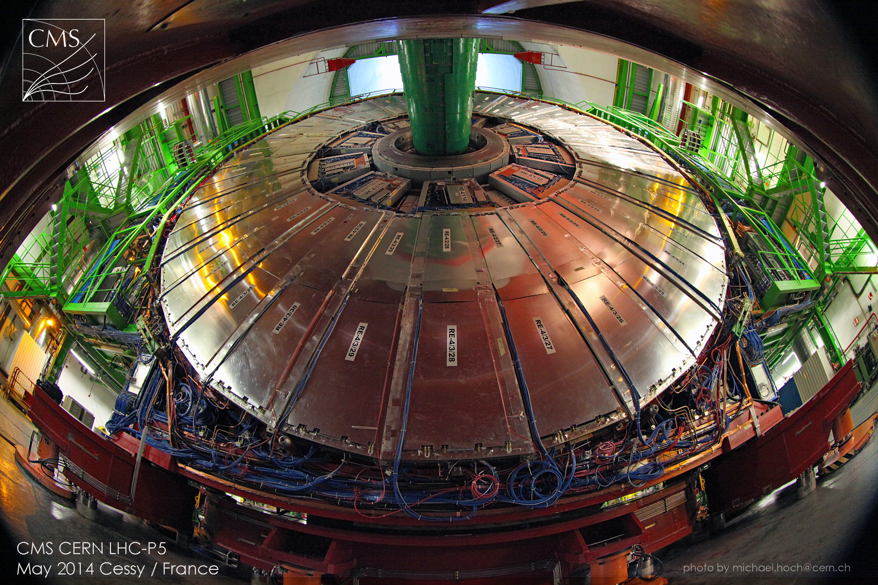
CMS status report
Pierluigi Paolucci (INFN of Napoli)
on behalf of the CMS collaboration
118th meeting of LHCC Open Session – 4 June 2014 CERN

Slide 2
Outline
LS1 activities
Sub-system status report
DAQ-Offline-Computing
Physics highlights
Conclusion

Slide 3
LS1 activities
Sub-system status report
DAQ-Offline-Computing
Physics highlights
Conclusion

Slide 4
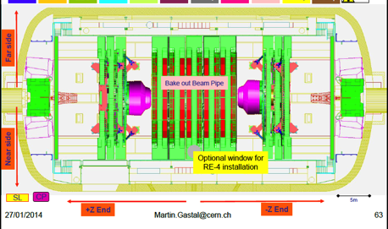
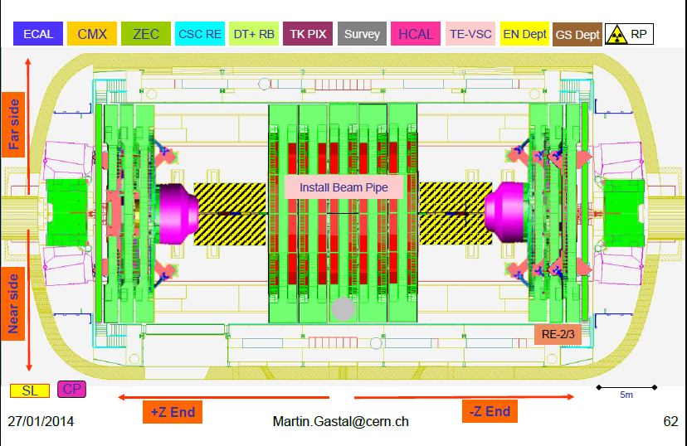
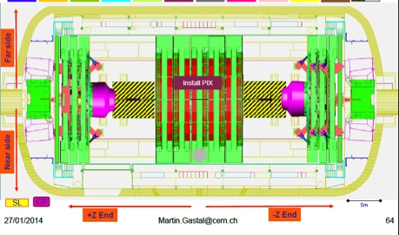
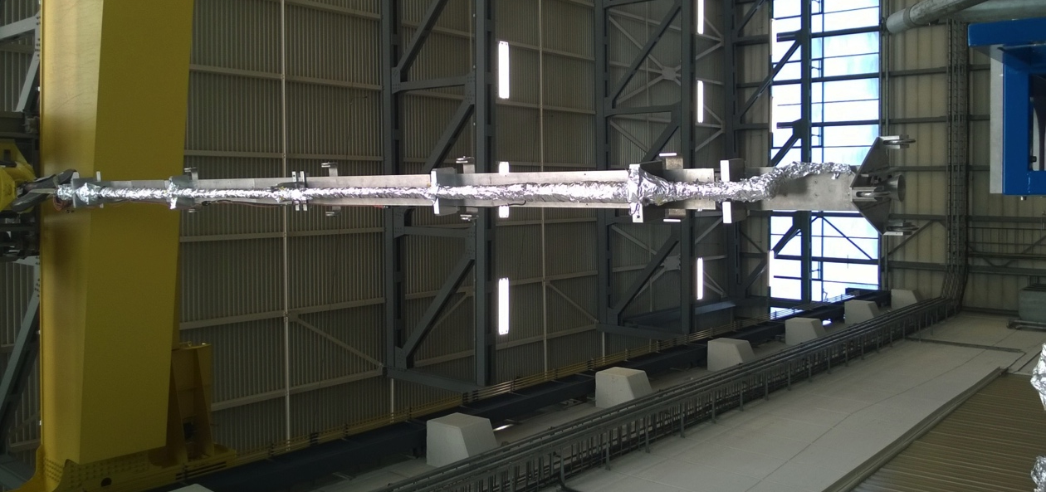
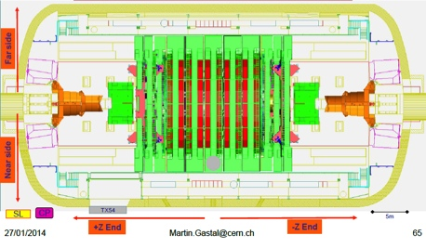
Technical Coordination
Currently configuring for beam-pipe installation
new central beam-pipe installation (45mm outer
diameter) starts next week followed by pixel
Installation.
Bake-out
July-Aug
Install pixel
(barrel+forward)
BCM+PLT
Aug-Sep
Closed for
magnet test
& CRAFT
Oct-Nov
Keep contingency for re-opening
beam-pipe pump-down:
Jan 2015 then ready for physics

Slide 5
LS1 winding down
A sample of what still needs to be deployed…
  DAQ2
  Trigger Control and Distribution System (TCDS)
  L1 trigger improvements
  Forward HCAL back-end electronics
  Lumi DAQ

Slide 6
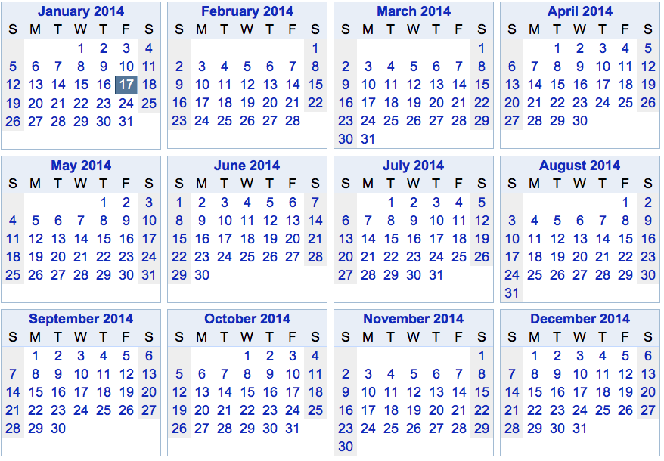
Global Run tentative schedule
Cooling maintenance + DAQ2 installation/commissioning
Commissioning runs
Cosmic alignment run at B=0T
Cosmic alignment run at B=3.8T

Slide 7
LS1 activities
Sub-system status report
DAQ-Offline-Computing
Physics highlights
Conclusion

Slide 8
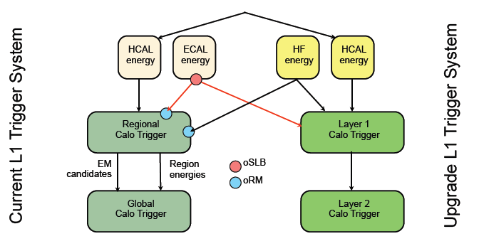
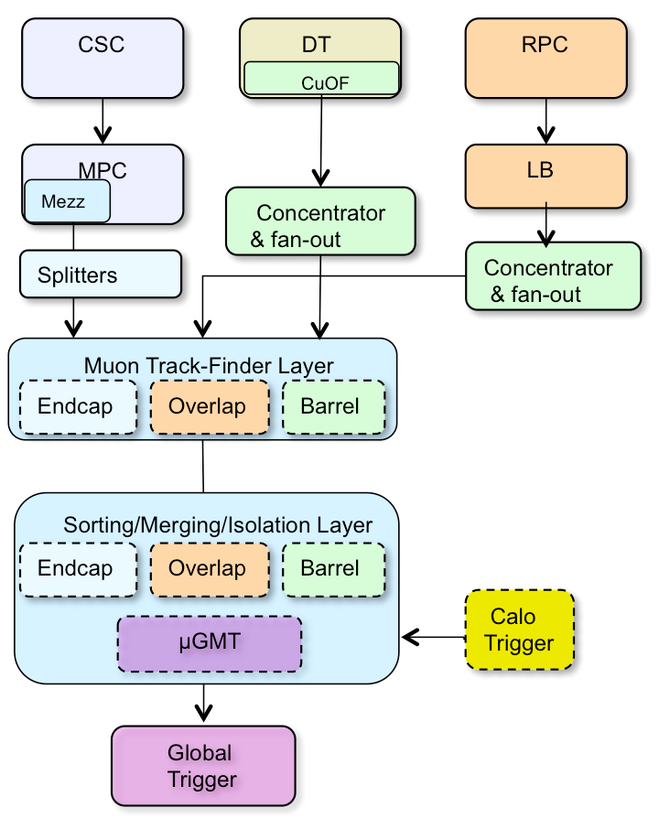
Trigger Upgrade Status
  Trigger rate up to 6 times the RUN1 is expected.
  Calorimeter and Muon trigger upgrade necessary.
  CALO: Legacy trigger and new trigger for 2015 run
Calo Layer 1 (CTP7)
  2 prototypes + 6 additional pre-production boards built.
  Excellent results with processor system, power supplies,
  clock system and optical/backplane links
    Tested 4.8 & 6.4 & 9.6 Gbps synch. and 10 Gbps asynch.
Calo Layer 2 (MP7) about ready
Muon: combining 3 independent subsystem triggers
Work in progress:
Muon trigger link concentration and fan-out
Muon Track-Finder (barrel/endcap/overlap)
Calo
Muon

Slide 9
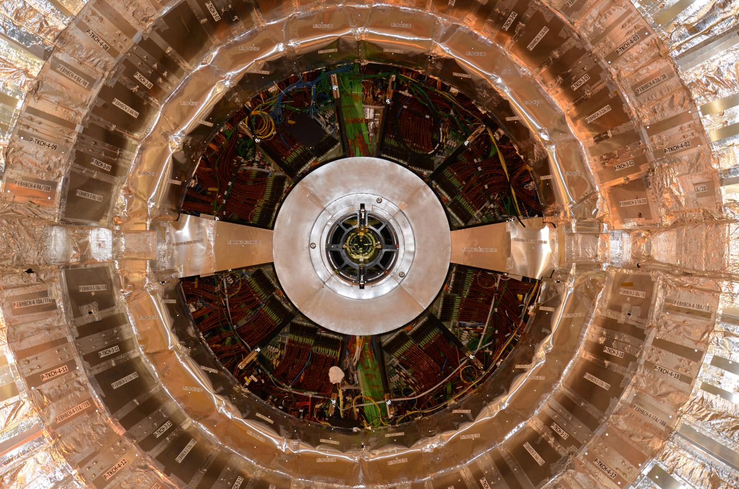
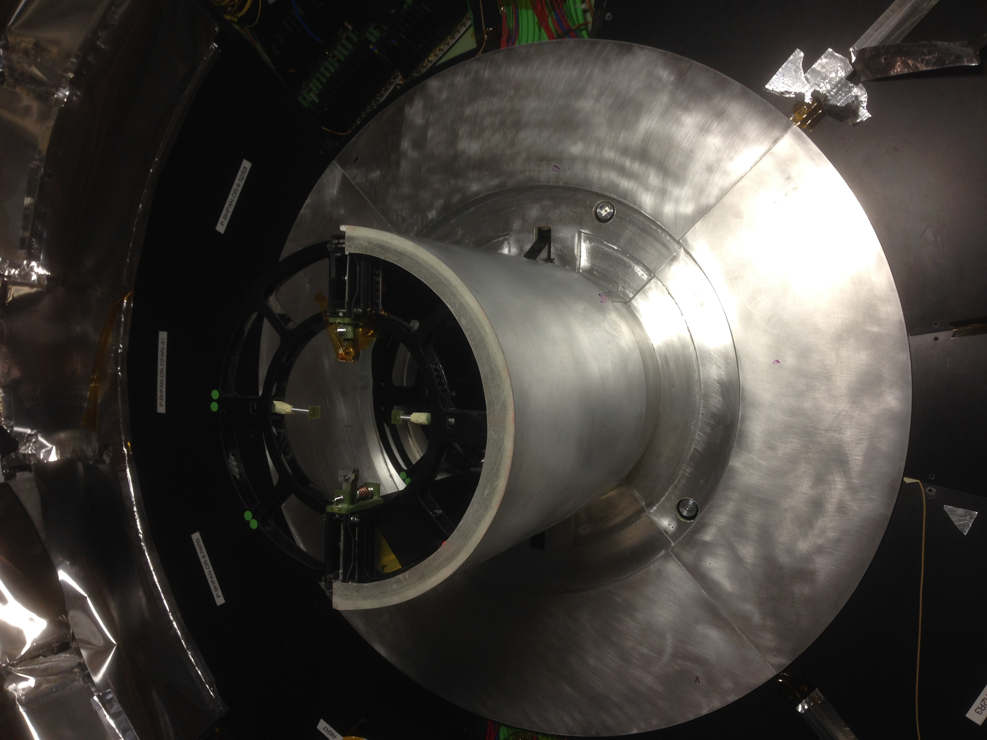
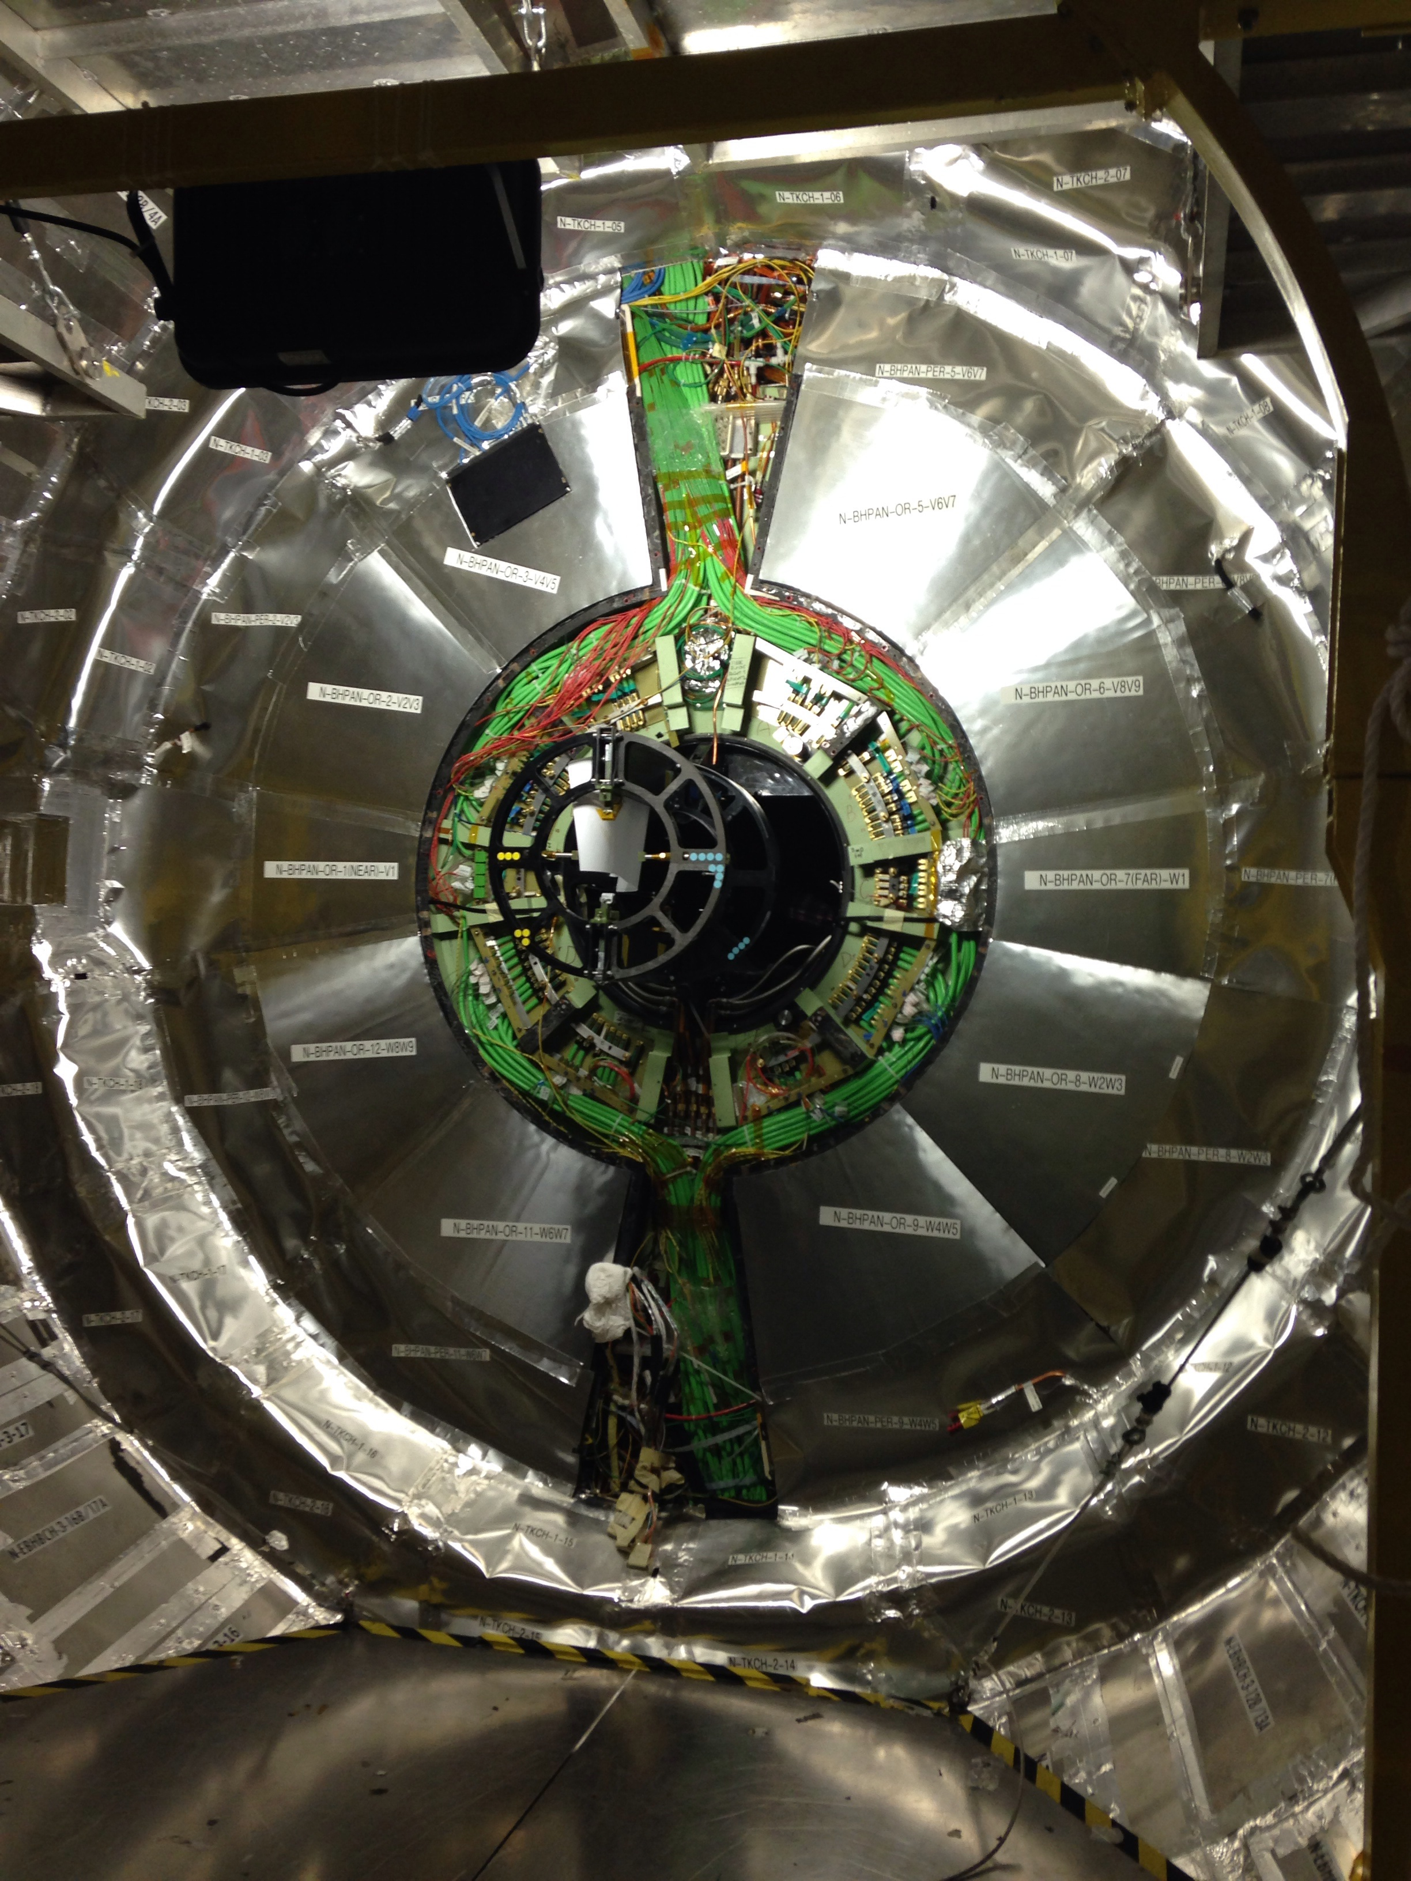
Tracker readiness for RUN2 ready to operate at -15 ºC (validated at -20 ºC)
Finalizing the new molds for the inner nose
Final insulation from the bulkhead periphery all the way to the edge of the vac-tank
Pixels are pre-calibrated on surface lab
Pixel almost ready for re-installation
9

Slide 10
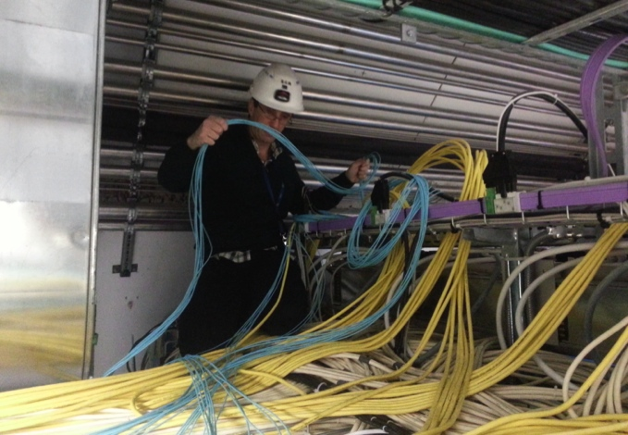
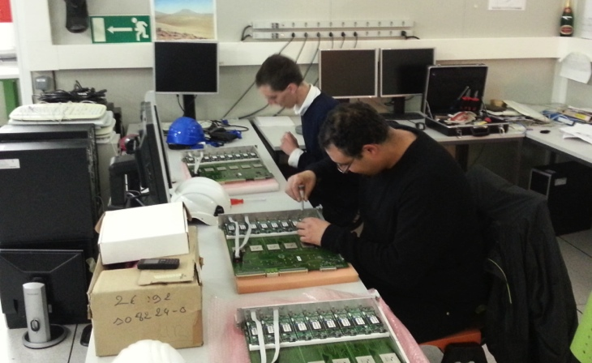
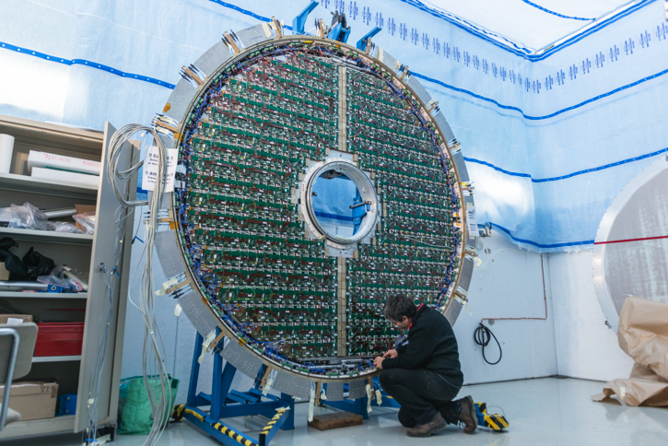
ECAL + eγ trigger
Removal of SLB→RCT cables
(the white ones, underneath!)
Upgrade to ECAL Level-1 trigger: change links between ECAL Trigger Concentrator Cards (TCC) and Regional Calorimeter Trigger (RCT) from electrical to optical
All hardware in place and optical fibers being installed and commissioned
Replacing SLBs with oSLBs
Finishing the repair of ES
Nov. 2013: damaged connector found on ES.
Both ES removed from CMS to the surface, repaired, reinstalled and now re-commissioned.
99.95% channels operational.

Slide 11
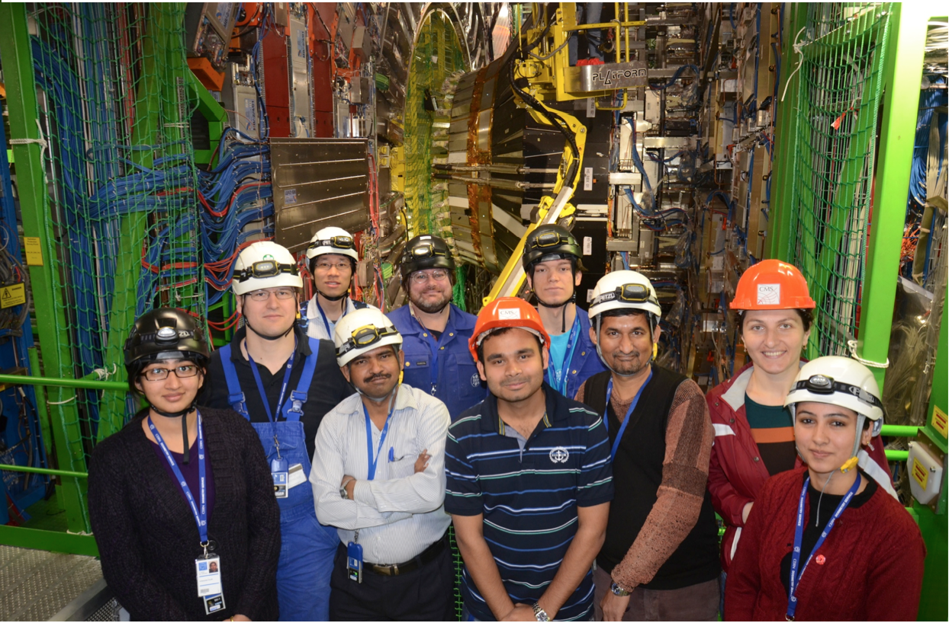
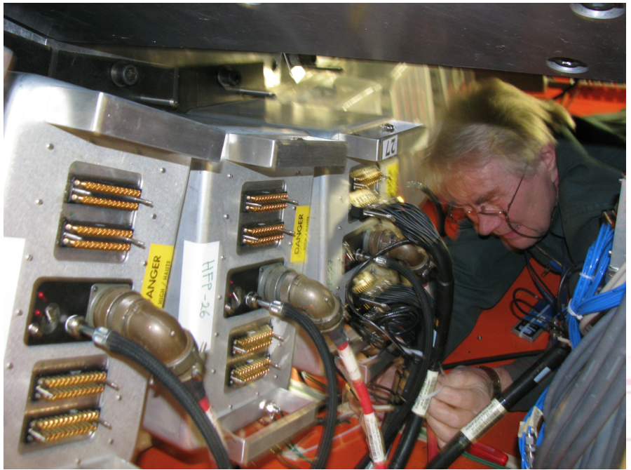
HCAL status
Installation and commissioning of SiPM readout on HO (April) - DONE
Installation of new thin window, multi-anode PMTs DONE
  Being commissioned by July
Production of new Back-End board for HF
  Pre-production (10 boards) ok, production ordered and expected delivery at CERN in July
  Commissioning planned for late September.
HF Front End
Test of new QIE10-based readout successfully tested at FNAL test beam
Expected installation in Year-end Technical Stop 2015/16

Slide 12
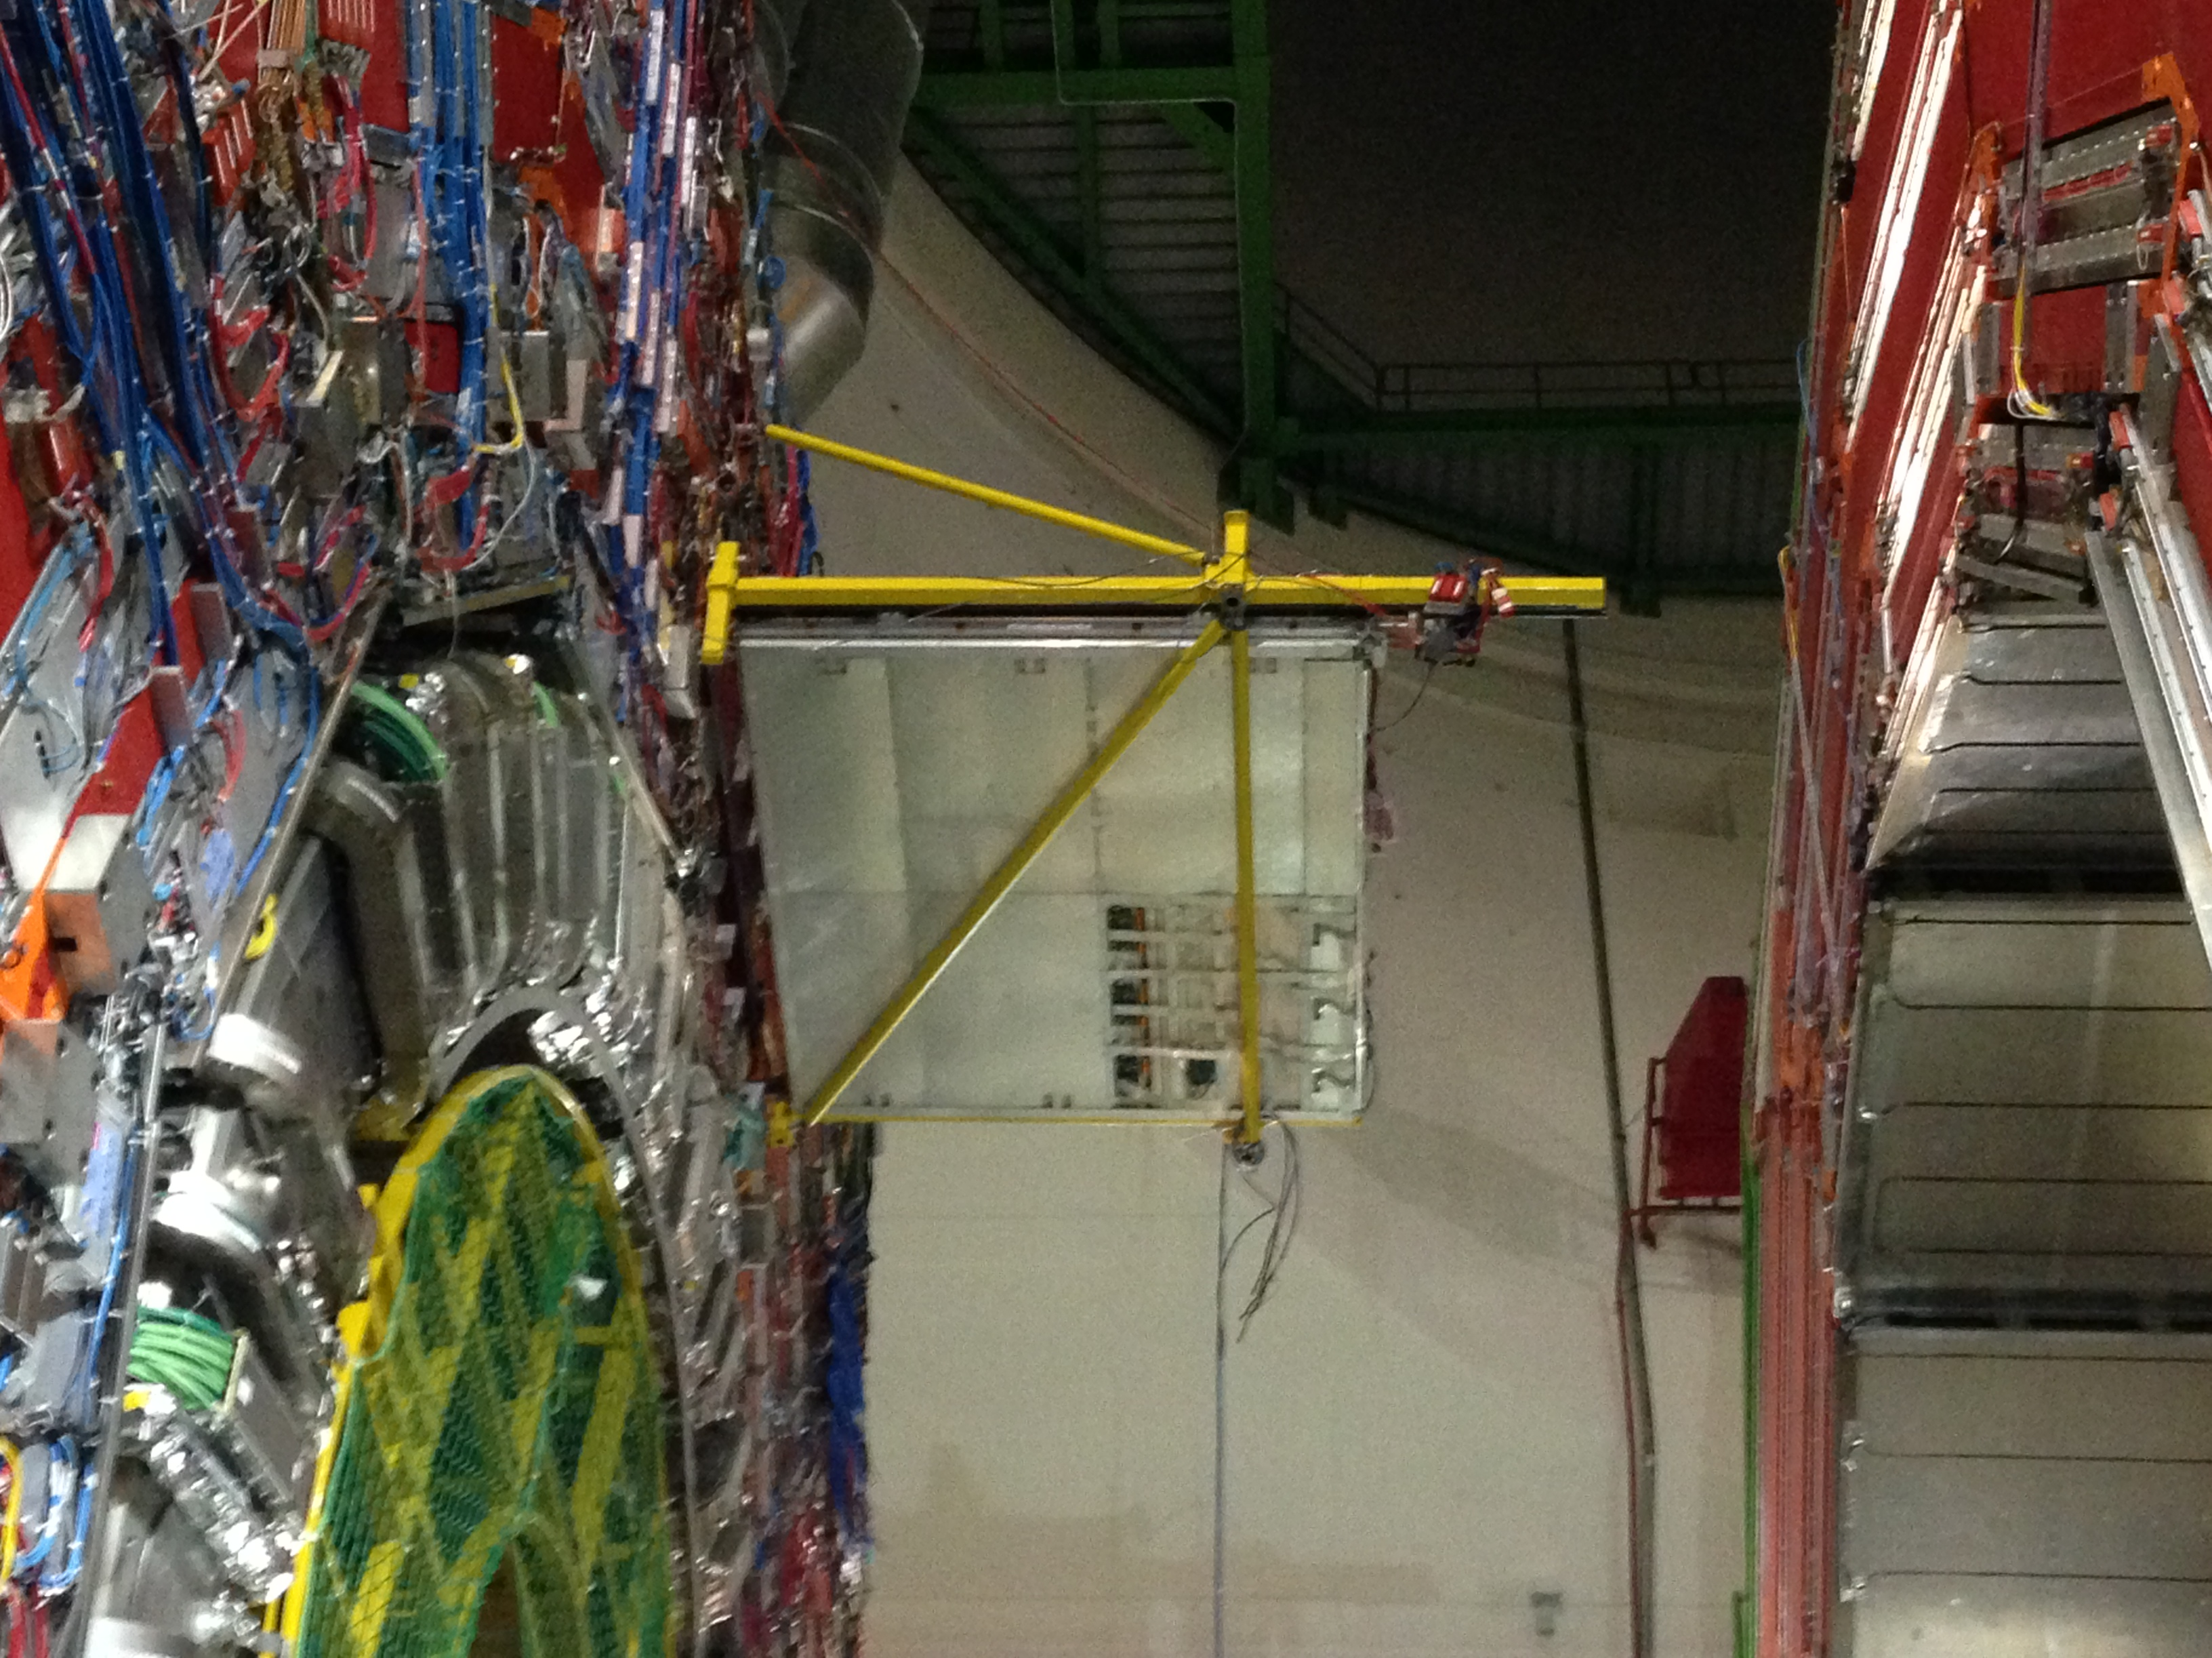
Drift Tubes towards Run2
250 chambers
172200 drift tubes
Chamber HV: 312 channels recovered
Chamber Minicrates:
3200 channels recovered
Sector Collector (Read-Out and Trigger) relocated out of UXC: installed 3500 optical links that make single outputs of all 250 chambers available in USC

Slide 13
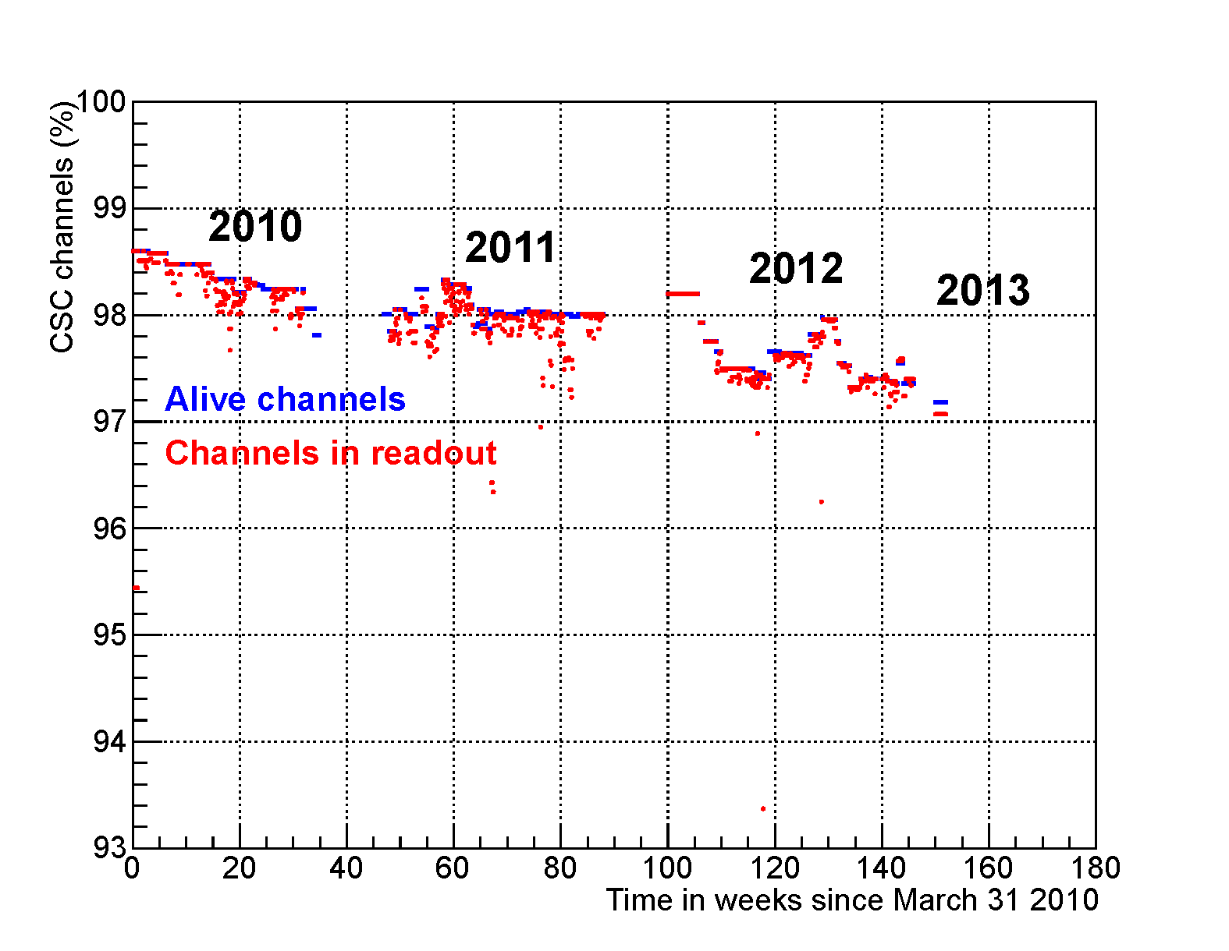
Review of CSC activities during LS1
Focused on 3 main areas (in order of priority):
  Present system consolidation, maintenance and repair
    Repair system faults from Run 1 –> recover highest efficiency. Improve system reliability (HV, LV, racks, detector infrastructure)
  ME1/1 chamber electronics upgrade
    72 chambers extracted, refurbished and reinstalled in CMS.
    Increase capacity for data rate and exploit full chamber segmentation in 2.1<|η|<2.4 to enhance rate capability (including @ HL-LHC) and improve muon reconstruction
  Completion of station 4 (ME4/2 ring 1.2<|η|<1.8 )
    Re-establish 4-station redundancy over all 0.9<|η|<2.4 range. Improve muon-ID efficiency and sustain high-Lumi L1 rates at a reasonably low pT threshold
    Construct and test 72 CSC at CERN, install and commission in CMS (in close coordination with RE4 project)
Chamber efficiency during Run 1

Slide 14
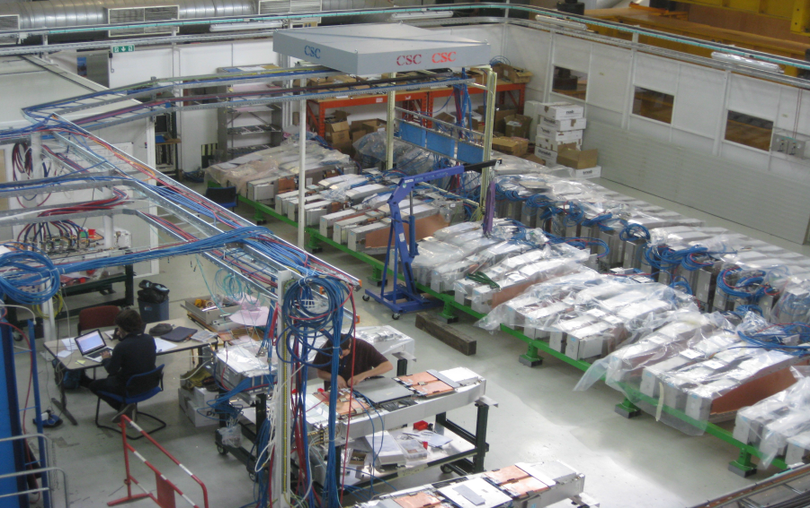
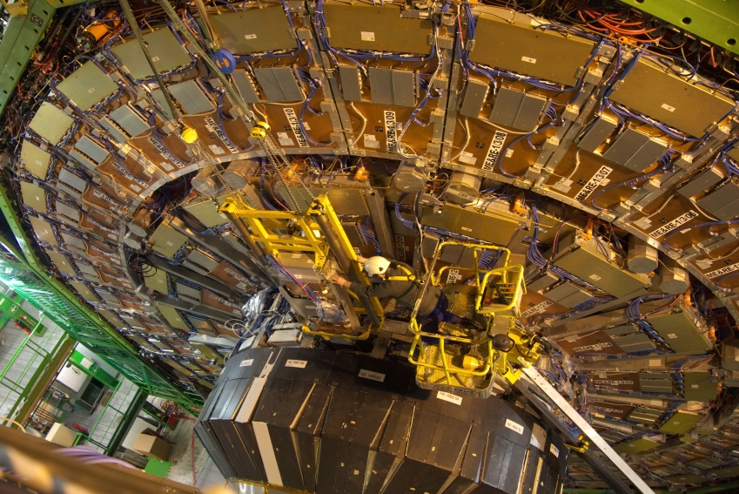
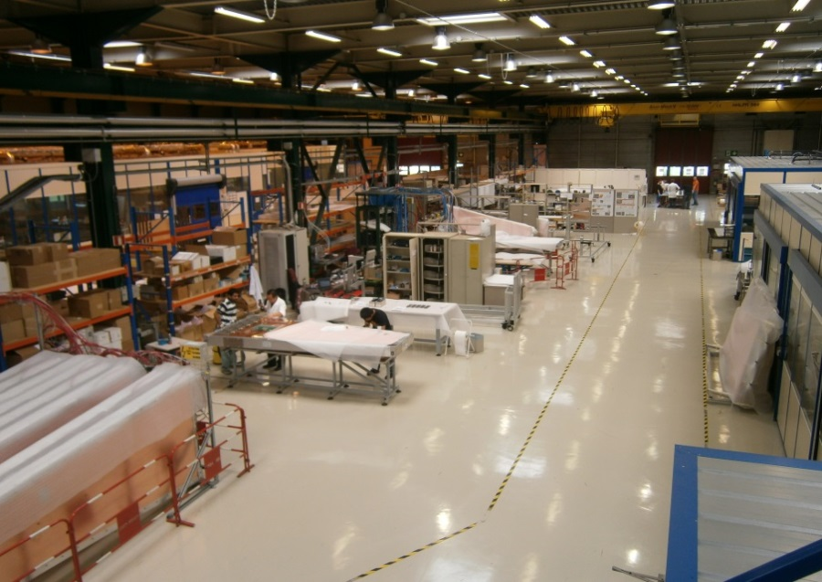
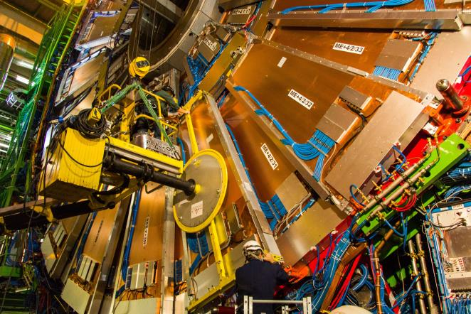
CSC consolidation in pictures
ME1/1 refurbishment lab
in SX5
ME1/1
installation
ME4/2 chamber factory in B904
ME4/2
installation

Slide 15
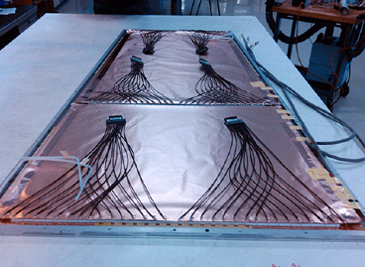
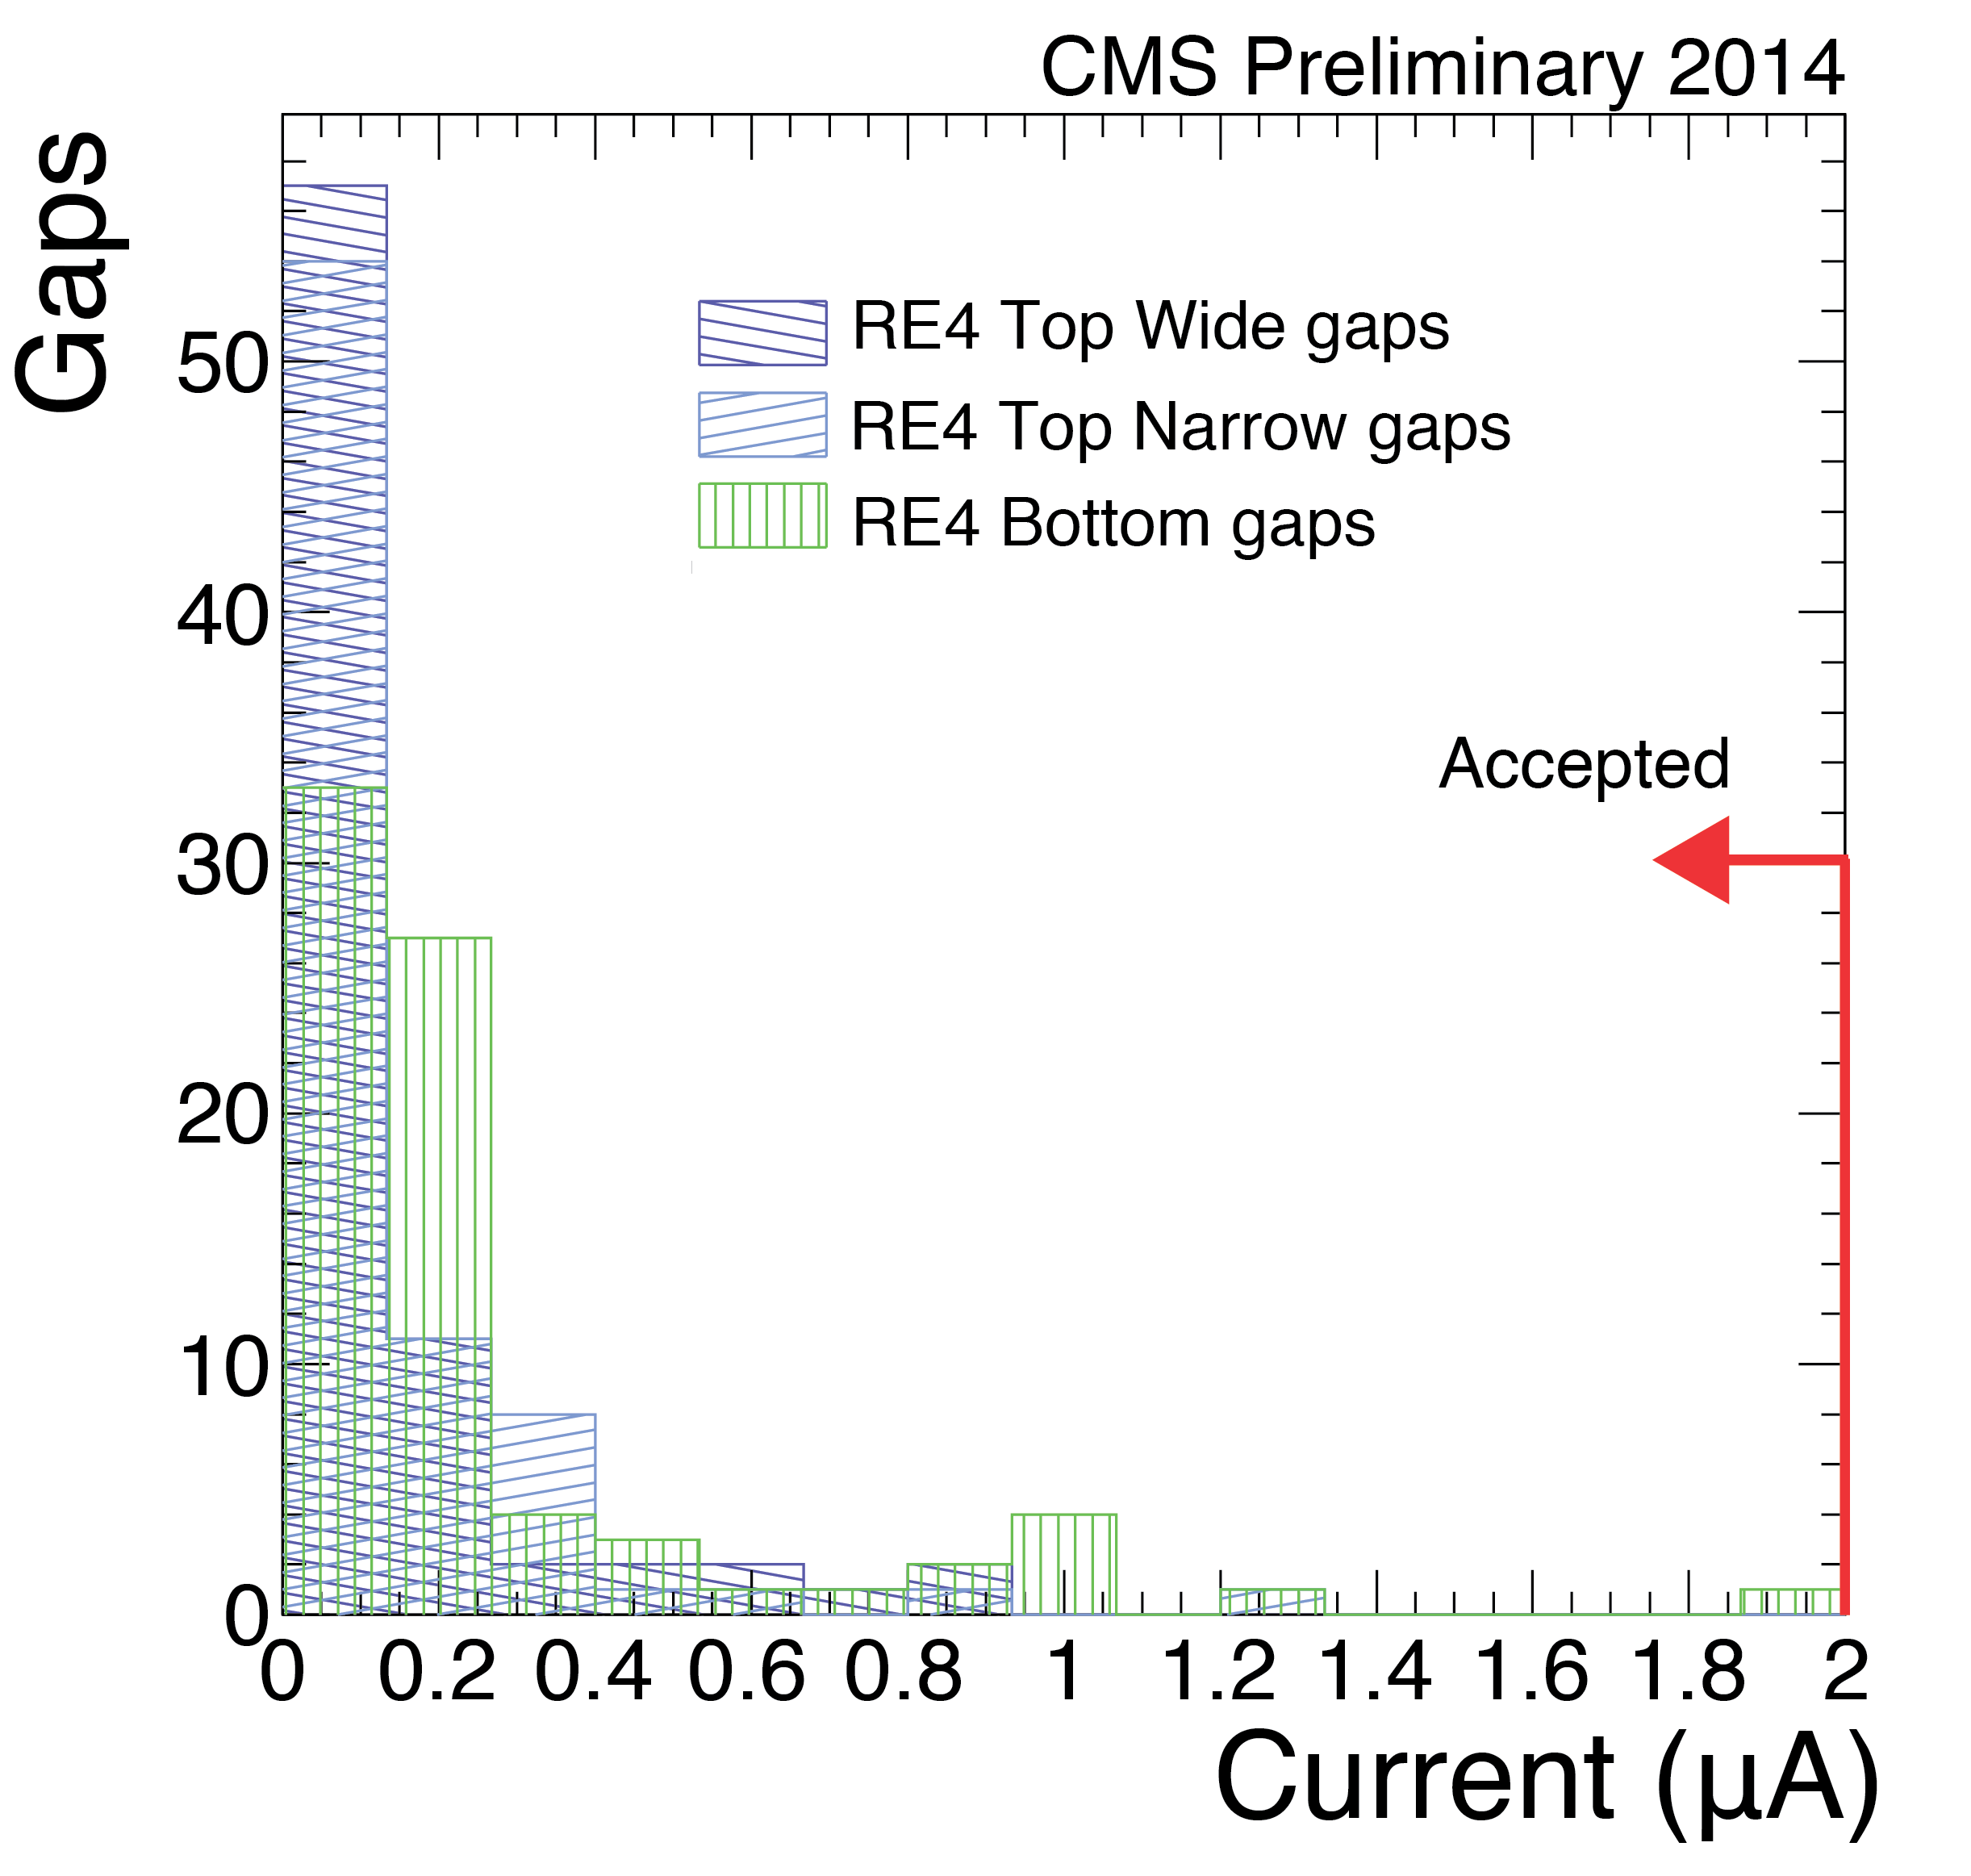
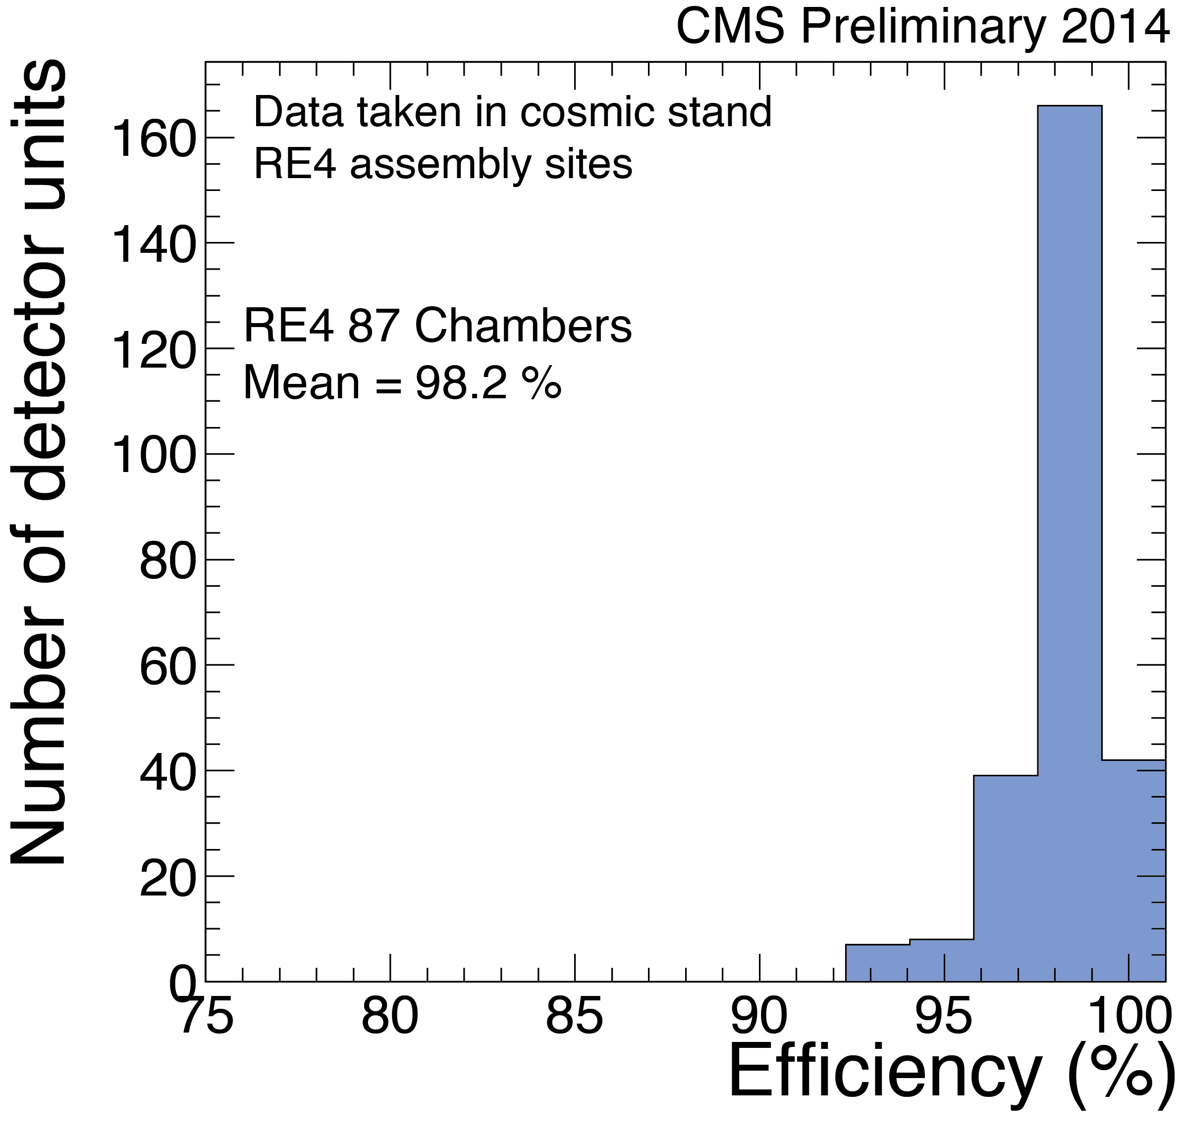
RPC upgrade
Maintenance and repairs
99.5% of working channels today
RPC upgrade (RE4) completed on May 5.
686 gaps produced in 22 months
72 super-modules installed ahead of schedule
Commissioning is on-going. No major problem encountered until now.
RE4 project has been completed on schedule and in the budget
Production quality
Production quality
Naked Super-Module

Slide 16
RPC RE4 144 chambers installed

Slide 17
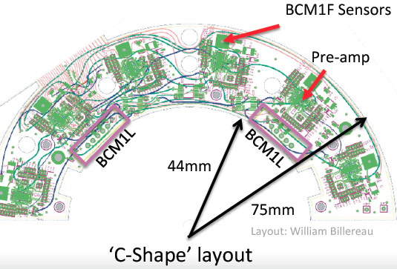
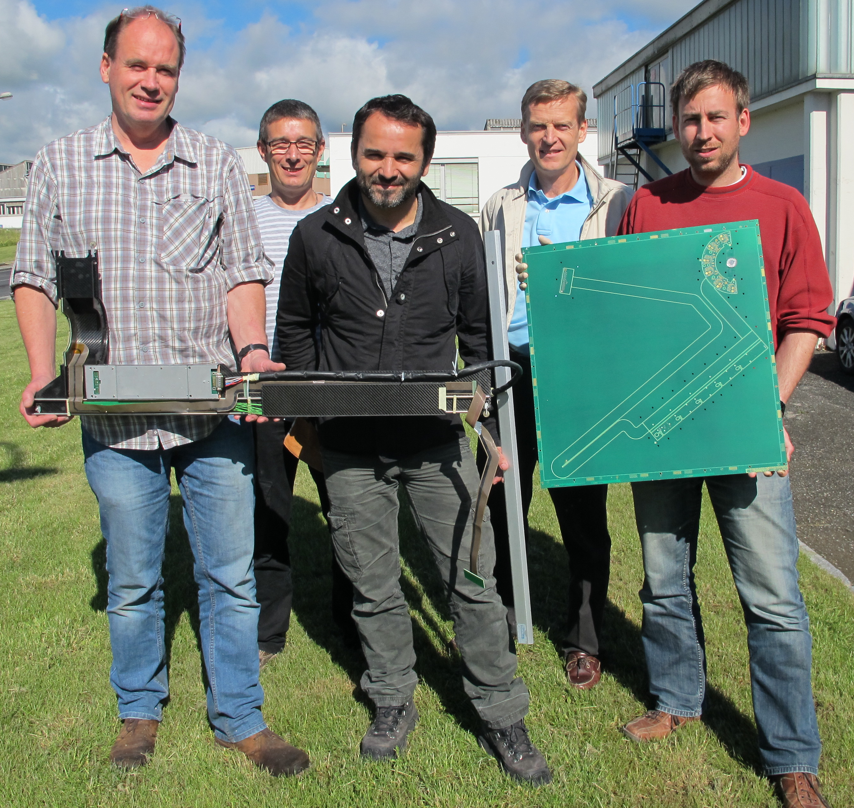
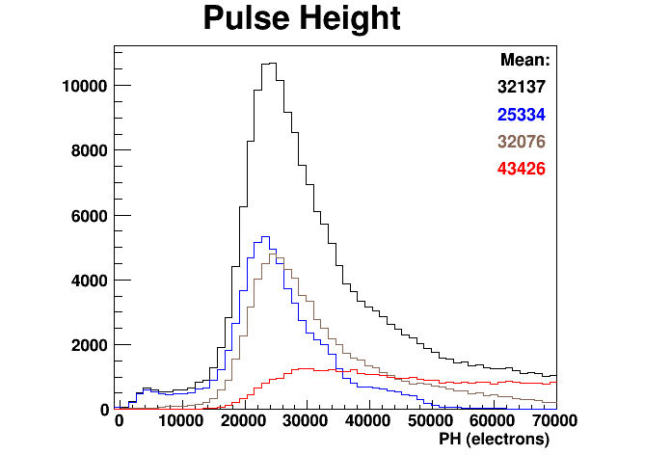
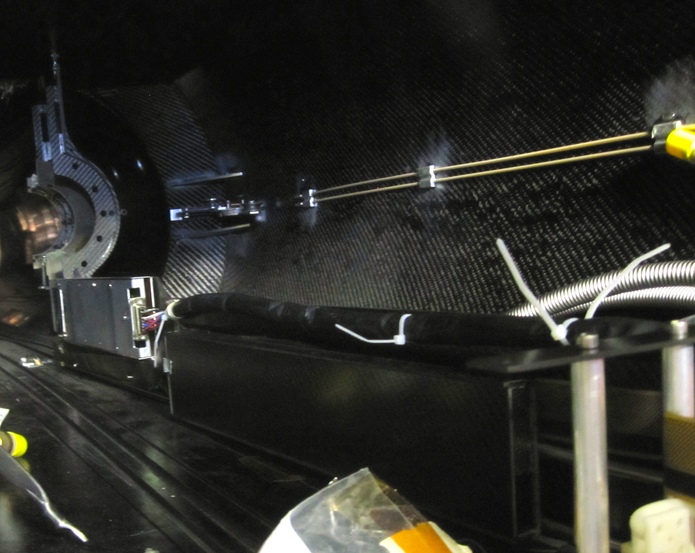
Beam monitoring and luminosity
BRIL (Beam Radiation Instrum. and Luminosity) milestones achieved
Upgrade Fast Beam Conditions monitor
  Single integrated PCB with rigid and stiff component, minimizing material budget and connections: structure done.
Si-Pixel Luminosity Telescope
  Success trial installation of new detector mock-up in pixel volume
  Hybrid board production & testing in full swing
PLT calib.
Some members of the Design and production team at CERN

Slide 18
April Global Run: some achievements
Lots of new things in the April Global Run (7-11 April)
All: clock frequency scan
ECAL: test new optical links
Strips: run constantly at −15°C
HCAL: Commission new SiPMs
DT: Commission relocated electronics
Muon Endcap: First global run with 4th endcap station (RPC and CSC)
First run with Prompt Calibration Loop on cosmics

Slide 19
LS1 activities
Sub-system status report
DAQ-Offline-Computing
Physics highlights
Conclusion

Slide 20
DAQ status
DAQ2: New central DAQ system for run 2
  Aim:
    Accommodate new uTCA based sub-detector back-end electronics as well as legacy ones
    Replacement of most networking and computing equipment (5-years end-of-life)
    Lumi-DAQ system to acquire data time-based (independent of level-1 triggers)
    Various improvements motivated by operational experience from run 1
  Status:
    Most components demonstrated on small scale test bed
    Custom electronics 100% produced and installed
    Most of the IT-equipment delivered and installed
  On track for changeover scheduled July-2014 (global run)
HLT farm for RUN2: plan to order CPU and storage in few months
Online cloud: Use of HLT farm for offline processing
  Was recently used for offline production (Heavy Ion reprocessing for QM2014)

Slide 21
Run II readiness: CSA14
Planning integrated Computing, Software and Analysis Challenge 2014 (CSA14) for Summer
major milestone for analysis readiness towards data-taking
  New lepton ID, new PU rejection, new jet definition for high-PU 13TeV collisions
  Realistic beam conditions, detector alignment and calibration
  Intense work to update DQM code (online and offline) to new run conditions and new DAQ
Considered scenarios
Bunch Spacing [nsec] | Int. Lumi | Target Lumi [10³³ cm⁻²s⁻¹] | PU
50 | 100 pb⁻¹ | 7.5 | 40
25 | > 1 fb⁻¹ | 7 to 14 | 20 to 40

Slide 22
Computing
Resources are fully utilized
  Several high-priority campaigns (detector upgrade studies, CSA14, specific physics results)
Computing improvements will be validated during CSA14:
  More flexible and efficient access to data
125% utilization at Tier1s
99.8% utilization at Tier2s
  Improved distributed analysis tools
  Prompt reconstruction distributed also to Tier1 sites

Slide 23
Next major CMSSW version to be released in June
Major new features include:
  Geometry for 2015 CMS detector
  Integration of Geant 4.10
  Deployment of multi-threaded framework
Our change to a multi-threaded framework is needed in 2015 to:
  Process large samples in less time
  Reduce the total memory per node
Modifications to our reconstruction algorithms have been done to effectively use this framework

Slide 24
LS1 activities
Sub-system status report
DAQ-Offline-Computing
Physics highlights
Conclusion

Slide 25
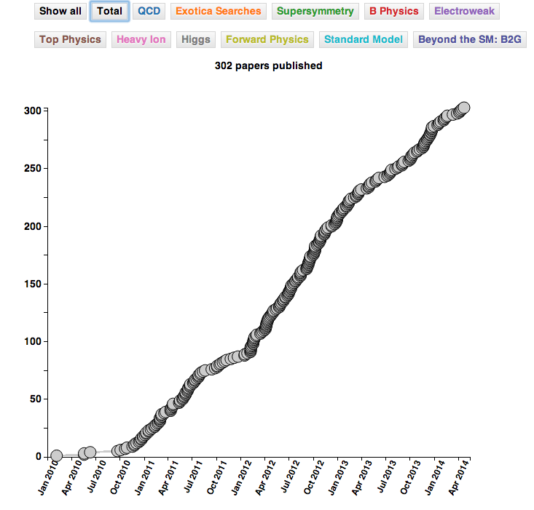
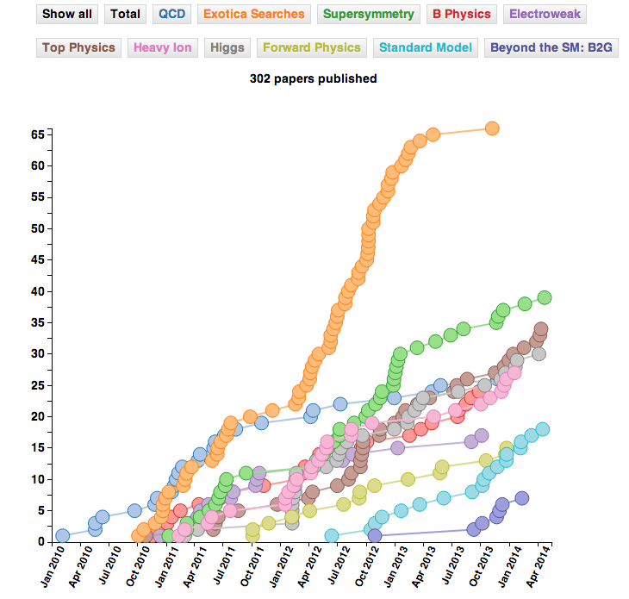
Published papers (from CDS)
Steady rate of publication, in all groups
309 published

Slide 26
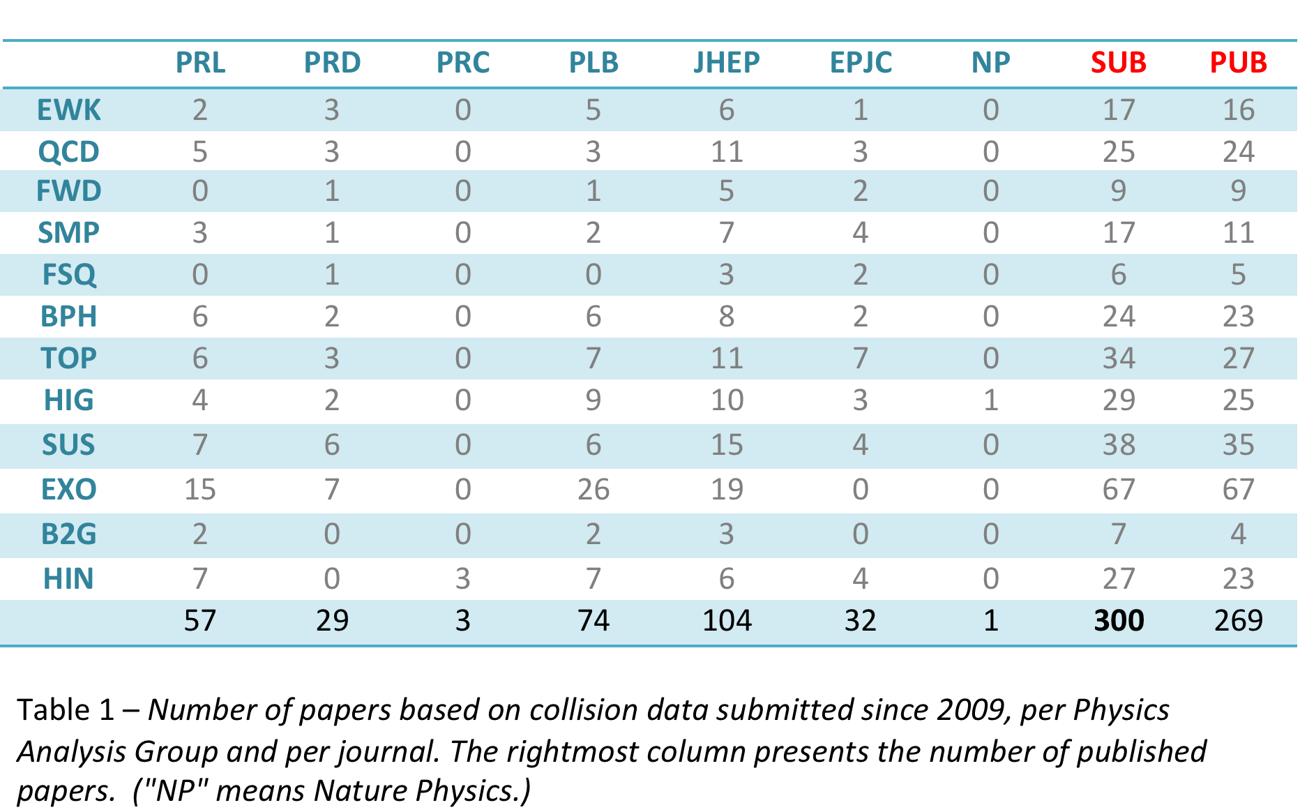
Breakdown of CMS Publications
Table with April 2014: submitted “collision” papers
312 274
June 2014

Slide 27


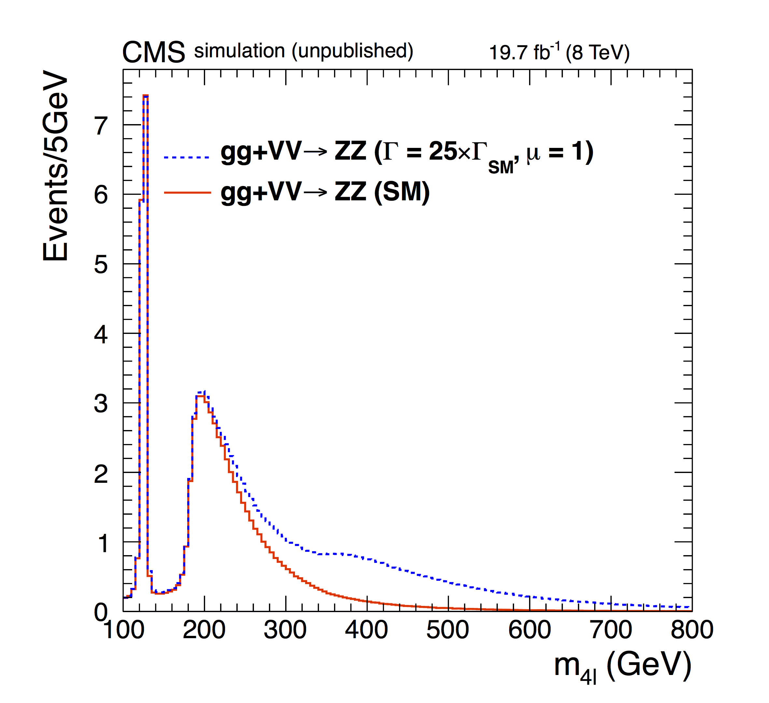
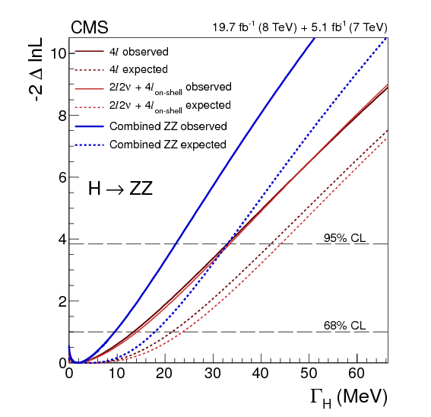
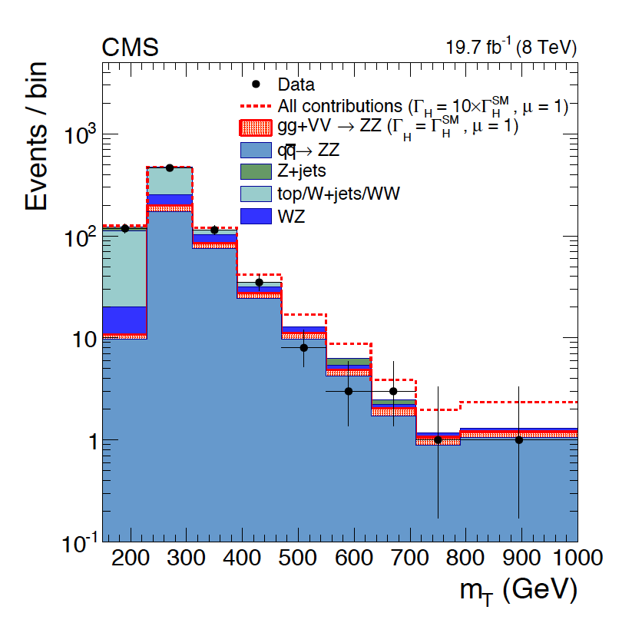
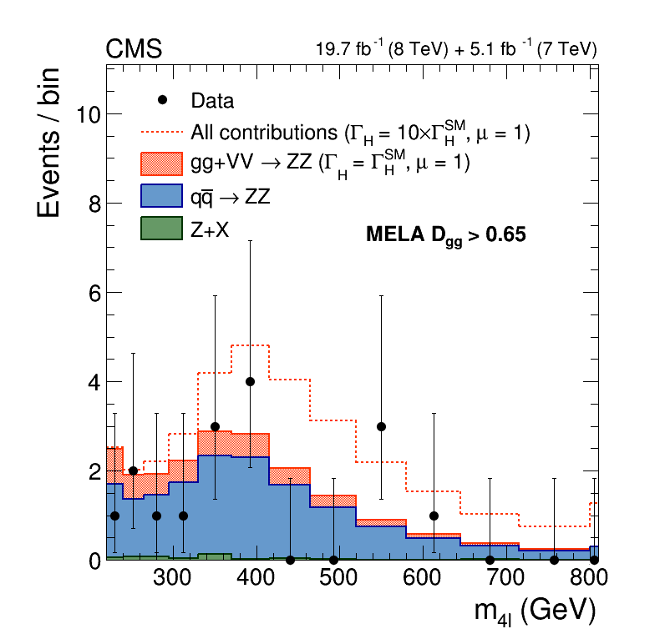
Constraints on the Higgs boson width
arXiv: 1405.3455 – submitted to PLB 14 May
A measurement of relative off-shell and on-shell production and H→ZZ decay provides direct information on ΓH
H→ZZ→4l channel: at high mass 2D fit on m4l and a matrix element likelihood discriminant Dgg
H→ZZ→2l2ν channel: fit on the transverse mass or ET
4-lepton invariant mass distribution
A clear enhancement is visible using
ΓH = 25 ΓSM
Combined with H→ZZ→4l on-shell measurement, an upper limit is set at 95% CL of ΓH < 22 MeV (corresponding to 5.4×ΓHSM)
dashed line total yield for ΓH = 10 ΓSM

Slide 28
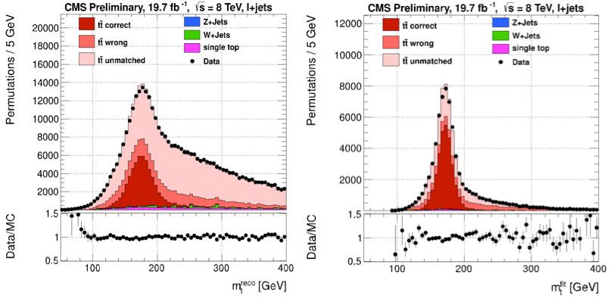
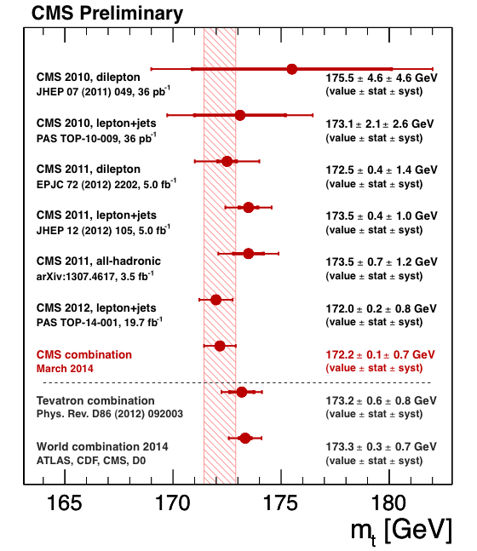
Top Mass from 8 TeV data
At the recent “Rencontres de Moriond” conference, the CMS collaboration presented a new improved mass measurement (80% of the data collected during Run I).
The new measurement yields a top quark mass m_{top}=172.04±0.19±0.75 GeV
Signature: 1 lepton + 4 jets (2 from b) + missing transverse momentum
Reconstructed invariant mass distributions for events before and after the kinematic fit to a top-quark pair event hypothesis.
Systematic: jet energy scale, pile-up effect and modeling of the jet-energy resolution

Slide 29
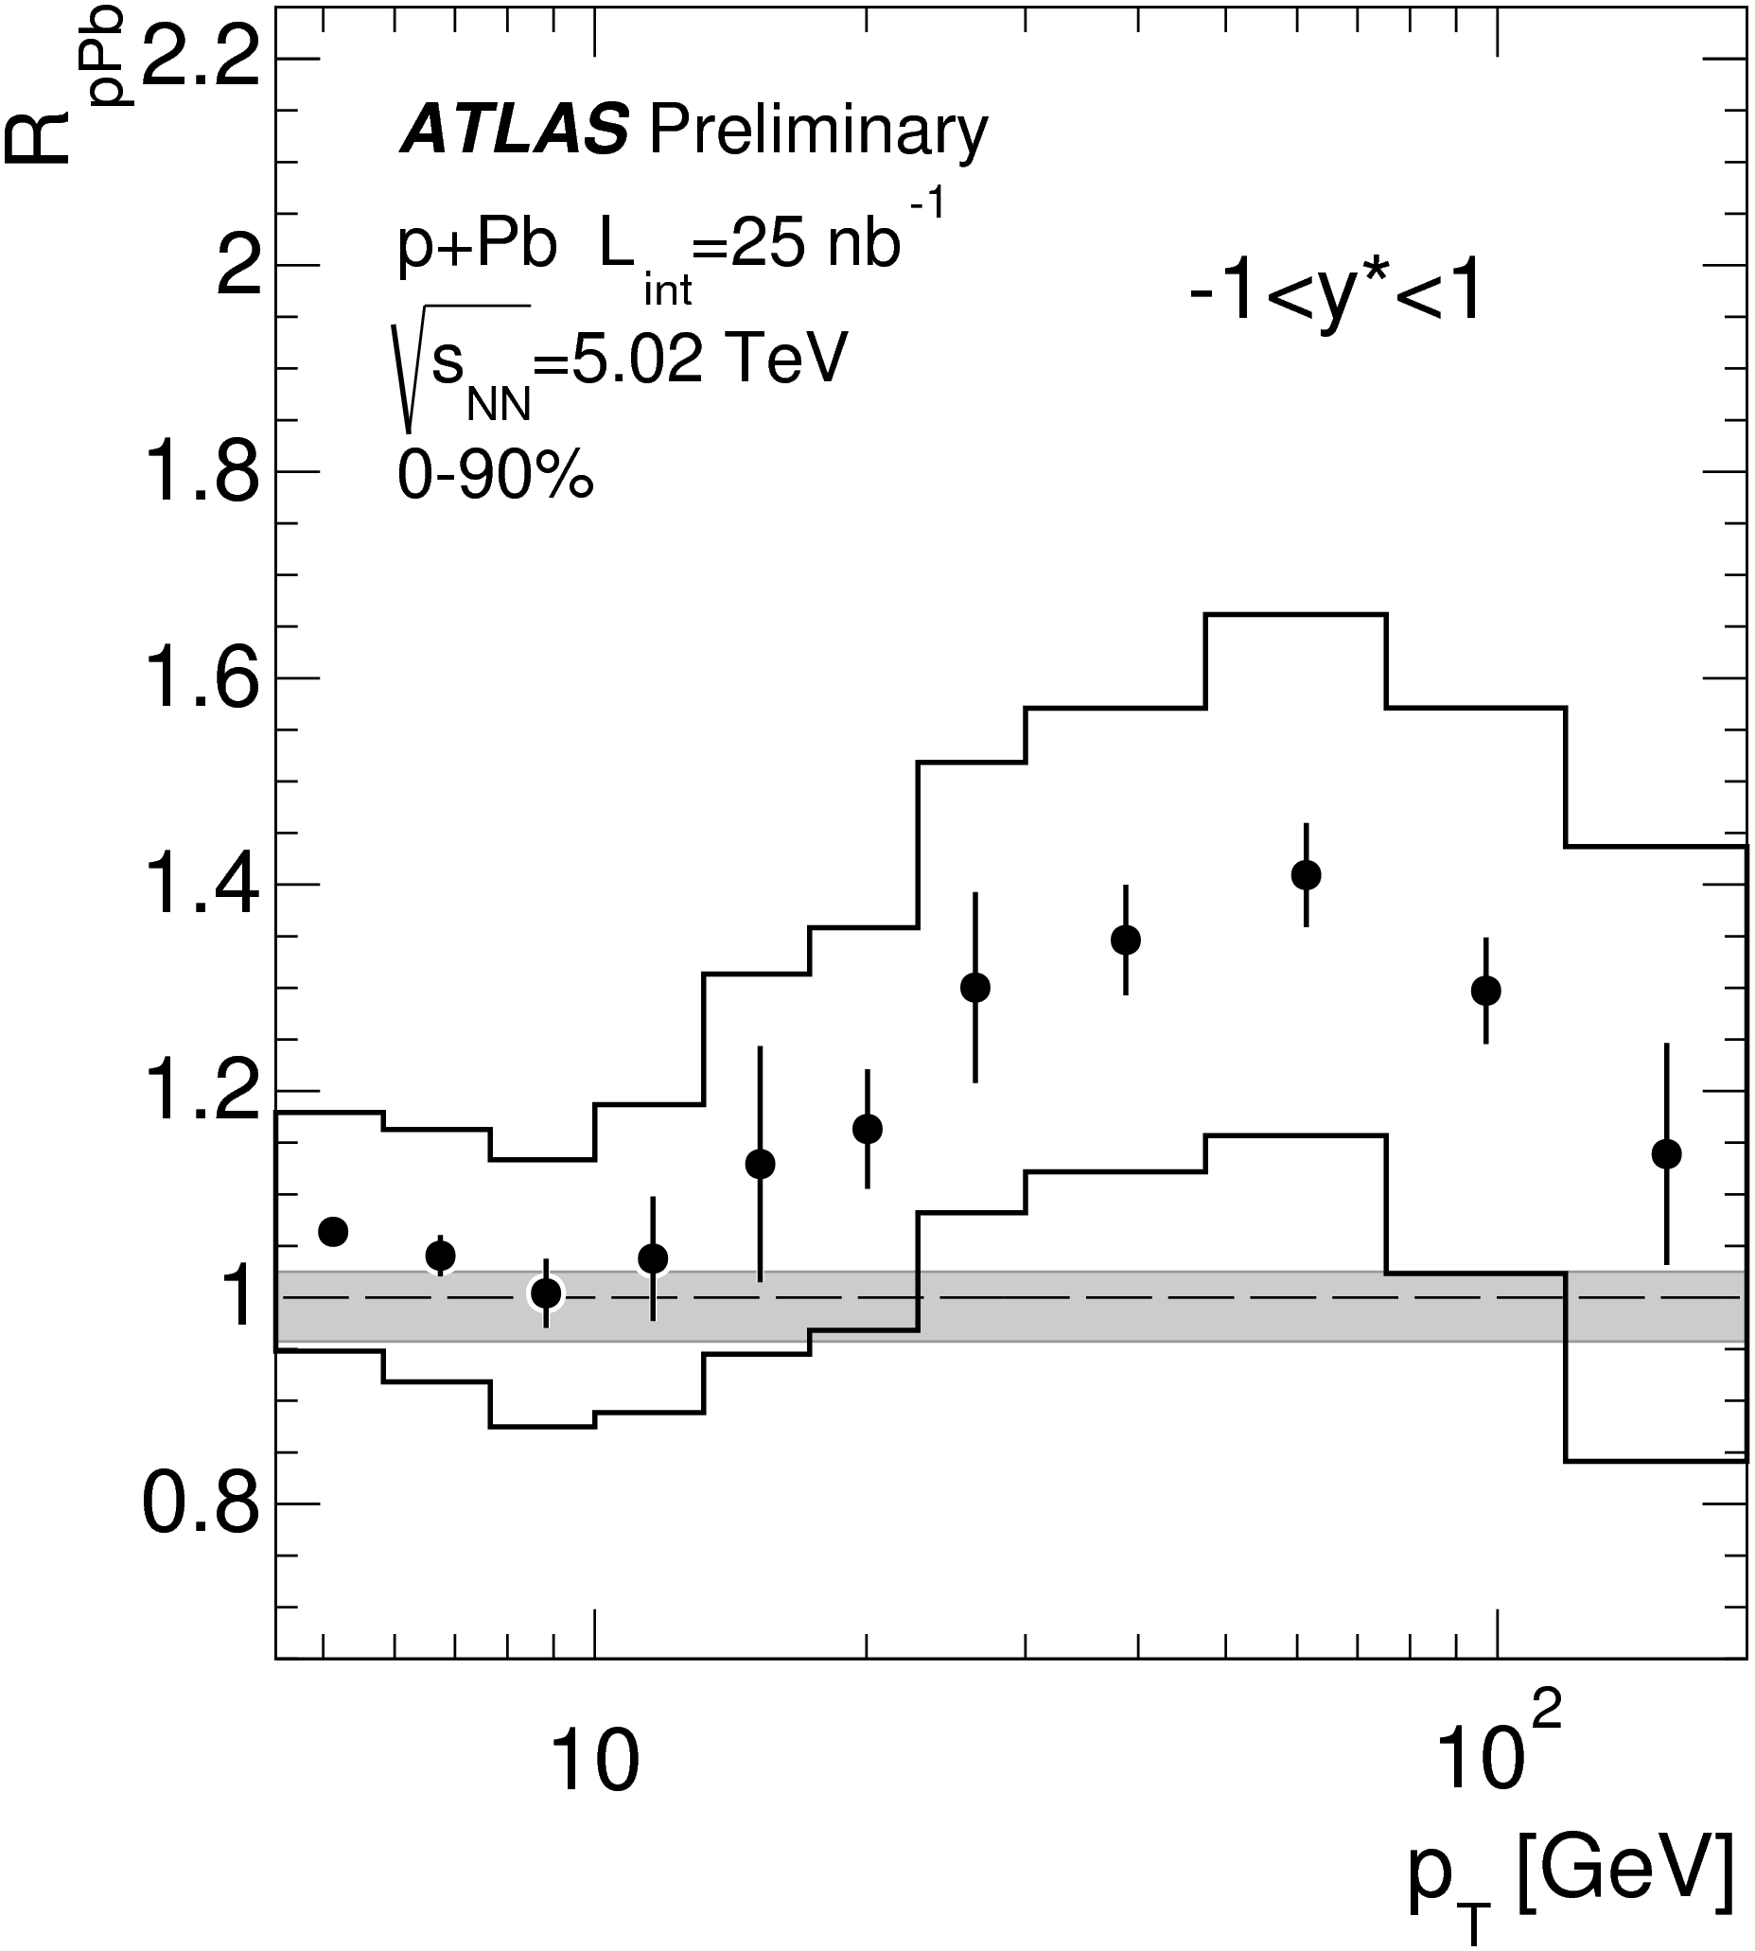
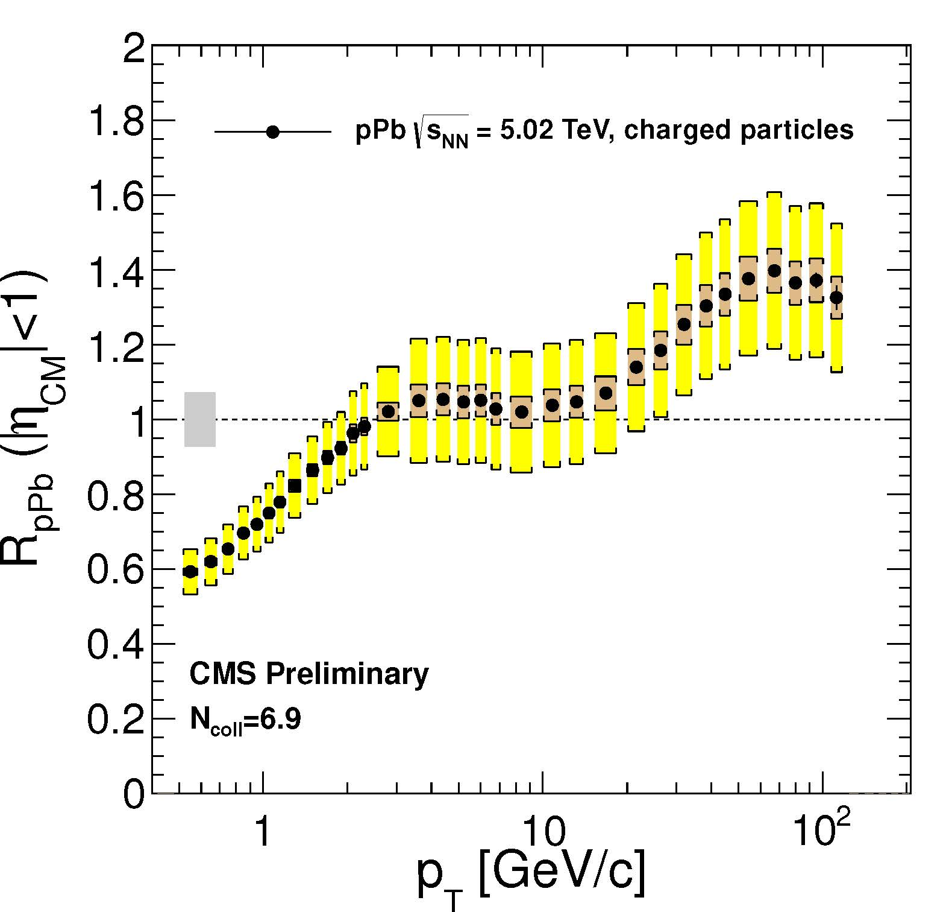
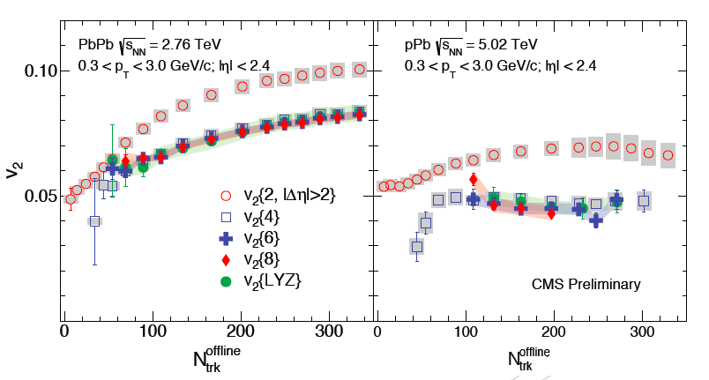
Heavy Ions highlights
PAS-HIN-14-006
Gives info about the mechanism of particle production in proton-nuclei collision.
The azimuthal anisotropy Fourier harmonic v2, extracted with 4, 6, 8 and all (LYZ) particle correlations shows that the v2 signal in pPb collisions is of COLLECTIVE nature. This supports the interpretation that hydrodynamic expansion behavior is observed in pPb collisions as well as previously in PbPb interactions.
ATLAS confirmed the surprising Hadron RpPb result
CMS made public in November 2013.
5.02 TeV pp reference data to increase R_{pPb} precision
Nuclear modification factor in pPb normalized to p-p. It rise above 1 (anti-shadow region)
ATLAS (left) and CMS (right)
The 2-4 particles correlation analysis extended to 6-8

Slide 30
More data analysis results
Since LHCC March 5th
EXO-12-030 - Search for LQ with top+tau pairs
FSQ-13-003 - Drell-Yan pT distributions at low and high mass
HIG-14-003 - H -> gamma gamma with Dalitz decays
HIG-14-001 - tHq, H -> gamma gamma
TOP-14-006 - LHC Top charge asymmetry combination
SUS-13-018 - Search for direct Sbottom production
TOP-13-014 - Top Mass World Combination
TOP-14-001 - Top mass in lepton+jets (e,mu)
SUS -13 020 - pMSSM interpretation 8TeV
HIG-14-002 - Width measurement from off-shell production in H->ZZ S
Since Moriond
HIG-13-032 - H->hh->2gammagamma 2b
GEN-14-001 - Underlying Event Tunes and Double Parton Scattering
TOP-14-003 - Search for anomalous single top + photon production (FCNC)
TOP-14-007 - Limits on anomalous couplings and FCNC in t-channel single top
B2G-13-004 - Search for Dark Matter production in association with top quark pairs
EXO-12-047 - Monophoton search
SMP-13-013 - Measurement of Z production as function of pT, Y
QCD-11-006 - Studies of Multijet Events at 7 TeV

Slide 31
Summary
Maintenance and repair of the present system is proceeding very well.
Set of global and cosmic runs foreseen in 2014 to prepare the community for RUN2.
Muon upgrade (CSC and RPC) have been completed in time and within budget.
Many improvements on-going in the reconstruction and online software.
DAQ upgrade (DAQ2) progressing on schedule.
Trigger for 2015 on schedule.
309 papers published.
A lot of new results in the physics analyses.
Not covered here: preparation of Technical Proposal for Phase II in full swing.

Slide 32
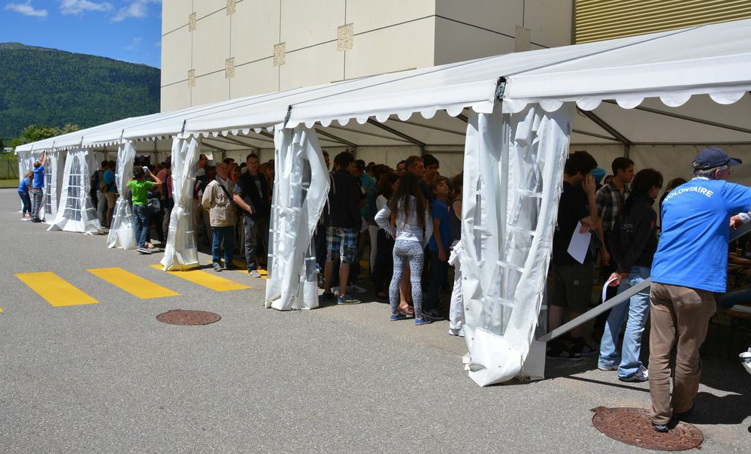
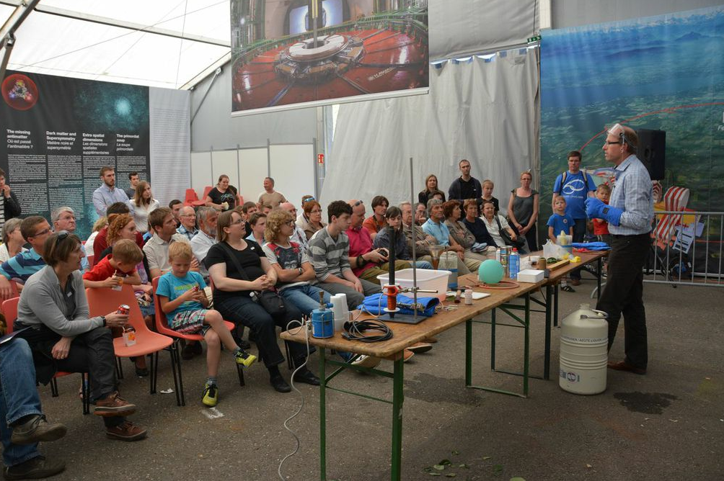
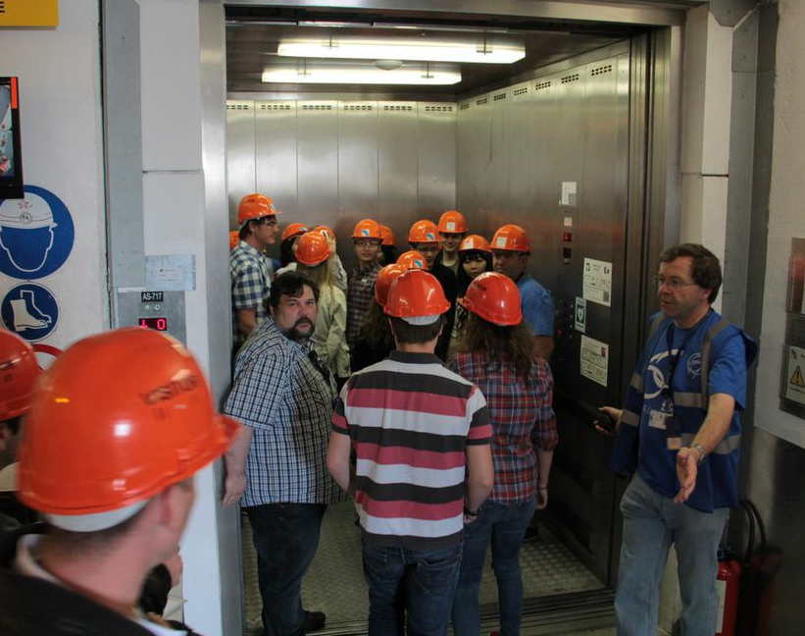
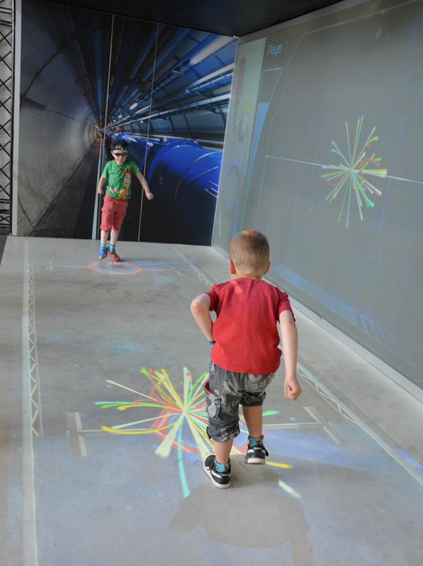
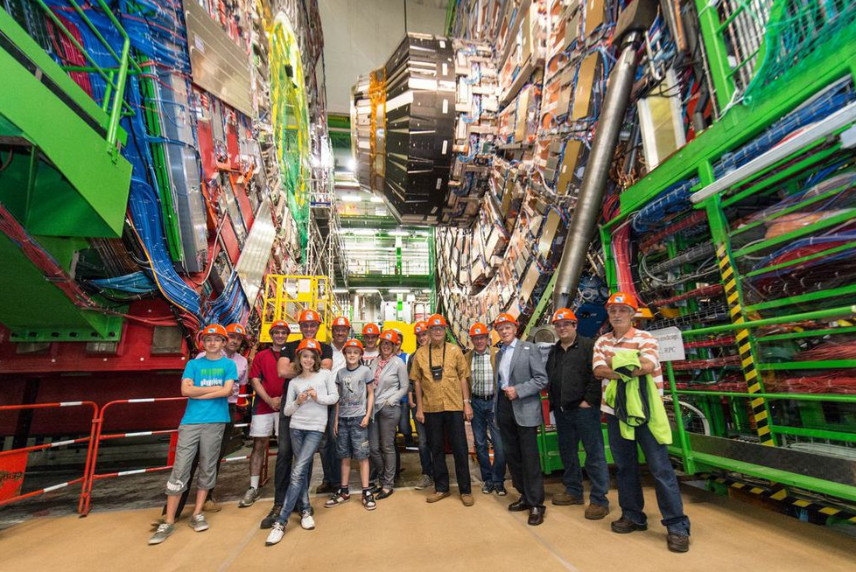
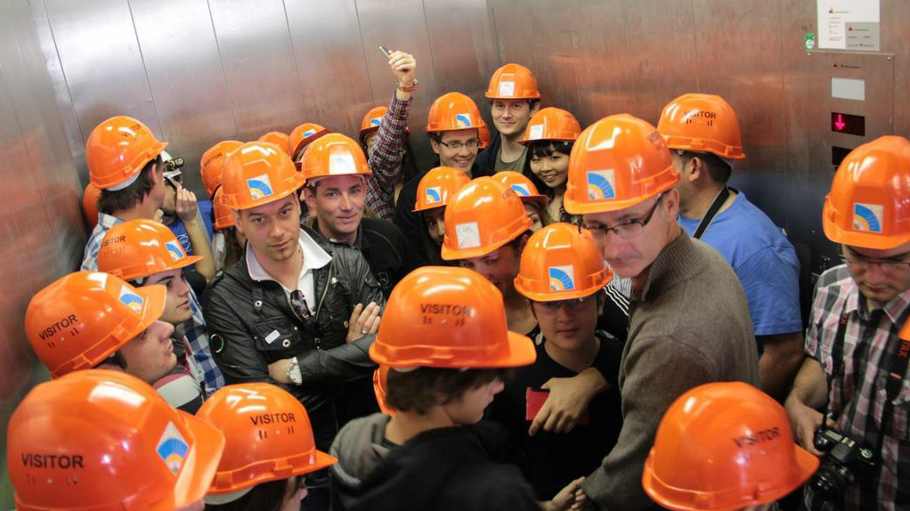
24 & 25 May - general public
4536 visitors: 300 people/h visiting

Slide 33
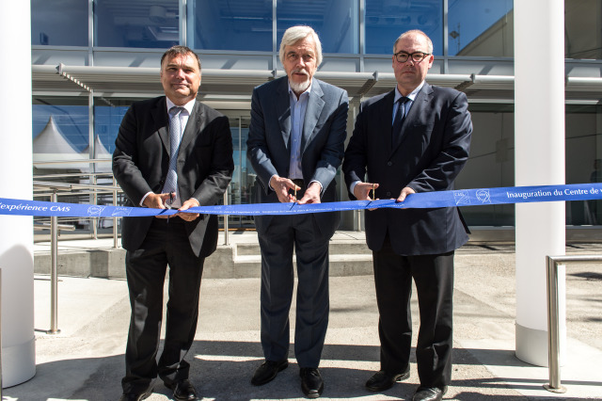
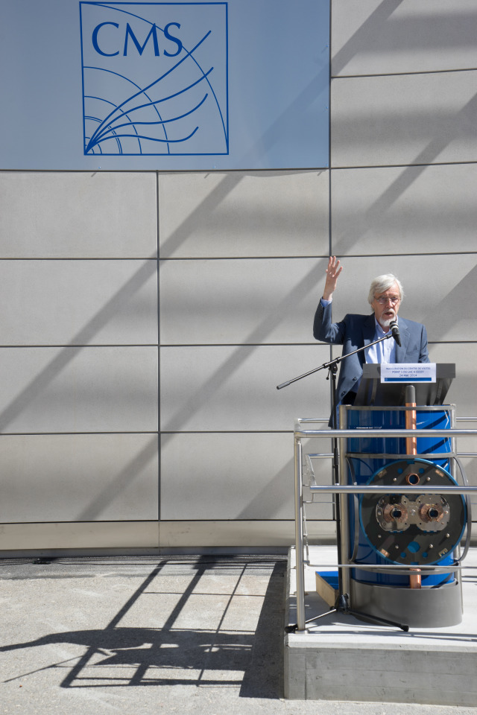

New CMS building at P5: inaugurated 24 May

Slide 34
Thanks a lot

Slide 35
Backup

Slide 36
HIN Analyses for Quark Matter
Analysis Entry | Description
HIN-12-007 | Psi(2s)/Psi(1s) in PbPb w/ updated 2013 pp reference
HIN-13-007 | W boson x-section and charge asymmetry in pPb
HIN-14-001 | Jet x-section and nuclear modification factor in pPb
HIN-14-002 | Long-range (ridge) correlations with K⁰_{s} and Λ in high multiplicity pPb
HIN-14-003 | Z boson x-section and forward-to-backward ratio in pPb
HIN-14-004 | Exclusive B meson x-section and nuclear modification factor in pPb
HIN-14-006 | Multiparticle correlations in PbPb and high multiplicity pPb
HIN-14-007 | b-jet x-section and nuclear modification factor in pPb
HIN-14-008 | Eta dependence of long-range (ridge) correlations in pPb
HIN-14-010 | Jet-track correlations (missing p_{T}) in PbPb
HIN-14-012 | Flow factorization breaking in pPb and PbPb
HIN-14-013 | Bose-Einsten correlations w/ identified pions and kaons
https://twiki.cern.ch/twiki/bin/view/CMSPublic/PhysicsResultsHIN

Slide 37


Trigger Coordination Status
Many changes in the object reconstruction at HLT
  Goals: reduce CPU time, particularly in tracking
  improve resolution to allow tighter thresholds
  Improve efficiencies

Slide 38

2015 Intermediate Calo Trigger Upgrade
Connection of legacy trigger
from Regional Calo Trigger
to new uTCA Layer-2 processors
for jets, EG, taus, and energy
sums via ORSC optical interface
Met key milestone this month on testing the ORSC optical link interface to the MP7 layer-2 processor
(10 Gbps asynchronous link)
  50 hour communication test of 2 ORSCs to one MP7 (full calorimeter input) at 10 Gbps asynch. with no errors and with data aligned

