Slide 1


Report from DPHEP Collaboration W/S
Jamie.Shiers@cern.ch
DPHEP Collaboration Workshop
CERN, 8/9 June 2015

Slide 2
Goals
Establish the motivation for long-term data preservation in HEP in terms of succinct Use Cases
  Are there a common set of Use Cases, such as those that were recently agreed for the 4 main LHC experiments but in a more global scope?
Review the existing areas of "Common Projects"
  Can these be extended (similarly) from their current scope - often LHC - to become more global?
Perform a site-experiment round-table to capture the current situation HEP-wide
  A summary paper / presentation will be made to PV 2015 (accepted as Oral presentation)
  (We may also wish to submit a paper / talk to iPRES 2016, October 2016 in Bern)
  A longer document – closer to a Blueprint update – is foreseen ~by next workshop – see agenda for outline

Slide 3
Themes
Collaboration
  This is not the first DPHEP workshop, but the first one since the Collaboration Agreement has been signed (7 sites; more coming)
The move (transition?) to Open Science
  This is happening “externally” – but also matches quite well what is happening inside the project and the experiments

Slide 4
Use Cases – January GDB
Preserve data, software, and know-how in the collaborations
  Foundation for long-term DP strategy
  Analysis reproducibility: Data preservation alongside software evolution
Share data and associated software with larger scientific community
  Additional requirements:
  Storage, distributed computing
  Accessibility issues, intellectual property
  Formalising and simplifying data format and analysis procedure
  Documentation
Open access to reduced data set to general public
  Education and outreach
  Continuous effort to provide meaningful examples and demonstrations
Bit preservation
  Data taken by the experiments should be preserved
Strategy and scope in approved policy documents for all (LHC) collaborations
  http://opendata.cern.ch/collection/data-policies

Slide 5
Use Cases – “all HEP”
Bit preservation
  Data taken by the experiments should be preserved
Preserve data, software, and know-how in the collaborations
  Foundation for long-term DP strategy
  Analysis reproducibility: Data preservation alongside software evolution
Share data and associated software with (larger) scientific community
  Additional requirements:
  Storage, distributed computing
  Accessibility issues, intellectual property
  Formalising and simplifying data format and analysis procedure
  Documentation
Open access to reduced data set to general public
  Education and outreach
  Continuous effort to provide meaningful examples and demonstrations
Strategy and scope in approved policy documents for all (LHC+LEP) collaborations
  http://opendata.cern.ch/collection/data-policies
  LEP (and other?) access policies exist (L3?) – need to be uploaded & given DOI

Slide 6
Use Cases – “all HEP”
Bit preservation – basically ok (at CERN) but not a formal policy
  Data taken by the experiments should be preserved
Preserve data, software, and know-how in the collaborations
  Foundation for long-term DP strategy
  Analysis reproducibility: Data preservation alongside software evolution
Share data and associated software with (larger) scientific community
  Additional requirements:
  Storage, distributed computing
  Accessibility issues, intellectual property
  Formalising and simplifying data format and analysis procedure
  Documentation
Open access to reduced data set to general public
  Education and outreach
  Continuous effort to provide meaningful examples and demonstrations
Strategy and scope in approved policy documents for all (LHC+LEP) collaborations
  http://opendata.cern.ch/collection/data-policies
  LEP (and other?) access policies exist (L3?) – need to be uploaded & given DOI

Slide 7
CAP Use Cases (I) (=know-how?)
The person having done (part of) an analysis is leaving the collaboration and has to hand over the know-how to other collaboration members.
A newcomer would like join a group working on some physics subject
In a large collaboration, it may occur that two (groups of) people work independently on the same subject
There is a conflict between results of two collaborations on the same subject

Slide 8
CAP Use Cases (II)
A previous analysis has to be repeated
Data from several experiments, on the same physics subject, have to be statistically combined
A working group or management member within a collaboration wishes to know who else has worked on a particular dataset, software piece or MC
Presentation or publication is submitted for internal/collaboration review and approval: lack of comprehensive metadata
Preparing for Open Data Sharing

Slide 9
Knowledge capture – beyond the grave
No-one(?) believes that this is possible today
But LHC (&FCC) experiments have to solve “the succession problem”
The above may be enough whilst the collaborations exist (+ a bit longer)
This goes way beyond the ambition of many past experiments (targetting ~2020)

Slide 10
Joint Projects
Bit Preservation
Virtualisation (CernVM + CernVMFS)
Analysis Capture & Preservation
Open Access, including Discoverability etc
Open Data → Open Science
Concern: how to “drive” such projects between DPHEP workshops – particularly involving the boarder DPHEP Collaboration (community)

Slide 11
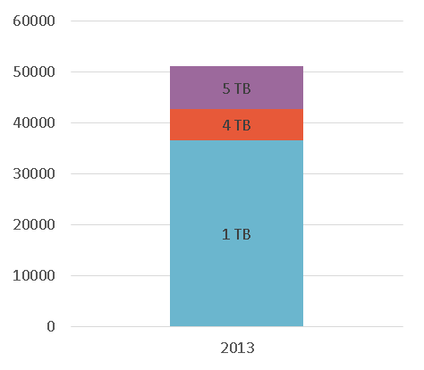
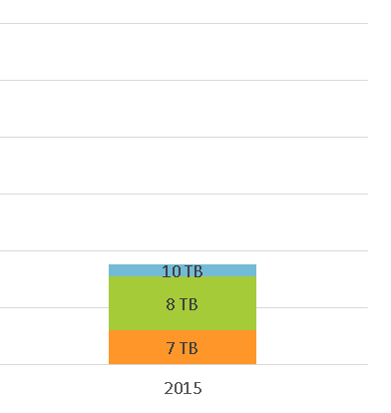
Large scale media migration
Challenge:
  ~85 PB of data
  2013: ~51 000 tapes
  2015: ~17 000 tapes
  Verify all data after write
    3x (255PB!) pumped through
    the infrastructure
    (read->write->read)
  Liberate library slots for new cartridges
    Decommission ~35 000 obsolete tape cartridges
Constraints:
  Be transparent for user/experiment activities
  Preserve temporal collocation
  Finish before LHC run 2 start

Slide 12
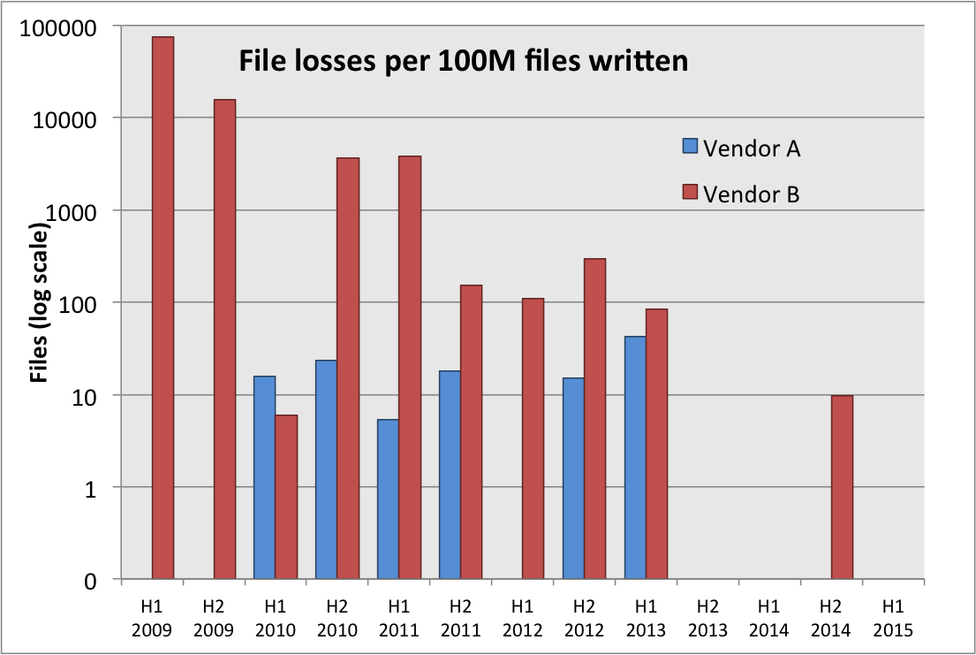
CERN Archive Reliability
Ongoing activity to improve
archive reliability
  Continued systematic verification
  of freshly written + “cold” tapes
  Less physical strain on tapes
  (HSM access, buffered tape marks)
  With new hardware/media, differences between vendors
  getting small
  For smaller experiments, created
  dual copies on separated libraries / buildings
No losses
No losses

Slide 13
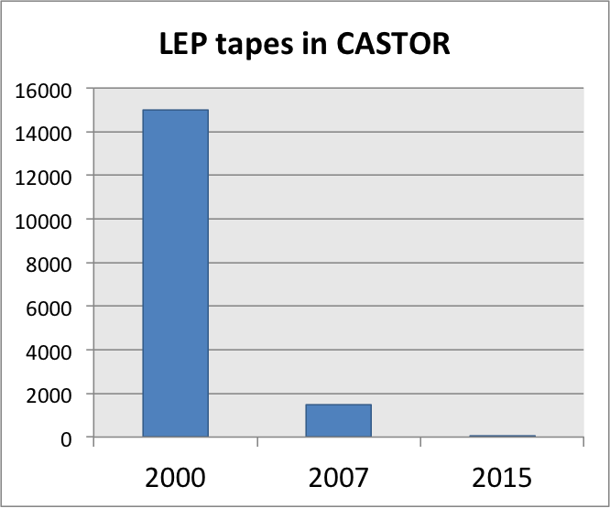
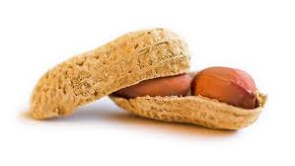
… and the past
LEP-era data: ~370TB
2000:
  ~ 15’000 tapes
2007:
  ~ 1500 tapes
2015:
  30 tapes… x 2 (replicated in separate buildings)
  Cost:
LEP data: 2 (3?) copies at CERN + outside

Slide 14
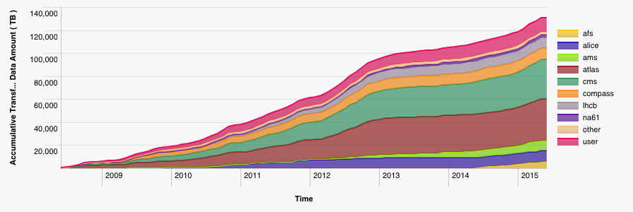
CERN Archive current numbers
Data:
~105 PB physics
data (CASTOR)
~7 PB backup (TSM)
Tape libraries:
IBM TS3500 (3+2)
Oracle SL8500 (4)
Tape drives:
~100 archive
Capacity:
~70 000 slots
~25 000 tapes
Data to CASTOR tape, 2008-2015

Slide 15
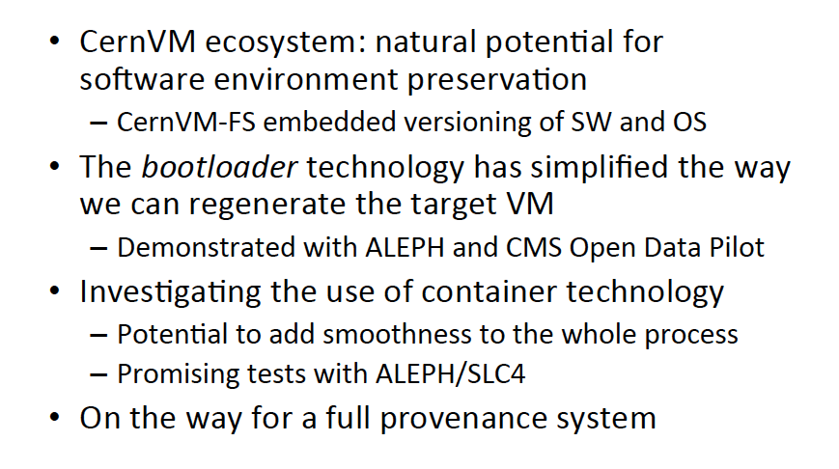
CernVM[FS] – Summary

Slide 16
CernVMFS – “Request”
Store past experiment s/w (including non-CERN, e.g. JADE) in CernVMFS
IMHO & CERNLIB too!
(Plus “archiving” of CERNLIB documentation in a Digital Library)
Web copy of CERNLIB doc “unavailable” (again & again & again…)

Slide 17
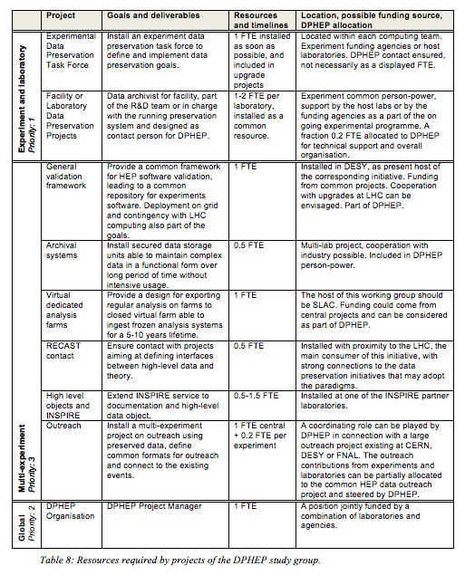
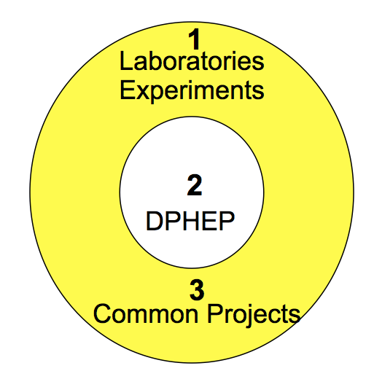
Projects and PP estimates
In the released document
Table 8

Slide 18
A note on the physics case
Many hypothesis and concrete examples discussed in the past workshops: re-analysis, re-cast, combinations etc.
Did all this continue to happen?
  Do we have now continued evidence for the physics case of preserved data?
Did data preservation initiatives within experiments played any role in enhancing the physics output flow for the ending experiments?
Does it play any role in the running of the present experiments?
… and in the planning for new experiments?

Slide 19
Site / Experiment Reports
Belle I & II
BES III & others
HERA (DESY + MPP)
LEP
LHC
CDF + FNAL (Tevatron)
BaBar
TRIUMF, SNOLAB etc
Many similarities in approaches
  But not so much that can really be called “common projects”
Numerous issues with manpower
  Would more coordination / collaboration help?
  Experiment man-power is often the issue…
“Its never too early to consider DP”
  But this advice is often not followed…
Bit preservation is not (should not be) an issue…
  Nor preservation of documents that actually exist…
  Nascent “definitions” of what “knowledge capture” might mean

Slide 20
Progress(?)
Its just over 3 years since the DPHEP Blueprint was published and …
The DPHEP session @ CHEP 2012 and …
The DPHEP input to ESPP update
The progress has simply been remarkable

