Slide 1
The EGI Cloud Federation
T. Ferrari, A. Lopez Garcia

Slide 2
Principles
The EGI Cloud is a open hybrid cloud federation
  Different levels of federation are possible offering various degrees of interoperability
  All cloud providers pooling resources and data in a multi tenant model
    Need to adhere to a set of common policies, procedures and processes for federated service management
    Can join in by adopting the federation model that provides the interoperability needs of the target groups
    Can choose among federated services offered by EGI in a modular way, while still relying on local tools and exposing own service interfaces to the federation, as applicable
  Low barriers to join the federation

Slide 3
Services of the EGI Cloud Federation 1/4
SSO for authentication and authorization across the whole cloud federation supporting the IGTF identify federation as well as other IdP federations through a credential translation service (pilot phase)
Federated accounting system to collect, aggregate and display usage information across the whole federation: number of VM instantiated and consumed CPU wall time by user, user group, VO and cloud provider

Slide 4
Services of the EGI Cloud Federation 2/4
Federated information discovery allowing users and tools to have information about capabilities and services available in the federation
  cloud compute and storage service end-points
  the list of locally available VM images and flavors per cloud provider
Information can be retrieved
  by end users via the Application Database to instantiate VMs in the federations
  by platforms via LDAP queries to gather information for brokering functions

Slide 5
Services of the EGI Cloud Federation 3/4
Federated monitoring to perform federated service availability monitoring and reporting of the distributed cloud service end-points, and to retrieve this information programmatically
Service registry for configuration management of the federated cloud services (GOCDB)
VM image catalogue: open library of virtual appliances (bundle of one or more VM images) for use on a cloud or for personal download, supporting VM image management operations like: registration of new instances, reuse of existing ones and contextualization. It uses the HEPiX image lists technology.

Slide 6
Services of the EGI Cloud Federation 4/4
EGI endorsed VM images: a set of base images containing only the OS and already prepared to run in a cloud environment in a secure manner
VM image management with a central registration point for virtual appliances which can be automatically and securely distributed to any resource provider
Federated service management system of processes, policies, activities and supporting tools customized to the federated cloud

Slide 7
Definitions
EGI Cloud Federation
  hybrid cloud (private, community, public)
EGI Cloud Realm
  subset of cloud providers exposing homogeneous cloud management interfaces and capabilities
  the Open Standards Cloud Realm supports OCCI and CDMI for full interoperability across different CMFs
Community Platform
  Set of community-specific data, tools, applications and brokering solutions, which can be supported by one or more realms of the federation.

Slide 8
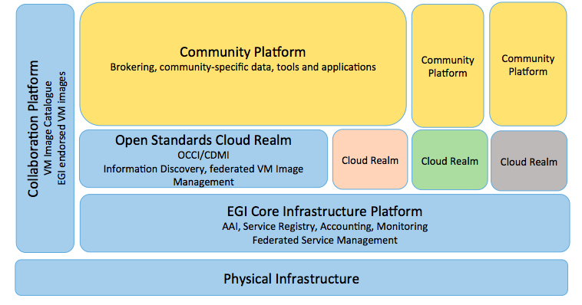
Federation model

Slide 9
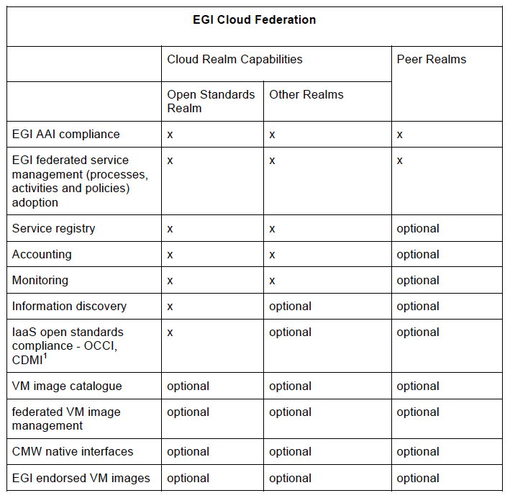

Slide 10
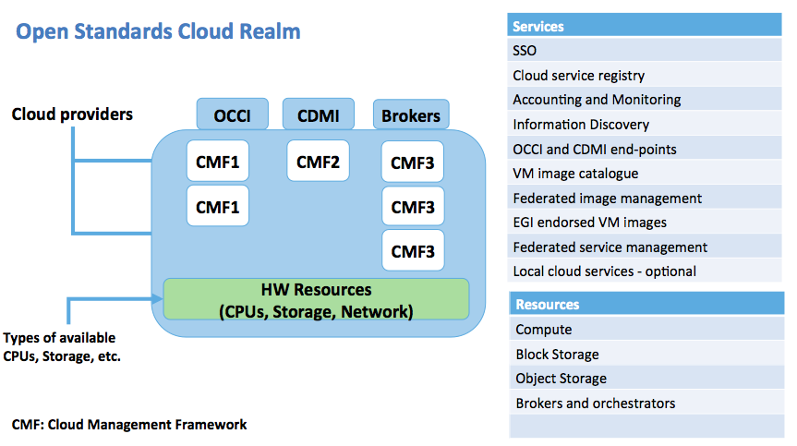
Open Standards Cloud Realm

Slide 11
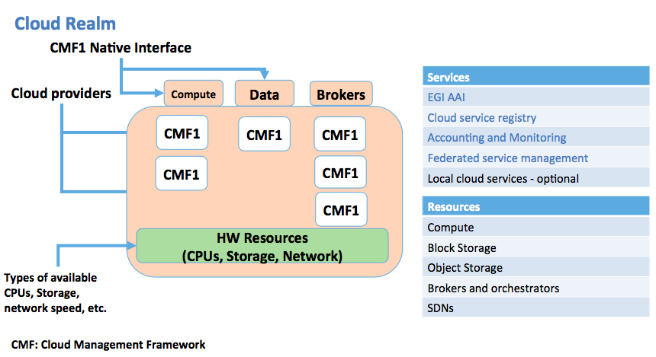
Cloud Realm

Slide 12
Value proposition - users
SSO support for accessing the cloud federation
Integrated accounting across the whole federation
Contribute own tools to an open library of virtual appliances: registration of new instances, reuse of existing ones and contextualization
Access the list of EGI endorsed VM images: a set of base images containing only the OS, and already prepared to run in a cloud environment in a secure manner
Distribution of the VM images to the federation cloud providers
Choose among different community platforms and softwares ported to the EGI federated cloud
User support

Slide 13
Community platforms - example
VOSpace (Int. Virtual Observatory Alliance)
  Access to federated distributed astronomical data repositories from survey projects
Integration of the EGI Cloud Federation and CANFAR (Canadian Advanced Network for Astronomical Research)
  Joint effort of EGI and INAF, and the Canadian Astronomy Data Centre
  Objective: implemented a distributed international cloud for astronomers, with agreed policies for data replication of data collections from telescopes, most of the data is open (estimated data: 1 PB)
  Capabilities: store and share of data, configurable VM management, interactive VMs, persistent VMs and batch processing with VMs

Slide 14
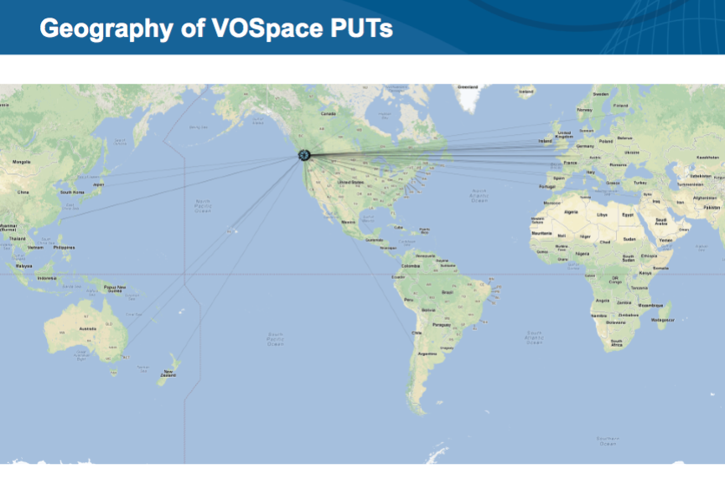
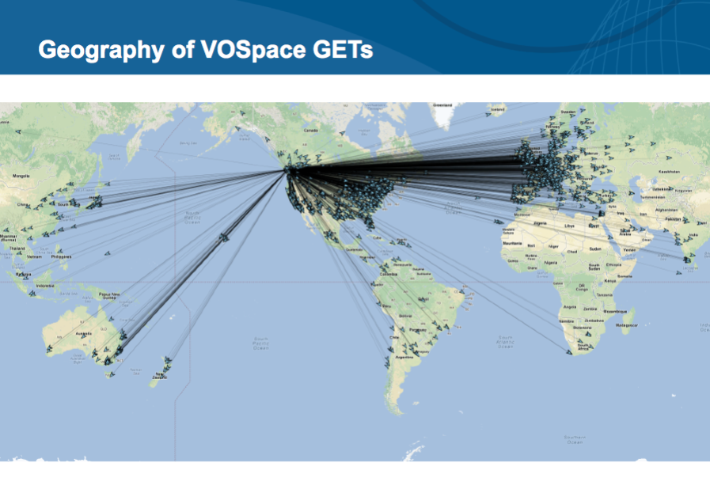
VOSpace – current status
(S. Gaudet/CADC)

Slide 15
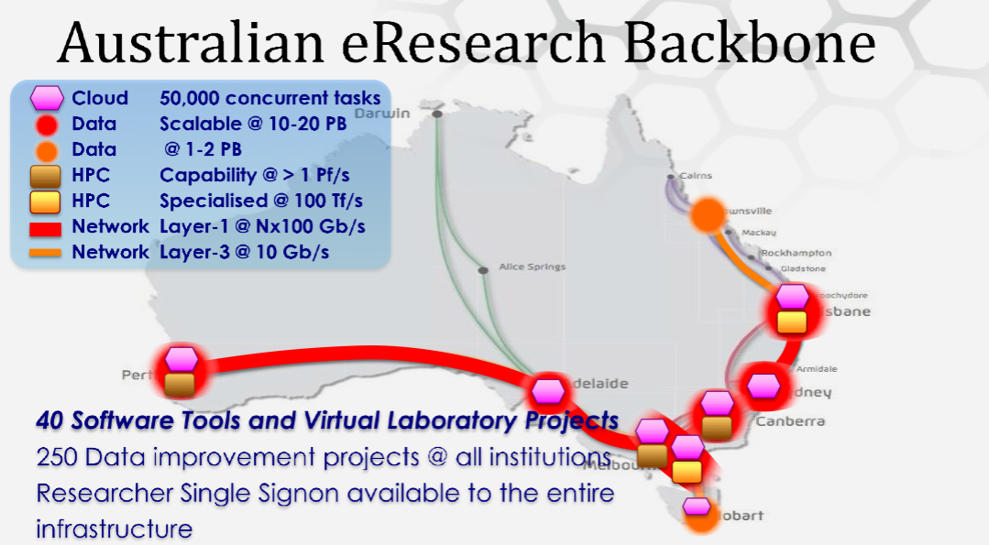
Federating worldwide - NeCTAR
Project supported by the Australian Government, 8 institutions and research organizations
Part of the National Research Infrastructure of Australia (NCRIS)
Offer: shared data, data storage, HPC, Virtual laboratories
International collaborations of common interest
  Data integration for neuroinformatics (HBP, Monash University), EMBL datasets, Astronomy
Discussion in progress on the federation model and AAI integration
Objective: share community tools and virtual laboratories, federate data

Slide 16
Other cloud integration efforts
ELIXIR Compute Platform – EGI-Engage ELIXIR CC
  GOCDB features in place allowing the EBI IdP to be accepted
  ELIXIR Compute Platform integration starting from sites in the Cloud WP of the EXCELERATE project
    EBI, then by CESNET, Surfsara, CSC
BBMRI private cloud, DARIAH…
D4SCIENCE for operating Virtual Research Environments for freshwater and marine resources conservation research (iMARINE)

