Slide 1
Accounting Update
John Gordon

Slide 2
Outline
Multicore
CPU Accounting Developments
Cloud Accounting
Storage Accounting
Miscellaneous

Slide 3
MultiCore Usage
The campaigns to encourage sites to start publishing accounting information on the number of cores used were successful.
>99% of LHC usage reports #cores.
Of the remaining <1%, 90%+ is due to ARC CEs at DESY-HH
Intractable interaction between ARC CE and PBS
Should be fixable as CREAM was fixed.
Very low level of failed jobs on ARC CEs still report 0 cores with little or no cpu and small wall.

Slide 4
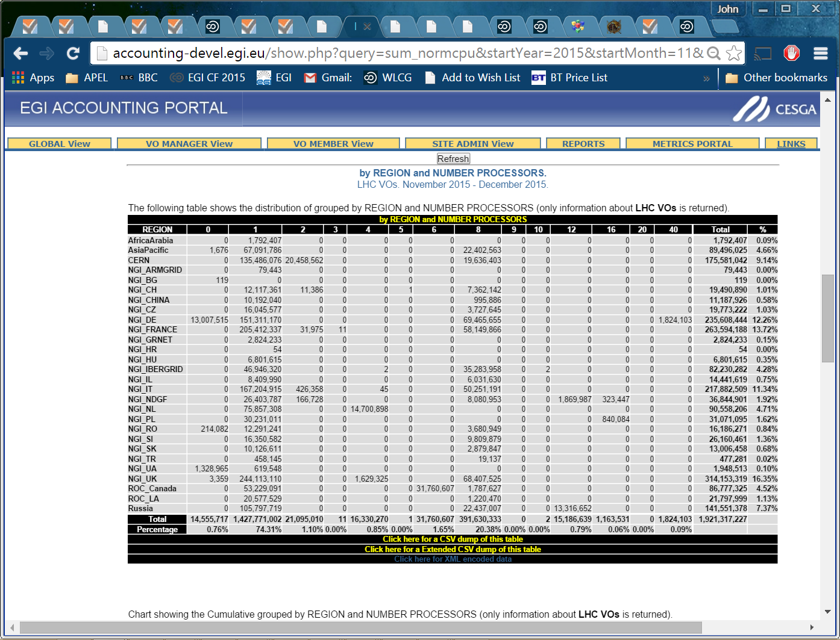

Slide 5
Monthly Reports
While waiting for APEL to migrate, the monthly WLCG Reports were adapted to take their data from the development portal with its information on cores used.
The November report, available now for checking by sites uses wallclock*ncores

Slide 6
Viewing in production portal
The Accounting Portal is in the middle of a major rewrite and they are loath to make major changes (lack of effort, etc)
They have added a new tree EMI3 (WLCG?) alongside the EGI one and the former contains the data visible today on the development portal which now has historical data going back 18 months. (Earlier data will follow shortly)
The Tier1 and Tier2 trees (and reports?) are from the latest data and include SubmitHost, Number of Processors(cores) and Number of CPUs. Wallclock time is viewable as raw, normalised and normalised*ncores. The last number is used to calculate efficiency.
Please let us know of any discrepancies you see either with what is visible in the original production view (EGI) or with what you expect to see for your site.

Slide 7
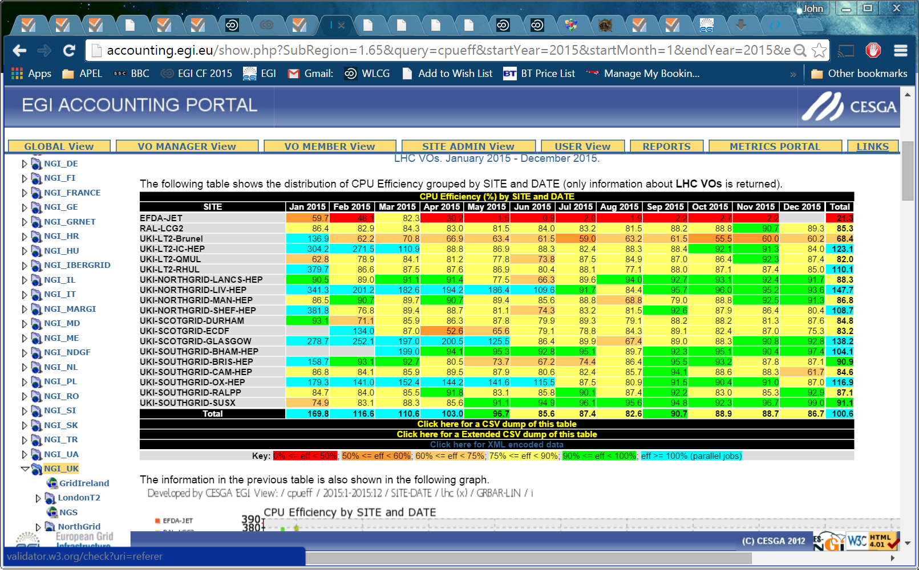
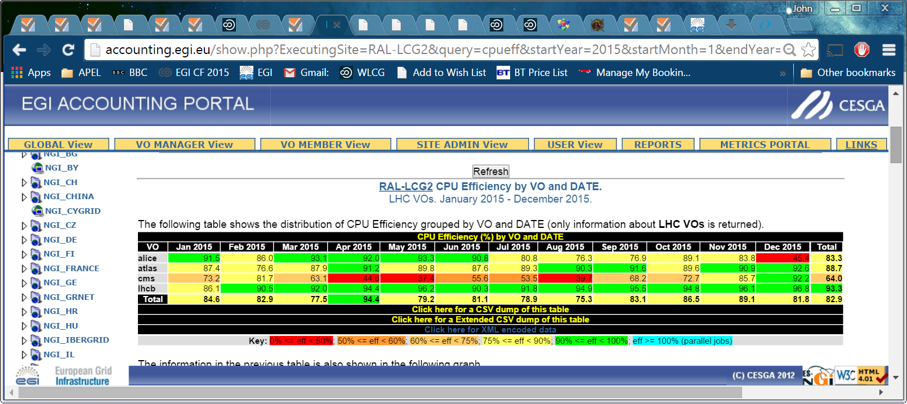

Slide 8
CPU Accounting Developments
ARC Parser
This will allow a site to publish their CREAM and ARC in one go from a single host.
Keeps local history and allows easy republishing.
Under test. VO info still to be added
HTCondorCE
Rumours of use outside OSG (and CERN)
Can anyone testing please get in touch so accounting can be developed in parallel, and not when someone alerts us after it is in production
New versions
The same request applies to new releases of batch systems. Several times we have had tickets raised by production sites who have upgraded their batch systems and only then looked at accounting.
Some planning would be good. Is there a forum where the first WLCG site about to try a new level of batch system can announce this?
We are happy to get involved in testing and can run logs through our test client.

Slide 9
Cloud Accounting
Updated Usage Record
Allows benchmark and structure within a site
Waiting for developers to test their producers
Monthly reports for long-running VMs
Under development. Implemented at server end by APEL.
Tier2 view but only 5 T2s are reporting cloud usage to APEL. (no Tier1s). Of these only 1 runs LHC work. There is LHC usage at non T2 sites.
I know there are many tests using cloud infrastructures. Can more of them please report accounting of their VMs.
It is not necessary to join the EGI FedCloud but if you don’t meet their criteria you may not be visible in EGI accounting, only in the WLCG views.
The infrastructure is in place.

Slide 10
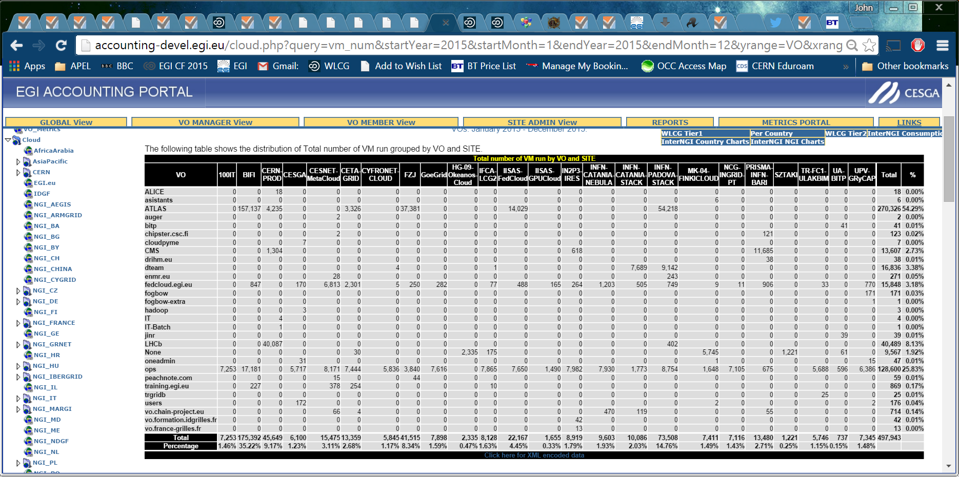
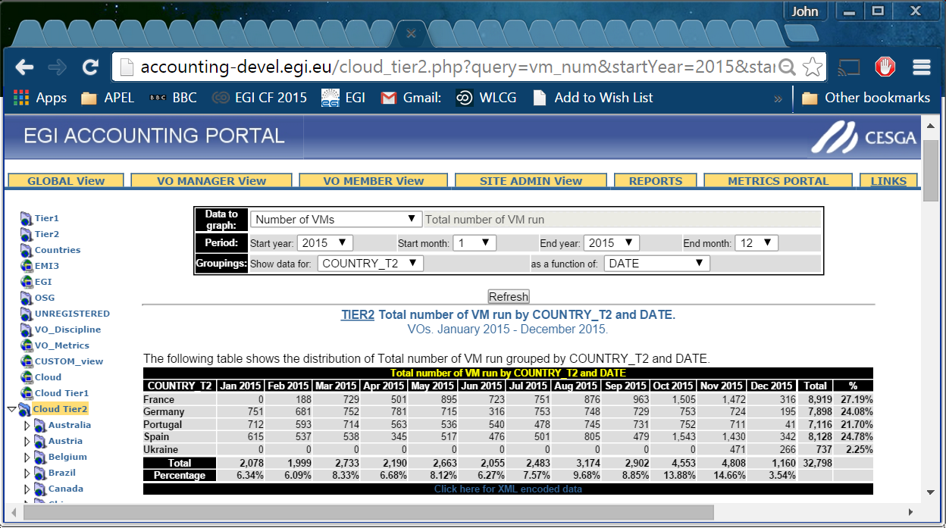
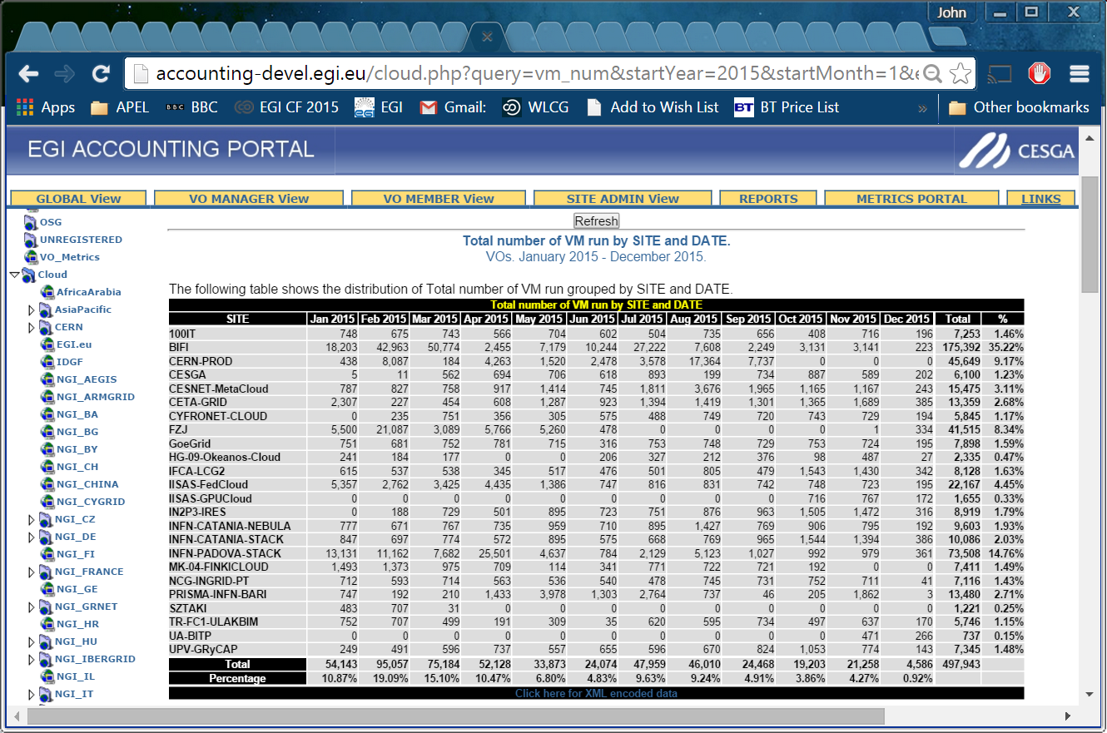
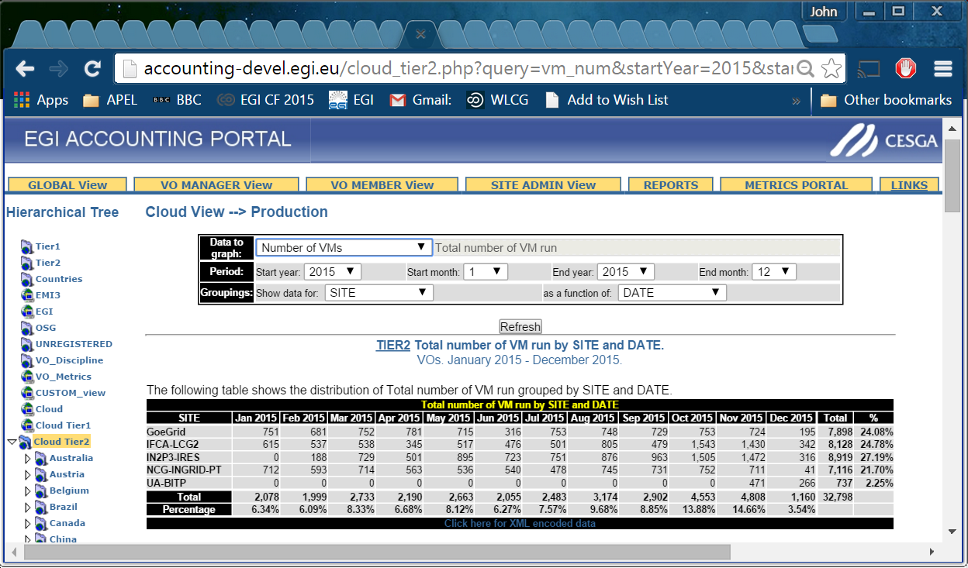
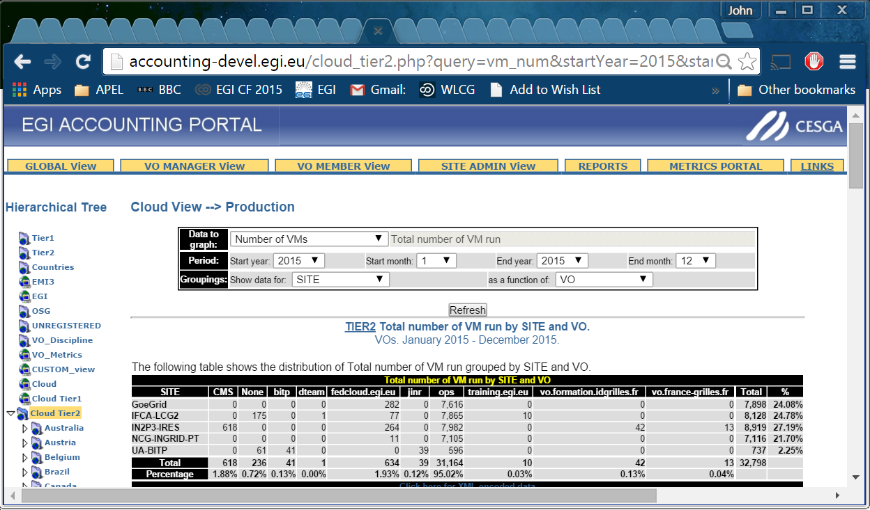
Cloud Views

Slide 11
Storage Accounting
This stalled and has recently been revived.
We have data from a few dpm and dcache sites.
There are discrepancies in the data they publish: different time ranges; missing data.
Still need to work with developers. Useful discussions at pre-GDB DPM Workshop.
Work still needed to check correctness for all configurations.
The Accounting Portal Storage view has been improved
EGI plan a wider roll out in February

Slide 12
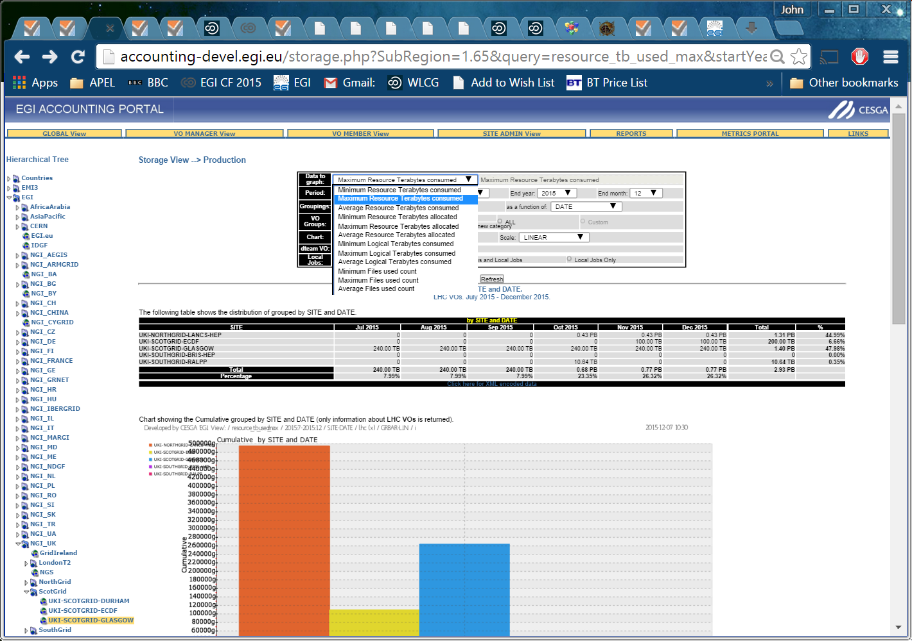
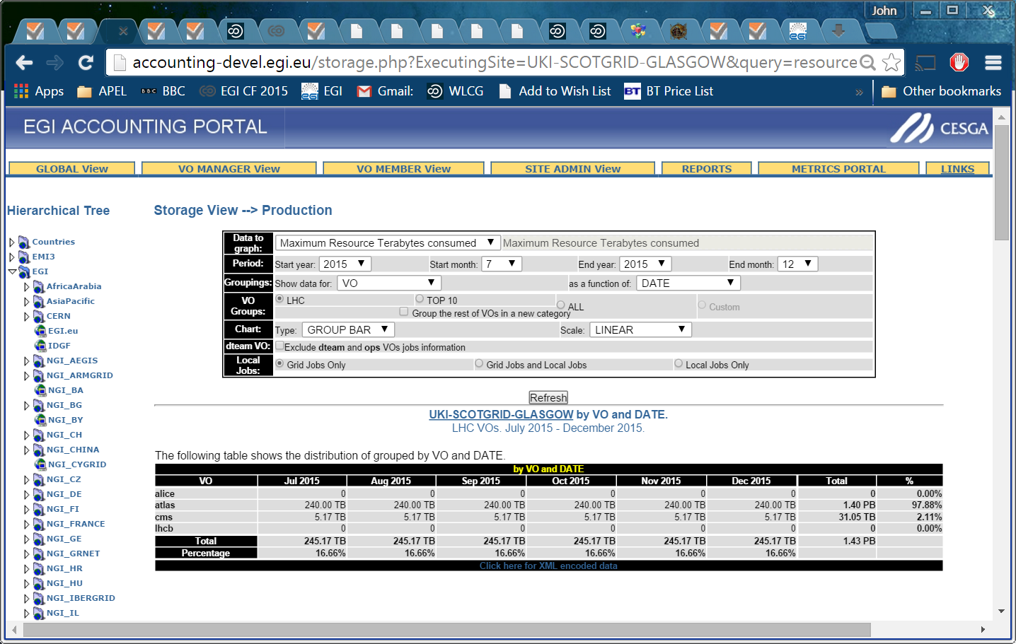
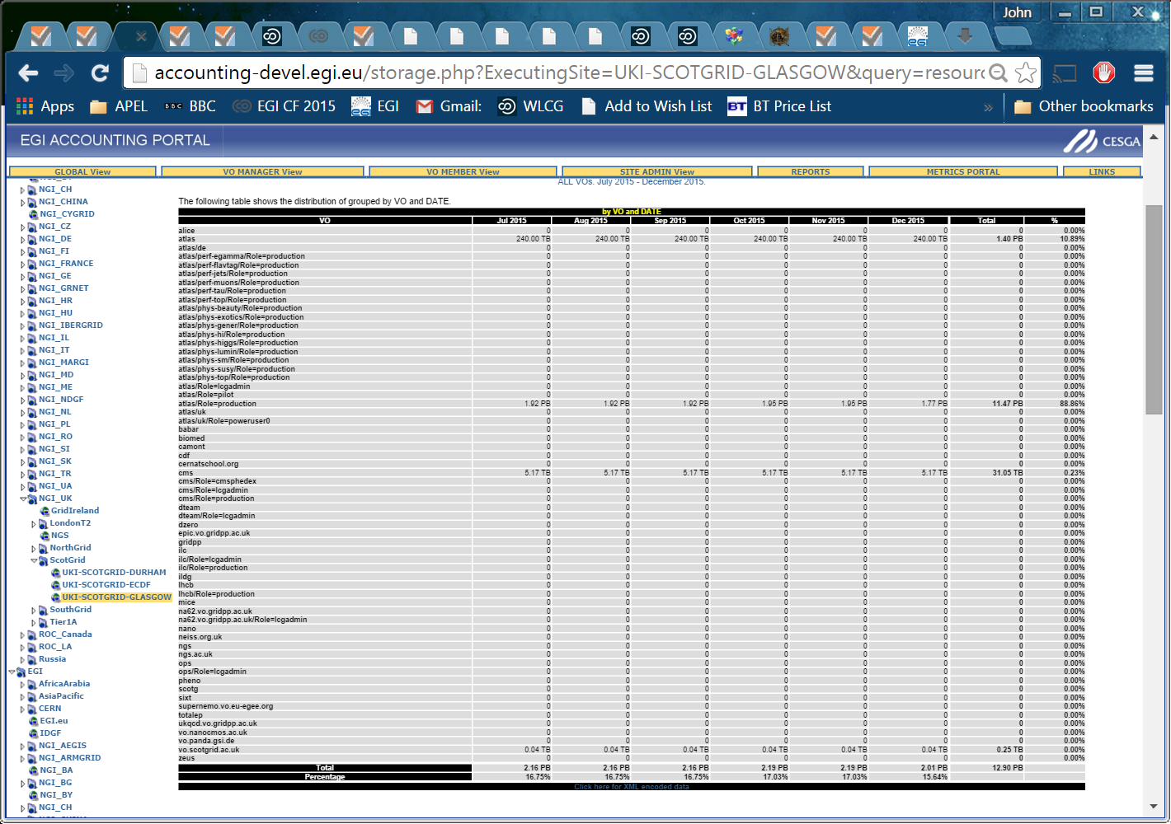
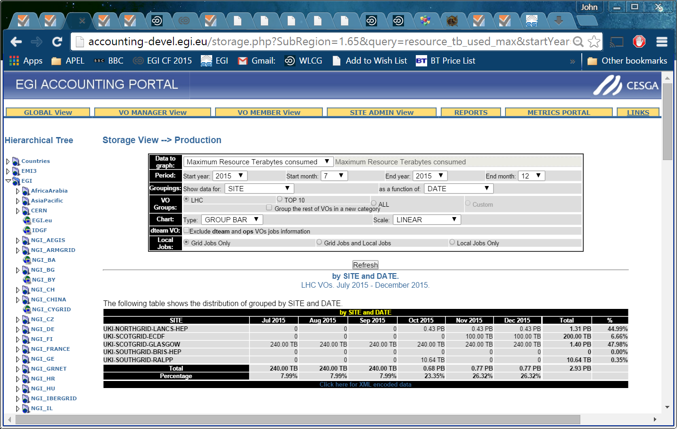
Example Of Storage Portal

Slide 13
SL5 and Poodle
The Poodle SSLv3 vulnerability was not considered high risk for a service like the APEL repository and the EGI Message Brokers.
The plan is to block SSLv3 in the brokers if the SVG deems it necessary.
If MBs block SSLv3, APEL servers running on SL5 OpenSSL will fail.
SL5 is in security-only support until 31March2016 so sites will need to upgrade by then. To mitigate the risk of SSLv3 being blocked at short notice, please plan to upgrade to SL6 now.
Unfortunately we cannot tell which sites, if any, are still running SL5 on APEL node.

Slide 14
Indigo DataCloud
As part of RAL’s work in Indigo DataCloud we will develop a RESTful interface to extract data directly from the repository by approved clients.
The Accounting Portal also has a deliverable in EGI-Engage to provide a RESTful interface to their data.
We will work together to make the interfaces as similar as possible while meeting possibly different requirements.
Such interfaces may be of interest to anyone who currently downloads data from the portal.
We will involve WLCG in defining the spec if anyone is interested.

