Slide 1


Modeling quench propagation in a protection heater covered YBCO coil
Tiina Salmi
Tampere University of Technology (TUT), Finland
The Kyoto Workshop on HTS Magnet Technology for HEP (WAMHTS-2)
Nov 14 2014
Thanks to : A. Stenvall (TUT) ,
G. Kirby (CERN), E. Härö (TUT), J. Van Nugteren (CERN)

Slide 2
Outline
Purpose of protection heaters and important parameters
Simulation tool
Analyzed cases
Simulated heater delays and quench propagation velocities
Ideas for future heater concepts and conclusion

Slide 3
Important heater parameters

Slide 4
Quench protection heaters
After quench detection the magnetic energy (E = I²L_{mag}/2) must be safely discharged
  Option 1: Extraction via external dump resitor
  Option 2: Internal dissipation via Joule heating in resistive coil segments
Important parameters: Delay time to induce a quench, and the amount of quenched winding
R_{dump} limited by V:
Large I₀, large E → Extract only a small fraction
(LTS) Heaters to quench large fraction of winding for fast I decay and uniform E dissipation

Slide 5
Heater
Heater
Heater
Heater
insulation
Cable insulation
Heat
Heat
Heat
Delay 1:
A quench intiated under heater
YBCO cable
Hotspot!
Hotspot!
Hotspot!
Quench propagation
Quench propagation
y
z
Delay 2:
Entire cable quenched
x

Slide 6
Simulation model

Slide 7
CoHDA: Code for Heater Delay Analysis
Computes heat diffusion from heater to a cable in 2-D (neglect transv.)
Quench when I_{c} == I_{op} → Delay 1
  Account for current redistribution
Heat generation due to current in Cu
  Current sharing model with critical surface
Quench propagation between heating stations → Delay 2
Heat balance eq. to be solved:
Heat generation in heater:
  T. Salmi et al., Trans. IEEE Trans. Appl. Supercond. 24(4), 2014
  T. Salmi et al., Trans. IEEE Trans. Appl. Supercond. 25(3), 2015
Heat generation in cable:

Slide 8
Analyzed cases

Slide 9
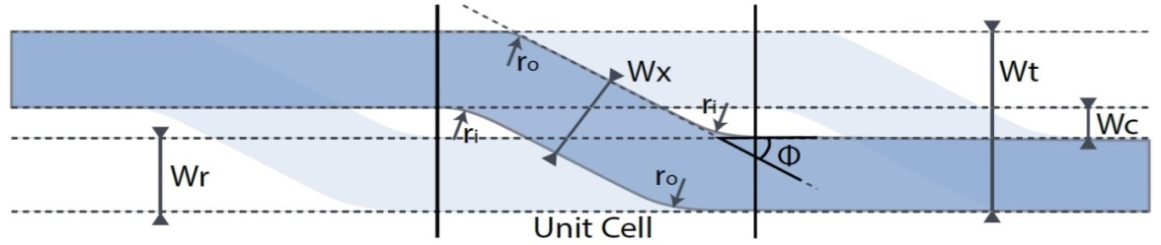
Analyzed cables based on EuCard-2 FM0
Heater
15-tape Roebel cable modeled as stacked tape cable
Cable 1
15 Tapes
5.7 mm
Wt = 12 mm
Wx = 5.5 mm
Heater
Cable 2
7.5 Tapes
11.4 mm
Conserving A_{cable} and material fractions
  f_{Cu} = 0.315
  A_{cable,ins} = 12.2 mm² f_{Hastelloy} = 0.385
  A_{YBCO} = 0.171 mm² f_{Voids (epoxy)} = 0.1
  f_{Cable ins.}= 0.2
  G. Kirby and M. Durante, EuCARD2 Milestone report, MS64, 2014

Slide 10
Simulation domain
T = T_{op}
Tape width
5.7 mm or 11.4 mm
dT/dx=0
dT/dx=0
I_{mag}
T = T_{op}

Slide 11
Analyzed operation points
CASE | Top (K) | Imag (kA) | B (T) | B angle (α) to ab-plane (°) | Tcs (K)
A | 4.5 | 6 | 15 | 5 | 22.3
B | 4.5 | 10 | 10 | 5 | 22.7
C | 4.5 | 6 | 10 | 5 | 28.8
D | 35 | 6 | 1.5 | 5 | 52.5
D
  J_{c}(B,T,α): J. Fleiter (see talk by Glyn yesterday)
6 kA
C
10 kA
A
B
α = 5°

Slide 12
Analyzed heater
State-of-the-art in LTS, typical values:
  25 µm thick stainless steel
  50 µm Kapton
  50 W/cm² (20 W/mm³) (min.)
  τ_{RC} 50 ms (capacitor powered)
Result presented at ASC-2014: In HTS heater like this does not have enough energy to quench for T_{cs} > ~20 K
Here is analyzed heater with 4 x more E
  50 µm thick stainless steel
  50 µm Kapton
  200 W/cm² (40 W/mm³)
  τ_{RC} 50 ms
  H. Felice et al., IEEE TAS 19(3), 2009
  T. Salmi et al., IEEE TAS 24(3), 2014
  T. Salmi and A. Stenvall, IEEE TAS 25(3), 2015

Slide 13
Simulation results

Slide 14
Delay 1 vs. heater coverage
B
Cable 1
Need 40 – 80 mm long heating stations (roebel?)
C
A
Cable geom. impacts the delay 40-60% !
Delay 1 (ms)
Heater energy must be related to the cable energy margin
  See extra slides
C
Cable 2
A: 4.5 K, 6 kA, 15 T (5°): Tcs = 22.3 K
B: 4.5 K, 10 kA, 10 T (5°): Tcs = 22.7 K
C: 4.5 K, 6 kA, 10 T (5°): Tcs = 28.8 K
D: 35 K, 6 kA, 1.5 T (5°) : Tcs = 52.5 K
A
B
1-D with ” --- ”
Coverage (mm)

Slide 15
Normal Zone Propagation Velocity
I = 6 kA (4.5 K)
B = 10 → 15 T
NZPV = 0.3 → 0.5 m/s
B = 10 T (4.5 K)
I = 6 → 10 kA
NZPV = 0.3 → 0.8 m/s
Geometry does not matter
Consistent with other studies
B
A
C
Cable 1 ” --- ”
Cable 2 ” __”
A: 4.5 K, 6 kA, 15 T (5°): Tcs = 22.3 K
B: 4.5 K, 10 kA, 10 T (5°): Tcs = 22.7 K
C: 4.5 K, 6 kA, 10 T (5°): Tcs = 28.8 K
D: 35 K, 6 kA, 1.5 T (5°) : Tcs = 52.5 K

Slide 16
Delay 2 vs. heater period
Cable 1
C
Max 120 – 150 mm period
  Or > 300 K under heater
  Coverage min 30-50% (compare to 10-30% in LTS)
If protected with heaters, better to find a way to cover all with the heater!
A
B
Delay 2 (ms)
Cable 2
C
A
A: 4.5 K, 6 kA, 15 T (5°): Tcs = 22.3 K
B: 4.5 K, 10 kA, 10 T (5°): Tcs = 22.7 K
C: 4.5 K, 6 kA, 10 T (5°): Tcs = 28.8 K
D: 35 K, 6 kA, 1.5 T (5°) : Tcs = 52.5 K
B
Period (mm)

Slide 17
Ideas for future heaters and conclusions

Slide 18
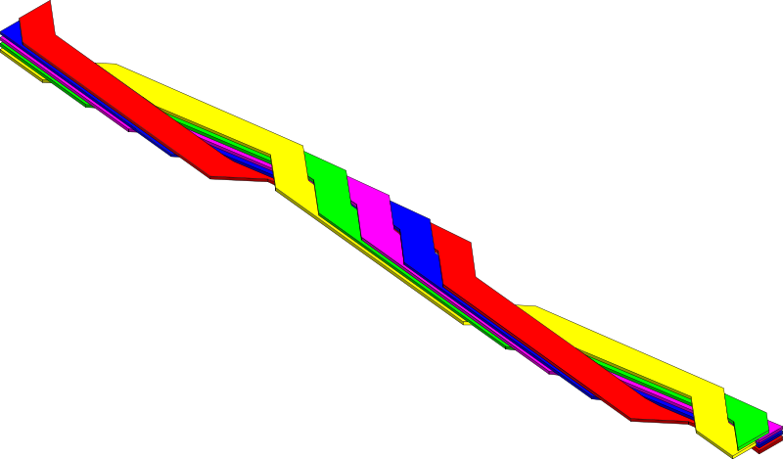
Ideas for alternative heaters 1/2
1. Heater co-wound as one of the strands,
or as a wider strip on the cable wide side
+ Good heater contact with cable
+ Need less heater power
- Still need insulation between heater and other strands
- May require ”take-outs” from the middle to limit the voltage
Example:
If the pink was a heater
Coverage for the blue
Coverage for the green
Fig. From Wikimedia commons, authored by Christian Barth

Slide 19
Ideas for alternative heaters 2/2
+ Can make several short heaters with high power (and low voltage) to cover a long coil
+ PH current leads only at coil ends
- Need many HFU’s
- Less uniform trace thickness
2. Several shorter ”layered” heaters on top of the coil
PH1: Current route (copper)
PH2: Current routes
+
+
-
-
PH2: Stainless steel
First Kapton
PH1: Stainless steel
Second Kapton

Slide 20
Conclusion
The CoHDA simulation tool now includes also quench propagation in a YBCO cable
Analysed heater delays in FM0 cable
  Modeling roebel cable as stacked tape
    Dimensions impact on heater delay time but not on NZPV
Seems that with a powerful heater cables can be quenched, but the quench propagation is so slow that it is better to try to cover the entire cable with heater and not rely on heating stations
  Needed delays depend on J, L and detection time
Must investigate also other protection options than heaters
Future work will consists of interfacing the heater model to a current decay model for a comprehensive quench protection analysis

Slide 21
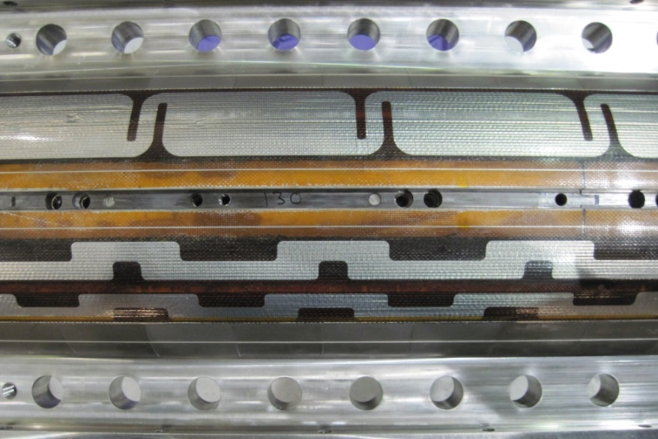
Examples of heater geometries
Cov.
Per.
Cov.
Per.
Cov.
Per.
Two geometries tested in 3.3 m long LARP LHQ 15 T Nb₃Sn quadrupole coil.

Slide 22
Design plot to estimate delay 1 vs. T_{cs}
Cable 1, T_{op} = 4.5 K
100 W/cm² (148 ms)
50 W/cm² (>300 ms)
Example T_{cs}
200 W/cm² (22 ms)
300 W/cm² (39 ms)
Heater powered with a square pulse.
Pulse width so that T max. in heater is 300 K.
Delay 1, when heater powered with 100 W/cm² (t_{pulse} = 148 ms)

Slide 23
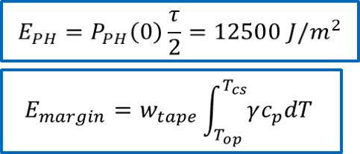
Enthalpy vs. Temperature margin
Heater energy must be related to the cable energy margin

Slide 24
Current ”redistribution”
We go through cable segments column by column
QUENCH = 0
t_{delay1} = -1
DO j = 1, K
I_{SC,j} = 0
DO i = 1, N
I_{SC,j} = I_{SC,j} + J_{C} (B, T_{i,j}) * A_{elem}
IF (I_{SC,j} ≤ I_{op}) QUENCH_{j} = 1
END DO
IF (t_{delay1} = 0) t_{delay1} = time
I_{Cu,j} = Max (0, I_{op} - I_{SC,j})
END DO
. . .
1,1
1,2
1,K
A_{elem} = A_{YBCO}/N
2,1
. . .
. . .
T_{i,j}
i,j
. . .
. . .
N,1
N,K

Slide 25
Heat generation
Δx and Δy constant in cable
Δx
V_{tot} = 0
DO j = 1, K
J_{Cu,j} = I_{Cu,j} / A_{cu}
V_{k} = J_{Cu,j} * ρ_{Cu,i=N/2,j} * Δx
f_{gen} = I_{op} * V_{ku} / (A_{Cable}* Δx)
V_{tot} = V_{tot} + V_{k}
END DO
. . .
Δy
1,1
1,2
1,K
2,1
. . .
. . .
T_{i,j}
i,j
. . .
A_{cable} =
A_{cu}/ f_{Cu}
. . .
N,1
N,K

Slide 26
For all VT’s
NO
Is Joule heat generated at the location of the VT?
YES
Record the time of first heat generation (TqVT)
Compute the quench propagation velocity between VT’s
Do all combinations of VT’s
(Consider only VT’s where heat generation)

