Slide 1


Quench & protection: modelling and review of toolings
Massimo Sorbi
with the great help of:
Helene Felice
WAMHTS–2, Nov. 13th and 14th 2014 - Kyoto

Slide 2
Introduction
This presentation mostly comes from the description done by Helene Felice in WAMSDO-2013.
It’s a review of some codes. For each code it will described:
Code “ID”
  Overview
  Programming
  Validation
  Distribution / Availability
  Some users
  Some references
Brief description

Slide 3
Non exhaustive list of codes
We can distinguish 2 kinds of codes:
Highly specialized “quench protection” codes
  QuenchPro (FNAL)
  QLASA (INFN-LASA)
  ROXIE (CERN)
  Cobham Vector Field Quench Analysis program (VF)
More general codes applied to quench protection:
  FEM codes: ANSYS, CAST3M

Slide 4
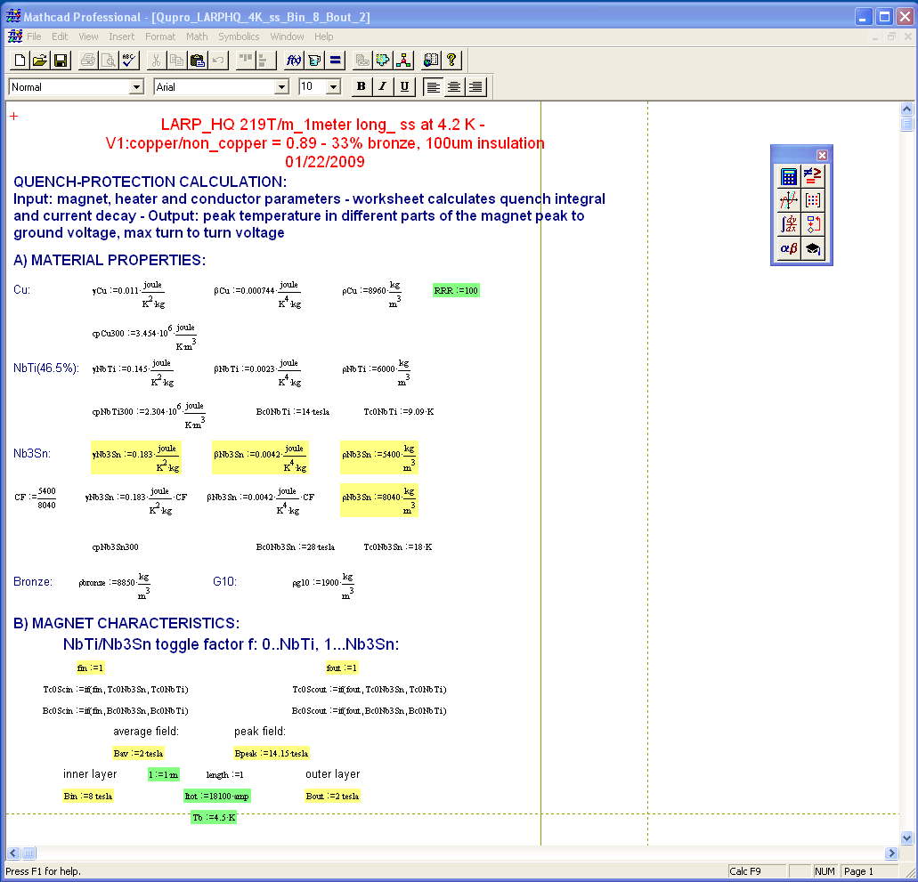
QuenchPro ID
Overview
Adiabatic model
Calculation of the hot spot temperature and current decay
Programming
Mathcad 7 spreadsheet developed by Pierre Bauer
Validation
LARP magnets and comparison with other codes (QLASA)
Availability
Available upon request to the owner (Pierre Bauer or Giorgio Ambrosio)
Some users
Giorgio Ambrosio (FNAL), Helene Felice (LBL)
Some References
P. Bauer et al., FNAL TD-00-027, FNAL TD note TD-01-003 and 4
Lidia Rossi, FNAL TD-12-11
QuenchPro developed at FNAL by P. Bauer

Slide 5
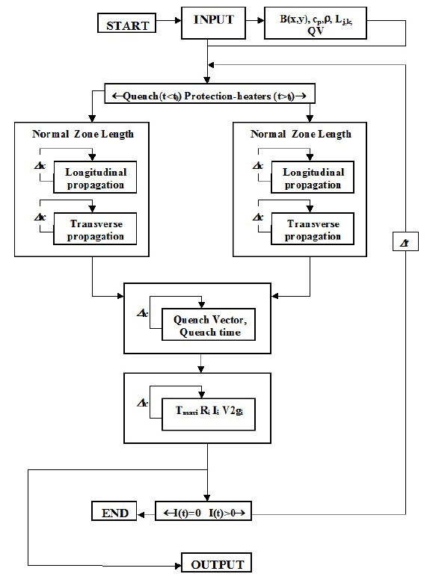
QuenchPro - Principle
Part 1:
Input
  Definition of the magnet in a series of 16 sub-coils
  Magnet Operational Parameters: field, bath temperature
  Preliminary calculations of the material properties
  Definition of the protection system
    Value of the dump
    PH: coverage, delay…
    Detection time
Normal zone propagation Routine – for each time step
  Calculation of the resistance
  Current decay: exponential, with τ_{i} update each temporal step t_{i}
  Temperature: computed based on the MIITs accumulation at t_{i}
Flowchart from Lidia Rossi thesis – TD-12-11

Slide 6
QuenchPro – Principle(II)
Part 2:
Voltage computation
Definition of each turn coordinates to allow the calculation of the turn to turn inductance => inductance matrix
Calculation of the turn to turn voltage and turn to ground voltage
Some Limitations
Absence of user manual
Various versions modified by various people
No quench-back effect

Slide 7
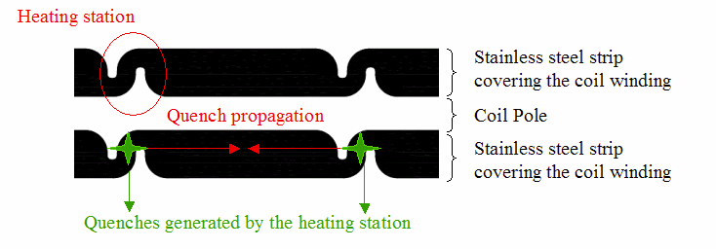
QuenchPro improvement by Lidia Rossi
(available upon request to G. Ambrosio)
Implementation of heating stations
Normal zone growth account for quench propagation from heating stations
Implementation of the differential inductance
Initially constant in the original QuenchPro
“If” loop to introduce L(I)
Example of LARP Long Quad (LQ)

Slide 8
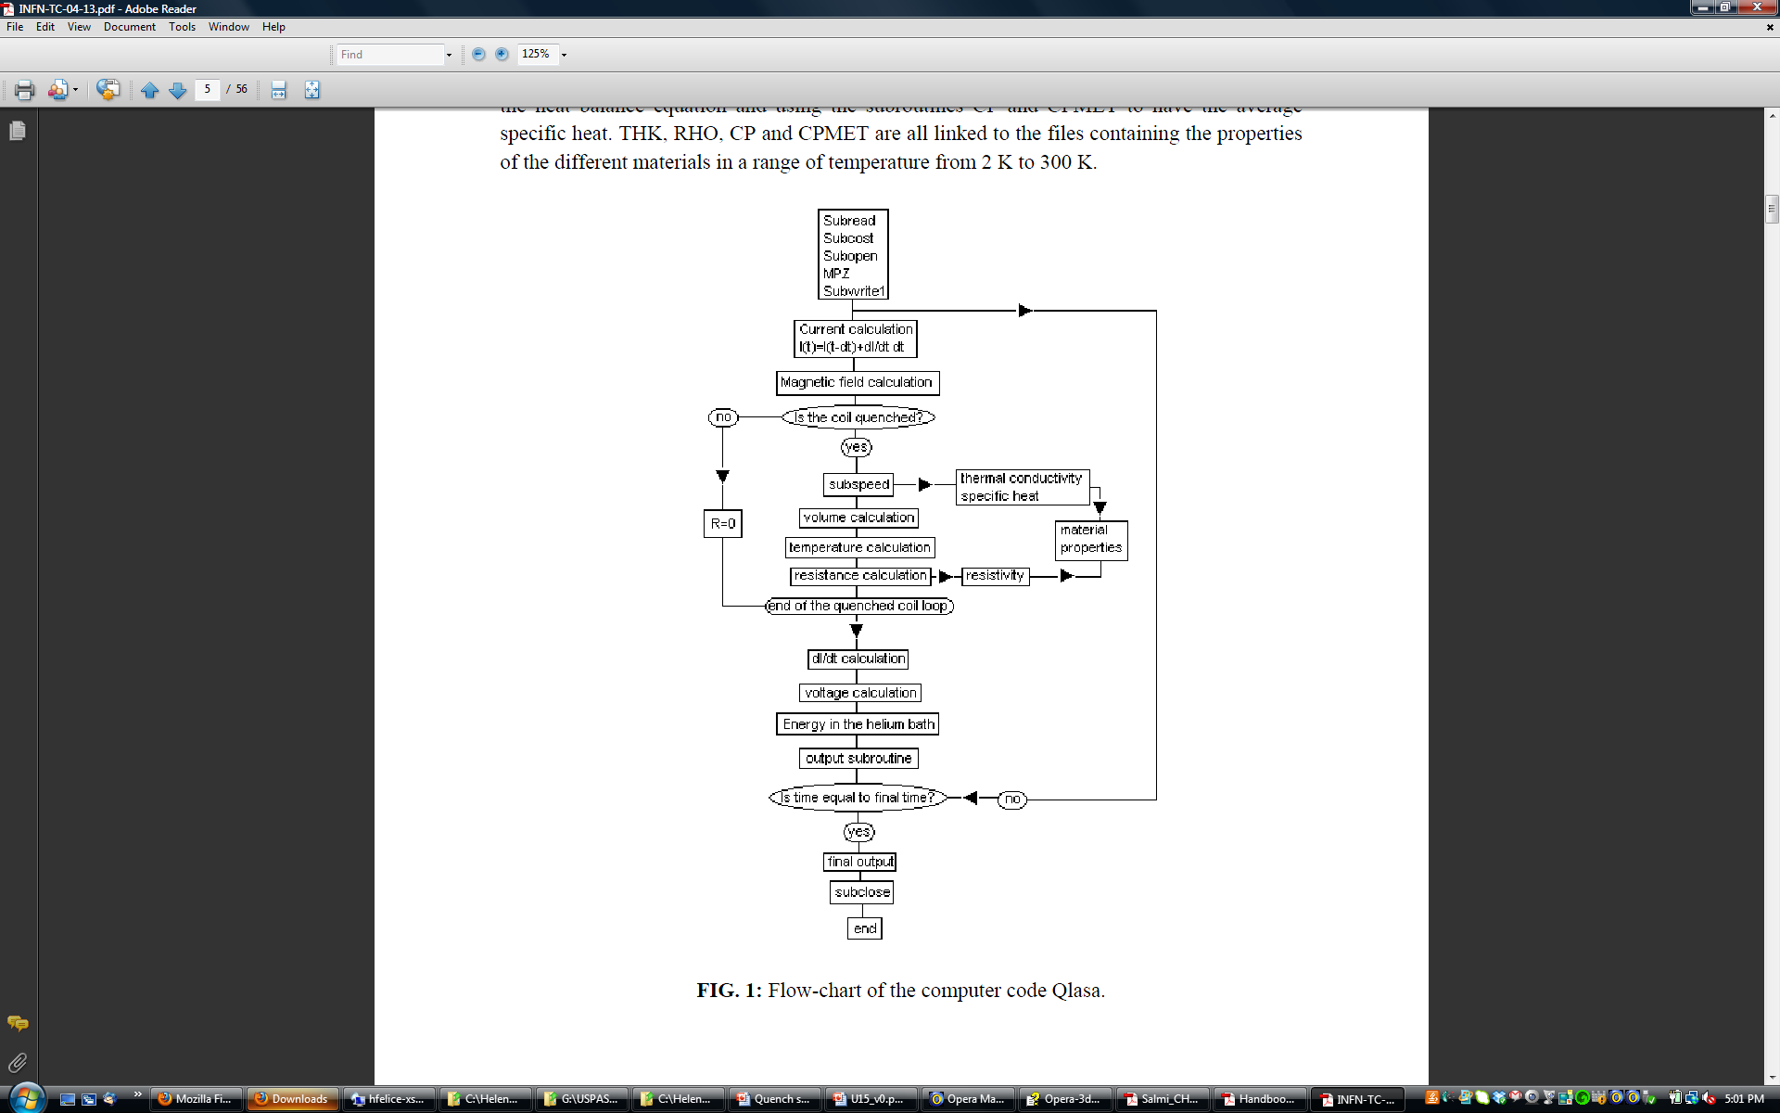
QLASA - ID
Overview
Quench code developed at LASA
Adiabatic assumption for hot spot temperature calculation
Initially intended for superconducting solenoids and inductively coupled elements
No quench-back effects
Programming
Fortran 77
Availability
Available upon request to the owner (INFN-LASA)
Some users
Massimo Sorbi, Vittorio Marinozzi (INFN – LASA)
Some References
L. Rossi, M. Sorbi, QLASA: a computer code for quench si,ulation in adiabatic multicoil supercond. winding
INFN/TC-04/13

Slide 9
QLASA - Principle
Reads the input data
Geometry
Time steps
Vtaps location
Self an Mutual inductance
Cable components
…
Current computation
B computation
Propagation velocity computation
Resistance and
Temperature
Current decay
Voltage:
Driven Mode: Accounting for change of mode of the power supply (from current mode to voltage mode)
Persistent mode available
Flowchart from INFN/TC-04/13

Slide 10
Material properties library: MATPRO
Fortran 77 computer library providing electrical and thermal properties of most common materials used for the construction of superconducting magnets. The physical properties dealt by the code are:
1. Density.
2. Specific heat.
3. Electrical resistivity
4. Thermal conductivity.
It covers typical material for LTC Supercond. (NbTi, Nb3Sn, Copper, G10, Bronze, Al, Stainless-steel, Kapton,….) but also some material for HTC (YBCO, BSCCO, Ag) - less tested..
Matpro can be included as an external routine by others codes (QLASA, Roxie, etc.)
Availability
Available upon request to the owner (INFN-LASA)
Ref.
G. Manfreda, L. Rossi and M. Sorbi, “ MATPRO -Upgraded version 2012: a Computer Library Of Material Property At Cryogenic Temperature”, INFN-12-04/MI

Slide 11
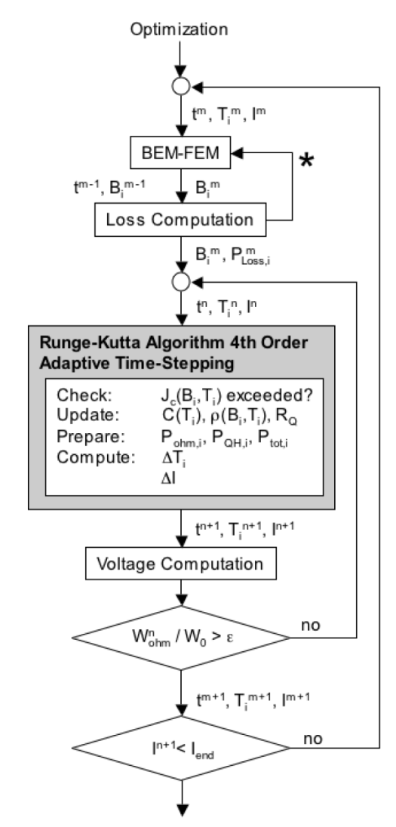
ROXIE Quench Module ID
Overview
Solve the heat equation by FEM
Programming
Developed by Nikolai Schwerg and Bernhard Auchmann
Validation
TQ , 11 T dipole
Availability From CERN with the ROXIE license
Some users
Bernhard Auchmann, Susanna Izquierdo Bermudez (CERN)
Tiina Salmi (LBNL)
Some References
N. Schwerg et al.,, IEEE Trans. On Magn., Vol. 44, N. 6, June 2008
N. Schwerg et al., IEEE Trans. On Appl. Supercond, Vol. 19, No. 3, June 2009

Slide 12
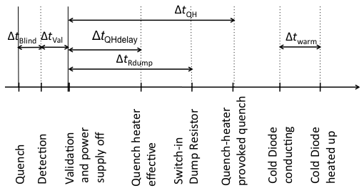
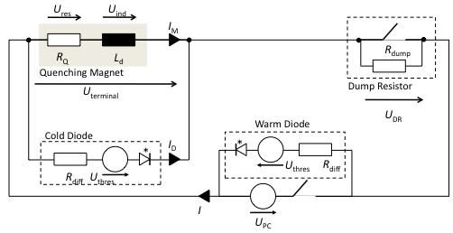
ROXIE - Description
N. Schwerg et al., “Quench simulation in an integrated design environment for superconducting magnets”.
IEEE Trans. on Magn., vol 44, June 2008.
R//
R_{//ext}
L_{ext}

Slide 13
ROXIE Description (II)
The heat equation is discretized by an equivalent thermal network model.
In the coil cross-section, each conductor corresponds to a node in the network
The thermal model considers:
cooling to a cold surface,
the influence of helium
heat sources due to ohmic heating,
quench heaters: no diffusion time computation
induced losses (which is a form of quench-back)
It is a 2D modeling, with the 3rd dimension longitudinal subdivision supplied by the user (not the details of coil-ends).

Slide 14
ROXIE Material properties
G. Manfreda, Review of ROXIE's material properties database for quench simulation, EDMS 1178007, Nov 2011
MATPRO:
collection of cryogenic material properties from Università degli Studi di Milano and Istituto Nazionale di Fisica Nucleare (INFN)
developed with the work, among the others, of Lucio Rossi and Massimo Sorbi.
database used by QLASA quench simulation code;
NIST: the official website of the National Institute of Standard and Technology contains a database of cryogenic material properties;
CryoComp:
collection of properties for materials commonly present in superconducting magnets.
version 5.1. CryoComp material properties are for example used in Qcode from Lawrence Berkeley National Laboratory.

Slide 15
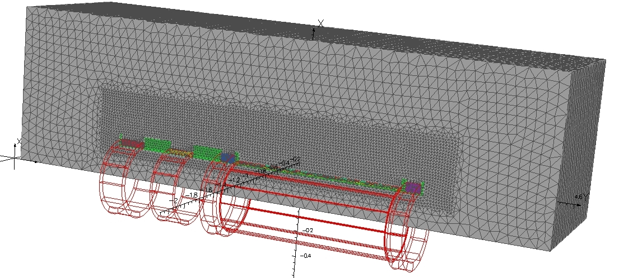
Cobham Vector Field – Quench Analysis Program
Overview
The Quench Analysis Program is one of the Analysis programs of the Opera-3D Analysis Environment.
Incorporates the non linear solution of the transient problem using the TEMPO-Transient Thermal Analysis
Can be coupled with ELEKTRA/TR analysis to model transient electromagnetic fields and external circuits
Validation
Wilson code, MICE spectrometer
Availability
$$ Cobham
Some users
Heng Pan (LBNL)

Slide 16
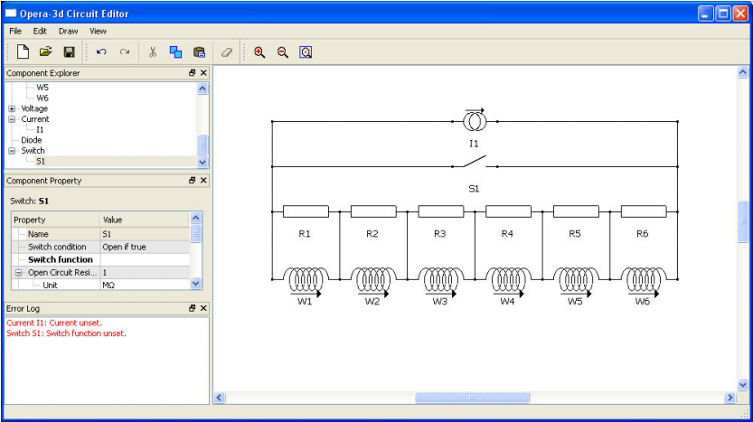
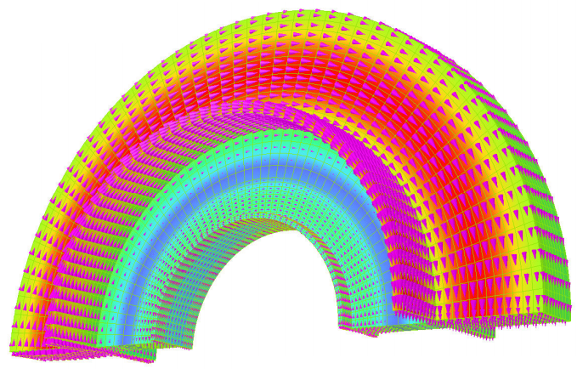
Vector Field Quench Analysis Program
Material properties need to be more referenced
Material properties used at LBNL: Cryocomp.
It has the advantages of a “commercial” specialized code: documentation, graphics, easy-accessibility…

Slide 17
FEM - ANSYS
Programming
FEM (thermal analysis)
Current externally guided (i.e. exponential decay, voltage constant, measurements…)
Calculates temperature and voltage distribution
Availability
$$ ANSYS
Some users
S. Caspi (LBNL), P. Ferracin (CERN), R. Yamada (FNAL)
Some References
S. Caspi et al., and published in “Calculating Quench Propagation With ANSYS”, IEEE Trans. Appl. Supercond, Vol. 13, No. 2, June 2003
P. Ferracin et al., “Thermal, Electrical and Mechanical Response to a Quench in Nb3Sn Superconducting Coils”, ”, IEEE Trans. Appl. Supercond, June 2004
Yamada et al. present a thermal – mechanical analysis in “2D/3D Quench Simulation Using ANSYS for Epoxy impregnated Nb3Sn High Field Magnets” in IEEE Trans. On Applied Superconductivity, Vol. 13, No. 2, June 2003

Slide 18

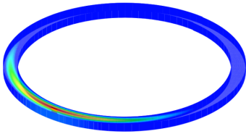
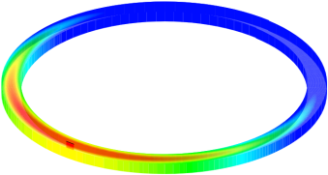
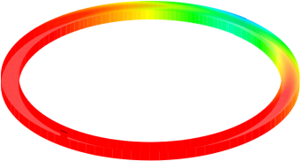
FEM CAST3M- ID
Overview
Finite element code developed and used at CEA
Compute eddy currents in coil casing → quenchback
Use FEM thermal analysis for heat diffusion & quench propagation
Programming
FEM
Validation: CMS, RD3b
Availability: Free
Some users: Philippe Fazilleau (CEA)
Some References
-P.Verpeaux, T. Charras, and A. Millard,“CASTEM 2000 une approche moderne du calcul des structures,” in Calcul des structures et intellig. artificielle, Pluralis, 1988, pp. 261–271.
-P. Fazilleau et al. “The R3B-GLAD Quench Protection System”, IEEE Trans. On Applied Superconductivity, Vol.. 20, No. 3, June 2010
Simulation de propagation dans une bobine d’YBCO
(champ de température)

Slide 19
In summary
A NON EXHAUSTIVE list of codes
Many labs. have their own developed code
Need to pick the right code fitting the user’s goals
  Adiabatic code → very fast results (for parametric study)
  FEM code → time consuming (detailed 3D analysis)
Most of the codes are free and accessible but some might lack of documentation
Need the validation with experimental data for HTS

