Slide 1
Recent progress of coil applications using DI-BSCCO wires at Sumitomo Electric
Kazuhiko Hayashi
Superconductivity Technology Division
Sumitomo Electric Industries, Ltd.

Slide 2



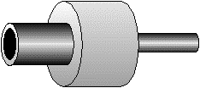
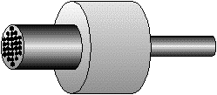
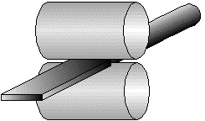
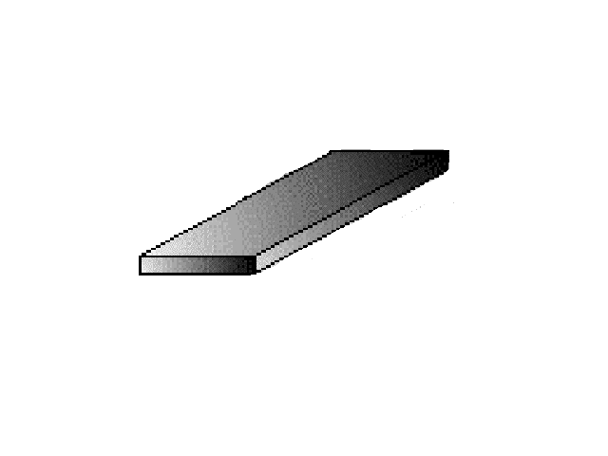
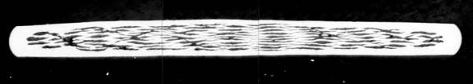
Bismuth-based high temperature superconducting wire production process (BSCCO;Bi2Sr2Ca2Cu3O10)
Powdery process
Processing process
Sintering process
Sintering
Sintering
Powder
Filling
Single core wire drawing
Stack
Multifilament wire drawing
Primary rolling
Primary sintering
Repetition
Silver pipe for outer sheath
The second rolling
The second sintering
Silver pipe
Tape wire rod
Crush
Pressurization sintering:
Total control of temperature, pressure, the atmosphere
ConTrolled OverPressure Sintering

Slide 3
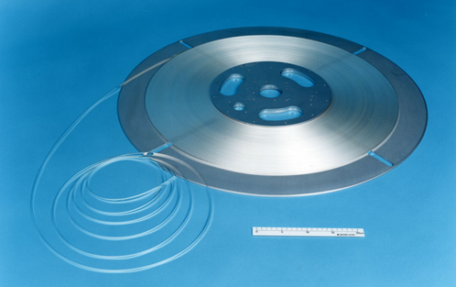
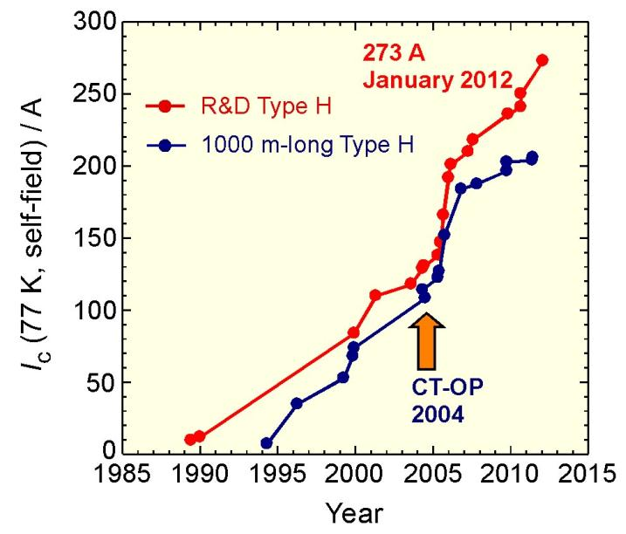
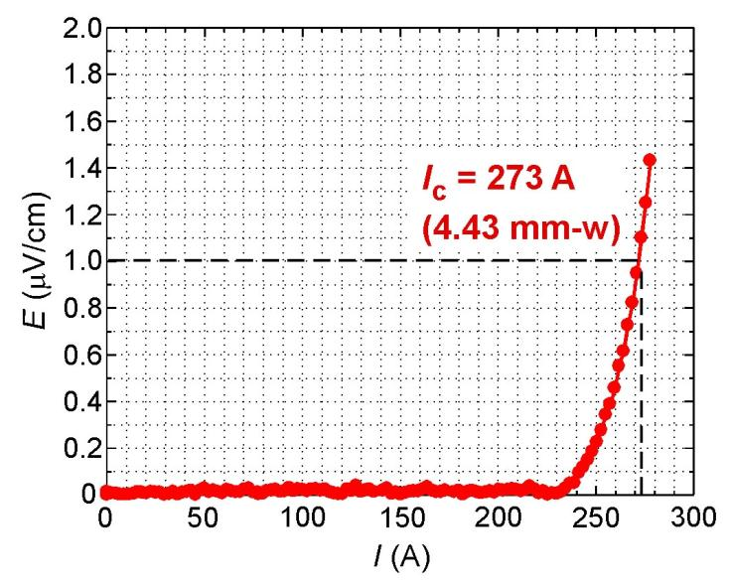
Performance enhancement of the bismuth-based HTS wire
Ic: 273A (@ 77K, s.f)
Jc: 77kA/cm2
→613 A/cm-width
Notes:
7
7

Slide 4
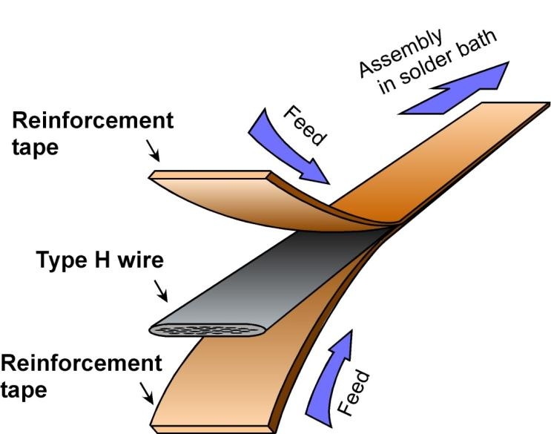
Type HT (mechanically-reinforced Type H)
Process of lamination
Bare wire (Type H)
Type HT-SS
(Reinforced with Stainless Steel)
SS
SS
Type HT-CA
(Reinforced with Cu-alloy)
Cu-alloy
Cu-alloy
Type HT (Type H with Toughness) is laminated with reinforcement tapes.
They are firmly bonded with Type H, and de-lamination never occurs,
as long as the wire temperature is kept below 200ºC.

Slide 5
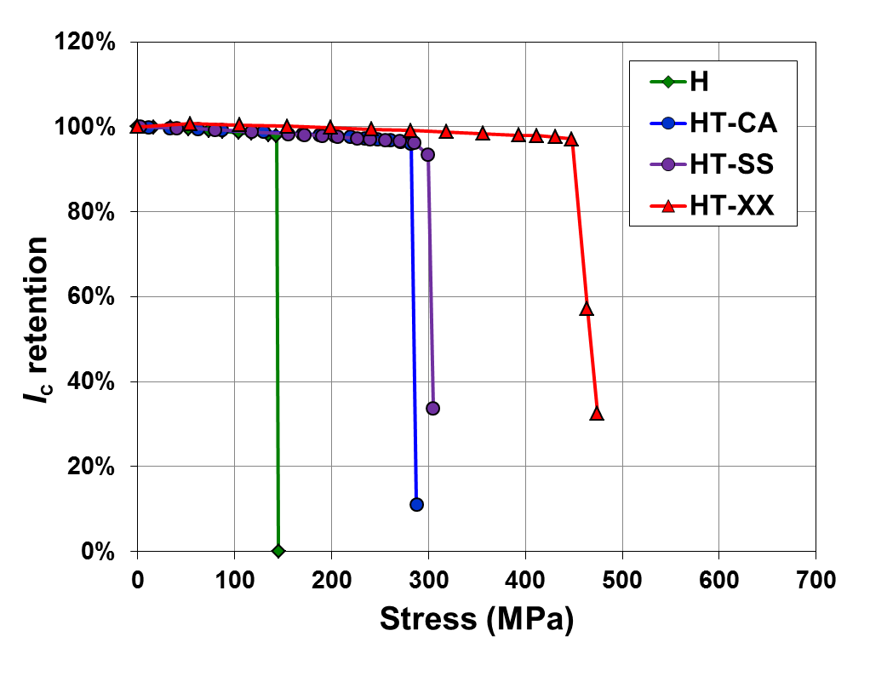
Specifications of DI-BSCCO wire
 | Type H | Type HT-SS | Type HT-CA | Type HT-XX
Width | 4.3+/-0.3mm | 4.5+/-0.3mm | 4.5+/-0.3mm | 4.5+/-0.3mm
Thickness | 0.23+/-0.03mm | 0.30+/-0.04mm | 0.36+/-0.04mm | 0.29+/-0.04mm
Reinforcement | － | SS | CA | XX
Allowable tension * (RT) | 80N ** | 230N ** | 280N ** | 410N **
Allowable stress * (77K) | 130 MPa ** | 270 MPa ** | 250 MPa ** | 430 MPa **
Allowable strain * (77K) | 0.2% ** | 0.4% ** | 0.3% ** | 0.5% **
Allowable bending diameter * (RT) | 70mm ** | 60mm ** | 60mm ** | 40mm **
* Correspond to 95% of critical currents * * Reference

Slide 6
R&D for Higher Strength Wire
TypeHT
(ss100)
TypeHT
(ss80)
TypeHT
(ss50)
TypeHT
(ss20)
DI-BSCCO TypeHT wire with stainless steel tapes
Stainless steel tape thickness | Critical Tensile Stress (77K) | Critical Double Bend Diameter (RT) | J_{e} (ex. I_{c}=200A)
20μm | 285MPa | 40mm | 157A/mm²
50μm | 360MPa | 38mm | 131A/mm²
100μm | 460MPa | 34mm | 102A/mm²

Slide 7
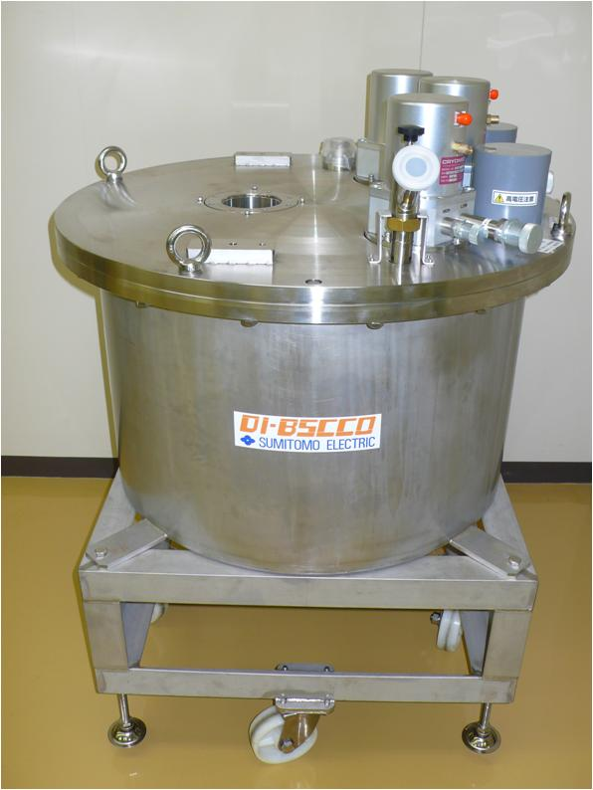
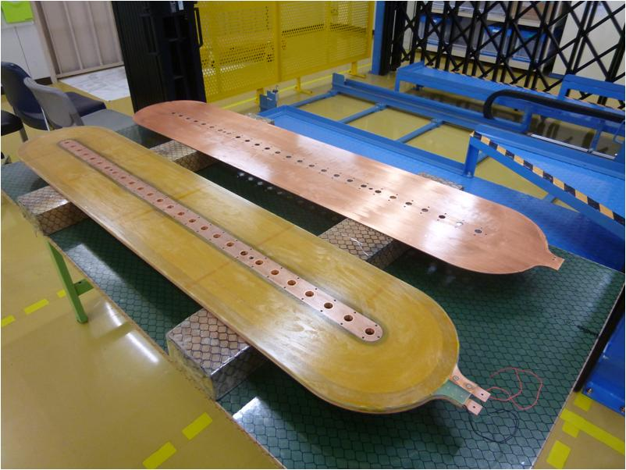
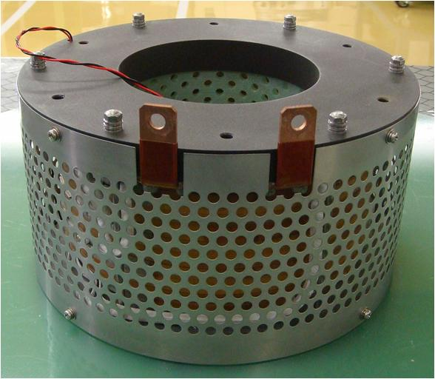
Refrigerator cooling type
Magnet system
Liquid nitrogen cooling
Magnet
Coil for the rotating machine
1,620mm
320mm

Slide 8
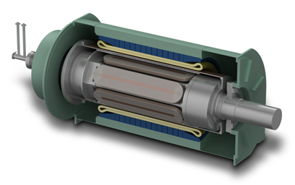
3 MW HTS ship motor
He Gas
Stator
Rotor
Manufactured by Kawasaki Heavy Industries
superconducting coil
HTS coil
● Rated output 3 MW
● Rotating speed 160 rpm
● Efficiency 98%
● Fuel saving 18%
● Torque density 40 kNm/m³
The 3 MW HTS motor with DI-BSCCO field coils succeeded in load test, and achieved the high efficiency of 98% with half the size of a conventional motor.
This study was supported by New Energy and Industrial Technology Development Organization (NEDO) of Japan.

Slide 9
Field coils for 3 MW HTS motor
● Coil number 24 coils / 6 poles
● DI-BSCCO wire 70km / 24 coils
● Total turn 21,600 turns
● Rated current 200A at 30 K
● Magnetic field 5 T
1,620mm
Type HT-SS
320mm
Type H
To endure small-diameter bending, the inner winding is Type HT-SS.
To increase current density, the outer winding is Type H.
This study was supported by New Energy and Industrial Technology Development Organization (NEDO) of Japan.

Slide 10
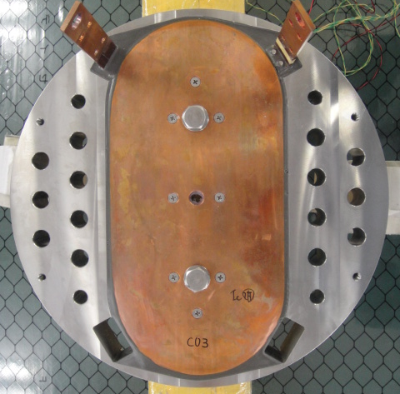
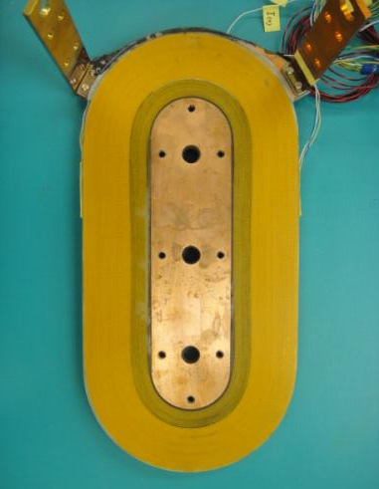
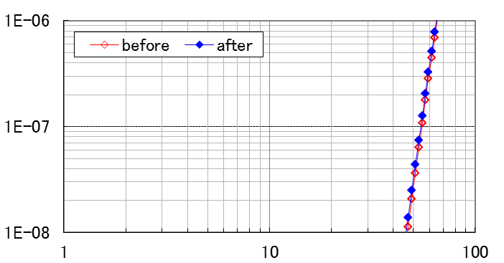
Long-term durability test
Test Coil
Reinforced with stainless steel case
Peel stress
Peel stress
Type H
Type HT-SS
Coil temperature | 4.2 K
Backup field | 4.2 T
Coil current | 0 ⇔ 330A
Applied stress | 43 MPa = rated stress (29 MPa) x 1.5
Number of cycle | 2,400 Equivalent to 20 years operation
No Degradation
Electric Field (V/cm)
77 K
Current (A)
This study was supported by New Energy and Industrial Technology Development Organization (NEDO) of Japan.

Slide 11
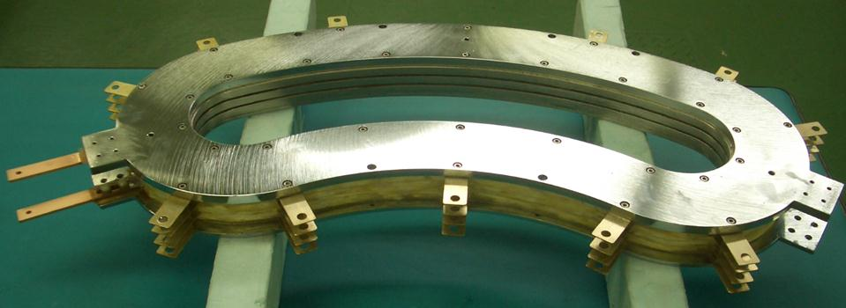
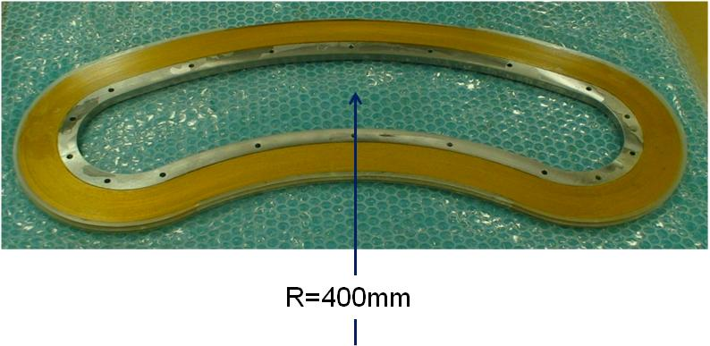
Deflection magnet
Coil for Osaka university
Notes:
Proton beam, heavy particle wire
A radius of an orbit: A 400mm inclination angle: 60˚ magnetic pole gap: Inspection laminating York of the 30mm cold pole interchange excitation
A wire rod: DI-BISCCO Type-HT(SS20)
0.46*0.36
12.5μm polyimide (half lap)
The coil reel number: 600*2 turn
Coil temperature: 20K
A critical electric current:
A wire rod: 160 ~ 178A
D. P.: 60 ~ 70A
A coil: 47A, 51A

Slide 12
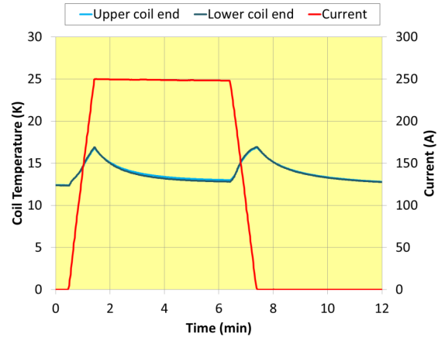
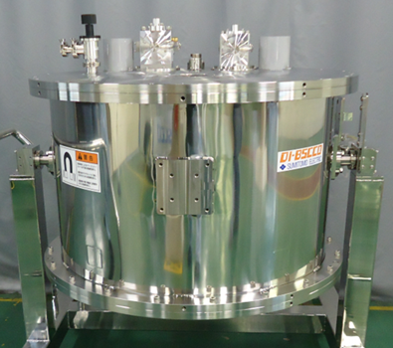
Refrigerator cooled magnet
+/-5 Tesla /φ100 mm
+/-5.7 Tesla /φ150 mm
 | A | B | C | D
Center field | +/-5 T | +/-10 T | +/-5.7 T | +/-5 T
R.T. bore | 100 mm | 100 mm | 150 mm | 300 mm
Iop | 175A | 250A | 250A | 250A
Inductance | 4 H | 11 H | 5H | 20 H
Storage Energy | 61 kJ | 344 kJ | 156 kJ | 625 kJ
Sweep rate | 5 T / 30s | 10 T / 10 min. | 5 T / 50s | 5 T / 180s
Wire type | Type H | Type HT-SS, Type H | Type HT-SS, Type H | Type HT-SS, Type H
Notes:
Φ300-5Tφ100 X L100, magnetic field less than +-2%, skew less than +-1 degrees
Φ100-10T 30mm corner *30L, magnetic field less than +-1%
Φ150-5.7Tφ75 *60L, magnetic field less than +-3%, skew less than +-2 degrees

Slide 13
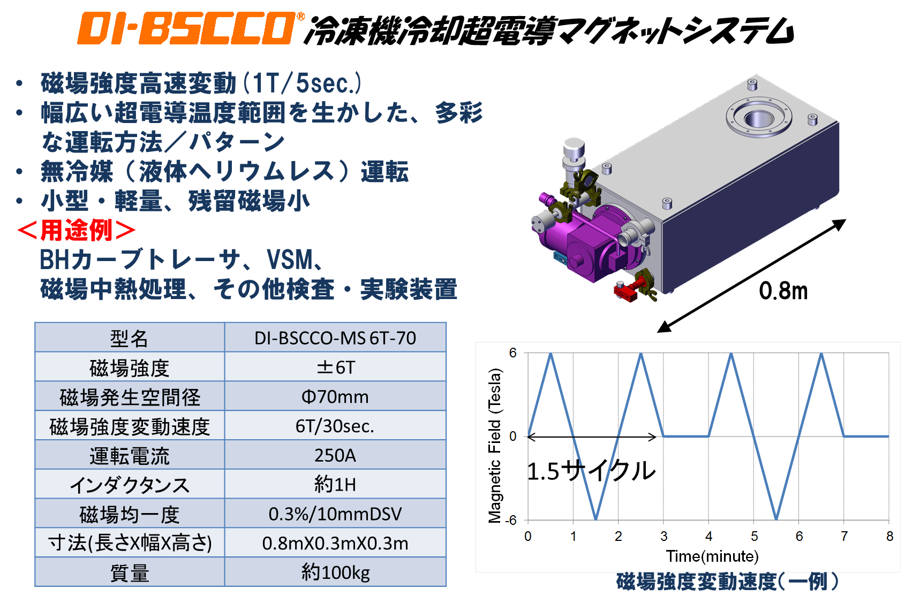
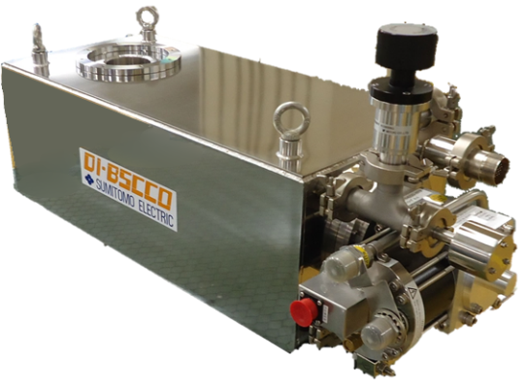

Compact magnet system
Fast sweep rate (1T / 5 sec.)
A wide variety of operating methods and patterns
No refrigerant
Compact, light, and low residual field
< Use application >
BH curve tracer, VSM, Field annealing, Test, Experiment
0.8m
Model name | DI-BSCCO-MS 6T-70
Field strength | ±6T
R.T. bore | Φ70mm
Sweep rate | 6T/30sec.
Operating current | 250A
Inductance | about 1H
Field homogeneity | 0.3%/10mmDSV
Size | 0.8mX0.3mX0.3m
Weight | About 100kg
1.5 cycles

Slide 14
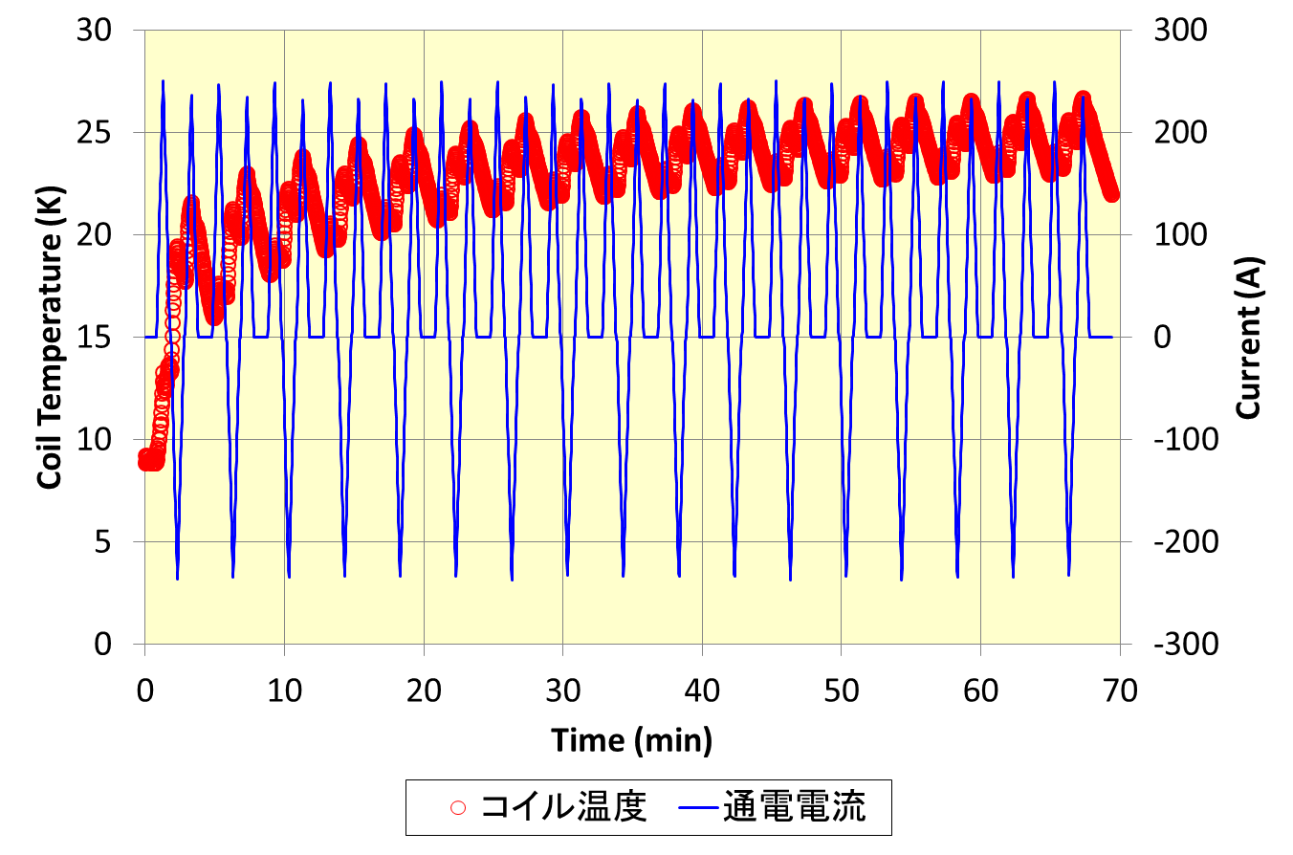
6 Tesla - 70 mm magnet
Temperature change
3 minutes / 1.5 cycles + 1 minute interval
○ Coil temperature
－ Operating current

Slide 15
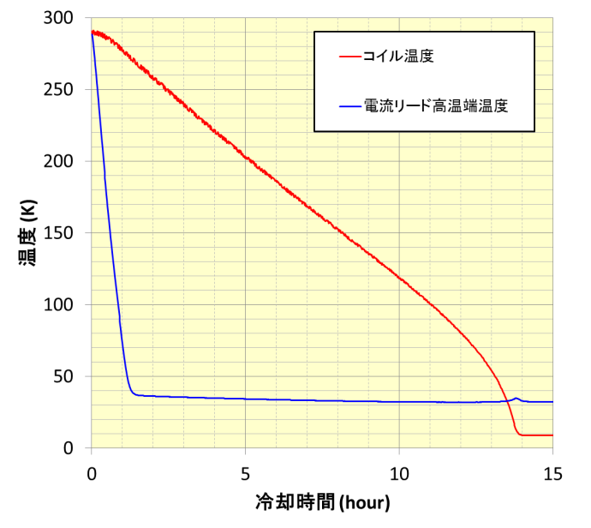
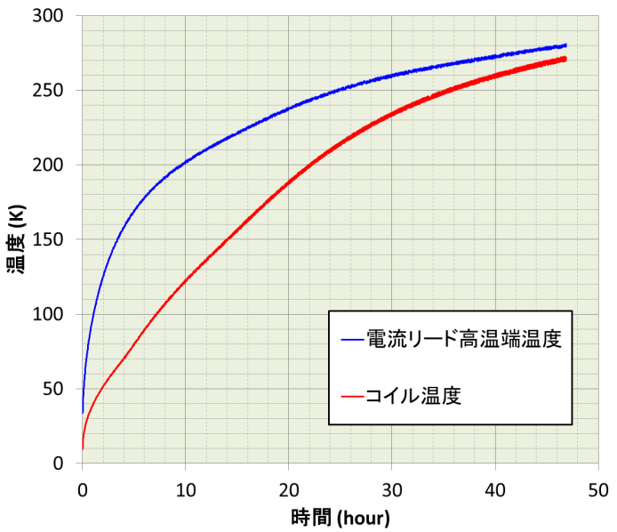
6Tesla - 70mm magnet
－Coil
－1st stage
Temperature (K)
Temperature (K)
－Coil
－1st stage
Cooling time (hour)
Cooling time (hour)
Coil can be cooled down in a night.

Slide 16
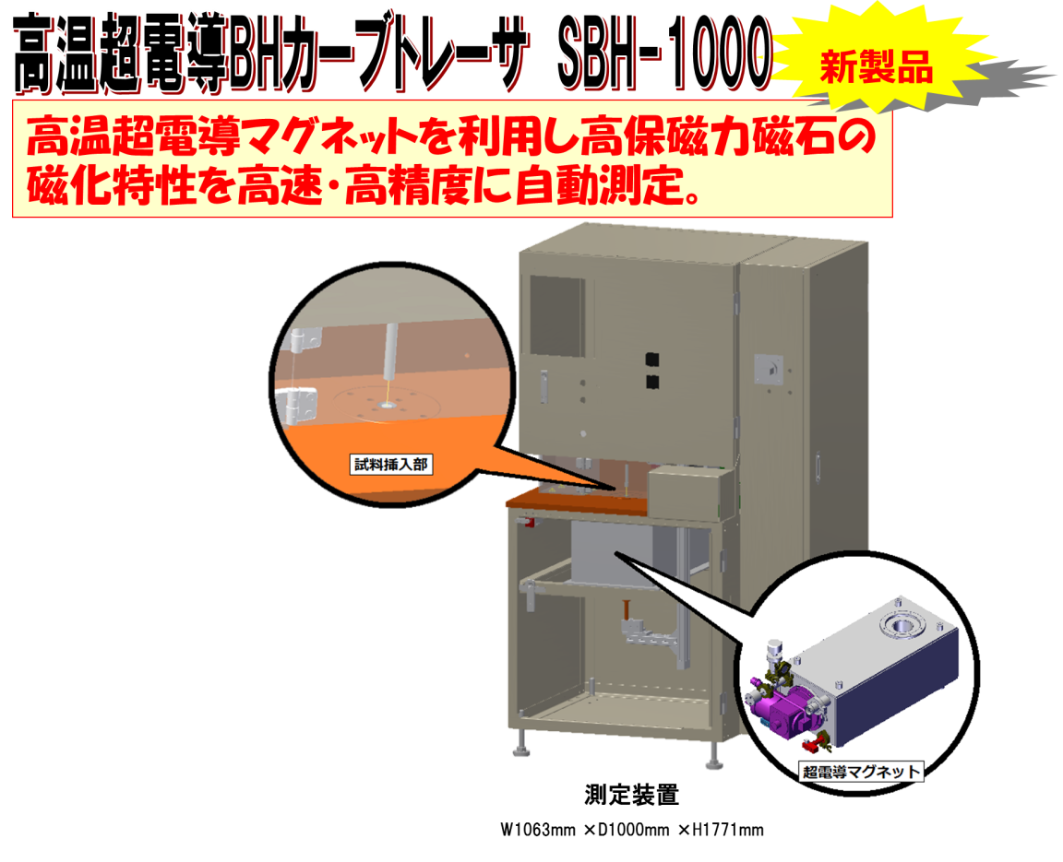

NIHON DENJI SOKKI Co., Ltd HTS BH curve tracer

Slide 17
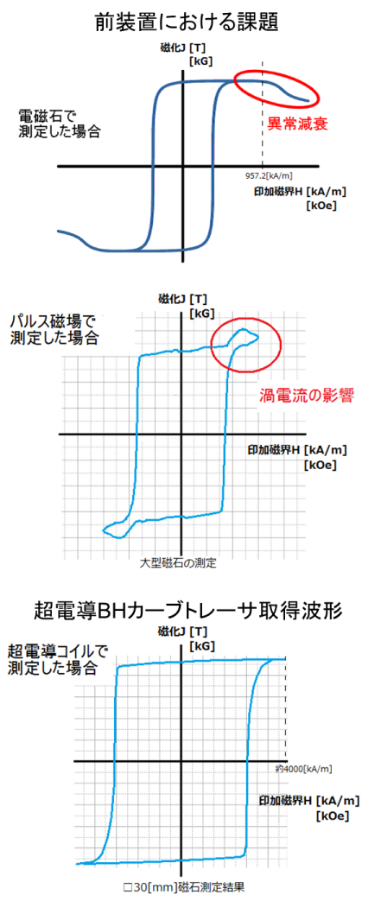
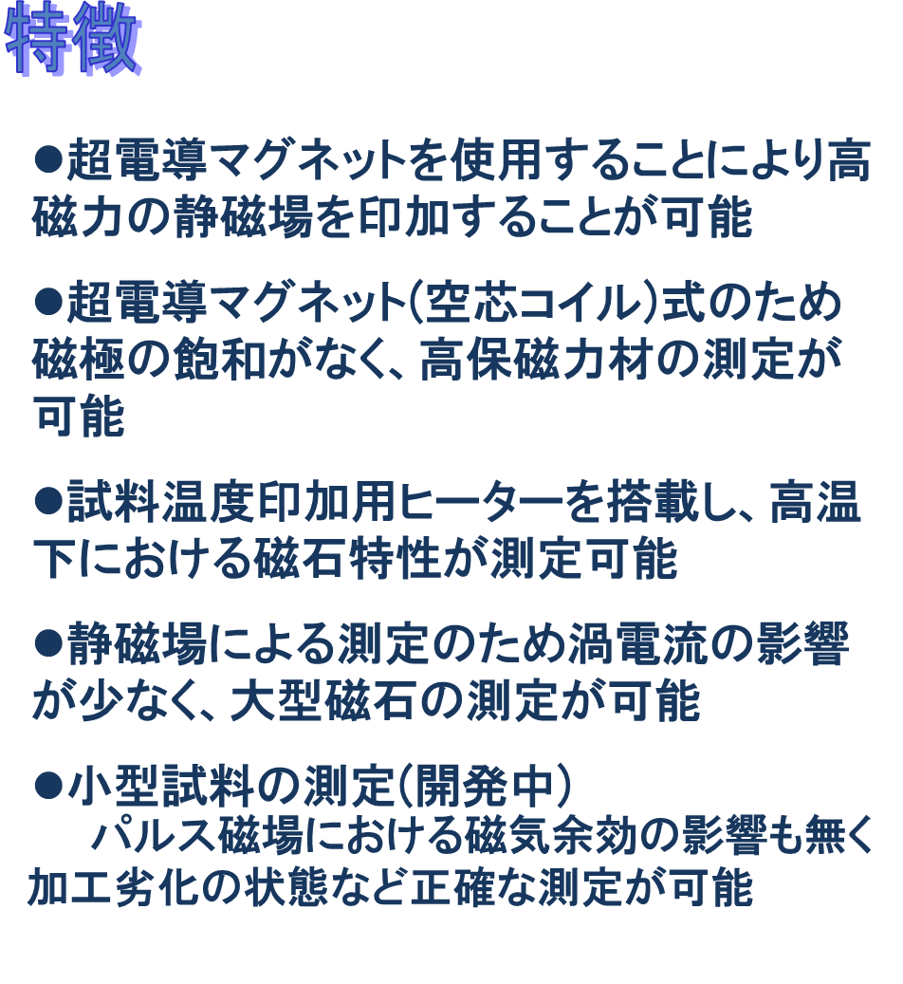
NIHON DENJI SOKKI Co., Ltd HTS BH curve tracer
Previous problems
Features
Static magnetic fields can be applied by HTS magnet
Air core HTS magnet allows magnets with a high coercive force to be measured owing to no saturation of magnetic poles.
Magnetic properties at a high temperature can be measured.
Static magnetic fields allow large-sized magnets to be measured because of little influence of eddy currents.
Measurement of a small-sized specimen (under development)
Precise measurements such as degradations after processes are possible because of no influence of magnetic aftereffect by a pulse field.
Magnetization J[T]
Electric magnet
Abnormal
attenuation
Field H[kA/m]
Pulse magnet
Magnetization J[T]
Influence of eddy current
Field H[kA/m]
Measurements of large-sized magnet
Wave form with HTS BH curve tracer
HTS magnet
Magnetization J[T]
Field H[kA/m]
Measurements of l30 mm squared magnet

Slide 18
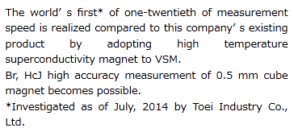
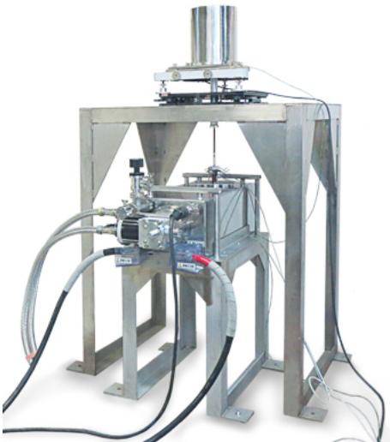
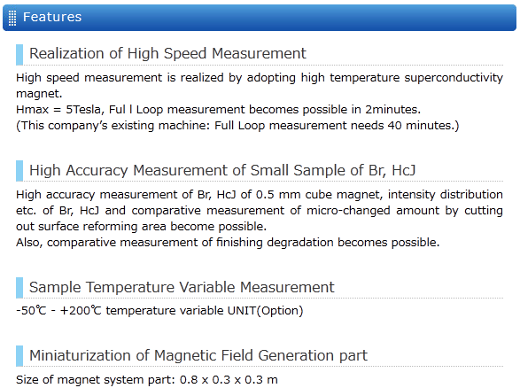
Toei Industry Co., Ltd adopted HTS VSM
High speed
High accuracy
Compact
Refer to http://www.toeikogyo.co.jp/english/products/sei-01/vsm-5hsc.html
VSM is a device measuring the magnetization characteristic of the sample by vibrating the sample in the uniform magnetic field at a constant frequency and an amplitude, and by detecting electromotive force evoked by the detection coil which is located in the neighborhood of the sample using PSD (Phase Sensitive Detector phase sensitive detection).

Slide 19
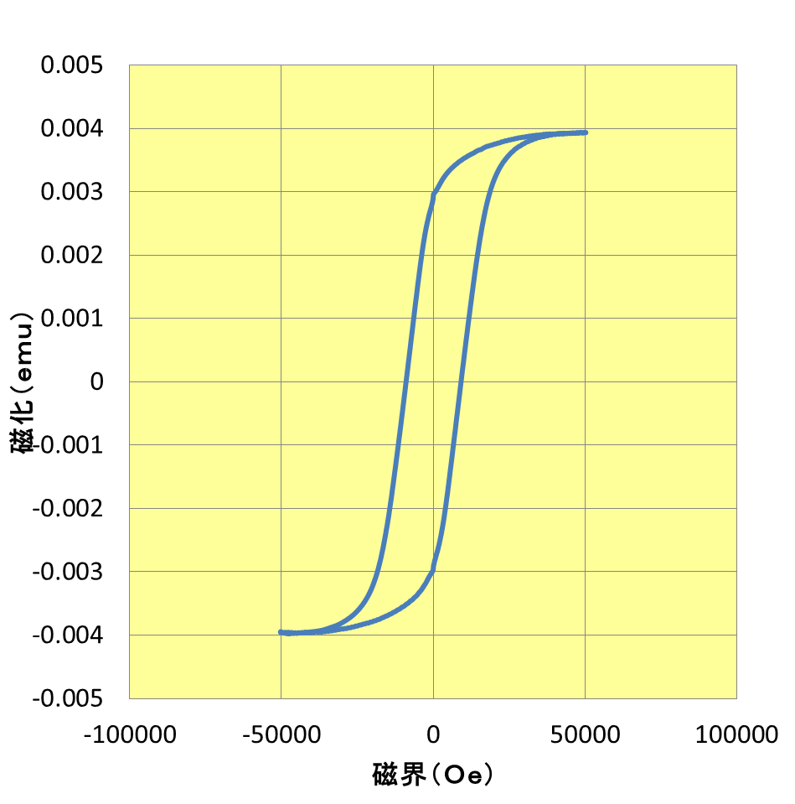
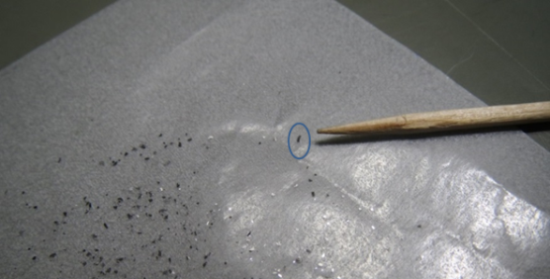
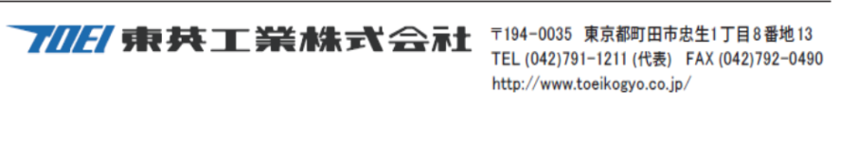

Measurement of extremely small Sm-Co by HTS VSM
Magnetization (emu)
SmCo
Ms = 0.00383 emu
Mr = 0.00293 emu
Hc = 9153 Oe
Measurement time 6 minutes
Use of DI-BSCCO magnet
Field (Oe)

Slide 20
Example of protection circuit
With protective circuit reducing a magnetic field in a short time in case of the abnormality such as a blackout or a breakdown.

Slide 21
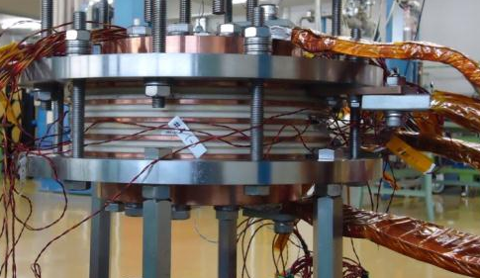
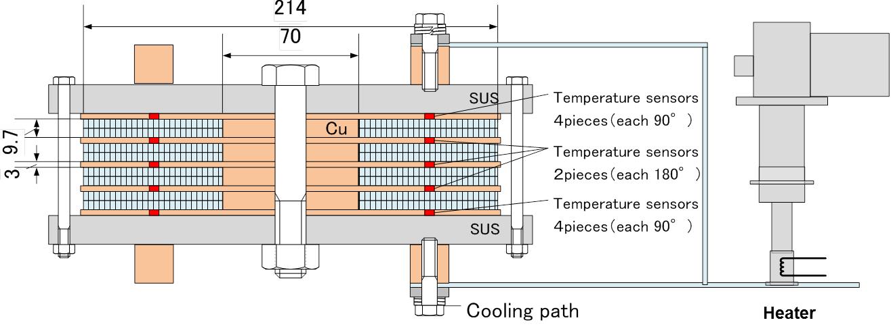
DI-BSCCO coil for quench protection tests
This study was supported by Japan Science and Technology Agency (JST) of Japan.
Notes:
20mw機と同じ構成とした。
本来はロータ中心側からの冷却との話だが、試験をより厳しくするために上下伝導冷却

Slide 22
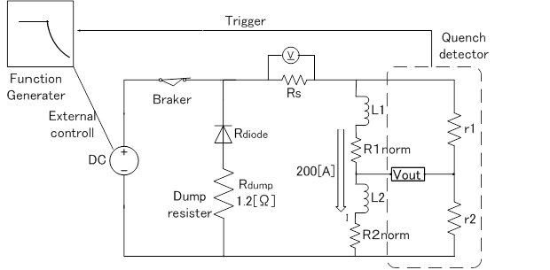
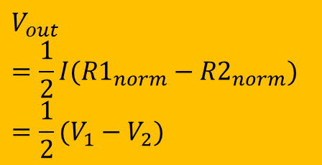
Experimental methodology
$$V_{out}$$
$$=\frac{1}{2}{I(R1}_{norm}−{R2}_{norm})$$
$$=\frac{1}{2}(V_{1}−V_{2})$$
Operation current | 200 A
Quench detection | Detection voltage is parameter. Detection time is 0.1sec.
Quench generation | Raise the coil temperature from 35K
Current decay | External control with wave form generation I(t)=200A×exp（-t/τ） τ= 4, 10, 20, 60 sec.
This study was supported by Japan Science and Technology Agency (JST) of Japan.

Slide 23
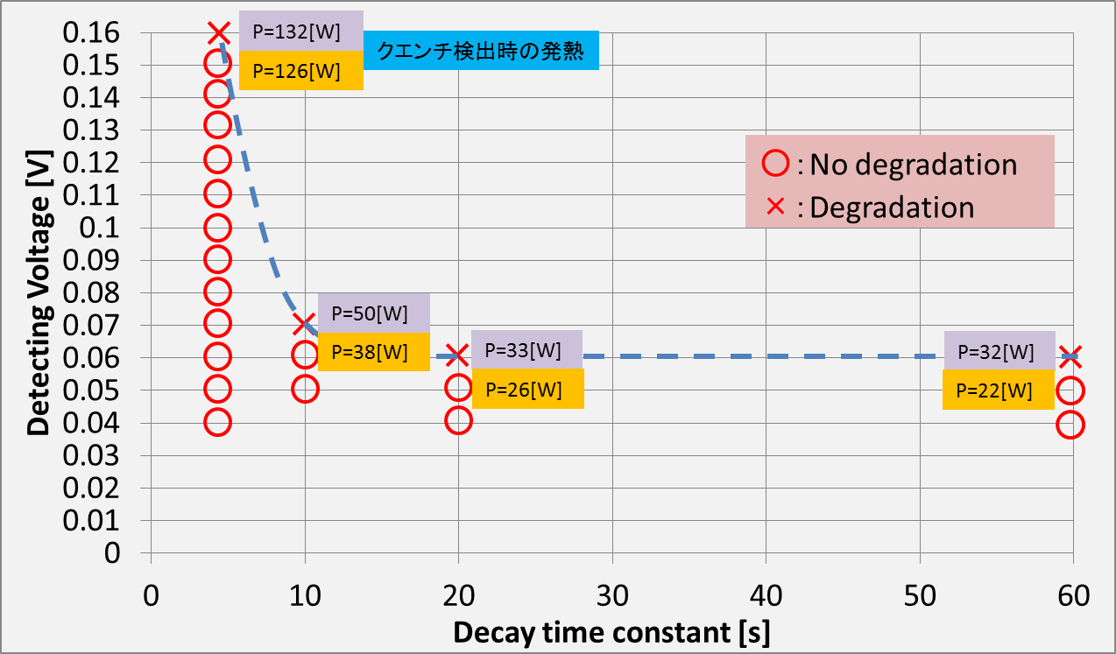
Results of quench protection tests
P is heat generation of coil at quench detection.
This study was supported by Japan Science and Technology Agency (JST) of Japan.

Slide 24
Large-diameter magnet (1)
A design of 5 T – φ 300 magnet
z
Type HT-SS
Type H
Calculated hoop stress (BJr)
r
Coil center
The inner 55% of the total wire length is Type HT-SS and the outer 45% is Type H, not to exceed each allowable stresses (designed values).

Slide 25
Large-diameter magnet (2)
A design of 5 T – φ 500 magnet with Type HT-XX
Type HT-SS
z
Type HT-XX
Type H
Hoop stress (BJr)
r
Coil center
The inner 44% of the total wire length is Type HT-XX, the medium 24% is Type HT-SS, and the outer 32% is Type H.
Type HT-XX will realize higher field and/or larger-size magnet.

Slide 26
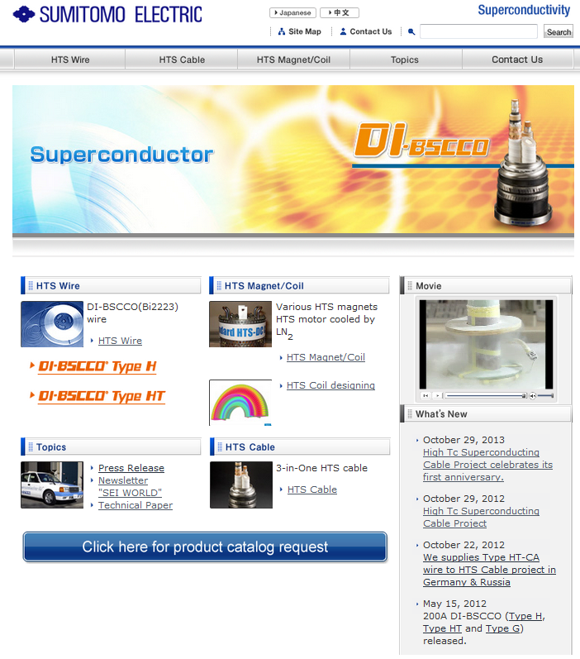
Thank you for your attention.
Please utilize our WEB site.
www.sei.co.jp/super/

