Slide 1
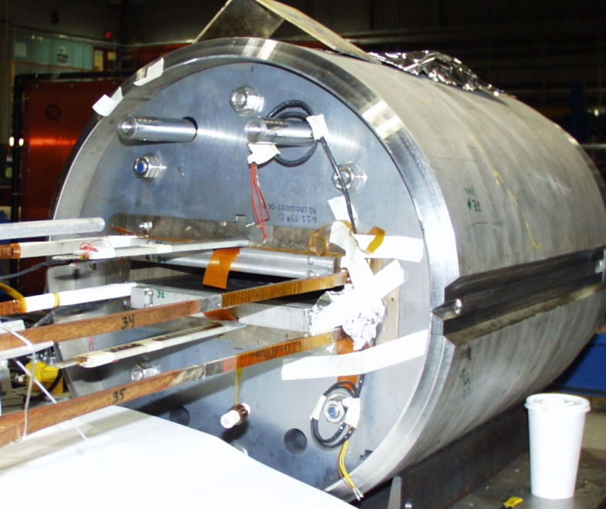
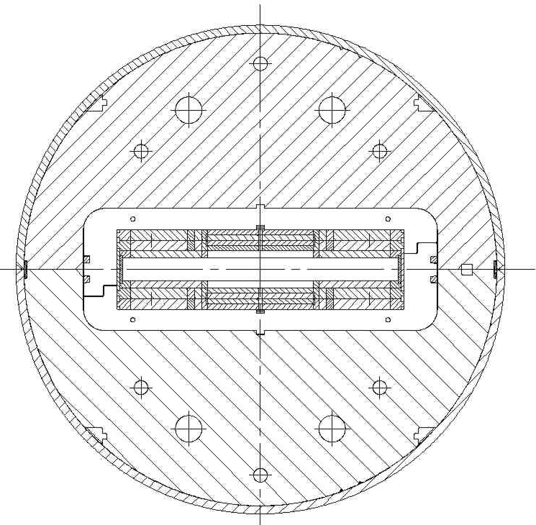
Hybrid Magnet Test Opportunity
A 20 T dipole will be a hybrid HTS/LTS magnet.
We measure short sample in background field, which gives useful but not complete information.
Testing of short coil in background field would give information on field quality (magnetization), and magnet operation, etc. That would provide feed back to machine physicists and to magnet designers.
However, it is generally expensive and time consuming to do such coil tests in the background field of magnet.
Fortunately, there is a possibility to commission such a facility where an HTS coil can be tested as somewhat similar to testing the short sample.
The 10+ T Nb₃Sn magnet shown on the right has large open space for insert coil testing (~200 mm wide and ~30 mm high) without opening it for fast turn-around.
This should play a useful role in FCC magnet R&D.
The HTS coil becomes a part of the hybrid test magnet.

