Slide 1

Coated conductors being used at the NHMFL are (not yet anyway) uniform
Data provided by Dmytro Abraimov (32 T testing), and further selected samples by Lidia Rossi, Xinbo (Paul) Hu Jan Jaroszynski and Tak Kametani
David Larbalestier
Data taken from D Abraimov(WAM-HTS Hamburg talk) and Lidia Rossi (MS thesis, University of Paris Marie Curie, June 2014 with stage at NHMFL Jan-Jun 2014)

Slide 2
Simple points
Procurements have taken place over about 3 years
SF 77K is not sufficient to specify conductor for any of our high field coils
We have invested strongly in characterization capabilities
Many variations are seen, more than those whose cause is understood!

Slide 3
The 32 T procurements show a very wide range of behavior even though supposed to be identical (each end short samples)
Abraimov WAM-HTS Hamburg

Slide 4
Self field 77 K does NOT provide good prediction of 4 K high field properties
Q: How do we (or the manufacturer) understand better such scatter?
Partial A: in field at 77 K is better………
Abraimov WAM-HTS Hamburg

Slide 5
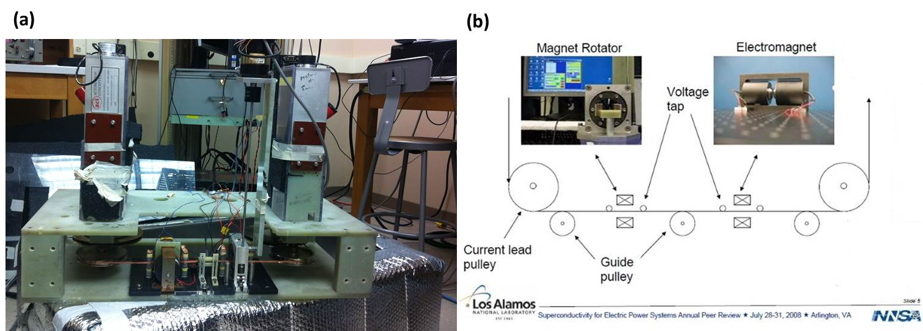
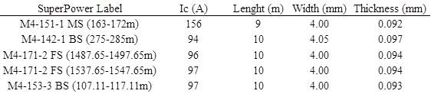
Lidia Rossi MS thesis

Slide 6
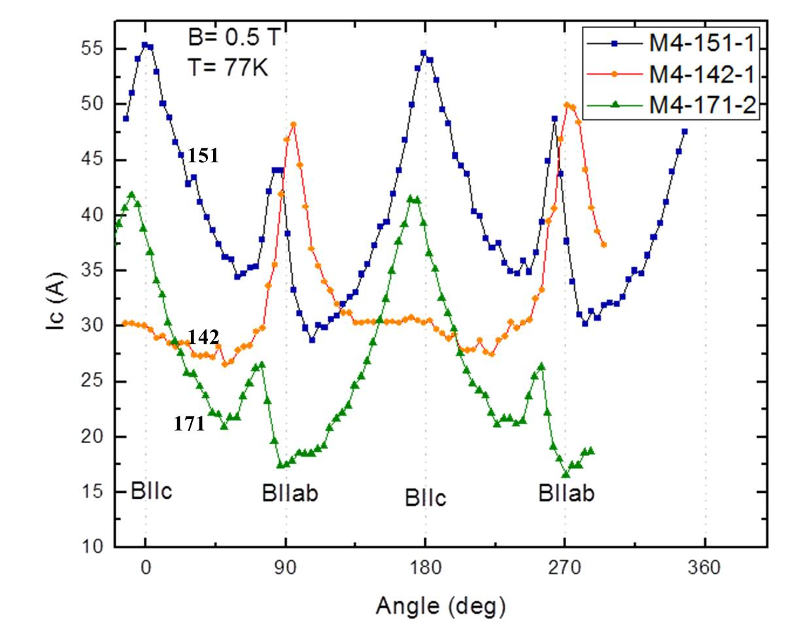
Select 5 from 100….
Lidia Rossi MS thesis

Slide 7
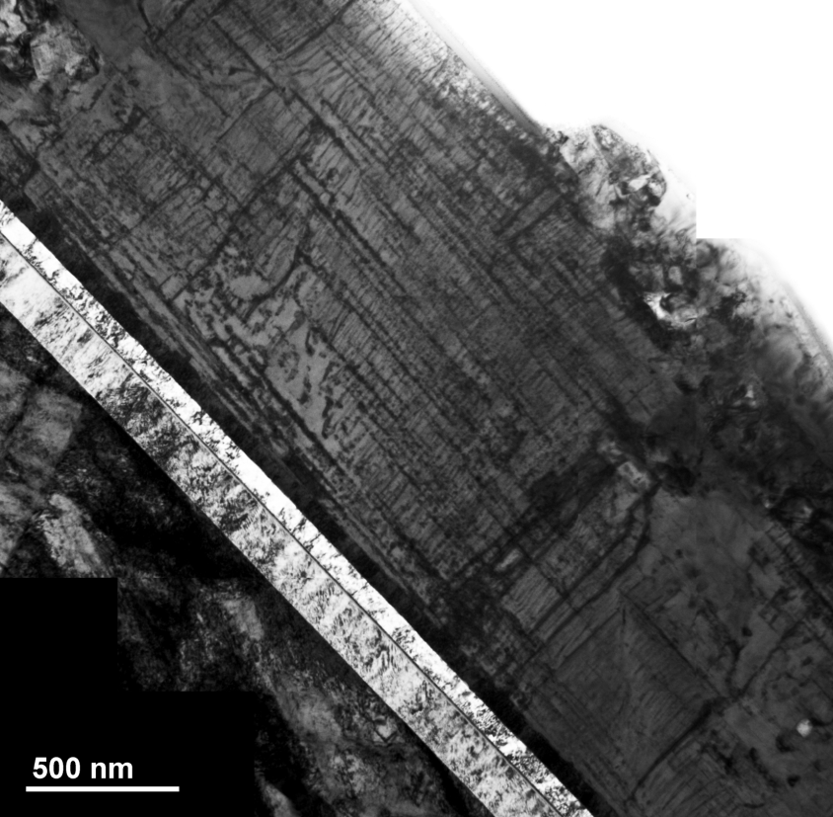
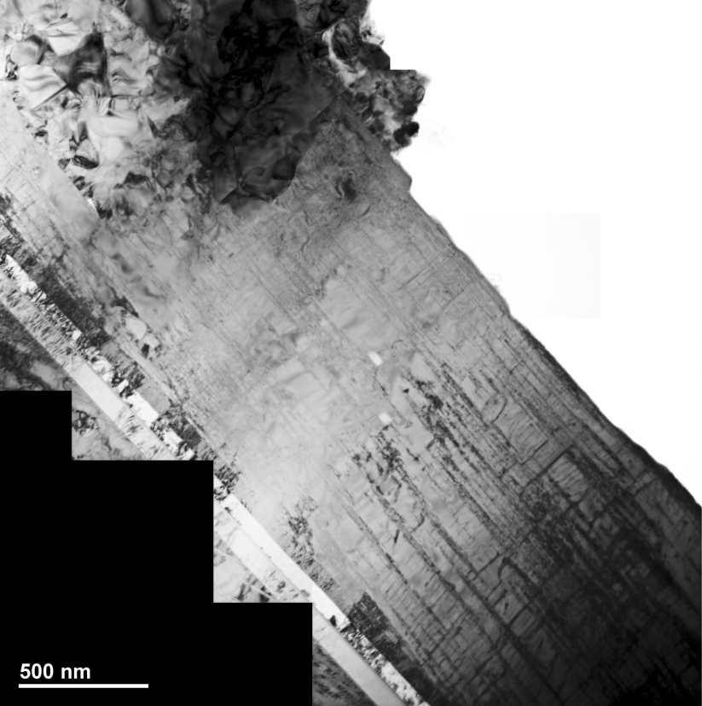
TEM by Fumitake Kametani
M4-151
M4-142
M4-171
Conductor Ic at 0.5 T, 77 K | M4-151 | M4-171-4 | M4-142 | Comment
B parallel ab | 44 A | 26 A - lowest | 47 A - highest
B parallel c | 55 A - highest | 42 A | 30 A - lowest
microscopy | Dense c-axis BZO and ab-plane Re2O3 | Fewer BZO c rods and many fewer ab- plane Re2O3 | Few c-axis BZO nanorods with dominant ab plane ppts.

Slide 8
Conclusion
Both extrinsic and intrinsic defects control Ic in coated conductors and both types are present.
In situ REBCO growth, especially with strong vortex pinning defects like BaZrO3 (BZO) is VERY susceptible to local growth perturbations that affect Jc(B, T, θ) and Ic(x)
The right tools – multiple ones – are needed to sort them out

