Slide 1
Report from WAMHTS-1 in Hamburg @ EuCARD2 CM
Lucio Rossi
With contribution from L. Bottura and L. Cooley and other participants

Slide 2
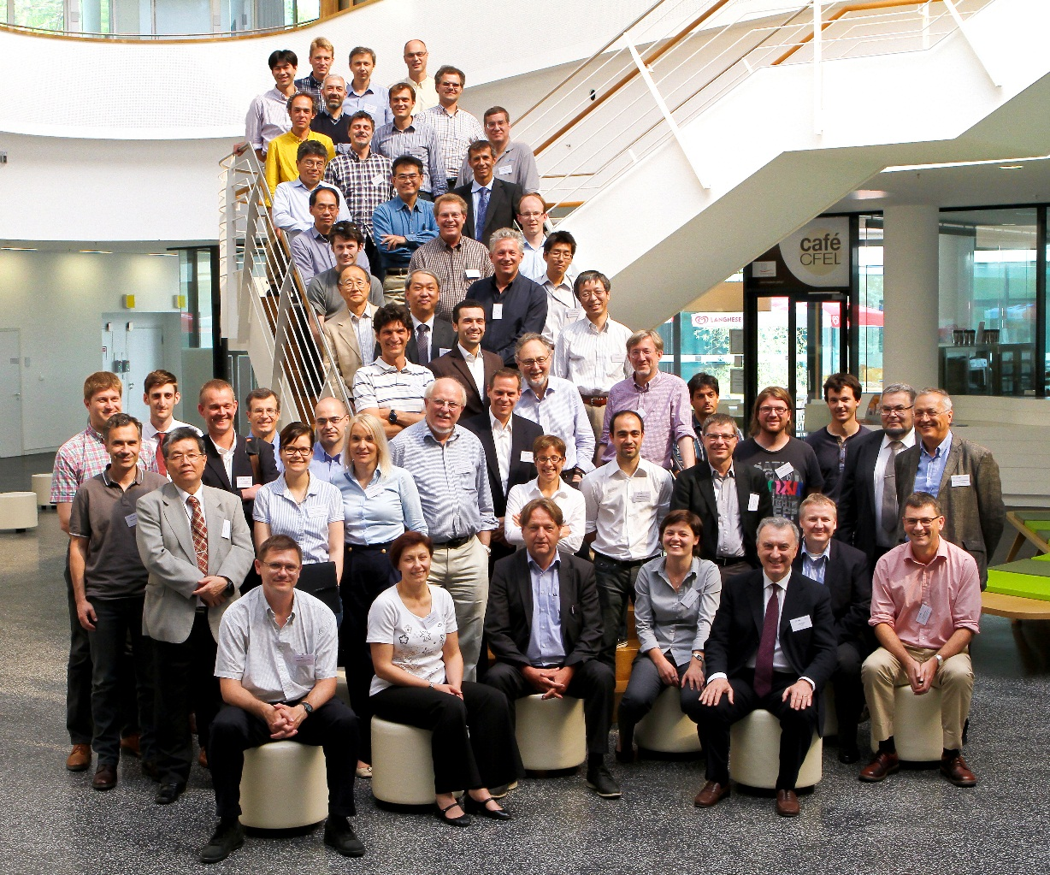
WAM HTS – 1 General
Triggered by HE-LHC, alter FCC-hh
  EuCARD²
Following tradition of WAMS and WAMSD, it has been the 1st dedicated to HTS technology for Accelerator Magnets.
Aim was to provide a forum where material scientists, conductor designers, and magnet engineers, all meet, also with Industry.
57 participants in WAMHTS-1 in Hamburg

Slide 3
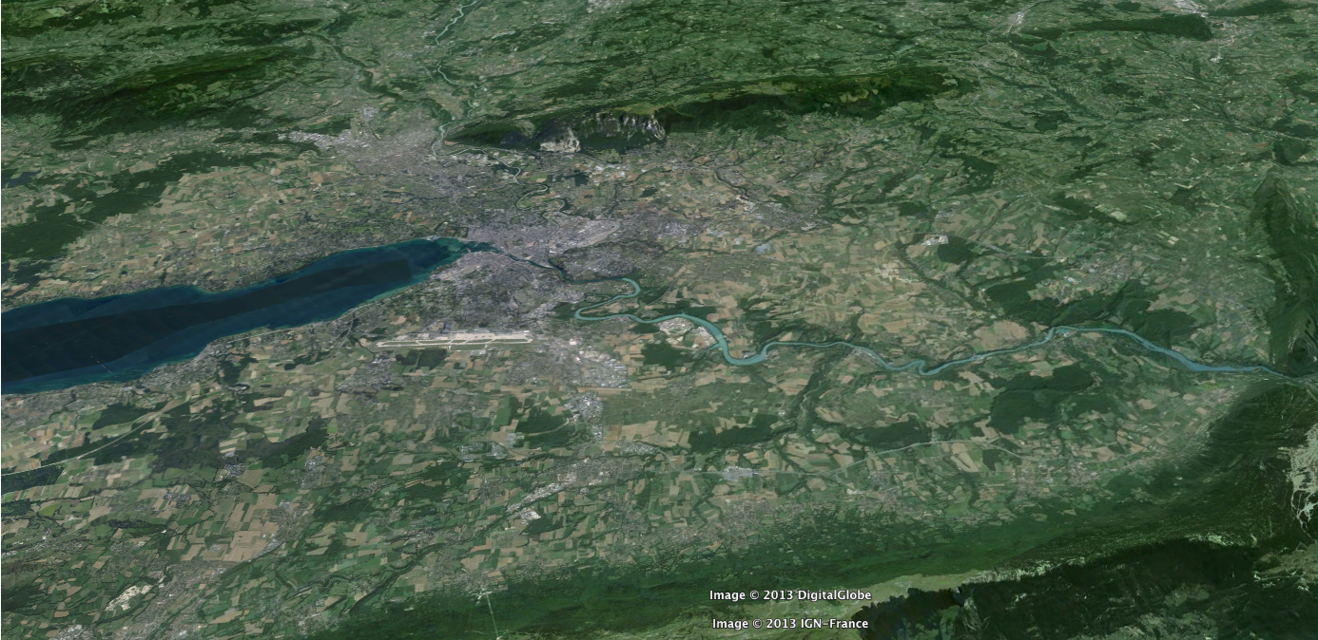
The FCC-hh is the main goal (but not the only one )
Geneva
PS
SPS
LHC
L. Bottura at WAMHTS-1
LHC
27 km, 8.33 T
14 TeV (c.o.m.)
HE-LHC
27 km, 20 T
33 TeV (c.o.m.)
FCC-hh
80 km, 20 T
100 TeV (c.o.m.)
FCC-hh
100 km, 16 T
100 TeV (c.o.m.)

Slide 4
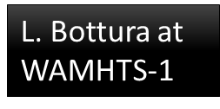
A summary
HTS for field (MB)
  Attain o(20) T, reducing length and civil engineering in the main dipoles, and providing ad-hoc solutions for specific regions (e.g. function similar to the LHC 11 T Nb₃Sn dipole). Only HTS can do this
HTS for operating margin (D1)
  The FCC IR and collimator regions will be a “hell of a place”, with particles and energies never experienced before. Radiation tolerance, heat removal and temperature margin will be paramount to reliable operation. HTS can do this
HTS for low consumption (booster/injector)
  The FCC injector complex requires high energy efficiency to maintain the installed power at a reasonable level (e.g. the LHC SPS uses today o(50) MW). HTS at 20…77 K is a good candidate for this
HTS for power transmission
  The scale of the accelerator requires high-current lines over km lengths. HTS, combined with advances in cryogenic distribution, would be the ideal solution

Slide 5
HEP & HTS
HEP has never been a driver for HTS
Since a few years it is
WAMHTS-1 hs enhanced this positive dynamism
    Stared in USA af ew years ago
    Boosted by HE-LHC and FCC
    Other projects in Japan and elsewhere
Company are looking at us with interest
  8 superconductor companies attended WAMHTS-1 !!
  We need not deceive them

Slide 6
Results of the HEP - HTS
Return of interest toward
High Field (say > 10 T)
Low temperature 4-20 K regime
For us they are not HTS : they are HFS High Field Superconductors
Now many reputed companies (except one) have optimization program for high field; laboratories are studying how to relate characterizion at 77 K s.f. (easy and continuous) to properties at 4.2 K – 20 T
This interest ⇒ indicator of difficulties in penetrating the real marked
  for us economics is important but not a barrier – to a certain extend
  We are a good partner, willing to test with perseverance

Slide 7
Compilation producers by
Lance Cooley and Luca Bottura
Region | Vendor | Material and Route*
E.U. | Bruker (internal use) | REBCO (ABAD+PLD)
 | SuperOx | REBCO (IBAD+PLD)
 | Theva (not attending) | YBCO (ISD+RCE)
U.S.A. | SuperPower | YBCO (IBAD+MOD)
 | AmSC (internal; not attending) | REBCO (RABiTS+MOD)
Asia | Fujikura (also Europe) | REBCO (IBAD+PLD)
 | Sunam | REBCO (IBAD+RCE/DR)
 | Sumitomo | DI Bi-2223
There are more HTS producer than Nb-Ti !
To add :
OST for Bi-2212 (in other session)
* REBCO = rare-earth (usually Gd) doped YBCO, where YBCO = YBa₂Cu₃O_{7-x}; IBAD/ABAD = Hastelloy C or stainless steel substrate with MgO buffer layer textured by ion/alternating beam assisted deposition; PLD = pulsed laser deposition; RCE = reactive combination of elements; ISD = inclined substrate deposition; MOD = metal-organic chemical vapor deposition; RABiTS = rolling assisted bi-axial textured substrates; DR = diffusion reaction.

Slide 8
Recommendation following tape session
Unification of terminology :
  lift factor… (ratio between performance at different temperature – field…)
Increasing the YBCO thickness is a direct route for increasing the overall current density.
Process optimization should maintain or improve the critical current variation along the unit length to 2.5%.
Batch-to-batch consistency of critical current should be maintained at 5% level among unit lengths.
Kilometer unit lengths should be achieved.
Conductor thickness should be controlled to better than 5 mm, and width to better than 50 mm, including copper coating, to avoid stress concentration during winding or cabling.

Slide 9
Conductor
CORC is certainly making competition to Roeble
Other configuration (stacked tape) are also considered, with different problem
We do not have an ideal cable – conductor - today…
  Je tape is now not far for our goal!
  Need UNIFORMITY and long lengths & cost reduction
How to transform the good tape perfomance int a good conductor?
Except Bi-2212:
  Rutherford cable is a gift
  However the 1 producer; the overpressure in O2 atmosphere and the transverse pressure needs to be addressed and demonstrated to be not a practical show-stopper

Slide 10
Points of reflection (provocations) to Magnet Designer and Engineers
Industry needs orders…
Industy need continuous orders…
The downselection today is too early: we do not not know which of the variou processes will be the best for industrial production
HTS Conductor is not yet mature to make good magnets
Magnet manufatcurer must use the HTS as it is now
  Built devices that reach a single goal (single goal demo, rather than final demo) even if the whole set of parameters for the application is not met, yet
  Are we ready to use a conductor not good enough?
HTS means HIGHER STABILITY, evn at 4.2 K: how we use this characteristic?
Are we ready to rediscuss margins and other categories?
Mantras are not good for accommodate novelties

