Slide 1
Structural design of EuCARD2 magnets
Second Workshop on Accelerator Magnets in HTS (WAMHTS-2)
13/11/2014
Maria DURANTE
In behalf of EuCARD2 Task 10.3 members

Slide 2
WAMHTS-2 presentations on EuCARD2 magnets
Structural design of EuCARD2 magnets
    by Maria Durante
Considerations during the development of a HTS research accelerator magnet
by Glyn Kirby
Electrical Network Model for ReBCO Cables and Coils
by Jeroen Van Nugteren
Design of alternative cos-theta magnet with Roebel cable
by Clément Lorin
Modeling thermal propagation and quench behavior in a protection heater covered YBCO coil
by Tiina Salmi (tomorrow afternoon)

Slide 3
EuCARD2 Magnets Task 10.3 - Objectives
Subtask 10.3.1 HTS accelerator magnet design
  Explore magnet concepts suitable for HTS cable and ribbon based conductors providing magnetic field of accelerator quality in view of the 20 T HE-LHC dipole.
  Compare saddle winding design with block winding design.
  Adapt the protection scheme of superconducting magnet to the use of HTS conductor.
Subtask 10.3.2 Bi-2212 magnet developments
  Design and manufacture a prototype magnet using Bi2212 cable.
  Bi-2212 dipole prototype must be designed to achieve 5T alone, or 20T as an insert, or to measure the limiting stresses on this material.
Subtask 10.3.3 YBCO magnet developments
  Design and manufacture an accelerator like prototype magnet using YBCO tape based conductor carrying at least 5kA at 4.2 K and 20 T.
  Study field homogeneity and current redistribution in the ribbon based conductor.

Slide 4
EuCARD2 Magnets Task 10.3 - Contributions
Institute | CEA | CERN | INPG | TUT | DTI | INFN
 | Maria Durante Clément Lorin | Glyn Kirby Jeroen van Nugteren Jaakko Murtomäki | Pascal Tixador Arnaud Badel John Himbele | Antti Stenvall Erkki Härö Tiina Salmi | Nikolaj Zangenberg | Giovanni Volpini Massimo Sorbi
Activities | Design and construction of YBCO made coil, development of proper technology Participation to design of Bi-2212 coil | Design and support to construction of the YBCO Design and construction of Bi-2212 coil in the collaboration with USA, development of proper technologies System for magnetic measurement evaluation | Design of HTS coils Analysis of e.m. behavior Development of technology (small coils for investigation, tests under high fields) | Modeling of HTS coils both YBCO and Bi-2212 Quench analysis and protection evaluation | Development of insulation technology for YBCO conductor Fabrication and test of samples and then of all tapes/cables Study of extension to Bi-2212 | Quench computation Link to test boundary conditions

Slide 5
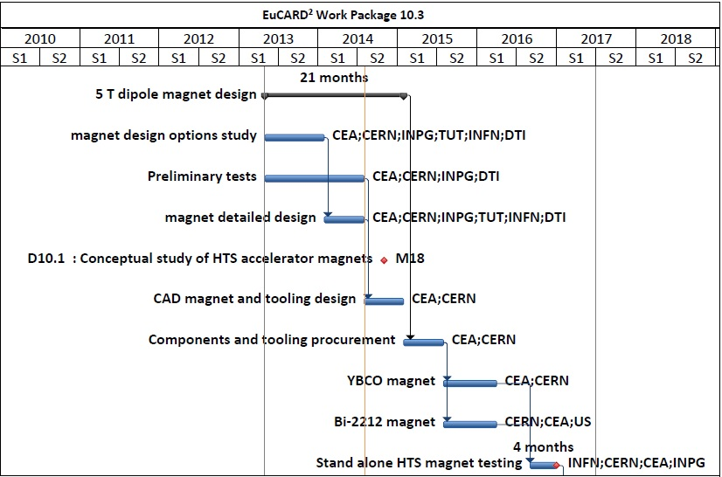
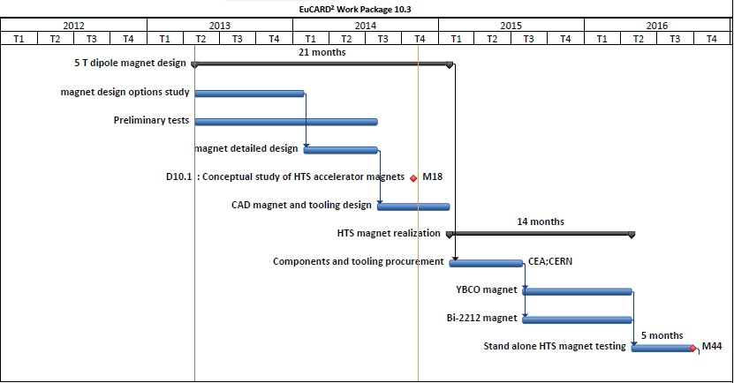
Magnet Task 10.3 Schedule

Slide 6
Conductor specifications
Parameter name |  | Symbol | Value YBCO Magnet | Value Bi-2212 Magnet | Remarks
CONDUCTOR | Engineering critical current density (20T, 4.2K) | J_{E, 20T} | 600 A/mm² | 600 A/mm² | In strand/tape At field perpendicular to wide face for YBCO tape
 | Available cable Engineering critical current density (20T, 4.2 K) | J_{E, 20T} | 400 A/mm² |  | For small development magnets
 | Bare cable width | w_{cbl} | 10-12 mm | 9.5 mm | YBCO Baseline : 12 mm
 | Bare cable thickness at 50 MPa | t_{cbl} | 0.8-1.2 mm | 1.5-2.0 | YBCO Baseline : 1.2 mm

Slide 7
Magnet specifications
Parameter name |  | Symbol | Value YBCO Magnet | Value Bi-2212 Magnet | Remarks
MAGNET | Central field | B₀ | 5 T | Up to 5 | at 4.2 K (20% margin on loadline)
 | Clear bore aperture | Φ_{b} | 40 mm |  | High energy LHC dipole magnet (beam size 25-28 mm)
 | Operational temperature | T | 4.2 K | 4.2 | 1.9 K also possible 77 K tests during magnet realization
 | Current at 20 T | I | 5 to 10 kA | 5 to 10
 | Stray magnetic field | B_{out} | ≤ 0.2 T |  | At border of cryostat
 | Magnetic multipoles at 2/3 Φ_{b} | b_{n} | 5 10⁻⁴ | - | Geometric
 | Magnetic multipoles at 2/3 Φ_{b} | b_{n} | 30 10⁻⁴ | - | Including magnetization and persistent current (best effort)
 | Magnetization | M | 300 mT | 300 | Allowing fast ramping up
 | Straight section length | L | ≥200 mm | ≥200 | As short as possible while remaining compatible with field quality for YBCO
 | Magnet length | L_{M} | < 1500 mm |  | 700 mm uniform field (Fresca2) Grenoble test facility
 | Magnet outer diameter | Φ_{M} | < 99 mm (∅) < 140 mm x 90 mm (rect) |  | Without iron yoke – FRESCA2 (100 mm) or EDIPO (143 mm x 93 mm)

Slide 8
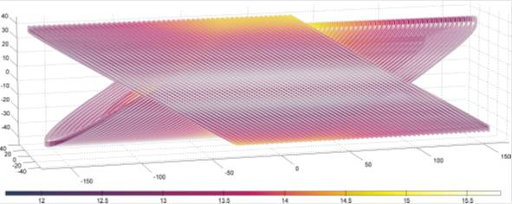
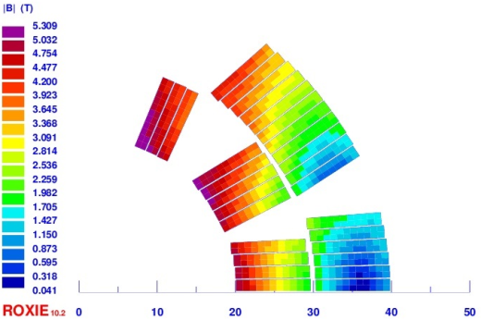
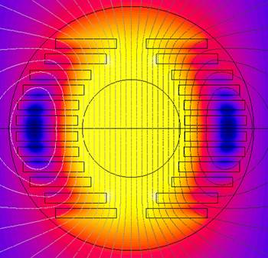
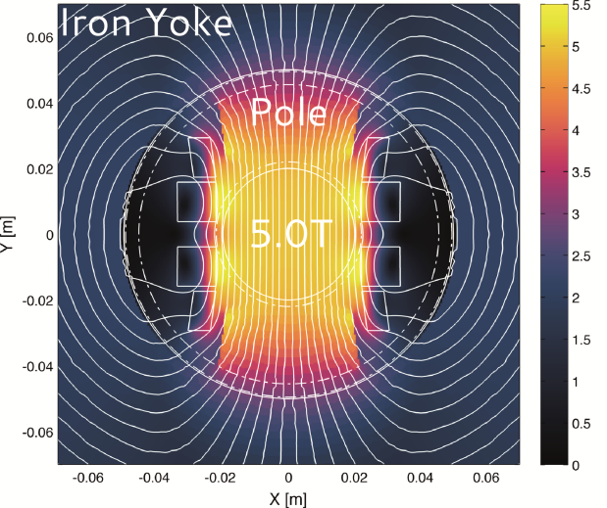
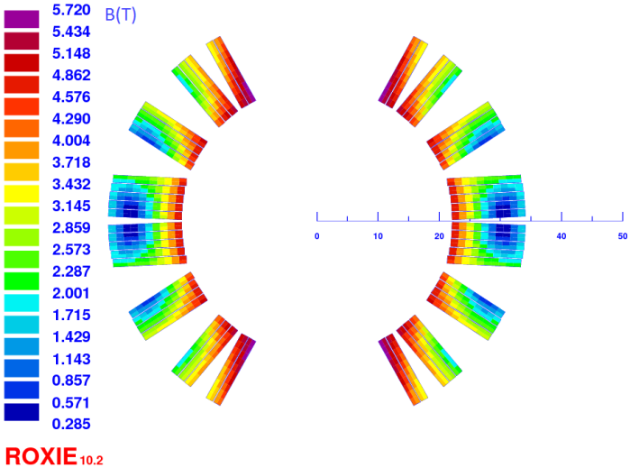
Magnet design concepts under study
BSCCO Rutherford cable CCT design
BSCCO Rutherford cable Cosine-theta design
YBCO Stacked tapes cable Block design
YBCO Roebel cable Aligned Block design
YBCO Roebel cable Cosine theta design
9.89 mm

Slide 9
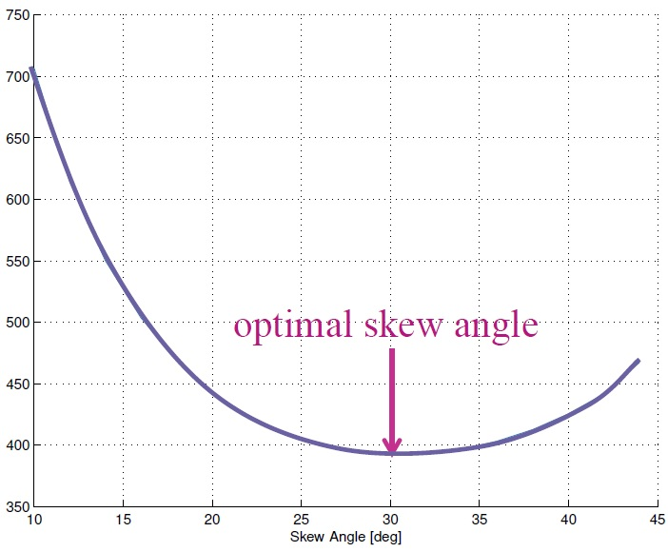
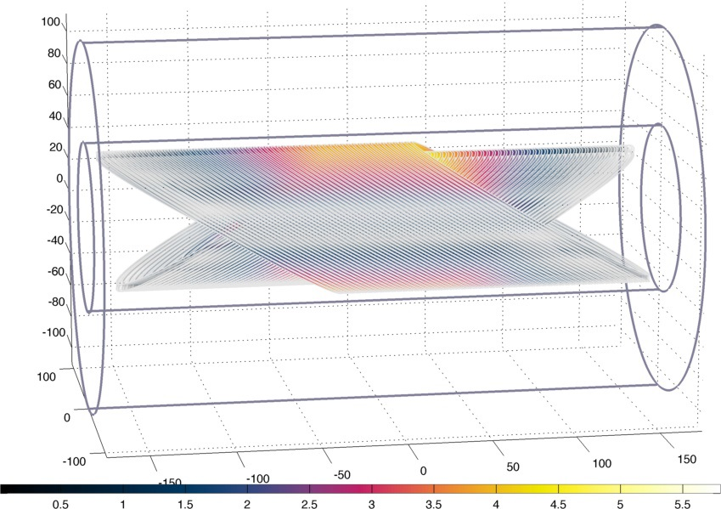
BSCCO Rutherford cable CCT Design
Jeroen van Nugteren,
Shlomo Caspi
BSCCO Rutherford cable, 1.4 mm x 4.2 mm (2x 6 strands, ∅ 0.7 mm)
Skew angle optimization to attain 5T with the minimal amount of conductor
  30 deg skew angle
  4 layers
  Je = 510 A/mm² (80% Jc)
  Operating current = 3 kA
  Cable length : 65 m
Conductor volume (cm³)
Skew angle (degrees)

Slide 10
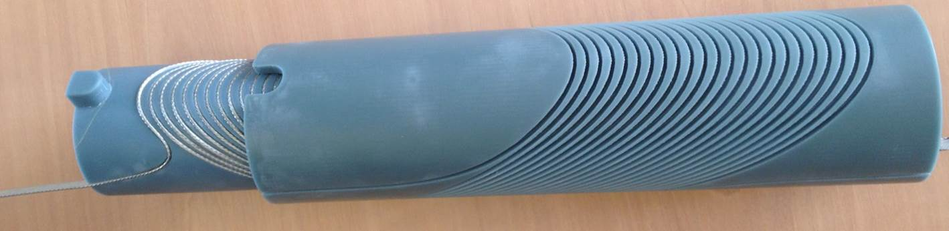
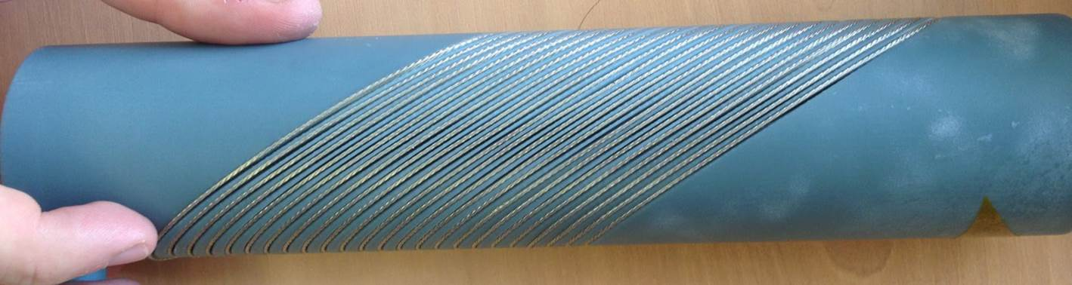
BSCCO Rutherford cable CCT Design
Jeroen van Nugteren
Glyn Kirby
CERN CCT demonstrator: 3D printed blue-stone coil former, NbTi cable

Slide 11

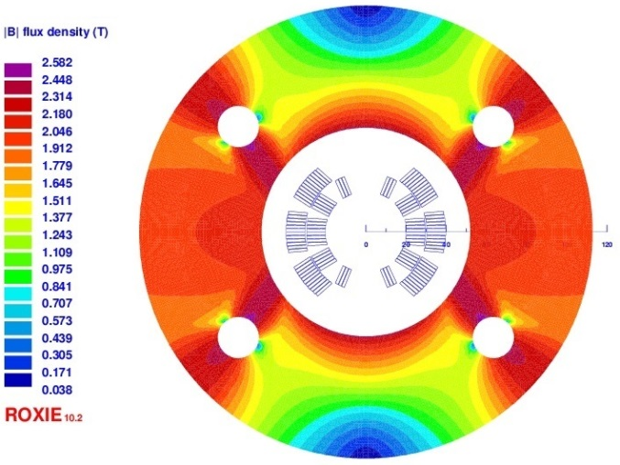
BSCCO Rutherford cable Cosine theta Design
Clément Lorin
BSCCO Rutherford cable, 1.39/1.52 mm x 9.5 mm (15 strands, ∅ 0.8 mm)
5T central field with required field quality
Je = 434 A/mm² (72% Jc)
In stand-by.
Mechanical design : we expect similar results than for YBCO Roebel designs → if the mechanical structure has to fit inside FRESCA2 inner diameter, it will not be strong enough to avoid non-acceptable stress in the coils.

Slide 12
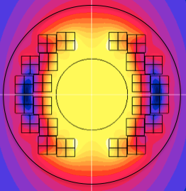
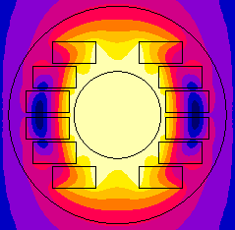
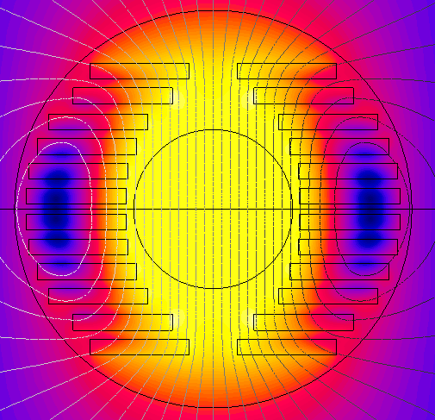
YBCO stacked tapes cable Block Design
John Himbele
Arnaud Badel
YBCO tape 4 mm x 0.13 mm
4 x 4 mm stack cable of 28 insulated tapes (vertical)
Transposition by twisting in coil ends : 1 twist per turn
Studies on twisting efficiency is ogoing.
Design optimization using hand made code.
“EuCARD2 requirements”
J_{overall} = 397 A/mm²
+“Blocks on same line”
J_{overall} = 391 A/mm²
+“twist and support”
J_{overall} = 415 A/mm²

Slide 13
YBCO stacked tapes cable Block Design
John Himbele
Arnaud Badel
Mechanical support and twisting
Minimum bending radius : 6 mm
(easy way bending)
Inner and outer bore : 2 mm margin
Between pancakes : 2.2 mm

Slide 14
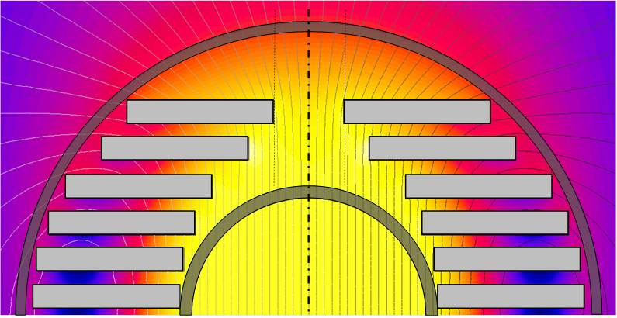
YBCO stacked tapes cable Block Design
John Himbele
Arnaud Badel
Mechanical support and twisting
Minimum bending radius : 6 mm
(easy way bending)
Inner and outer bore : 2 mm margin
Between pancakes : 2.2 mm
Distribution of the 4 turns to
allow reinforcement and twisting

Slide 15
YBCO stacked tapes cable Block Design
John Himbele
Arnaud Badel
Mechanical support and twisting
Minimum bending radius : 6 mm
(easy way bending)
Inner and outer bore : 2 mm margin
Between pancakes : 2.2 mm
Distribution of the 4 turns to
allow reinforcement and twisting
All turns can be twisted at the same position

Slide 16
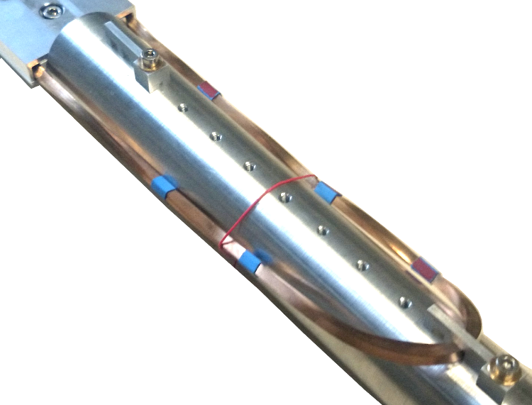
YBCO stacked tapes cable Block Design
John Himbele
Arnaud Badel
Mechanical support and twisting
Minimum bending radius : 6 mm
(easy way bending)
Inner and outer bore : 2 mm margin
Between pancakes : 2.2 mm
Distribution of the 4 turns to
allow reinforcement and twisting
All turns can be twisted at the same position
3 pancakes are flat :
  180° twist one side, 0° on the other
3 pancakes have twist-and-bend heads :
  180° twist one side,
  and 360° on the other side

Slide 17
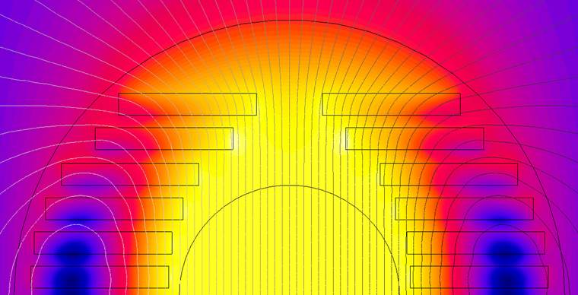

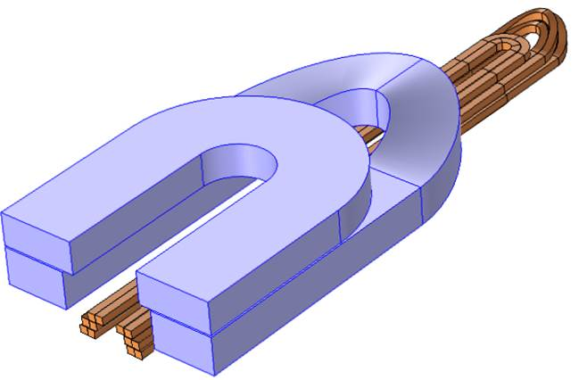
YBCO stacked tapes cable Block Design
John Himbele
Arnaud Badel
Tapes aligned to main field direction → OK
But in the twist region sthe tapes are in transverse field
  Operation at lower Je < 600 A/mm²
  → B0 < 4.6 T
  Twist outside the background field
  Need to do short coil heads !
5.3 T
5
4
3
2
1
0
B_{center} = 5 T
J_{overall} = 415 A/mm²
Each block : 4 turns
→ J_{e} = 648 A/mm²

Slide 18
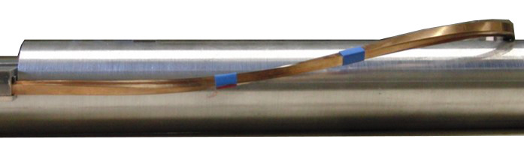
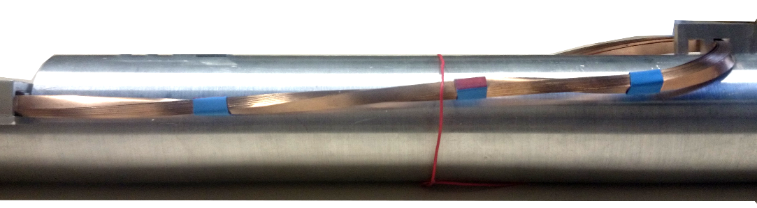
YBCO stacked tapes cable Block Design
John Himbele
Arnaud Badel
End geometry under study
“Twist and bend” test on dummy cable
Side view : 180° side
Coil end length for lower pancake,
inner turn : 22 cm
Need to spread the turns in the heads :
10 cm additional length for 1 pancake
Flat pancakes heads are shorter :
10 cm for 180° twisting + 4 cm for U-turn
Expected complete coil head length :
30-40 cm
90° twisting
(5 cm)
Bending upward
(easy way, 10 cm)
90° twisting
(5 cm )
U –Turn
(Ø 12 mm min)
Side view : 360° side
90° twisting
(5 cm)
Bending upward
+ 180° twisting
(10 cm)
90° twisting
(5 cm )
U –Turn
(Ø 12 mm min)

Slide 19

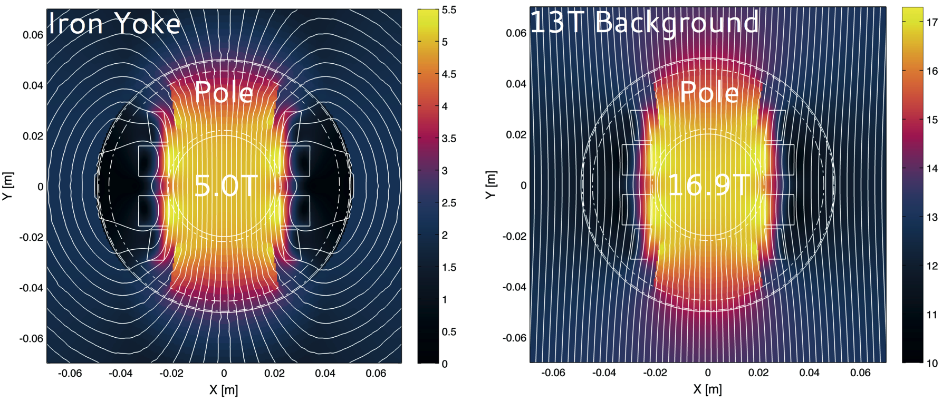
Roebel cable Aligned Block Design - 2D
Jeroen van Nugteren
Glyn Kirby
Baseline Roebel YBCO cable, 12 mm x 1.2 mm
Tapes oriented in the direction of the field lines (in 13 T background field) → Critical current of the cable is maximized
Je = 650 A/mm²
Magnetic Field [T]
Stand-alone mode
In 13T ideal background field

Slide 20
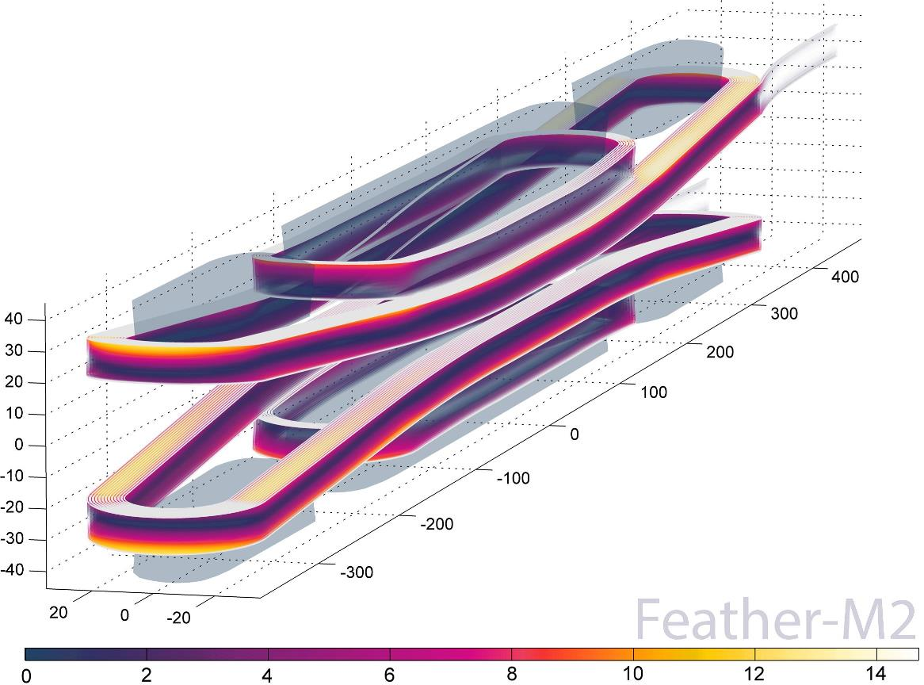
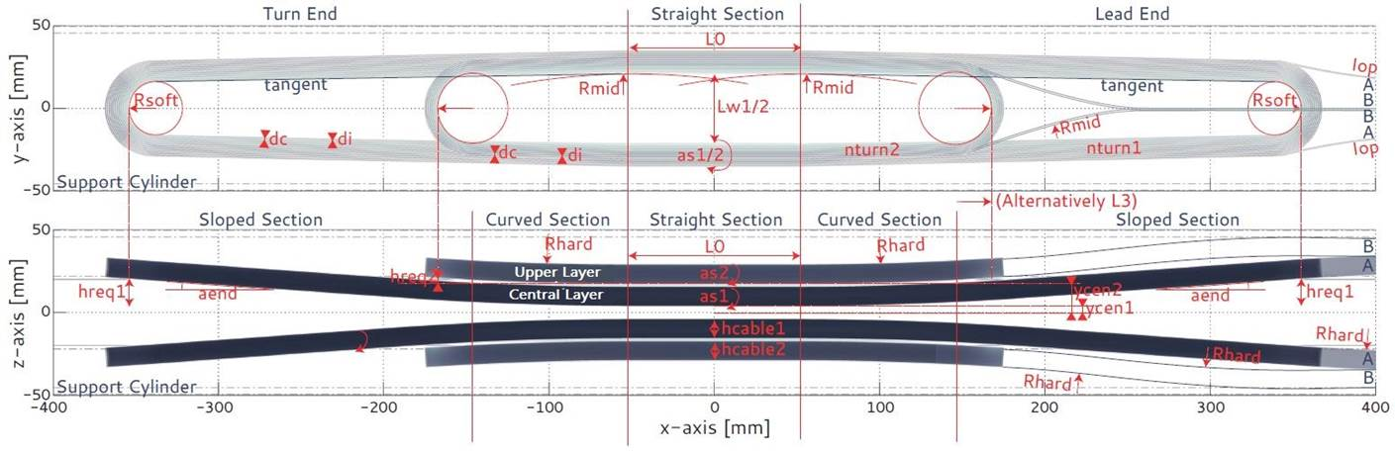
Roebel cable Aligned Block Design - 3D
Jeroen van Nugteren
Glyn Kirby
Tracking along each strand there is
always a low angle, high Jc volume.
Lower limit expected on coil ends
Minimum bending radius :
  Soft way : 11 mm
  Hard way : 2 m
Field Angle in 13T Background Field

Slide 21
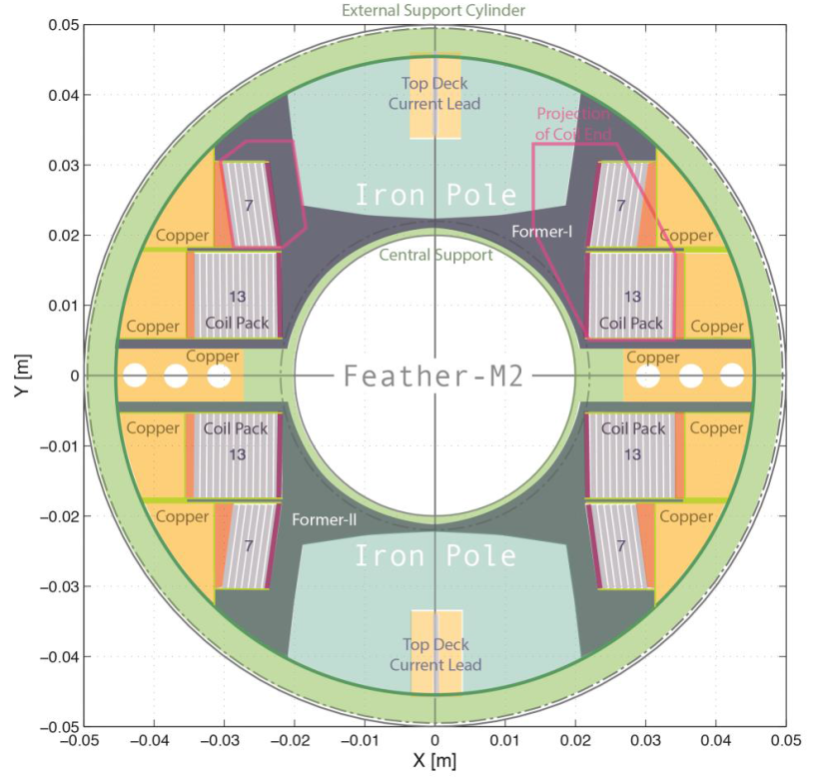
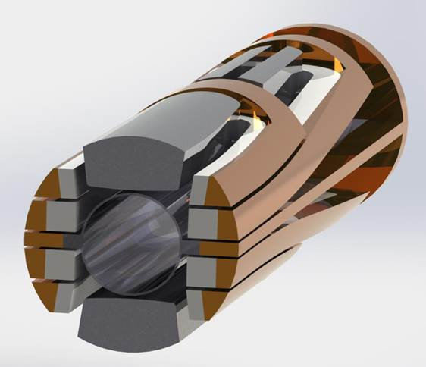
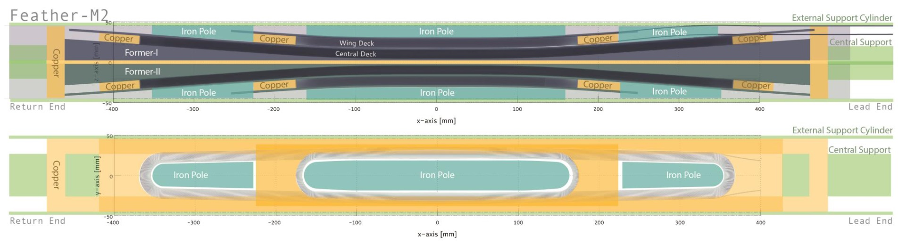
Roebel cable Aligned Block Design - Structure
Jeroen van Nugteren
Glyn Kirby
Former
External support
Central support tube
YBCO Coils
ICEE (copper)

Slide 22
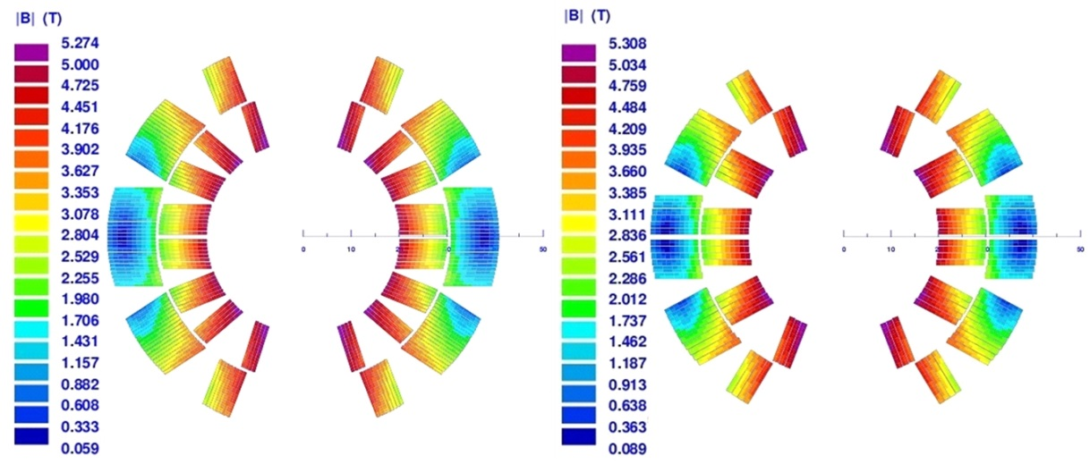
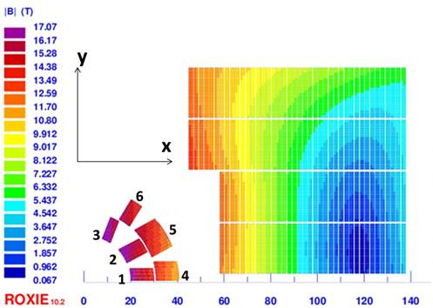

YBCO Roebel Cosine-Theta Designs
Clément Lorin
Narrower Roebel YBCO cables, 10 mm x 0.8/1.2 mm
    B0 stand-alone = 5T with Je < 470 A/mm²
Baseline Roebel YBCO cable, 12 mm x 1.2 mm
    B0 = 5T stand-alone in iron yoke, Je = 684 A/mm²
    B0 = 2 T in 15 T background field, Je = 363 A/mm²
B0 = +4 T
9.89 mm
→ see Clément presentation

Slide 23
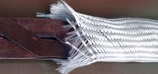
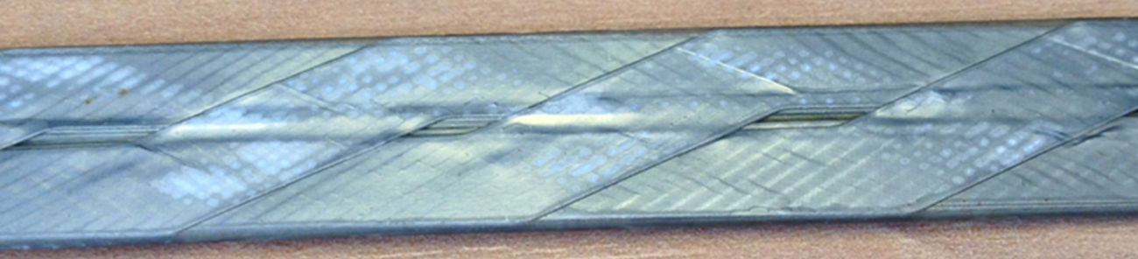
Studies : Roebel Cable Insulation
Studies
In parallel, DTI is developing insulation techniques for REBCO tapes based on sol-gel approach.
Adhesive Kapton tape , “C" wrap and 49% overlap. Problem with cable width.
Glass fibers sock over cable, impregnated with resin. Tested > 5KV insulation turn-to-turn.
Baseline insulation for Roebel cable

Slide 24
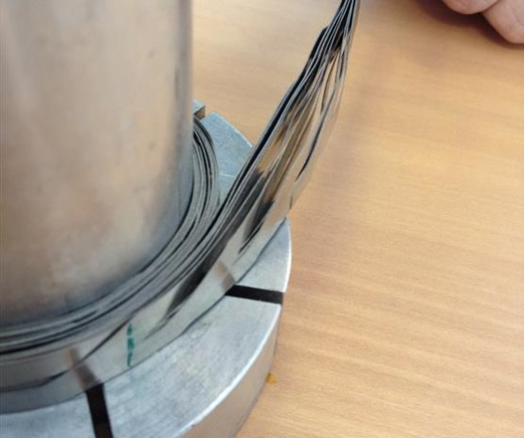
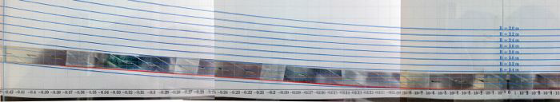
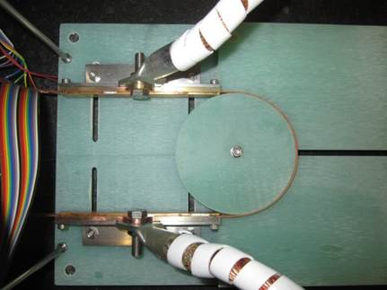
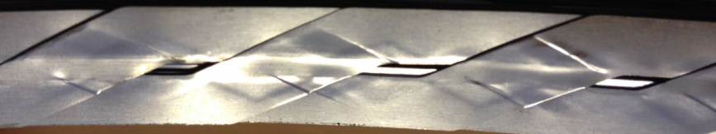
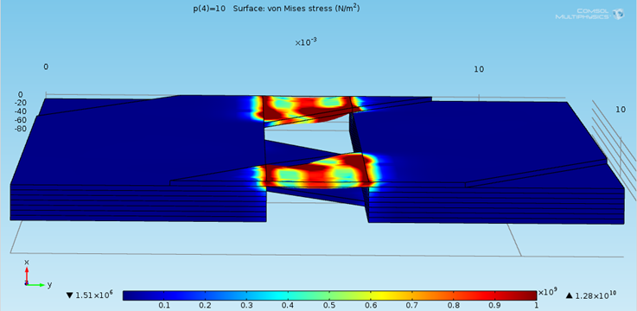
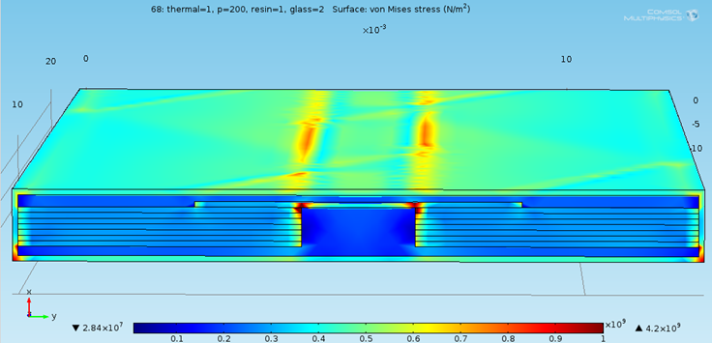
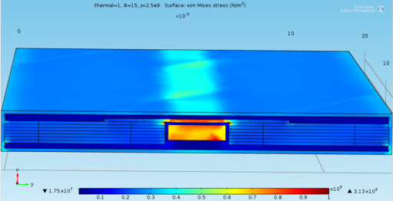
Studies : Roebel Cable mechanical behavior
Roebel cable characterization
Roebel cable modeling
Easy way and hard way bending
Not impregnated - Pressure on top
Easy way bending set-up at KIT
Nabil Chouika
Not impregnated - Pressure on top
Glass sock + Impregnation
Cooled to 4K + Pressure applied on top surface
Impregnated + Copper insert
Cooled to 4K + Magnetic forces on the edges of the tapes

Slide 25
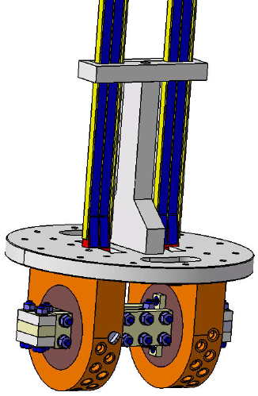
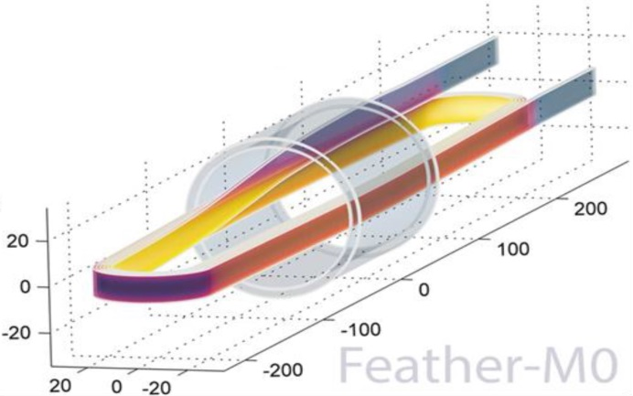
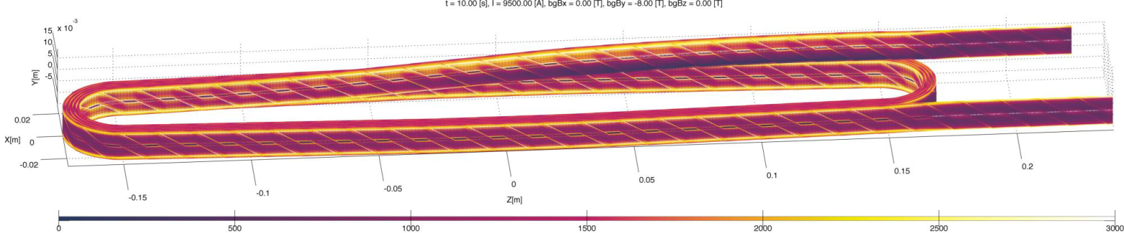
Studies : YBCO Cable electrical behavior
Current distribution, magnetization measurements
  Single layer single tape coils in LNCMI varying field angle facility
    New instrumentation and modified coil geometry under study
  Subscale models manufacturing and test
→ see Glyn and Clément
presentations
Current distribution modeling
→ see Jeroen
presentation

Slide 26
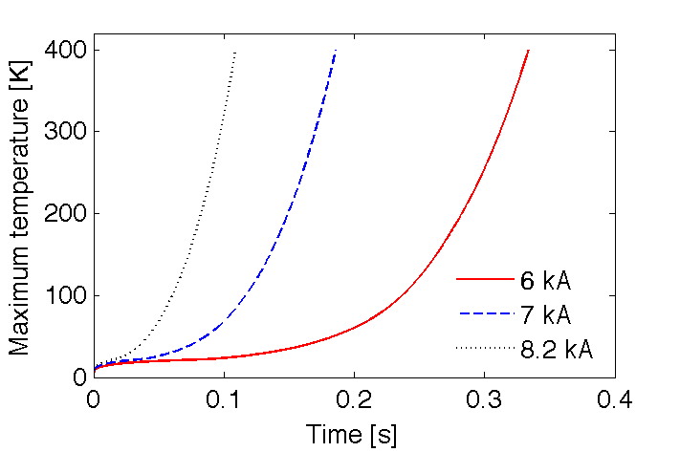
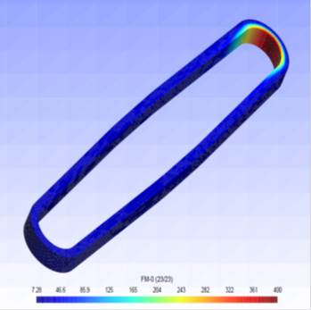
Studies : Quench protection
Antti Stenvall Tiina Salmi
Erkki Härö
Quench protection studies started on subscale models
→ see Glyn presentation
Quench heaters for HTS coils → see Tiina presentation tomorrow afternoon

Slide 27
Thanks for your attention
Structural design of EuCARD2 magnets
    by Maria Durante
Considerations during the development of a HTS research accelerator magnet
by Glyn Kirby
Electrical Network Model for ReBCO Cables and Coils
by Jeroen Van Nugteren
Design of alternative cos-theta magnet with Roebel cable
by Clément Lorin
Modeling thermal propagation and quench behavior in a protection heater covered YBCO coil
by Tiina Salmi (tomorrow afternoon)

