Slide 1
HTS IN MAGNETS
FOR THE FUTURE CIRCULAR COLLIDER
Kyoto, 13th November 2014
WHAMTS
E. Todesco
CERN, Geneva Switzerland
Acknowledgements:
L. Bottura, J. Van Nugteren

Slide 2

CONTENTS
L. Bottura at WAMHTS-1
LHC
27 km, 8.33 T
14 TeV (c.o.m.)
HE-LHC
27 km, 20 T
33 TeV (c.o.m.)
FCC-hh
100 km, 16 T
100 TeV (c.o.m.)
FCC-hh
80 km, 20 T
100 TeV (c.o.m.)

Slide 3
20 T DIPOLES: APERTURE
The 80 km option for FCC: E=50 TeV, B=20 T
  Keeping the same energy increase as in the LHC, injection energy 7 times larger as in the LHC
  Aperture scaling:
    β∝L , and cell length increases by ~2 (to have less quads)
  So factor √(7/2) ~ 2 is gained, but tolerances do not scale
    Initial guess of 40 mm
  Large radiation, so shielding is needed
    Larger apertures should be also considered (50 mm)
Beta functions in the LHC, with cell lenght L= 100 m

Slide 4
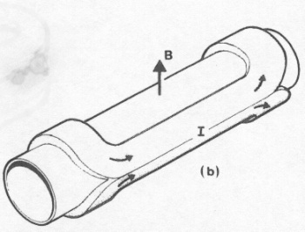
20 T dipoles: coil width
  With a conservative choice of the order of 350−400 A/mm²
    This provides ~2.5 T for 10 mm thickness, ~80 mm for 20 T
  More aggressive strategy can possibly go to 60 mm, but not less
We will have a magnet with large coil width/aperture
  RHIC: 10/40~1/4 LHC: 30/28~1 FCC: 80/20~4
Operational field versus coil width in accelerator magnets, models and design under study

Slide 5
20 T dipoles: DEPENDENCE ON APERTURE
Aperture issue
  With these data, quantity of superconductor does not depend dramatically on aperture
  Example: 20% aperture increase from 40 mm to 50 mm gives 12% increase of quantity of superconductor

Slide 6
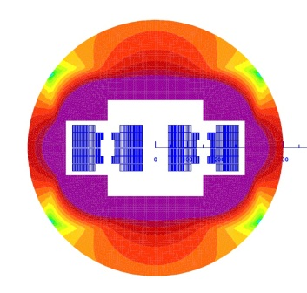
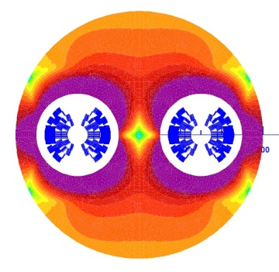
20 T dipoles: FIELD QUALITY
Field quality
  Magnets with large coil width w.r.t. aperture have easier field quality
  A lot of coil is far from the aperture, contributing to main field but not to multipoles
  Wedges probably not needed for field quality
    Unless cos theta layout (to recover keystone angle)
  Persistent current will be lower than in the LHC

Slide 7
20 T dipoles: PROTECTION
How much copper?
  RHIC dipole had 2.25 (69%)
  LHC dipole had 1.65-1.95 (62%-66%)
  D20 pushed down to 0.43 (30%)
  HD2 had 0.8 (44%)
  LARP quads 1.0-1.2 (50%-54%)
Energy cannot be extracted (long magnet)
  Simulations done for 15 T and 20 T cross-section suggest that ~1.4 (~58%) is viable, but less is not

Slide 8
20 T dipoles: Jc TARGET
Margin is still undergoing a wide debate
  20% margin on the loadline is considered conservative by many of us, pushing for 15% or less
    I find 20% quite challenging
    Consider we have few thousand magnets!
    But this margin is very expensive … this is why we have this debate
So a good target can be
  400 A/mm² and 20 T operational
  500 A/mm² and 25 T short sample
  15% of insulation
  → 600 A/mm² in the strand, with a fraction of 60% of stabilizer (Cu)

Slide 9
20 T dipoles: GRADING
With such a large quantity of superconductor, and given the price of HTS, grading is a must
  HTS used only for covering the range 15 to 20 T
  One can have as little as 1/6 HTS in the whole coil [E.. Todesco L. Rossi, Malta workshop 2011]
Layouts allowing grading are necessary
  Possible both with cos theta and block
    But inner grading (within the same layer) is necessary – forget about the nice onion structure of solenoids …
  I don’t see how grading can be done with a canted
Design proposal for 20 T with grading [E. Todesco, MT17 (2013)]
Typical field map in a cos theta [C. Lorin]

Slide 10
HTS FOR THE 15 T OPTION
The 15 T option, 100 km tunnel has also some need for HTS
Cell quads do not require HTS
  LHC: 220 T/m, 3.15 m integrated gradient ∼700 T
  From 7 to 50 TeV: * 7.14
  From L=100 to L=200 m (cell length) : /2
  Needed gradient: ∼2500 T
    With 40 mm aperture
      Gradient of 500 T/m, Gr=10 T, plus 15% overshoot of peak field in the coil, this means 11.5 T peak field – OK with Nb₃Sn
      So 5 m long magnets with Nb₃Sn
    HTS could allow to reach Gr= 15 T, 16.5 T peak field, so 750 T/m
      This would give 3.3 m long magnet – you save 2 m every 100 m, so 2% - this is not so worth

Slide 11
HTS FOR THE 15 T OPTION
The 15 T option, 100 km tunnel has also some need for HTS
On the other hand, IR quads are a challenge and HTS can be helpful
  7 times energy → 7 times larger integrated gradient
  A 150 mm aperture triplet in Nb₃Sn (today 30 m of magnets in HL-LHC) would need 210 m long triplet !
    That’s very long …
  We are today considering a 90 mm aperture triplet
    But this limits the β*, which is inverse propto to the aperture
    Only way of compensating the loss of squeeze, is to put more protons → larger stored energy in the beam, synchrotron loss, cryogenic load …
      Anything to avoid this is welcome …
      So an hybrid quadrupole Nb₃Sn and HTS of 90-120 mm aperture is very interesting

Slide 12
CONCLUSIONS
We outlined the main requirements for a 20 T magnet in the FCC
  Aperture 40-50 mm
  Current density in the strand 600 A/mm², at 25 T
  60% copper in the strand for protection
  Design with grading to avoid stellar cost
  Is 20% margin on the loadline enough/too much?
There is also need of HTS for the IR magnets in the 15 T, 100 km option for FCC
  To increase triplet aperture keeping a compact triplet
  This allows to reach smaller β*, and not to limit the increase in beam intensity

