Slide 1
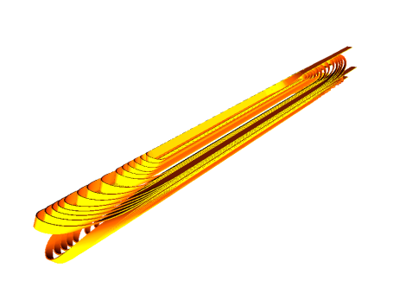
Design of alternative cos-θ magnet with Roebel cable
Clément Lorin and WP10.3 members
Second Workshop on Accelerator Magnets in HTS (WAMHTS-2)
13/11/2014

Slide 2
Framework
Field target: Accelerator-type magnet
  stand-alone mode + yoke: 5 T
  insert mode: the more the better
Constraints:
  Magnet dimension: 40 mm aperture and 100 mm outer diameter
  Roebel cable: stringent easyway radius (10 mm) hardway radius ( 2 m)
Contents
Double layer design:
  10-mm wide Roebel cable
Single layer design:
  12-mm wide Roebel cable

Slide 3
Double layer design (1/2)
2D magnetism:
  J_{e,cable} = 460 A/mm² (J_{o} = 386 A/mm²)
  5 T standalone + yoke
  3.75 T standalone
  13 T + 3.75 T in Fresca2
  Geom. in Fresca2: b₃=6,b₅=1,b₇=1
2D mechanics:
Prestress + cool-down + Lorentz forces
8.6 mm left for mechanical structure

Slide 4
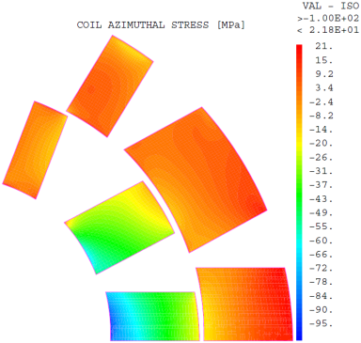
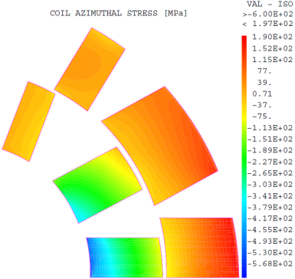
Double layer design (2/2)
Azimuthal stress (no prestress)
  Stand-alone: 5 T
  Insert: 16.78 T
Field [T] | ET thickness [mm] | Peak stress [MPa]
5.00 | 8.0 | 100
16.78 | 8.0 | 600
5.00 | 20.0 | 30
16.78 | 20.0 | 250
Show stopper: Mechanical structure for double layer cosine-theta too weak.
What can be done with a single layer design?

Slide 5
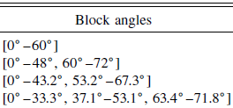
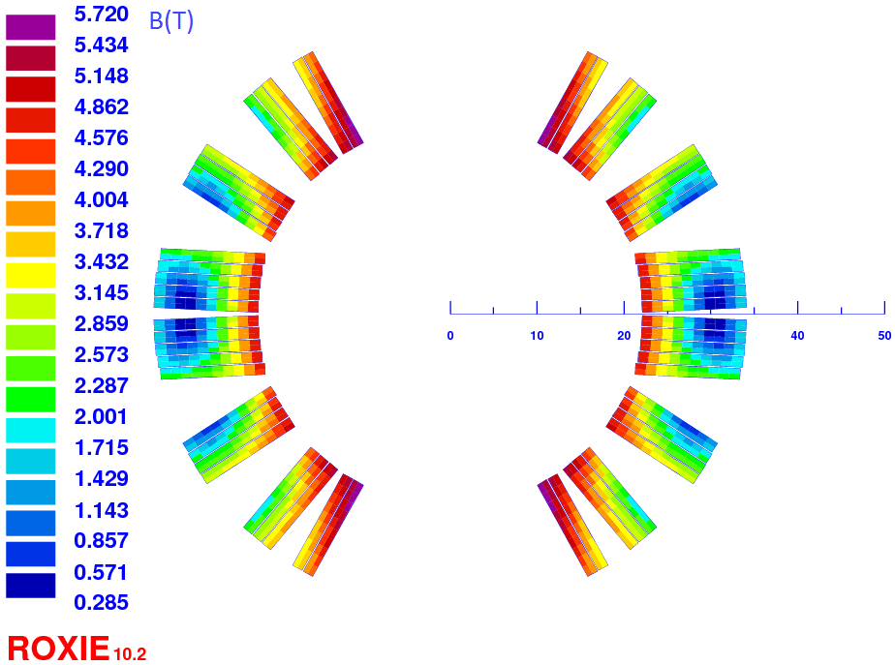
Single layer design (1/5)
Rossi-Todesco
PhysRevSTAB.10.112401
End coil design + Roebel cable
  Easyway bending radius (10 mm)
    -> R = 22 mm and field degradation in stand-alone
    R·sin(angle) = 6.84 mm
R = 20 mm ; angle = 70°
Standalone, 5 T if:
I = 11635 A (15x5.5x0.15 & 80 % margin)
J_{e,cable} = 811 A/mm²
J_{o} = 684 A/mm²
Jc_{e,tape} = 1200 A/mm² (6 T@4.2 K)
9.89 mm
Insert, 2 T if:
I = 6210 A (15x5.5x0.15 & 80 % margin)
J_{e,cable} = 431 A/mm²
J_{o} = 363 A/mm²
Jc_{e,tape} = 630 A/mm² (18 T@4.2 K)
Geom. in Fresca2: b₃ = 9 ; b₅ = 1 ; b₇ = 5

Slide 6
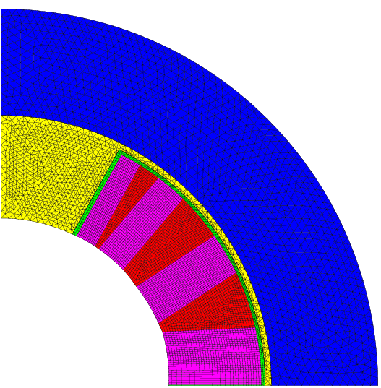
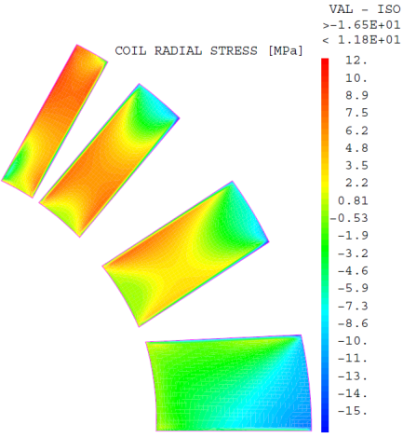
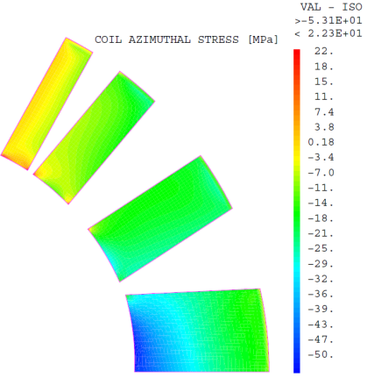
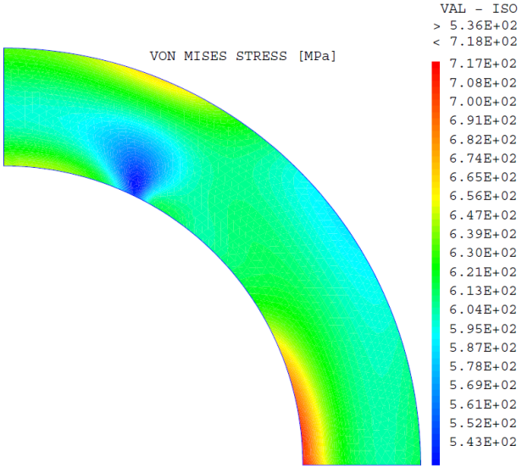
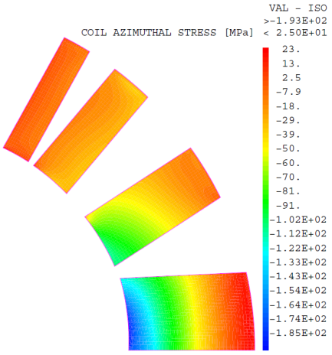
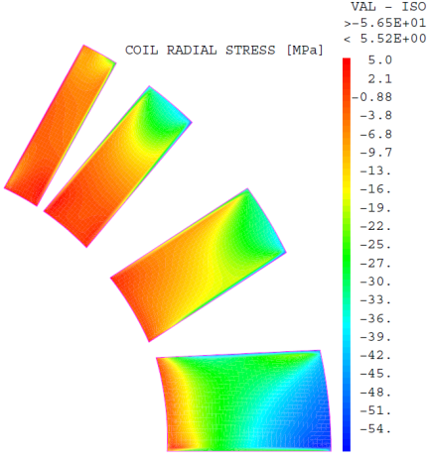
Single layer design (2/5)
2D mechanics: (peak values)
  Stand-alone: 5 T
azi.
60 MPa
radial
20 MPa
22 mm
12 mm
14 mm
  Fresca2 (@1.9 K) + insert = 15 T + 2 T
azi.
200 MPa
radial
60 MPa
Von Mises
720 MPa

Slide 7
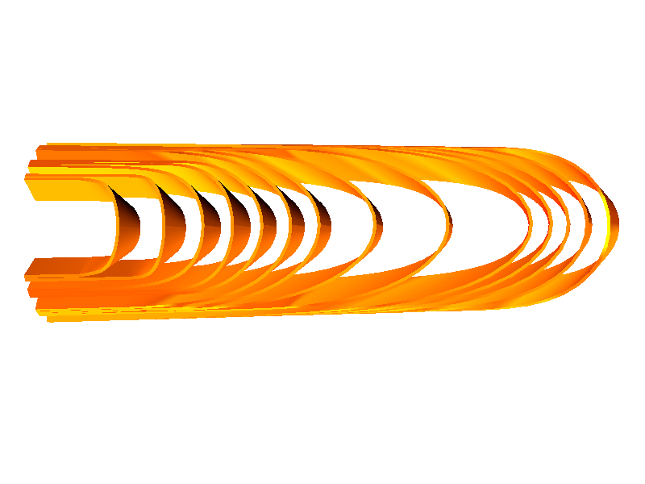
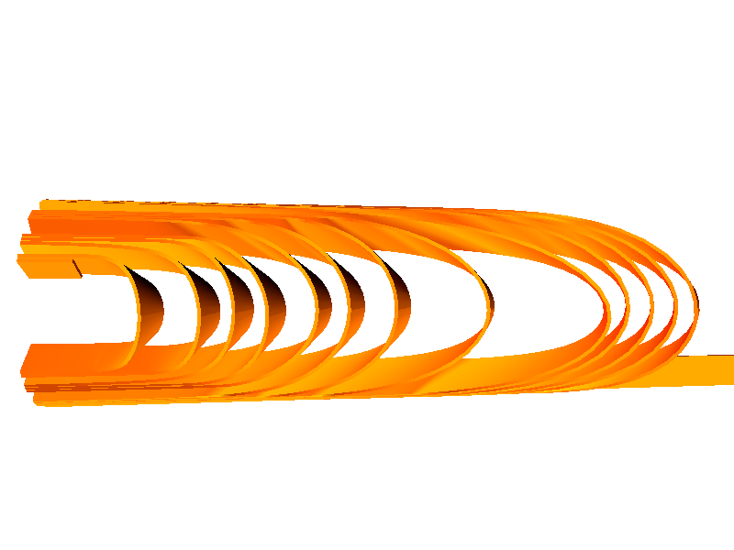
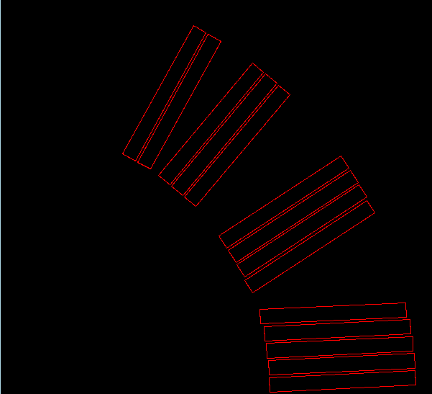
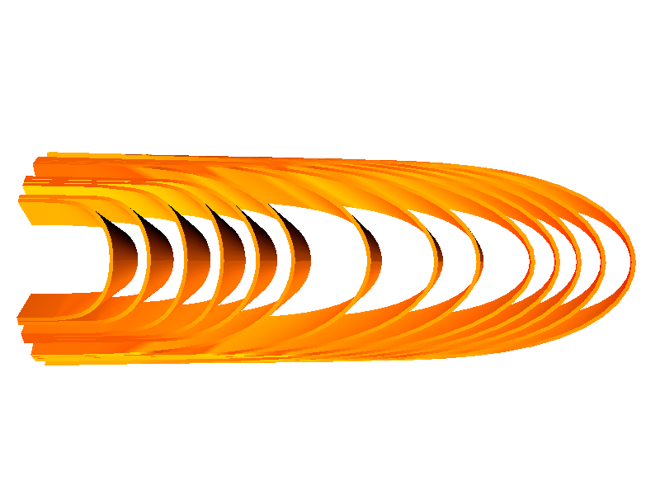
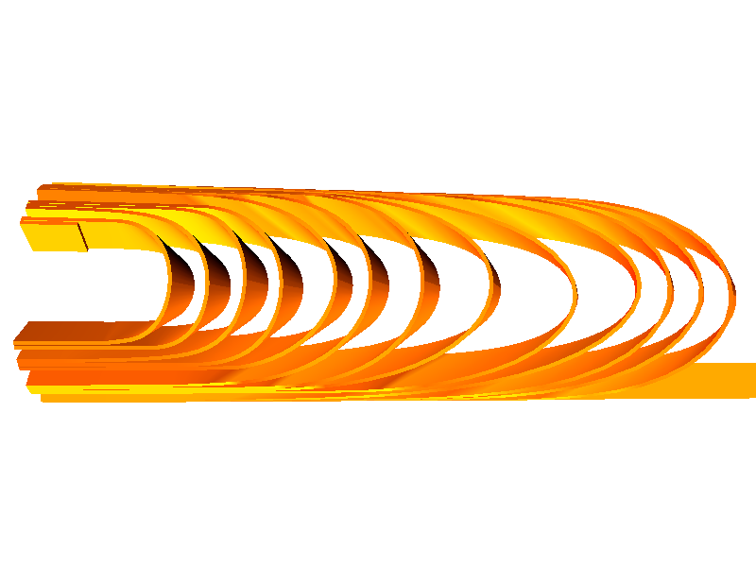
Single layer design (3/5)
cable | ew (mm) | hw (m) | L (mm)
14 | 8.73 | 2.71 | 20
13 | 9.43 | 3.75 | 29
12 | 9.44 | 2.30 | 57
11 | 10.61 | 6.32 | 36
10 | 9.80 | 3.03 | 44
9 | 10.11 | 4.21 | 74
8 | 9.91 | 7.92 | 70
7 | 9.55 | 4.10 | 106
6 | 10.03 | 2.57 | 111
5 | 10.24 | 2.06 | 176
4 | 10.81 | 2.88 | 176
3 | 12.10 | 3.82 | 176
2 | 13.98 | 5.37 | 160
1 | 16.72 | 11.04 | 130
Coil end design:
  First try:
14
  Upper cable less square +
  shorter lower cable:
cable | ew (mm) | hw (m) | L (mm)
14 | 7.60 | 2.05 | 22
13 | 8.33 | 3.46 | 28
12 | 9.81 | 2.03 | 33
11 | 10.61 | 6.32 | 36
10 | 9.80 | 3.03 | 44
9 | 10.11 | 4.21 | 74
8 | 9.91 | 7.92 | 70
7 | 9.55 | 4.10 | 106
6 | 10.03 | 2.57 | 111
5 | 9.29 | 2.48 | 144
4 | 10.05 | 3.26 | 145
3 | 11.03 | 4.87 | 145
2 | 11.48 | 3.00 | 142
1 | 12.24 | 7.80 | 138
1

Slide 8
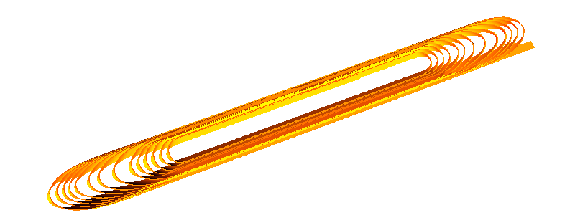
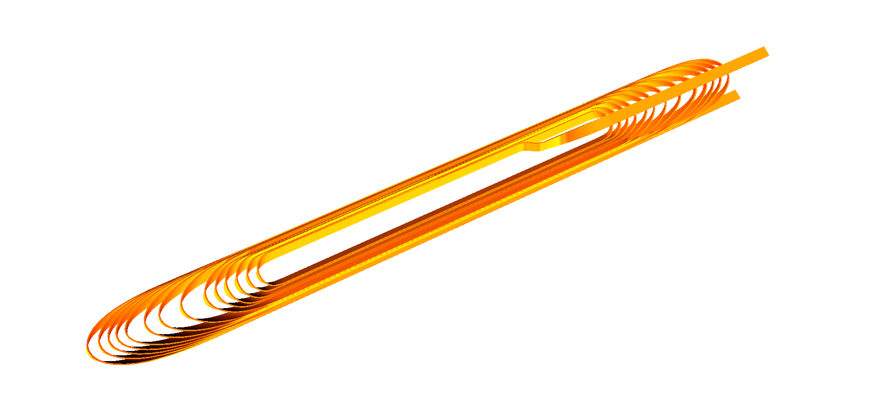
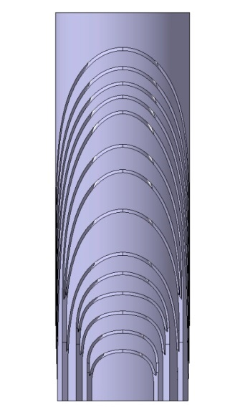
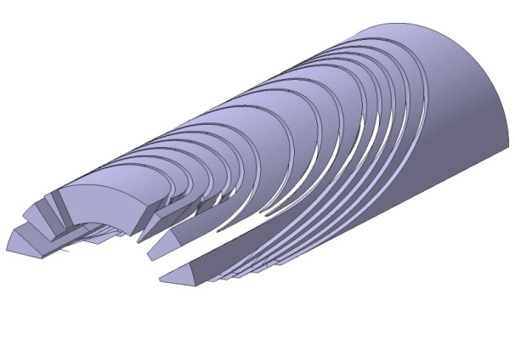
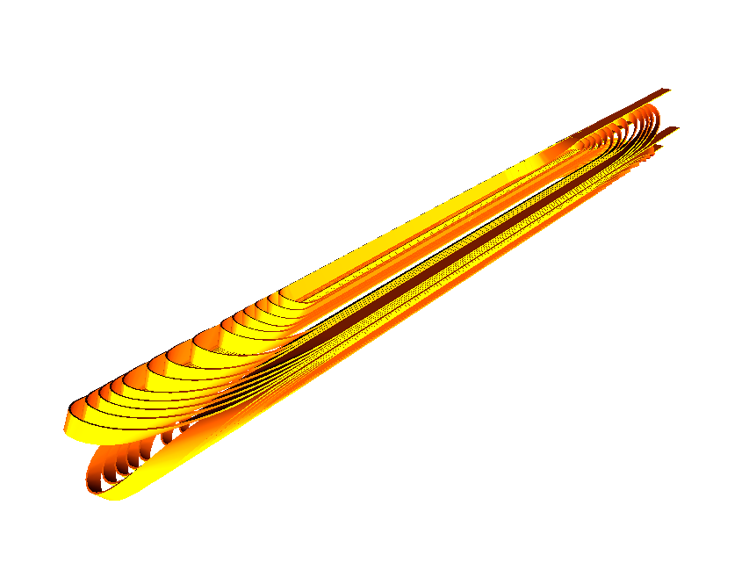
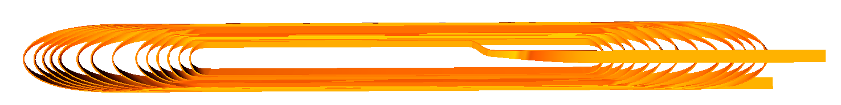
Single layer (4/5)
Easyway: 20 mm radius
How to go out?
Twist: 60° over 100 mm
Full design: SS ≈ 230 mm; heads ≈ 2x180 mm, cable length ≈ 2 x 17 m
-345
-170
0
+65
+175
+350

Slide 9
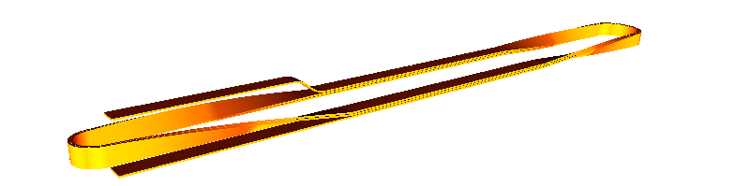
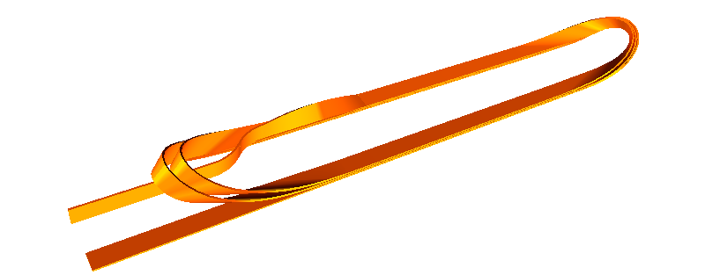
Single layer design (5/5)
Subscales:

Slide 10

Conclusion
Double layer design does not fit into Fresca2
Single layer if cosθ configuration must be investigated (200 MPa, still challenging)
Between 4 - 5 T in stand-alone and 2 T as insert
One dedicated spacer for each turn
Thank you to William Gamache from CEA for end spacer generation as well as Susana Izquierdo-Bermudez and Bernhard Auchmann for useful discussion about Roxie and coil end design.

Slide 11
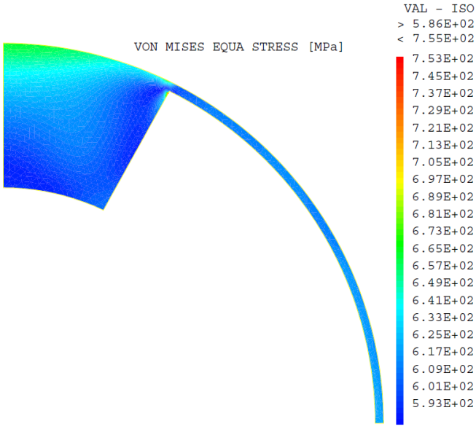
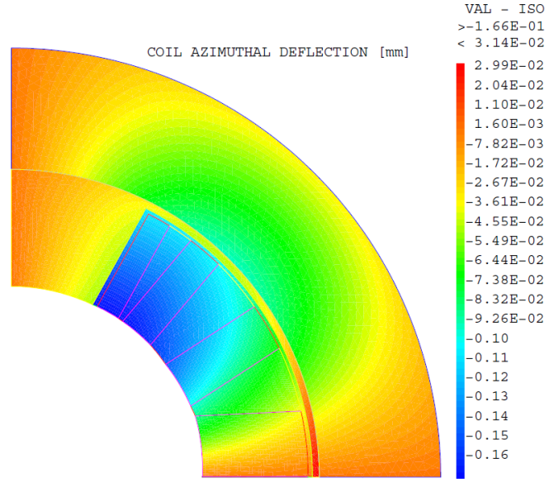
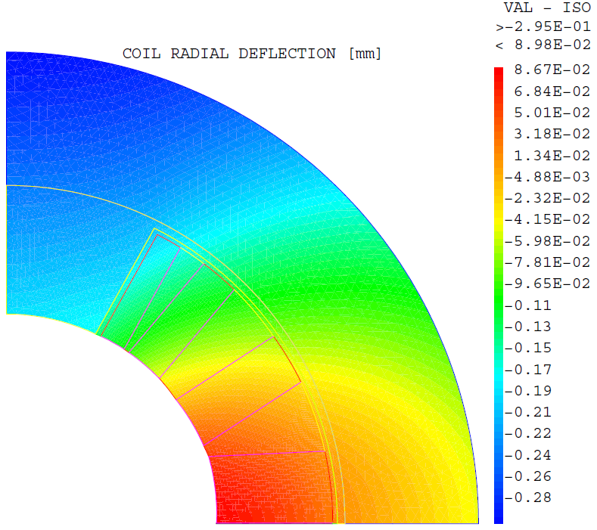
Extra data 1/2
SI Frettage;
MCOIL = MATE OCOIL YOUN 30000. NU 0.3 ALPH 3.9E-3;
SINON;
MCOIL = MATE OCOIL YOUN 42000. NU 0.3 ALPH 3.9E-3;
FINSI;
MWEDGE = MATE OWEDGE YOUN 110000. NU 0.3 ALPH 3.6E-3;
MINPO = MATE OINPO YOUN 4000. NU 0.3 ALPH 6.0E-3;
MIMAS = MATE OIMAS YOUN 4000. NU 0.3 ALPH 6.0E-3;
MCOLL = MATE OCOLL YOUN 210000. NU 0.3 ALPH 2.9E-3;
MFRETTE = MATE OFRETTE YOUN 210000. NU 0.3 ALPH 2.9E-3;

Slide 12
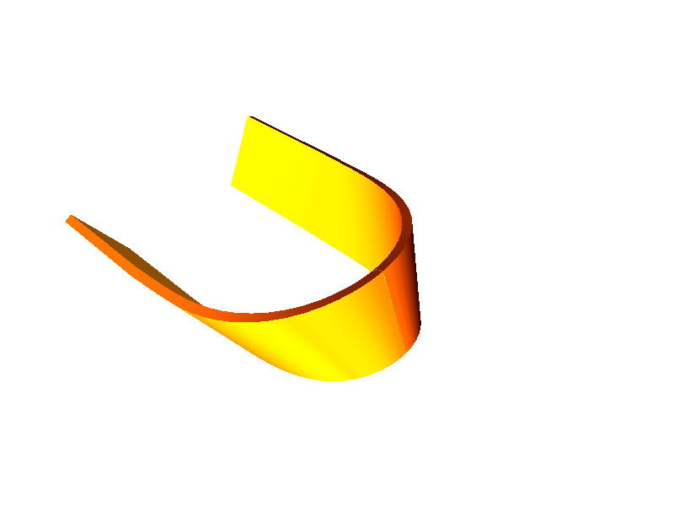
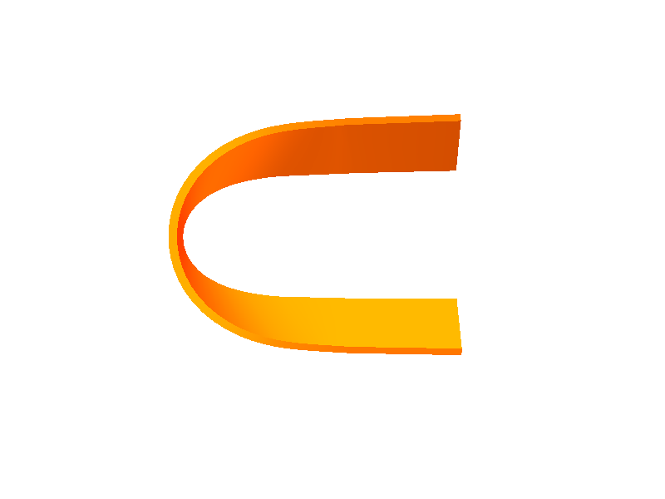
Extra data 2/2
ew = 6.6 mm; hw = 2.65 m
It is certainly very hard to make good dipole ends with basically no hard-way bend AND little easy-way bend, and 2 meters seems to me to be a very ambitious goal. Personally I think it’s almost impossible, unless you implement one dedicated spacer for each turn […]
But I think it’s the boundary conditions imposed by mathematics you’re fighting with more than ROXIE

