Slide 1
R&D of fundamental technologies of accelerator magnets using coated conductors
The 2014 Kyoto Workshop on HTS Magnet Technology
for High Energy Physics
(WAMHTS-2)
November 13 – 14, 2014
Kyoto, Japan
N. Amemiya, Z. Zhang, T. Sano, Y. Sogabe, T. Nakamura (Kyoto Univ.)
T. Ogitsu (KEK), K. Koyanagi, S. Takayama, T. Kurusu (Toshiba)
Y. Mori (KURRI), Y. Iwata, K. Noda (NIRS), M. Yoshimoto (JAEA)
This work was supported by Japan Science and Technology Agency under Strategic Promotion of Innovative Research and Development Program (S-Innovation Program).

Slide 2
Outline
Overview of the S-Innovation Project on R&D of fundamental technologies of accelerator magnets using coated conductors
As a topic: study on magnetization of coated conductor and field quality

Slide 3
Overview of the S-Innovation Project

Slide 4
Outline the project
Name of project | Challenge to functional, efficient, and compact accelerator system using high T_{c} superconductors
Objective | R&D of fundamental technologies for accelerator magnets using coated conductors Constructing and testing prototype magnet
Future applications | Carbon caner therapy Accelerator-driven subcritical reactor
Participating institutions | Kyoto University, Toshiba, KEK, NIRS (National Institute of Radiological Sciences), JAEA
Period | Stage I: 01/2010 – 03/2012 Stage II: 04/2012 – 03/2016 Stage III: 04/2016 – 03/2019
Funding program | Strategic Promotion of Innovative Research and Development (S-Innovation) Program by JST

Slide 5
Key issues in R&D
HTS magnet design which is compatible with accelerator design
Winding technology for negative-bend coils and 3D shape coils to realize the designed magnets
Tape magnetization which affects the field quality of magnets

Slide 6
Project overview and key R&D issues at stage I & II
Stage I and II: to establish fundamental technology
Winding technologies
Magnetization and field quality
Design study
Accelerator
(Carbon therapy, ADSR)
Negative-bend winding
Field
measurement
Simulation technology
Magnet
3D winding
Prediction / correction
Model magnet
Stage III: to demonstrate function of beam guiding
Prototype magnet

Slide 7
Magnet design
Spiral sector FFAG accelerator for carbon cancer therapy
Radial magnetic field distribution
FFAG accelerator: strong focusing with dc magnet
Type | Spiral sector
Purpose | Carbon cancer therapy
Particle | C⁺⁶
Energy | 40 - 400 MeV/u
Major radius | 4.65 m
Average orbit radius | 3.8 – 5.5 m
Field index (k value) | 5.7
Integrated field at r = 5.5 m | 3.98 T·m
Spiral angle | 58.4 deg
Number of cell | 10
Packing factor | 0.5

Slide 8
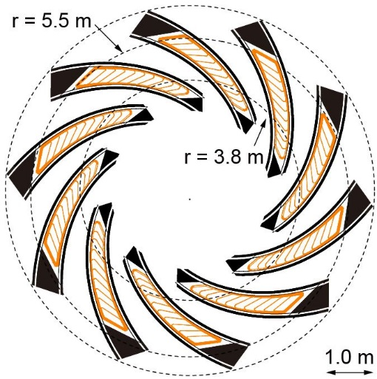
Magnet design
Spiral sector FFAG accelerator for carbon cancer therapy
Radial profile is provided by ladder shape coils.
Field with spiral angle is provided by coils with negative bend and iron.
Preliminary estimation
Weight of iron ~ 60 t; stored energy ~ 2 – 3 MJ; B @ conductor ~ 7 – 8 T

Slide 9
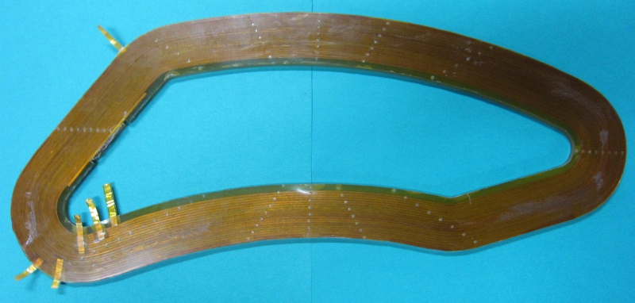
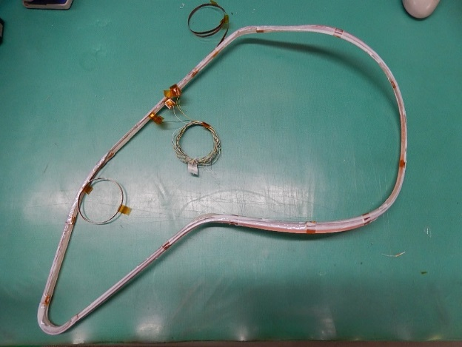
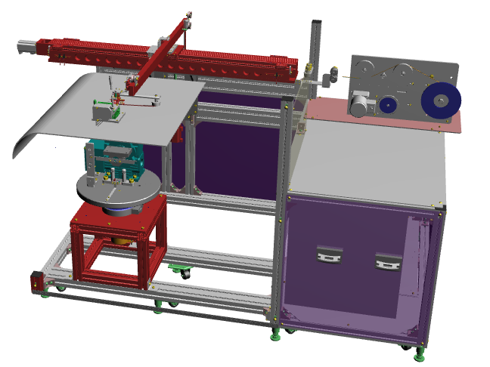
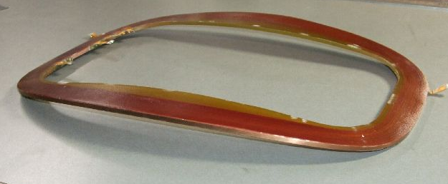
Winding technology R&D
Examples of test winding
240 mm
350 mm

Slide 10
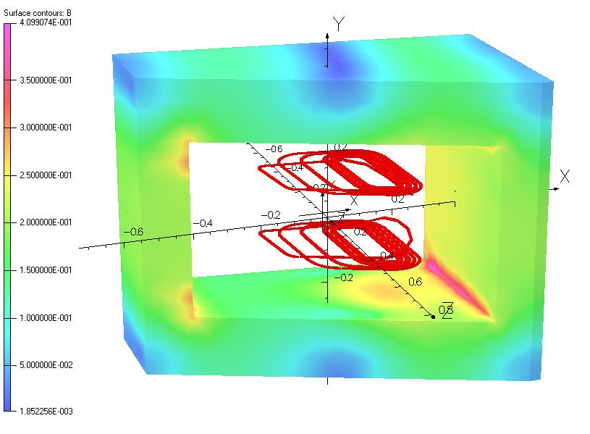
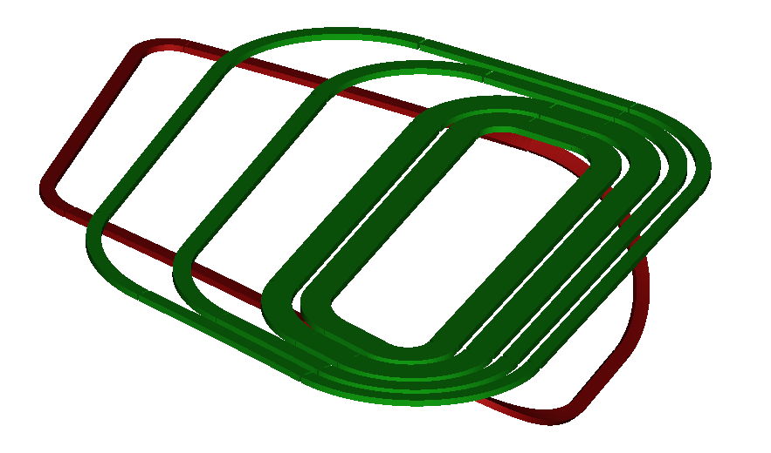
Model magnet to verify developed technologies
Coils are put in cryostat and cooled by using GM cryo-cooler
Iron is placed at room temperature
Magnetic field distribution will be measured by using scanning Hall probe and rotating pick-up coils

Slide 11
Study on magnetization of
coated conductor and field quality

Slide 12
Content of this part
Magnetic field harmonics measurements in small dipole magnets
  Comparisons with 2D electromagnetic field analyses
3D model for electromagnetic field analyses to evaluate magnetic field harmonics
Perspective: how to manage this issue

Slide 13
Magnetic field harmonics measurements

Slide 14
Tested magnets
 | RTC4-F | RTC2-F | RTC4-SP
Number of racetrack coils | 4 | 2 | 4
Inner / outer width of racetrack | 96 mm / 152.8 mm | 80 mm / 132 mm | 96 mm / 134 mm
Length of straight part | 250 mm | 250 mm | 250 mm
Number of turn | 83 turns/coil | 76.5 turns/coil | 108 turns/coil
Separation between pole | 58 mm | 52.8 mm | 56.2 mm
Coated conductor | FYSC-SC05 | FYSC-SC05 | SCS4050
Cooling | LN₂ | GM cryocooler | GM cryocooler
Dipole field | 0.088 T @50 A |  | 0.5 T @200 A
Conductor field | 0.23 T @50 A |  | 1.45 T @200 A

Slide 15
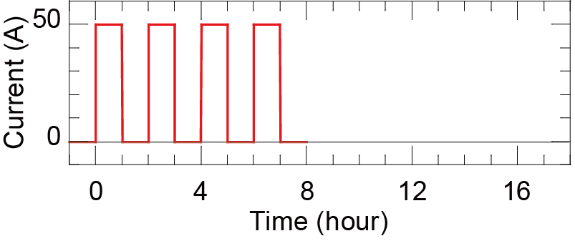
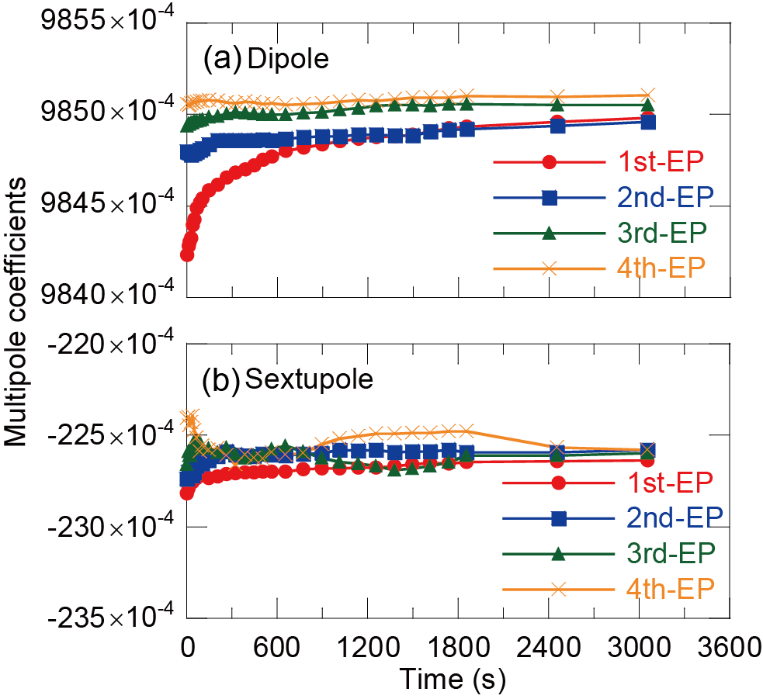
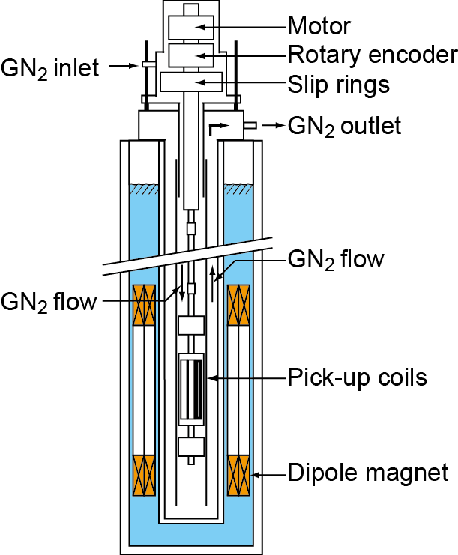
RCT-4, LN₂, experimental setup, typical data

Slide 16
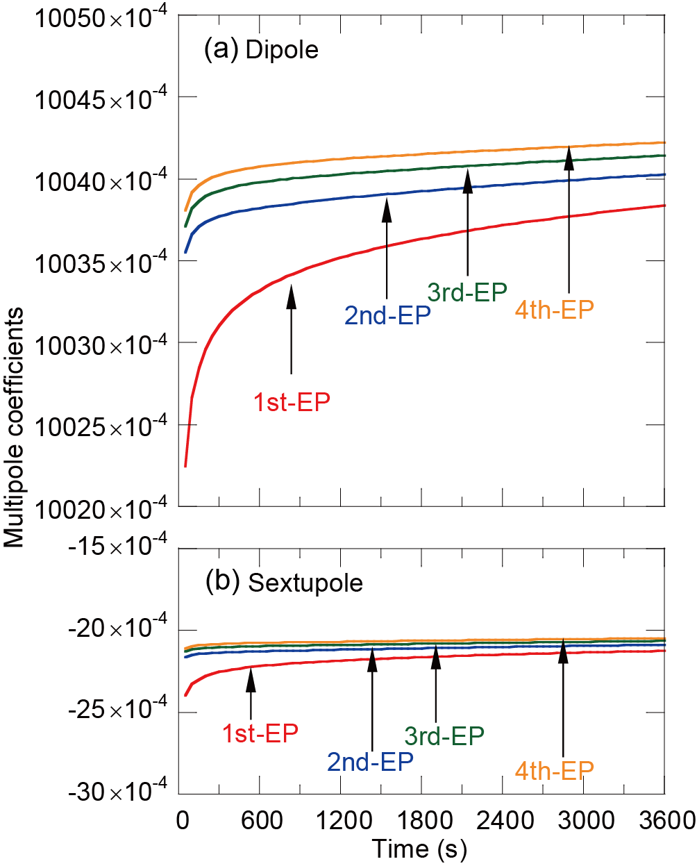
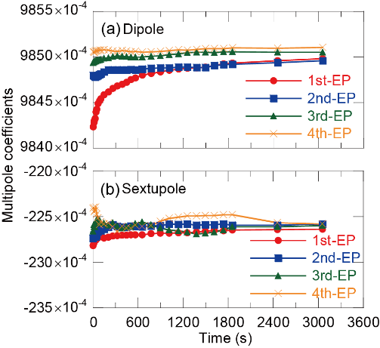
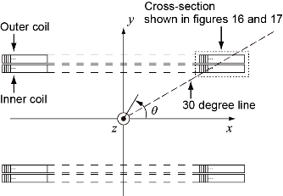
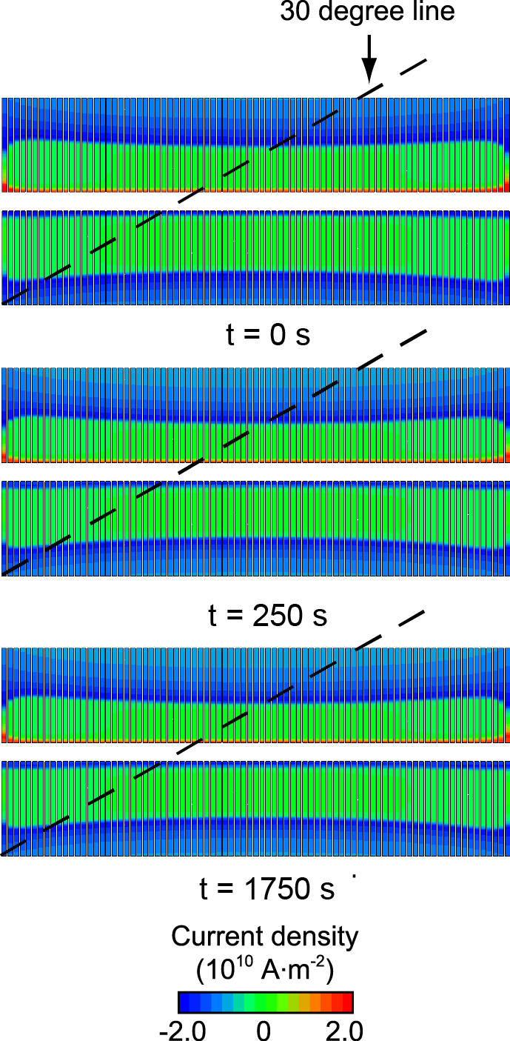
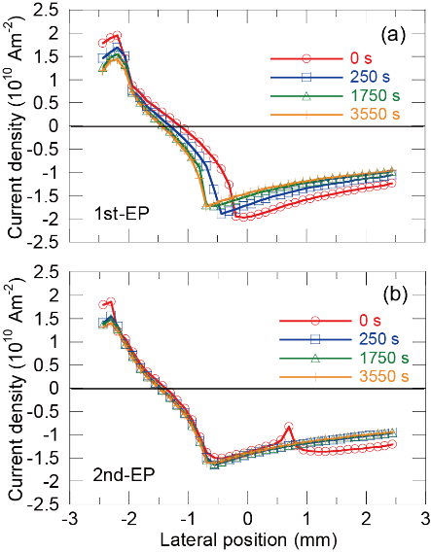
RCT-4, LN₂, 2D electromagnetic field analyses

Slide 17
RTC4-SP, GM cryocooler, drifts in dipole and sextupole
200 A, 3 hour @20 K
Drift in dipole
8.9 × 10⁻⁴
Drift in sextupole
0.72 × 10⁻⁴

Slide 18
RTC4-SP, GM cryocooler, temperature dependence
100 A, 3 hour @20 K
100 A, 3 hour @30 K
Drift in 3 hours
Dipole: 1.4 ×10⁻⁴
Sextupole: 0.22 ×10⁻⁴
Drift in 3 hours
Dipople: 5.5 ×10⁻⁴
Sextupole: 0.60 ×10⁻⁴

Slide 19
RTC4-SP, GM cryocooler, field (current) dependence
100 A (0.725 T @conductor) 3 hour @20 K
200 A (1.45 T @conductor) 3 hour @20 K
Drift in 3 hours
Dipole: 1.4 ×10⁻⁴
Sextupole: 0.22 ×10⁻⁴
Drift in 3 hours
Dipople: 8.9 ×10⁻⁴
Sextupole: 0.72 ×10⁻⁴

Slide 20
3D model for
electromagnetic field analyses
to evaluate magnetic field harmonics

Slide 21
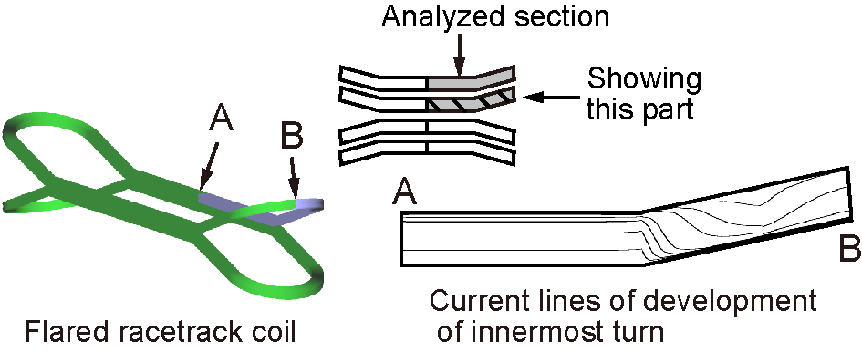
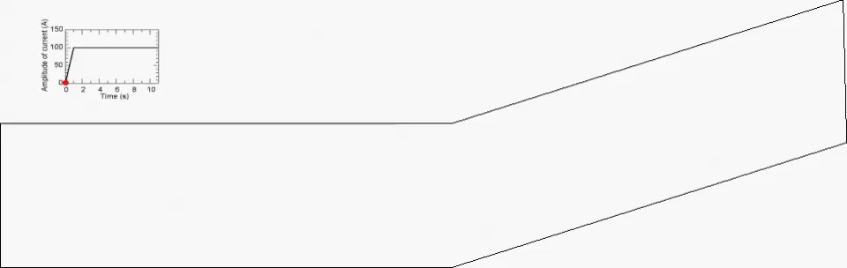
Flared-end racetrack coils

Slide 22
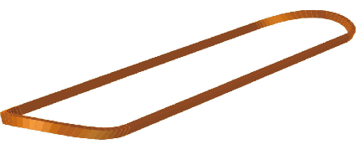
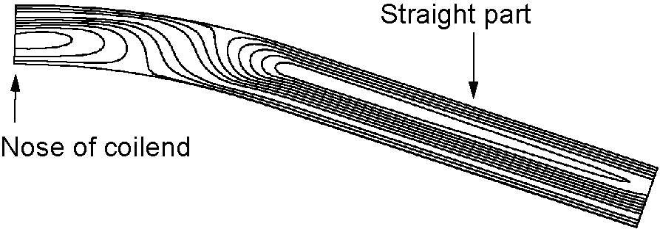
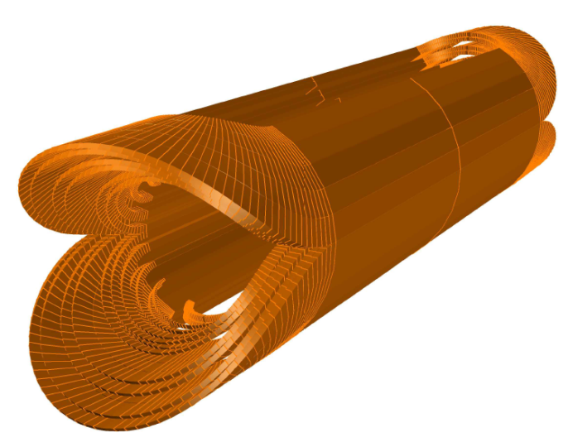
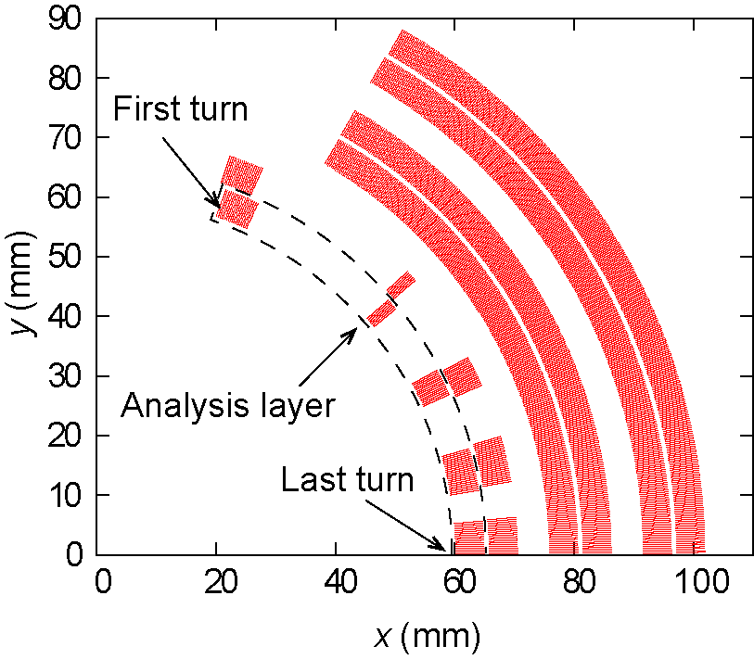
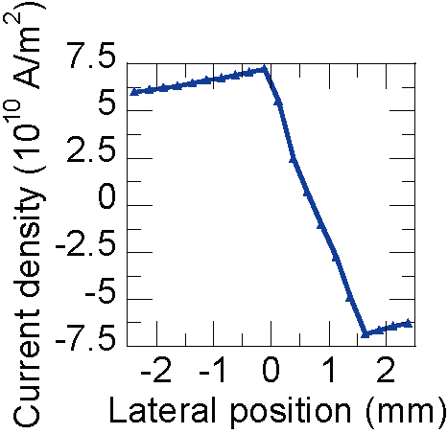
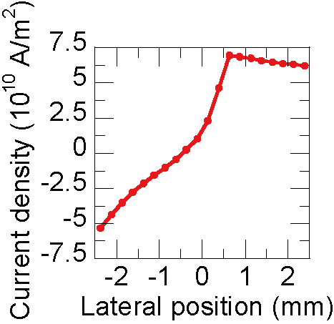
A cosine-theta dipole magnet for rotating gantry for carbon cancer therapy
Analysis of 1st layer only
1st turn in 1st layer
Multi-pole coefficients | Analyzed value (with magnetization) | Uniform current | contribution of magnetization
6 pole | 100.124 | 91.504 | 8.620
10 pole | 9.611 | 7.277 | 2.334
14 pole | 1.064 | 1.013 | 0.051

Slide 23
Perspective

Slide 24
How to manage this issue?
We have to accept the existence of the large magnetization in coated conductors.
A good news: reproducible magnetization
3D modeling will enable us the magnetic field design considering the magnetization: at least if the magnetization current is stable and hardly decays, we can design a coil which can generate the required magnetic field, not assuming uniform current but considering the calculated not uniform current distribution with magnetization current.
Drift in harmonics caused by the decay of magnetization must be a more serious issue.
Another good news:
  Not very large drift: at the order of unit, most possibly less than 10 units
  Dipole drifting more but higher harmonics drifting less
  Less drifts at lower temperature

Slide 25
Back-up slides

Slide 26
Dipole magnet RTC4-F comprising race-track coils
Coated conductor | Fujikura (FYSC-SC05)
Superconductor | GdBCO
Width × thickness | 5 mm × 0.2 mm
Stabilizer | 0.1 mm – thick copper
Critical current | 270 A – 298 A
Shape of coils | Single pancake race-track
Number of coils | 4
Length of straight section | 250 mm
Inner radius at coil end | 48 mm
Outer radius at coil end | 76.4 mm
Coil separation | 58 mm
Number of turns | 83 turn/coil
Length of conductor | 74 m/coil
I_{c} ~ 110 A

Slide 27
Equation for analyses
〔Biot-Savart’s law〕
〔Definitional of current vector potential〕
〔Faraday’s law〕
Equivalent conductivity derived from power law characteristic
Thin strip approximation
Neglecting current density component normal to SC layer / magnetic flux density component tangential to SC layer
Transformed to 2D problem

Slide 28
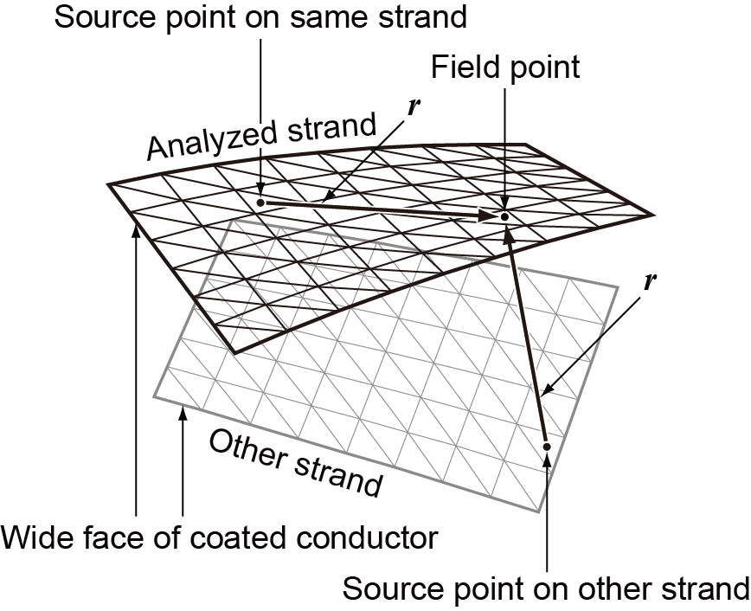
Consideration of three-dimensional geometry of coated conductors in a coil
r : vector from the source point where the current resides to the field point where the potential is calculated.
Superconductor layers are mathematically two-dimensional (no thickness), but follow the curved geometry of coated conductors in a coil.
The three-dimensional geometry of the coil is retained in the modeling, while region of analysis is mathematically two-dimensional.

