Slide 1

Deatailed design of a 25 T Cryogen-free Superconducting Magnet (25T-CSM)
Nov.13-14, 2014, Kyoto, Japan
High Field Laboratory Superconducting Materials,
IMR Tohoku University
Satoshi Awaji

Slide 2
Collaborators
HFLSM, IMR, Tohoku Univ. H. Oguro, Y. Tuchiya, K. Watanabe
Toshiba H. Miyazaki, M. Takahashi, Y. Tosaka,
K. Tasaki, S. Hanai, S. Ioka
Fujikura S. Fujita, M. Daibo, H. Iijima
Furukawa M. Sugimoto, H. Tsubouchi
NIMS G. Nishijima，S. Matsumoto，S. Nimori，
H. Kumakura, T. Shimizu
LNCMI-CNRS Y. Miyoshi, X. Chaud, F. Debray

Slide 3
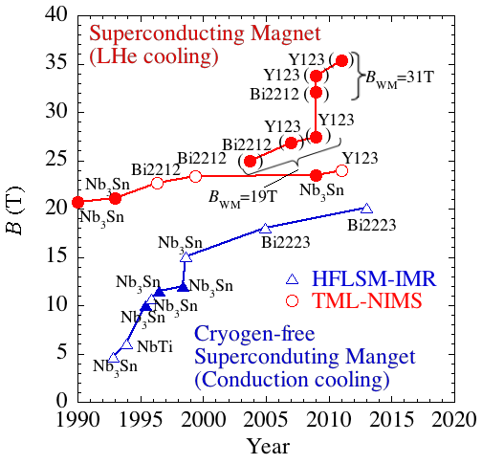
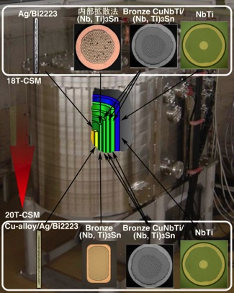
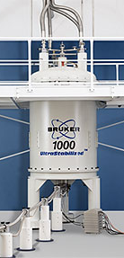
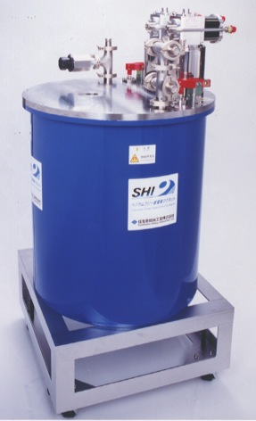
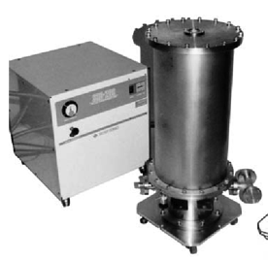
Progress of Superconducting Magnets
1GHz-NMR
(23.5T-φ54)
20T-φ52
25T-CSM
4T-φ36
15T-φ52

Slide 4
Content
Development of 25T-CSM
  Overview
  Key technology of LTS coils (CuNb/Nb₃Sn Rutherford )
  HTS coils (Gd123 CC )
    Load line and mechanical stress
    Epoxy impregnation (Deamination)
    AC-loss
    Quench protection

Slide 5

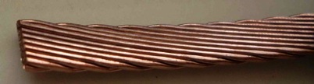
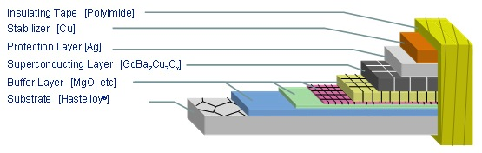
Overview of the 25T-CSM
68 GdBCO single pancakes
3 CuNb/Nb₃Sn Rutherford solenoid
3 NbTi Rutherford solenoid
712mm
96mm
LTS part: 14T
HTS part: 11.5T
628mm
2 x 1 stg GM cryocooler
2 x GM/JT cryocooler (8.6W@4.3K)
2 x 4K-GM cryocooler (3W@4.2K)

Slide 6
Conceptual design of 25T-CSM
 |  | REBCO | Nb3Sn | Nb3Sn | Nb3Sn | NbTi | NbTi | NbTi
Current | A | 135 | 851
Inner radius | mm | 48.0 | 150.0 | 185.9 | 229.2 | 272.5 | 301.3 | 313.9
Outer radius | mm | 140.0 | 182.9 | 226.2 | 269.5 | 301.3 | 310.9 | 355.8
Height | mm | 394.4 | 540.0 | 627.8 | 627.8 | 627.0 | 628.1 | 628.1
Coil current density | A/mm² | 110.8 | 68.9 | 68.9 | 68.9 | 71.6 | 90.0 | 90.0
No of turns/layer | - | 68 | 80 | 93 | 93 | 95 | 107 | 107
No of layer | - | 438 | 18 | 22 | 22 | 16 | 6 | 26
Total No of turns | - | 29784 | 1440 | 2046 | 2046 | 1520 | 642 | 2782
Bmax | T | 25.66 | 13.77 | 11.35 | 8.37 | 6.83 | 6.22 | 5.84
Br | T | 4.80 | 4.65 | 5.58 | 5.71 | 5.71 | 5.71 | 5.52
B0 | T | 11.56 | 2.43 | 2.91 | 2.73 | 1.91 | 0.78 | 3.24
Width of conductor | mm | 5.00 | 6.45 | 6.45 | 6.45 | 6.30 | 5.57 | 5.57
Thickness of conductor | mm | 0.13 | 1.83 | 1.83 | 1.83 | 1.80 | 1.61 | 1.61
Thickness of layer insulation | mm | 0.080 | 0.075 | 0.075 | 0.075 | 0.075 | 0.075 | 0.075
Jcon | A/mm² | 207.7 | 105.8 | 105.8 | 105.8 | 105.8 | 138.1 | 138.1
Tcs | K |  | 5.87 | 7.28 | 8.58 | 5.92 | 6.12 | 6.32
Averaged compressive stress | MPa | -35 | -39 | -51 | -50 | -49 | -59 | -53
Hoop Stress BJR | MPa | 376 | 219 | 223 | 203 | 154 | 129 | 92
Hoop stress Wilson | MPa | 461 | 251 | 243 | 200 | 138 | 112 | 52
（stress is for a whole cross-section of the conductors.）
L ≈ 97H, Stored Energy ≈ 10.7MJ

Slide 7
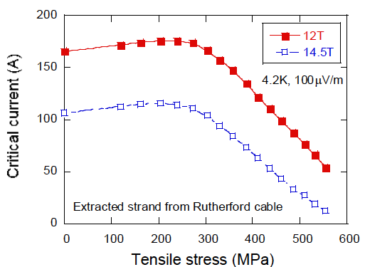
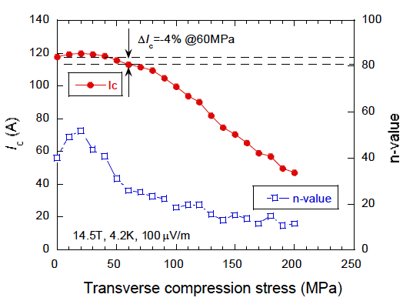
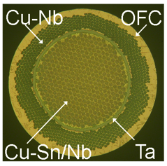

Mechanical stress effects
– strand in Rutherford cable–
CuNb/Nb₃Sn Rutherford cable
Axial stress
Transverse stress
251MPa
5０MPa
(b) Strand and pre-bent cable for 25T-CSM

Slide 8
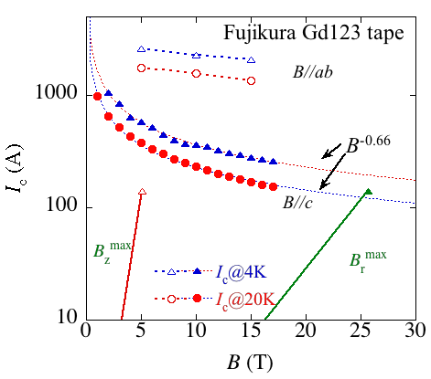
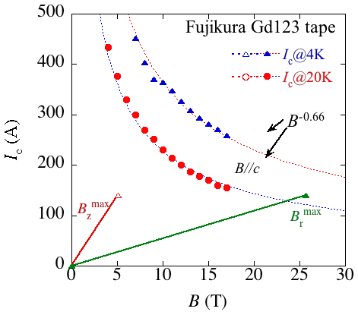
Performance of Gd123 CC
455MPa

Slide 9
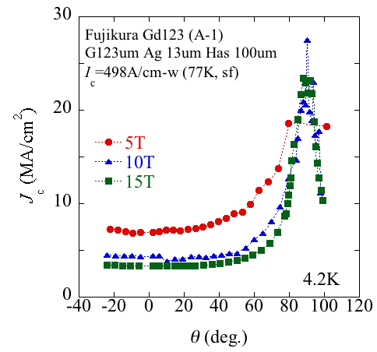
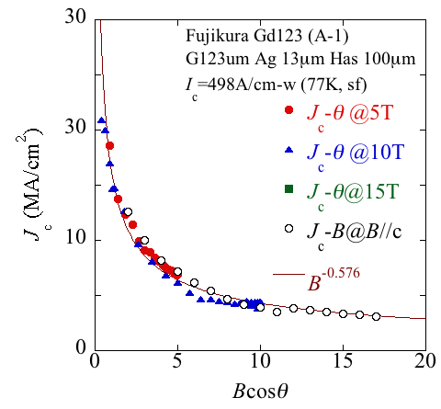
J_{c} (B, θ) at 4.2 K
Measured by Fujikura
The c-axis component of magnetic field determines J_{c} (B, θ).
Intrinsic pinning is dominant.

Slide 10
Field and J_{c} distribution（@25.5T）
B (T)
Angle of B (deg)
I_{c} (A)
I_{c}^{min}=403A
T = 4.2K
B_{max} = 25.7 T

Slide 11
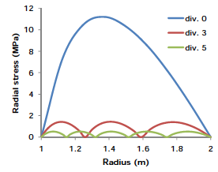
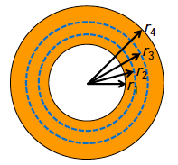
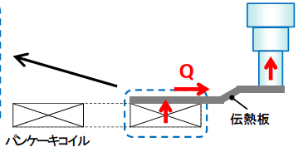
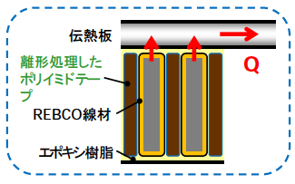
Epoxy Impregnation (Delamination)
3 sections : r_{i}^{out}/r_{i}^{in} ≈ 1.26
5 sections : r_{i}^{out}/r_{i}^{in} ≈ 1.15
2nd stage
Cooling plate
F coated polyimide tape
REBCO tape
Al cooling plate
Epoxy resin
Pancake coil
All turns are un-bonded but the edge part is connected to the cooling plate.
Notes:
Bond, stick

Slide 12
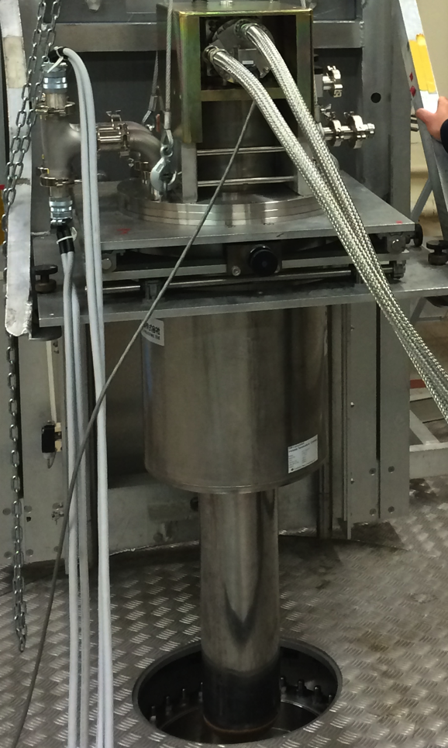
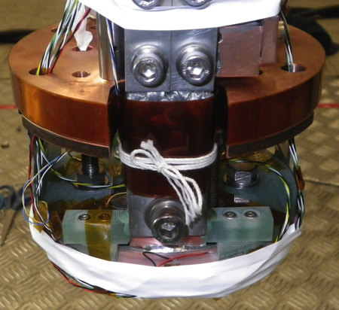
R&D test @LNCMI, Grenoble
M10@LNCMI,
Grenoble, France
19 T-170mm RT bore
Gd123 coil
Tape | Fujikura Cu-plated Gd123
Tape Ic | 297 A
Tape w | 5 mm
Tape tick | 0.12 mm
Turn tick | 0.18 mm
Coil D_{in} | 96 mm
Coil D_{out} | 119.7 mm
Coil h | 10.7 mm
Turn No. | 58 x 2
Tape L | 20 x 2 m
Ic@77K, sf | 109 A (upper) 108 A (lower)
n-values | 28 (upper) 29 (lower)
section 2
D_{out}/D_{in} ≈ 1.10

Slide 13
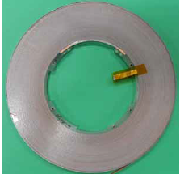
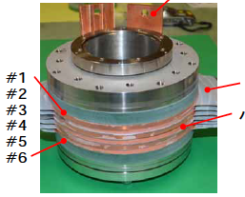



6 stacked coil
 | #1, #3, #5 | #2, #4, #6
Tape | Cu-plated Gd123 | Cu lamination on Cu plated Gd123
Tape width | 5 mm
Tape thickness | 0.12 mm | 0.17 mm
Inner diameter | 96 mm
Outer diameter | 172 mm
No of turns | 208 | 160
Tape length | 87 m | 68 m
Cooling plate
coils
Cu-plated
^{t}0.05-Cu
Cu laminated
Joints

Slide 14
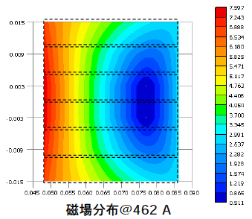
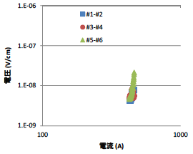
Test results -6 stacked coil-
7.6T
20K
E (V/cm)
0.51T
I (A)
Magnetic field @462 A
 | 60 K |  | 50 K |  | 40 K |  | 30 K |  | 20 K
 | I_{C}(A) | N | I_{C}(A) | N | I_{C}(A) | N | I_{C}(A) | N | I_{C}(A) | N
#1-#2 | - | - | 260 | 25 | 337 | 24 | 416 | 32 | - | -
#3-#4 | 182 | 21 | - | - | - | - | - | - | - | -
#5-#6 | - | - | - | - | - | - | 420 | 32 | 521 | 33

Slide 15
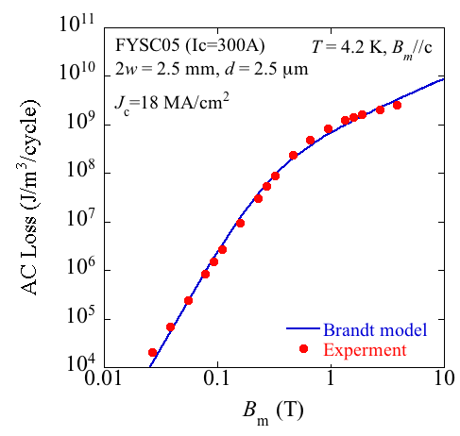
AC loss of Gd123 tape
Experimental data were provided by Prof. Iwakuma using the saddle-shaped pick-up coil.
Very good agreement can be seen, but we have to take the effects of stacking into account!
B_{r}
Single strip
Stacked strip

Slide 16
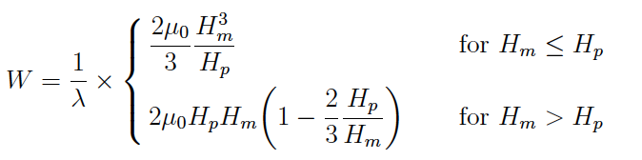

Models of AC loss
Brandt model for a strip (H. Brandt et al. , PRB, 48(1993)12893.)
B
thickness << width
Kajikawa model for a slab (Kajikawa et al., 4LPo2B-06, http://arxiv.org/abs/1405.7765.)
B
thickness >>width
Mawatari model for stacked strips (Y. Mawatari, PRB, 54 (1996) 13215.)
B
W₀ = m₀J_{c}wH_{c}, c = πw/D, h = H_{m}/H_{c} and H_{m} is an amplitude of applied magnetic field.

Slide 17
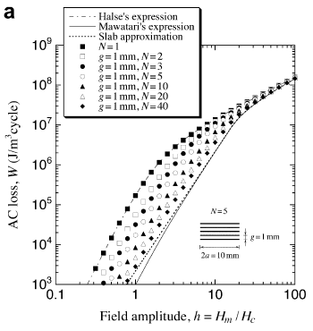
Effect of tape stacking on AC-loss
N
strip
slab
Kajikawa et al., Physica C 469 (2009) 1436.
The AC-loss approaches from the strip model to the slab model, when the number of stacks increases.
Due to an increase of B_{p} by tape stacking, AC losses in low field region decreases.

Slide 18
Calculation of AC loss power
(time derivative)
Slab model
Strip model (Brandt) w/o transport current (only external field)
B_{z}
B_{r}
J_{c}

Slide 19
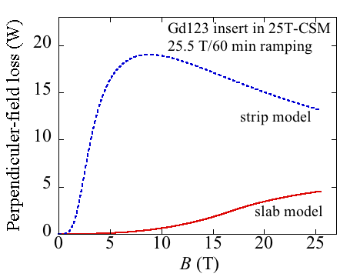
Perpendicular-field loss
The perpendicular-field ac loss of about 5 W estimated, if the effect of tape stacking, although it is about the twice of loss without the stacking effects (stripe model). In particular, the field dependency are much different each other.

Slide 20
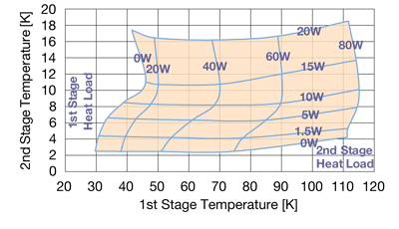
Cooling the HTS coil in the 25T-CSM
If the temperature rise to about 10 K is allowed, the heat load of 20 W
(10 W/cooler) can be permitted.

Slide 21
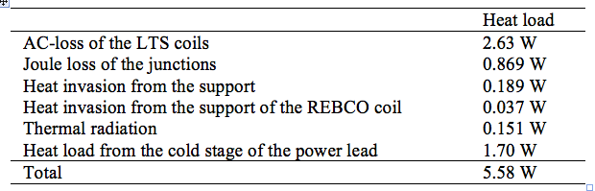
Cooling the LTS coil in the 25T-CSM
Heat load to the GM/JT cryocoolers at 4 K
Cooling modes
mode 1 (300–50 K)
mode 2 (50–20 K)
mode 3 (20–4 K)

Slide 22
Design of a 25T-CSM (modified)
 |  | YBCO | Nb3Sn | Nb3Sn | Nb3Sn | NbTi | NbTi | NbTi
Current | A | 140 | 851
Inner radius | mm | 51 | 150.0 | 185.9 | 229.2 | 272.5 | 301.3 | 313.9
Outer radius | mm | 138 | 182.9 | 226.2 | 269.5 | 301.3 | 310.9 | 355.8
Height | mm | 408 | 540.0 | 627.8 | 627.8 | 627.0 | 628.1 | 628.1
Space current density | A/mm² | 110.8 | 68.9 | 68.9 | 68.9 | 71.6 | 90.0 | 90.0
No of turns/layer | - | 68 | 80 | 93 | 93 | 95 | 107 | 107
No of layer | - | 435 | 18 | 22 | 22 | 16 | 6 | 26
Total No of turns | - | 29580 | 1440 | 2046 | 2046 | 1520 | 642 | 2782
Bmax | T | 25.68 | 13.77 | 11.35 | 8.37 | 6.83 | 6.22 | 5.84
Br | T | 4.80 | 4.65 | 5.58 | 5.71 | 5.71 | 5.71 | 5.52
B0 | T | 11.5 | 2.43 | 2.91 | 2.73 | 1.91 | 0.78 | 3.24
Width of conductor | mm | 5.00 | 6.45 | 6.45 | 6.45 | 6.30 | 5.57 | 5.57
Thickness of conductor | mm | 0.13 | 1.83 | 1.83 | 1.83 | 1.80 | 1.61 | 1.61
Thickness of layer insulation | mm | 0.070 | 0.075 | 0.075 | 0.075 | 0.075 | 0.075 | 0.075
Jcon | A/mm² | 217 | 105.8 | 105.8 | 105.8 | 105.8 | 138.1 | 138.1
Tcs | K |  | 5.87 | 7.28 | 8.58 | 5.92 | 6.12 | 6.32
Averaged compressive stress | MPa | -35 | -39 | -51 | -50 | -49 | -59 | -53
Hoop Stress BJR | MPa | 417 | 219 | 223 | 203 | 154 | 129 | 92
Hoop stress Wilson | MPa | 455 | 251 | 243 | 200 | 138 | 112 | 52
（stress is for a whole cross-section of the conductors.）
L ≈ 97H, Stored Energy ≈ 10.7MJ

Slide 23
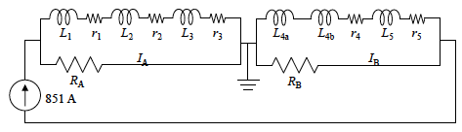
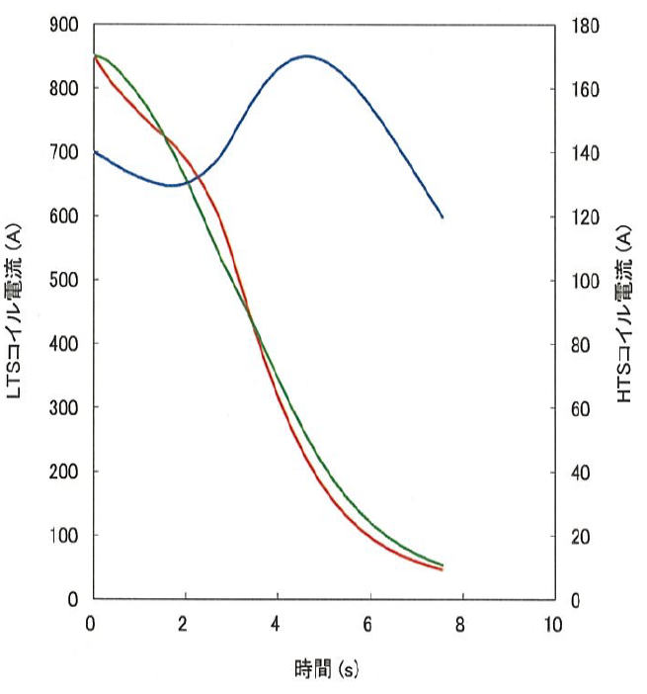
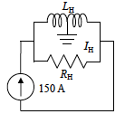
Protection circuit
LTS part
V_{max} ≈ 1.87kV
R_{A}=R_{A}=1Ω
HTS part
HTS
R_{H}=11Ω
140A
I_{LTS}(A)
I_{HTS}(A)
LTS-B
LTS-A
The quench is detected by the balance voltage of LTS.
The quench of HTS is not cared because of its high stability.

Slide 24
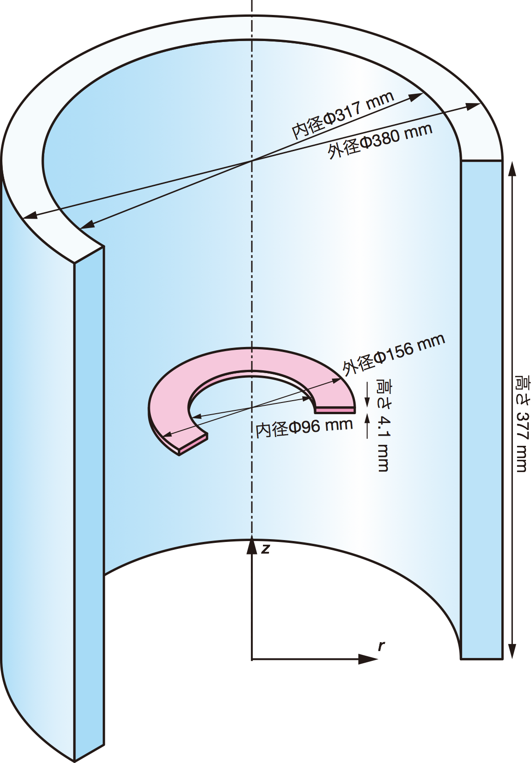
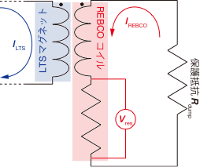
Quench test of small coils
Outer LTS Magnet
 | LTS | REBCO
D out(mm) | 380 | 156
D in (mm) | 317 | 96
Height(mm) | 377 | 4.1
L (mH) | 24 | 1.73
M (mH) | 34
SC thickness(μm) |  | 1.5
Cu thickness(μm) |  | 100
REBCO
Single pancake coil
Dump Resistance
Resistive V

Slide 25
Quench behavior
Dump resistance dependence
Initial Temp. dependence
Resistive Vres (V)
w temperature rise
Maximum Tmax
Higher T for Lower Initial-T
w/o temperature rise

Slide 26
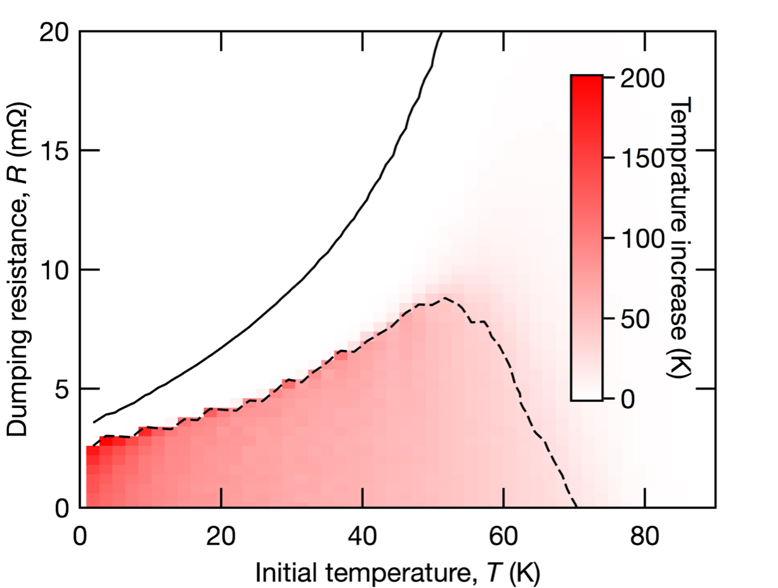
Temperature rise
Temperature Increase Tinc(Tini, R)
Imax = Ic
Negligible T-rise
Protection by
temp. margin
Tmax = Tc
Protection by Quench heater

Slide 27
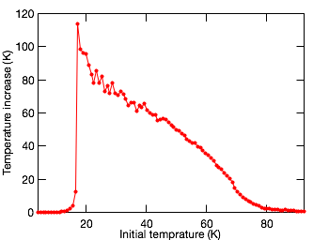


Quench analysis
Temperature rise
Initial-T dependence
Inner
Outer
←コイル内径
コイル外径→
Smaller hot-spot at lower-T
Higher Temp rise at lower-T
低温ほどホットスポット領域が狭い
低温ほどホットスポットによる温度上昇は大きい
Initial-T | low | high
Temperature rise | large | small
Hot-spot area | narrow | wide
Risk of burn-out | large | small
Low temp.
High temp.
Hot-spot at High-T is more safty!

Slide 28
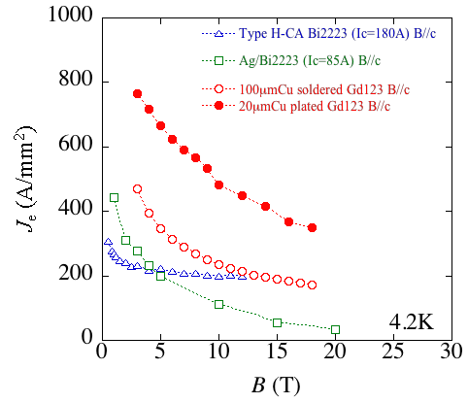
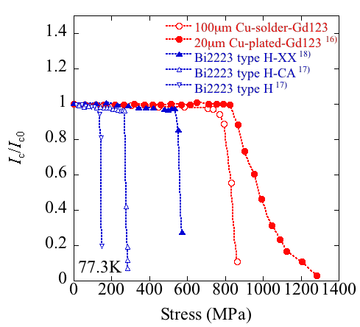
Performance of HTS tapes
淡路 智，まぐね， vol.9, No4 (2014)

Slide 29
HTS insert for 25T-CSM (modified)
 |  | YBCO | Bi2223
Current | A | 140 | 224
Inner radius | mm | 51.1 | 48.0
Outer radius | mm | 140.0 | 139.3
Height | mm | 394.4 | 391.4
Space current density | A/mm² | 117 | 112
No of turns/layer | - | 68 | 76
No of layer | - | 435 | 234
Total No of turns | - | 29580 | 17784
Bmax | T | 25.66 | 25.62
Br | T | 5.11 | 4.95
B0 | T | 11.5 | 11.50
Width of conductor | mm | 5.00 | 5.15
Thickness of conductor | mm | 0.13 | 0.32
Thickness of layer insulation | mm | 0.080 | 0.07
Jcon | A/mm² | 215 | 157
Averaged compressive stress | MPa | -35 | -32
Hoop stress Wilson | MPa | 455 | 330

Slide 30
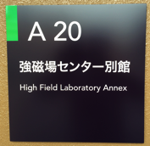
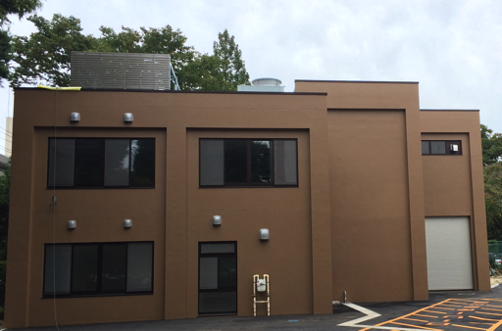
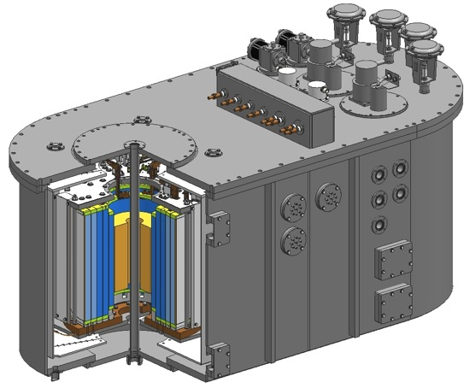
HFLSM annex building and 25T-CSM
HFLSM Annex １F
Measuring-
equipment
storage
25T-CSM
Machinery
Hall
Front
door
Closet
Experimental
preparation
room
WC
Sink
WC
1390^{W}X2840^{L}X1190^{H}

Slide 31
Summary
The 25T-CSM project is going on now at the HFLSM, Sendai, Japan.
We adopted a high stress design for both of LTS and HTS coils.
The issues of impregnation, AC losses, quench protection are being overcome.
However, we just start to consider the possibility of high strength Bi2223 tape (HT-XX) for the HTS insert.
The construction must be finished by March, 2015.

