Slide 1
Canted-Cosine-Theta (CCT) magnets
Shlomo Caspi
Superconducting Magnet Group
Lawrence Berkeley National Laboratory
Kyoto Japan, November 13-14, 2014
2014 Kyoto Workshop on HTS Magnet Technology for High Energy Physics
The 2nd Workshop on Accelerator Magnet in HTS (WAMHTS-2)
For the superconducting magnet group:
D. Arbelaez, L. Brouwer, D. Dietderich, H. Felice, A. Godeke, S. Gourlay, A. Hafalia Jr, M. Marchevsky, H. Pan, S. Prestemon, X. Wang

Slide 2
Superconducting Magnet Beyond the LHC
The Future-Circular-Collider (FCC) is a mandate for a change
  Some critical performance questions:
How much margin can we afford ? short-sample?
How much training can we afford ? first quench is the last quench?
Technology – “magnet business” not as usual.
  Technology wish list:
Perfect field - a Cosine-n-Theta like - effective use of the bore
Low conductor stress at any field – magnet is strain independent
No need for pre-stress – easy assembly and cool-down
Reduce cost – reduce number of parts, tooling, R&D
Reduce complexity – less analysis, less optimization

Slide 3
The Canted-Cosine-Theta (CCT) – a paradigm shift
  The CCT comes close to answer the technology wish list
  The CCT is yet to prove it can meet the performance wish list
Perfect field:
    As “true” a cosine-theta current density distribution
    Field quality over the straight section and “ends”
Low conductor stress:
    Structure intercepts Lorentz-Forces, reduced coil stress by an order of magnitude
    No need for pre-stress
    Small or large bores
    Grading - same strand in all cables
Cost-effective:
    All poles inclusive – just like solenoids, Inherently a 3D structure
    Fewer parts, simplified tooling and assembly
    Compatibility between NbTi, Nb₃Sn and HTS
Original paper by D.I. Meyer and R. Flasck “A new configuration for a dipole magnet for use in high energy physics application”, Nucl. Instr. and Methods 80, pp. 339-341, 1970.)

Slide 4
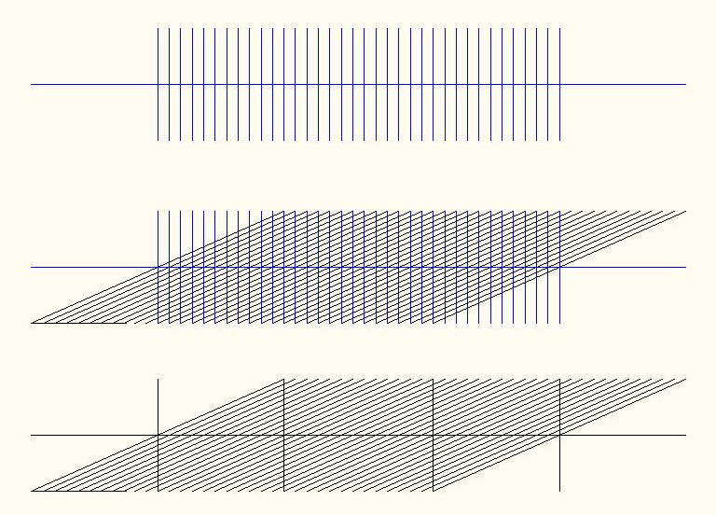
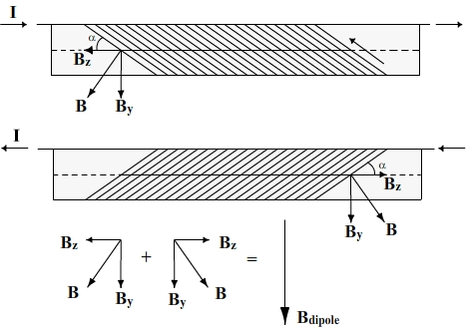
What is the Canted-Cosine-Theta (CCT) Magnet
Solenoid
Canted solenoid
Canted ~15 degrees
Canted-Cosine-Theta
Two superimposed coils, oppositely skewed, achieve a pure cosine-theta field and eliminate axial field.

Slide 5
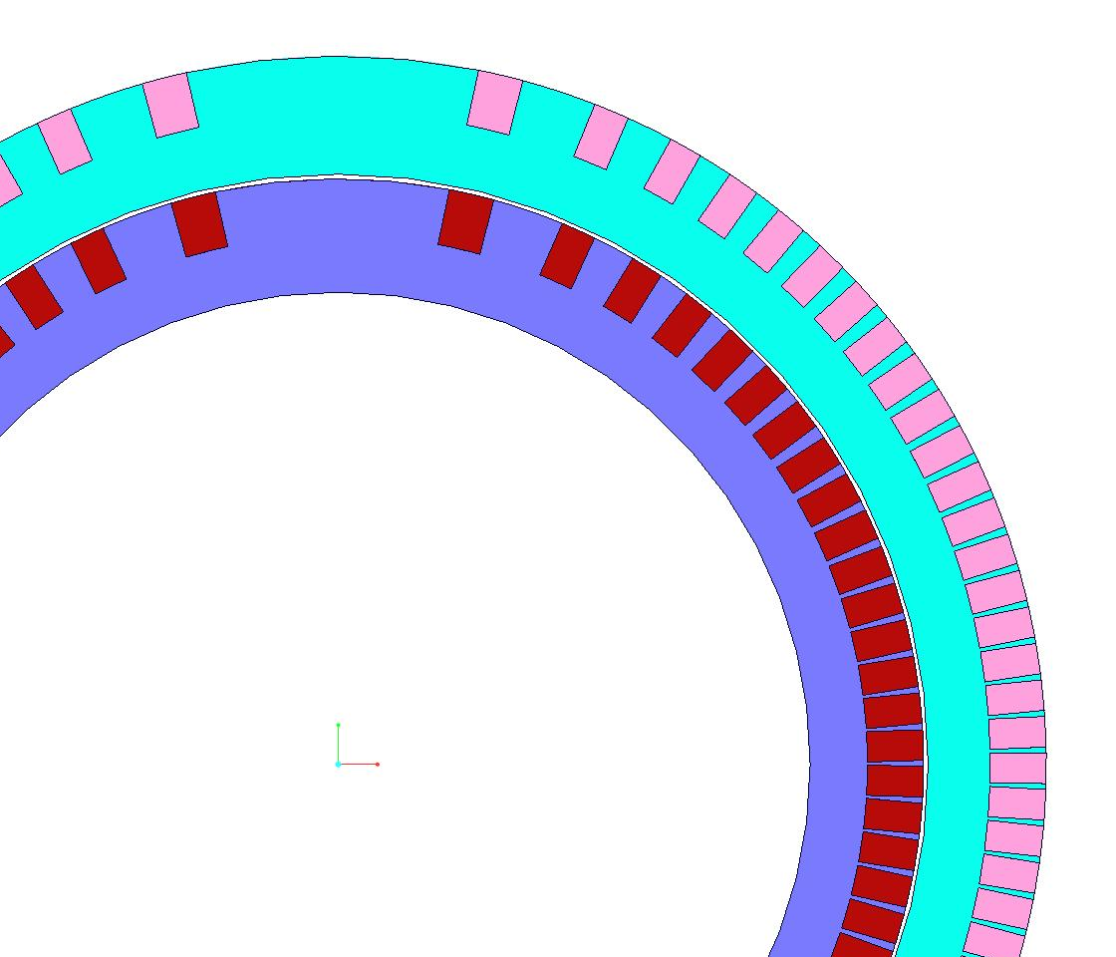
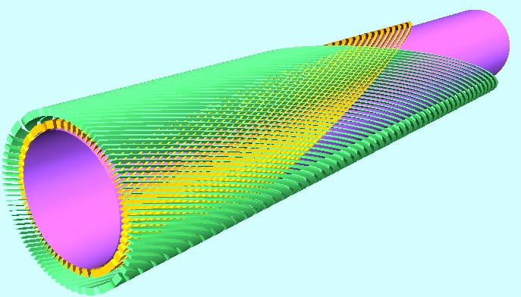
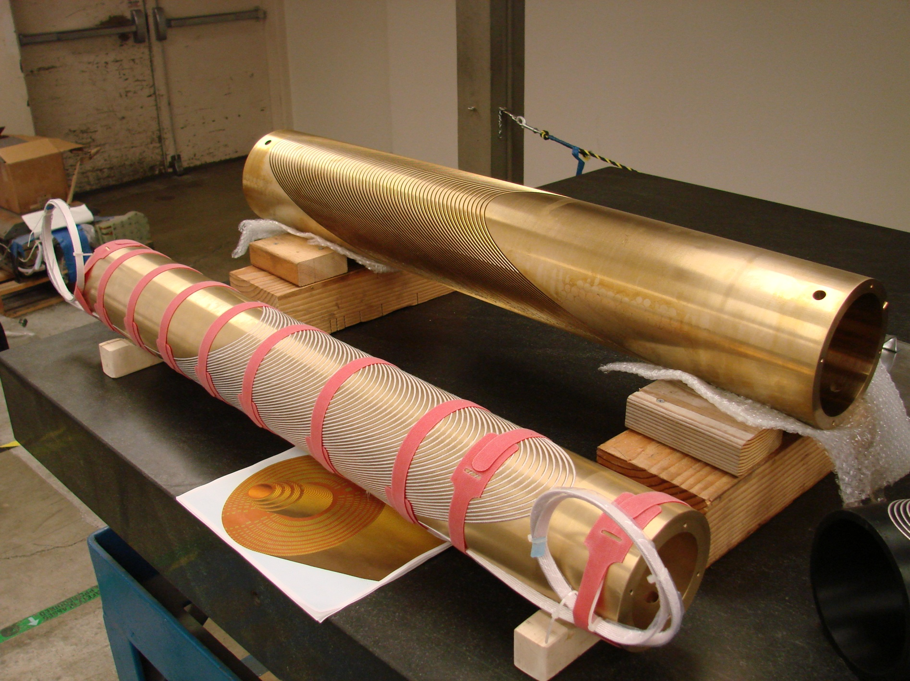
The CCT Magnet
Ribs (wedges) create a “perfect” magnetic field and intercept the Lorentz forces
Turns
Ribs or “wedges”
The Spar integrates forces
Spiral channels are cut into a cylinder.

Slide 6
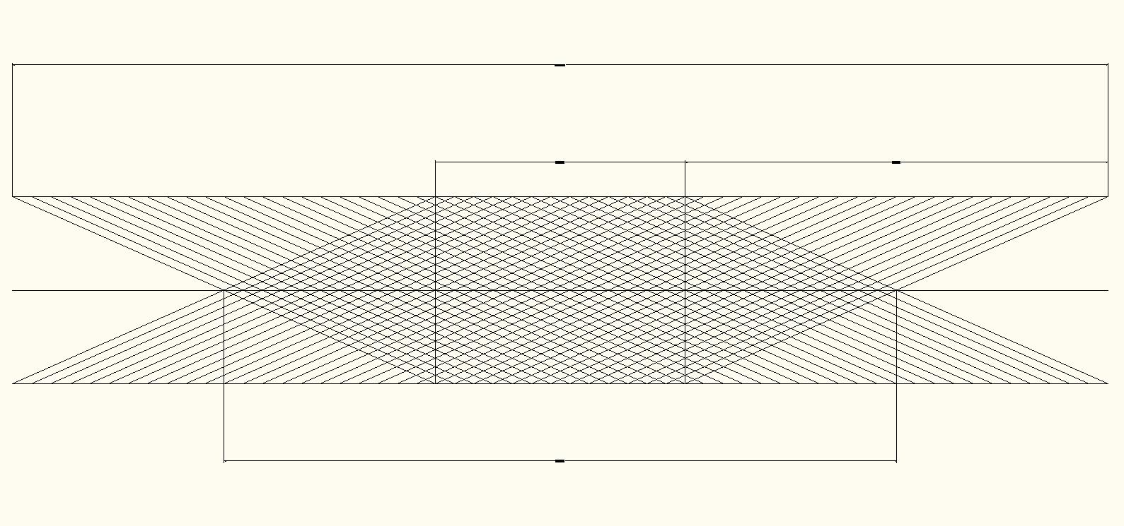
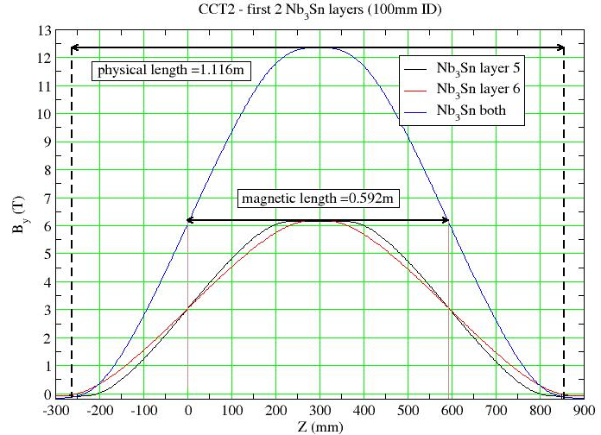
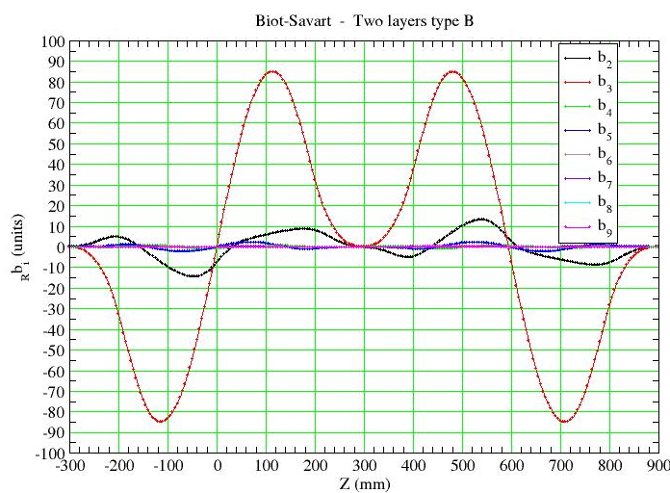
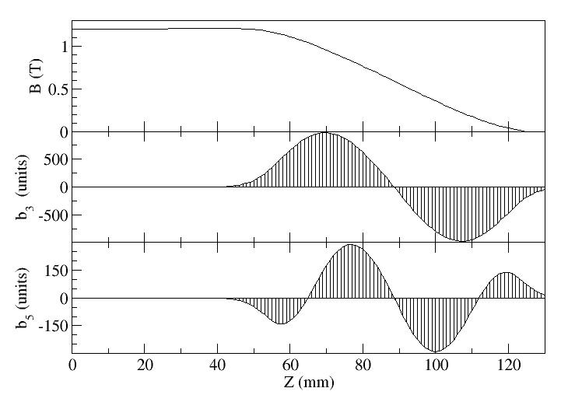
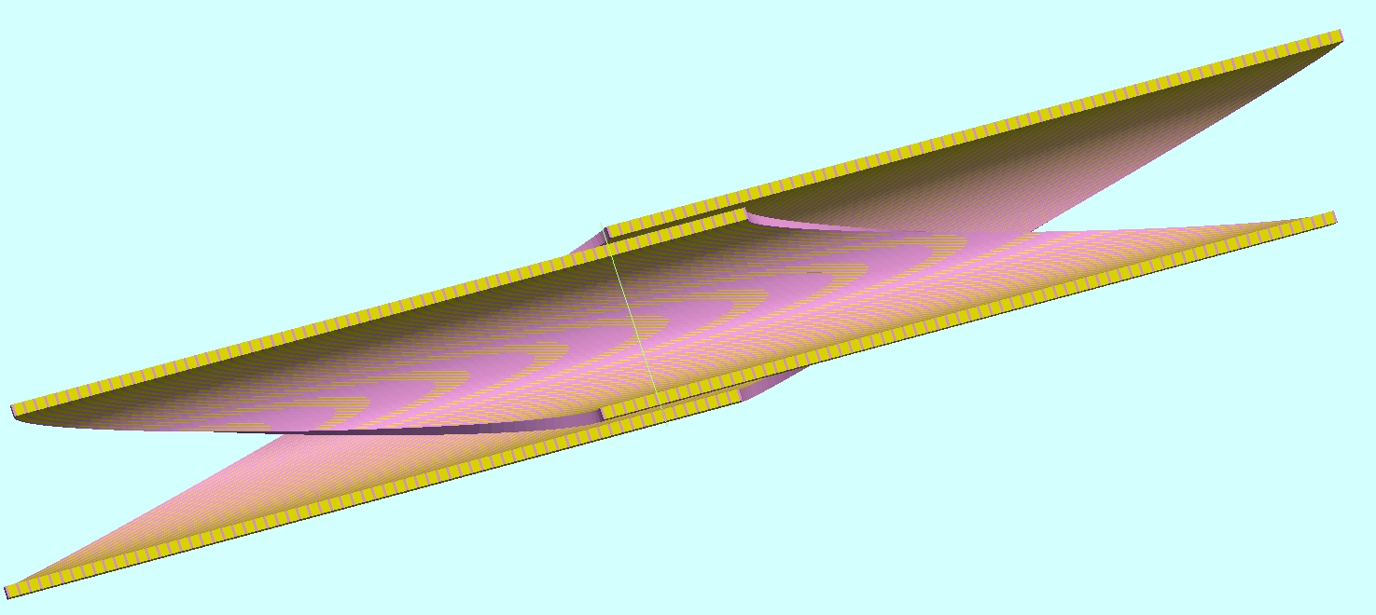
CCT Magnetic Length and “ends” (Nb₃Sn)
Magnet length
Straight-section-length
End-length
Magnetic-length
dipole
Magnetic-length = pitch*Nturns
harmonics
Straight-section
Harmonics over each “end” integrate to zero

Slide 7
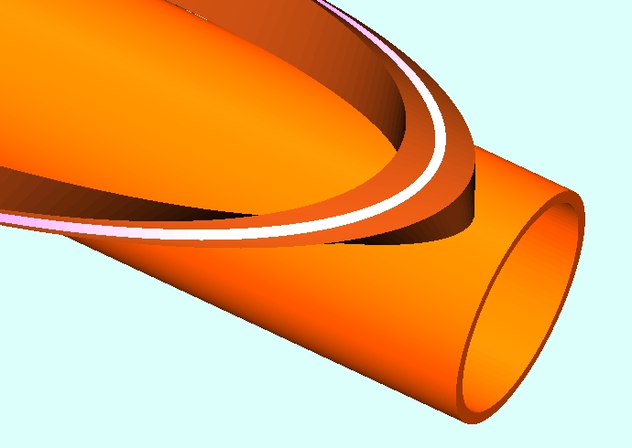
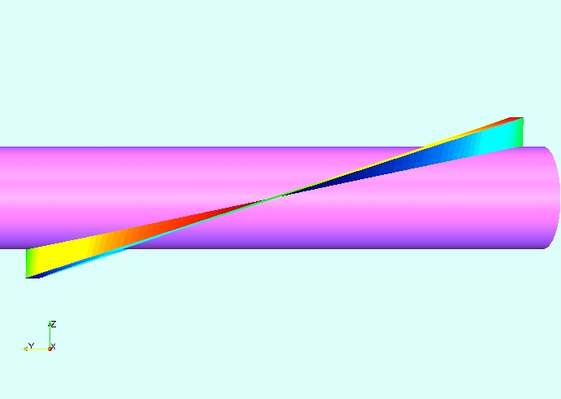
CCT – Stress Interception
  Where the force is large the rib is thick
The conductor (cable) is placed into a channel that is cut normal to a cylinder.
Tangential (bi-normal) forces are intercepted by the channel walls that are held by the inner spar thereby intercepting the turn to turn force.
  Where the force is small the rib is thin
Turn normal to cylinder
Radial Stress Max
Bi-normal Stress 0
Stress integrator (Spar)
Bi-normal Stress (z direction) Max
Radial Stress 0
Bi-normal Stress ~ Sin(theta)
Radial Stress ~ Cos(theta

Slide 8
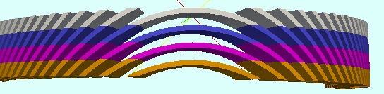
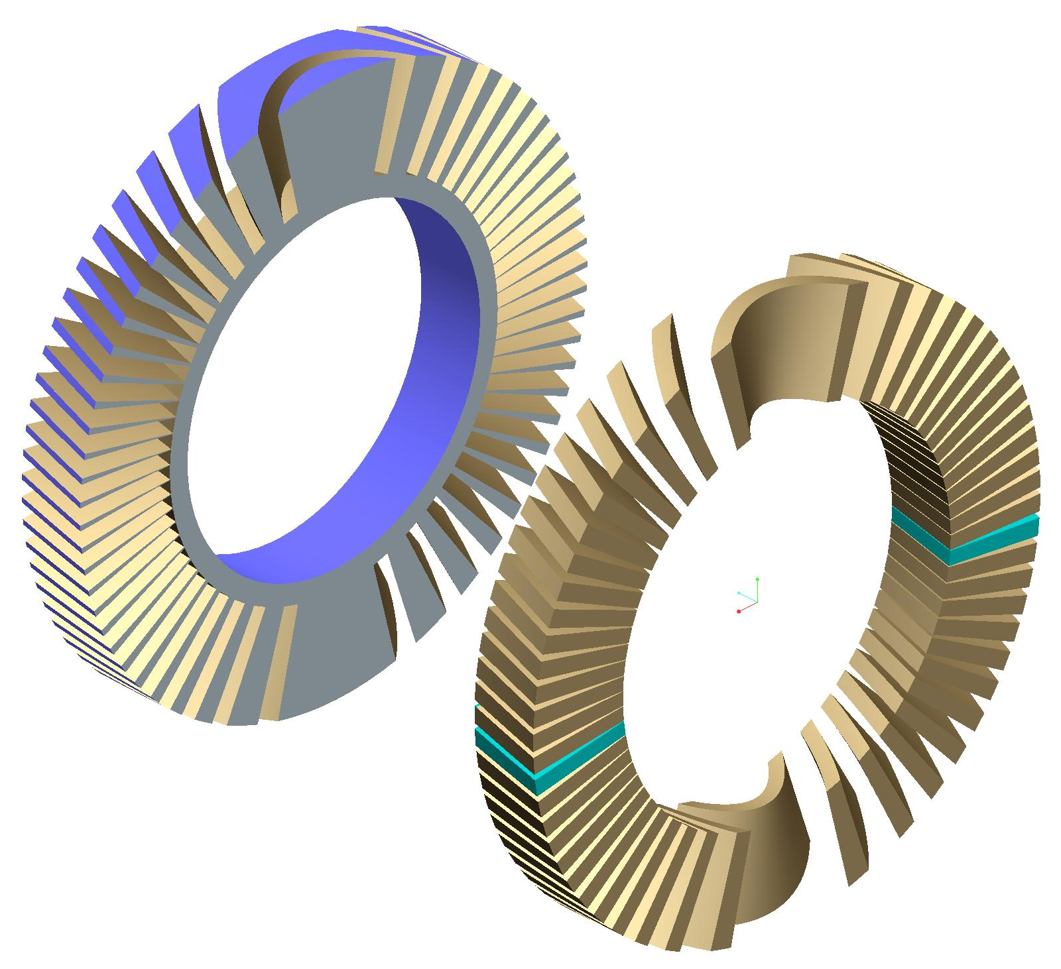
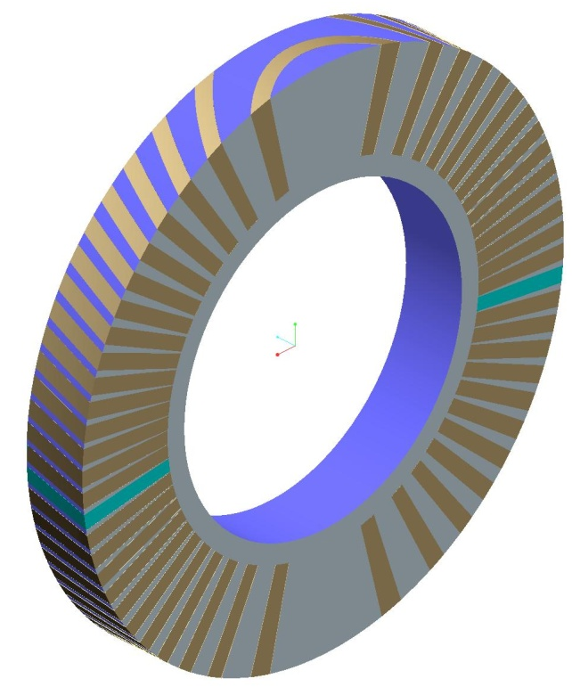
Lamination
Laminations repeat every pitch length
Mandrel
= Internal structure
= ribs and spar
Conductor
Impact:
Construction
Computation
Conductor and structure

Slide 9
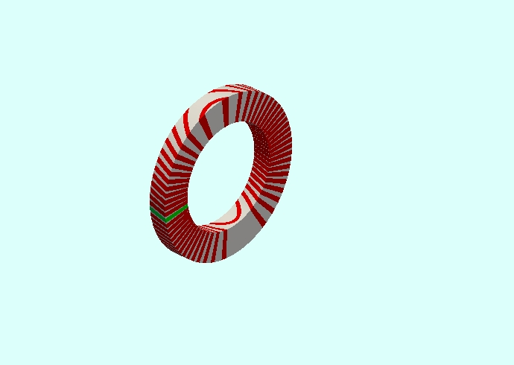
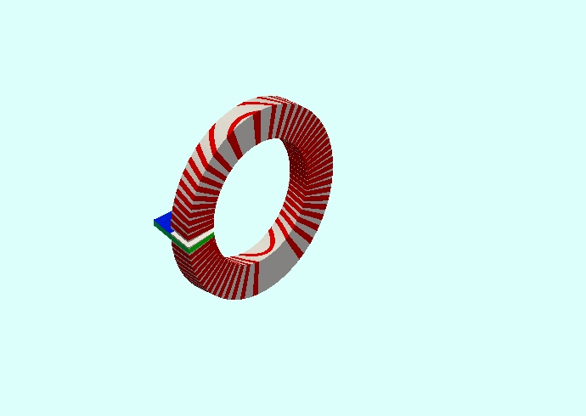
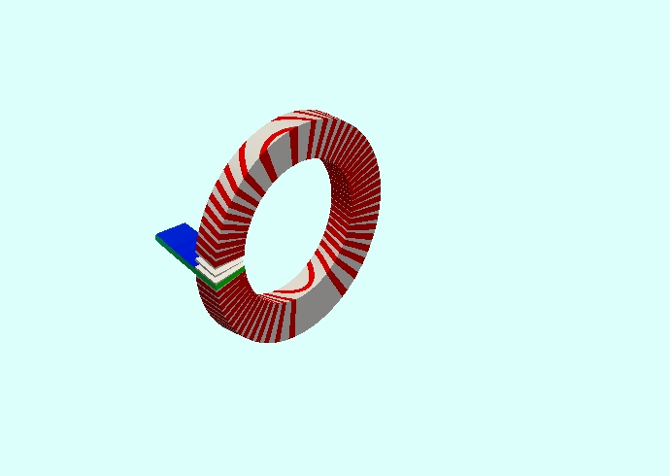
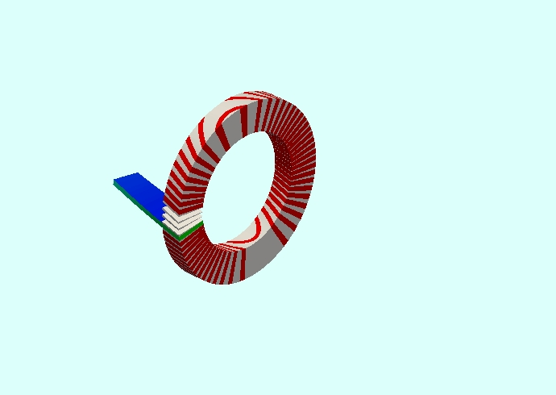
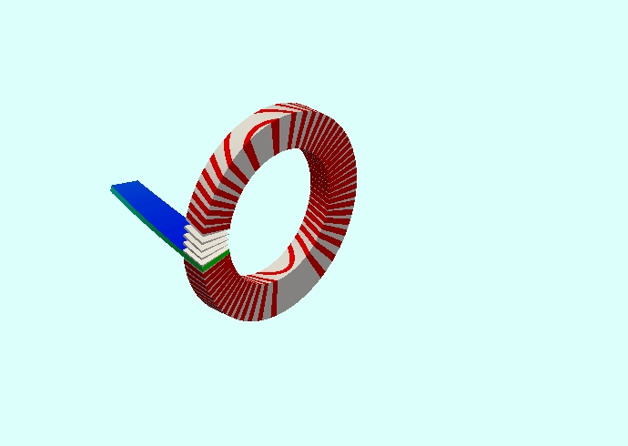
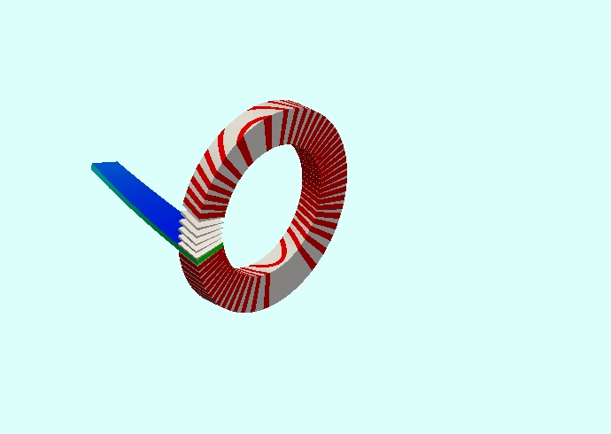
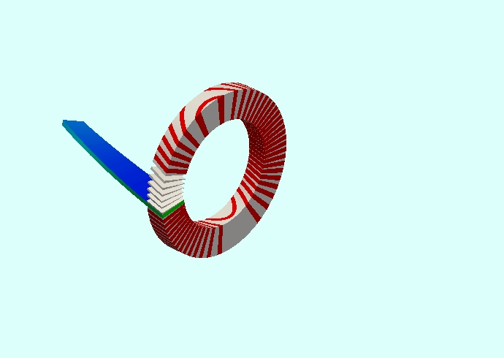
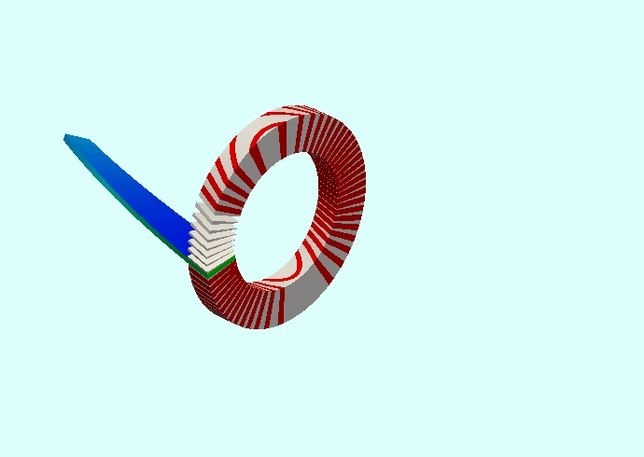
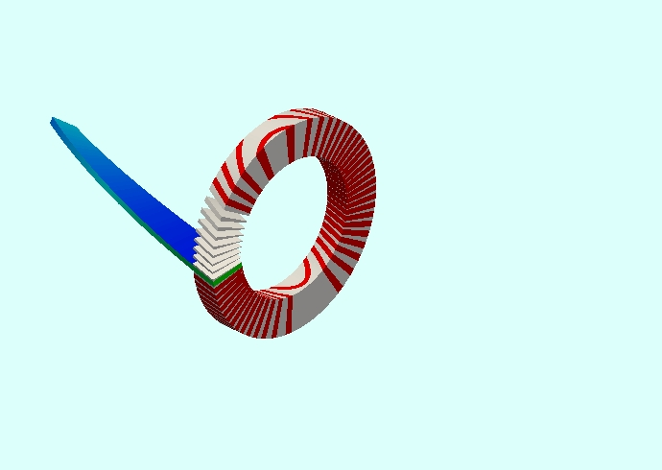

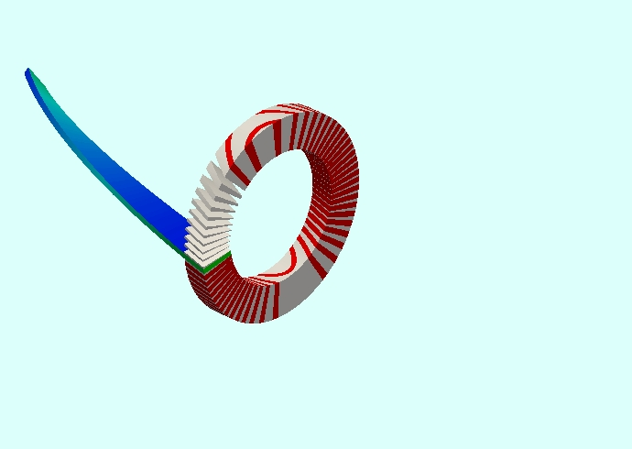
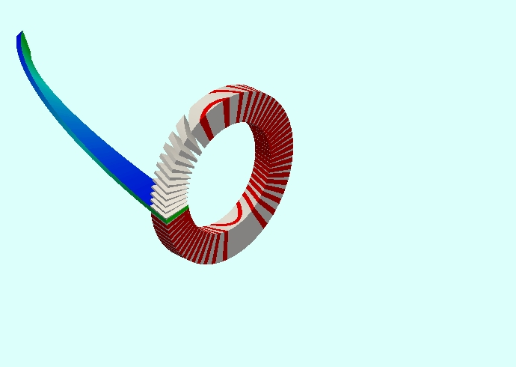
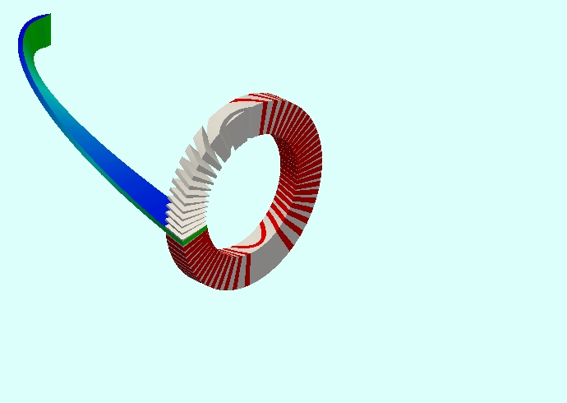
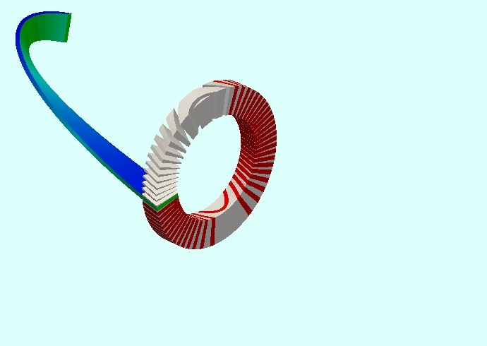
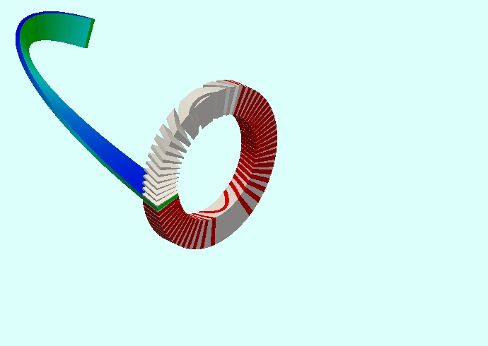

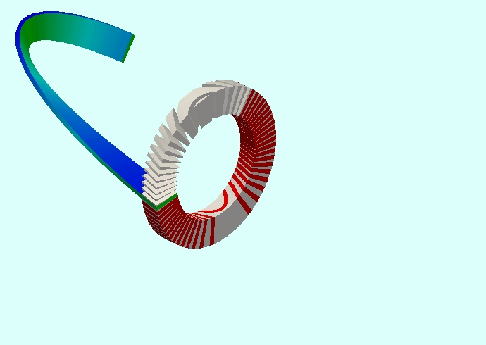
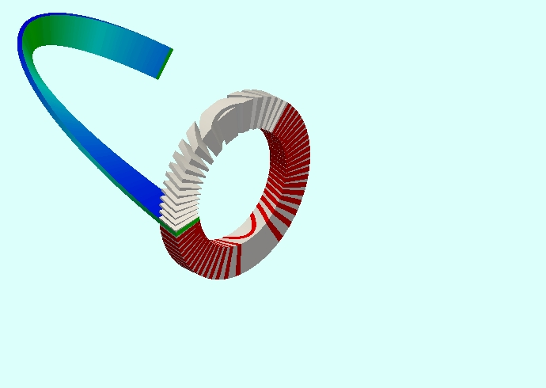
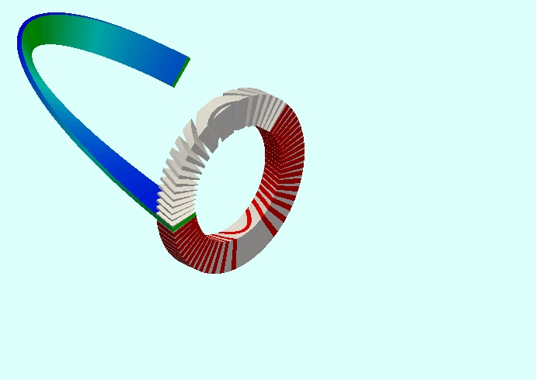
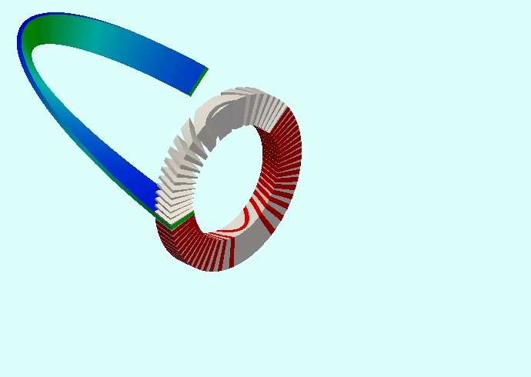
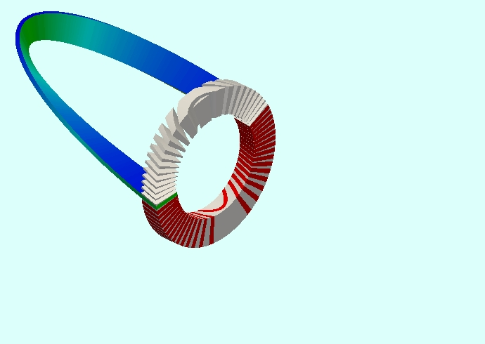




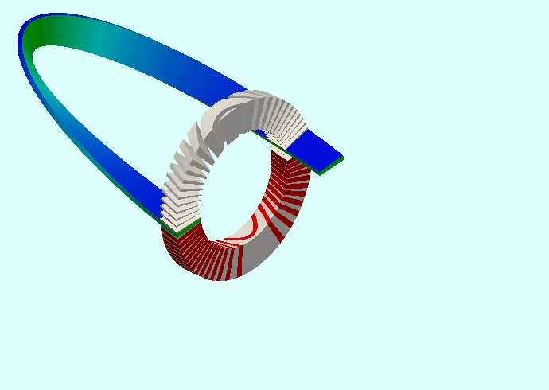
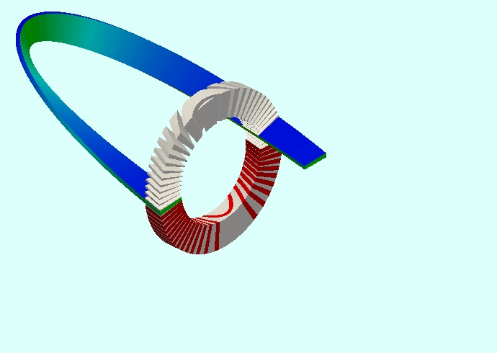
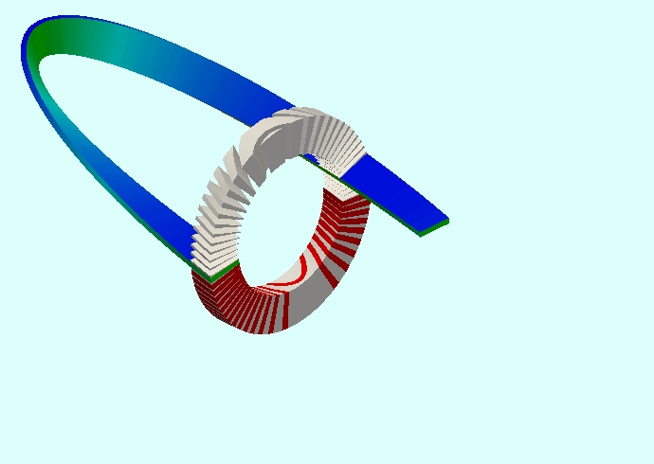
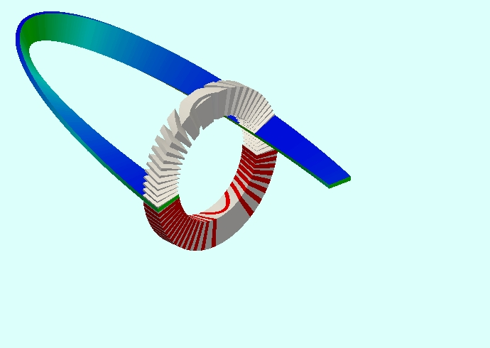
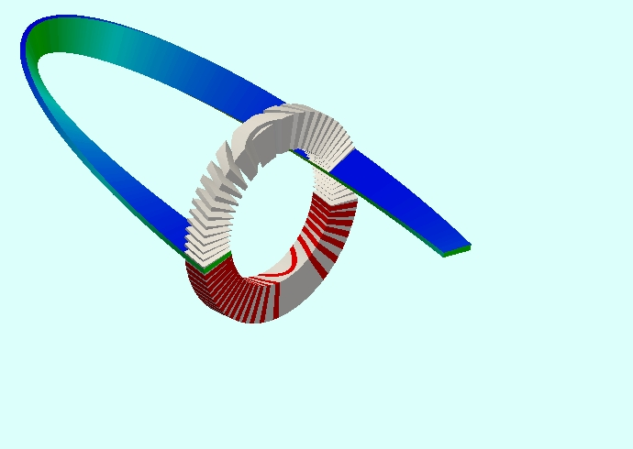
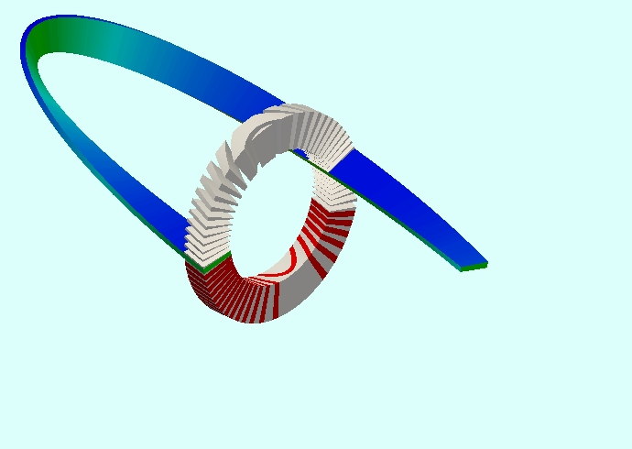
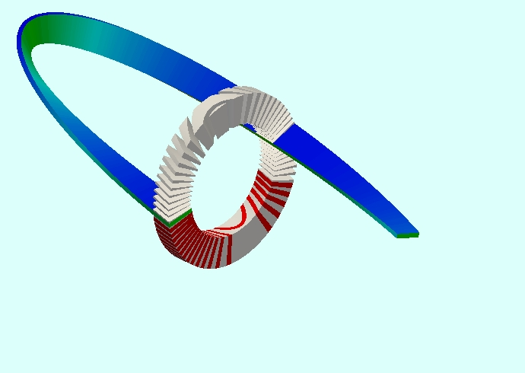
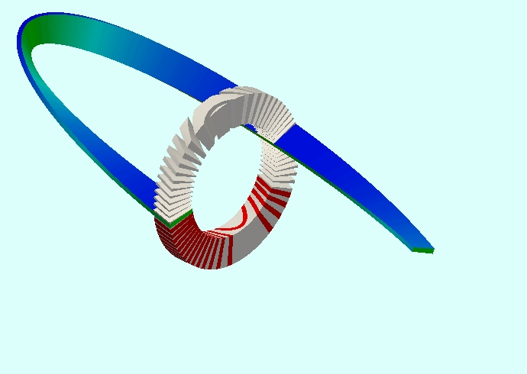

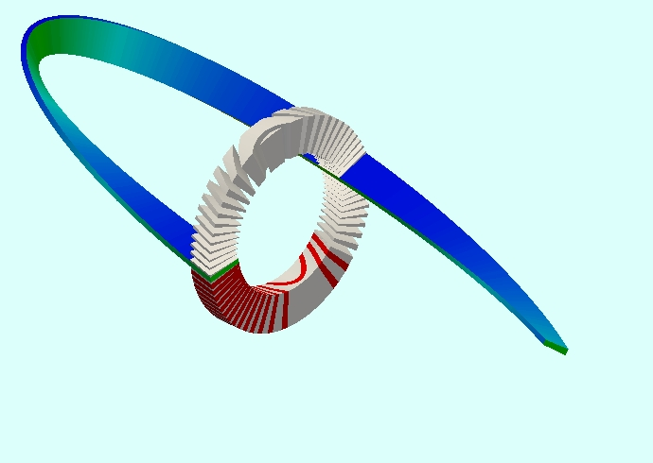


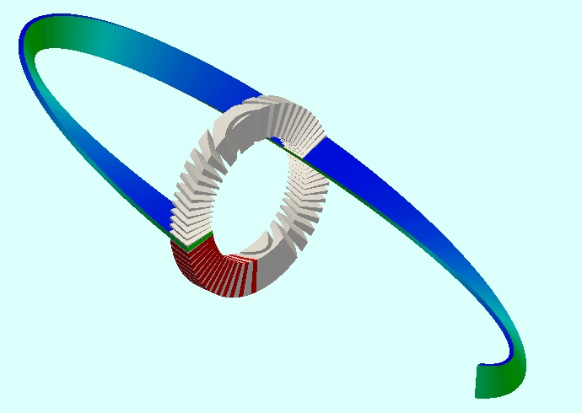
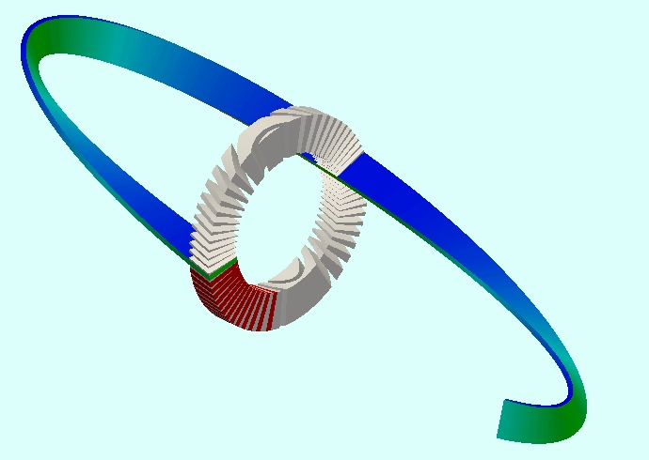
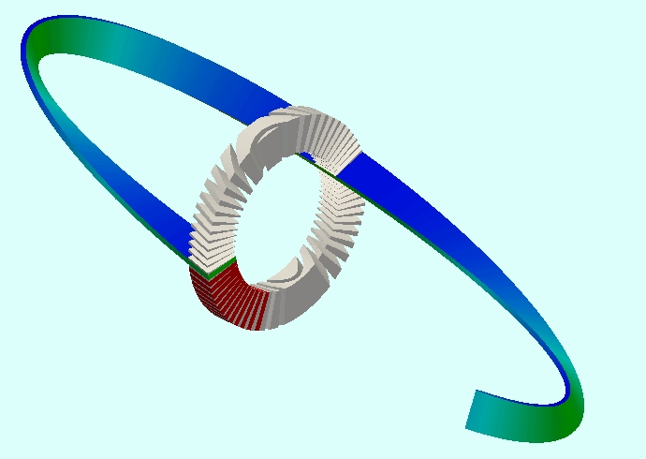

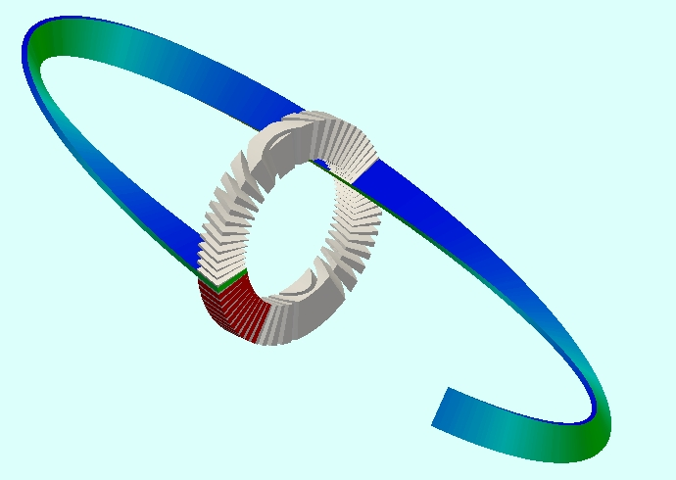
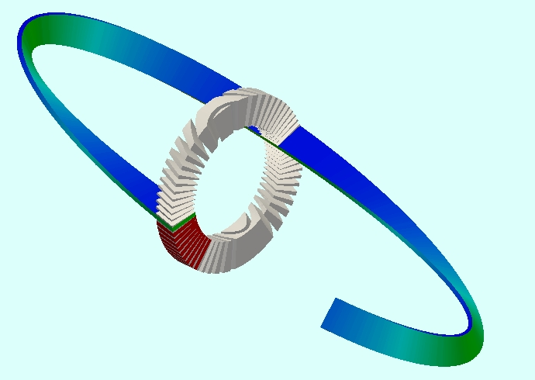
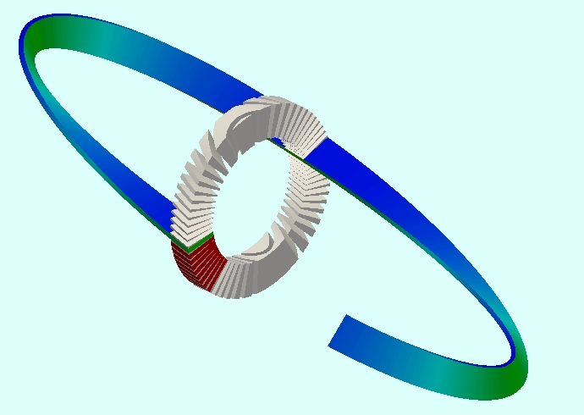
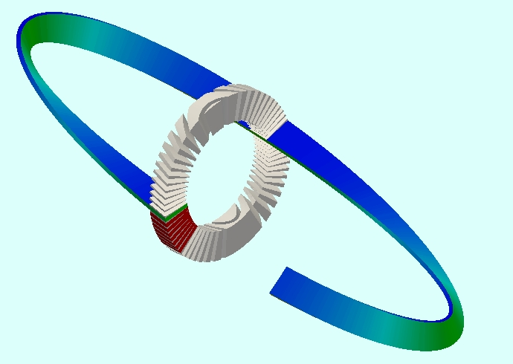








The CCT is a 3D object - lamination

Slide 10
Summary – Nb3Sn Magnets
Operation | Non CCT | CCT
Winding tooling | Mandrel, clamps, tension | Mandrel
Coil parts | islands, “end” spacers, wedges
Winding | binding
Curing | cavity tooling, press
Reaction | Cavity tooling | Wrap
Potting | Cavity tooling | Wrap
Pre-assembly | assemble poles with pads, align
Final-assembly | Outer structure -Iron, Shell | Nest and align layers
Pre-stress | azimuthally
Pre-stress | axially

Slide 11
A High Field CCT Dipole Design

Slide 12


A 18T CCT
Clear bore ID=40mm,
OD=274.3mm
8 layers Nb₃Sn
4 layers Bi2212 insert

Slide 13

A 12 layers Nb₃Sn-Bi2212 CCT
Nb3Sn double layers graded
Bi2212 not graded
Field > 10T, cannot use NbTi

Slide 14



8 layers Nb₃Sn + 4 layers Bi2212
Bybore
8 layers of Nb₃Sn contributing 1.9T/layer (7580A)
4 layers of Bi2212, contributing 0.7T/layer (2620A)
Each layer has the same number of turns and angle
Same magnetic length each layer 1m=pitchXturns
The magnet has no-iron
Conductor |Bmod| is at the magnet center
Bore field is 17.7T |Bmod|max=18.1T (2.2% higher))
Pitch=7.63mm, 131 turns
|B|cond

Slide 15
~18T CCT with 8 layers Nb₃Sn + 4 layers Bi2212
Layer | Material | I (A) | J_{sc} (A/mm²) | J_{strand} (A/mm²) | J_{channel} (A/mm²) | |B-cond-max| (T) | strand (m/m) | Cable (m/m) | Conductor (Kg/m)
1 | Bi-2212 | 2620 |  | 651 | 455 | 18.1 | 395.8 | 49.48
2 | Bi-2212 | 2620 |  | 651 | 455 | 17.8 | 495.6 | 61.95
3 | Bi-2212 | 2620 |  | 651 | 455 | 17.5 | 595.3 | 74.42
4 | Bi-2212 | 2620 |  | 651 | 455 | 17.1 | 695.1 | 86.9
1 | Nb₃Sn | 7580 | 1395 | 655 | 364 | 16.3 | 2450.1 | 106.5 | 10.85
2 | Nb₃Sn | 7580 | 1395 | 655 | 364 | 15.4 | 3046.0 | 132.4 | 13.49
3 | Nb₃Sn | 7580 | 1887 | 887 | 493 | 14.4 | 2650.4 | 155.9 | 11.73
4 | Nb₃Sn | 7580 | 1887 | 887 | 493 | 13.5 | 3007.9 | 176.9 | 13.32
5 | Nb₃Sn | 7580 | 2673 | 1256 | 698 | 12.6 | 2351.1 | 195.9 | 10.41
6 | Nb₃Sn | 7580 | 2673 | 1256 | 698 | 11.8 | 2554.7 | 212.8 | 11.31
7 | Nb₃Sn | 7580 | 3565 | 1675 | 931 | 11.2 | 2057.7 | 228.6 | 9.11
8 | Nb₃Sn | 7580 | 3565 | 1675 | 931 | 10.1 | 2188.4 | 243.1 | 9.69
*|B-cond-max| is the maximum conductor field at the pole.
***strand, cable and conductor weight are per 1m magnetic length
Total length of Nb3Sn strand (0.8mm) 20.3Km/1m-magnetic-length (~180k$)
Total length of Bi2212 strand (0.8mm) 2.2Km/1m-magnetic-length (factor of 10 ?)

Slide 16



3D ANSYS Stress Analysis
Conductor Azimuthal Stress
Structure Azimuthal Stress
Meshed layer
See L. Brouwer, S. Caspi, and S. Prestemon “Structural Analysis of a 18 T Hybrid Canted-Cosine-Theta Superconducting Dipole”
IEEE Transactions on Applied Superconductivity paper 4LPO2F-08 to be published ASC 2014
See L. Brouwer, D. Arbelaez, S. Caspi, H. Felice, S. Prestemon, and E. Rochepault “Structural Design and Analysis of Canted–Cosine–Theta Dipoles”
IEEE Transactions on Applied Superconductivity, vol. 24, no. 3, june 2014

Slide 17



ANSYS ~18T with 8 layers Nb₃Sn + 4 layers Bi2212
σt, σr, σb are stress along the path, radial and normal to the rib (bi-normal) ANSYS
Stress plotted around a single turn for the innermost Bi2212 and Nb3Sn layer.

Slide 18
Conductor stress for different layers – ANSYS*
σ_{t} : Tangential Stress (along cable)
σ_{r} : Radial Stress
σ_{b} : Binormal Stress (perp. to rib)
Stress at short-sample | Max/Min σ_{t} | Max/Min σ_{r} | Max/Min σ_{b} | Layer
2 Layer: 10 T (Nb₃Sn) | 60/-38 | 18/-42 | 27/-67 | inner
8 Layer: 16 T (Nb₃Sn) | 102/-45 | 28/-51 | 72/-76 | inner
12 Layer: 18 T (Nb₃Sn) | 41/-28 | 27/-29 | 36/-48 | 5’th
12 Layer: 18 T (Bi2212) | 74/-35 | 43/-48 | 60/-59 | inner
Depending on how the Lorentz force density and rigidity scale,
going to higher field by increasing the number of layers could have very little effect,
or even improve the situation
* Courtesy of L. Brouwer

Slide 19
Present and Future Plans

Slide 20
Present and Future Plans
What has been done and what is being done:
Tested a 2.4-T NbTi CCT dipole.
Designed a short 2 layer dipole 5T NbTi (CCT2) and a 10T Nb3Sn (CCT3)
Fabricate identical mandrels for both magnets (Q1 2015)
Designed an 18-T dipole - field quality, loads and mechanical stresses for the various stages.
Develop fabrication processes and cost-effective tooling.
18T in sequential steps:
8 layers of Nb₃Sn coils with progressive fields from 10T to 16T (several independent tests)) (2015-16)
Develop a HTS insert raising the field to 18T (2016)

Slide 21


CCT1
NbTi Cable 1.3x3 mm (SSC outer strand)
2 aluminum mandrels
No impregnation (cable free within the channel)
56mm clear bore
Magnet reached 2.5T
b3~7, b5~0, b7~0.5 units at 3900A (Ref=66%)

Slide 22




CCT Magnet Technology – in progress
Reaction tooling
Winding, no tension no curing
Potting tooling
Wind using a deeper channel --2x10mm
Test reaction tooling and winding position
Test potting tooling and winding position
Reacted coil

Slide 23

The CCT – Plans
# of layer | Material | I (A) | |B-cond-max| (T) | B-bore (T) | JssXBss (N/mm^3)
1-2 | NbTi | 10600 | 5.9 | 5.3
1-2 | Nb₃Sn | 20700 | 11.6 | 10.3 | 10
1-2-3-4 | Nb₃Sn | 13550 | 13.8 | 13.1
1-2-3-4-5-6 | Nb₃Sn | 10100 | 15.2 | 14.7
1-2-3-4-5-6-7-8 | Nb₃Sn | 8100 | 16.2 | 15.8 | 5
1-2-3-4 | Bi-2212 | 3950 | 4.9 | 4.4

Slide 24






Curved Accelerator Magnets
Linear configuration
Curved configuration
Direction of current
  A winding concept on a toroid that produces a combined function field and higher multipole fields (e.g. gantry magnets for proton-carbon beam therapy)
  Multipole Winding Path
Toroidal coordinate system.
Combined function

Slide 25
CCT - Summary
A New Magnet Type – Canted-Cosine-Theta
Magnetic and structural elements (Islands, wedges, “end” spacers) replaced by spar and ribs
Stress interception with applied Lorentz Force (large bore ok)
Assembly and cool-down - no pre-stress required
Grading not limited, the same strand in all cables
2D and 3D high field quality over an extended range (no optimization)
Conductor insulation to ground only (ceramic coating=no cable insulation)
Generic design for all conductor types – NbTi, Nb3Sn, HTS
Simplified tooling
A linear structure (e.g. dominated by structure not conductor properties)
Combined function field, (handle geometric errors)
Extended technology to curved coils and other magnet types

Slide 26
Conclusions
The CCT is a paradigm shift in the design of high field SC magnets and the potential of high gain in SC magnet technology (reduce stress, improve training and “short-sample” expectation, field quality etc)
The CCT has the potential of reducing cost especially at high fields
We proposed a R&D program that demonstrate CCT technology with NbTi , Nb3Sn and HTS (we have addressed the choice of material, mandrel manufacturing, coil winding, reaction, impregnation and analysis)
Part of a cost analysis of a high field option for the FCC

