Slide 1



Reduction of internal porosity in 2212 round wires with overpressure (OP) processing
Maxime Matras
J. Jiang, N. C. Craig, P. Chen, F. Kametani, P. J. Lee, U. P. Trociewitz,
H. Kandel, C. Scheuerlein* , E. E. Hellstrom, and D. C. Larbalestier
Applied Superconductivity Center, National High Magnetic Field Laboratory, Florida State University
*CERN

Slide 2
Driving questions
Why do we need overpressure (OP) processing to make 2212 wire a candidate for high field applications?
  To increase J_{E} by densification of the 2212 filaments
When and how does conductor densification occur?
  High densification is reached homogeneously above 800°C
How much reduction in diameter does OP produce?
  About 4% decrease in diameter
What is the effect of OP on coil? (Peng Chen - NHMFL)
Can we densify 2212 wires before winding?
  Cold isostatic pressing is one option
What length of conductor does not densify in case of seal failure?

Slide 3
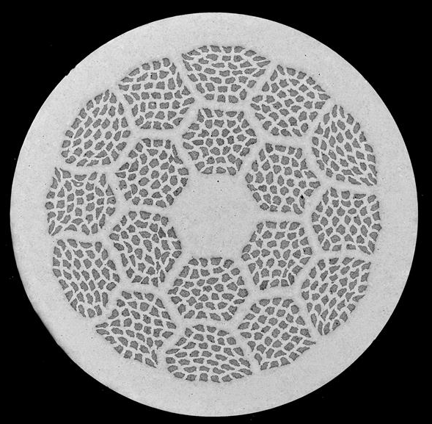
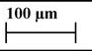
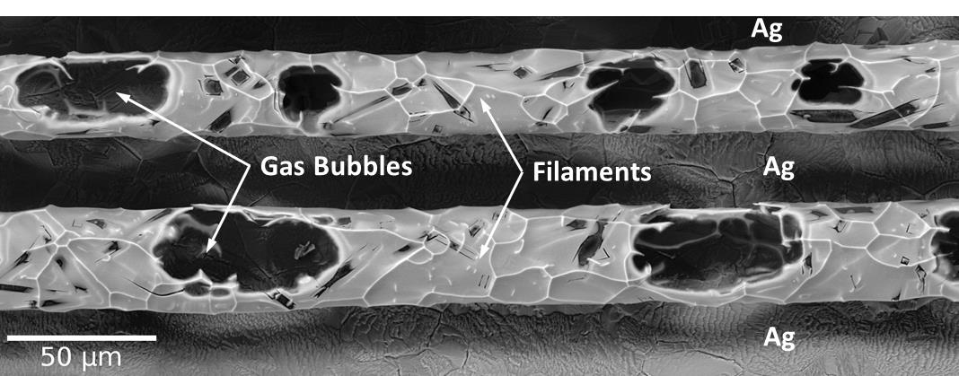
As-drawn wires are only 60% dense
Cross section as-drawn 37x18 (W13)
As-drawn filaments are 60±5 % dense (PIT process)
40±5 % gas bubbles after 2212 melts
Bubbles block current transport
Wire expands at high temperature
Problems:
Filament cavity and 2212 powder have different volumes
Internal gas causes Ag creep at high temperature
(T. Shen)
Filaments from wire quenched in the melt
Kametani et al., Supercond. Sci. Technol. 24, 075009 (2011)

Slide 4
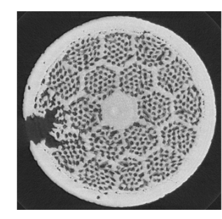
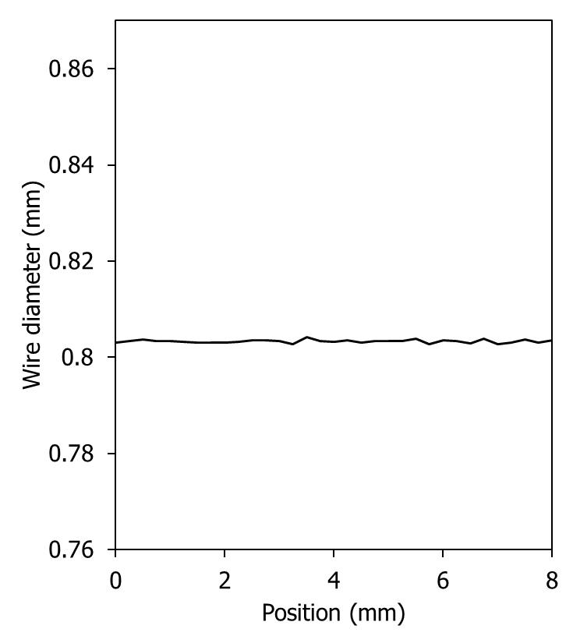
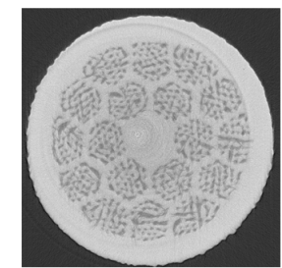
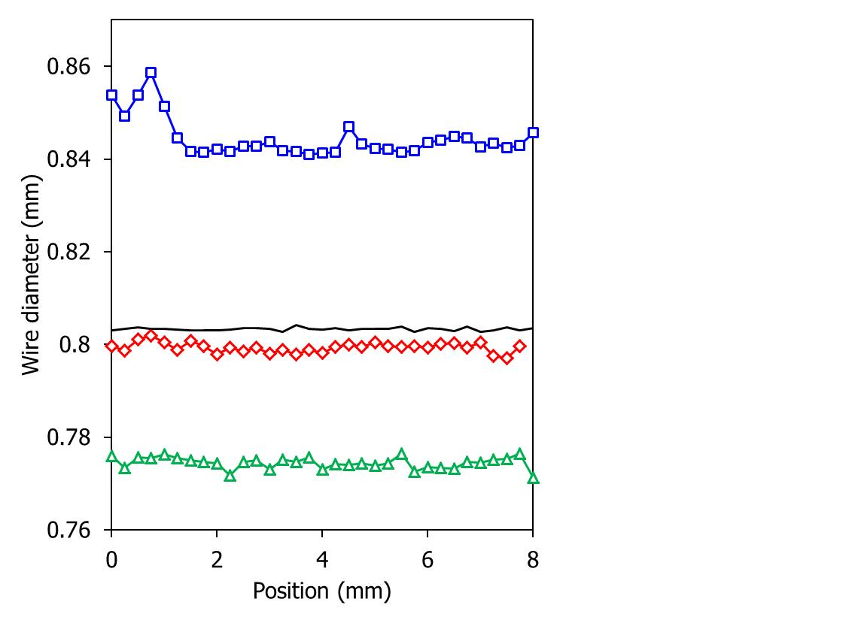
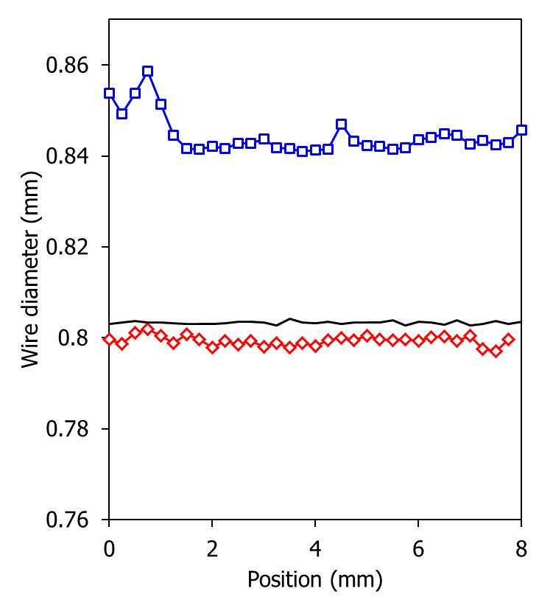

Overpressure (OP) densifies 2212 wires
0.8 mm diameter
closed ends 8 cm long samples
Assumption: closed ends short samples behave the same as long coil length
1 atm closed ends
Closed ends 1 atm: gas trapped
<60% dense
expansion
As-drawn 60% dense
Courtesy Dr C. Scheuerlein
Closed ends 100 atm OP:
Densification
100 atm closed ends
Courtesy Dr C. Scheuerlein

Slide 5
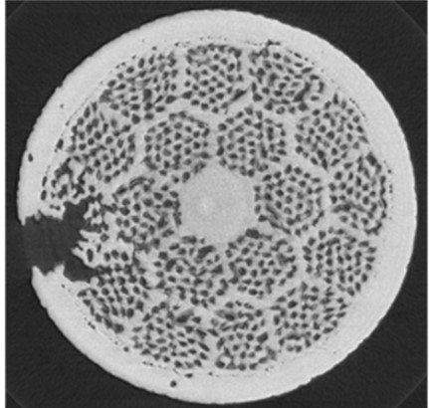
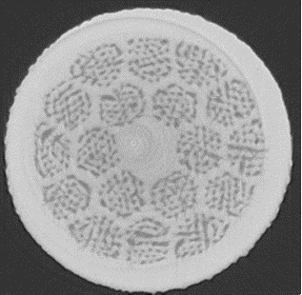
Overpressure (OP) densifies 2212 wires
Problems at 1 atm:
Filament cavity and 2212 powder have different volumes
Gas causes Ag creep, further dedensifying the 2212 and causing local eruptions
With 100 atm OP
Volume of filament cavity is reduced and match closer 2212 powder volume
OP stops gas expansion.
Courtesy Dr C. Scheuerlein
Courtesy Dr C. Scheuerlein

Slide 6
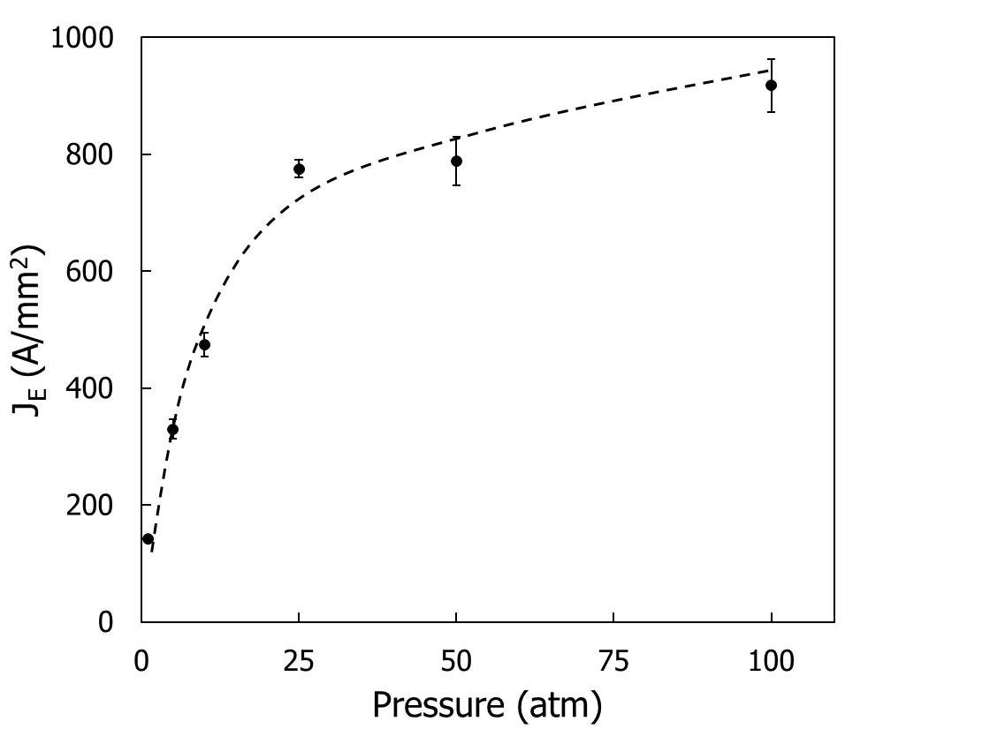
Dense filaments are the key for high J_{E}
Experiment done on short wires (8cm long) (37x18)
Closed ends 100 atm (coil behavior)
[4.2K, 5T]
(⇒ 611 A/mm² 20 T)
917 A/mm²
J_{E} 6x
Closed ends 1 atm (coil behavior)
150 A/mm²
OP at 100atm makes 2212 a candidate for high field applications.
35 m long 10 bar samples fell on the curve and many more coils are coming (Peng Chen talk)
J_{E} is calculated from diameter of OPed wires. What about J_{C}?

Slide 7
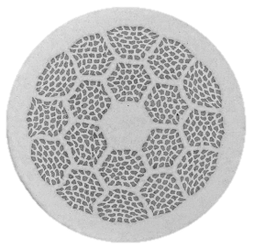
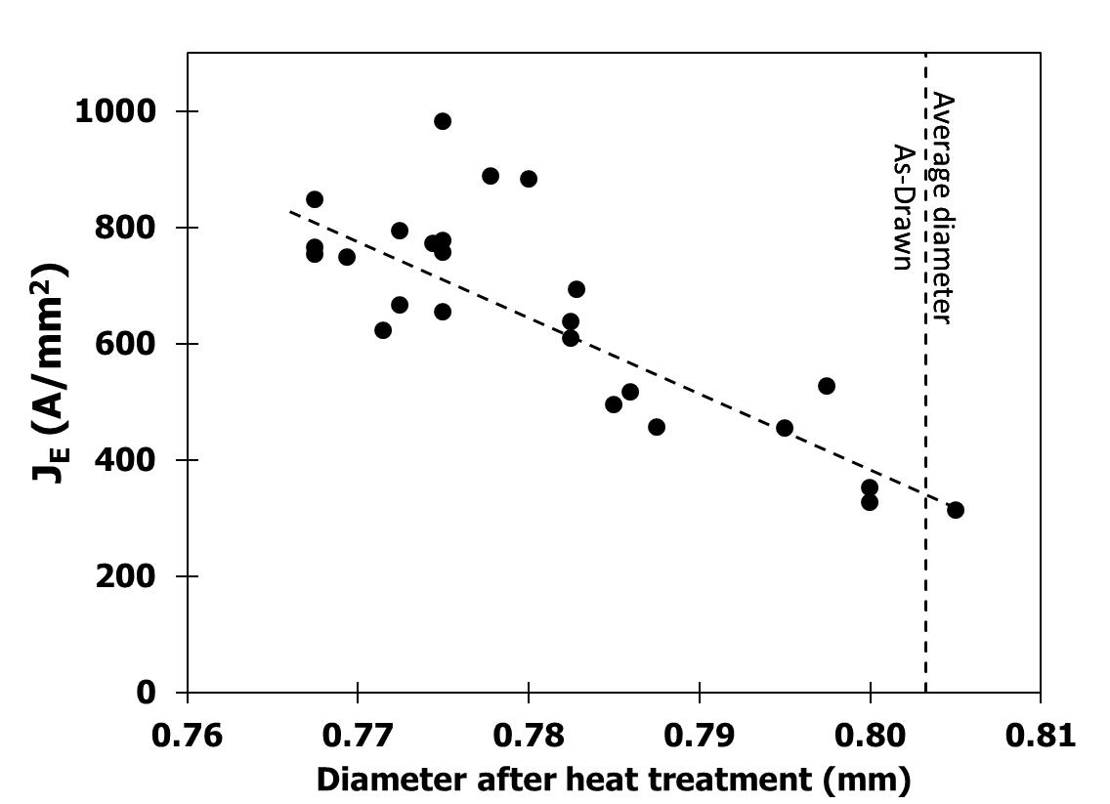
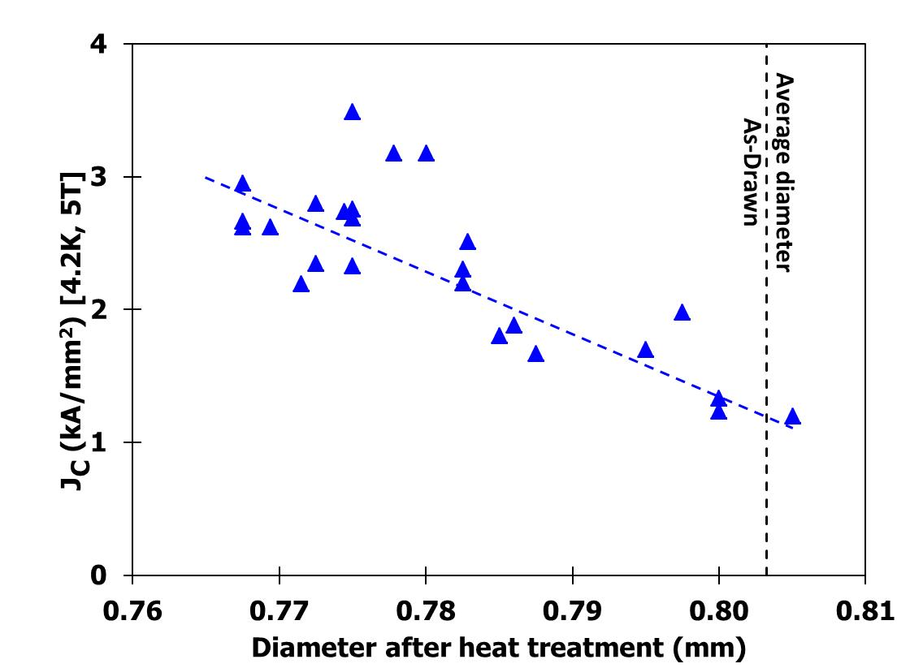
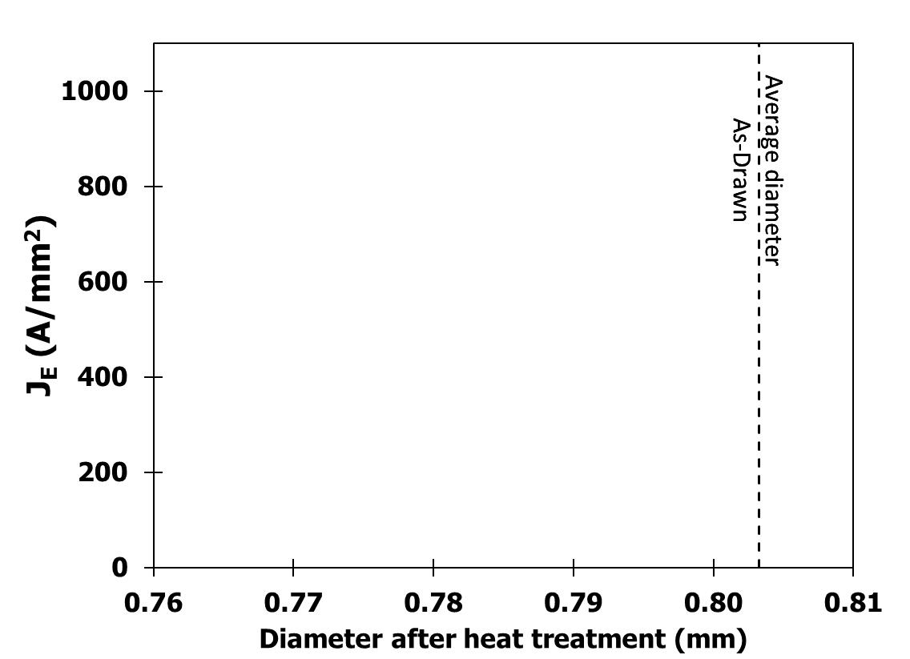


Dense filaments are the key for high J_{E}
Cross section
as-drawn 37x18 (0.8mm diameter)
J_{C} is calculated using the as-drawn wire filament cross sectional area (60% dense filaments)
J_{C} increases (actually it triples) with decreasing wire diameter as full physical connectivity occurs.
$$J_{E}=\frac{I_{C}}{area OP wire}$$
$$J_{C}=\frac{I_{C}}{area filament as−drawn wire}$$
[4.2K, 5T]
[4.2K, 5T]
Experiment done on short wires (8cm long)

Slide 8
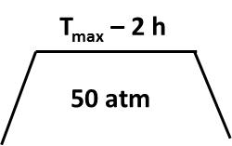
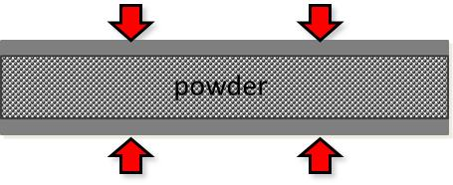
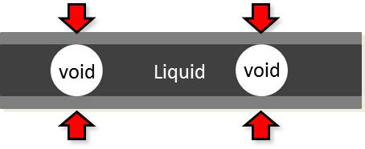
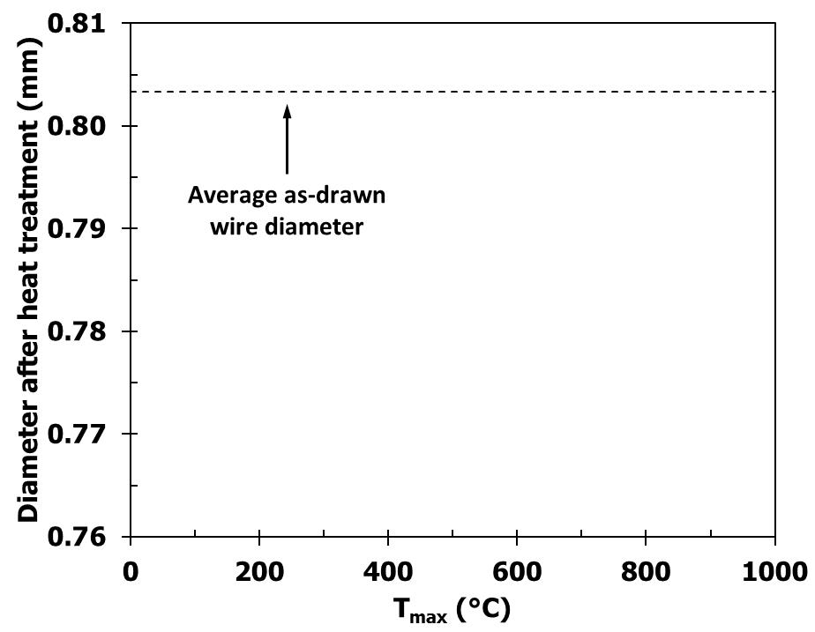
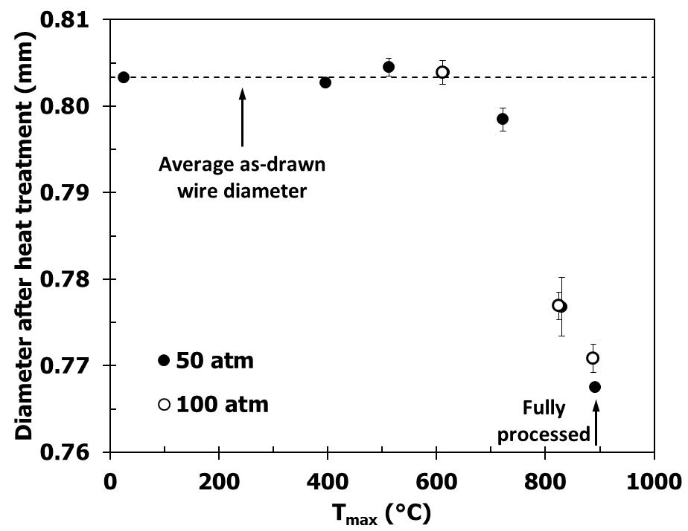


Filaments densify before 2212 melts
When does densification occur?
Special heat treatment:
Before 2212 melts
After 2212 melts
Densification is reached at about 821°C for 2h.
50 atm and 100 atm show similar results.

Slide 9
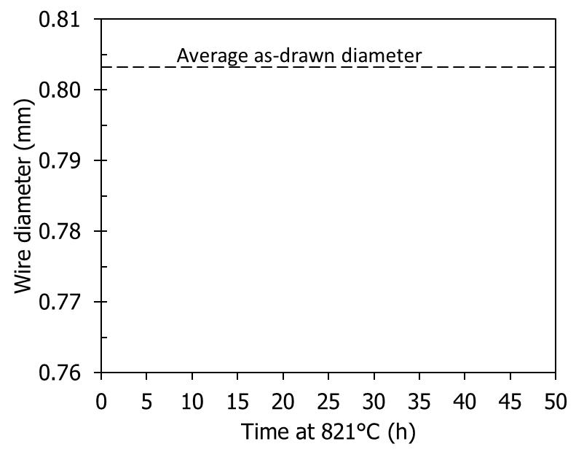
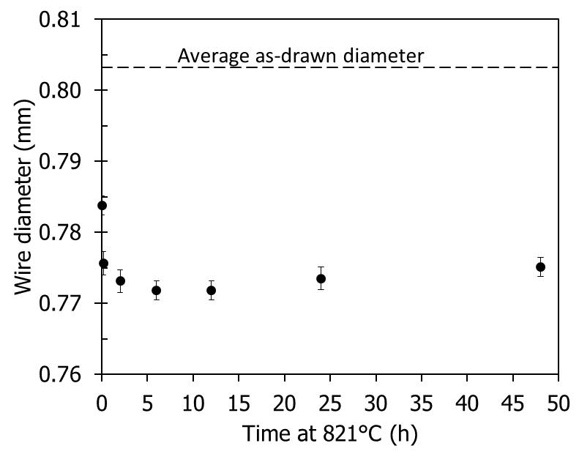
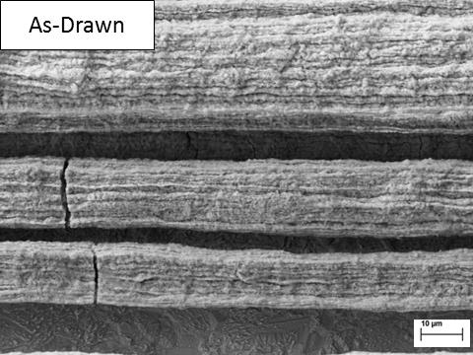
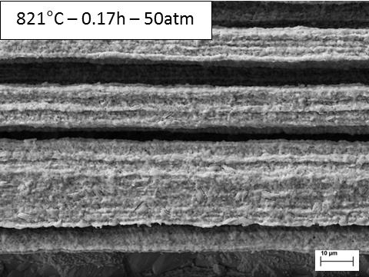
Filaments densify before 2212 melts
Special heat treatment:
821°C - t_{max}
50 atm
0.17h (10 min)
3.75 ± 0.13%
2h
Densification occurs within 2 h
86.7 ± 1.7% dense filament from 2h
No change in filament shape after densification
For large size magnet, high densification is expected to be homogeneously reached for the whole winding pack before melting the 2212.

Slide 10
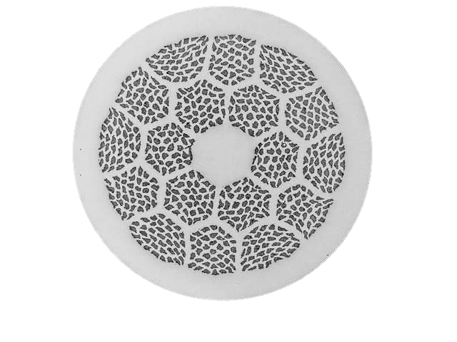
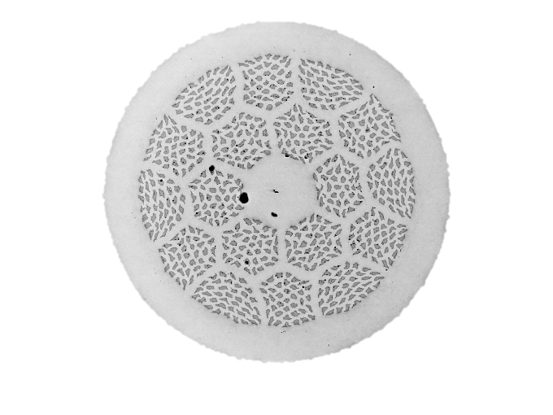
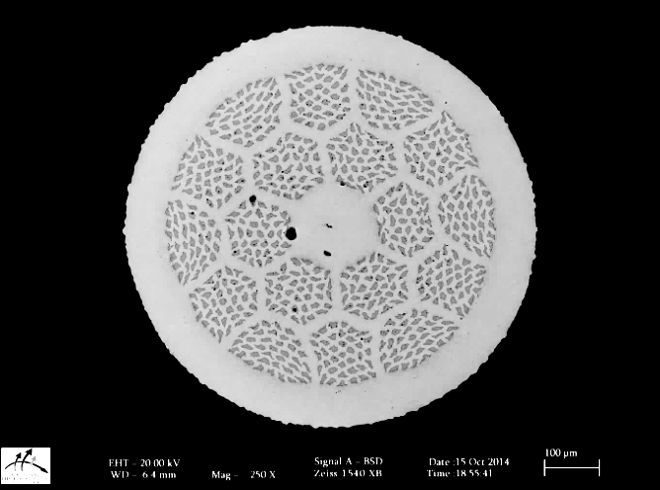

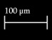
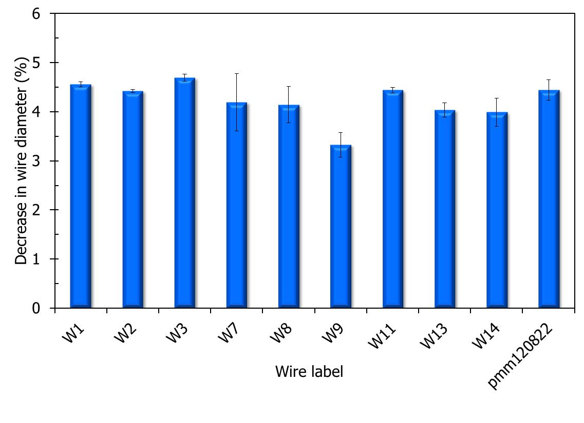
4.2 % decrease in wire diameter at 100 atm
As-drawn
100atm 821°C-12h
100 atm OP significantly decreases the wire diameter.
Issue:
For magnet construction, this change in diameter poses an interesting challenge. (See Peng talk).
100 atm full heat treatment
4.2 ± 0.3%

Slide 11
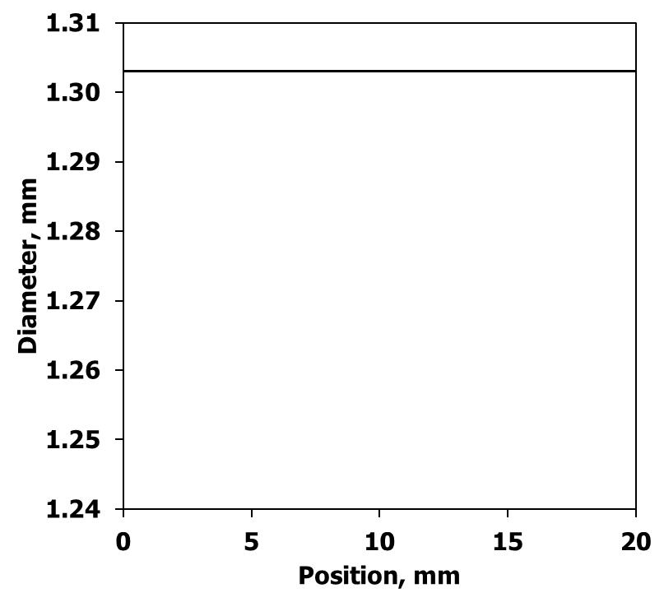
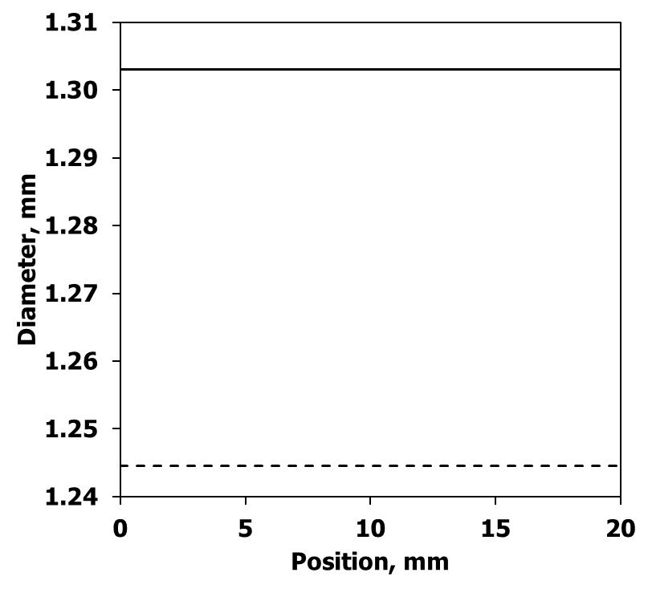
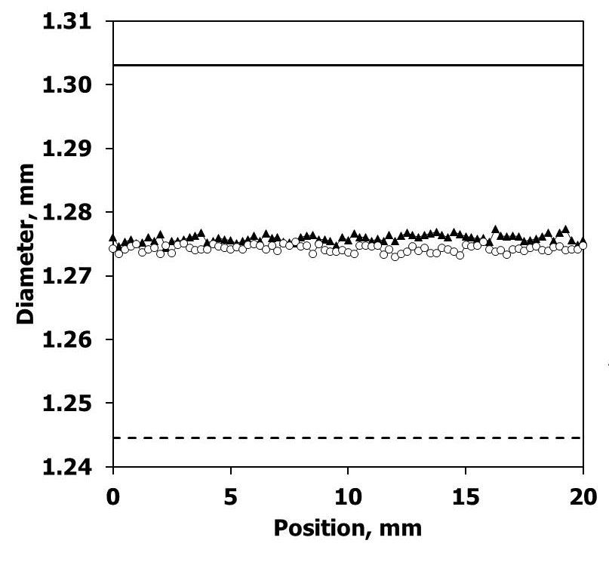
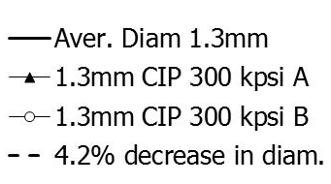
CIPing densifies wires at room temperature
Average as-drawn diameter
Goal:
We want to decrease wire diameter at room temperature before winding magnet to anticipate the diameter shrinkage of the wire during the 100 atm OP HT.
2.1 %
CIPed at 20.4 katm
4.2 %
Results:
Half of the OP densification can at least be reached at room temperature using a CIPing pressure of 20.4katm (300kpsi).
Average diameter 100atm OP HT

Slide 12
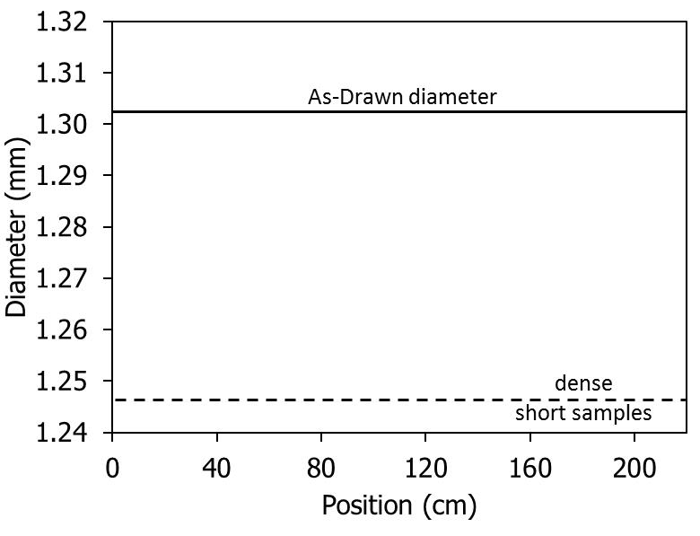
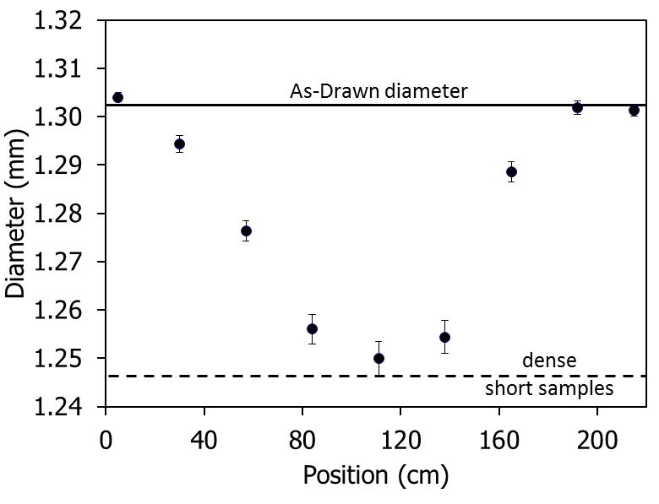
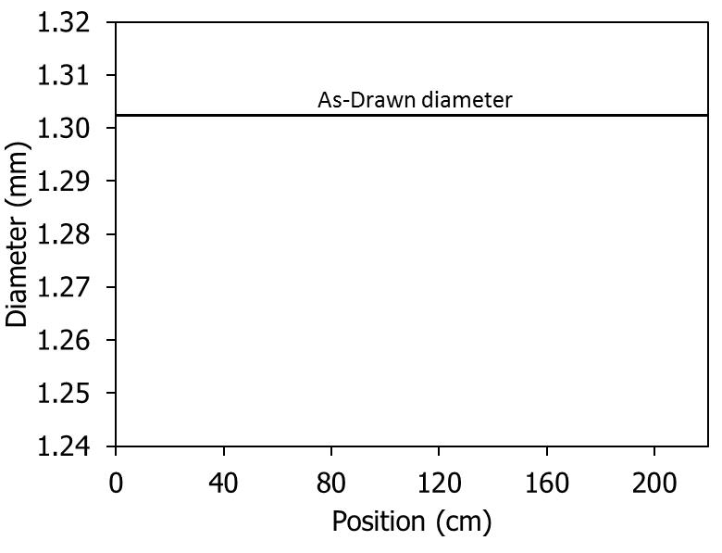
Wire fully densifies about 1 m in from the open end
2.2 m long sample fully heat treated at 100 atm
Both ends open (worth case)
1 extra meter needs to be added to coil terminals when OP processed
1 m
1 m

Slide 13
Conclusion
Wire densification with overpressure is the key for high J_{E} and high J_{c}.
Filaments densify before 2212 melts, starting at about 800°C, high density (87%) occurring at about 821°C within 2 h.
Wire diameter decreases by 4.2 ± 0.3% at 100 atm.
CIPing at 20.4katm provides decrease in diameter of at least 2.1%.
Without seal, wire fully densify about 1 m in from the open end.

Slide 14
Acknowledgement
Collaborations with Y. Huang, H. Miao, S. Hong, and J. A. Parrell of Oxford Superconducting Technology
Technical support from B. Chew, W. L. Starch, V. S. Griffin, and J. Craft at FSU.
Support by BSCCO strand and cable collaboration (BSCCo), a grant of the US Department of Energy and by the NHMFL, which is supported by the NSF under NSF/DMR-1157490 and by the State of Florida.

Slide 15

Thank you for your attention
This is a Sub-title

