Slide 1
APEL Cloud Accounting
APEL Team
Status and Plans
John Gordon

Slide 2
Outline
Current Status
Changes to UR
Monthly Reporting
Accounting Portal

Slide 3
Current Status
Regular publication from ~20 OS and ONE sites.
Prototype Portal - requirements
New versions of accounting scripts have been rolled out to most FedCloud sites.
  Corrects reporting of VO, Wallclock (cpu reported = Wallclock).

Slide 4
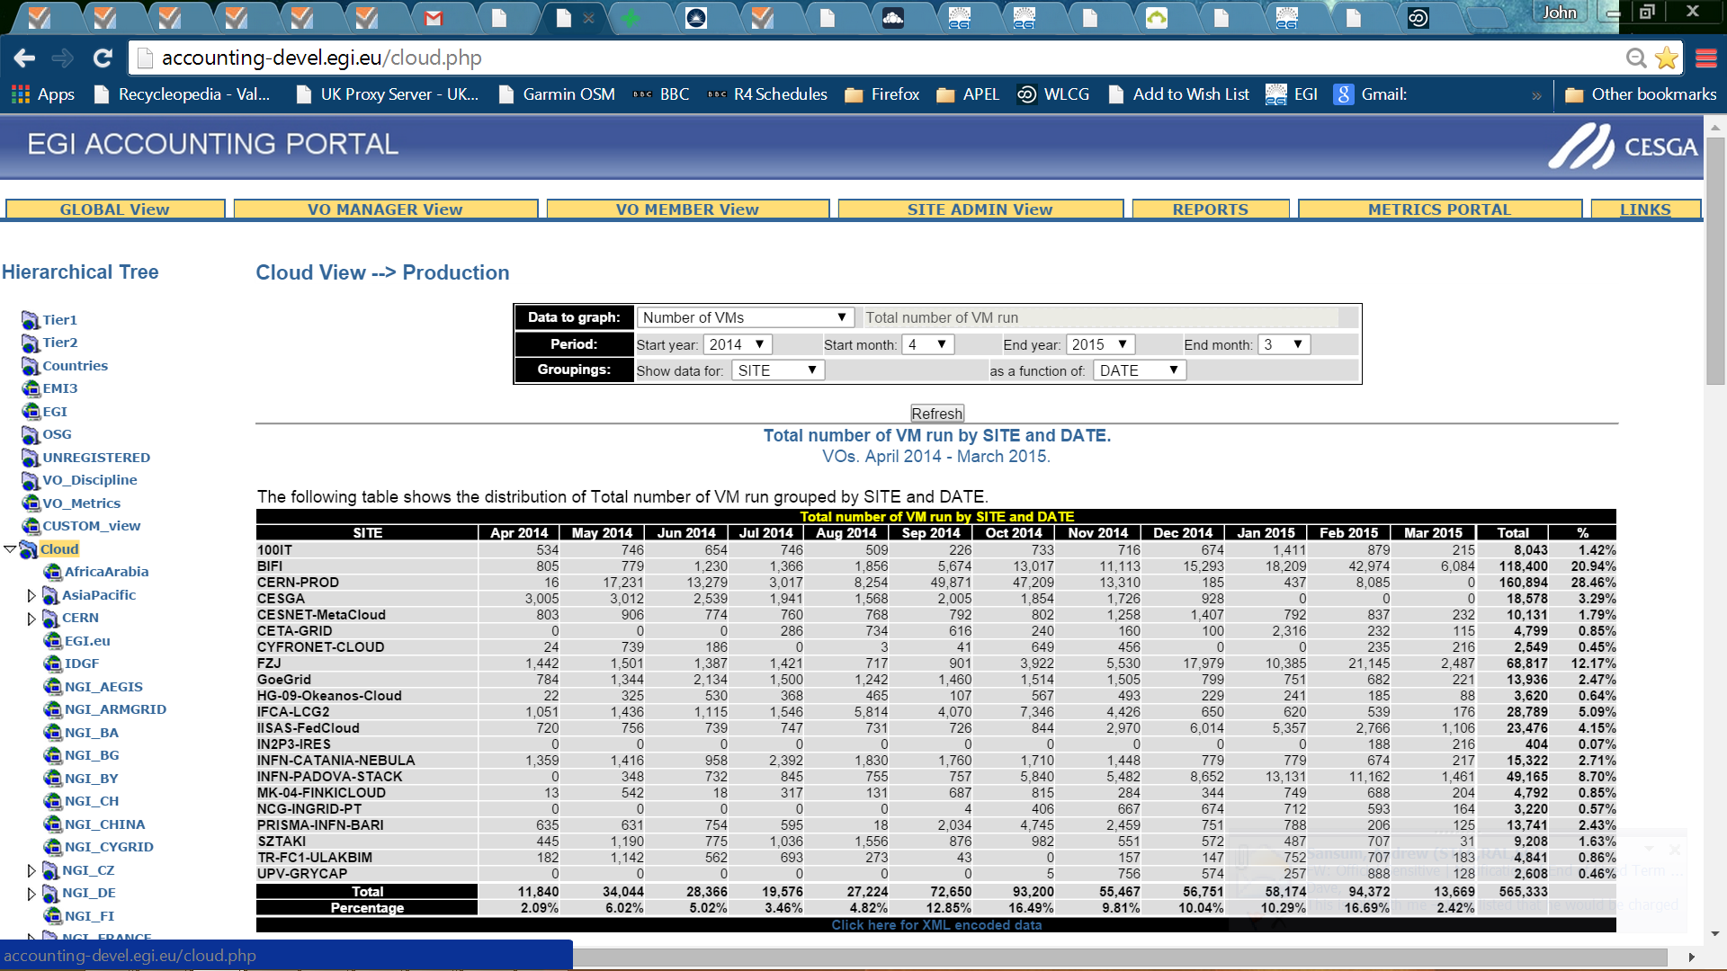
Cloud Portal

Slide 5
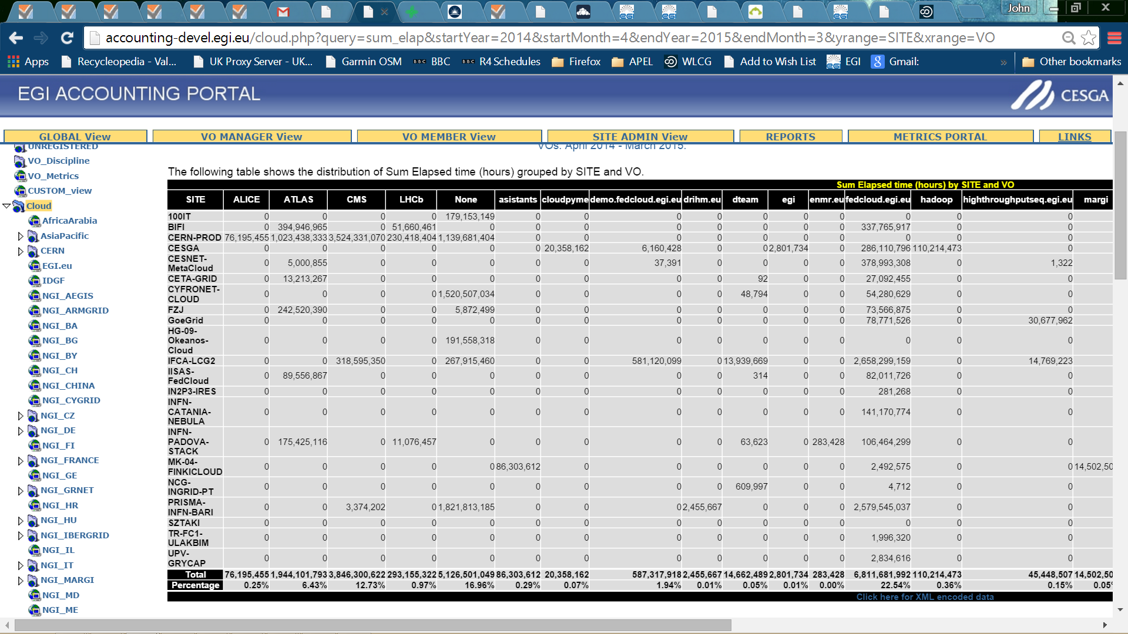
LHC VOs

Slide 6
New Versions of the publishing scripts
OpenNebula
  https://wiki.egi.eu/wiki/Fedcloud-tf:WorkGroups:Scenario4#OpenNebula_Accounting_Scripts
OpenStack
  https://wiki.egi.eu/wiki/Fedcloud-tf:WorkGroups:Scenario4#cASO
Sites should upgrade and republish old VMs
  APEL will have a memory of old records and/or summaries that will need cleaning up. Open a GGUS ticket.
  Useful to compare old with new to check what has been republished.

Slide 7
Usage Record Revision
UR versions 0.4 was agreed at a FedCloud F2F last month.
  https://wiki.egi.eu/wiki/Fedcloud-tf:WorkGroups:Scenario4#Agreed_new_version
  Added benchmarking values
  Structure within a site (multiple clouds at a site)
  Report image from Marketplace
First to be implemented in loader and database; then in scripts.

Slide 8
New Fields
CloudComputeService | varchar(255) | Name identifying cloud resource within the site. Allows multiple cloud resources within a site. i.e. a level of granularity.
PublicIPCount | int | Number of public IP addresses assigned to VM
BenchmarkType | varchar(255) | Name of benchmark used for normalization of times (eg HEPSPEC06)
Benchmark | Decimal | Value of benchmark of VM using BenchmarkType

Slide 9
Clarifications
VMUUID | varchar(255) | Virtual Machine's Universally Unique Identifier concatenation of CurrentTime, SiteName and MachineName
Needs to be unique.
OpenNebula followed this definition
OpenStack claim that the internal name is universally unique
ImageId | varchar(255) | Every image has a unique ID associated with it. - For images from the EGI FedCloud AppDB this should be VMCATCHER_EVENT_AD_MPURI - for images from other repositories it should be a vmcatcher equivalent For local images - os_tpl mixin https://appdb.egi.eu/store/vo/image/de355bfb-5781-5b0c-9ccd-9bd3d0d2be06:174/ Image for CentOS 6 minimal [CentOS/6.x/KVM]_egi Image for CernVM [Scientific Linux/6.0/KVM]_atlas
Already implemented in new scripts

Slide 10
Unresolved Uncertainties
NetworkType | varchar(255) |  | Needs clarifying
Possible values?
What do management systems tell us?
What might one charge for?
StorageRecordId | varchar(255) | Link to other associated storage record
Originally thought that we could define a StAR record for storage used.
This would need to be done before the UR could be cut.
Is this relevant for remote traditional storage (No); remote cloud storage (??); storage internal to the VM (Yes)

Slide 11
Future Revisions
Main requirement not addressed by v0.4 is assigning usage across time.
Current reporting assigns all usage to the StartTime point.
Intermediate records are cut but each one replaces the previous one and builds up the usage of the VM until it ends, when the final values are taken.
For long-running VMs this distorts the record of usage patterns. Can we assign usage to specific time periods during the lifetime of the VM?

Slide 12
Current Proposal
Propose multiple records for a defined timeslot, say since the last record, could be daily but doesn’t have to be. We can then summarise all records with record EndTime in a month to get a monthly summary.
Proposal https://cernbox.cern.ch/index.php/apps/files/ajax/download.php?dir=%2F&files=Monthly%20Cloud%20Accountingv0.2.docx
Add new fields defining time period and the usage within that period
In addition to existing cumulative fields
APEL will summarise these new records according to the month of the time period so the usage will be spread across multiple months instead of just one.
The Summary schema should not need to be changed (check) so the portal should continue to handle them.

Slide 13
WLCG Issues
APEL is a flat database of site data
For Grid, the accounting portal applies structure from external metadata.
  T1 and T2 structure from REBUS
  No FedCloud definition yet
  Do we define WLCG Cloud, or just hang sites under T2s?
    TF decided to use existing T2 structure
APEL will accept cloud UR data from WLCG, not just as EGI FedCloud. Probably other projects too.,
  In Grid we take secondary data from (eg) OSG to give a single view for a VO
Input welcome on benchmarking and monthly reporting.

Slide 14
Portal Issues
Drill down from tree to NGI and Site
Display various fields as f(VO, Date)
  #VMs, cpu,wall,cores,memory,networkIO,diskIO
VO Manager view
  Choosing a selection of VOs would be good.
Download single view as XML
Currently displaying cpu and wall in seconds
Summarised monthly by StartTime of VM
All usage assigned to Month of StartTime !!

Slide 15
Portal
http://accounting-devel.egi.eu/cloud.php
Activate tree of T2 as in grid portal views

Slide 16
VAC/VCycle
VAC/Vcycle cut their own grid accounting records.
These are published directly to APEL.
No record that these were cloud ‘jobs’
Could use InfrastructureType in APEL UR

Slide 17
Next
APEL to accept new schema format.
  This allows benchmark to be published
  Ulrich to discuss the content of these fields.
Portal to display T2 (and T1) structure view
  Not many T2 sites visible in Cloud Accounting now
Portal view of Grid+Cloud
Encourage non-VAC cloud sites running LHC VO work to register in T2.
Consider how to integrate possible T2 use at other sites.

