Slide 1
The Data Bridge
Cloud storage access for Grid and volunteer computing
Fabrizio Furano (speaker)
Laurence Field
IT/SDC
Pre-GDB 9 March 2015

Slide 2
Intro
The Data Bridge is a component that bridges authentication domains for storage access
Context: volunteer computing (BOINC) and Grid environment
It’s built on Apache plus the Dynamic Federation technology with S3 buckets as backends
  S3 was key to simplicity, provides an effective delegation mechanism
  Dynafeds exploit that, plus giving scalability, uniform authorization and flexibility
  Apache can host any number of other ‘standard’ authentication plugins, it will work
It’s a generic idea to harmonize Cloud storage and multiple authentication domains, including Grid/X509/VOMS

Slide 3
BOINC workflow: main points
A volunteer PC gets a job agent running on a VM
Agent gets work to do from a shared queue
Agent writes its output to a known place
FTS moves data (once validated) to some prod storage

Slide 4
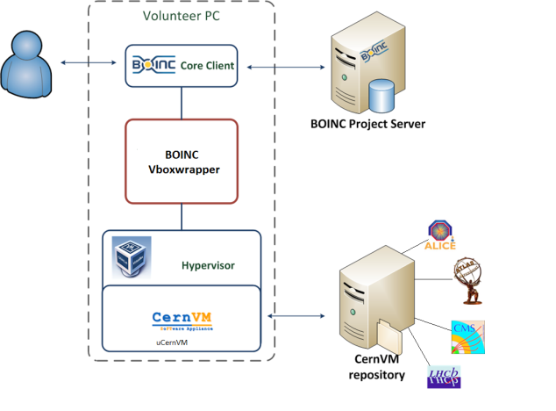
BOINC and Virtualization

Slide 5
The Challenge
VO
(X509/VOMS)
Volunteer
(BOINC auth)
Needs to push Job (queue)
Workload Manager
Volunteer
VM
Job Wrapper
Needs to deliver to VO/Grid
(through park area visible by FTS)

Slide 6
The Initial Architecture
VO
(X509/VOMS)
Infrastructure
Volunteer
(BOINC auth)
Workload Manager
Job Description
Messaging
Service
Volunteer
VM
Plugin
Agent
Push
Pull job desc
Data I/O
Data I/O
Data Bridge
Job Wrapper
FTS
How to authorize access?
May need to scale!
What to use?
Grid

Slide 7
Authentications
BOINC users are authenticated by BOINC
  In the VM, BOINC credential provided via /dev/fd0
    BOINC_ID
    BOINC_AUTHENTICATOR
  A BOINC Project DB provides the user Identity (IDP)
    MySQL
    User Table
The Grid (and FTS) speaks X509 with VOMS… how to match that ?
BOINC users need to receive the Job desc AND write the output
Grid agents (FTS) need to read what the BOINC user wrote

Slide 8
Solution: the Data Bridge
The Data Bridge is an authentication bridge AND a shared authorized cloud-based storage
  Uses mod_auth_mysql to recognize BOINC users
    Maps username/password to DB table
    AuthMysqlUserTable user
    AuthMySQLNameField id
    AuthMySQLPasswordField authenticator
  Uses mod_gridsite/mod_ssl to recognize X509 with VOMS
    That’s normally the WebDAV entry point of the Dynamic Federation
  Uses the Dynamic Federation on S3 to provide properly delegated redirections
    Together with authorization, high performance data discovery and extreme scalability
Based on Apache, reusing Web components and cloud storage

Slide 9
The Data Bridge
Workload
Manager
PUT/GET
Apache
PUT/GET
BOINC
User
HTTPS redirect & sign
HTTPS redirect & sign
ssl
mysql
Multiple
S3 buckets
anywhere
DynaFed
PUT/GET
PUT/GET
FTS
Grid

Slide 10
Data Bridge-based Message Queue
Messaging services ActiveMQ-like do not support BOINC authentication
  Not clear if it is possible or worthwhile to provide functionality
Simple queuing implemented on the Data Bridge itself as a Web app
  A shared storage that already authenticates clients properly
Two simple cgi scripts
  put-job.cgi
  get-job.cgi
Simple file-based queue
  python-dirq
Job descriptions from Workload mgmt
Generic, supports arbitrary info
in the queue
No additional systems!
Web Server
dirq
Get
put

Slide 11
Dynamic HTTP Federations
Dynafed implements federated storage over HTTP/WebDAV
  In testing in LHCb and Canada (ATLAS)
  Federates WebDAV or S3 enabled storage systems
  Apache front end, no catalogues needed
Can be used as a data bridge, in conjunction with S3’s delegation mechanism
  S3 storage backend(s)
  Acts as a security gateway between X509 or BOINC Auth
    Authorized clients then redirected directly to the storage
  Quick response time (low latency, thousands reqs/s)
  Robustness (automatic RT checking of endpoints status)
  Great scalability potential
    Global system, smart replica selection (availability, proximity)
http://svnweb.cern.ch/trac/lcgdm/wiki/Dynafeds
http://federation.desy.de/

Slide 12
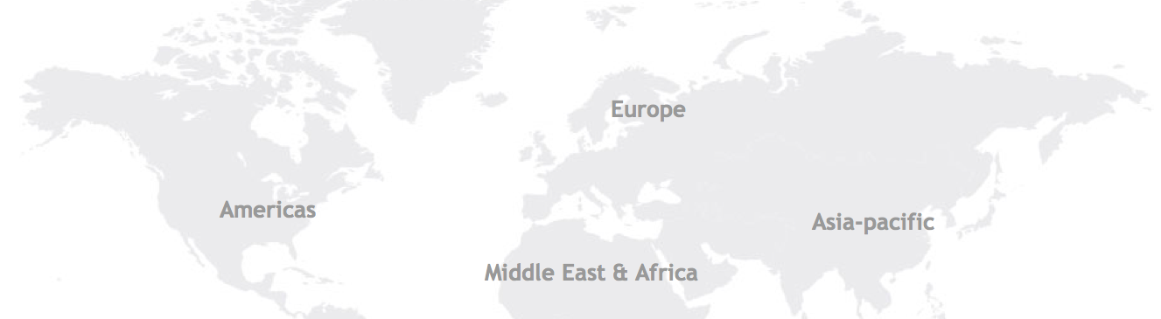
Aggregation of S3 buckets
With 2 replicas
This is what
we want to see as
users
Sites remain
independent and
participate to a
global view
All the metadata
interactions are
hidden and
cached on the fly
For S3, clients are
redirected using
S3 signatures
The result looks
like a normal WebDAV big repo
/dir1
/dir1/file1
/dir1/file2
/dir1/file3
.../dir1/file1
.../dir1/file2
.../dir1/file2
.../dir1/file3
S3 bucket 1
S3 bucket 2

Slide 13
Final Architecture
VO
(X509/VOMS)
Infrastructure
Volunteer
(BOINC auth)
WMS
Volunteer
GET (queue)
Message Queue
VM
Plugin
Agent
PUT
Data Bridge
PUT/GET
Multiple
S3 buckets
anywhere
Job Wrapper
FTS
Grid

Slide 14
Adoption
Can be adopted by other BOINC-based projects
Build upon vLHC@home and the data bridge as a platform
Require:
  WM to POST job description to the data bridge message queue
  Stage input data to the data bridge’s input bucket (if needed)
  CernVM3 Image
    Contextualized including CVMFS configuration
    Credentials read from /dev/fd0
      BOINC_ID and BOINC_AUTHENTICATOR
    Job Agent
      Method to get job description
      GET input from the data bridge
      Run job
      PUT output on the data bridge
  Read data from the data bridge’s output path (stored in a bucket)

Slide 15
Rollout Plans
CMS@Home
  Pioneered the adoption of the data-bridge
  Will hopefully enter the beta testing phase soon
Test4Theory
  Plan to migrate to the data bridge within the next 2 months
    To address co-pilot support issues
Beauty@Home
  Currently integrating the data-bridge
    This will solve the x509 credential distribution issue
      Allowing to open the project up to the public

Slide 16
Summary
The Data Bridge spans auth domains
Reuses HTTP federation component with S3
  Friendly feel, quick and scalable
Honours X509/VOMS and BOINC auth at the same time
  Can honour any other apache-based authentication
Secure S3 delegation mechanism
Web tech used for the job descriptions queue
Infrastructure provides a VM image along with a job agent
Adopted by CMS@Home, Test4Theory, Beauty@Home
Generic, towards a platform for volunteer computing
Next: moving to production
Next: experience with Single Sign On auth (CERN, Google, Facebook…) and bridge with the Grid/VOMS

