Slide 1
Introduction of conservation problem on data driven models
KOI, Tatsumi

Slide 2
Energy and Momentum Conservation
Beyond two body reactions, data driven approach difficult to establish energy and momentum conservation.
Energy and momentum conservation is not guaranteed not only in single interaction but also in average.
NeutronHP adjusts the final states for trying to establish the conservations
Setting environment variable of “G4NEUTRONHP_DO_NOT_ADJUST_FINAL_STATE” make skip this.
However you may loss production of residual nucleus.

Slide 3
Reproduction Experimental Result
For example photon emission
Data library usually provides inclusive energy spectrum and multiplicity of the reaction
In real, energy spectrum depends on
number of photons.
Therefore we should sampling energy
of photons from the distribution
Inclusive
One photon
Two photon
Three photon
I
E

Slide 4
I will show several examples of problem caused by this kind of issues

Slide 5
Validation of gammas emission from neutron captured by Nitrogen nucleus
Data: G. E. THOMAS et al., NIM 56, pp325-337 (1967)

Slide 6
ENDF-VII INL 1.42 [barn]
ENDF-VII cont 1.29
G4HP non adjust 1.38 [barn]
G4HP 1.42
G4LEND 1.28
HP:G4NDL3.15
LEND:ENDFVII.0

Slide 7
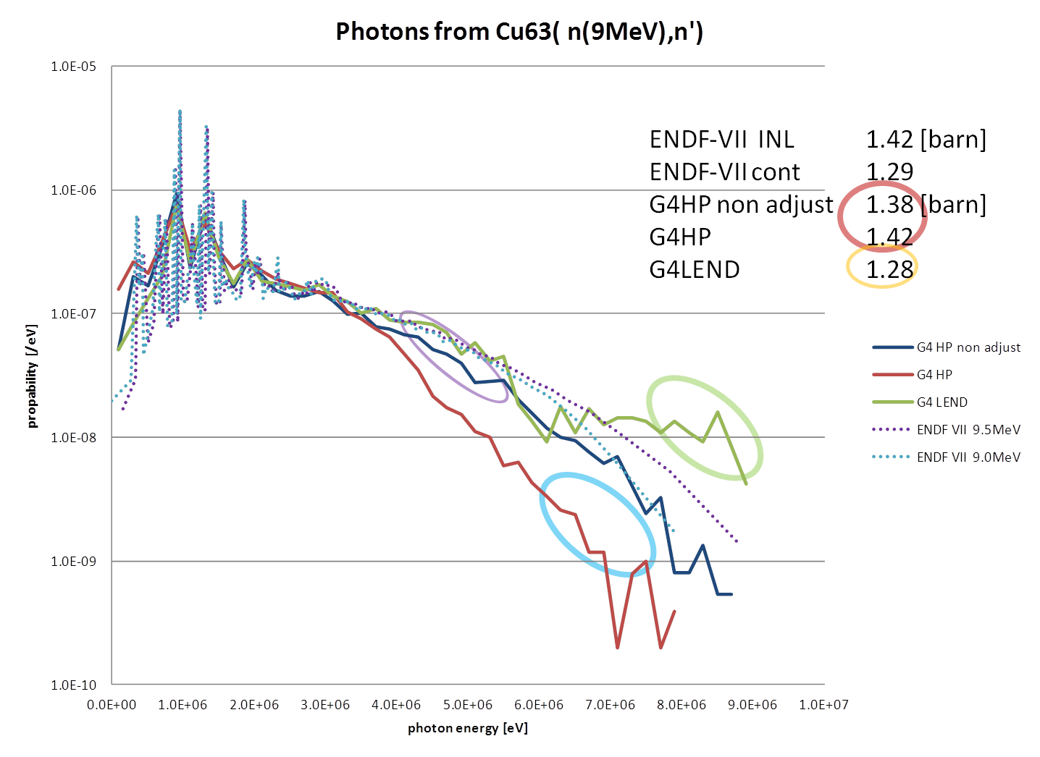
The differences from
ENDF values are caused by
Multiplicity
  Poisson Distribution
Equal probability bin
  Number of bins
Photon emission in LEND
  No photons from L1 and L2 channels ???
Adjustment for better conservation
  Disable by “G4NEUTRONHP_DO_NOT_ADJUST_FINAL_STATE”
Adjustment by remaining energy for the interaction
  No option for disabling this

Slide 8
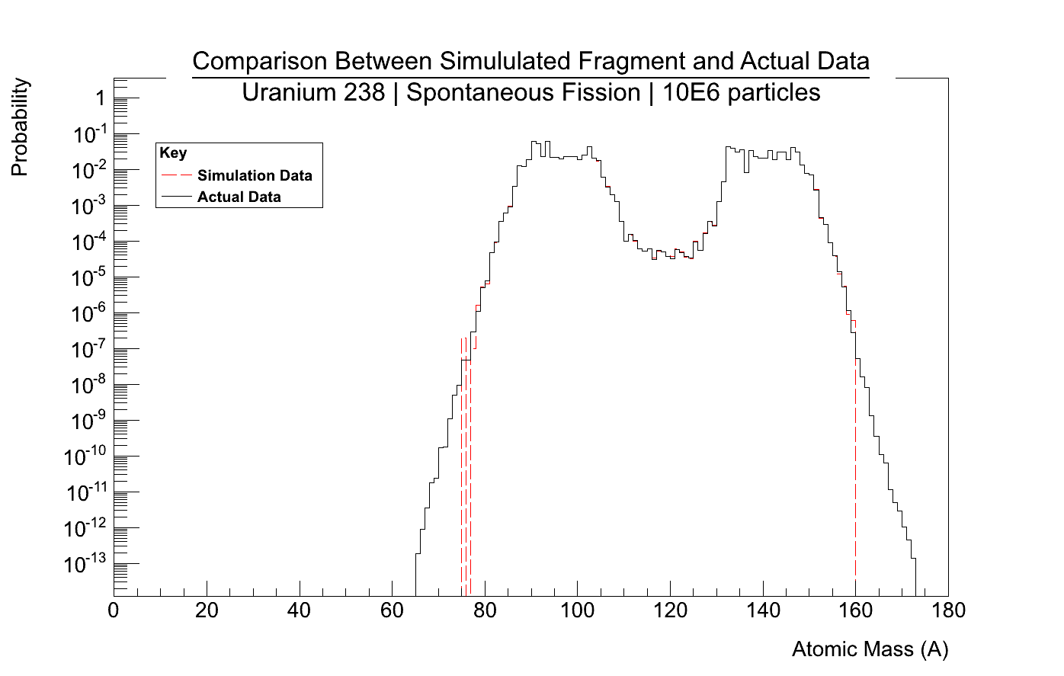
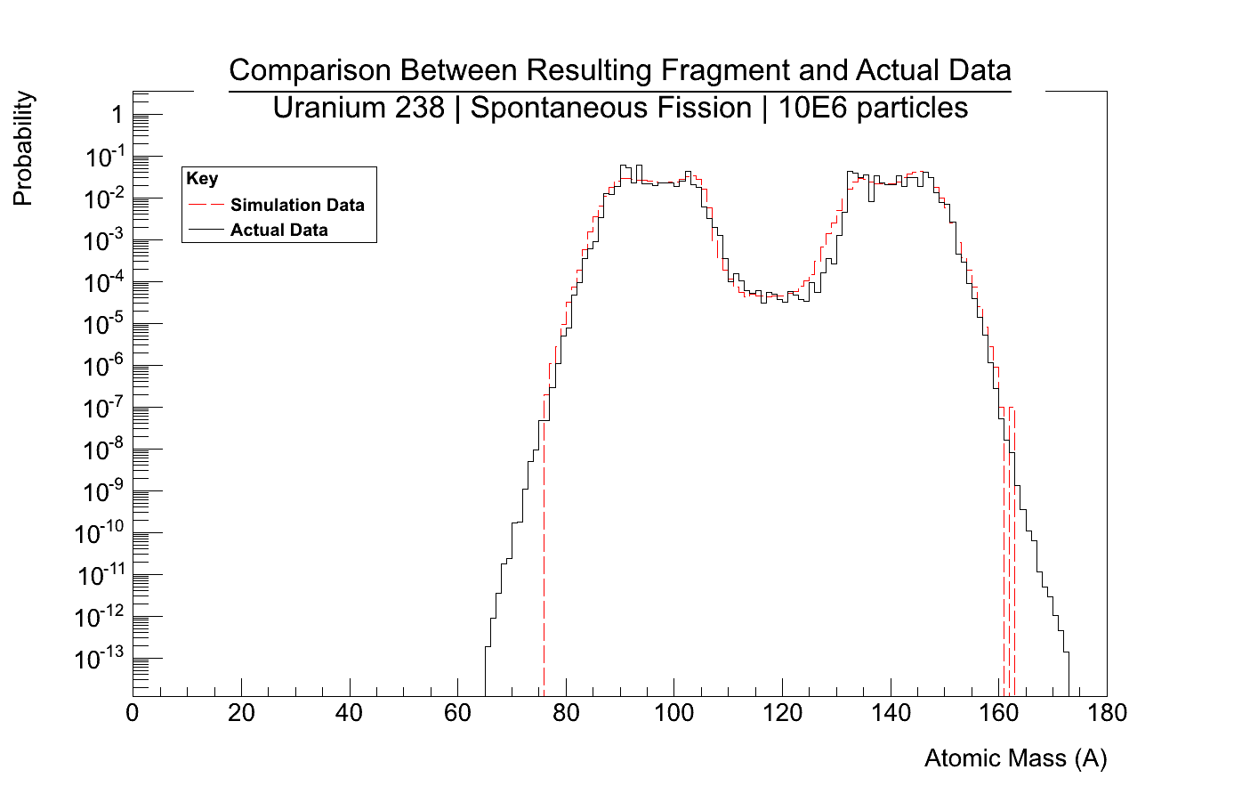
Fragment Distributions
Sampled Fragment (from data)
Resultant Fragment (remaining mass)
The bumps and dip are reflected physics

Slide 9
Environment variables
G4NEUTRONHP_USE_ONLY_PHOTONEVAPORATION
Always use G4PhotonEvaporationModel for generating photons from capture reaction
G4NEUTRONHP_SKIP_MISSING_ISOTOPES
Set cross section 0 to isotopes those does not have corresponding data files
G4NEUTRONHP_NEGLECT_DOPPLER
Do not do on flight Doppler boarding
G4NEUTRONHP_DO_NOT_ADJUST_FINAL_STATE

Slide 10
Bug and interpretation miss of ENDF procedure should be fixed
Important physics quantities depend on use case
Default behavior makes unhappy for some users
We agreed to make ENDF_ONLY (should be similar to G4NEUTRONHP_DO_NOT_ADJUST_FINAL_STATE ) mode previous meeting

