Slide 1
neutron_hp/particle_hp: interpolation of double differential cross sections
Pedro Arce Dubois
CIEMAT

Slide 2
Interpolation in neutron_hp/particle_hp
Double differential cross sections in evaluated databases appear in the form of
tables : a list of parameters for each fixed incident energy
ZZAAA Angular_representation Interpolation_scheme No_incident_energies
13027 2 1 41
No_ranges (different interpolation scheme for each range)
1
Range_1 Interpolation_scheme_1
41 2
Incident_particle_energy No_energies No_discrete_energy No_parameters
1e+06 2 0 2
2ary_energy_1 Param_1_1 Param_1_2 2ary_energy_2 Param_2_1 Param_2_2
0.000000e+00 1.000000e+05 0.000000e+00 1.000000e-05 0.000000e+00 0.000000e+00
Incident_particle_energy No_energies No_discrete_energy No_parameters
5.80333e+06 2 0 2
2ary_energy_1 Param_1_1 Param_1_2 2ary_energy_2 Param_2_1 Param_2_2
0.000000e+00 1.000000e+05 0.000000e+00 1.000000e-05 0.000000e+00 0.000000e+00
Incident_particle_energy No_energies No_discrete_energy No_parameters
6e+06 2 0 2
2ary_energy_1 Param_1_1 Param_1_2 2ary_energy_2 Param_2_1 Param_2_2
0.000000e+00 2.766337e-06 0.000000e+00 3.614889e+05 0.000000e+00 0.000000e+00
Incident_particle_energy No_energies No_discrete_energy No_parameters
7e+06 6 0 2
2ary_energy_1 Param_1_1 Param_1_2 2ary_energy_2 Param_2_1 Param_2_2
0.000000e+00 5.687485e-07 1.011000e-01 3.614889e+05 0.000000e+00 0.000000e+00
6.024814e+05 0.000000e+00 0.000000e+00 8.434740e+05 0.000000e+00 0.000000e+00
…

Slide 3
Interpolation in neutron_hp/particle_hp
neutron_hp/particle_hp when distribution law is G4ParticleHPContEnergyAngular uses the list of parameters from the upper energy set:
  If incident_energy = 40 MeV, it uses the parameters corresponding to 45 MeV
  If incident_energy = 42.5 MeV, it uses the parameters corresponding to 45 MeV
  If incident_energy = 45 MeV, it uses the parameters corresponding to 50 MeV
No interpolation: results are not right!
(and it uses parameters of energy “>”, not “>=“)

Slide 4
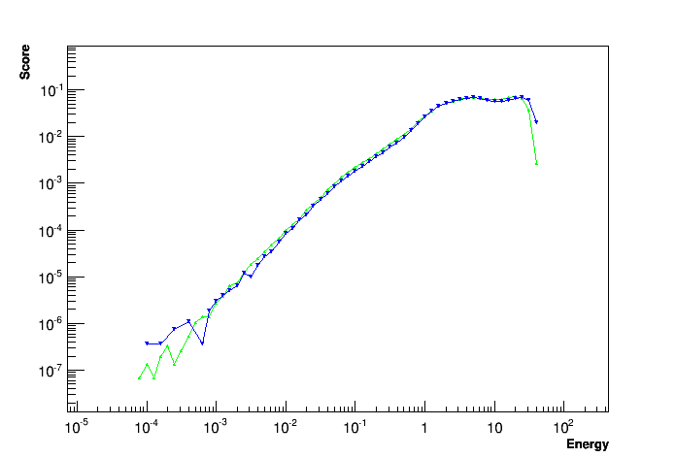
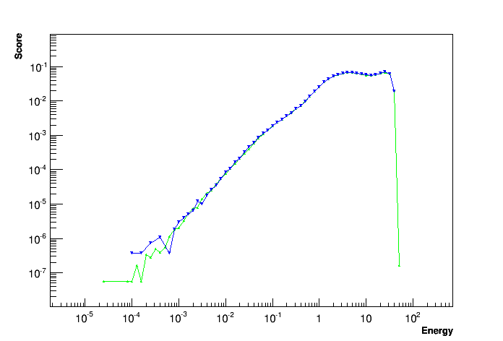

Old interpolation scheme
Spectra of emitted neutrons from protons against Al27 at fixed energy (force ProtonInelastic collision)
40 MeV GEANT4
40 MeV MCNP
40 MeV GEANT4
45 MeV MCNP
42.5 MeV GEANT4
45 MeV MCNP

Slide 5
Correcting G4ParticleHPContEnergyAngular
% isotopes that use G4ParticleHPContEnergyAngular in GEANT4 databases for inelastic collisions:
 | 0:Isotropic | 1: ContEnergy-Angular | 2:DiscreteTwo-Body | 3:Isotropic | 4:DiscreteTwo-Body | 6:NBodyPhase-Space | 7:LabAngular-Energy
G4NDL4.2 | 10 | 62 | 14 | 1 | 13 | 0.02 | 0.02
ENDF-VII0 |  | 70 | 28 | 2 | 0.02 | 0.04 | 0.04
ENDF-VI8 |  | 73 | 24 | 3
BROND-2.2 |  | 77 |  | 3 |  | 20
JEFF30N |  | 65 | 24 | 10 |  | 0.1 | 1
JEFF31N |  | 62 | 37 | 1 |  | 0.03 | 0.1
JENDL330 |  | 99 |  |  |  |  | 1
TENDL2012-proton |  | 100 |  |  |  | 0.01
TENDL2012-deuteron |  | 100 |  |  |  | 0.01
TENDL2012-triton |  | 100 |  |  |  | 0.01
TENDL2012-He3 |  | 100 |  |  |  | 0.01
TENDL2012-alpha |  | 100 |  |  |  | 0.01

Slide 6
Correcting G4ParticleHPContEnergyAngular
Interpolate double differential cross sections using the way recommended in ENDF-6 format manual (Document ENDF-102
Report BNL-XXXXX-2009, pp. 25-27)
GEANT4 code modifications:
G4ParticleHPContEnergyAngular::Sample instead of looking at the upper energy G4ParticleHPContAngularPar, builds a new one interpolating the lower and upper ones:
void G4ParticleHPContAngularPar::BuildByInterpolation(G4double anEnergy, G4InterpolationScheme aScheme, G4ParticleHPContAngularPar & angpar1, G4ParticleHPContAngularPar & angpar2)
CPU penalty is small, because most collisions are elastic
50 MeV p on Fe56: 3 % for production cut 0.01 mm, 6 % for production cut 1. mm
1 MeV n on Fe56: 0.3 %
1 MeV n on Al27: 0.1 %

Slide 7
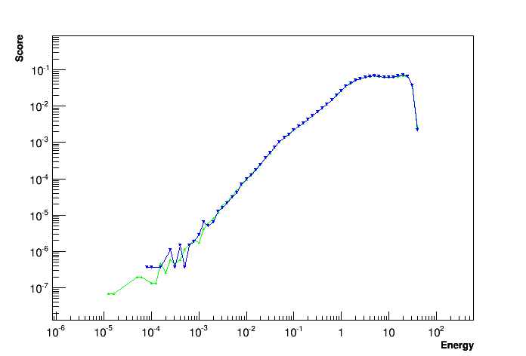
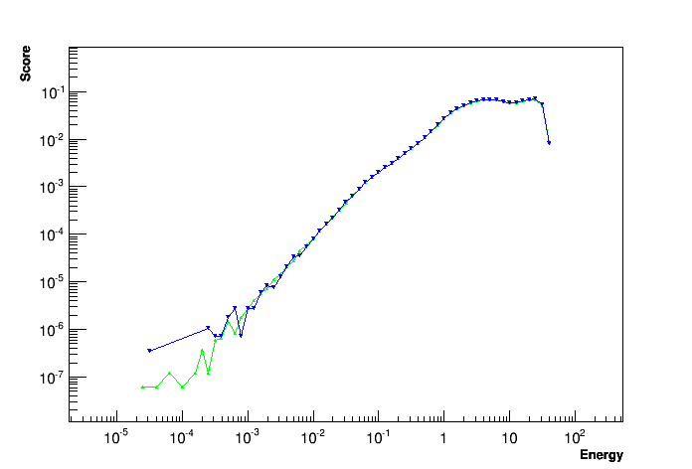
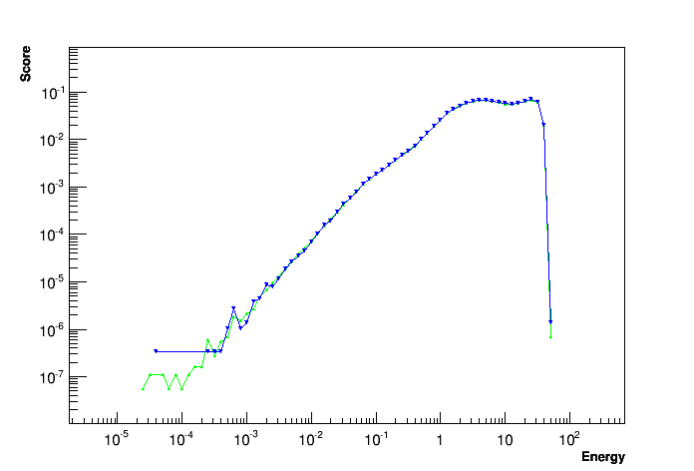
New interpolation scheme
Spectra of emitted neutrons from protons against Al27 at fixed energy (force ProtonInelastic collision)
40 MeV GEANT4
40 MeV MCNP
42.5 MeV GEANT4
42.5 MeV MCNP
45 MeV GEANT4
45 MeV MCNP

Slide 8
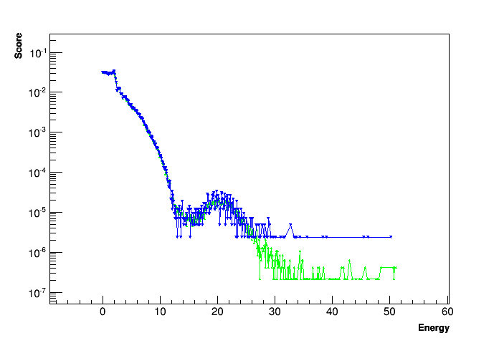
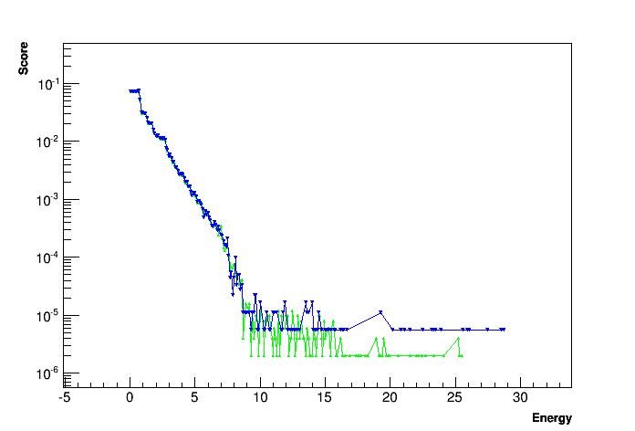
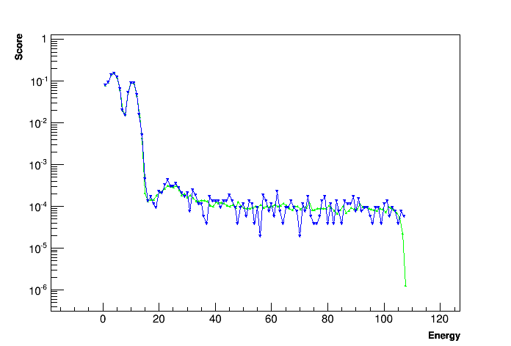
New interpolation scheme
Spectra of emitted gammas from protons at fixed energy (force ProtonInelastic collision)
Al27 42.5 MeV GEANT4
Al27 42.5 MeV MCNP
Pb208 25.2 MeV GEANT4
Pb208 25.2 MeV MCNP
O18 103 MeV GEANT4
O18 103 MeV MCNP

Slide 9
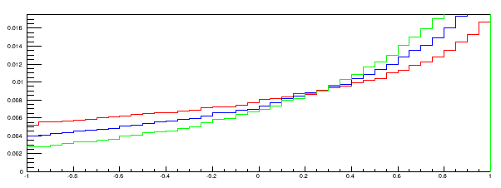
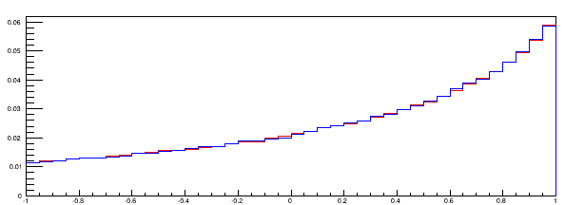
Angle Interpolation
For Kallbach-Mann angular representation database has a coefficient for energy and a coefficient for angle:
Incident_particle_energy No_energies No_discrete_energy No_parameters
1e+06 2 0 2
2ary_energy_1 Param_1_1 Param_1_2 2ary_energy_2 Param_2_1 Param_2_2
0.000000e+00 1.000000e+05 0.000000e+00 1.000000e-05 0.000000e+00 0.000000e+00
Angle coefficients are interpolated the same way as energy coefficients: linearly
  Checked that behaviour is linear: compare angle distribution of proton 6 MeV on Al27 changing “by hand” the angle coefficients
N entries
coeff = 0.
coeff = 0.5
coeff = 1.
N entries
coeff = 0. + coeff = 1.
coeff = 0.5
cos(θ)
cos(θ)

Slide 10
Summary
Current Geant4 neutron_hp/particle_hp does not interpolate energy/angle coefficients of secondary particles (it takes the set corresponding to the upper energy)
The interpolation has been implemented, following ENDF-6 recommendations, for G4ParticleHPContEnergyAngular distributions (60-70 % for neutrons, 100 % for charged particles)
Energy distributions now match MCNP results
Angle distributions do not match MCNP results, with or without interpolation
Other angular representations should follow

