Slide 1
GND, GIDI and FUDGE
Presented to SLAC 2014
8 July 2014
Bret Beck

Slide 2
SG38’s seven tasks to develop
Low-level data containers
  Similar to ENDF LIST, TAB1, TAB2, etc.
  Work with other data projects (e.g., ENSDF, EXFOR, RIPL)
Top-level hierarchy for storing nuclear reaction data
Hierarchy for storing particle data and nuclear level schemes and decay data
Infrastructure for data handling, processing, plotting, etc.
API for reading and writing data in the new structure
Tests that will be needed to assure quality of data
Documentation and governance
Caleb’s talk
This talk

Slide 3
Outline
GND
  New “nuclear” data structure to replace ENDF-6 format
    ENDF atomic data also
GIDI
  Transport code API for reading and sampling GND data
FUDGE
  Infrastructure for reading, viewing, modifying, checking, processing and writing GND data

Slide 4
GND
Will be covered by Caleb Mattoon’s talk tomorrow
Briefly:
  New, modern structure to replace legacy nuclear data formats (e.g., ENDF-6)
  Being designed by an international committee
    OECD/NEA/WPEC sub-group 38
  Hopefully, will be completed around Dec. 2015
GND will most likely be the international standard within 5 years.

Slide 5
Status of ENDF translation to GND
For ENDF-VII.1 sub-libraries:
  Can translate:
    neutrons/ protons/ deuterons/ tritons/ helium3s/ gammas/ standards/
  Can be translated into GND-like format, these are not yet integrated with FUDGE:
    nfy/ sfy/ thermal_scatt/
  Currently not supported:
    Decay/ electrons/ photoat/ atomic_relax/
Have issues with TENDL as it has bad data.
Evaluations “H1 + H2” and “H2 + H3” have bad data

Slide 6
Pre-processing a GND evaluated file
An ENDF file converted to GND (or any evaluated GND file) requires the follow processing before it can be used by GIDI:
  Convert resonance parameters to cross section.
    This may not be required in 5 years as computers get faster.
  Heat cross sections to desired temperature.
    This may not be required in several years as computers get faster.
    Multiple temperature files for a given projectile/target can be read in and GIDI will interpolate between temperatures.
  Convert Legendre data to pointwise.
    This will not be needed in the near future.
FUDGE handles all of this processing.

Slide 7
GIDI
General Interaction Data Interface.
Reads GND files.
  Currently only GND/XML.
  Will most likely add GND/HDF5 support within the next few years – if access speed is an issue.
Samples data for Monte Carlo transport code.
  GEANT4 (G4LEND).
  Mercury (LLNL).
    Replacing legacy MCAPM.
  Tripoli (France).

Slide 8
GIDI code languages
Written in C
  will probably convert to C++ in the next few years
GEANT4 wrappers written in C++
  Interface called G4LEND
    Low Energy Nuclear Data (LEND)
Needs several LLNL libraries
  PoPs (Property of Particles)
  statusMessageReporter
  numericalFunctions

Slide 9
Stringing things together
GND (and in part GIDI) use “string”s to designate particles and reactions
  Particle examples
    n, H1, O16_e4, U235, Am242_m1
  Reactions examples
    n + H1 ⇒ n + H1
    n + U235 ⇒ 2n + U235
    n + Am242_m1 ⇒ 2n + Am241
    n + Am242_m1 ⇒ n + Am242
    H1 + O16 ⇒ H2 + N15
    n + O16 ⇒ H1 + ( N16_e1 → n + N15 )
GIDI converts all particle (reaction) strings to an integer ID.
IDs are determined as needed (i.e., they are not guaranteed to be the same between “runs”).
Routines to get an ID from a particle string exists.

Slide 10
Parallel computing
OpenMP
  GIDI routine arguments have one or both of the following
    Thread safe data
    Thread specific input
MPI
  At LLNL we read the data on one process and use MPI broadcasting
    At LLNL this is needed for GIDI to insure each particle has the same IDs for all MPI processes as particle move from process to process (load balancing and domain decomposition).
    We provide the routines to do the broadcasting.
We may need to work out some details here.

Slide 11
Reaction sampling
LLNL and GEANT4 currently treat nuclear reactions differently.s
  LLNL via GIDI has no restriction on the type of nuclear reaction.
  GEANT4/G4LEND has only 4 types of nuclear reactions:
    elastic, capture, fission and other.
At LLNL GIDI samples a projectile+target’s reaction.
GEANT4 gets cross section data for the 4 reactions from G4LEND and sample the reaction.

Slide 12
Product sampling
Products are the output particles for a reaction.
At LLNL GIDI samples these.
  All ENDF interpolation and data types are supported except Legendre which is converted to pointwise.
For GEANT
  Elastic: sampled angle in center of mass is returned.
  All others: products are sampled.
    Energy and momentum are conserved if data allow.
Currently, pointwise product data sampled from cdf/pdf.

Slide 13
Testing
Being tested in LLNL stand-alone Monte
Carlo code Mercury.
  Testing with critical assemblies.
    Getting expected result with and without delayed neutrons.
  Testing with ‘broomsticks’.
Delayed neutrons.
  Time-to-birth is sampled by GIDI and returned.

Slide 14
GIDI Performance and Biasing
Performance
  Currently very crude in GIDI. Needs a lot of work.
Biasing
  In MCAPM we have angle biasing which will be replicated in GIDI.

Slide 15
Known issues for LLNL
Unresolved resonance probability table.
Thermal scattering generation.
  We need to implement something like NJOY’s LEAPR
  and THERMR.
Others?

Slide 16
LLNL’s infrastructure - FUDGE
For Updating Data and Generating ENDL
Started around 2002 to manage and process ENDL formatted data
Interface written in Python
  Has C/C++/Fortran routines for computationally intensive calculations
Modified to support the new format (GND) being developed at LLNL
  Well support the new SG38 nuclear data format

Slide 17
Brief Overview of FUDGE
Data representation and python modules
Starting a FUDGE session
Reading/writing
Printing/plotting
Processing
Modifying
Checking

Slide 18
Python modules and data representation
Python is an object-oriented language
Heavy use of python classes are used in FUDGE
  Example: cross section
    Cross section component class stores all representations (forms) of a cross section for a reaction
    Some current cross section forms are
      resonancesWithBackground:
      pointwise: σ(E) as (E_{i}, σ_{i}) tabulated data
      piecewise: tabulated regions with different interpolations
      grouped: deterministic grouped representation
      reference: link to another reaction's cross section component
from fudge.gnd.reactionData import crossSection
xSec = crossSection.component( )
xSec.addForm( crossSection.pointwise( data ) )

Slide 19
Starting a FUDGE session
The top level FUDGE infrastructure consists of python modules
  Like the cross section module in the prior slide
Top of FUDGE directory hierarchy must be in PYTHONPATH
Python modules are included in a python session using the ‘import’ statement
Command prompt: python
>>> from fudge.legacy.converting import endfFileToGND
>>> from fudge.gnd import reactionSuite

Slide 20
Reading/writing
FUDGE can read/write ENDL, ENDF and GND/XML
  Reading ENDF formatted file
    File is read and converted to GND/Python
  Reading GND/XML
  Writing GND/XML
rce = endfFileToGND( ‘n_092_U_236.endf’ )
reactions = rce['reactionSuite’]
covariances = rce[’covarianceSuite’]
reactions = reactionSuite.readXML(‘n_092_U_236.xml’ )
  reactions.saveToFile( ‘n_092_U_236.xml’ )

Slide 21
Reading/writing – cont.
Writing GND/Python to ENDF
f = open( ’n-092_U_236.endf6', 'w' )
f.write( reactions.toENDF6( ... ) )
f.close( )

Slide 22
Printing
Data can be printed to the screen or saved to a file
elastic = reactions.getReaction( 'elastic' )
pwXSec = elastic.crossSection.toPointwise_withLinearXYs( )
print pwXSec.toString( )
1.00000000e-05 2.09543355e+00
9.99670958e+01 1.26157920e+00
.
.
.
1.80000000e+07 1.26291400e+00
2.00000000e+07 1.17962800e+00
fOut = open( ‘xSec.dat’, ‘w’ )
fOut.write( str( pwXSec.axes ) )
fOut.write( pwXSec.toString( ) )
fOut.close( )

Slide 23
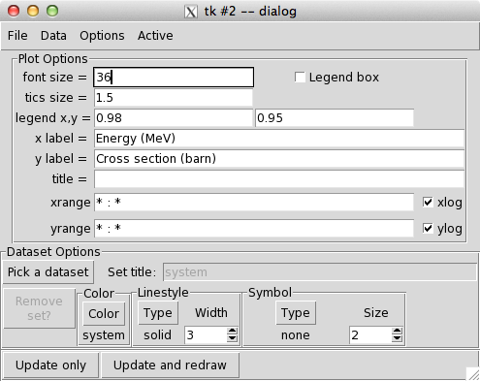
Plotting
Temperature
pwXSec.plot( ) # single curve
heated = elastic.crossSection.heat( '1 keV', … )
multiPlot( [ pwXSec, heated ] ) # many curves

Slide 24
Processing
Reconstructing cross sections from resonance parameters
reactions.reconstructResonances( )
Heating cross sections
heated = crossSection.heat( '1 keV', '1e-6 eV' )
Determistic transport processing (like NJOY, AMPX)
reactions.process( )
Released beta version of GND to ACE code

Slide 25
Processing continued
What’s missing from processing
  Unresolved resonance probability table generation
  Thermal scattering generation
    We need to implement something like NJOY’s LEAPR
    and THERMR
  Probably a few other things

Slide 26
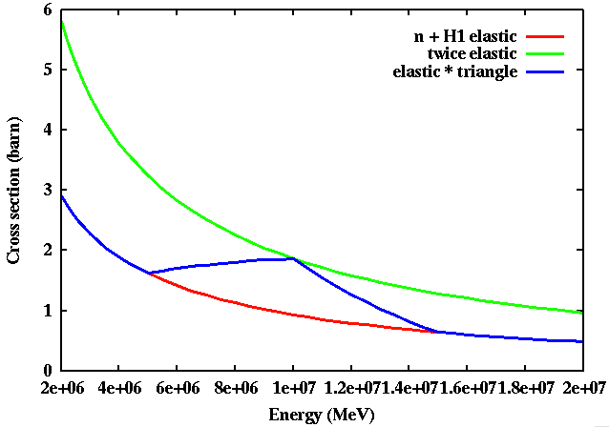
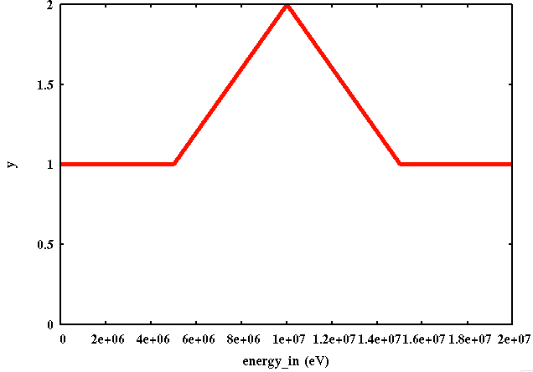
Modifying GND data
Various operations on data types are supported
Including +, -, *, /, etc. on 1d data types
h(x) = f(x) × g(x)

Slide 27
Checking data
Maybe the best! – legacy codes not being updated
Found many issues with ENDF/B-VII.0 that we reported and helped fix before the release of VII.1.
issues = reactions.check( )
for issue in issues : print issue
.
.
.
reaction label 21: He4[multiplicity:'2'] + Fe60
WARNING: Calculated and tabulated Q-values disagree: -3240787. vs -3247120.!
.
.
.
summedReaction label 29: total
WARNING: Cross section does not match sum of linked! Max diff: 1.68%

Slide 28
Testing the FUDGE infrastructure
Reconstructing cross sections
  Good agreement to PREPRO and NJOY
Heating cross sections
  Good agreement to PREPRO and NJOY
  Discovered bug in PREPRO
Calculating deterministic transfer matrices
  We are comparing to NJOY and AMPX
  Still some differences
    Most in how data are interpreted (mainly interpolation)

