Slide 1
Introductory Information

Slide 2
Welcome to Earthquake Country
Be aware of exits in your building
  Speaker will indicate locations for this meeting
Fire or other emergency evacuation
  Follow building residents out of building to the assembly area
Earthquake
  Remain in building: Duck, cover, and hold position until shaking stops
  Evacuate building to assembly area outside (follow others)
  Stay away from windows, downed power lines
In the event of an emergency
  Dial 9-911 from a SLAC phone; or
  Dial 911 from your cellular phone
  Provide SLAC address
  (2575 Sand Hill Road, Menlo Park, CA; cross street Saga Lane)
  and your building/room number.
  You are in Building 84

Slide 3
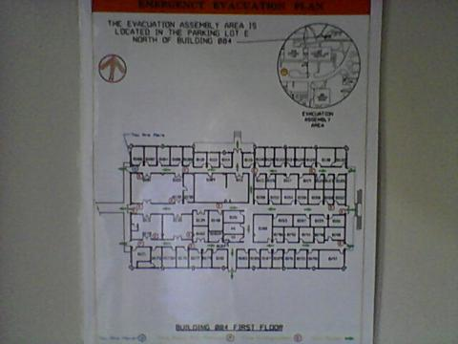
Emergency Evacuation Plan
We are here

Slide 4
Lunch
No cafeteria on site
Food Trucks (located in front of building 24) 11:00-14:00
Starbucks Kiosk (near the Guest House parking lot) 6:00-18:00
walk-up coffee and pastry takeout.
Sharon Heights Shopping Center (5min by car)
El Cerrito
Eric
Safeway
Dutch Goose (5-10min by car)
Burgers & Beer Pub
Alpine Inn (10-15min by car)
Burgers & Beer Pub, Wild west version of Dutch Goose

Slide 5
Group dinner
8th July (Today) 18:00-20:00
Juban Yakiniku House
712 Santa Cruz Ave
Menlo Park, CA 94025
Phone: (650) 473-6458
http://www.jubanyakinikuhouse.com

Slide 6
