Slide 1
Introduction
Koi, Tatsumi
SLAC National Accelerator Laboratory

Slide 2
Geant4 Neutron mini-workshop at SLAC
This is the second attempts gathering developers of low energy neutron models
The last one was held at CIEMAT in 2011 March
Early this year, Federico proposed me to have a dedicated workshop at SLAC and I got strong support from Alberto, Dennis and himself.
So we are able to hold the meeting with participation of developers from CERN, CIEMAT, LLNL and SLAC.

Slide 3
Feature of Low Energy Neutron Reaction
Cross Sections are strongly isotope depend, i.e., interactions are reflected complex nuclear structures
Relatively low multiplicity and limited number of channels
Existence of authorized libraries
ENDF: Evaluated Nuclear Data File
Tabulated data are often used in simulation.
MCNP, FLUKA
NeutronHP, G4LEND

Slide 4
Feature of Hadronic Framework of Geant4
Separate Cross Section and Final State Generator
Caused troubles in past on data driven models
Check 4 momentum conservations at the end of reaction
Artificially disabled for NeutronHP and G4LEND
Basically designed particle-target nucleus reaction
Not suitable for particle-material interaction in low energy neutrons
And we increase complexity of Hadronic Framework to handle low energy neutrons interactions in its.

Slide 5
Low Energy Neutron Models in Geant4
NeutronHP
  High Precision Neutron model, originally developed by Hans Peter Welch, using point-wise cross section data converted from ENDF/B-VII.r1 with processing NJOY-99.u364 for resonance reconstruction
  Tolerance of the processing is 0.001
  We are still using NJOY99, and once NJOY2010 becomes available we will re-processing
NeutronHPThermalScattering
  S(alpha, beta) model
  Thermal neutron scattering files from ENDF/B-VII thermal data (ENDF-6 File 7) are converted into G4NDL by NJOY99.u364 with reconstruction tolerance of 0.02
  There are about 20 materials in ENDF-VII thermal scattering
G4LEND
  Geant4 interface for GIDI-GND
  ENDL99 and ENDF/B-VII.r0 are converted

Slide 6
Generalize comparison
Material
  G4NistMaterial from G4_H, C, Al, Fe, Cu, Xe, Pb and U
  Single Isotope 18Ar36, 38 and 40, 26Fe54, 56, 57 and 58
  Temperature 273.15K
Primary neutron energies
  Logarithmic equal probability distribution from 1.0e-5 eV to 20.0 MeV

Slide 7
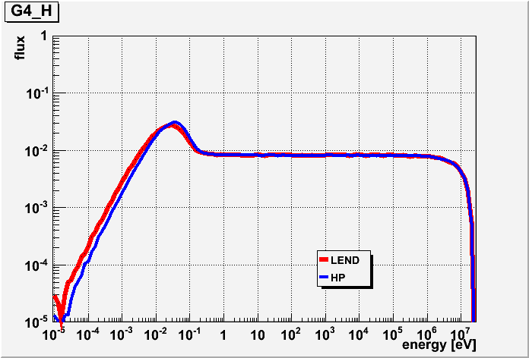
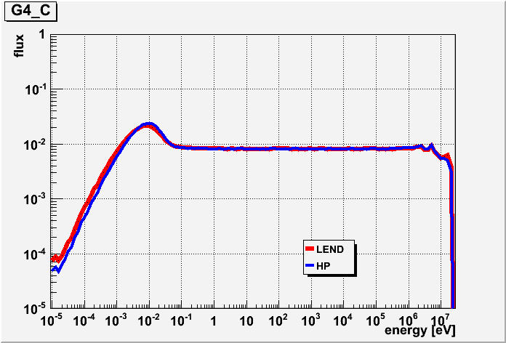
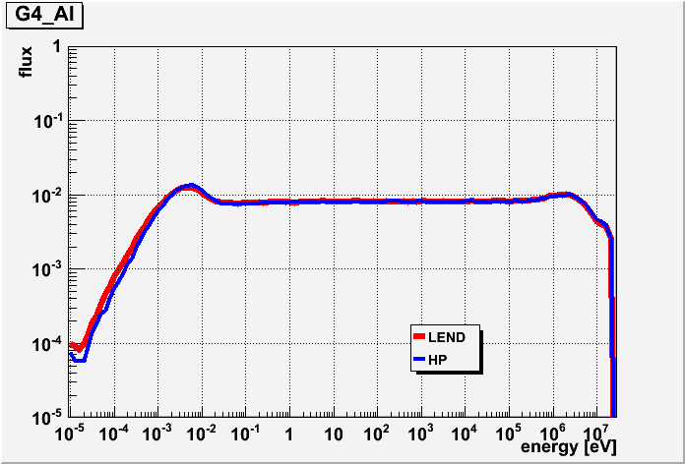
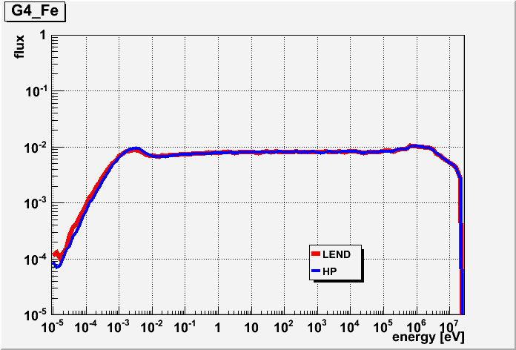
Out going neutron energy spectra
Shape and position of thermaliztion peaks
are slightly different

Slide 8
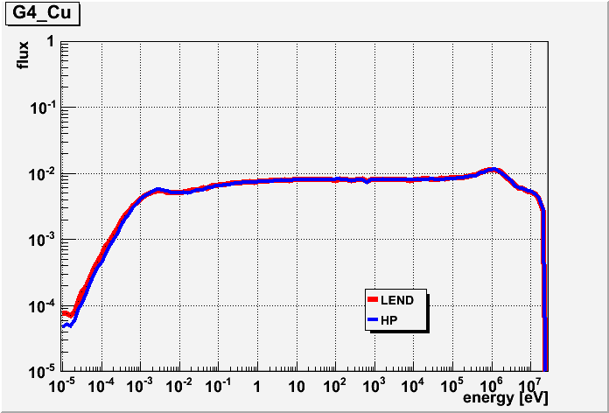
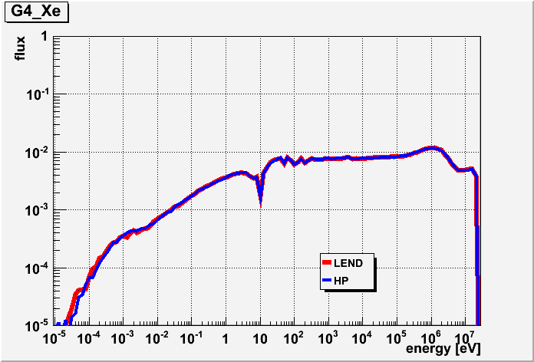
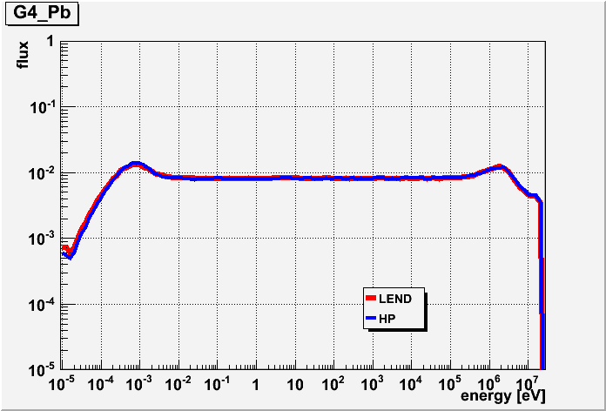
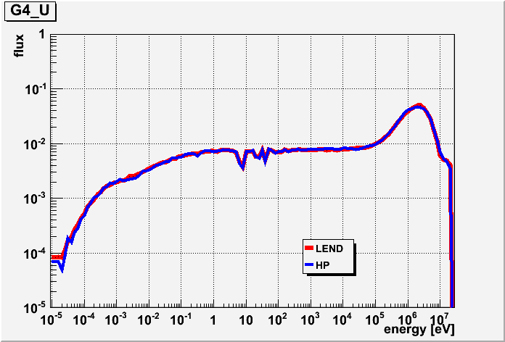
Out going neutron energy spectra

Slide 9
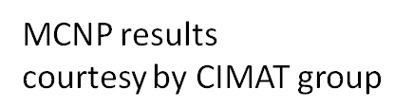
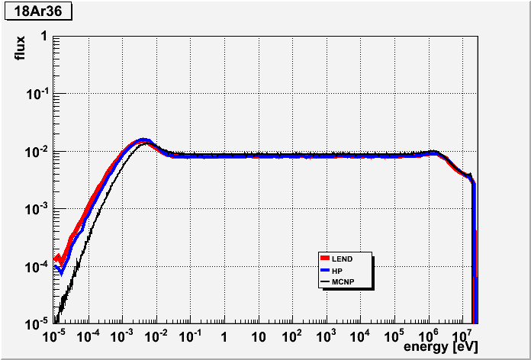
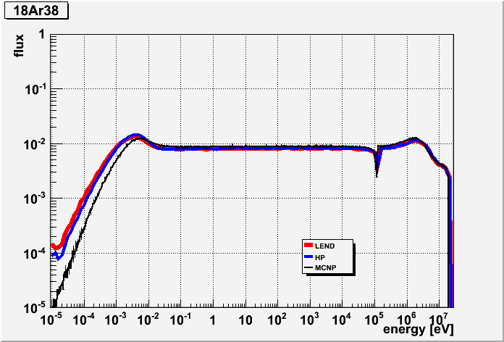
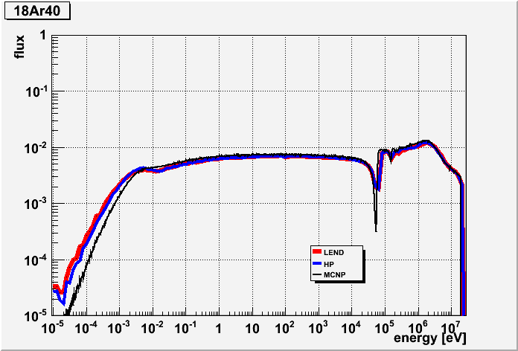
Comparison among
HP,LEND and MCNP
Thermaliztion problems?
Temperature of target
materials are 293 K
Binning

Slide 10
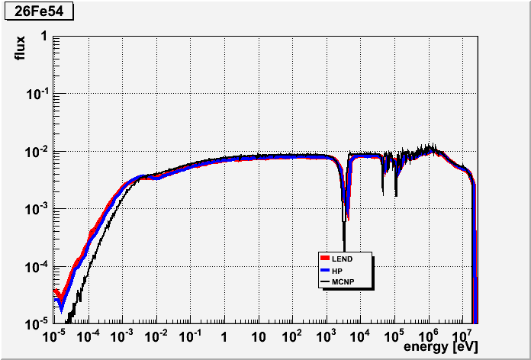
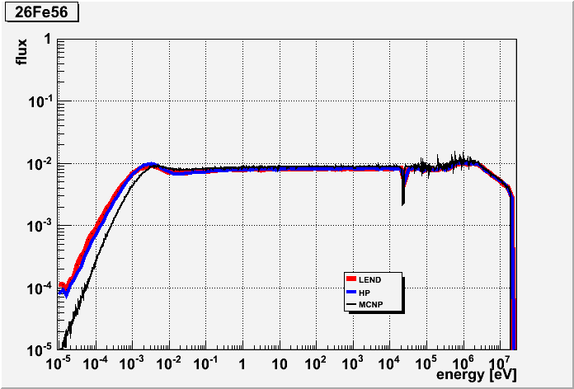
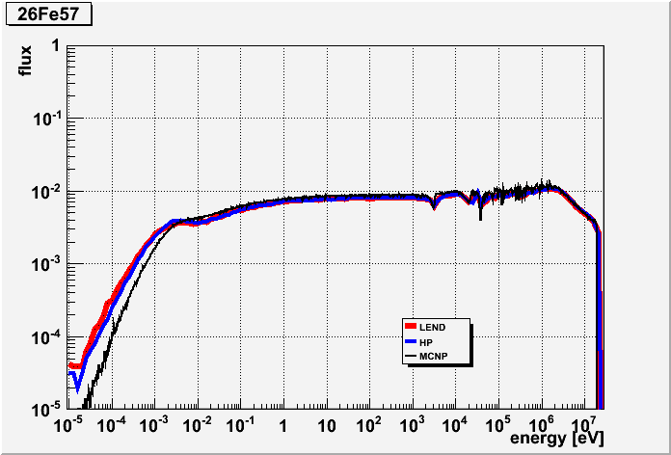
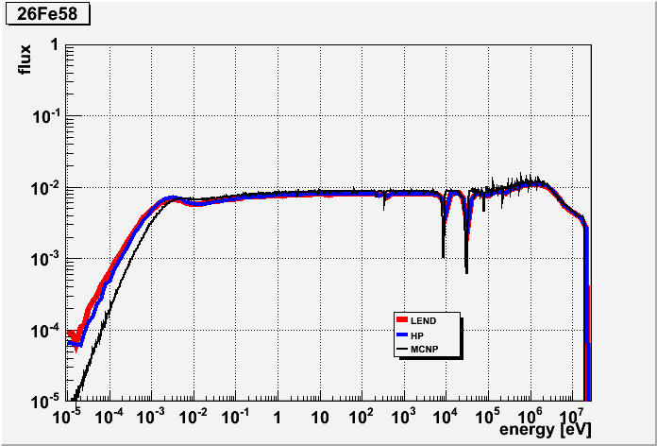
Comparison among
HP,LEND and MCNP
Binning

Slide 11
Cross section and Secondary Neutron Distributions using S(α, β) model

Slide 12
Angular Distribution of neutrons n (16MeV) on Au
The difference mainly comes from number of bins for equal probabilities.
In processing data, we use 32 as the number.
LEND(ENDL99)
Results of G4NeutronHP and G4LEND are derived by thin target like simulation

Slide 13
45-50MeV neutrons bombarding concrete slab
Neutron energy spectrum at depth of 1m

Slide 14
Validation of gammas emission from neutron captured by Nitrogen nucleus
Data: G. E. THOMAS et al.,NIM 56, pp325-337 (1967)

Slide 15
ENDF-VII INL 1.42 [barn]
ENDF-VII cont 1.29
G4HP non adjust 1.38 [barn]
G4HP 1.42
G4LEND 1.28
HP:G4NDL3.15
LEND:ENDFVII.0

Slide 16
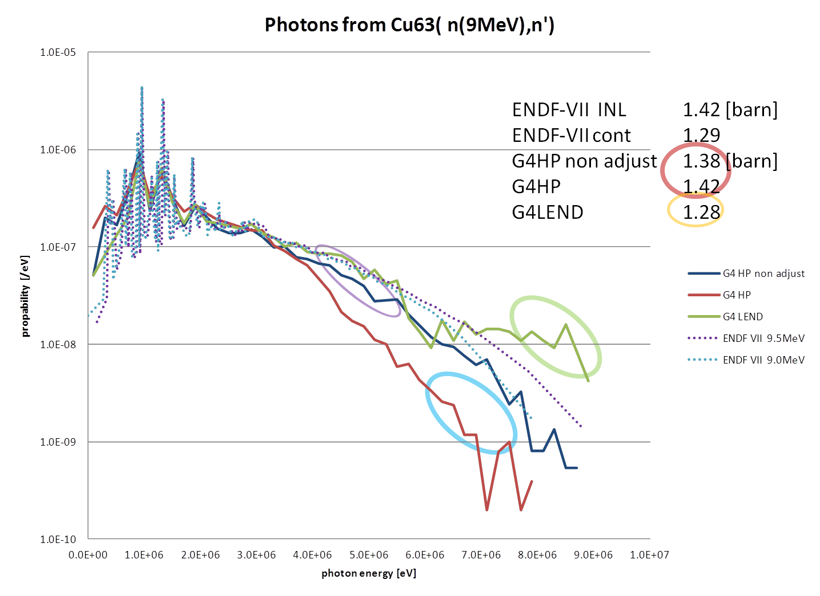
The differences from
ENDF values are caused by
Multiplicity
  Poisson Distribution
Equal probability bin
  Number of bins
Photon emission in LEND
  No photons from L1 and L2 channels ???
Adjustment for better conservation
  Disable by “G4NEUTRONHP_DO_NOT_ADJUST_FINAL_STATE”
Adjustment by remaining energy for the interaction
  No option for disabling this

Slide 17
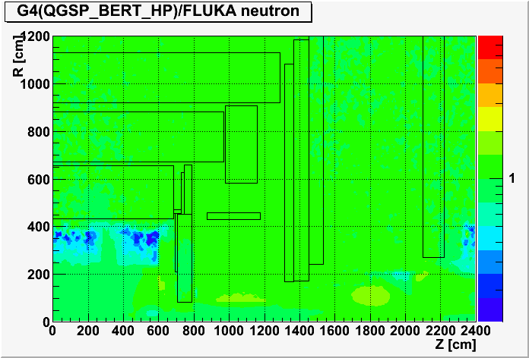
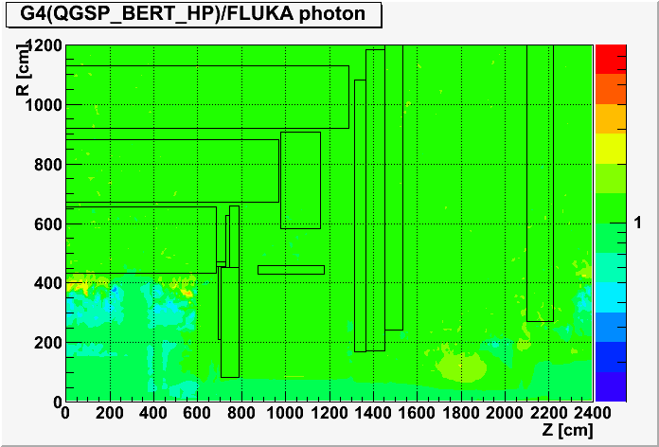
ATLAS Cavern background
“Monte Carlo calculations for the ATLAS cavern background”
Tatsumi Koi, David N. Brown, Alberto Fasso, Norman A. Graf, Paola Sala,
Dennis H. Wright and Charles C. Young
Progress in Nuclear Science and Technology
Volume 4 (2014) pp. 507-510

Slide 18
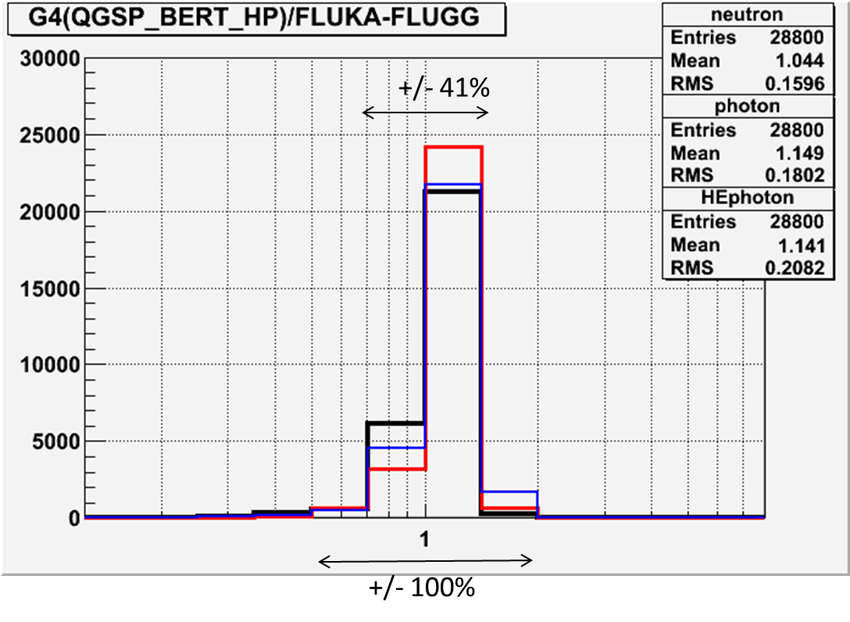
“The result of QGSP_BERT_HP, which uses the High Precision neutron model for low energy neutron transportation, is similar to the FLUKA result. Neutron and photon fluxes were compared throughout the entire ATLAS cavern and the differences between FLUKA and Geant4 are within +/- 41% in most regions.”

Slide 19
SATIF BNL Benchmark
Deep penetration experiments through steel and concrete shields for neutrons generated at mercury target irradiated by 2.83-and 24-GeV protons
Benchmark problem
  1) Accelerator (Organization): AGS (Brookhaven National Laboratory)
  2) Projectile (Energy) : Proton (2.83 and 24 GeV)
  3) Target Material : Mercury
  4) Shielding Material : Steel and Concrete
  5) Geometry : Slab Geometry
    implemented as Cylindrical Geometry for better simulation efficiency
  6) Instruments : Activation Detector (Bi) with HP-Ge Detectors
  7) Measured Quantities : Neutron Reaction Rate
    209Bi(n,4n)206Bi Threshold Energy of 22.6 MeV
    209Bi(n,6n)204Bi Threshold Energy of 38.1 MeV
    Reaction rate of them are given as a function of neutron flux from SATIF organizer

Slide 20
Benchmark overview
Bi Activation Detector
Shielding Material
Iron
Secondary Particles
Proton
2.83 and 24 GeV
Mercury Target
Secondary Particles
Concrete
Shielding Material

Slide 21
SATIF inter-comparison
Geant4 v10.p01

Slide 22
Geant4 v10.p01

Slide 26
Session Conveners
Tue. Moring: Tatsumi
Tue. Afternoon: Alberto (Tatsumi)
Wed. Moring: Federico
Wed. Afternoon: Dennis

Slide 27
New and Future Development (Tue. 09:30-12:00)
ParticleHP and Interpolation Scheme
Adding break up reaction to HP
Status and feature development of GND, GIDI and G4LEND
Development of Fission Fragment Generator

Slide 28
Performance Improvement (Tue. 13:30-15:00)
Performance improvement of neutronHP by simplified Doppler broadening
Advanced applications of neutron simulation and data formats

Slide 29
Conservation (Tue. 15:00-17:00)
Introduction of conservation problem on data driven models

Slide 30
Biasing (Wed. 08:30-10:00)
Review of Geant4 biasing

Slide 31
Nuclear Devices (Wed. 10:30-11:30)
G4-STORK: Stochastic Calculations of Reactor Kinetics
Accuracy and speed of the HP models

Slide 32
Data preparation and documentation
(Wed. 11:30-12:00,Lunch Break, 13:30-15:00)
CIEMAT data preparation for IAEA
LLNL data preparation and international GND project
Documentation of data format

Slide 33
Discussion

