Slide 1
CERN physics analysis and databases or “How to discover the Higgs boson inside a database”
Dr. Maaike Limper

Slide 2
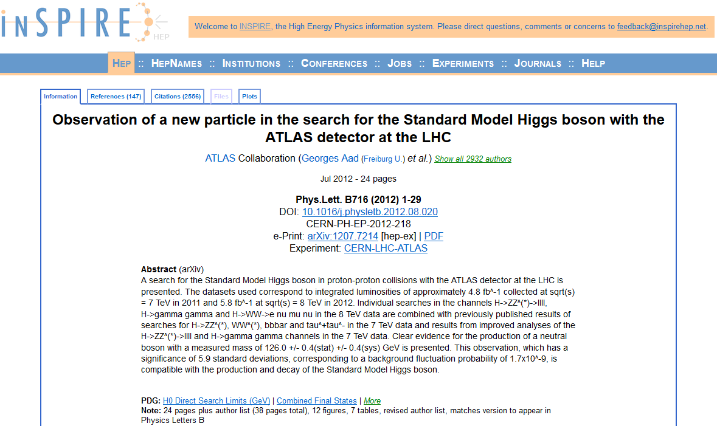
About me “Co-discoverer of the Higgs Boson”
2932 authors
including me!

Slide 3
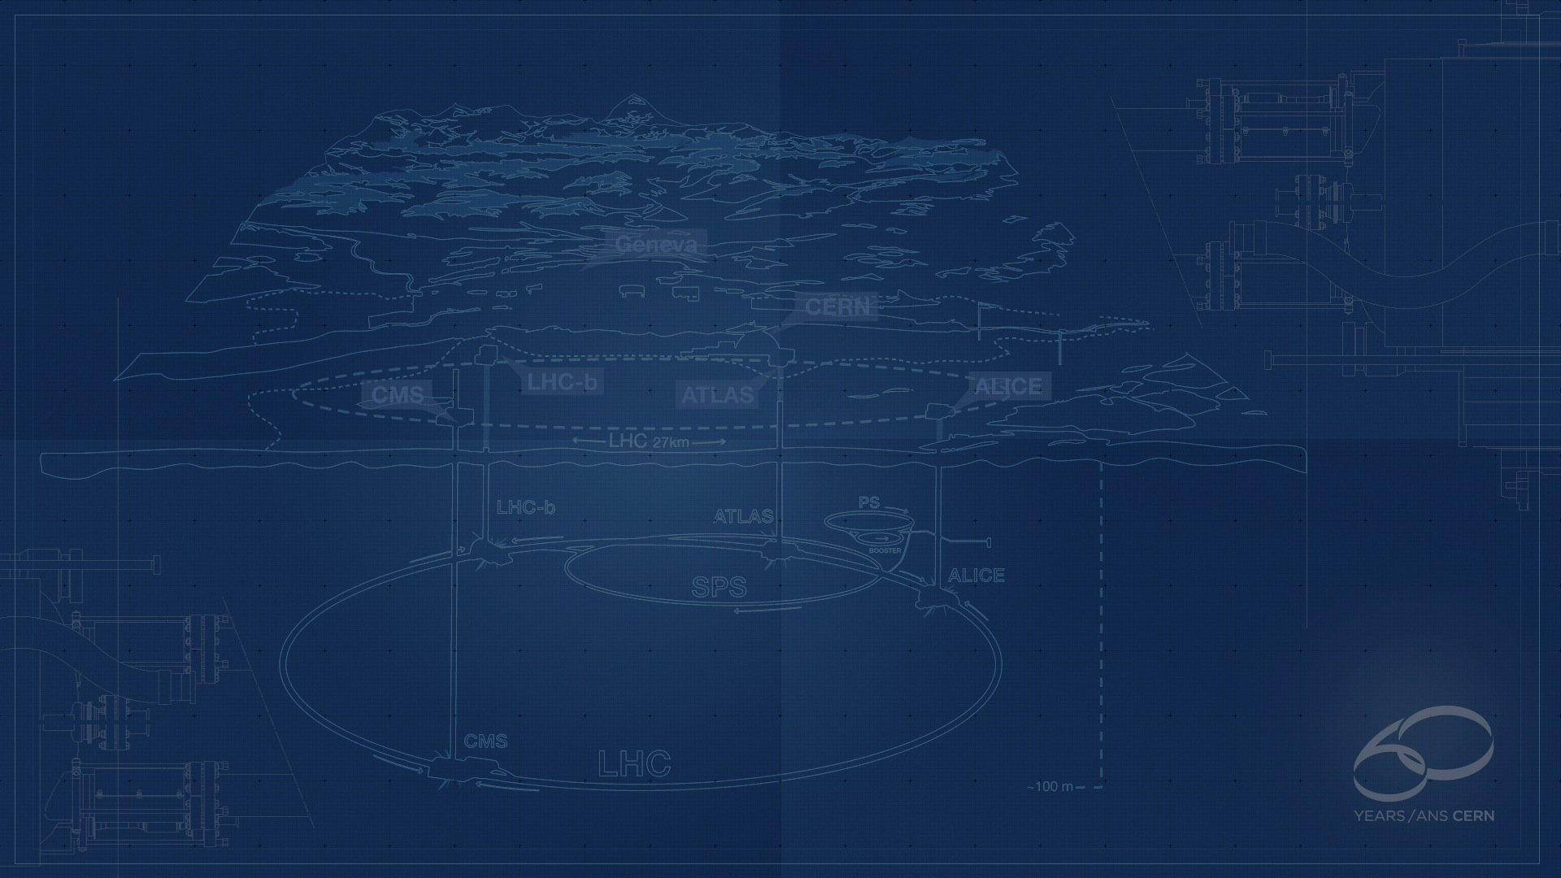
About CERN
CERN - European Laboratory for Particle Physics
Founded in 1954 by 12 Countries for fundamental physics research in a post-war Europe
Today is the global effort of 21 member states
  About 1 billion CHF yearly budget
  2’300 personnel, 10’000 users
Support the research activities of scientists from 110+ nationalities

Slide 4
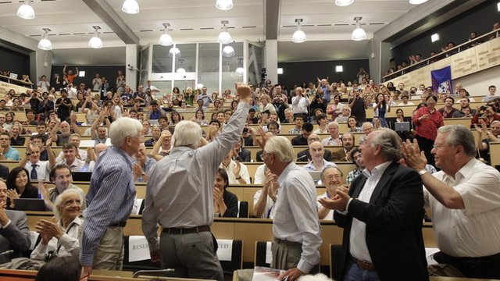
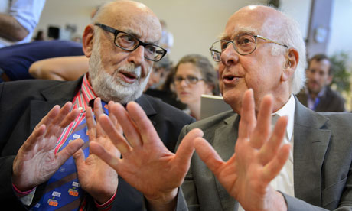
Higgs Boson discovery
4 July 2012: Scientists from ATLAS and CMS present Higgs discovery result
The Nobel Prize in Physics 2013 was awarded jointly to François Englert and Peter W. Higgs:
"for the theoretical discovery of a mechanism that contributes to our understanding of the origin of mass of subatomic particles, and which recently was confirmed through the discovery of the predicted fundamental particle, by the ATLAS and CMS experiments at CERN's Large Hadron Collider"

Slide 5

Our business: Fundamental Research
Why do particles have mass?
  The Higgs mechanism seems to be the answer
Why is there no anti-matter left in the universe?
  Big Bang would have produced amount of matter and anti-matter
Why do we have ‘Dark Matter’?
  Existence of Dark Matter inferred from gravitational effects; is there an unknown ‘invisible’ heavy particle?
…

Slide 6
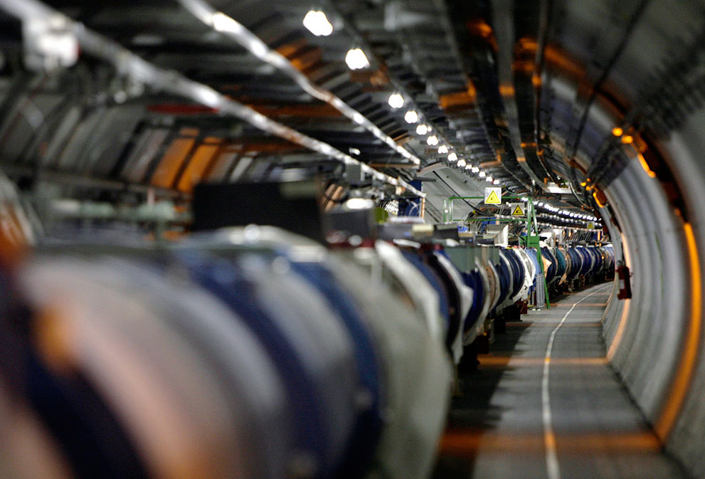
The Large Hadron Collider (LHC)
Fastest racetrack on Earth: protons circulate at 99.9999991% the speed of light
Emptiest place in the solar system: High vacuum inside the magnets
Coolest place in the universe
LHC operating temperature is 1.9 Kelvin (-456 °F) less than the Cosmic Background Radiation

Slide 7

The Large Hadron Collider (LHC)
Largest machine in the world: 27km, 6000+ superconducting magnets
Four main experiments: ATLAS, ALICE, CMS, LHCb

Slide 8
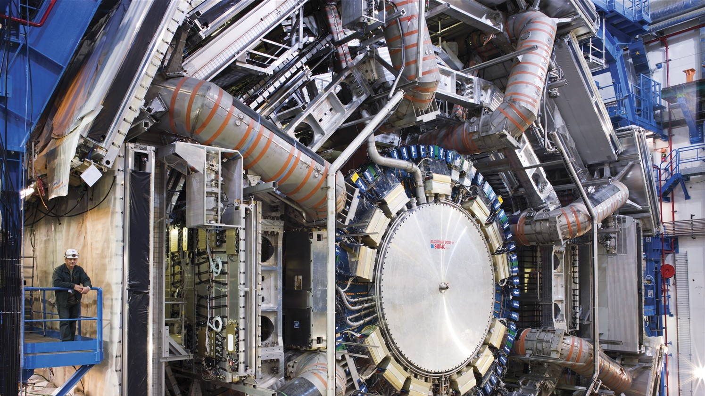
The ATLAS experiment
150 million sensors: various types of detectors to measure particles produced in LHC collissions

Slide 9
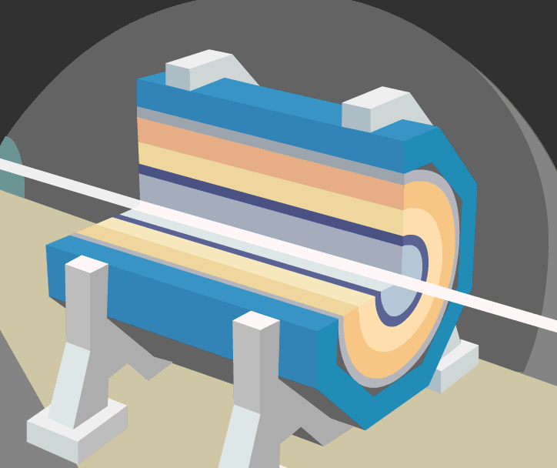
Events at LHC
Luminosity :
10³⁴cm⁻² s⁻¹
40 MHz – every 25 ns
Notes:
Quantum mechanics, which describe the interactions of particles and thus the world we live in, is all about probabilities. Luminosity tells us about the rate and density of the collissions, the higher the luminosity, the more Higgs bosons per second we produce.

Slide 10
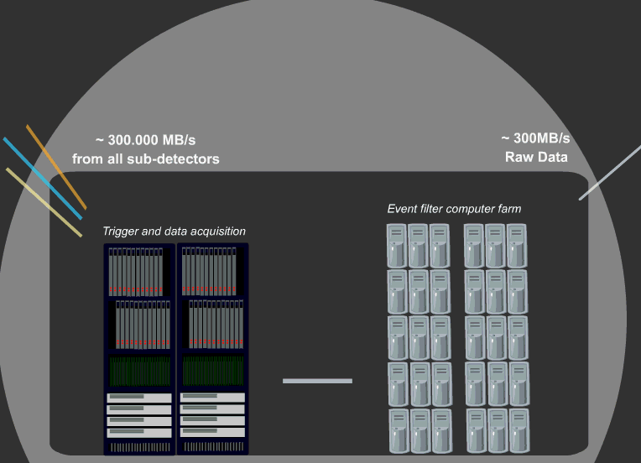
Trigger & Data Acquisition

Slide 11
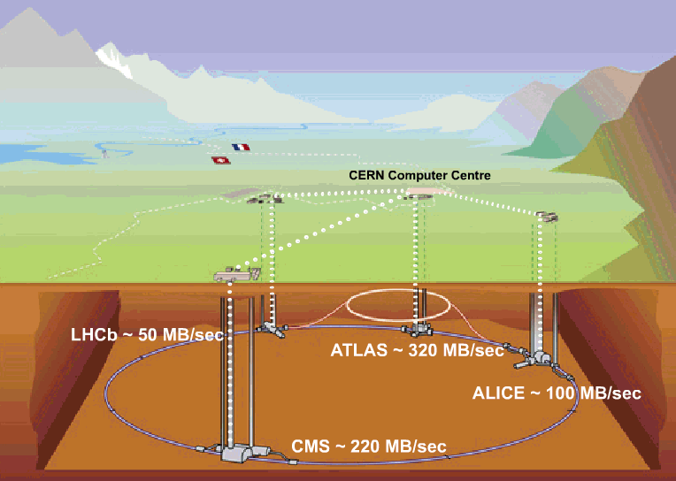
Data Recording

Slide 12
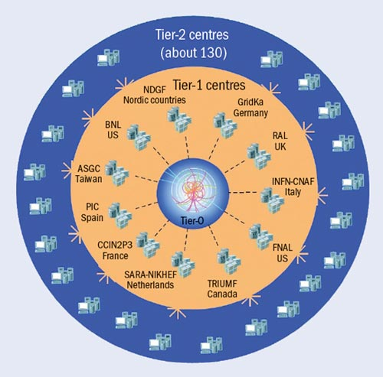
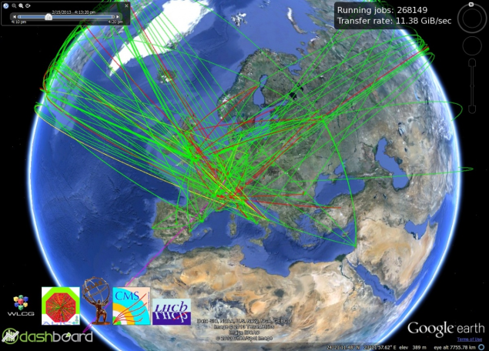
WLCG
World-wide LHC Computing Grid
The world’s largest scientific computing grid
  > 100 Petabytes of data stored in a custom file system, increasing with 20+ Petabytes/year
  Over 250K CPU cores, processing 2M jobs per day
  160 computer centres in 35 countries
  More than 8000 physicists with real-timedata access

Slide 13
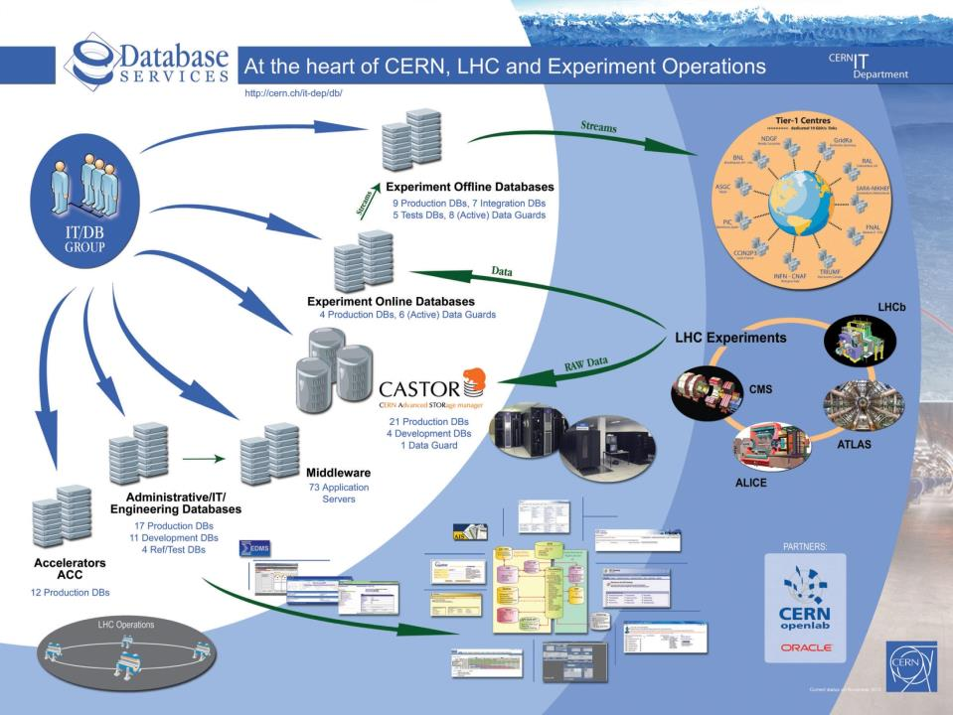
CERN IT/DB group
Notes:
About database at CERN: ofcouse some administrative stuff (10k users)

Slide 14

CERN’s Databases
~100 Oracle databases, most of them RAC
  Mostly NAS storage plus some SAN with ASM
  ~500 TB of data files for production DBs in total
Examples of critical production DBs:
  LHC logging database ~170 TB, expected growth up to ~70 TB / year
  13 production experiments’ databases ~10-20 TB in each
  Read-only copies (Active Data Guard)
Notes:
NAS=Network-attached storage (using netapp in our case=NFS)
SAN=Storage Area Network (to access our disk-arrrays)

Slide 15

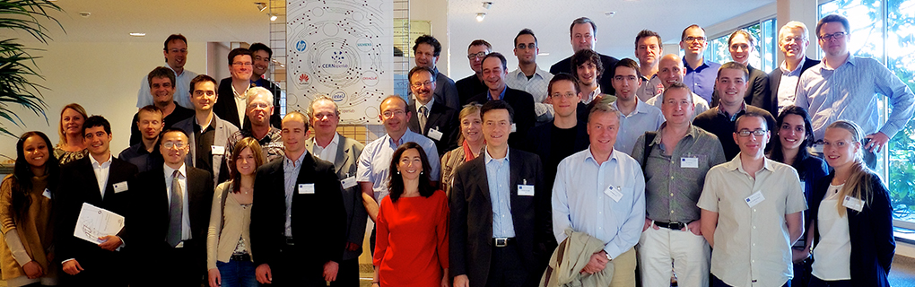
CERN openlab
“CERN openlab is a unique public-private partnership between CERN and leading ICT companies. Its mission is to accelerate the development of cutting-edge solutions to be used by the worldwide LHC community” http://openlab.web.cern.ch
Notes:
CERN has always been at the fore-front of latest technological innovations by the challenging demands of our experiments. Once our computer-center was one of the biggest int the world. CERN invented the world-wide web. But where once CERN was in the lead, industry is now surpassing us, and CERN needs to learn to benefit from the latest innovations brought by the Information Era.
15

Slide 16
CERN openlab & Oracle
Virtualization
Replication Technology
Enterprise Manager and 12c new Features
Data Analytics
In-Database Physics Analysis
Notes:
CERN has always been at the fore-front of latest technological innovations by the challenging demands of our experiments. Once our computer-center was one of the biggest int the world. CERN invented the world-wide web. But once CERN led, industry is now surpassing us, and CERN needs to learn to benefit from the latest innovations brought by the Information Era.
16

Slide 17
Data Analytics Challenges
Manuel Martin Marquez
LHC Availability – Estimated VS Observed

Slide 18
Data Analytics Challenges
Manuel Martin Marquez
Profit from our data investment
  Extracting knowledge.
Optimize our systems is mandatory
  Reducing and predicting faults and corrective interventions
  Increase the availability and operations efficiency
Control and Monitoring Systems
  Proactive
  Predictive
  Intelligent

Slide 19
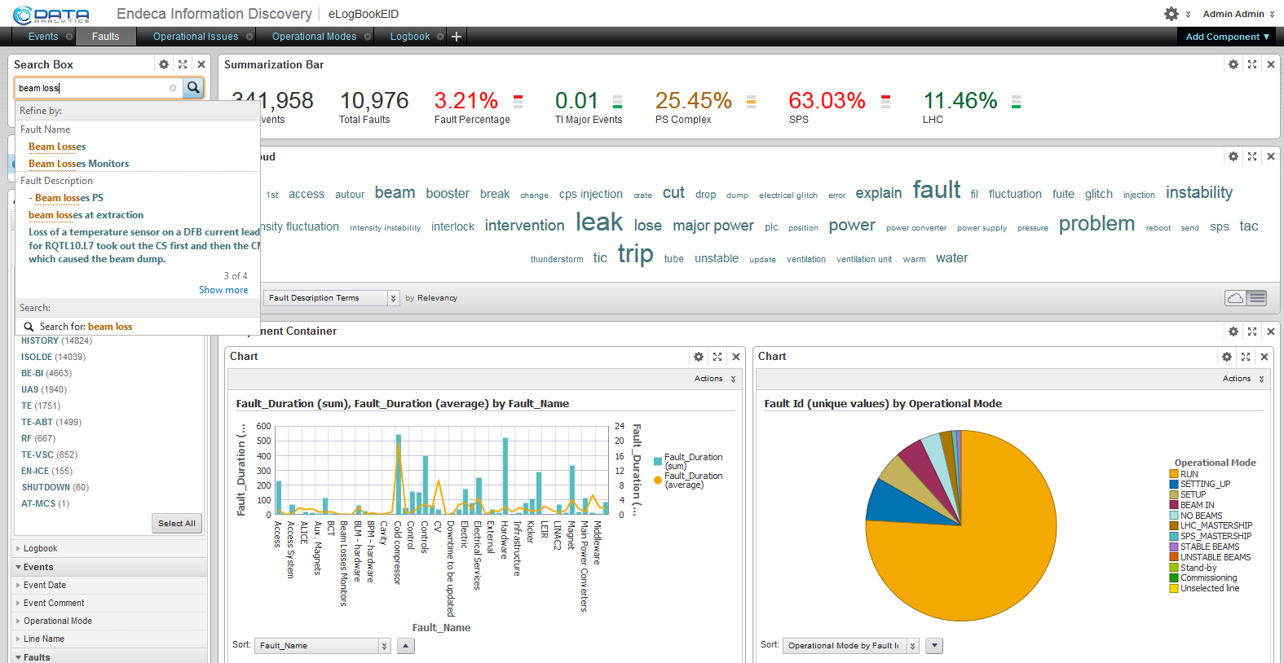
Endeca
Endeca provides an easy-to-use tool for studying LHC failures

Slide 20
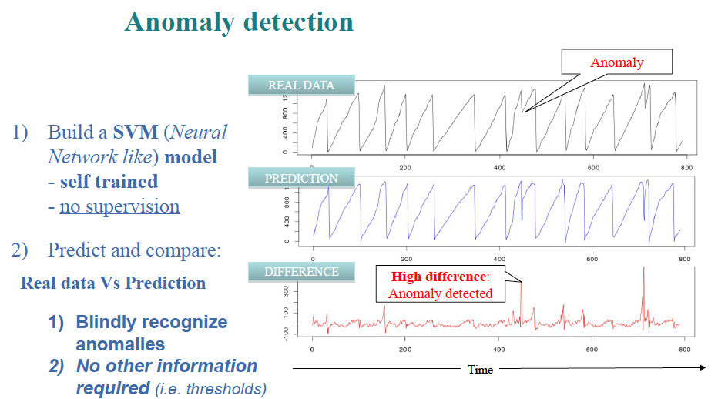
Anomaly detection
Manuel Martin Marquez
SVM - Support Vector Machines
.
Credit: Massimo Lamanna, Sebastien Ponce (IT-DSS), Stefano Alberto Russo (ex IT-DB)

Slide 21
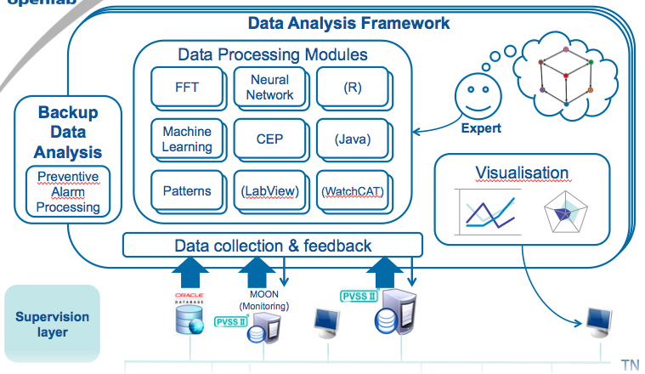
Analytics as a service
Manuel Martin Marquez
Work in preparation: “Analytics platform” or (Big data) “Analytics-as-a-service” (A³S ?):
Data fed from multiple sources (live)
Stored reliably
Data processing with multiple systems
Easy access, domain expert natural language (DSL)
Visualisation
Credit: CERN EN-ICE

Slide 22
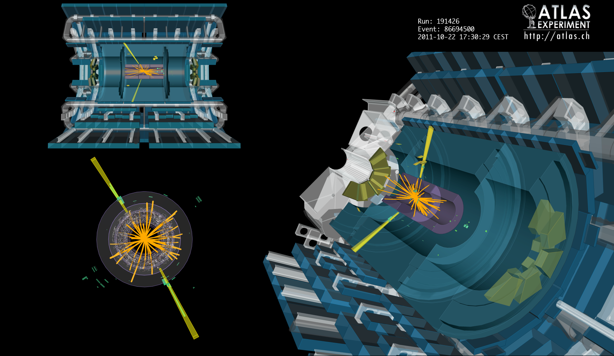
In-database physics analysis
Higgs decay to 2 photons candidate: event display from the ATLAS experiment

Slide 23
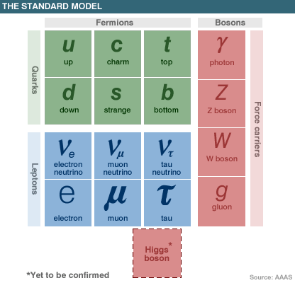
A quick course in Particle Physics
The Standard Model (SM) of particle physics, a very successful theory describing all the elementary particles and forces that are the building blocks of our world
Leptons: electrons and muons, relatively easy to detect , tau’s are tough
Neutrino’s can not be detected directly
Quarks: can not exist alone, but are bound together in pairs or triplets
Particles composed of quarks are called hadrons, proton is composed of two up plus one down quark
Force carriers: photons for electro-magnetism, Z/W bosons for ‘weak’ interaction, gluons to bind quarks together and the Higgs boson to give mass to particles

Slide 24
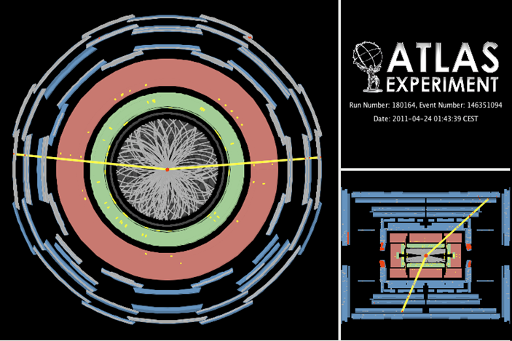
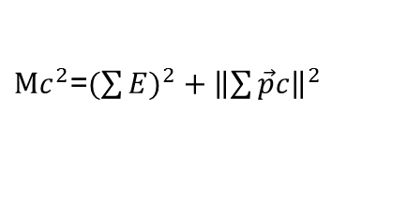
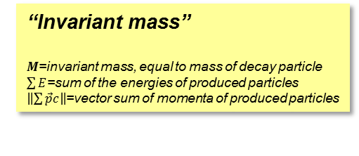
A quick course in Particle Physics
The energy in the LHC collision can be converted into the production of new particles
The detectors built around the collision point measure the produced particles
High energy quark production results in a ‘jet’ of particles seen in the detector
Energy resulting from a collision at the LHC is spread symmetrically, imbalance in the energy = Missing Energy, often due to neutrino’s
Z->μμ candidate, m_{μμ}=93.4 GeV
Many particles decay before we can measure them
We find these by their “invariant mass” calculated from the energy and momentum of the decay products
“Invariant mass”
$M$=invariant mass, equal to mass of decay particle
$\sum{E}$=sum of the energies of produced particles
$\left\|\sum{\vec{p}c}\right\|$=vector sum of momenta of produced particles
$\text{M}c^{2}$=$(\sum{{E)}^{2}}+{\left\|\sum{\vec{p}c}\right\|}^{2}$

Slide 25
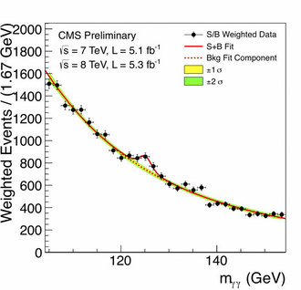
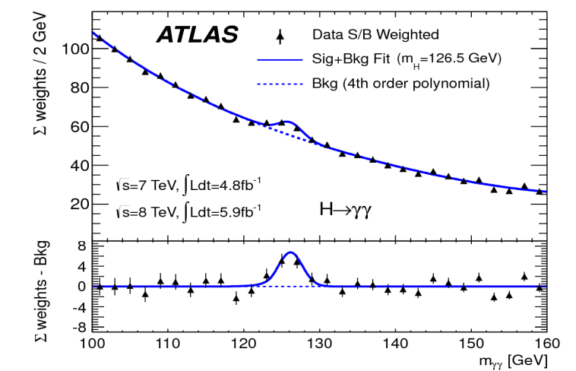
Higgs boson discovery
Plots of the invariant mass of photon-pairs produced at the LHC show a significant bump around 125 GeV …
4 July 2012: The discovery of a “Higgs boson-like” particle!
Operations of LHC and its experiments rely on databases (mainly Oracle) for storing conditions data, log files etcetera
… but the data-points in these plots did not came out of a database

Slide 26

From experiment to discovery
data acquisition
event
data taking
analysis
event
analysis
reconstruction
analysis objects
(extracted per physics topic)
event
reconstruction
raw data
ntuple1
ntuple2
simulated raw data
generation→simulation→digitization
event
summary
data
ntupleN
event
simulation
interactive
physics analysis
(thousands of users!)
Global computing resources to store, distribute and analyse LHC data are provided by the Worldwide LHC Computing Grid (WLCG)

Slide 27

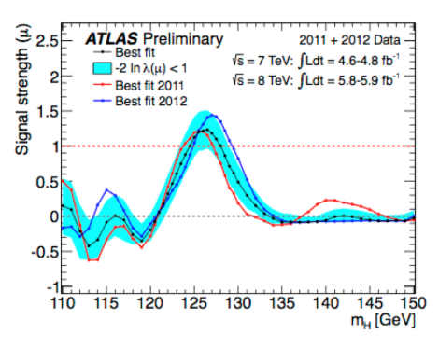
Data analysis in practice
LHC Physics Analysis is done with ROOT
Dedicated C++ framework developed by the High Energy Physics community, http://root.cern.ch
Provides tools for plotting/fitting/statistic analysis etc.
ROOT-ntuples are centrally produced by physics groups from previously reconstructed event summary data
Each physics group determines specific content of ntuple
Physics objects to include
Level of detail to be stored per physics object
Event filter and/or pre-analysis steps
ntuple1
event
summary
data
ntuple2
ntupleN

Slide 28
Data analysis in practice
Analysis is typically I/O intensive and runs on many files
analysis
event
analysis
Small datasets→ copy data and run analysis locally
Large datasets:→use the LHC Computing Grid
Grid computing tools split the analysis job in multiple jobs each running on a subset of the data
Each sub-job is sent to Grid site where input files are available
Results produced by sub-jobs are summed
Bored waiting days for all grid-jobs to finish→
Filter data and produce private mini-ntuples
analysis objects
(extracted per physics topic)
ntuple1
ntuple2
ntupleN
interactive
physics analysis
(thousands of users!)
My Openlab Project: Can we replace the ntuple analysis with a model where data is analysed inside a centrally accessible Oracle database?

Slide 29
ROOT ntuple data
Test sample of ATLAS analysis ntuples with 2012 collision data
  127 ntuples
  .5% of entire dataset
Ntuples contain 4000 “branches” holding objects per events
  Objects can be float, int, double, etc but also vector or vector-of-vector of float, int, double, etc
Physicists don’t use all variables, they pick&choose variables best suited for their analysis
ROOT-ntuple is designed to reduce I/O by loading only relevant branches

Slide 30
Physics Analysis DB
Store separate physics-objects in separate tables
  Allows users to only access objects relevant for their analysis
  Avoid storing vectors in columns to ensure easy predicate filtering

Slide 31
Physics Analysis C++
vector<float> el_pt;
vector<float> el eta;
tree->getBranch(“el_pt”,&el_pt);
tree->getBranch(“el_eta”,&el_eta);
//etc.
for ( ievent = 0 ; ievent<nevents ; ievent++){
//find good electrons
tree->NextEvent();
for(i=0; i<nelectrons; i++){
if( el_pt[i] > 25. && fabs(el_eta[i])<2.5 etc.) ngoodelectron++;
}
Notes:
31

Slide 32
SQL analysis
select “E”, “px”, “py”, “pz” from “electron” where “pt”>25. and abs(“eta”)<2.5 ...
Notes:
32

Slide 33
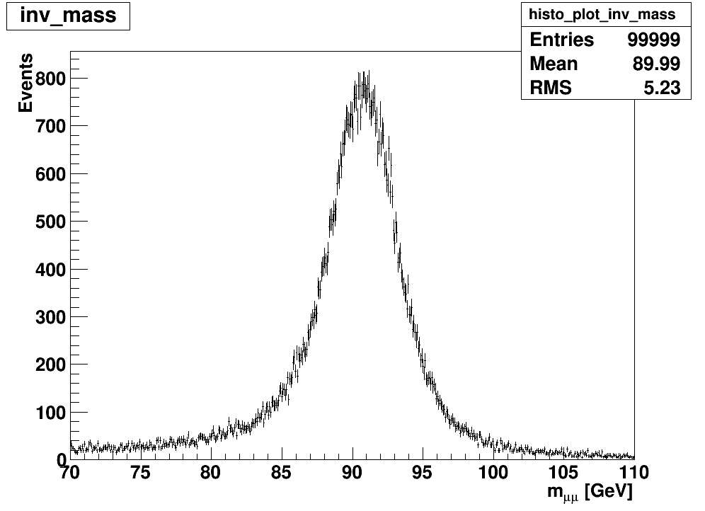
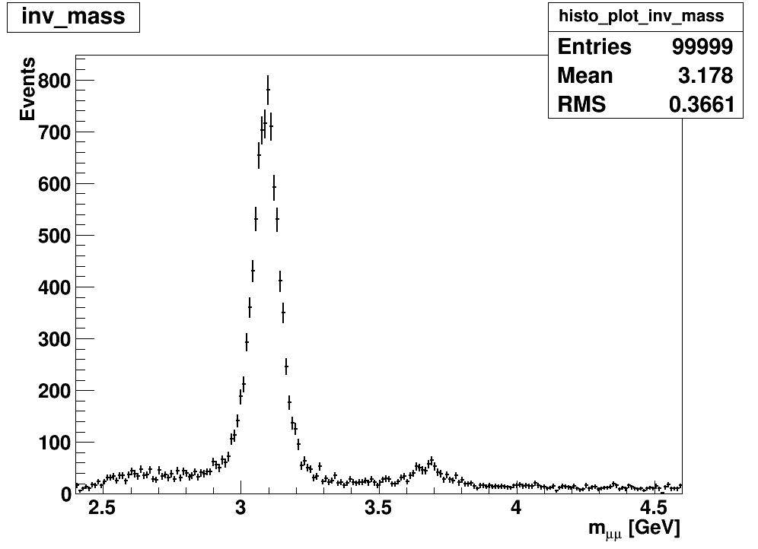
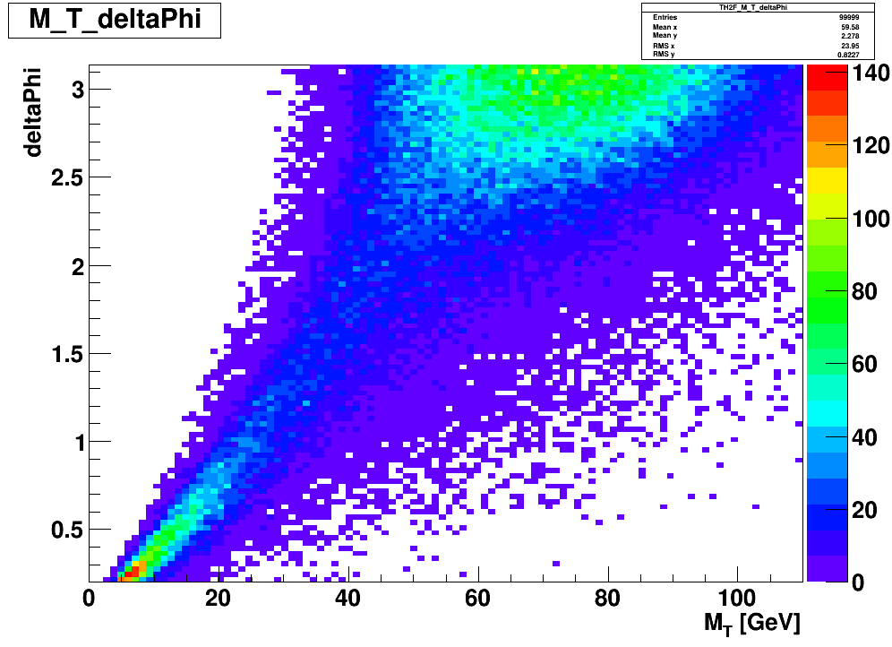
Live demo
  (Depending on internet in room)
  Show basic example to make quick physics plots with SQL
Z-boson
Charmonium
W-boson
J/ψ
Ψ(3686)

Slide 34
SQL analysis pros & cons
  Analysis via SQL on DB advantages:
  No need to re-compile macro while tweaking your analysis
  The DB can hold intermediate query-results to be studied (no need to store filtered results in ntuples)
  User can analyse the data anywhere with ROOT and connection to DB
    no need for large local storage and/or powerful machine
    no need to wait for jobs to run on the WLHCG

Slide 35
SQL analysis pros & cons
  Analysis via SQL on DB disadvantages:
  Complex functions from C++ to be made available centrally via “analysistools”-schema
  Adminstrator needs to prevent users from tying up all resources in badly-written SQL!
  Analysis SQL is not that easy to read/write/debug

Slide 36
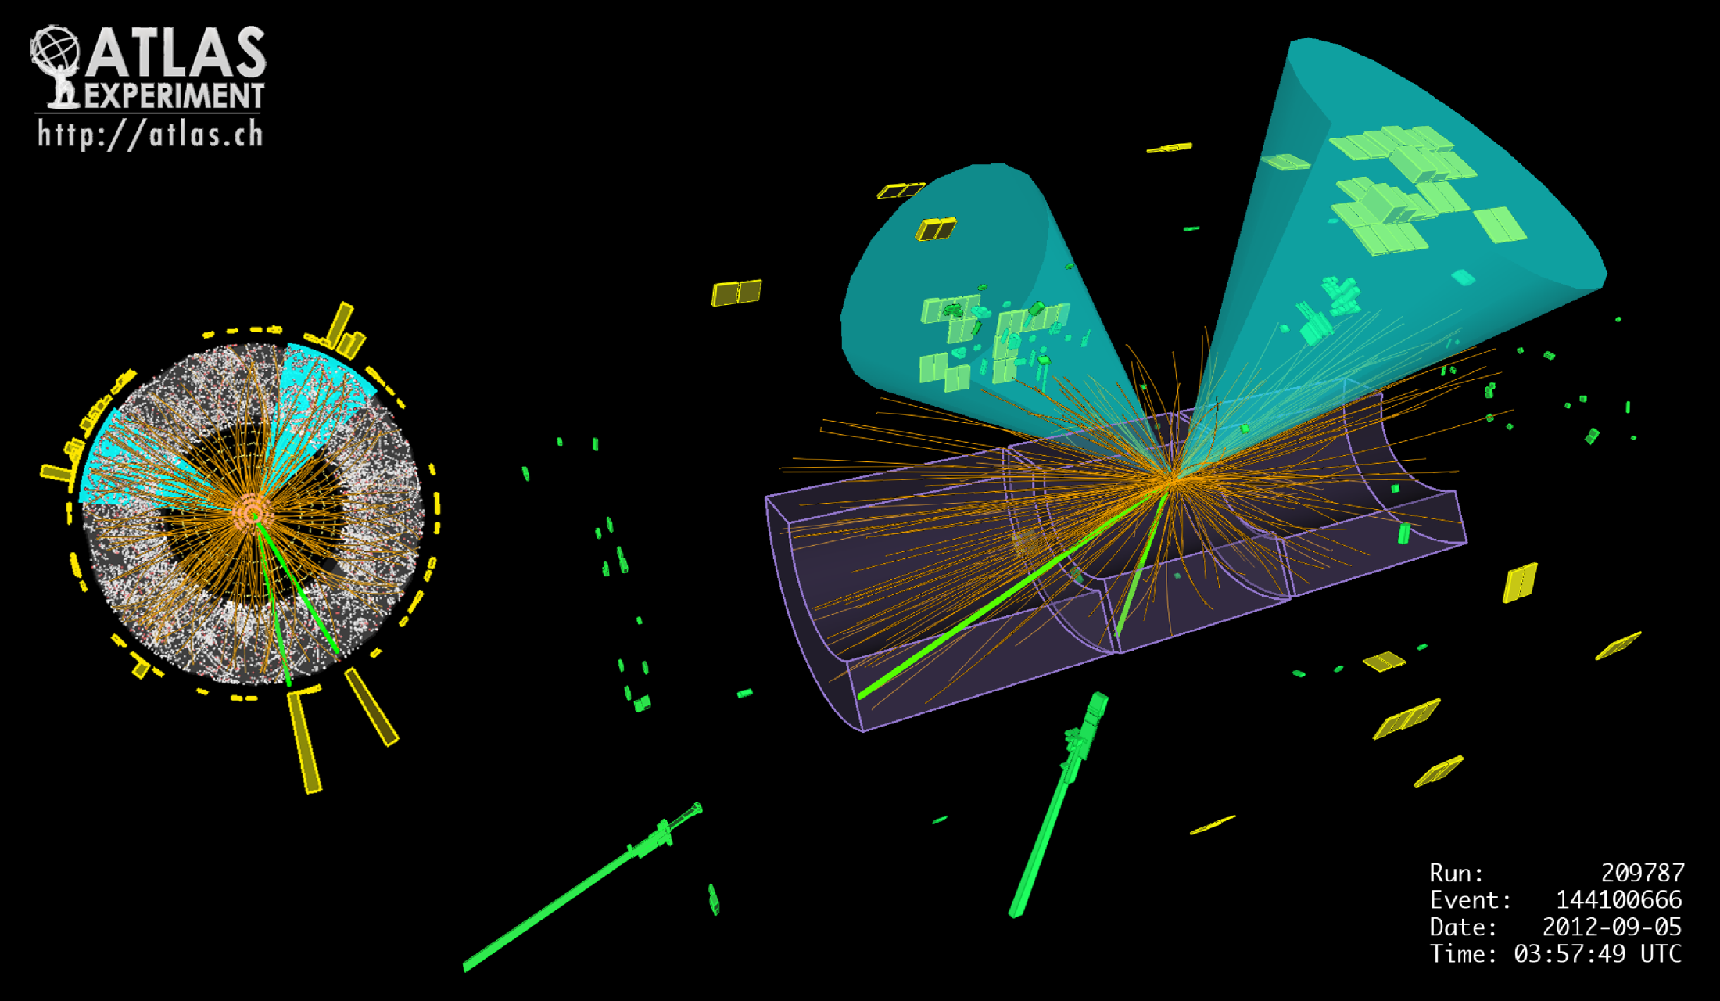
Physics Analysis Benchmarks
Z+H candidate event observed in ATLAS
Higgs+Z benchmark
Higgs decays to two b-quarks, select good b-jets
Z boson decays to lepton-pair, select two good muons or two good electrons
Require specific Event Filter (EF) triggers to select events
Require “good lumi-blocks” from Event Data
Require Missing Transverse Energy (MET) less than 50 GeV to exclude top-pair events
Notes:
36

Slide 37
Benchmark in SQL
Query starts by applying selection criteria via select-statements on relevant tables:
with sel_electron as
(select "electron_i","EventNo_RunNo",etc from "electron" where "pt" < 25. and abs("eta") <2.5 …etc. ),
sel_muon as
(select "muon_i","EventNo_RunNo",etc from "muon" where "pt" < 20. or abs("eta") < 2.4 .. etc. ),
sel_bjet as (
select "jet_i","EventNo_RunNo”,etc from "jet" where "pt">25. and abs("eta")<2.5and mv1("wIP3D","wSV1","wFCN",..)>0.6017),
Followed by JOINs to find events with two b-jets and two muons or two electrons
Finally a super-join where the calculated quantities, used to fill histograms, are returned:
select "EventNo_RunNo","EventNumber","RunNumber","DiMuonMass","DiElectronMass","DiJetMass" from sel_muon_events FULL OUTER JOIN sel_electron_events USING ("EventNo_RunNo") INNER JOIN sel_bjet_events USING ("EventNo_RunNo") INNER JOIN sel_MET_events USING ("EventNo_RunNo") INNER JOIN sel_EF_events USING("EventNo_RunNo") INNER JOIN sel_goodlbn_events USING("EventNo_RunNo")
Notes:
37

Slide 38
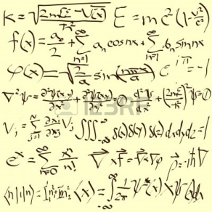
Calculations and external code
Easy calculations can be written directly in SQL
PL/SQL functions can be written for more complex calculations
Higgs+Z benchmark also uses external C++ code used to calculate the “b-jet probability”
  Due to overhead from external procedure agent, the benchmark instead calls the C++ library via Java

Slide 39
PL/SQL calling Java calling C++
PL/SQL
FUNCTION mv1Eval_java( w_IP3D IN NUMBER, w_SV1 IN NUMBER, w_JetFitterCombNN IN NUMBER, jet_pt IN NUMBER, jet_eta IN NUMBER ) return double precision
as language java
name 'MV1_interface.mv1Eval(double, double,double,double,double) return double';
Java
public class MV1_interface {
public native static double mv1Eval(double fl_w_IP3D, double fl_w_SV1, double fl_w_JetFitterCOMBNN, double pt, double eta);
static{ System.loadLibrary("MV1_interface.so");} }
C-interface calling C++
JNIEXPORT jdouble JNICALL Java_MV1_1interface_mv1Eval
(JNIEnv *, jclass, jdouble w_IP3D, jdouble w_SV1, jdouble w_JetFitterCombNN, jdouble jet_pt, jdouble jet_eta){
double value = mv1Eval(w_IP3D, w_SV1, w_JetFitterCombNN, jet_pt, jet_eta);
return value; }
Set permission to load library!
exec dbms_java.grant_permission(‘ANALYSISTOOLS','SYS:java.lang.RuntimePermission','loadLibrary.MV1_interface.so','');
Notes:
39

Slide 40
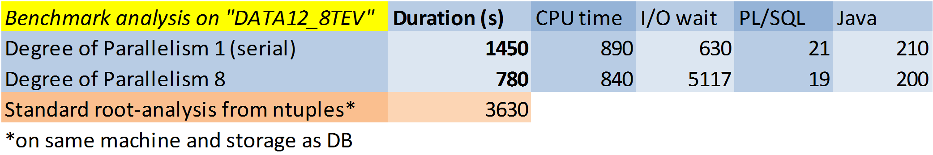
Performance comparison
Higgs+Z benchmark performance results on first setup:
DB limited by I/O!

Slide 41
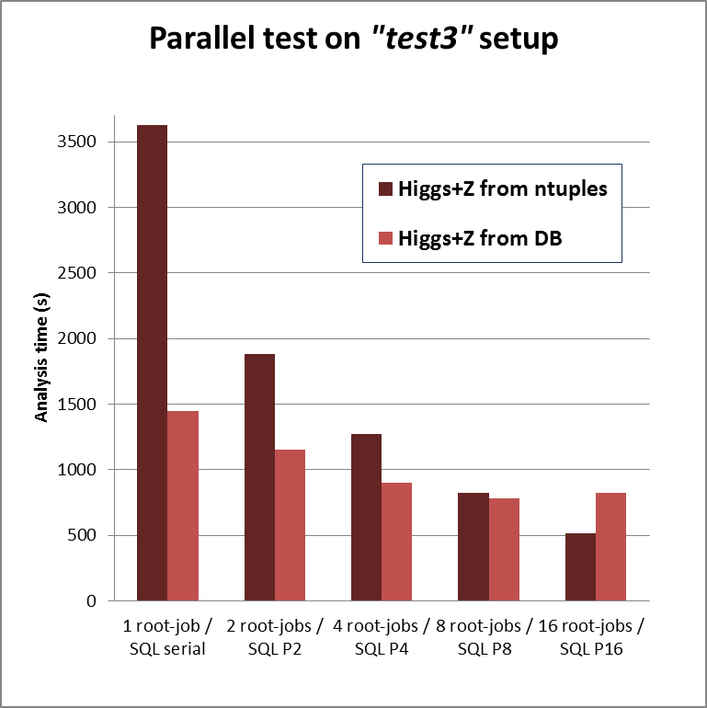
Performance comparison
Parallel ROOT: run multiple simultaneous root jobs, each on a subset of data
Ntuple-version improves more with parallelism as the DB is limited by IO
  more data read by the DB compared to the column-storage in ntuples
First setup had datafiles stored on NAS, resulting in relatively slow I/O speed of ~250 MB/s

Slide 42
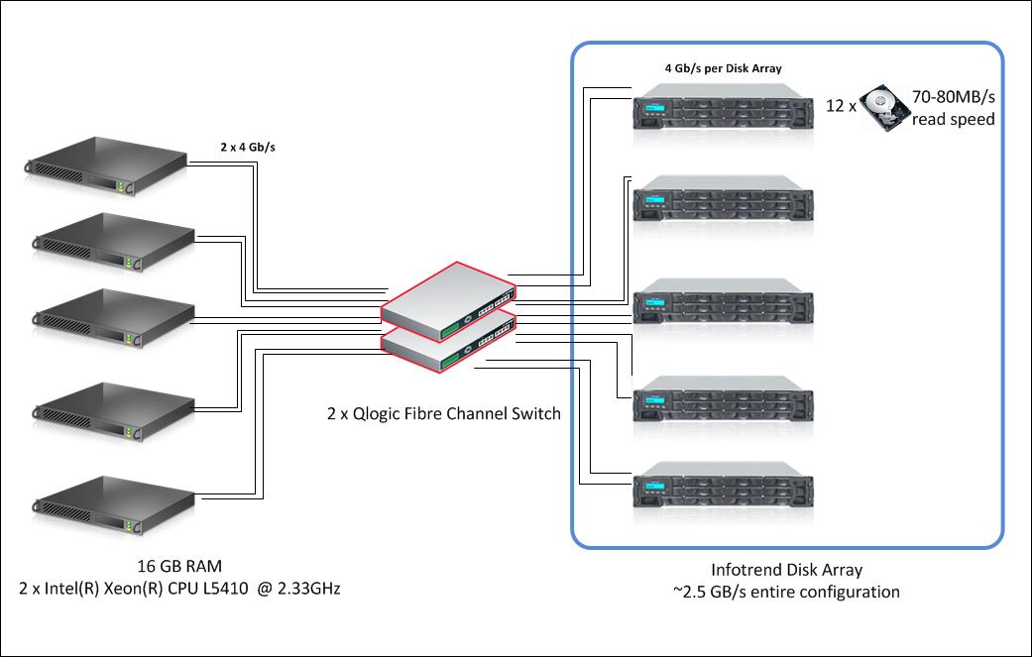
A new test setup
5 storage devices each with 12 disks
IO limited by 4 Gb/s per Disk Array
→ maximum I/O speed of ~2500 MB/s
Oracle 5-node RAC
Access to disks on all storages through ASM
ROOT-ntuple files divided equally over all disks

Slide 43
And another benchmark…
Higgs+Z: simplied version of the actual analysis uses 40 variables
ttbar cutflow: based on real analysis code uses 262 variables

Slide 44
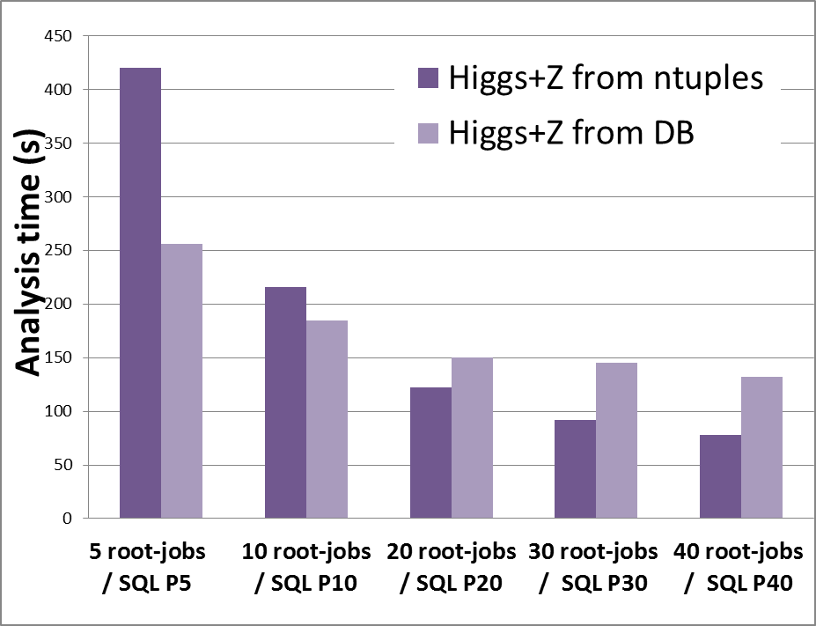
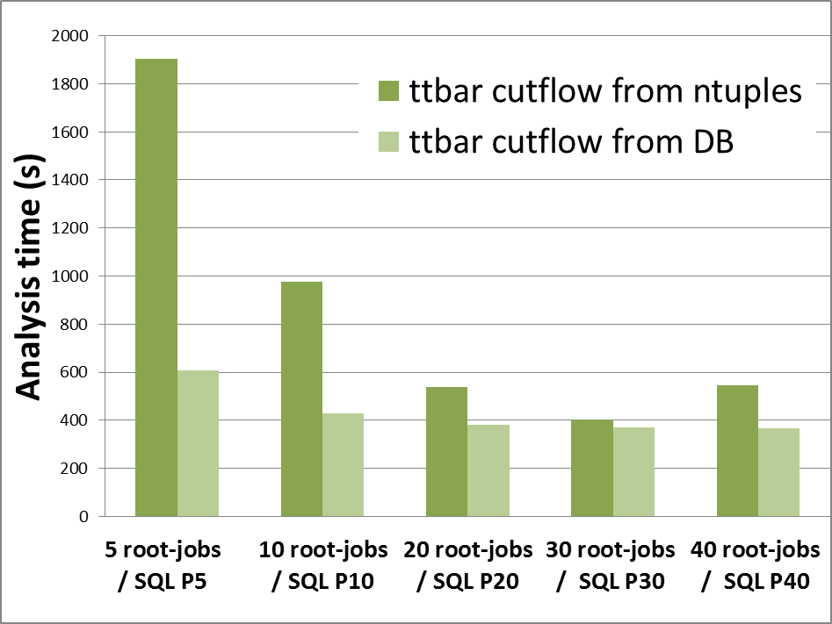
Performance comparison
Higgs+Z: ROOT ntuple-version is faster than DB with sufficient parallelism
ttbar cutflow: DB-version is always faster

Slide 45
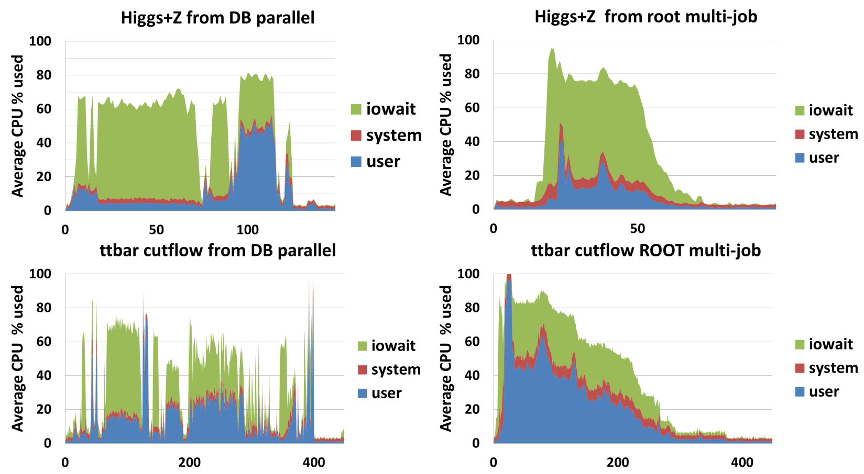
CPU usage comparison
DB: ‘dips’ between different table-scans for serial part of query execution
ROOT multi-job: long tail waiting for last job to complete
Notes:
CPU usage plots are always interesting to compare how the different techniques approach our problem and make use of the resources. In both case we see a bulk of iowait. Inevitable physics analysis scans through a lot of data to find the interesting events. But while ROOT goes through the data event-by-event, Oracle goes through the data table-by-table. The CPU profile of DB clearly shows dips between the different table-scans, and high-CPU usage at the jet-table scan. The ROOT multi-job analysis often end up with a long tail waiting for the last job to complete.

Slide 46
JOINs & Physics Analysis
All tables have an index on “RunNumber”, “EventNumber” which defines which the collission-event the object was recorded in
By design the SQL queries will involve JOINs to bring from different object-selections in the same event together
  self-join: calculate invariant mass of two good muons in one event
Best performance usually with HASH JOIN of pre-selection
Joining large pre-selection is potentially problematic
  Relies on selectivity of the object pre-selection

Slide 47
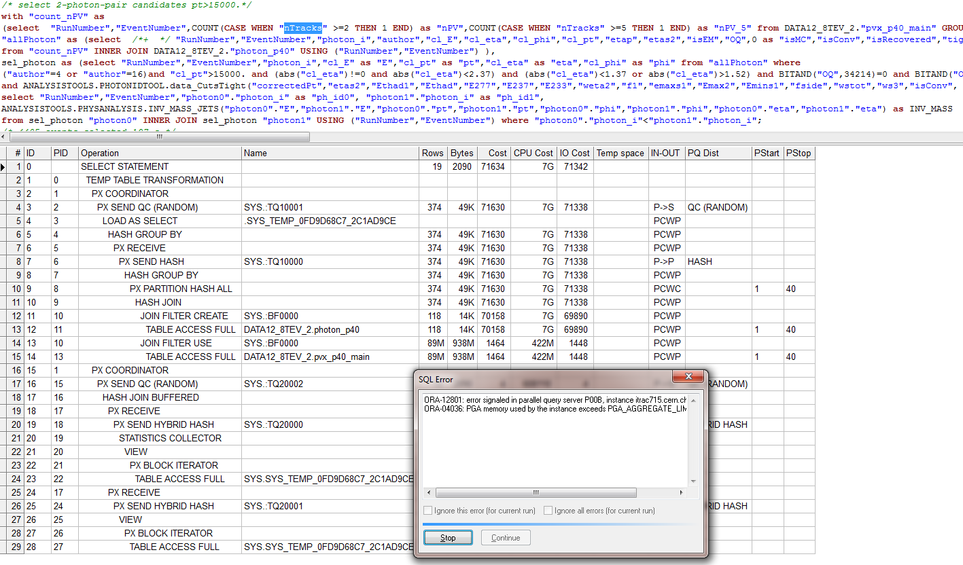
JOINs & Physics Analysis
Without ORDERED hint this query fails!
SQL optimizer expects 118 rows to pass photon-select
Decides to build bloom filter
Photon-selection actually passes 369k rows, PGA limit exceeded

Slide 48
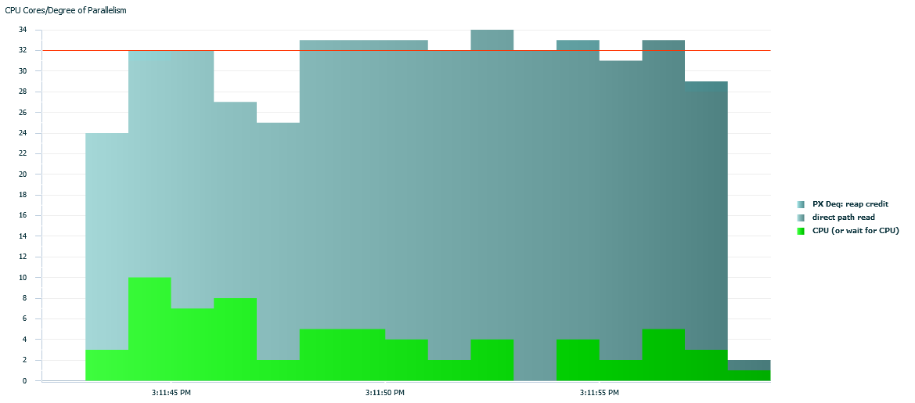
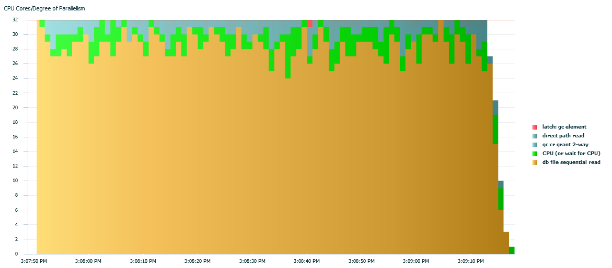
JOINs & Physics Analysis
SQL optimizer tends to underestimate the result from pre-selection
  (External) calculations & many variables involved
Can result in unwanted “Access by Index” unless hint specified!
USE_HASH hint: 17 s
No hint: 88 s

Slide 49
JOINs & Physics Analysis
Alternative parallel approach: run entire query on subset of events
Example ZH-benchmark: select events with two good muon or two good electrons and two good jets:
Requires pre-select to determine good-object
Requires self-join to find two good objects
Requires join between multiple tables
electron
muon
jet
10k
events
SELF
JOIN
SELF
JOIN
JOIN
SELF
JOIN
output P1
JOIN
10k
events
SELF
JOIN
JOIN
SELF
JOIN
JOIN
SELF
JOIN
output P2
10k
events
SELF
JOIN
SELF
JOIN
JOIN
SELF
JOIN
output P3
JOIN
Query result=sum output parallel servers
Notes:
Since I’m here at Oracle HQ, I thought I might as well ask: would it be possible to use another approach to parallelism. This is particular for my data that always involves joins on the same key.

Slide 50
JOINs & Physics Analysis
If joins where more efficient I could subdivide my tables in smaller sub-tables!
  Smart “horizontal” partitioning, to be defined by the data-owner, group related data together
  “vertical” partitioning by groups of events
  Distributed data analysis system to pick-out “horizontal” blocks based on analysis requirement and run one parallel server per group of events
Data A
Data B
Data C
Data D
Data E
Data F
X
events
select A.*, B.*,C.*,D.*,E.*,F.*
+
X
events
select A.*, B.*,C.*,D.*,E.*,F.*
+
X
events
select A.*, B.*,C.*,D.*E.*,F.*
+
X
events
select A.*, B.*,C.*,D.*,E.*,F.*
+
X
events
select A.*, B.*,C.*,D.*,E.*,F.*

Slide 51
JOINs & Physics Analysis
If joins where more efficient I could subdivide my tables in smaller sub-tables!
  Smart “horizontal” partitioning, to be defined by the data-owner, group related data together
  “vertical” partitioning by groups of events
  Distributed data analysis system to pick-out “horizontal” blocks based on analysis requirement and run one parallel server per group of events
Data A
Data B
Data C
Data D
Data E
Data F
X
events
select B.*,C.*, E.*,F.*
+
X
events
select B.*,C.*, E.*,F.*
+
X
events
select B.*,C.*, E.*,F.*
+
X
events
select B.*,C.*, E.*,F.*
+
X
events
select B.*,C.*, E.*,F.*

Slide 52
JOINs & Physics Analysis
If joins where more efficient I could subdivide my tables in smaller sub-tables!
  Smart “horizontal” partitioning, to be defined by the data-owner, group related data together
  “vertical” partitioning by groups of events
  Distributed data analysis system to pick-out “horizontal” blocks based on analysis requirement and run one parallel server per group of events
Data A
Data B
Data C
Data D
Data E
Data F
X
events
select A.*,E.*
+
X
events
select A.*, E.*
+
X
events
select A.*, E.*
+
X
events
select A.*, E.*
+
X
events
select A.*,E.*

Slide 53
Conclusion/Outlook
CERN openlab collaboration explores the limits of Oracle technology using its unique data challenges
  Analytics-as-as-Service platform to be implemented during the next Openlab phase
Physics analysis inside the database looks promising!
  But row-based storage is not optimal for physics data …
  I’d like to sub-divide into smaller tables I but need to optimize joins
  Good results in benchmark rely on use of hints in query
In-database physics analysis currently being tested with the in-memory columnar feature

