Slide 1

ECFA HL-LHC Workshop for 21st to 23rd October
October 2013 ECFA HL-LHC Experiments Workshop at Aix-les-Bains link at http://indico.cern.ch/conferenceDisplay.py?confId=252045
The report from this to ECFA can be found at https://cds.cern.ch/record/1631032
In 2014 will return to Aix (but now 20 Mb optical fibre installed for WiFi)
First 2014 SG meeting 27/3/14 at https://indico.cern.ch/event/309620/
Steering Group confirmed PG names last week and poster agreed with link to be at http://indico.cern.ch/event/315626/
All relevant material from last year can be found at http://indico.cern.ch/category/4840/
Fees foreseen for the workshop are 195/270 CHF without/with the dinner

Slide 2
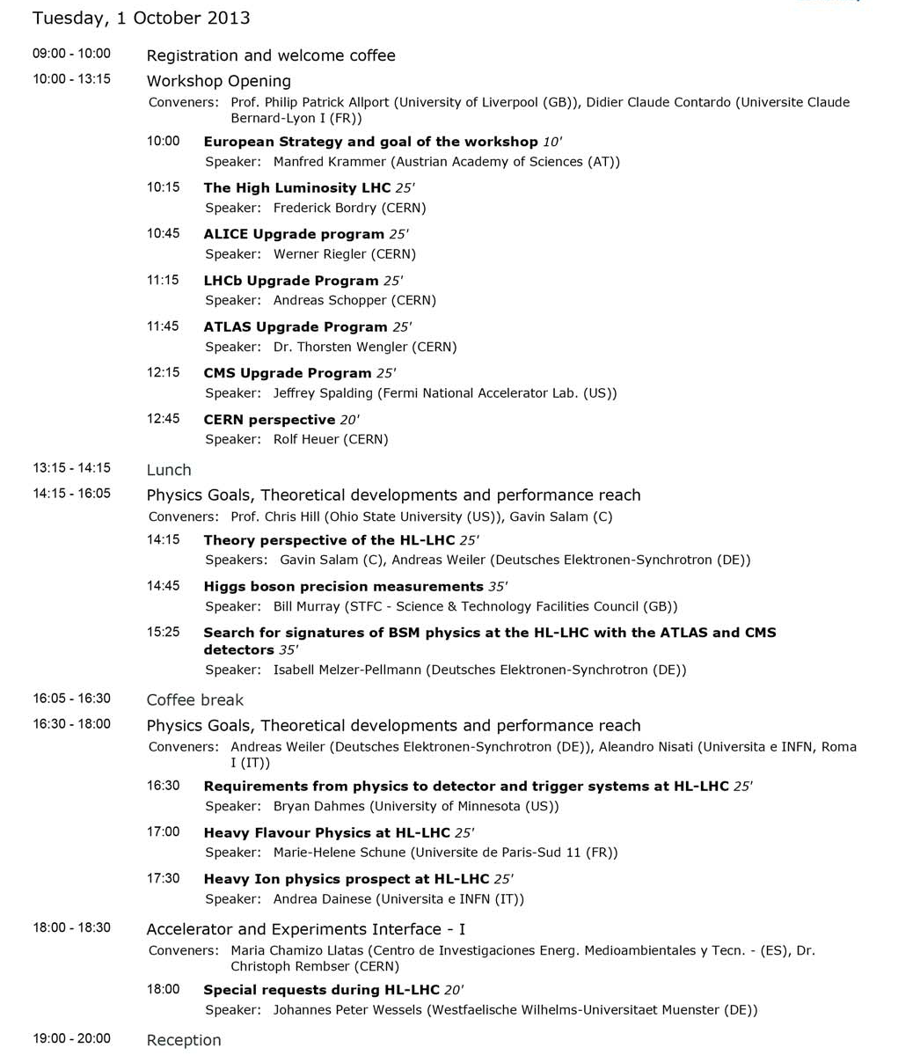
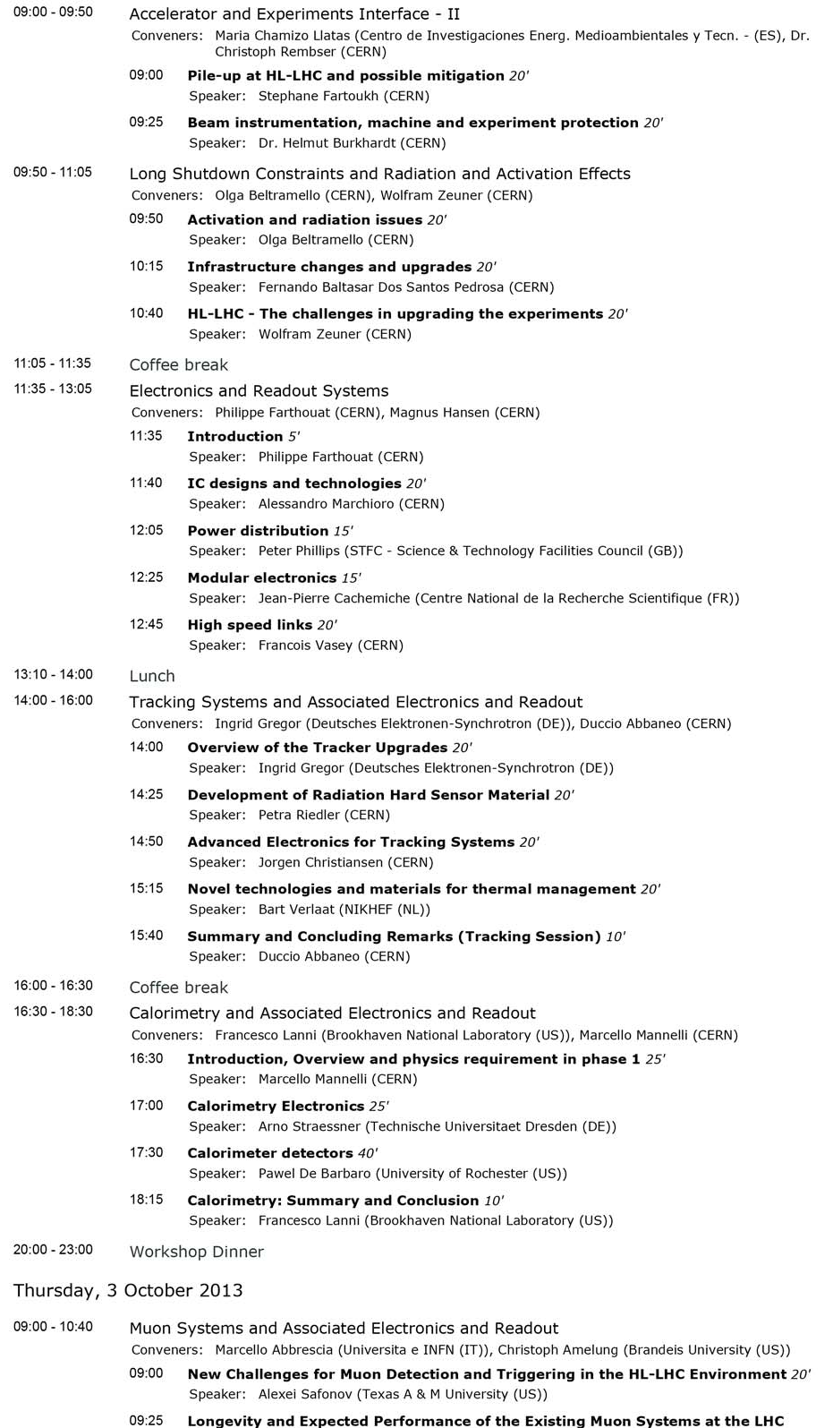
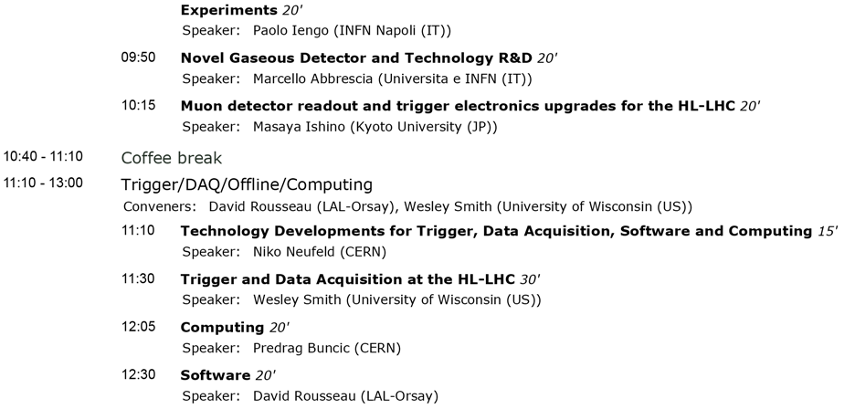
2013 Agenda
https://indico.cern.ch/conferenceOtherViews.py?view=standard&confId=252045

Slide 3
2013 Preparatory Groups
  PG1: Physics goals and performance reach
    CERN Theory: G.Salam, A. Weiller
    ALICE: Peter Braun Munzinger, Andrea Dainese
    ATLAS: Leandro Nisati, Pippa Wells, Bill Murray
    CMS: Chris Hill, Markus Klute, Isabell Melzer-Pellmann
    LHCb: Tim Gershon, Guy Wilkinson
  PG2: Tracking devices and associated electronics and readout
    ALICE: Vito Manzari, Werner Riegler
    ATLAS: Ingrid Gregor, Didier Ferrere, Craig Buttar
    CMS: Duccio Abbaneo, Francois Vasey, Stefano Mersi
    LHCb: Massimiliano Ferro-Luzzi
  PG3: Calorimetry and associated electronics and readout
    ALICE: David Silvermyr
    ATLAS: Francesco Lanni, Alberto Valero
    CMS: Marcello Mannelli, Dave Barney, Pawel. De Barbaro
    LHCb: Frederic Machefert
  PG4: Muon Systems and associated electronics and readout
    ALICE: Pascal Dupieux
    ATLAS: Christoph Amelung, Oliver Kortner, Stefano Veneziano
    CMS: Marcello Abbrescia, Kerstin Hoepfner, Alexei Safonov
    LHCb: Alessandro Cardini
Note:
At least one member per experiments
Chairs from ATLAS and CMS
Enlarged to other contributions in the preparation process (full list of contributors signed the ECFA report)

Slide 4
2013 Preparatory Groups
  PG5: Trigger/DAQ/Offline/Computing
    ALICE: Pierre Vande Vyvre, Thorsten Kollegger, Predrag Buncic
    ATLAS: David Rousseau, Benedetto Gorini, Nikos Konstantinidis
    CMS: Wesley Smith, Christoph Schwick, Ian Fisk, Peter Elmer
    LHCb: Renaud Legac, Niko Neufeld
  PG6: Electronics and read-out systems
    ALICE: Alex Kluge
    ATLAS: Philippe Farthouat, Maurice Garcia-Sciveres, Tony Weidberg
    CMS: Magnus Hansen, Jorgen Christiansen
    LHCb: Ken Wyllie
  PG7: Long Shutdown constraints and radiation and activation effects
    ALICE: Werner Riegler
    ATLAS: Olga Beltramello, Beniamino Di Girolamo
    CMS: Wolfram Zeuner, Christoph Schaefer
    LHCb: Rolf Lindner
  PG8: Accelerator and Experiment interface
    CERN Accelerator: L. Rossi, O. Bruning
    ALICE: Hannes Wessels
    ATLAS: Christoph Rembser, Beniamino Di Girolamo, Antonio Sbrizzi
    CMS: Maria Chamizo Llatas, Wolfram Zeuner
    LHCb: Burkhard Schmidt

Slide 5
How to Organise This Time:
We have started from the previous preparatory group structure but with modifications as the session topics do not map so well to the previous groups
We again ask a few individuals per topic (PG chairs) to help organise each session, but we should find a way to ensure we engage fully with the relevant players in all four LHC experiments, theory and accelerator communities and do so in as inclusive a way as possible
The audience composition might be broader if we can emphasise more the links with the accelerator and theory communities

Slide 6
How to Organise This Time:
Stay with all plenary format to keep the communication flow
Should not need as much introduction
Should involve theory and accelerator communities much more closely with more talks in these areas
Try to build on synergies identified/developed since last time and emphasise common approach
Therefore have proposed to organise sessions now more by R&D area than sub-detector/system
Need to keep clear relationship with HL-LHC detector needs (not a generic R&D discussion)
Need a way of preparing material that is as inclusive as possible ie:
  open groups to contributions from all interested collaborators
  through dedicated meeting or mini-workshops
Can be more flexible and include a few invited talks on topics not included in sessions

Slide 7
ECFA HL-LHC 2014: Possible Schedule
Opening |  | 30’
Accelerator Update | Current status and plans; injectors and LHC upgrades | 60’
Experiment Requirements | Motivation for R&D topics | 80’
PG1: Physics theory, Physics experiment, performance | Old PG1 (Physics goals and performance reach), plus theory talks | 180’
R&D sessions
PG2: Solid state tracking detectors | Old PG2 (tracker)+HGCAL | 120’
PG3: Scintillating devices | Old PG3 (calorimeter)+Tracking (LHCb) | 60’
Liquid noble gas | Invited talk | 30’
Large area fast timing detectors | Invited talk | 30’
PG4: Gaseous detector systems ( incl micro-pattern) | Old PG4 (muons)+TPC+CAL | 90’
PG5: Electronics systems ASIC - HDI - HBW links - Powering Scheme - Power Supply - Modular electronics & xTCA | Old PG6 (electronics) | 150’
PG6: Mechanics and Cooling | New session area | 60’
PG7: Trigger, Online and Offline Computing | Old PG5 (trigger/DAQ/Offline/Computing) | 120’
PG8: Accelerator and experiment interface, activation and mitigation | Old PG7 (LS and activation) and PG8 (accelerator experiment interface) | 90’
Conclusion (1 talk) |  | 30’

Slide 8
ECFA HL-LHC 2014: (PG membership not to be restricted and some additional names already known)
 | Accelerator/Theory | ALICE | ATLAS | CMS | LHCb
Opening
Accelerator Update | N/A | N/A | N/A | N/A | N/A
PG1: Physics theory, Physics experiment, performance | Gavin Salam, Andreas Weiler | Peter Braun Munzinger, Andrea Dainese | Leandro Nisati + 5 other suggested names to involve | Markus Klute + | Vincenzo Vagnoni Tim Gershon
Experiment Requirements |  | N/A | N/A | N/A | N/A
R&D sessions
PG2: Solid state tracking detectors |  | Walter Snoeys Vito Manzari | Daniel Munnstermann + 3 | Frank Hartmann + | Paula Collins
PG3: Scintillating devices |  | Federico Ronchetti, David Silvermyr | Jimmy Proudfoot | Pawel de Barbaro + | Christian Joram
Liquid noble gas |  | N/A | N/A | N/A | N/A
Large area fast timing detectors |  | N/A | N/A | N/A | N/A
PG4: Gaseous detector systems (incl micro-pattern) |  | Christian Lippmann Pascal Dupieux | Oliver Kortner, + 1 | Marcello Abbrescia + | Alessandro Cardini
PG5: Electronics systems ASIC - HDI - HBW links - Powering Scheme - Power Supply - Modular electronics & xTCA |  | Alex Kluge | Philippe Farthouat + 3 | Magnus Hansen + | Ken Wyllie
PG6: Mechanics and Cooling |  | Hannes Wessels | Danilo Giugni + 3 | Paola Tropea + | Massimiliano Ferro-Luzzi, Burkhard Schmidt
PG7: Trigger, Online and Offline Computing |  | Pierre Vande Vyvre, Predrag Buncic | Graeme Stewart + 4 | Wesley Smith + | Niko Neufeld, Pete Clarke
PG8: Accelerator and experiment interface, activation and mitigation | Oliver Bruning, Helmut Burkhardt | Werner Riegler | Olga Beltramello | Wolfram Zeuner + | Gloria Corti +
Conclusion (1 talk 30‘) |  | N/A | N/A | N/A | N/A

Slide 9
Preparatory Groups: Charge
The workshop is organized with only plenary sessions dedicated to each of the areas outlined above
The preparatory groups are charged to identify the key topics to be discussed and to organize their corresponding session at the workshop. In conjunction with program of other groups (avoid overlaps)
They will propose the detailed agenda within that session and propose speakers to the workshop Steering Committee
Chairs of the PGs will write a document of few pages summarizing the main outcomes of the workshop and proposing further steps on each topic
See 2013 charge at: http://indico.cern.ch/event/250557/material/0/1.pdf

Slide 10
Preparatory Groups: Modus Operandi
The chairs of PGs compile mailing lists of all those willing to contribute and organise dedicated meetings and/or mini-workshops advertised within the HL-LHC community to fulfil the objectives outlined above.
A common TWIKI page should be used to collect and circulate information and progress of each group as last time
(see https://twiki.cern.ch/twiki/bin/view/ECFA/ECFAHiLumiLHC)
The meetings of the groups should normally be fully open, although a mechanism to review talks and discuss material still being approved for release should be organised by the relevant PG chairs
The email lists from last time along with internal lists within the theory, accelerator and individual experiments can be used to find volunteers:
E-mail list of the PG members: PGMembers-HL-LHC-ECFA@cern.ch
E-mail list of the PG chairs: HL-LHC-ECFA-PGChairs@cern.ch
E-mail list of the workshop SC: HL-LHC_ECFAWorkshop_SC@cern.ch

Slide 11
Next Steps and Upcoming Events
Meetings of each PG
  Define topics to be addressed at the workshop
  Meeting among all chairs to compare proposed talk areas by end of June
Meeting of PGs with Workshop SC
  A half day meeting by end of July
  Presentation of progress from each PGs
  Develop the workshop agenda
  Session titles, number of talks and durations agreed and entered into indico with draft talk titles
September Preview of the Final Workshop Session Content
  Chairs report to the workshop SC
  Names of possible speakers to be discussed with SC
  Final talk titles to be entered into indico with speakers names

