Slide 1
Report from Linear Collider Collaboration
95th Plenary ECFA
Brian Foster
(Uni Hamburg/DESY/Oxford)
24/7/14

Slide 2
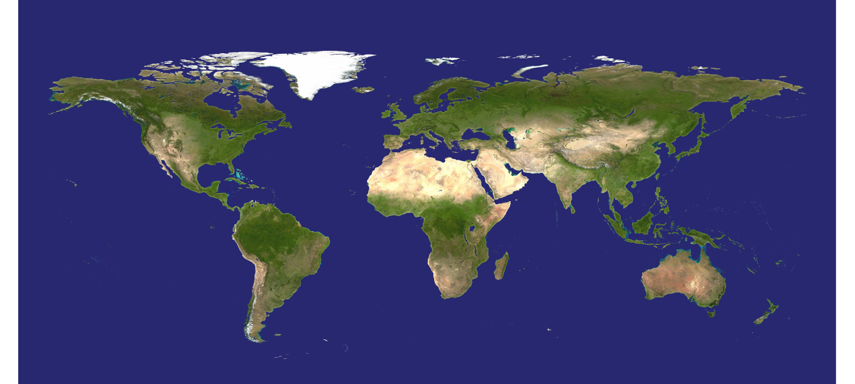































CLIC Collaboration
Seven new collaboration partners joined in 2013 (The Hebrew University Jerusalem, Vinca Belgrade, ALBA/CELLS, Tartu University, NCBJ Warsaw, Shandong University, Ankara University Institute of Accelerator Technologies (IAT)).
In 2014 two (SINAP Shanghai and IPM Tehran) more institutes
Detector collaboration operative with 23 institutes (growing slowly)
29 Countries – over 70 Institutes
Accelerator
collaboration
Detector
collaboration
Accelerator + Detector collaboration

Slide 3
Main activities
Parameters, Design and Implementation
Feedback Design, Background, Polarization
Machine Protection & Operational Scenarios
Electron and positron sources
Damping Rings
Ring-To-Main-Linac
Main Linac - Two-Beam Acceleration
Beam Delivery System
Machine-Detector Interface (MDI) activities
Drive Beam Complex
Experimental verification
Drive Beam phase feed-forward and feedbacks
Two-Beam module string, test with beam
Drive-beam front end including modulator development and injector
Modulator development, magnet converters
Drive Beam Photo Injector
Low emittance ring tests
Accelerator Beam System Tests (ATF and FACET, others)
X-band Technologies
X-band Rf structure Production
X-band Rf structure High Power Testing
Novel RF unit developments (high efficiency)
Creation and Operation of x-band High power Testing Facilities
Basic High Gradient R&D
Technical Developments
Survey & Alignment
Quadrupole Stability
Warm Magnet Prototypes
Beam Instrumentation and Control
Two-Beam module development
Beam Intercepting Devices
Controls
Vacuum Systems
Beam Transport Equipment
Integrated Baseline Design and Parameters
X-band Rf structure Design
Damping Rings Superconducting Wiggler
Cost, power, schedule, stages
Detector and Physics
Physics studies and benchmarking
Detector optimisation
Technical developments
Re-optimise for cost and power,
~360 GeV initial stage for Higgs, folding in technology progress.
The other activities illustrated by a few slides in the following:

Slide 4
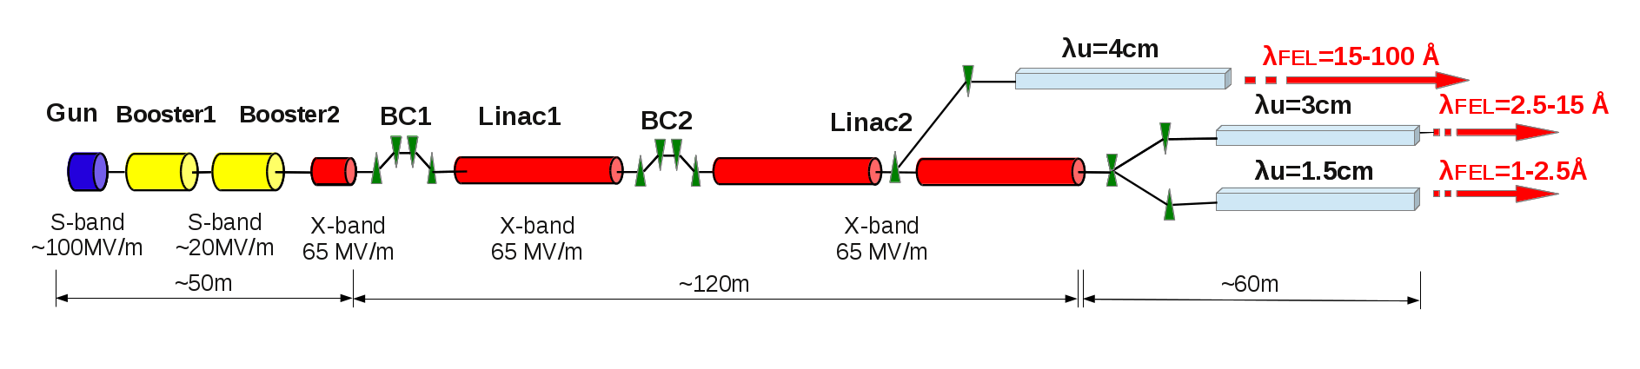
Xband facilities - FELs
X-band technology appears interesting for compact, relatively low cost FELs
  Logical step after S-band and C-band
  Example similar to SwissFEL: E=6 GeV, Ne=0.25 nC, s_{z}=8mm
Use of X-band in other projects (as FELs) will support industrialisation, Xband development, system developments
  They will be klystron-based, additional synergy with klystron-based first energy stage
Started to collaborate on use of X-band in FELs
  Australian Light Source, Turkish Accelerator Centre, Elettra, SINAP, Cockcroft Institute, TU Athens, U. Oslo, Uppsala University, CERN
Share common work between partners
  Cost model and optimisation
  Beam dynamics, e.g. beam-based alignment
  Accelerator systems, e.g. alignment, instrumentation…
Define common standard solutions
  Common RF component design, -> industry standard
  High repetition rate klystrons (500Hz soon to be ordered for CLIC)
Great potential for collaboration

Slide 5
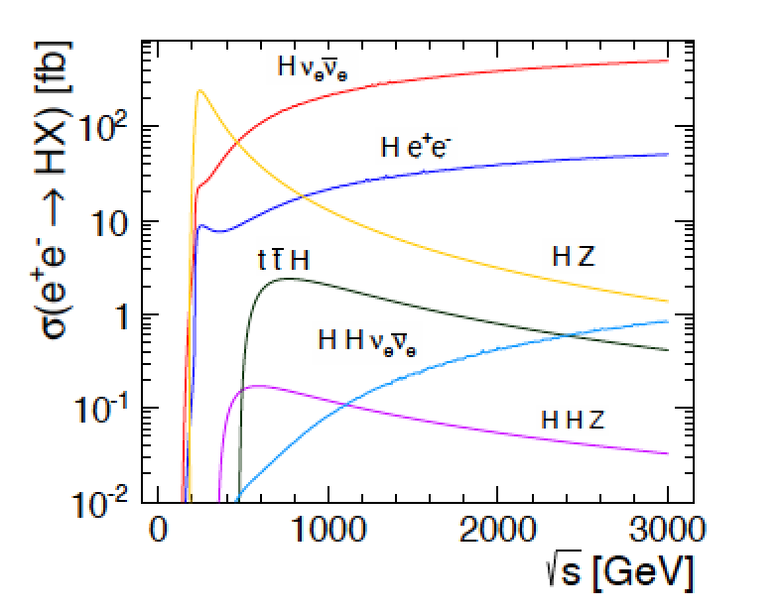
CLIC detector&physics

Slide 6






ILC - Introduction
On June 12th, 2013 ILC TDR was published in Worldwide Event.

Slide 7
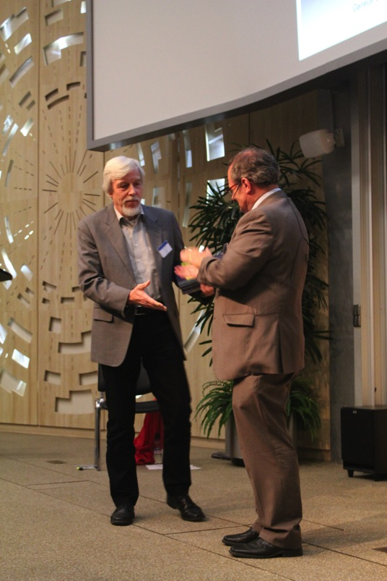
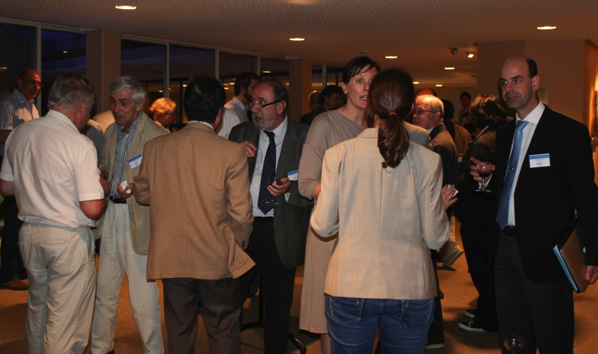
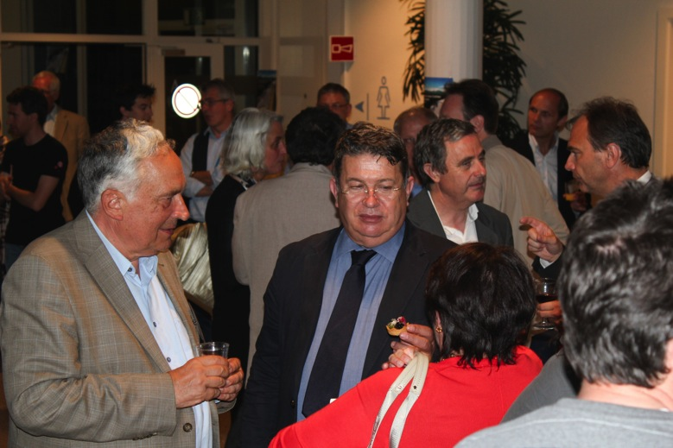
World-wide Event
On June 12th, 2013 ILC TDR was published in Worldwide Event.
End of major phase in ILC development – now what?

Slide 8
LCC Directorate
LCB
Chair: S. Komamiya
Lyn Evans
Director
Hitoshi Murayama
Deputy Director
Mike Harrison
Ass. Director, ILC
Hitoshi Yamamoto
Ass. Director, Physics & Detectors
Harry Weerts
Regional Director
Americas
Steinar Stapnes
Ass. Director, CLIC
Brian Foster
Regional Director
Europe
ILC
Technical
Board
CLIC Steering
Comm & Collaboration
Council
LCCPD
eb
Akira Yamamoto
Regional Director
Asia

Slide 9
Recent Developments on ILC
LCC-ILC Director: M. Harrison, Deputies: N. Walker and H. Hayano *KEK LC Project Office Head: A. Yamamoto
Sub-Group | Global Leader Deputy/Contact p. | KEK-Leader* Deputy | Sub-Group | Global Leader Deputy/Contact P. | KEK-Leader* Deputy
Acc. Design Integr. | N. Walker (DESY) K. Yokoya(KEK) | K. Yokoya | SRF | H. Hayano (KEK) C. Ginsburg (Fermi), E. Montesinos (CERN) | H. Hayano Y. Yamamoto
Sources (e-, e+) | W. Gai (ANL) M. Kuriki (Hiroshima U.) | J. Urakawa T. Omori | RF Power & Cntl | S. Michizono (KEK) TBD (AMs , EU) | Michizono T. Matsumoto
Damping Ring | D. Rubin (Cornell) N. Terunuma (KEK) | N. Terunuma | Cryogenics (incl. HP gas issues) | H. Nakai: KEK T. Peterson (Fermi), D. Delikaris (CERN) | H. Nakai Cryog. Center
RTML | S. Kuroda (KEK) A. Latina (CERN) | S. Kuroda | CFS | A. Enomoto (KEK) V. Kuchler (Fermi), J. Osborne (CERN), | A. Enomoto M. Miyahara
Main Linac (incl. B. Compr. & B. Dynamics) | N. Solyak (Fermi) K. Kubo (KEK) | K. Kubo | Radiation Safety | T. Sanami (KEK) TBD (AMs, EU) | T. Sanami T. Sanuki
BDS | G. White (SLAC), R. Tomas (Cern) T. Okugi (KEK) | T. Okugi | Electrical Support (Power Supply etc.) | TBD | TBD
MDI | K. Buesser (DESY) T. Tauchi (KEK) | T. Tauchi | Mechanical S. (Vac. & others) | TBD | TBD
 |  |  | Domestic Program, Hub Lab. Facilities | TBD | H. Hayano T. Saeki

Slide 10
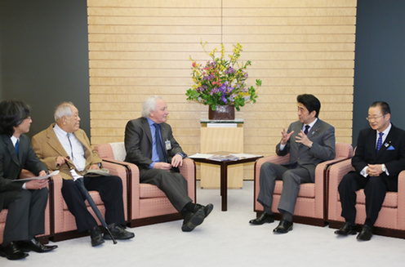
Recent Developments on ILC
Lyn Evans meets Prime Minister Abe one year ago

Slide 11
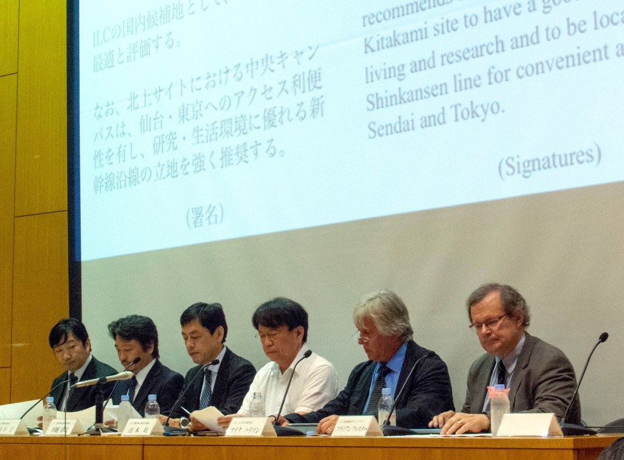
Japanese Sites for ILC

Slide 12
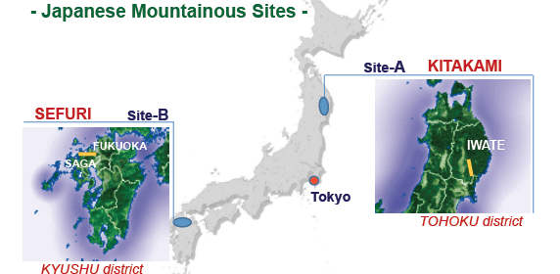
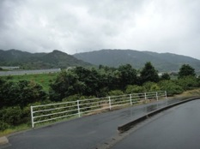
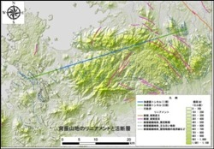
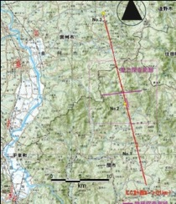
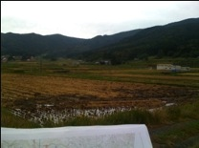
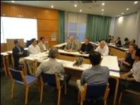
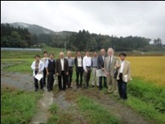
Japanese Sites for ILC
LCC Directorate/CF&S official site visits taken place.

Slide 13
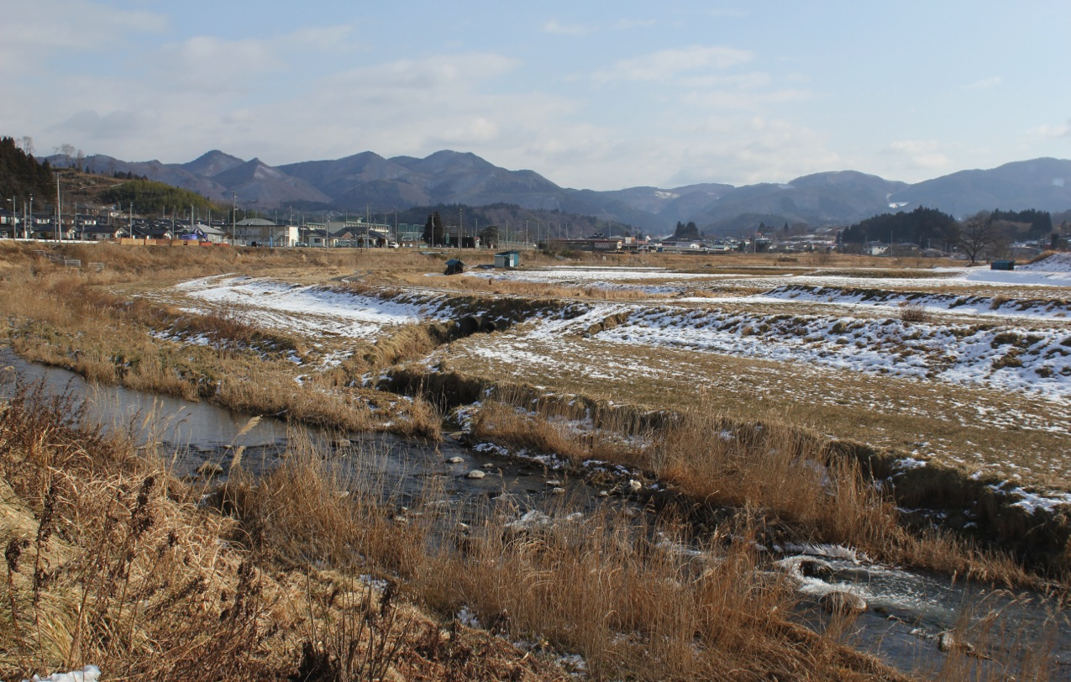
Japanese Site

Slide 14
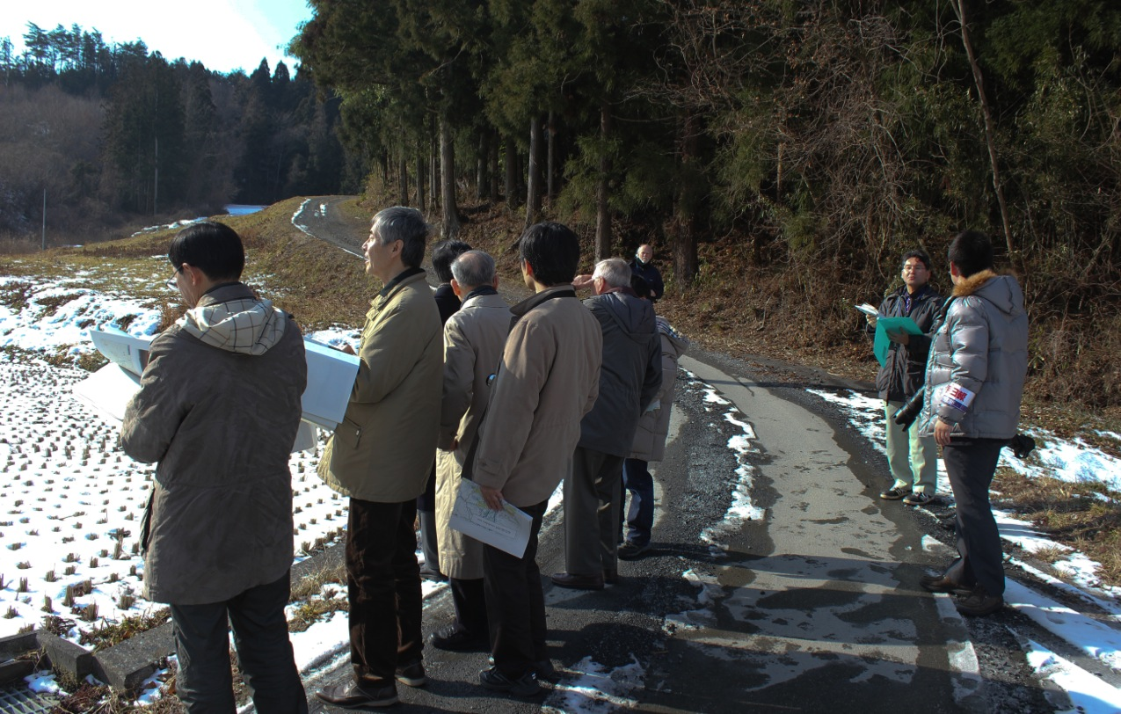
Japanese Site

Slide 15
Site-specific work plan
2014 |  | 2015 |  | 2016 |  | 2017 |  | 2018
Planning
Basic Design
Detailed Design
Tendering
Cost Estimate
Geological Survey
Basic Survey
Detailed Survey
Additional.
Topographical Survey
Basic
Detailed
Construction works
Land Acquisition
Compensation
Site Decision
Land Negotiation
Acquisition
Environmental Impact Study
Preparation
Environmental Impact Survey
Permission
2014 |  | 2015 |  | 2016 |  | 2017 |  | 2018

Slide 16
Collaboration broadening
Category | Work-base | Specific subject | Global Collaboration w/
Positron Source |  | Positron source | PosiPol Collaboration
Nano Beam | ATF | 37 nm beam 2 nm stability | ATF collaboration
SCRF Cavity Integration | STF | Power Input Coupler Tuner He-Vessel | CERN-DESY-KEK CEA-Fermi/SLAC-KEK DESY-KEK (WS at CERN? Autumn. 2014)
CM integration | STF, ILC | Conduction-cooled SC Quadrupole | Fermilab-KEK
Cryogenics | ILC | Cryog. Underground He inventry High p. Gas Safety | CERN-Fermilab-KEK (WS at CERN, 18 June)
CFS | ILC | CFS design prep. | CERN-Fermilab-KEK
Radiation Safety | ILC | ML radiation shield | SLAC-DESY-CERN-KEK

Slide 17
Detector Hall Evolution
Baseline (TDR) | Hybrid - A (ADI-CFS Joint Meeting)
2 Vertical Shafts (SiD Proposal) | Hybrid - A’ (KEK-CFS Proposal)
Assembly
Yd
DR
Surface
Yd
Assembly
Yd
DR Surface
Yd
UT Sht
Main Sht
DR/ AT
W8m Grad10%
DH/AT
W11m Grad7%
DR/ AT
W8m Grad10%
DH/AT
W8m Grad10%
D/H
D/R
D/H
D/R
DR
Surface Yd
Assembly
Yd
DR
Surface Yd
Assembly
Yd
UT Sht
UT Sht
DR/AT
W8m Grad10%
DR-DH Common AT
W8m Grad10%
Second Sht
Main Sht
D/H
D/R
D/H
D/R
Converge in September ? – CFS/MDI meeting
From Miyahara at al

Slide 18
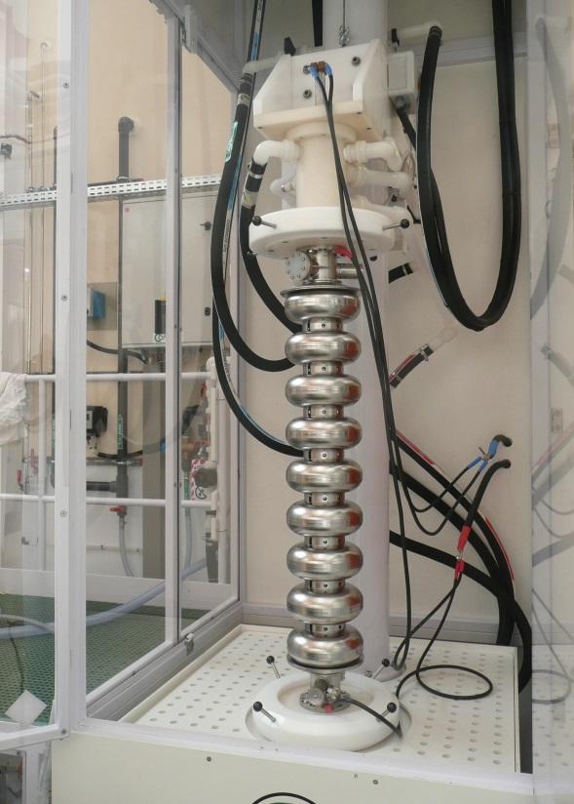
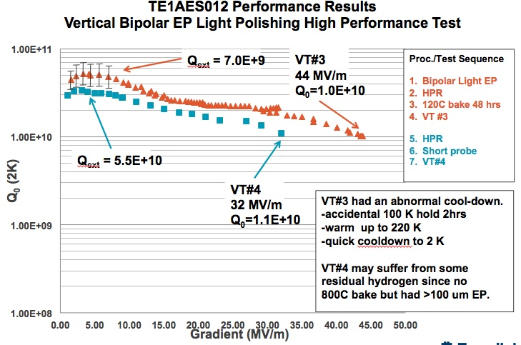
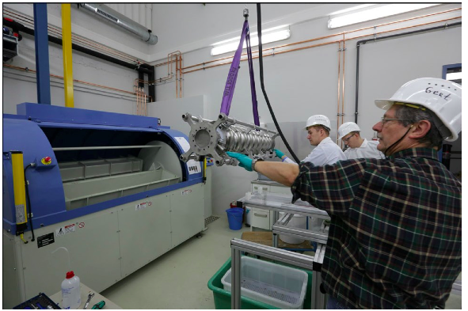
Technology optimisation
Bi-polar EP – Faraday Technology Co
Vertical EP - Saclay
Barrel Polishing DESY – No EP ?

Slide 19
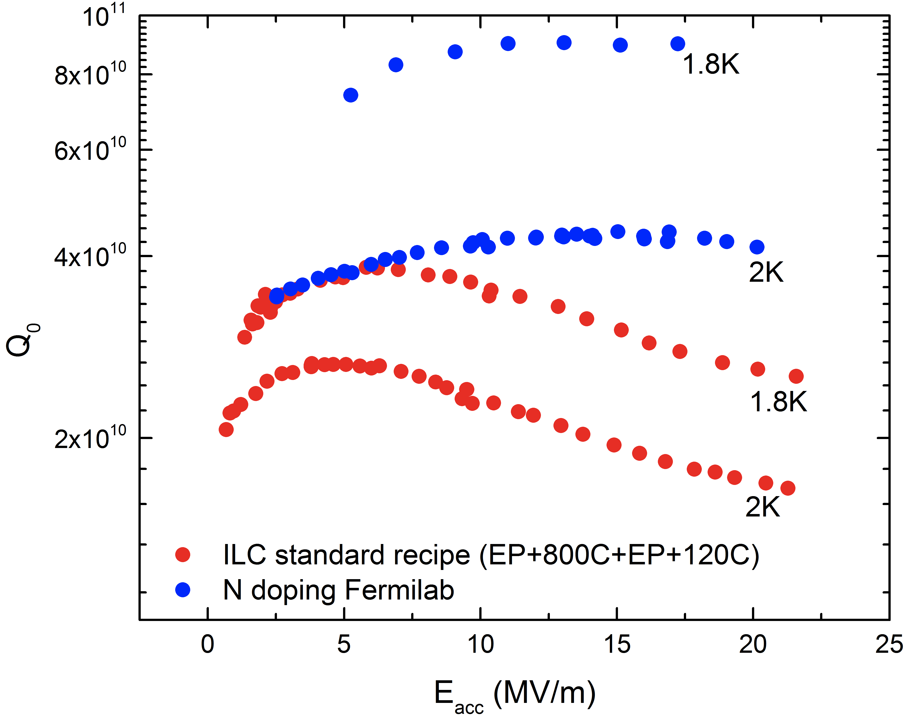
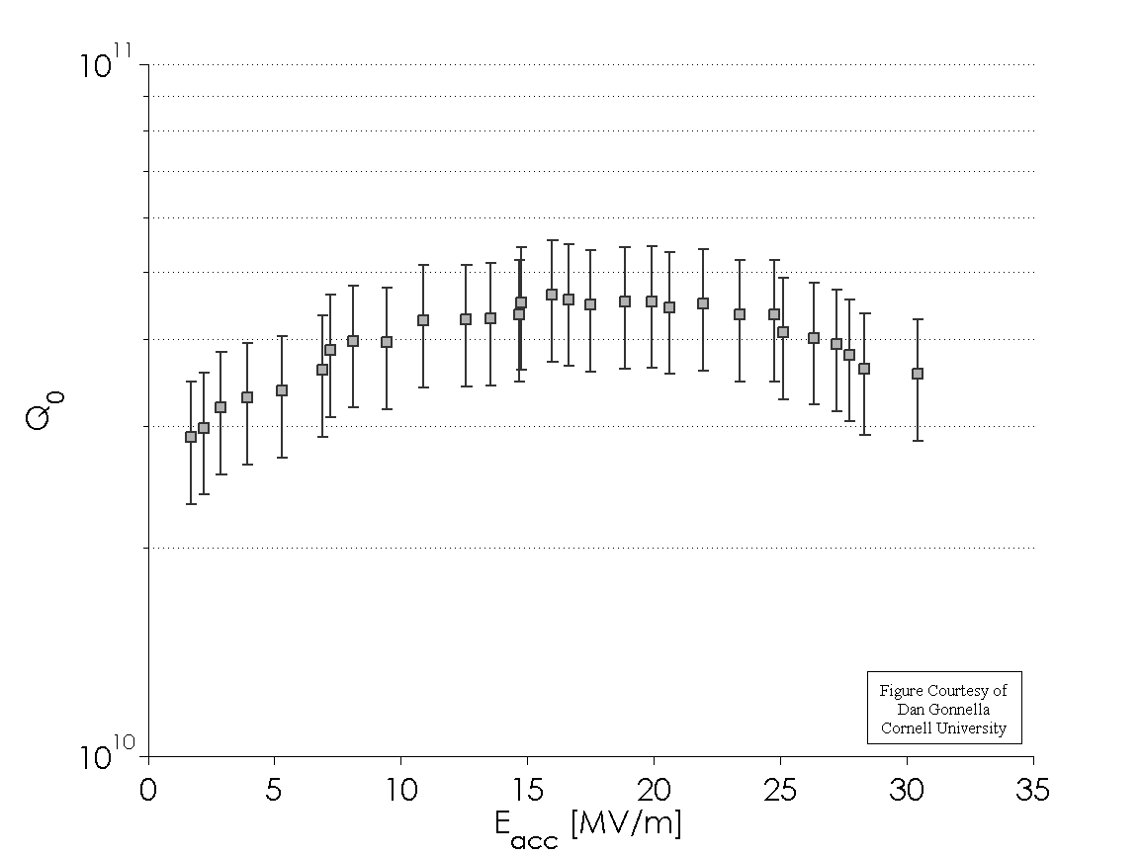
Technology optimisation – N₂
Cornell
Fermilab
Higher Q via nitrogen doping surface processing
High Q via efficient flux expulsion cooling
No high gradient yet

Slide 20
Industrial production - XFEL

Slide 21
ATF2 beam-size success
Currently 45± 3 nm
Field quality improvements, orbit stabilisation through feedback, shorted turn in 6-pole magnet, beam size monitor improvements

Slide 22
ILC Political Developments
Talk of Chair of Diet ILC Federation, ex-MEXT Minister
Mr Kawamura, @ LCWS in Tokyo, 12.13
While not a member of the government, he is a very senior figure in LDP and is known to have the ear of the Prime Minister Mr Abe:
“We are aware that people are usually worried that an increase of academic budget in one field may mean a decrease in other fields. … We shall arrange a dedicated budget to accommodate its much wider implications. It is the responsibility of the government to carry this out.”
2) “The Department of Education has requested the Department of Finance to provide an ILC investigation fund of 50 million yen in next year's budget. … once it has been approved, we members of the house will have achieved one of the most important milestones of recent years.”

Slide 23
ILC Political Developments
Talk of Chair of Diet ILC Federation, Mr Kawamura
3)“The Technical Design Report of ILC was issued in December 2012 (sic)…I would again like to express my appreciation of this effort. I understand that it is now the turn of politicians to respond
to this effort, and to construct a worldwide partnership to realize this project.
4) “I think that most Diet members' knowledge of physics is at high school students’ level. If you allow me, let me take the liberty of pointing out that the understanding of political dynamics by most particle physicists is also at high school students’ level. If physicists and politicians collaborate by using each other's area of expertise, it is certain that we can accelerate the realization of the ILC project.”

Slide 24
ILC Political Developments
The MEXT Minister has visited the US Secretary of Energy in January; ILC was discussed at the meeting. In February he sent the Secretary of Energy a letter following up that discussion in which he proposes inter-governmental discussion of the ILC project. A similar letter was subsequently sent to DG – designated by Council as European contact - cc EU Commission.
The MEXT Deputy Minister was in Europe in February and July and has had dinner meetings with the DG of CERN and Robert-Jan Smits, the Director of the EC Directorate of Research and Technology. The purpose of the meeting was to discuss ILC and the next steps. At the second meeting, representatives of funding authorities of major European countries and the USA also attended. All agreed that the meetings were very useful and further meetings are scheduled to follow.

Slide 25
ILC Political Developments
Lyn Evans visited the Indian Chief Science Advisor and the Head of the AEA in January. Lyn + some LCC members visited China in June and had very useful discussions.
MEXT has set up a committee of “wise persons” who are charged with addressing the major questions brought up in the Science Council of Japan Report. They are looking at issues such as the physics case, the translation of the costing into Japanese accounting, availability of expert staff to build ILC, etc. This is mostly an internal Japanese exercise to give MEXT reassurance in language it understands – there is LCC input. It is due to report before end of Japan Fiscal 2015 – less than 2 years from now.

Slide 26
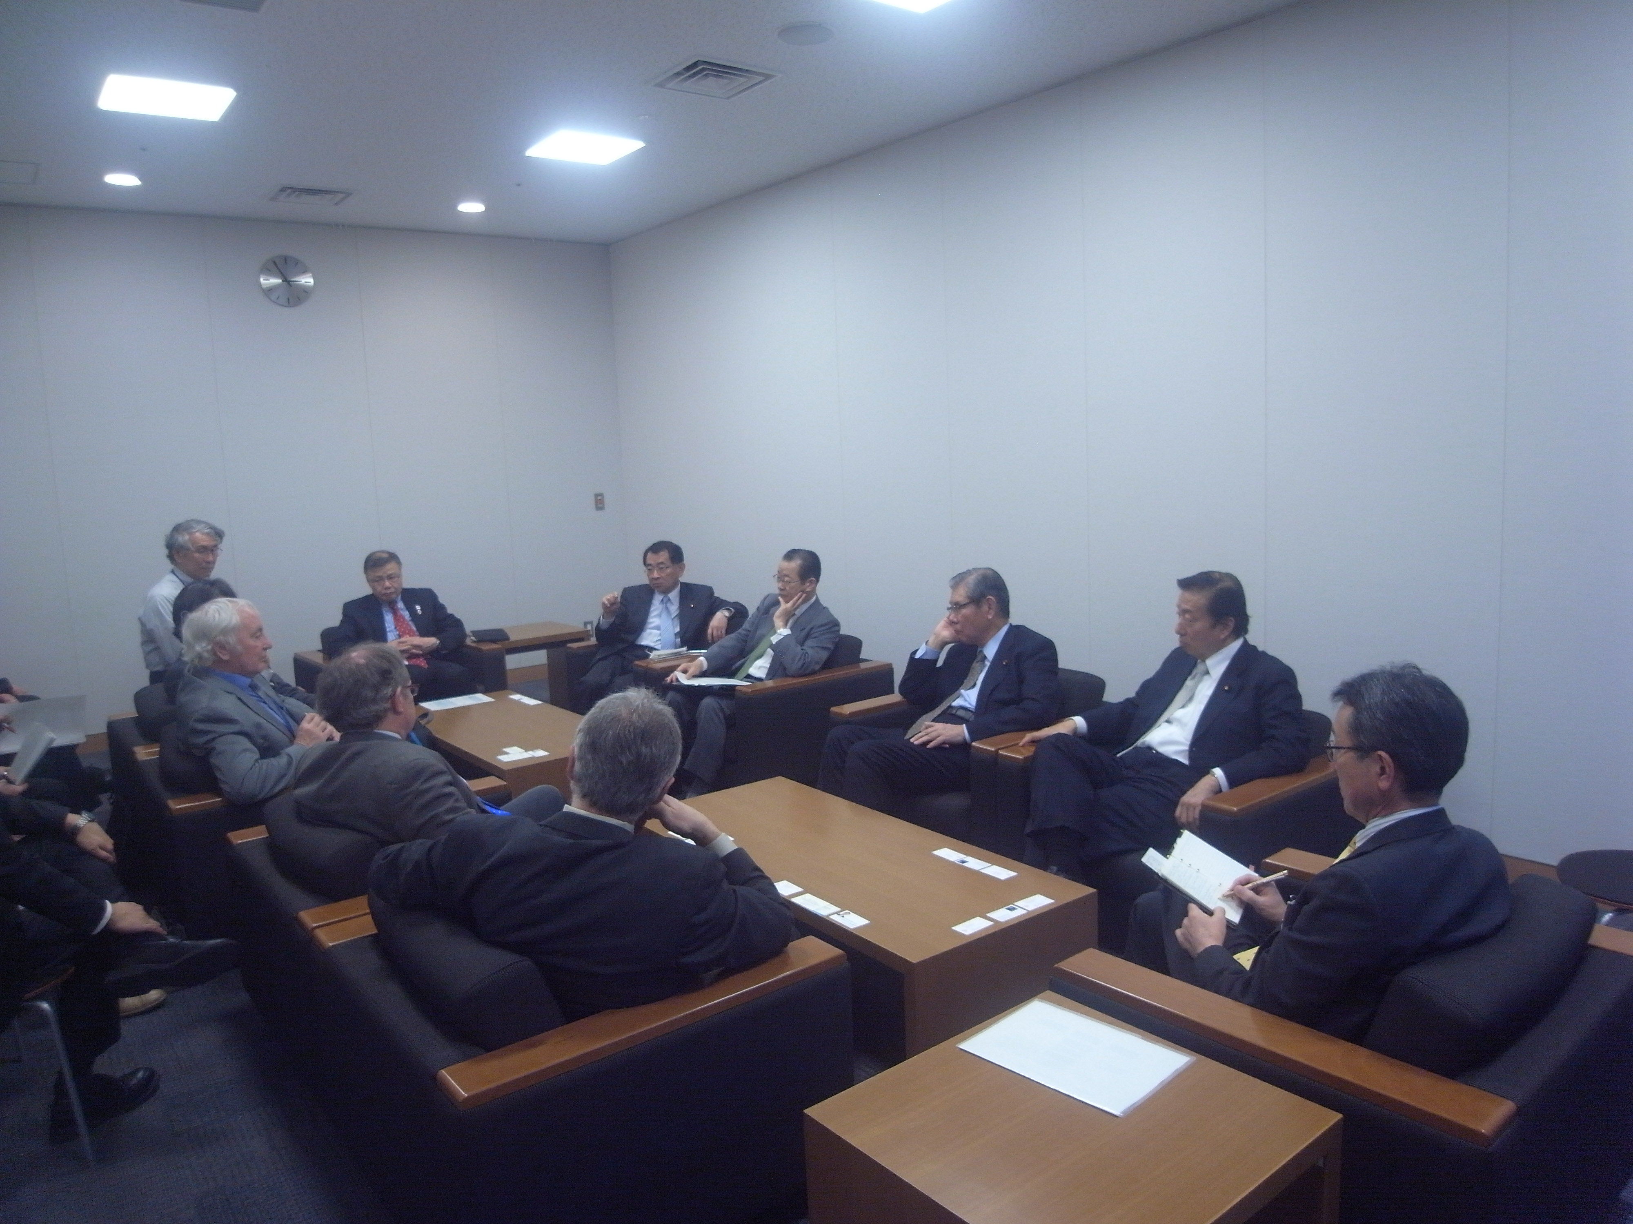
Most Recent Developments
A delegation from the LCC (Lyn, BF and
Harry Weerts; Hitoshi Murayama translated) met the leadership of the Diet Federation for the ILC – contains > 1/5 of all Diet members, independent of party. Kawamura-san, (chair), Shionoya-san, director general of the federation
Kosaka-san and Hori-san all attended. Each of these is very
influential; all are ex-senior Ministers.

Slide 27
Most Recent Developments
It was an unusually frank & constructive meeting; much of the discussion centered on Europe. Several important initiatives were agreed, including a letter from the Diet members to CERN DG and from MEXT – both have now been received.
ILC was discussed again at ICFA meeting in Valencia, particularly in the context of Chinese proposal for a circular machine, starting with e⁺e⁻ at 250 GeV and then moving to high-energy pp. Important statement agreed: “ICFA endorses the particle physics strategic plans produced in Europe, Asia and the United States and the globally aligned priorities contained therein. Here, ICFA reaffirms its support of the ILC, which is in a mature state of technical development and offers unprecedented opportunities for precision studies of the newly discovered Higgs boson. In addition, ICFA continues to encourage international studies of circular colliders, with an ultimate goal of proton-proton collisions at energies much higher than those of the LHC.”

Slide 28
European activities
In last 12 months, BF has visited European funding agencies – France, Italy, Germany, UK – to discuss ILC, situation in Japan and European involvement over the next few years.
BF attended annual CERN/EU meeting at CERN on 25.9. Attended by R-J Smit, DG of Directorate Research at EC. ILC was explicit item on Agenda.
BF described current situation and R-JS responded at length. Discussion was animated. EC is clearly interested in ILC and wishes to follow closely. Agreement to set up “contact group” to maintain close contact over ILC. Met in February - maintaining regular interchange ~ monthly.

Slide 29
Summary and Outlook
There is a great deal of activity, although much of it is necessarily behind the scenes.
A single site has now been selected and the political process has momentum.
The SCJ report is being responded to by MEXT, including consideration by an expert group.
Ministerial-level meetings have begun – still in a very early stage.
In Europe we are discussing way forward with national funding authorities and EU.
The next 2 – 3 years will be decisive…..

