Slide 1
Beam-induced Quench Tests of LHC Magnets
B. Auchmann, T. Baer, M. Bednarek, G. Bellodi, C. Bracco, R. Bruce, F. Cerutti, V. Chetvertkova, B. Dehning, P. P. Granieri, W. Hofle, E. B. Holzer, A. Lechner, E. Nebot Del Busto, A. Priebe, S. Redaelli, B. Salvachua, M. Sapinski, R. Schmidt, N. Shetty, E. Skordis, M. Solfaroli, D. Valuch, A. Verweij, J. Wenninger, D. Wollmann, M. Zerlauth,

Slide 2
Content
Motivation
Superconducting magnet
Short duration losses

Slide 3
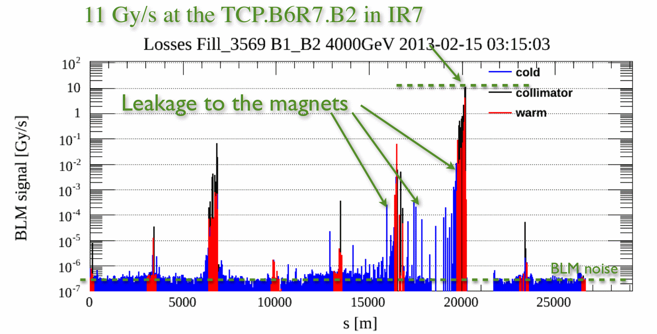
Efficiency of LHC collimation
Efficiency
beam
Determination of efficiency needed to plan upgrade requirements for collimation system

Slide 4
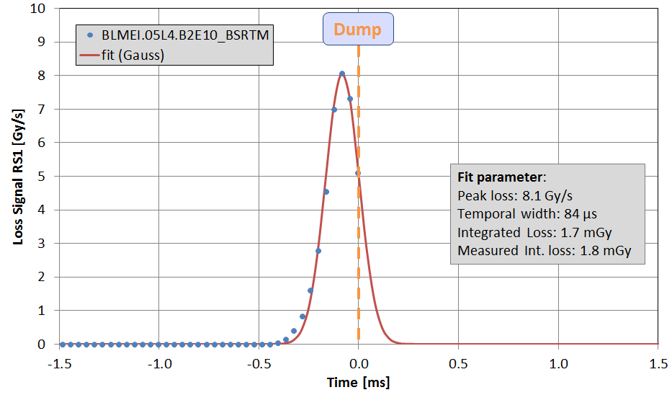
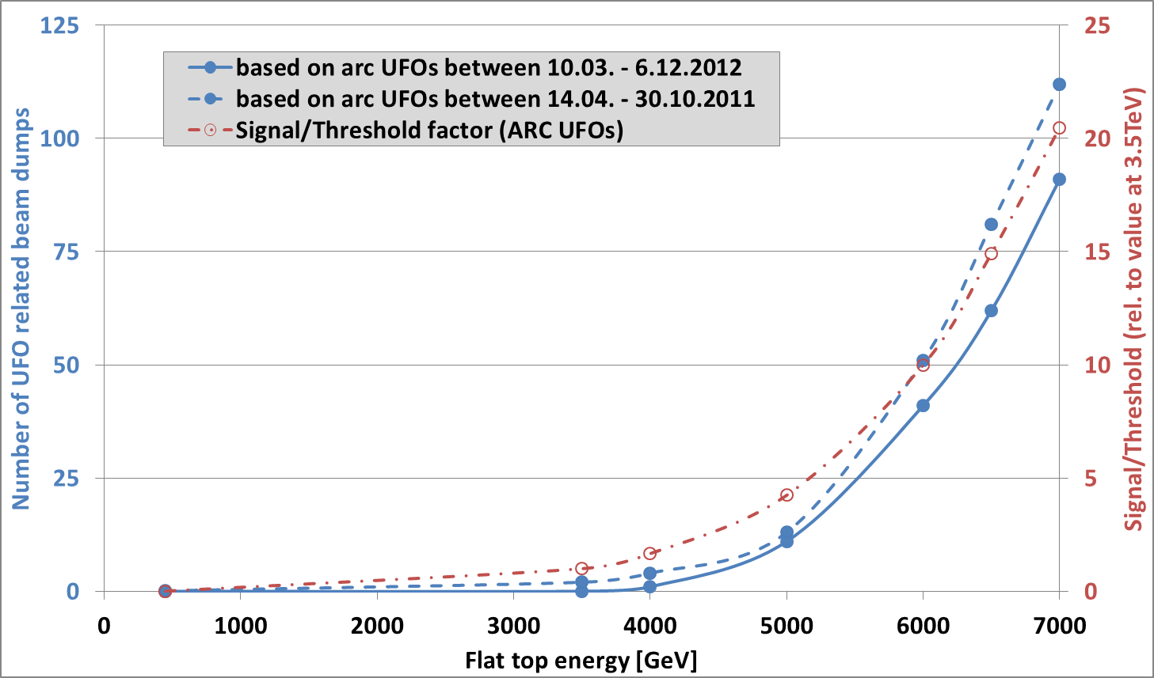
Dust particle and LHC operation
Observation from 2011 to 2013
Beam loss created with a duration between 100 us to several ms
Extrapolation of event rate to operation at 7 TeV
Number of events would cause significant downtime due to recover from quench of magnet
extrapolation
Increase of knowledge in the sub and millisecond range required for down time estimates

Slide 5
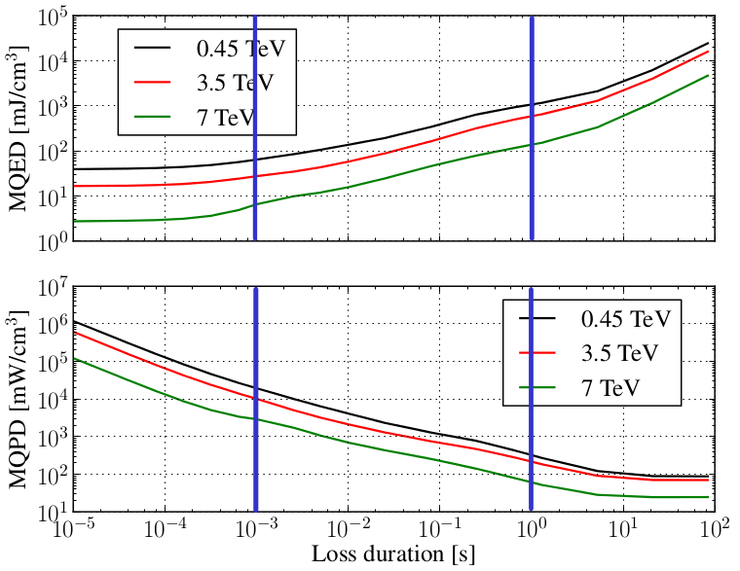
Super conducting magnet quench levels (LHC bending magnet)
Equivalent
presentation
quench levels
Short
Intermediate
Steady state
Loss durations
Energy
Constant heat
capacity
Heat capacity of strands
Cooling by He system
Power
Constant heat
transfer
Aim of quench test:
How much of beam intensity could impact on equipment and not quench a magnet

Slide 6
Methodology
Quench test
T > Tcrit
Proton Impact on equipment
Quench
energy
Coil
temperature
Measurement of beam intensity
Test results in upper and lower bound of quenching beam intensity

Slide 7
Methodology
Quench test simulation
T > Tcrit
Proton Impact on equipment
Shower
simulation
Quench
energy
Electro-thermal
simulations
Coil
temperature
B-field
Coil current
Cooling parameters
Coil parameter
Measurement of beam intensity
Shower simulation of local quench energy density
Lower and upper intensity bound => lower und upper local quench energy density bound
Electro-thermal simulation of local quench energy density
Quench test allows to validate combined result of shower and electro-thermal simulations

Slide 8
Methodology
Quench test simulation
T > Tcrit
Proton Impact on equipment
Shower
simulation
Quench
energy
Electro-thermal
simulations
Coil
temperature
B-field
Coil current
Cooling parameters
Coil parameter
Measurement of beam intensity
Beam loss monitor signal
Shower simulation of local quench energy density
Lower and upper intensity bound => lower und upper local quench energy density bound
Electro-thermal simulation of local quench energy density
Quench test allows to validate combined result of shower and electro-thermal simulations
Shower simulations are also validated by beam loss measurements

Slide 9
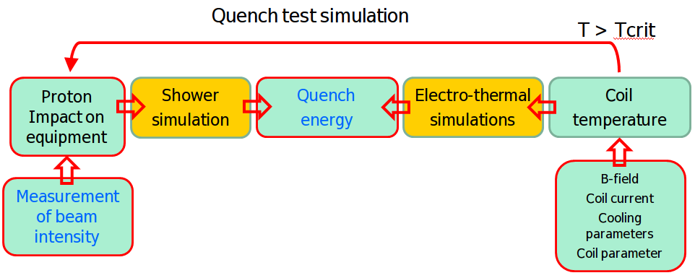
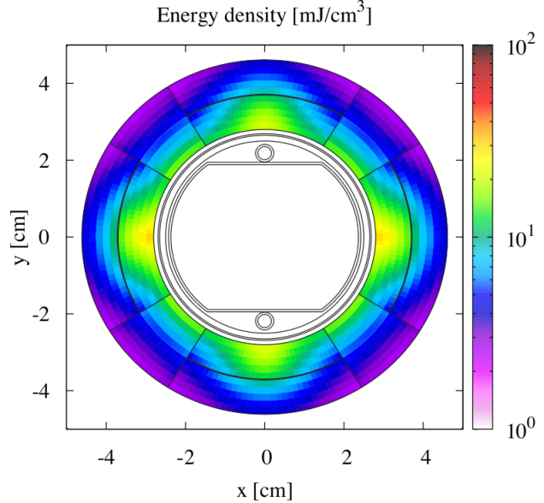
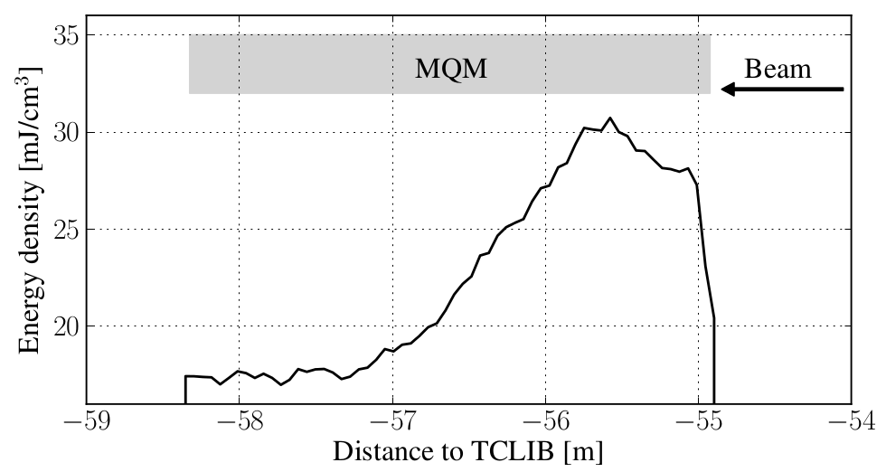
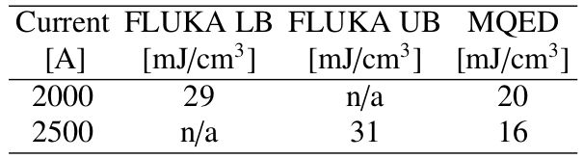
Short loss duration
Experiment
  Injected beam (6.5E10 p.) dumped on collimator (TCLIB)
  Quadrupole (Q6.L8, 4K) magnet exposed to shower particles
  Magnet current scanned to initiate quench
Maximum energy density peak
inside magnet
Symmetric energy
distribution
Result

Slide 10
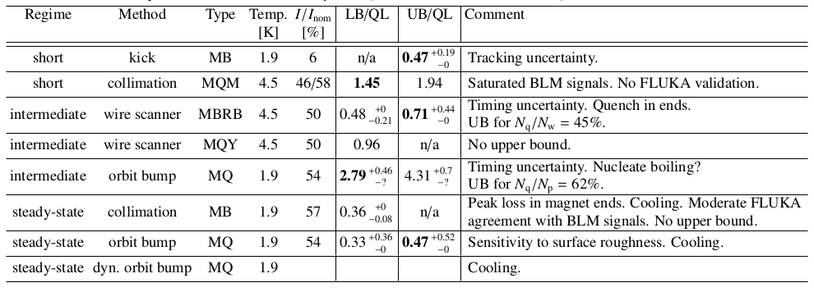
Results

Slide 11
Reserve slides

Slide 12
Short term losses
At E = injection energy
  Protection by collimators and quench protection system (QPS)
  Beam loss system posterior diagnostic
At E > injection energy
  Asynchronous beam bumps
  Sudden variation warm magnet current variations
  Collimator losses at and of energy ramp or during optic function the squeeze at the four experiments
Maximum value of energy distribution along cable cross section

Slide 13
Methedology
Quench test
T > Tcrit
Proton tracking
Proton Impact on equipment
Shower
simulation
Quench
energy
Electro-thermal
simulations
Coil
temperature
Quench test: observation quench at certain number of lost protons
Shower simulation, ratio energy in coil, BLM to number of lost particles
QT3: ratio of temperature increase to energy deposit in coil (quench energy)
BLM Time distribution (BLM system)
Magnetic field (
Coil temperature
Cooling conditions
Loss pattern
Beam current monitor

