Slide 1
CLIC accelerator development and now technology transfer

Slide 2
Overview
The CLIC project is developing the technology to make possible a TeV-range electron-positron linear collider.
One of the key objectives of the CLIC study has been to develop 100 MV/m accelerating structures along with the corresponding high-power, around 50 MW, rf systems.
Gradients in excess of 100 MV/m, are now routinely achieved.
We are actively seeking to apply our advances to other applications.

Slide 3
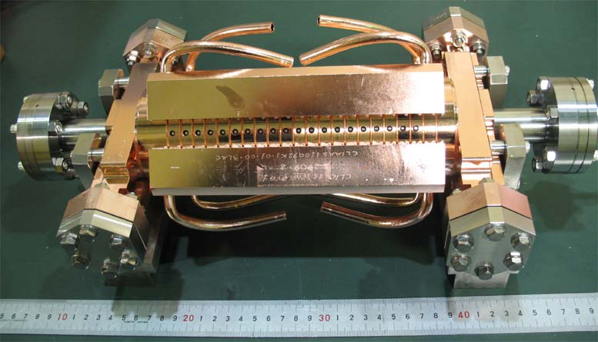
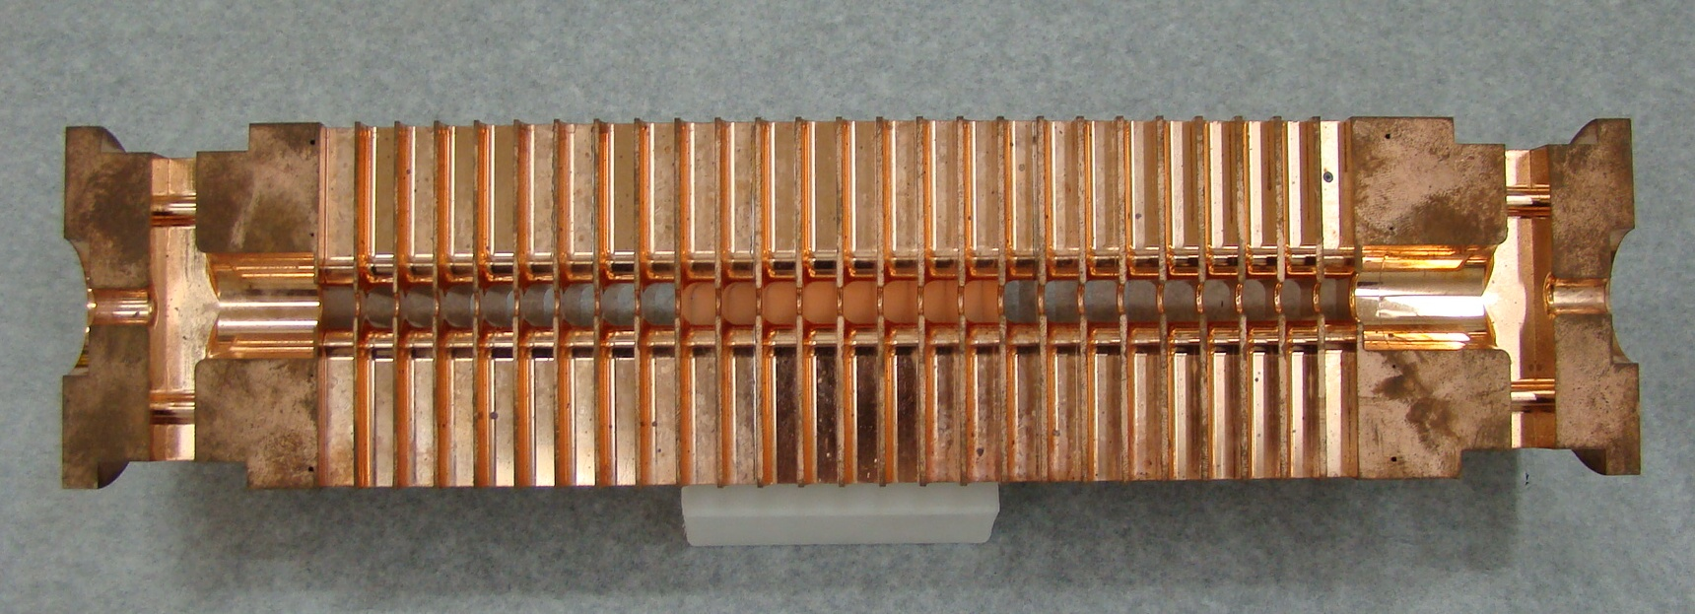
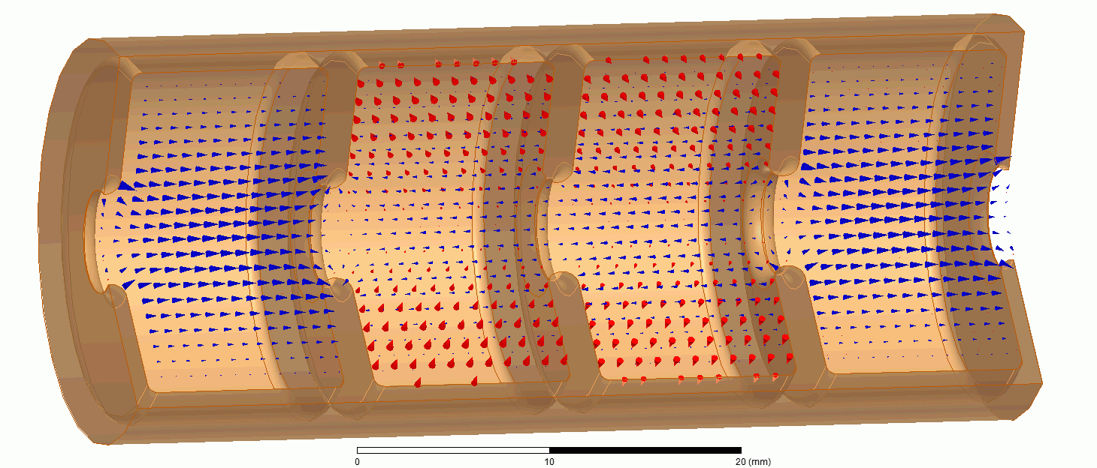
CLIC accelerating structure
Inside
11.994 GHz X-band
6 mm diameter beam aperture
Outside
beam propagation direction
Concept

Slide 4
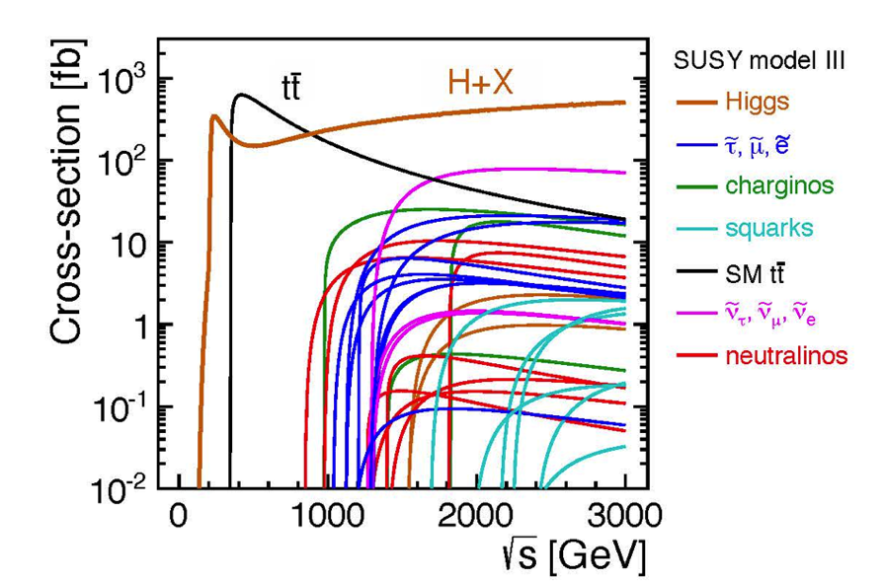
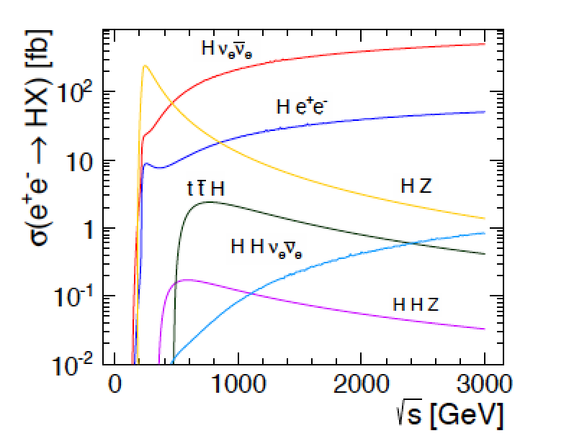
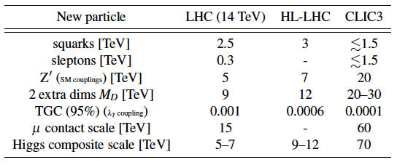
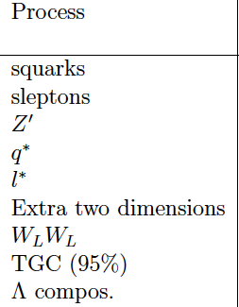
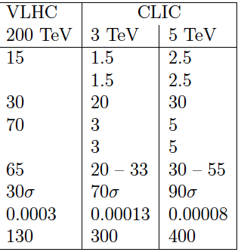
Physics at LC from 250 GeV to 3000 GeV
Physics case for the Linear Collider:
  Higgs physics (SM and non-SM)
  Top
  SUSY
  Higgs strong interactions
  New Z’ sector
  Contact interactions
  Extra dimensions
  …. AOP (any other physics) …
Specific challenges for CLIC studies:
Need to address Higgs-studies, including gains for measurements at higher energies
Reach for various “new physics” (list above) options; comparative studies with HiLumi LHC and proton-proton at higher energies (FCC).
References:
CLIC CDR and
http://arxiv.org/pdf/hep-ex/0112004.pdf

Slide 5
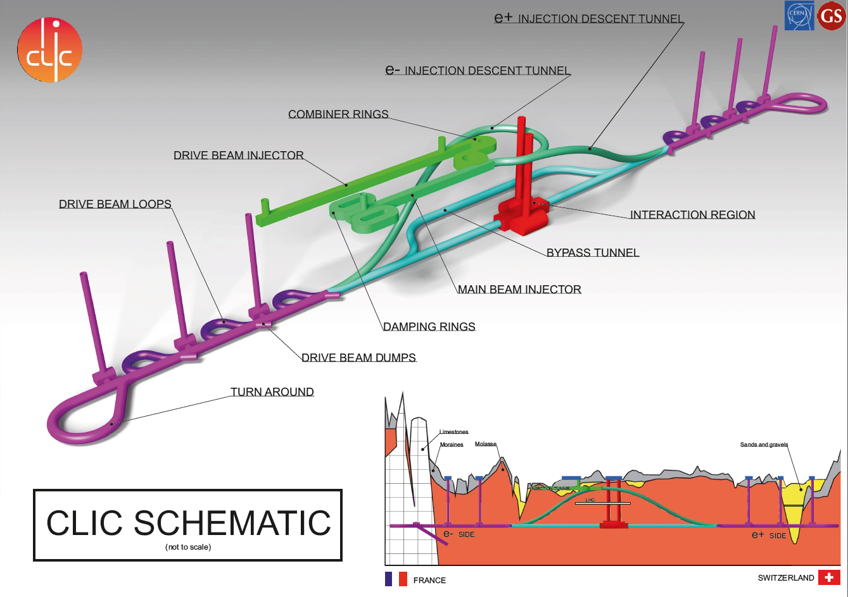

Slide 6
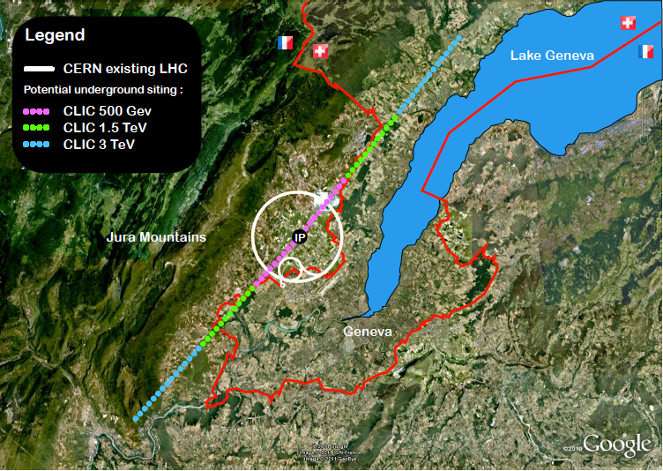
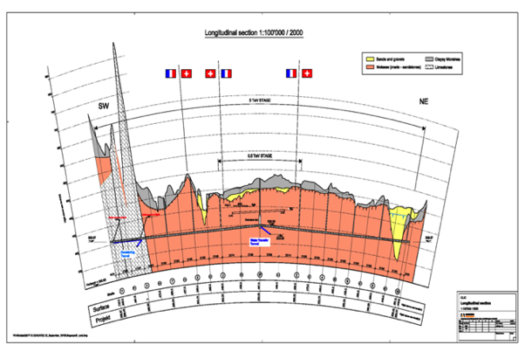
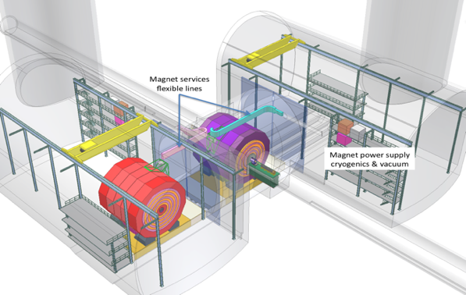
CLIC near CERN
Tunnel implementations (laser straight)
Central MDI & Interaction Region

Slide 7


High gradient – compact and potentially cheaper
State-of-the acceleration:
Normal conducting:
28 MV/m SwissFEL
35 MV/m SACLA
Superconducting:
24 MV/m European XFEL
31.5 MV/m ILC
Our goals:
100 MV/m CLIC
60-80 MV/m compact XFELs
50 MV/m low-β proton therapy linacs

Slide 8
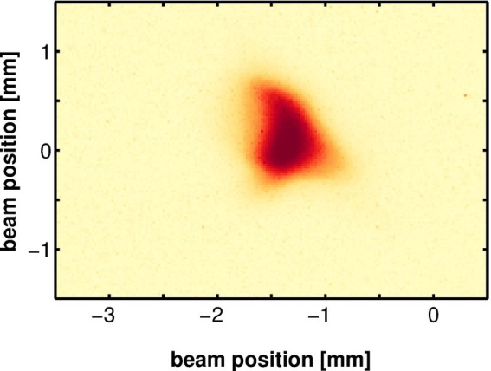
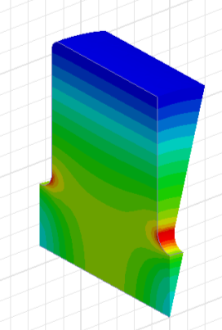
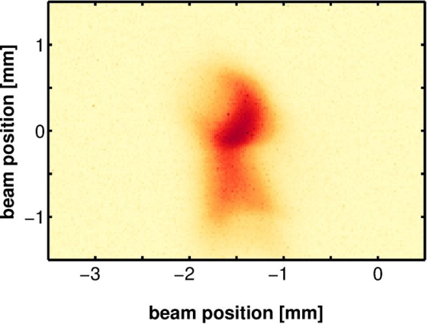
What is the main physical limitation?
Vacuum breakdown
An accelerating gradient of 100 MV/m corresponds to around 250 MV/m peak surface electric field.
The high field leads to ‘classic’ vacuum breakdown. Field emission, neutral copper emission, plasma formation, kA currents, collapse of fields. Beam is kicked, luminosity or brightness lost.
w/o BD
Surface electric field concentration on the beam-aperture irises
0.75 mm
With BD

Slide 9
Some (round) numbers for CLIC
Operating frequency | 12 GHz
Accelerating gradient | 100 MV/m
Peak surface electric field | 250 MV/m
Pulse length | 200 ns
Repetition rate | 50 Hz
Input power | 50 MW
Breakdown rate | <10⁻⁷ BD/pulse/m

Slide 10
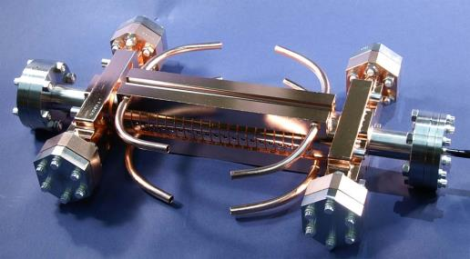
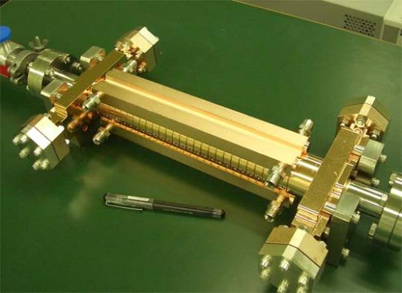
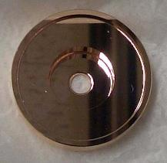

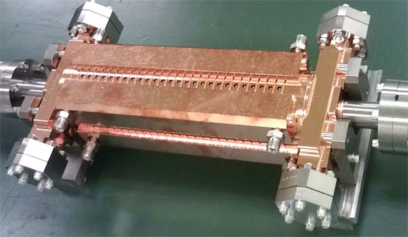
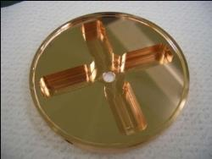
CLIC test structures; fabrication and test
T18 →TD18→T24→TD24→TD24R05
1. T18_Disk_#2
undamped
3. T24_Disk_#3
damped
2. TD18_Disk_#2
4. TD24_Disk_#4
5. TD24R05 under test now

Slide 11
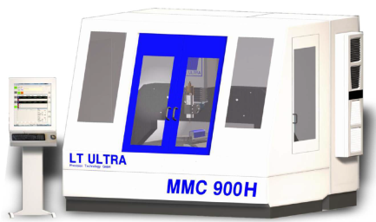
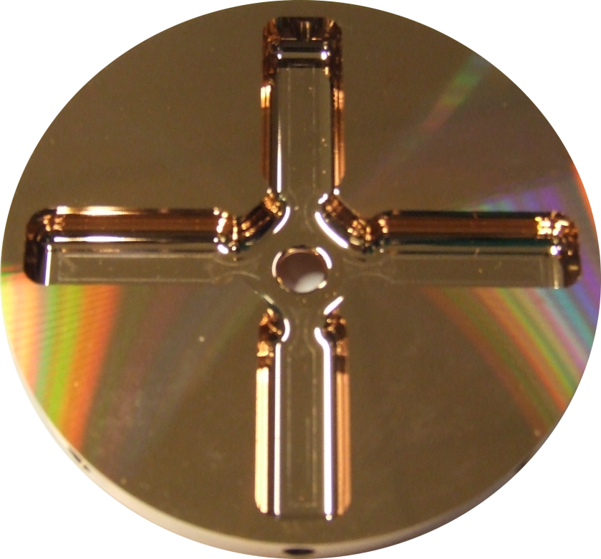
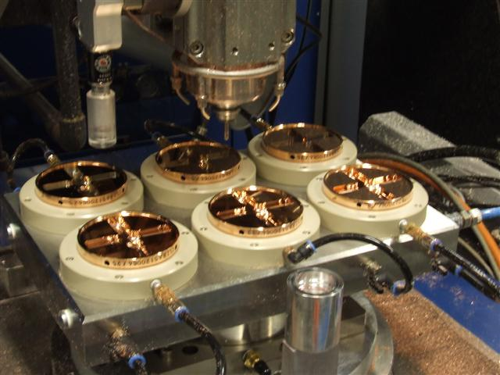
CLIC accelerating structure
Inside (cut)
Outside
6 mm diameter beam aperture, 25 cm long
Micron-precision turning and milling.

Slide 12
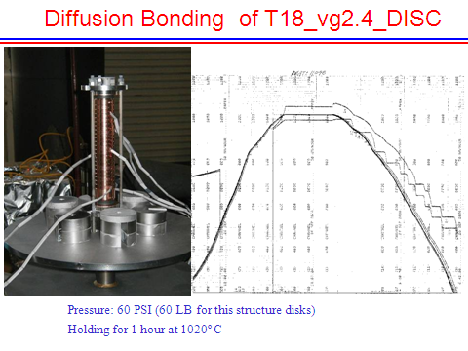
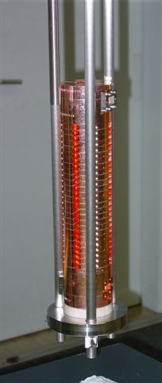
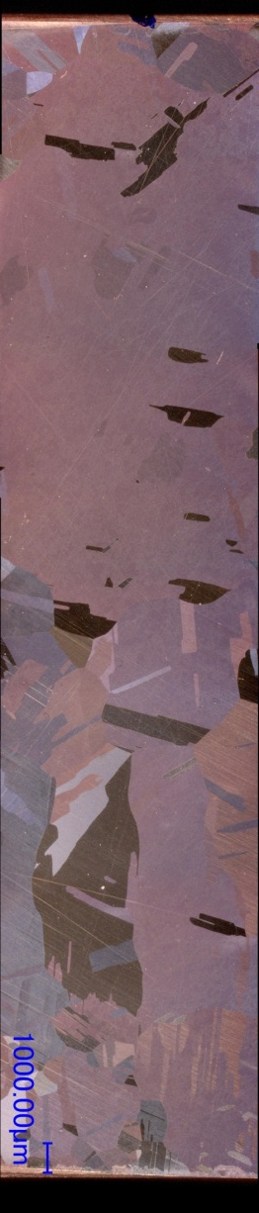
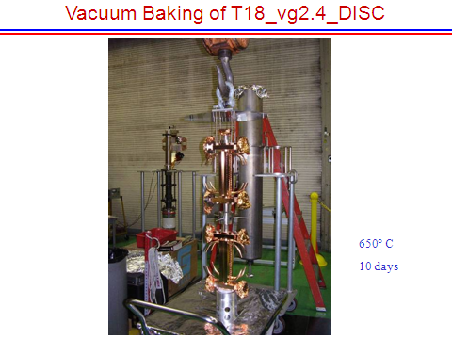
Heat treatment and material structure
TD18#3 at SLAC
TD18#2 at KEK
Stacking disks
Temperature treatment for high-gradient developed by NLC/JLC
Find the bonding plane!

Slide 13
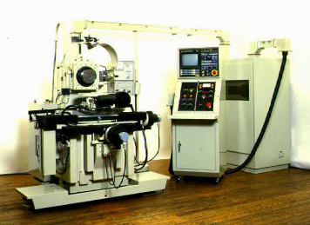
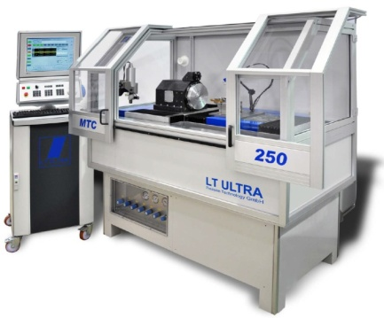
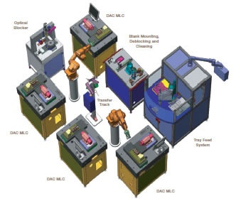
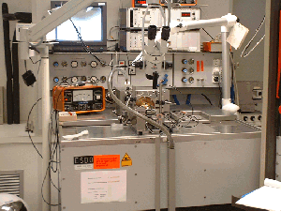
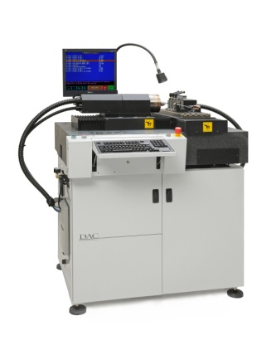
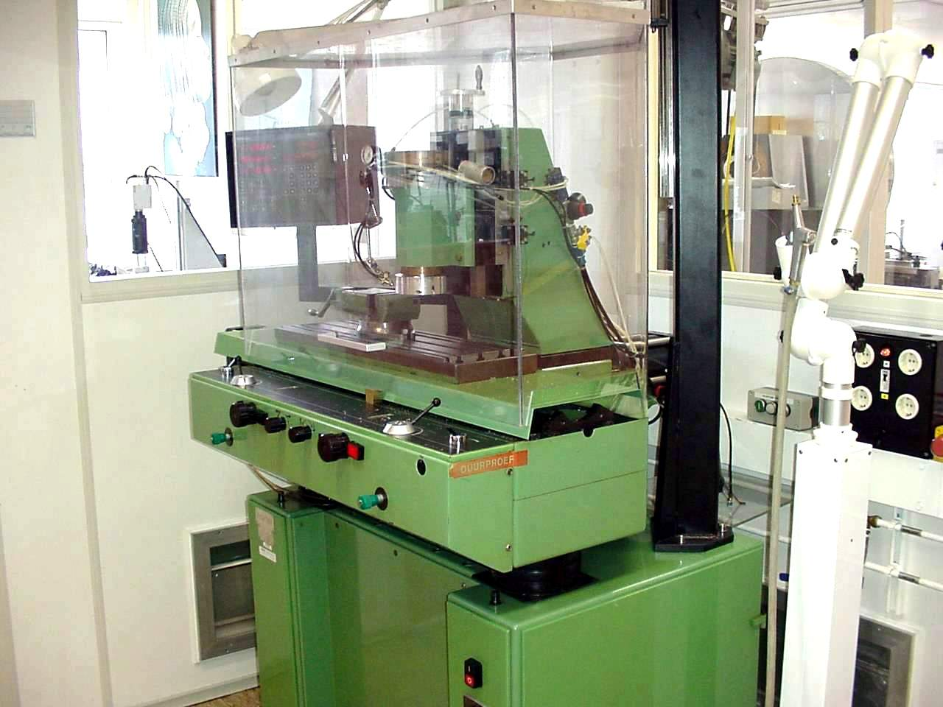
Evolution of machining capability
Single point diamond turning
Up to the 1980’s
1980’s - 1990’s
2000’s - 2010’s
Future ?
First machines at research institutes and universities
Start of industrialization
Optical recording
contact lenses
Larger machines
Multiple axis ( X/Y/Z and C)
Intelligent machines ?
  Robotisation ?
Ultra precision diamond milling (lagging more than a decade behind on turning)
Up to the 1990’s
1990’s - 2000’s
2010’s
Future ?
Limited to fly cutting
mirror optics
Laser scanner mirrors
Milling as add-on on lathes
Lens arrays
Intra ocular lenses
First proto type machines
Micro fluidics
Accelerator parts
Pallet machining?
  Robotisation ?

Slide 14
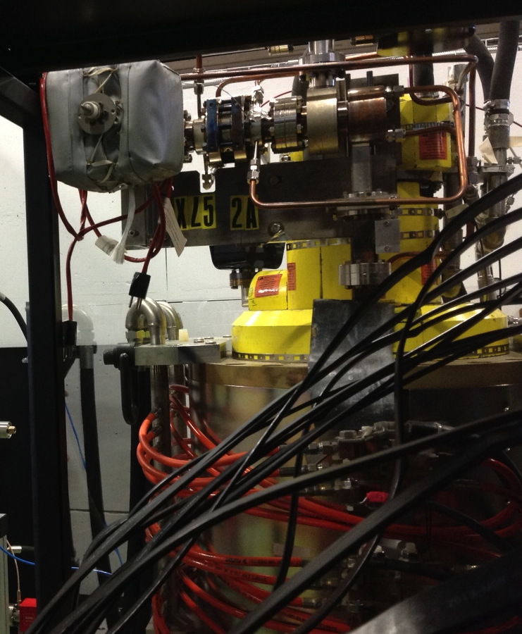
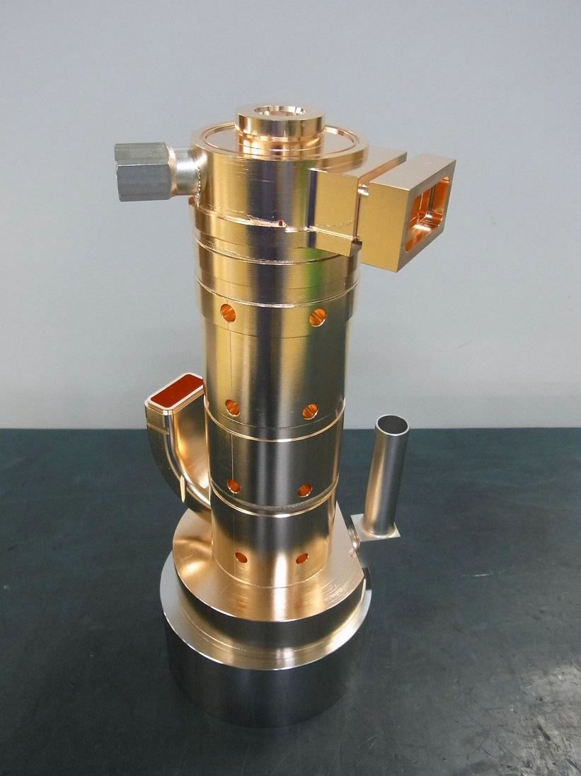
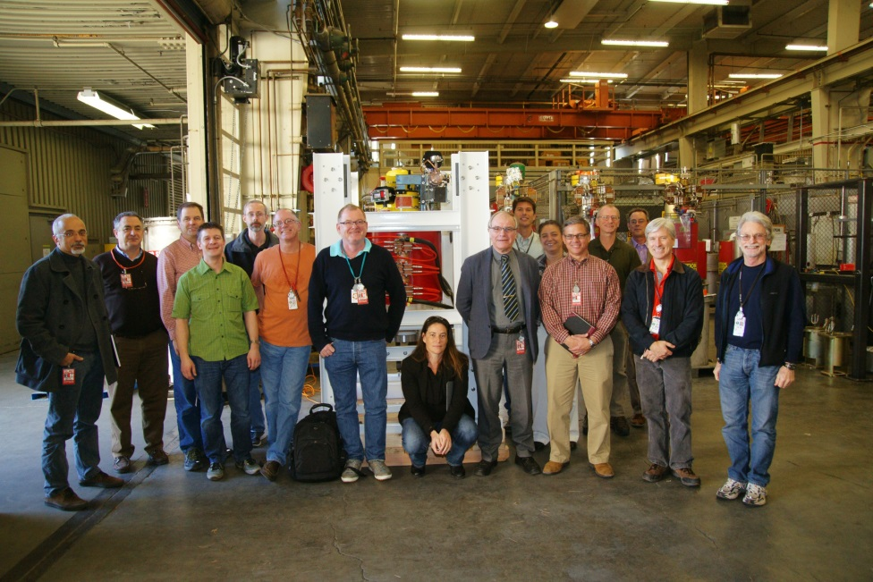
High – gradient testing infrastructure, klystrons
Toshiba 6 MW, 5 μs
50 MW
1.5 μs
SLAC
CPI

Slide 15
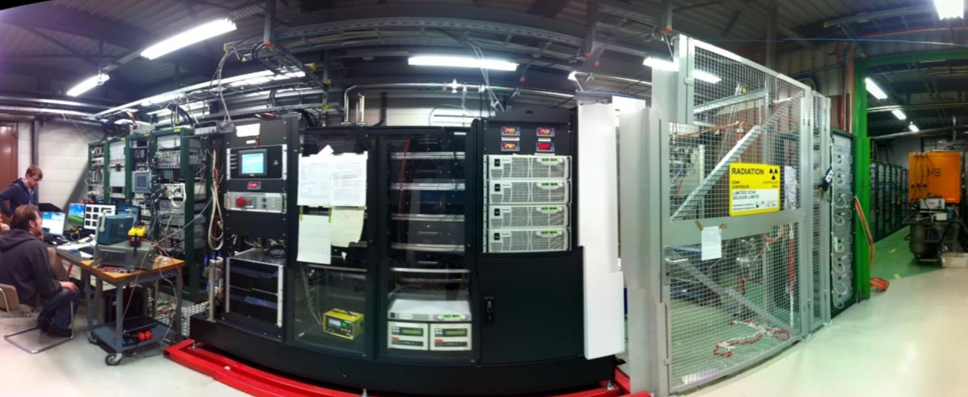
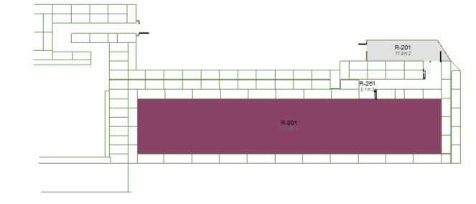
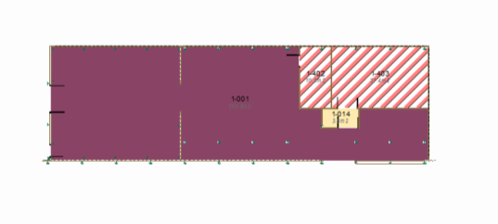
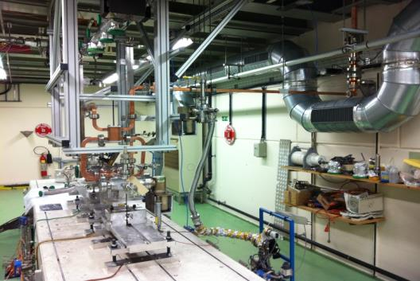
Xbox1
CTF3 klystron gallery
CTF2

Slide 16
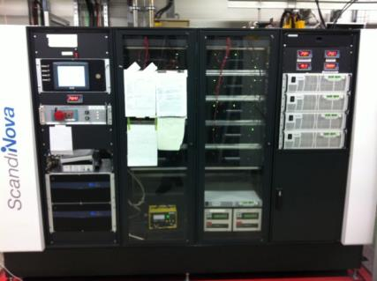
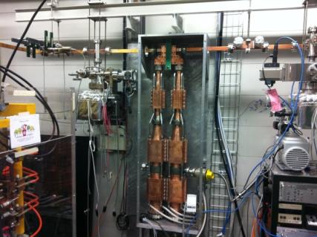
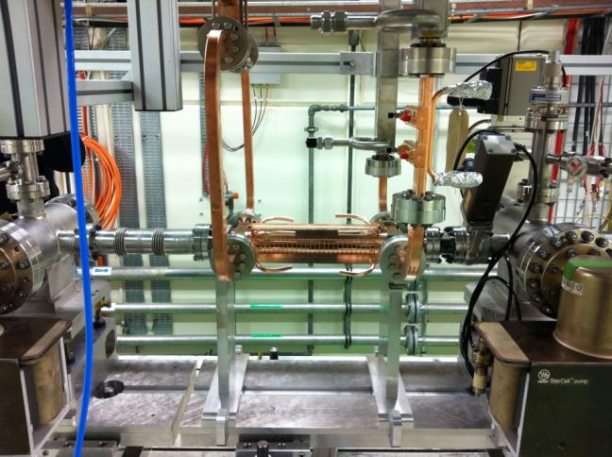

Xbox-1 Layout
Clockwise from top-left:
Modulator/klystron (50MW, 1.5us pulse)
Pulse compressor (250ns, ratio 2.8)
DUT + connections
Acc. structure (TD26CC)
Gallery
Bunker

Slide 17
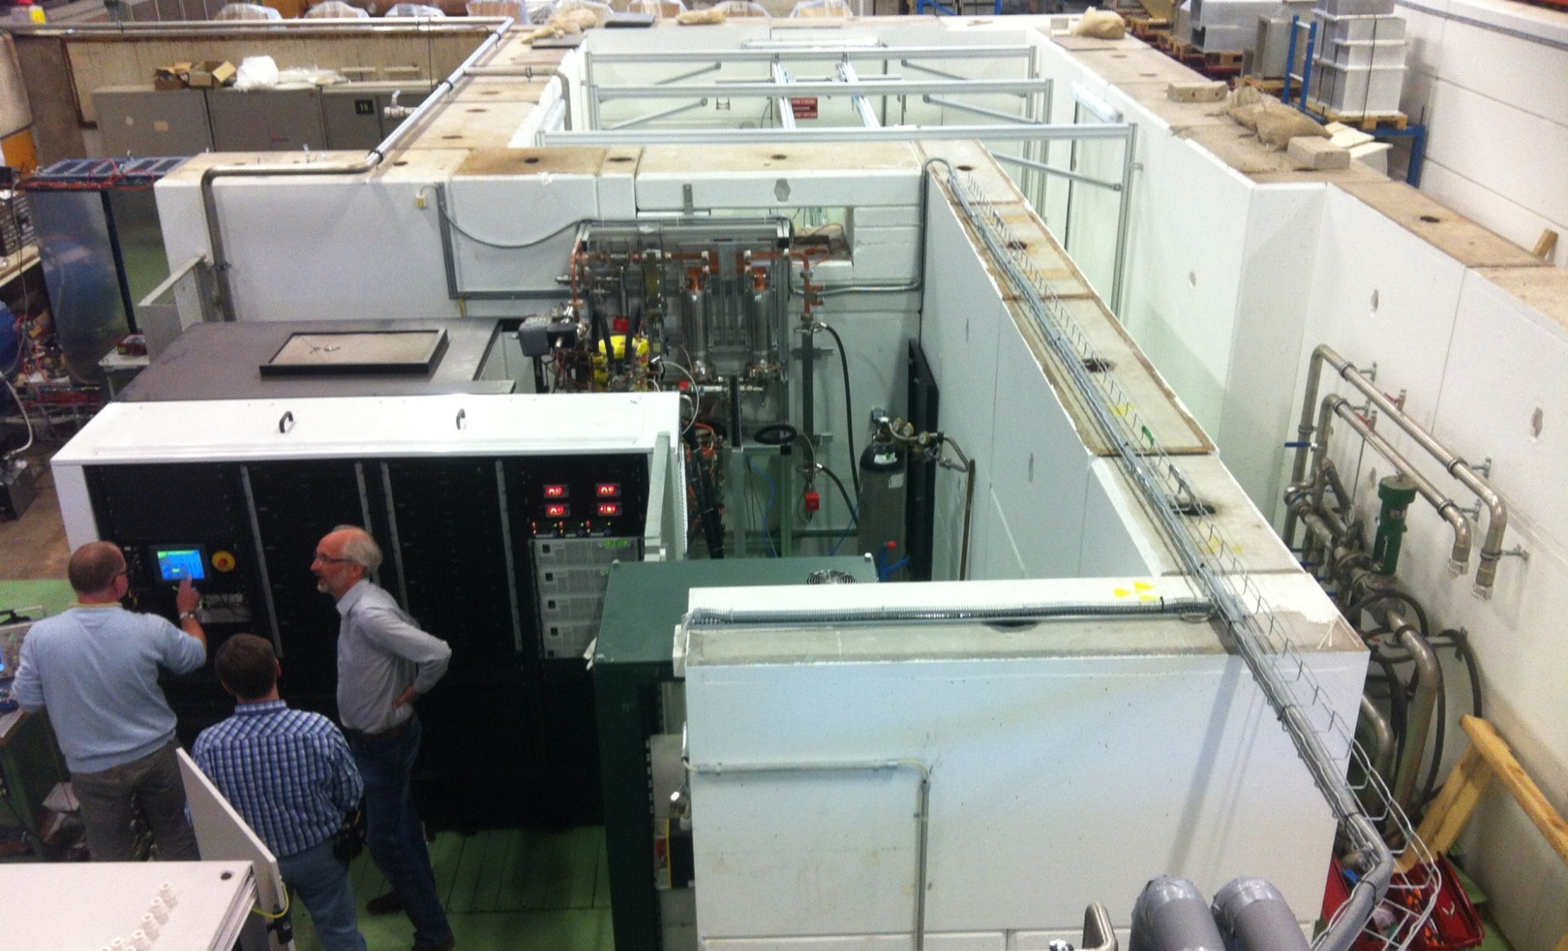
Xbox2
Diode testing has started to commission modulator

Slide 18
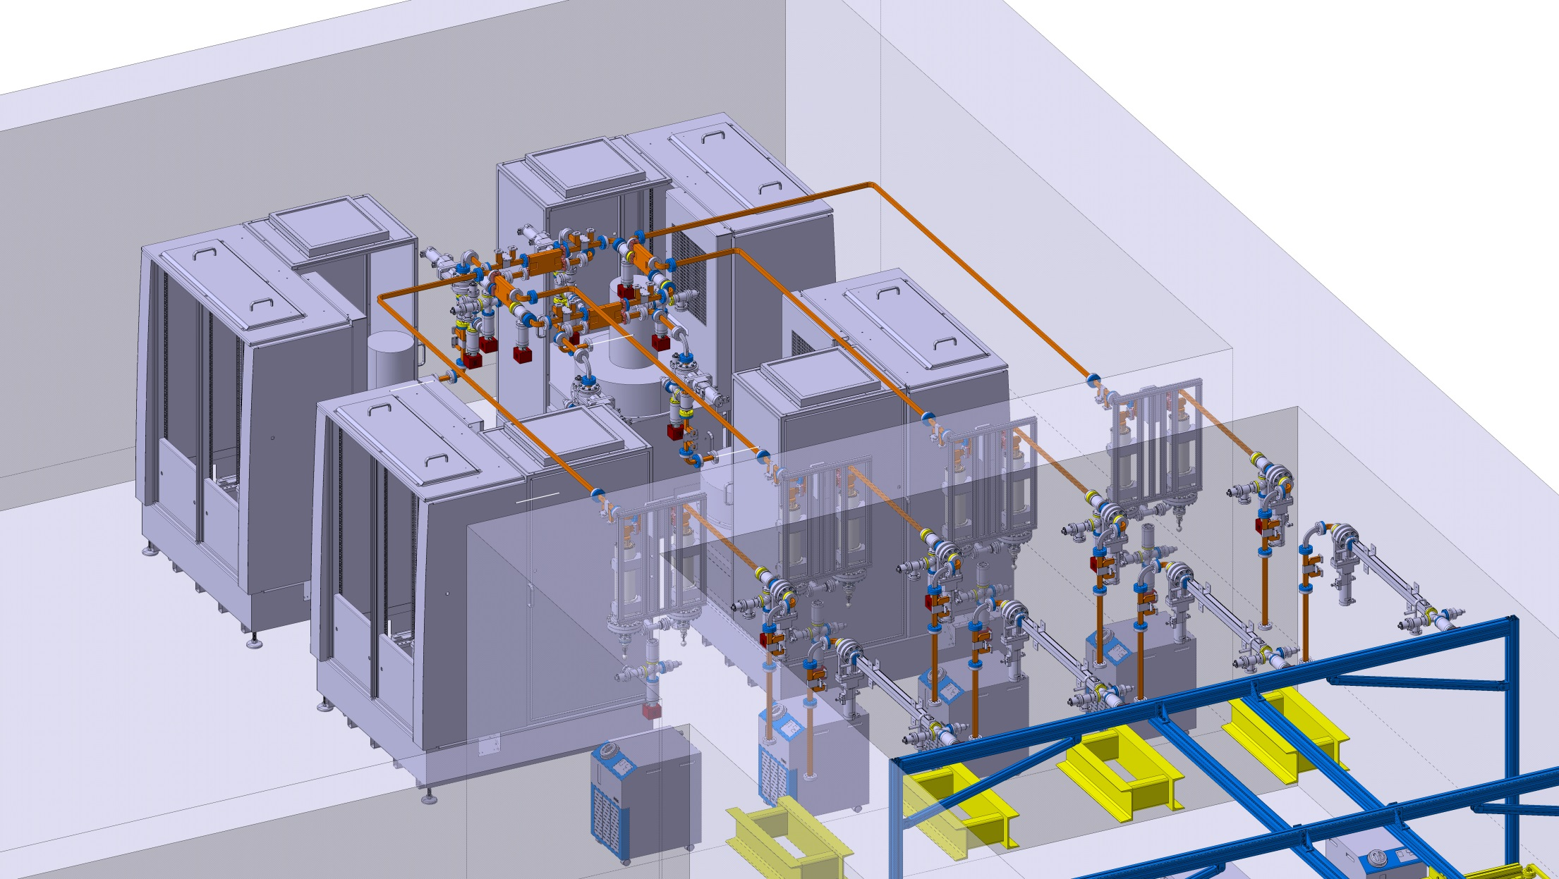
Xbox3. 3D layout/integration almost finished

Slide 19
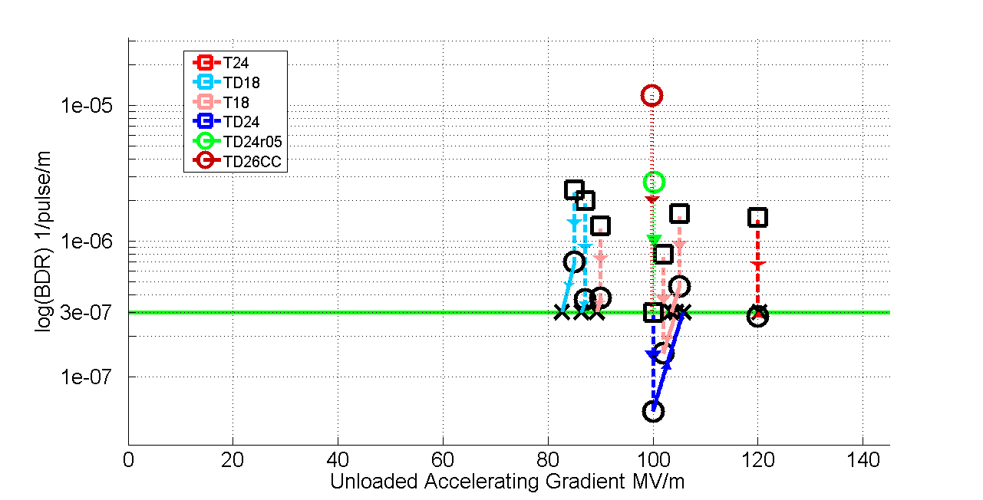
Accelerating structure performance summary

Slide 20
































CLIC Collaboration
29 Countries – over 70 Institutes
Accelerator
collaboration
Detector
collaboration
Accelerator + Detector collaboration

Slide 21
Outreach
Our development goals have basically been achieved – we now need to consolidate them, reduce cost, increase industrial supplier base etc. – while we wait for the LHC to clarify the physics case for our facility.
One of the most productive ways of achieving those goals is through promoting the use of our technology in other projects.
We have identified some potential applications:
The kind of projects we have identified which potentially benefit from high-gradient technology include:
FELs
Compton sources
Medical linacs
Imaging scanners
Pulsed neutron sources
There are also accelerator components such as:
Phase linearizing cavities
Deflectors
Rf guns

Slide 22
High-gradient medical accelerator
Objective – highest possible accelerating gradient for proton and ion acceleration by applying CLIC technology.
Target application is TERA’s TULIP project.
Collaboration between CLIC and TERA.
Prototype structure and experimental electronics funded by CERN KT. knowledge transfer fund (and also the office for CERN medical applications).

Slide 23
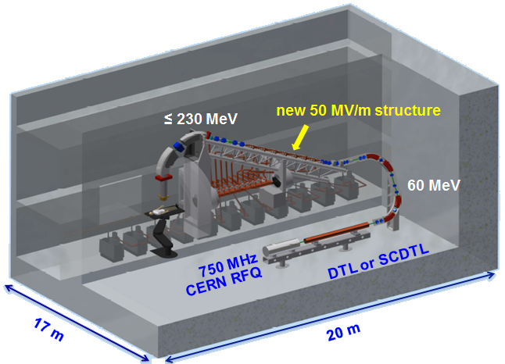
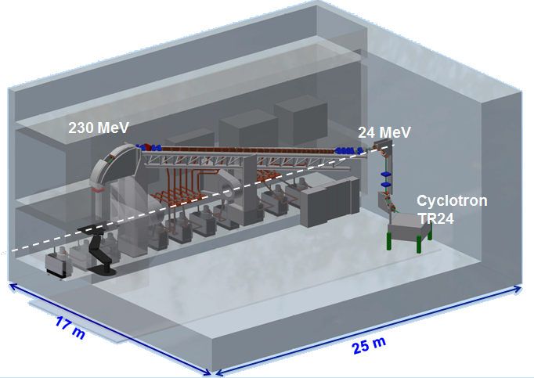
A linac based proton therapy facility
A single room protontherapy facility has been designed by TERA Foundation at CERN in collaboration with the CLIC group.

Slide 24
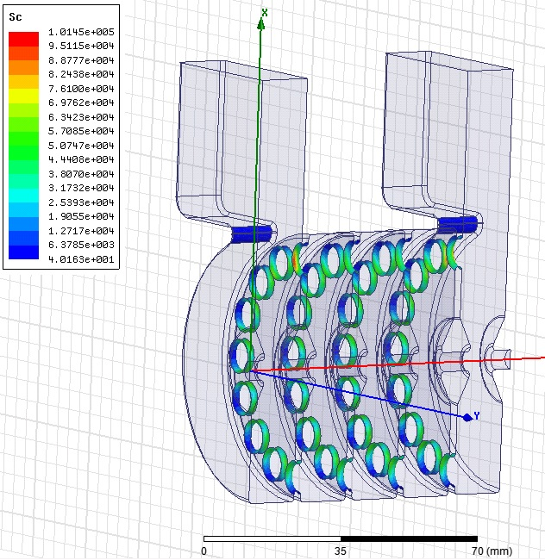
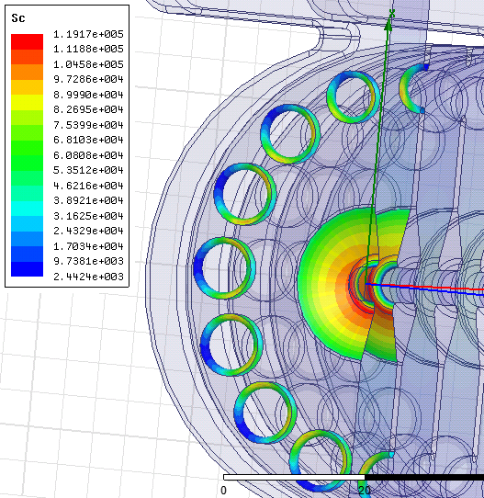


By reducing the coupling holes radius closer to the coupling slot the problem is solved
Sc up to 40% higher than in the regular cells holes
But we affect the vg, so the Ez
Particular effort dedicated to the input coupler design
Asymmetric design of the coupling hole radii to compensate for local enhancement of Sc
Couplers design

Slide 25




Thermal Test at Bodycote
5

Slide 26

FERMI@Elettra: present layout and energy upgrade

Slide 27
FERMI@Elettra: present layout and energy upgrade
FERMI current layout and performance
E_{beam} up to 1.5 GeV
FEL-1 at 80-10 nm and FEL-2 at 10-4 nm
Long e-beam pulse (up to 700 fs), with “fresh bunch technique”
More details in MOPP023
1.5 GeV
FEL-1 & FEL-2
Beam input energy
~ 0.7 GeV
50m
New FEL beamline
< 1 nm
X-band linac extension
High gradient X-band linac extension
Active accelerating length 40 m
Accelerating gradient 70 MV/m
Beam energy gain 2.8 GeV
Injection energy 0.7 GeV
3.5 GeV
New FEL beamline expected performance
Undulator period | 30 mm
Undulator parameter | 1
Fundamental wavelength | 0.5 nm
Peak power at saturation | 5.6 GW
N.B. The new layout could also provide two electron beams
at the same time (@25 Hz) with different energies

Slide 28

Shanghai Photon Science Center at SINAP
580m
Compact hard X-ray FEL (X-band, S-band)
Energy: 6.5GeV, 8GeV (200m linac)
SXFEL: Shanghai Soft X-ray FEL
S-band, C-band, X-band
Energy: 0.84GeV (Phase I), 1.3GeV (Phase II)
SSRF: Shanghai Synchrotron Radiation Facility
Energy: 3.5GeV, user operation

Slide 29

AXXS Design Project
Presentation to CLIC FEL Collaboration
18 September 2014
Mark Boland
Australian Synchrotron

Slide 30
Horizon2020 application for X-band XFEL

Slide 31
Conclusions
CLIC-developed X-band and high-gradient technology have enabled significant increases in accelerator performance.
There is the real possibility of seeing the technology implemented in projects in the near future, which we hope will launch a virtuous circle of further development, lower cost and further use.

