Slide 1



Low Breakdown rate operation of a high gradient accelerating structure under high beam loading conditions
J.L. Navarro (CERN), for the CLIC/CTF3 collaboration

Slide 2
Outline
From CLIC to the breakdown problem
The Dogleg experiment layout
First Results
Next steps
Conclusions

Slide 3
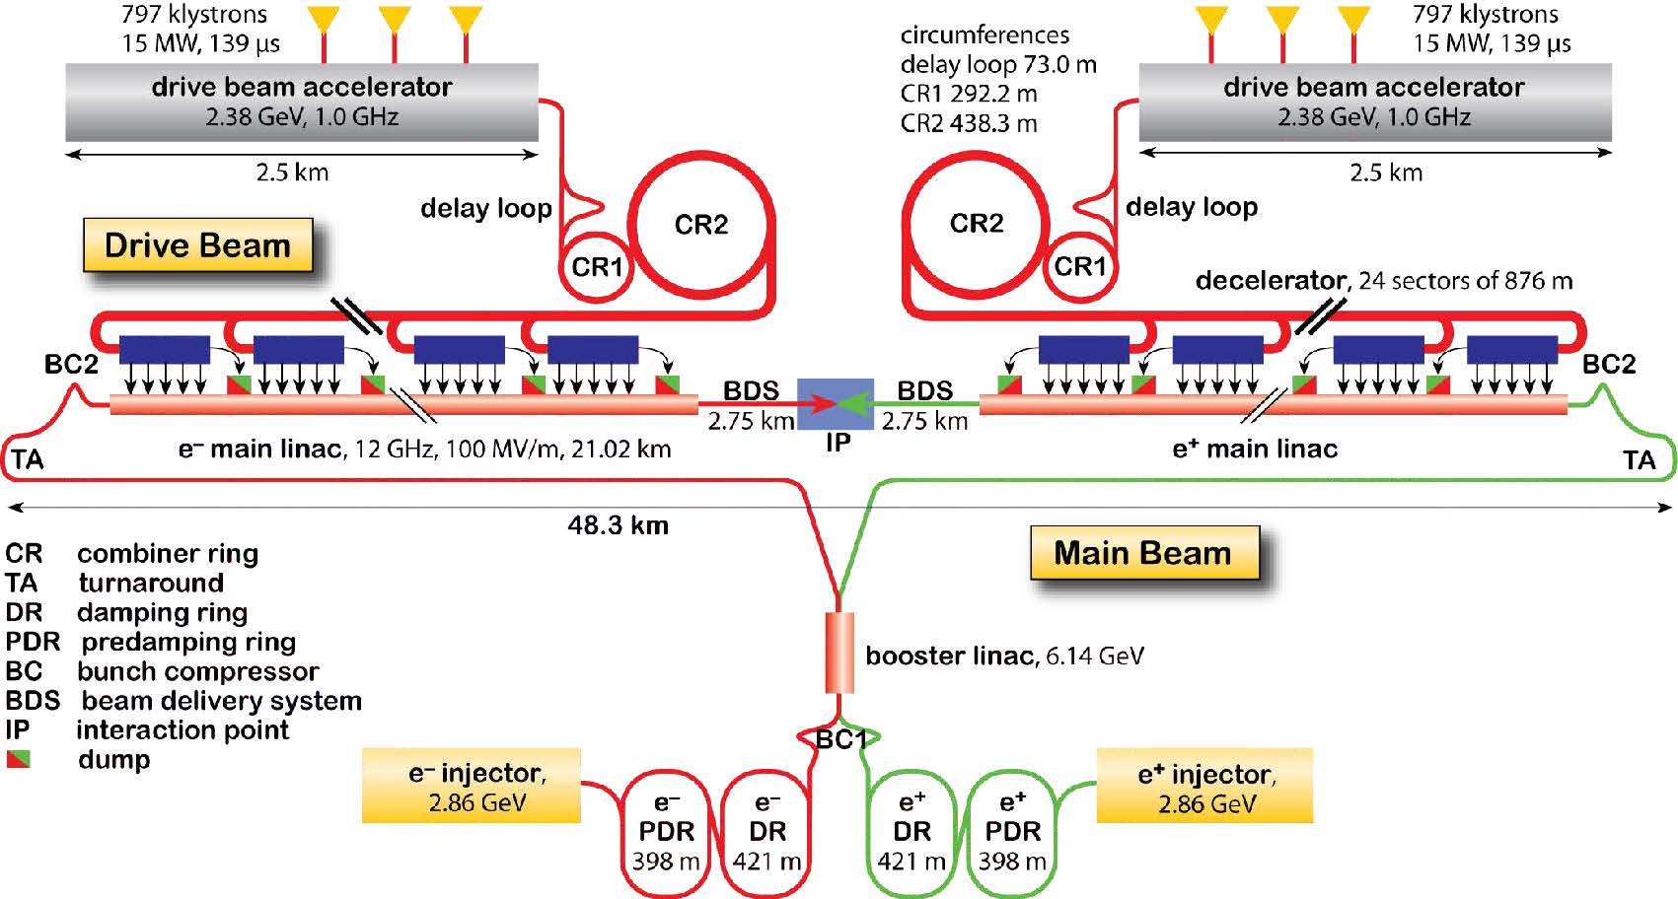
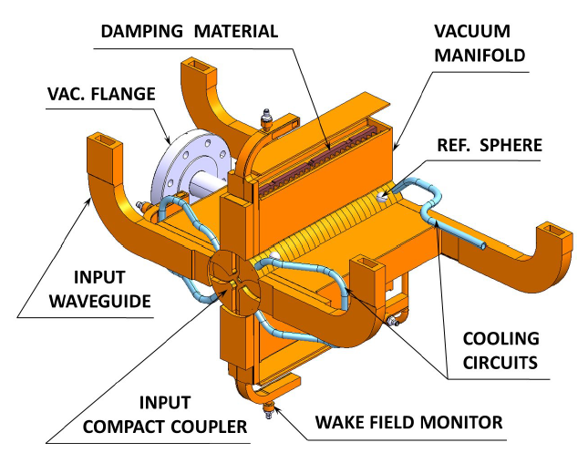
CLIC in a nutshell
The study is focused on the accelerating structures of the Main Beam Linac
Traveling waves cavities
Nominal gradient ~ 100 MV/m
Nominal RF pulse length ~ 240 ns (160 ns flat top)
Peak Power ~ 61 MW
Max. Surf. Field ~ 230MV/m
Notes:
CLIC relies in the two beam concept, where we transfer power from the drive beam to the accelerating structures of the main beam.
In these accelerating structures is where our study is focused.
They are traveling waves structures which supports a nominal average gradient of around 100 MV per meter for a pulse length of 240ns

Slide 4
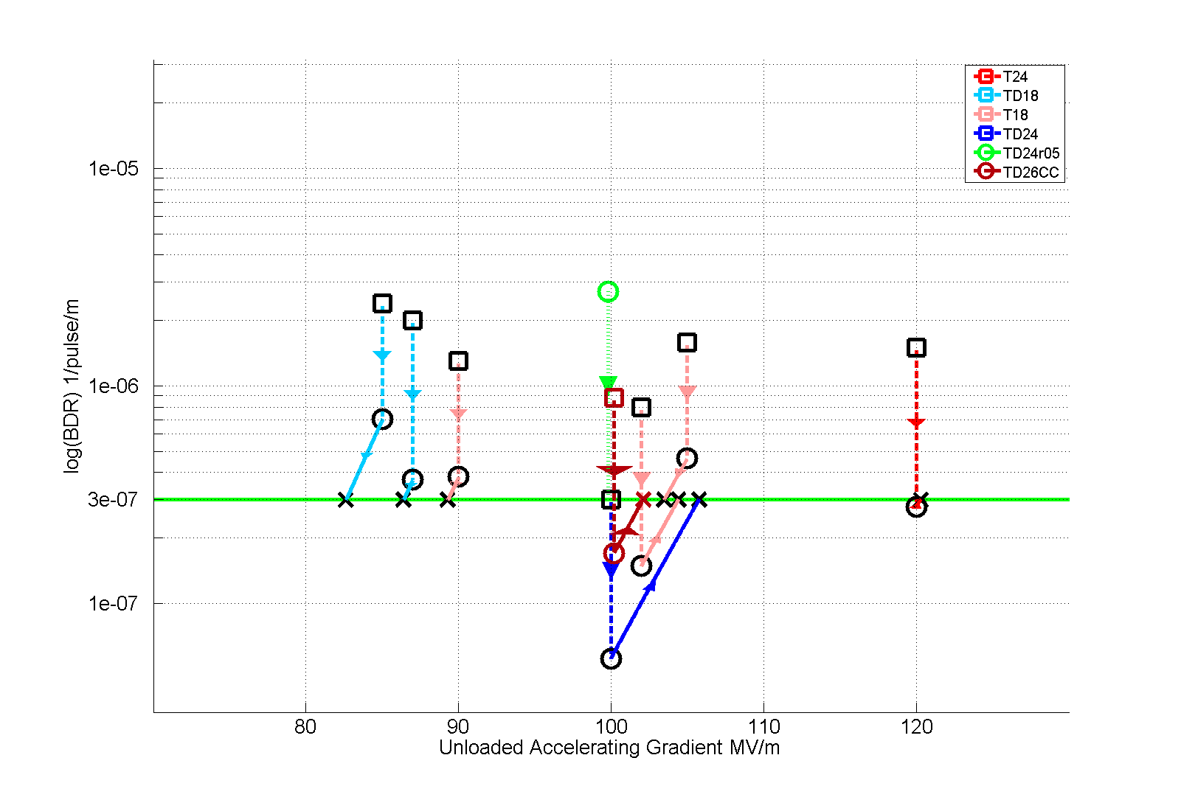
The breakdown problem
Strong Accelerating fields (~100 MV/m)
Problem of Break Downs (BD): Very fast (10 ns – 100 ns) and localized dissipation of stored energy in the structure.
Undesired effects:
Loss of acceleration
Damage in the structure
Kick in the beam
…
T24
TD18
T18
TD24
TD24r05
TD26CC
Luminosity Reduction:
Max DB rate allow for CLIC specifications:
3 10⁻⁷ BD pulse⁻¹ m⁻¹
Log(BDR) 1/pulse/m
Unloaded Accelerating Gradient MV/m
Notes:
With these strong accelerating gradients problems can appear, and these problems are called Break Downs.
A break down is nothing else that a very fast and localized dissipation of energy.
This energy dissipation has collateral effects with a direct impact in luminosity.
We need to keep this effect under control to meet the CLIC luminosity specifications.
So far, some structures have been already tested only with RF power with positive results.

Slide 5
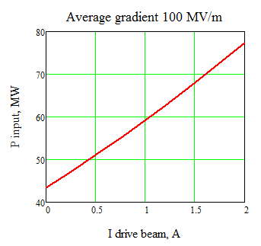
Beam loading effect
Beam Loading modifies the gradient distribution along the structure
Gradient, MV/m
I = 0 A
P ~ 43 MW
CLIC nominal
Length, m
Gradient profile along the structure without beam loading
Unloaded

Slide 6
Beam loading effect
Beam Loading modifies the gradient distribution along the structure
Gradient, MV/m
I = 0.35 A
P ~ 43 MW
CLIC nominal
Length, m
The beam loading modifies the gradient profile

Slide 7
Beam loading effect
Beam Loading modifies the gradient distribution along the structure
Gradient, MV/m
I = 0.6 A
P ~ 43 MW
CLIC nominal
Length, m
The beam loading modifies the gradient profile

Slide 8
Beam loading effect
Beam Loading modifies the gradient distribution along the structure
Gradient, MV/m
I = 0.95 A
P ~ 43 MW
CLIC nominal
Length, m
The beam loading modifies the gradient profile

Slide 9
Beam loading effect
Beam Loading modifies the gradient distribution along the structure
Gradient, MV/m
I = 1.2 A
P ~ 43 MW
CLIC nominal
Length, m
We do not have anymore 100 MV/m in average.

Slide 10
Beam loading effect
Beam Loading modifies the gradient distribution along the structure
Gradient, MV/m
I = 1.2 A
P ~ 53 MW
CLIC nominal
Length, m
We compensate increasing the RF input power

Slide 11
Beam loading effect
Beam Loading modifies the gradient distribution along the structure
Gradient, MV/m
I = 1.2 A
P ~ 63 MW
CLIC nominal
Length, m
What is the effect on BD rate?

Slide 12
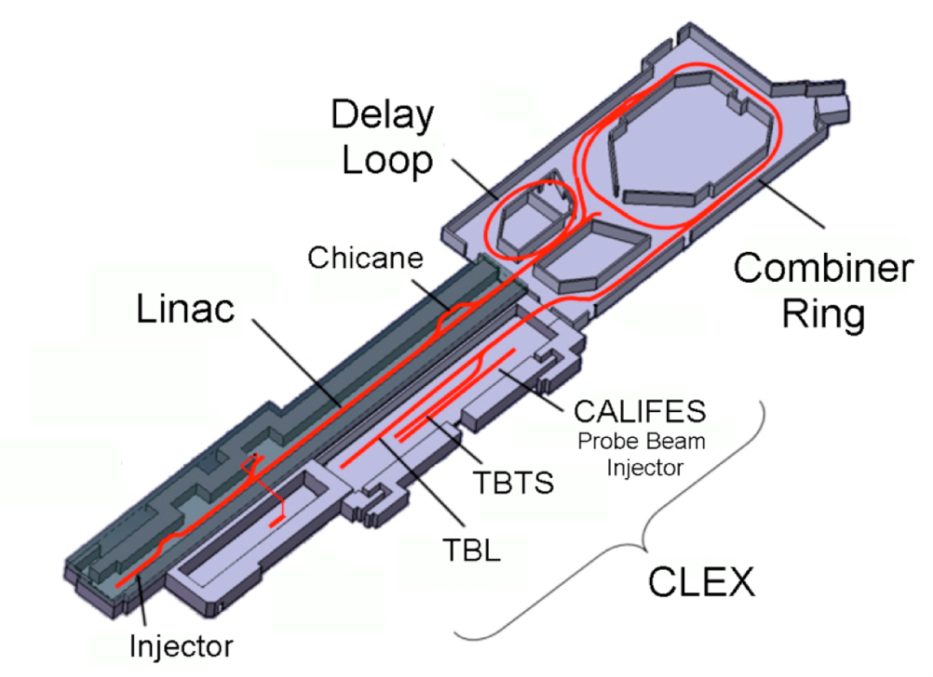
The Dogleg Experiment
Main goal: Measure and comparison (unloaded vs high beam loading) of the BD rate in high gradient accelerating structure
Experiment located at
the CLIC Test Facility CTF3 @ CERN
Dogleg
Drive Beam
XBox1

Slide 13
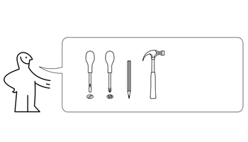
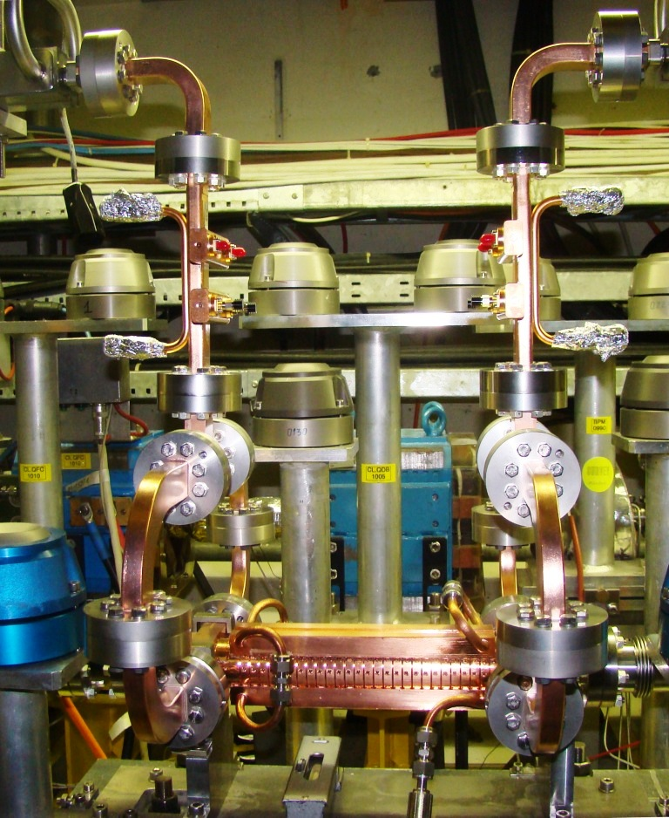
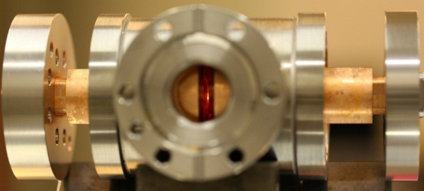

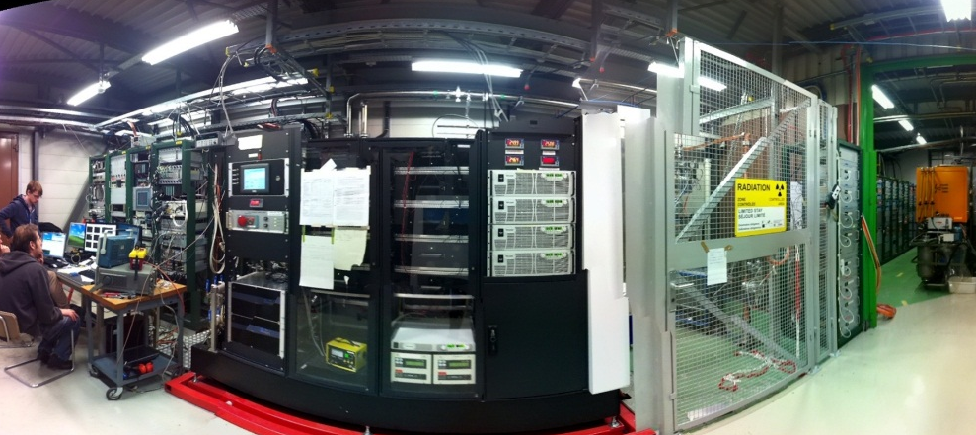

Experiment layout
1x
Nx
1x
Dogleg
XBox1
1x
3000000x

Slide 14
Experiment layout
Dogleg
12 GHz RF:
90 MW RF power
XBOX1
12 GHz RF
XBox1
CTF3 Injector
35 m low loss waveguide
Beam:
CTF3 Drive Beam modified to mimic CLIC main beam
3GHz beam with nominal current of ~1.2 A
Pulse length up to 250 ns
Energy ~125 MeV at structure
Up to 25 Hz pulse rep. rate
MKS02
3 GHz RF
MKS03
MKS05
MKS06
MKS07
Gun

Slide 15
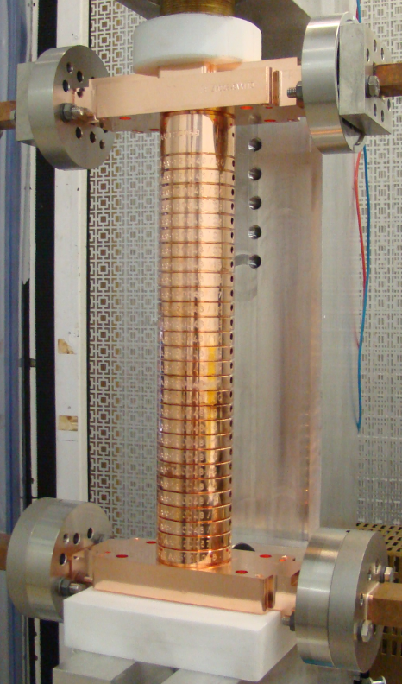
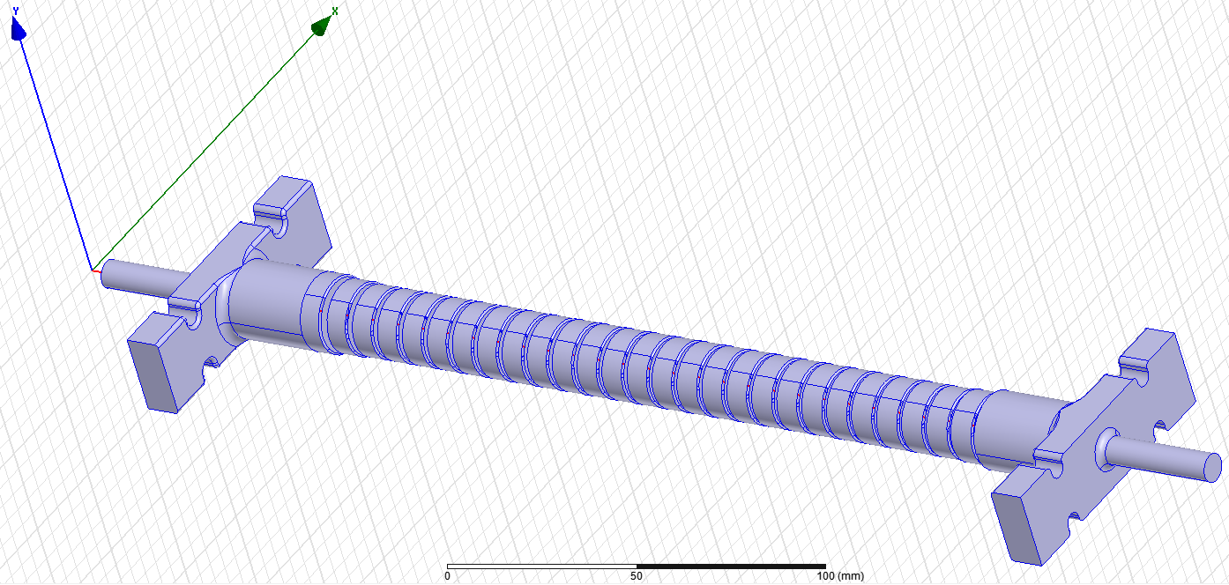
The 12GHz Accelerating structure
Normal conducting cooper structure
Travelling wave
Tapered linearly (Ø from 6.3 to 4.7 mm)
Without HOM Damping waveguides
24 cells + 2 coupling cells
Nominal accelerating gradient 100 MV/m
v_{g}/c [%] = 1.8 to 0.9
Filling time = 57.25 ns
Q_{Cu} = 6815
CERN’s T24 (12WNDSvg1.8 KEK N1)
Inner volume
Thanks to A. Grudiev for HFSS model

Slide 16
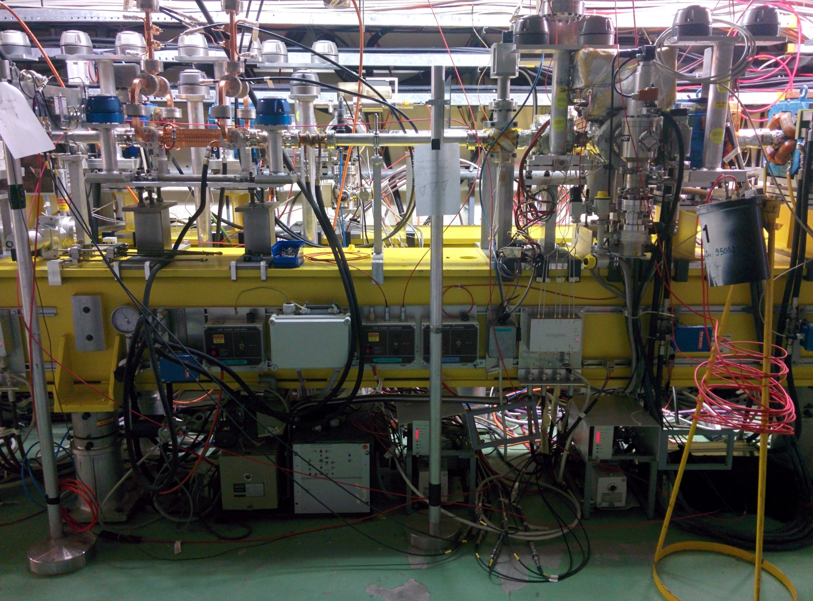
Diagnostic, control and protection
12 RF output
12 RF input
Vacuum pumps and gauges
Beam
6 mm collimator
BPM upstream
12 GHz
ACS
Fibre and diamond BLMs
12 GHz accelerating structure surrounded by a complete set of instrumentation:
2 inductive BPMs (1 upstream and 1 downstream)
6 mm collimator to protect the structure
Fibre optic and diamond beam loss monitors
Vacuum pumps and gauges in beam chamber and RF waveguides
BPM
downstream
BPMs
BLMs
Collimator
Vacuum readings
Interlock system

Slide 17
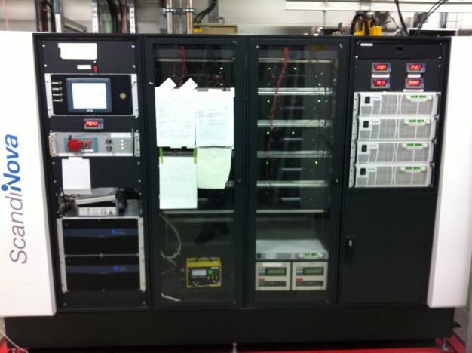
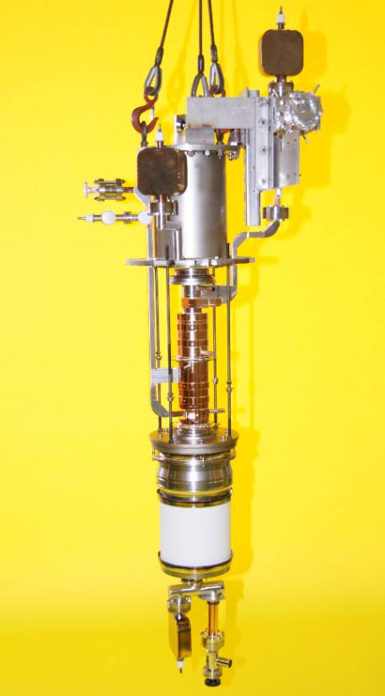
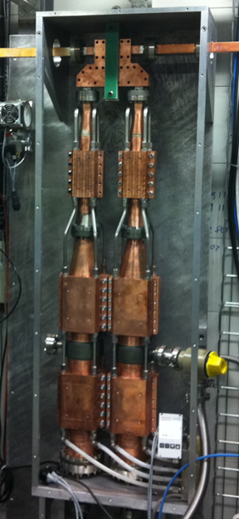
The 12GHz RF source
ScandiNova Modulator:
Designed for 400kV, 300A, 3.25us HV pulse width FWHM, 1.5us RF pulse width at 50Hz repetition rate
XL5 klystron:
50MW, 1.5us rf pulses
50Hz repetition rate at 400kV, 300A, 600W rf drive power
Working frequency 11.99424GHz
SLED II type pulse compressor:
Power gain of 2.82
Q_{loaded} = 2.375x10⁴,
Beta = 4.27,
Q₀ = 1.31x10⁵
5% power loss
Enough power to reach 100 MV/m loaded gradient
(~43 MW)

Slide 18
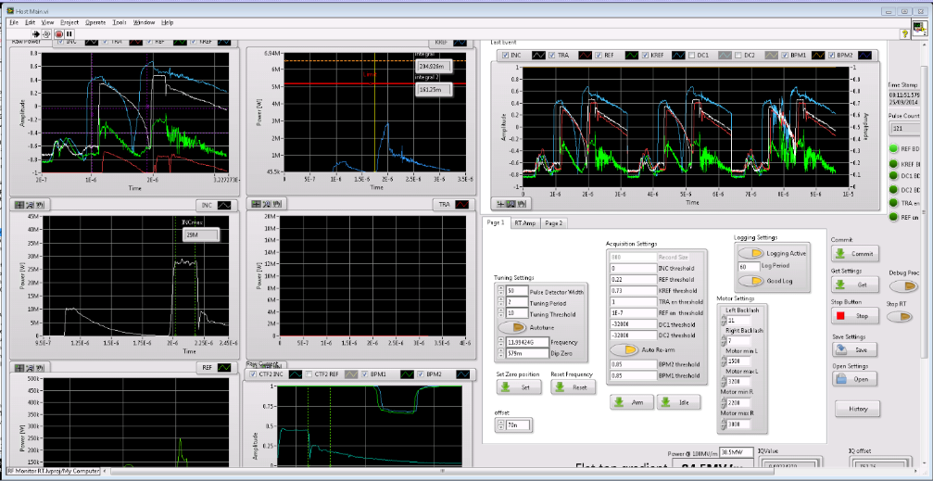
Control and DAQ system
PXI NI unit:
Real time interlocking
Data taking and storage
12 GHz RF control
Labview interface with user

Slide 19
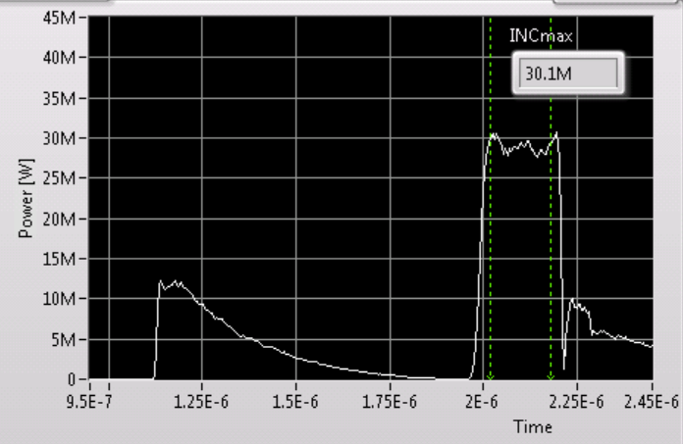
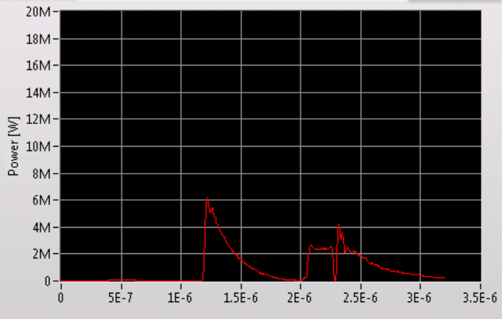
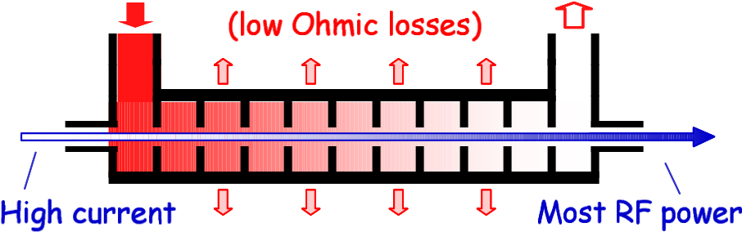
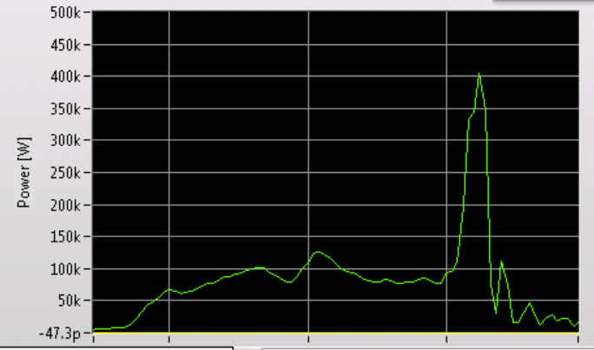
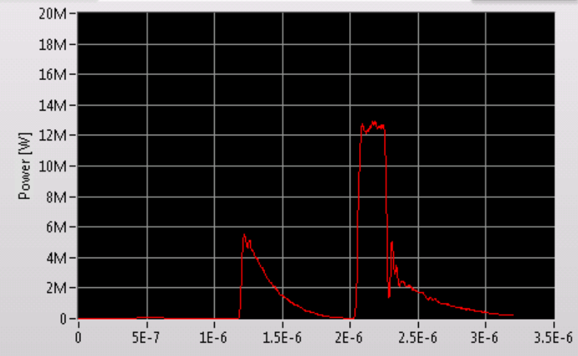
How do we detect breakdowns
Incident Signal
Loaded output signal
(beam presence)
Beam
Unloaded output signal
No beam presence
Reflected Signal

Slide 20
Data selection
Pulse repetition rate from 25 Hz to 50 Hz (a lot of data, needs pre-selection)
ACQ system stores:
1 event per minute
Breakdown-like events (soft criteria ~ 50% events are fake breakdowns)
Real breakdowns needs to be identified from the preselected sample.
Offline analysis selects breakdowns and nominal pulses, computes BDR
Final cuts for BD selection are not completely applied in the following results

Slide 21
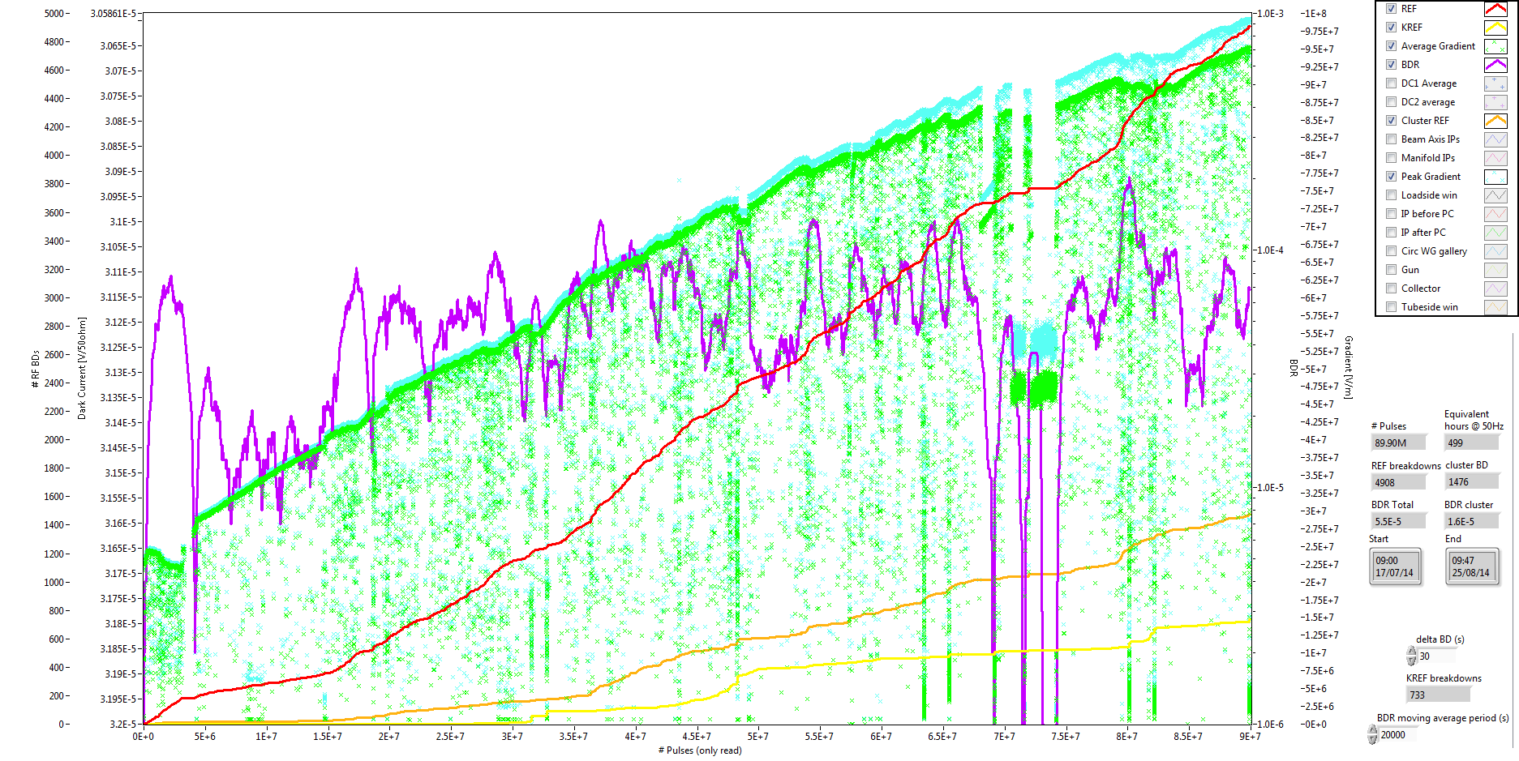
First Results
Conditioning history at 50ns pulse length
Peak Gradient
Avg Gradient
# BD
BD Clusters
BD rate
90 M pulses

Slide 22
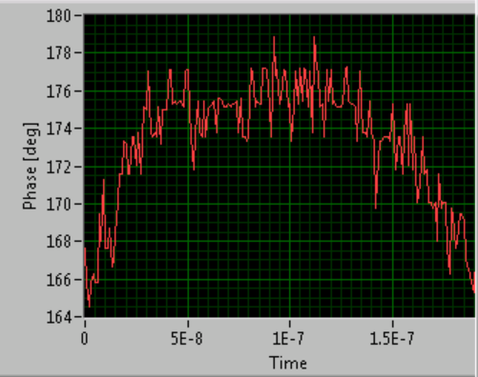
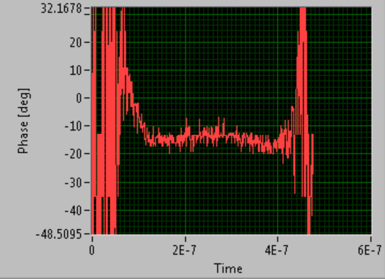
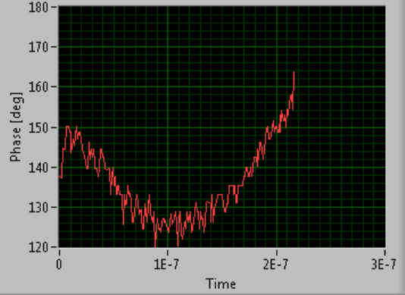
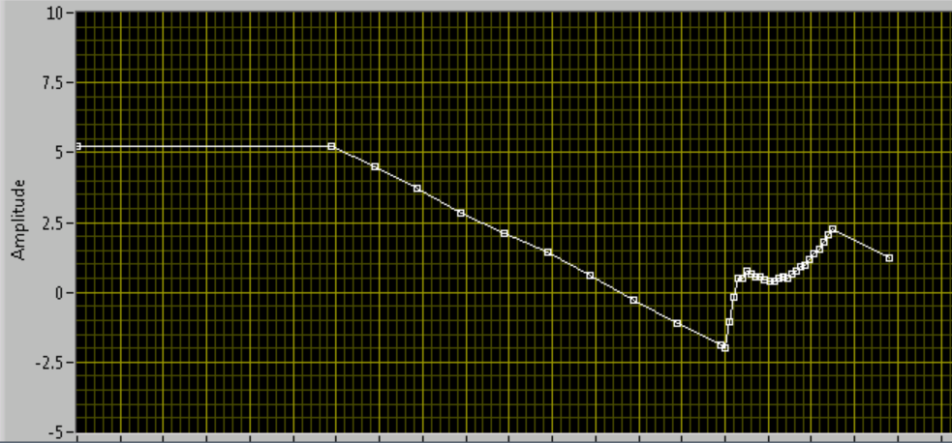
First Results
RF Phase
Beam Phase
A lot of effort was done matching RF and beam phases
Beam + RF Phase
with wrong slope
Phase function programed

Slide 23
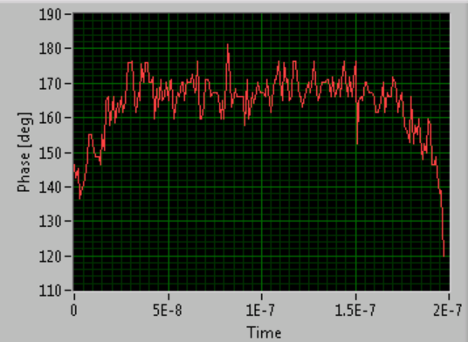
First Results
RF Phase
Beam Phase
Phase variation along the pulse is around 10 degrees
Beam + RF Phase
with correct slope
Phase function programed

Slide 24
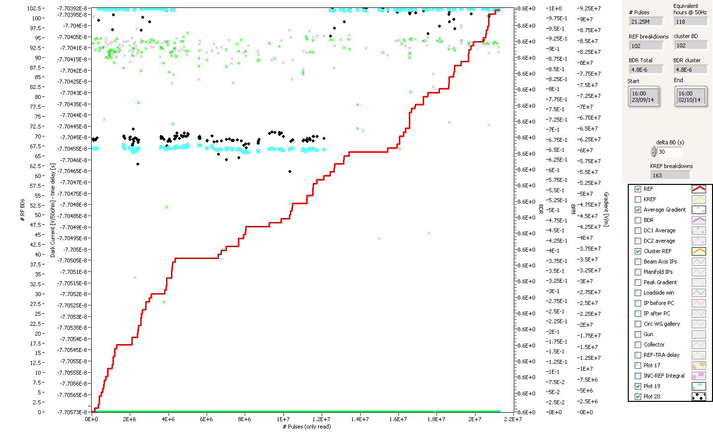
First Results
Breakdown measurements started 23/09/2014.
92
History plot from 23/09 to 02/10
100
No Beam
Beam
No Beam
Accelerating Gradient (MV/m)
41 PreSel
33 BD
5.7 M pulses
Number of BD
38 PreSel
25 BD
2.3 M pulses
23 PreSel
20 BD
4.9 M pulses
Very preliminary results!!!!!!
Time
~ 1 week

Slide 25
First Results
Very preliminary results!!!!!!
Data from 23/09/2014 to 02/10/2014
Gradient, MV/m
Period 1:
BD rate: 1.1 10⁻⁵ ± 0.2
Period 2:
BD rate: 4.0 10⁻⁶ ± 0.9
Period 3:
BD rate: 5.7 10⁻⁶ ± 1
Systematic errors not included!!!
Period 1 and 3
Period 2
Length, m
Preliminary Conclusion: Beam loading does not show an increased breakdown rate at constant input power

Slide 26
Ongoing measurements
Gradient, MV/m
Next measurement at ~85 MV/m loaded
(ongoing during this week)
Length, m
Notes:
The main goal is to measure and compare the DB rate in loaded and unloaded structure. The structure for the test is in our argot a T24: linearly tapered structure, with 24 cells without damping coupling. This experiment has been organized in two phases. We already have finished the first one that is basically all the optics design, and hardware and beam commissioning and we expect to begin with the second one by middle of this year.

Slide 27
Further actions
Main goal: Measure breakdown rate for nominal CLIC parameters.
Gradient, MV/m
Other measurements:
Cell distribution
Loading levels (RF phase)
Current dependencies
Different structures
…
Length, m
Notes:
The main goal is to measure and compare the DB rate in loaded and unloaded structure. The structure for the test is in our argot a T24: linearly tapered structure, with 24 cells without damping coupling. This experiment has been organized in two phases. We already have finished the first one that is basically all the optics design, and hardware and beam commissioning and we expect to begin with the second one by middle of this year.

Slide 28
Summary
Breakdown rate measurements in heavy loaded high gradient structures was a missing block in the high gradient program
CTF3/CLIC collaboration has successfully set up an experiment to measure the effect of beam loading at nominal CLIC gradients
The experiment has started collecting data from end of September
After one week of data preliminary analysis shows that the beam presence does not have a harmful effect on the breakdown rate at constant input power
The experiment will continue collecting data to probe different power and loading levels
More detailed analysis will be done to draw further conclusions
We are ready for new exciting results !!!
Notes:
The main goal is to measure and compare the DB rate in loaded and unloaded structure. The structure for the test is in our argot a T24: linearly tapered structure, with 24 cells without damping coupling. This experiment has been organized in two phases. We already have finished the first one that is basically all the optics design, and hardware and beam commissioning and we expect to begin with the second one by middle of this year.

Slide 29
Aknowledgements
RF/PM
CTF3
XBOX
BI
M. Filippova
A. Grudiev
D. Gudkov
P. Guyard
A. Olyunin
A. Samochkine
I. Syratchev
A. Solodko
P. De Souza
R. Corsini
S. Doebert
D. Gamba
J.L. Navarro
T. Persson
P. Skowronski
F. Tecker
S. Curt
A. Degiovanni
J. Giner
G. McMonagle
S. Rey
J. Tagg
L. Timeo
B. Woolley
M. Kastriotou
E. Nebot
Notes:
This experiment is the result of the collaboration of many people from different sections, thanks to all of them.

Slide 30


J.L. Navarro for the CLIC/CTF3 Collaboration

Slide 31
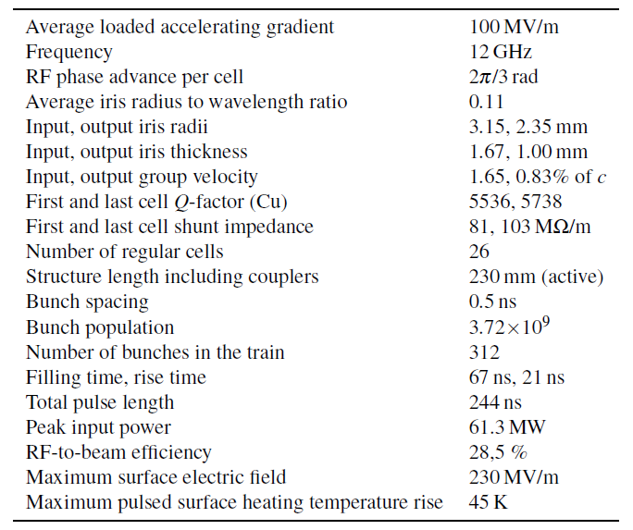
Backup: CLIC Nominal parameters

Slide 32
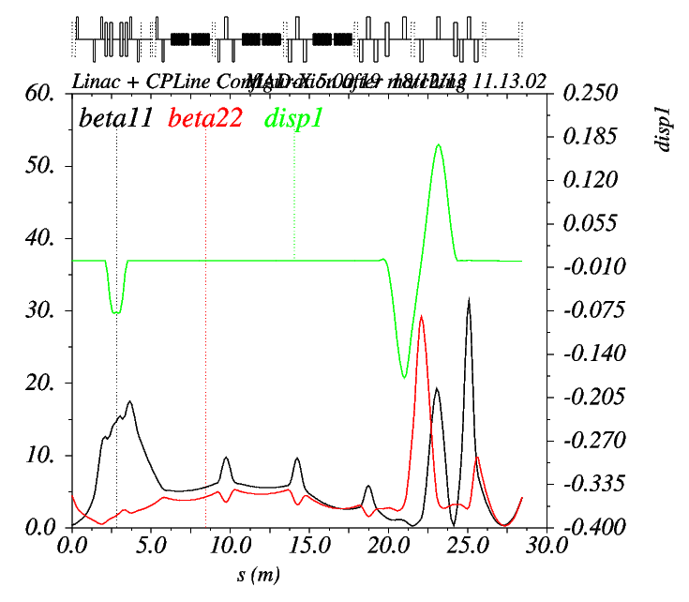
Optics design
Objective: Transport the beam trough the Linac up to the structure requiring…
- Full transmission efficiency
- Minimum beam size on average inside the structure
Structure
Maximize relative distances between aperture and beam size (M. Dayyani). MAD model by F. Tecker.
Beam envelope
Structure
Re-matched optics for last running
Linac+dogleg
Notes:
We need a careful design of the optics to perform this experiment. We need to design the optics in order to have the minimum beam side possible and no dispersion inside the structure to ensure no beam looses inside the structure. The left plot shows the designed optics to keep the minimum beam size in average inside the structure and the right one the measured optics during the last running.

Slide 33
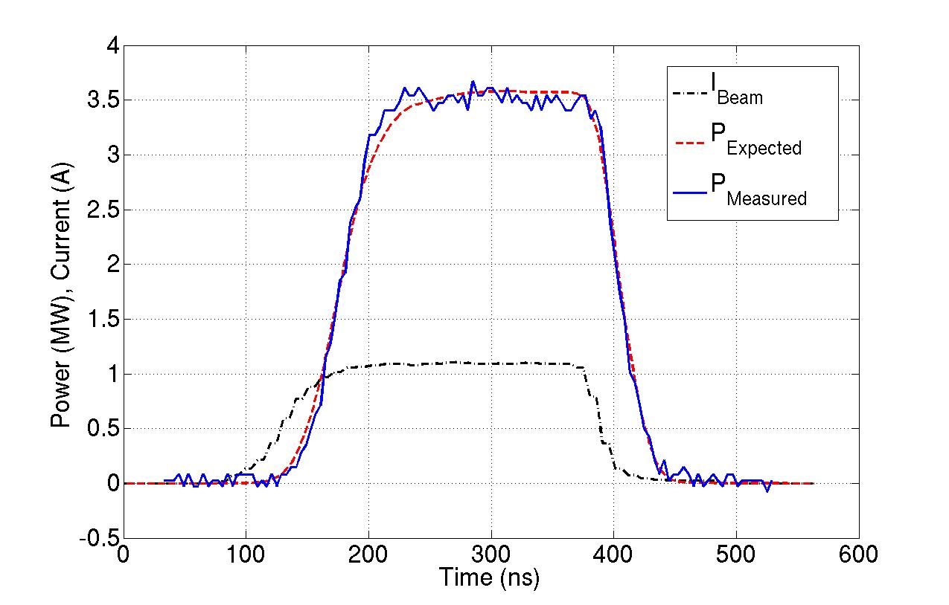
Phase I Results: Running of May 2013
Measured power scaled down by 3dB.
Shape reproduced…
…but error in calibration
Notes:
On the other hand we compared the measured pulse shape with the expected one. Black line shows the current profile crossing the structure and Red line shows the expected produced power when the current cross the structure. The blue line is the measured power scaled down by 3dB. It suggest that we had and error in the calibration that was confirmed with a calibration during the summer shutdown.

Slide 34
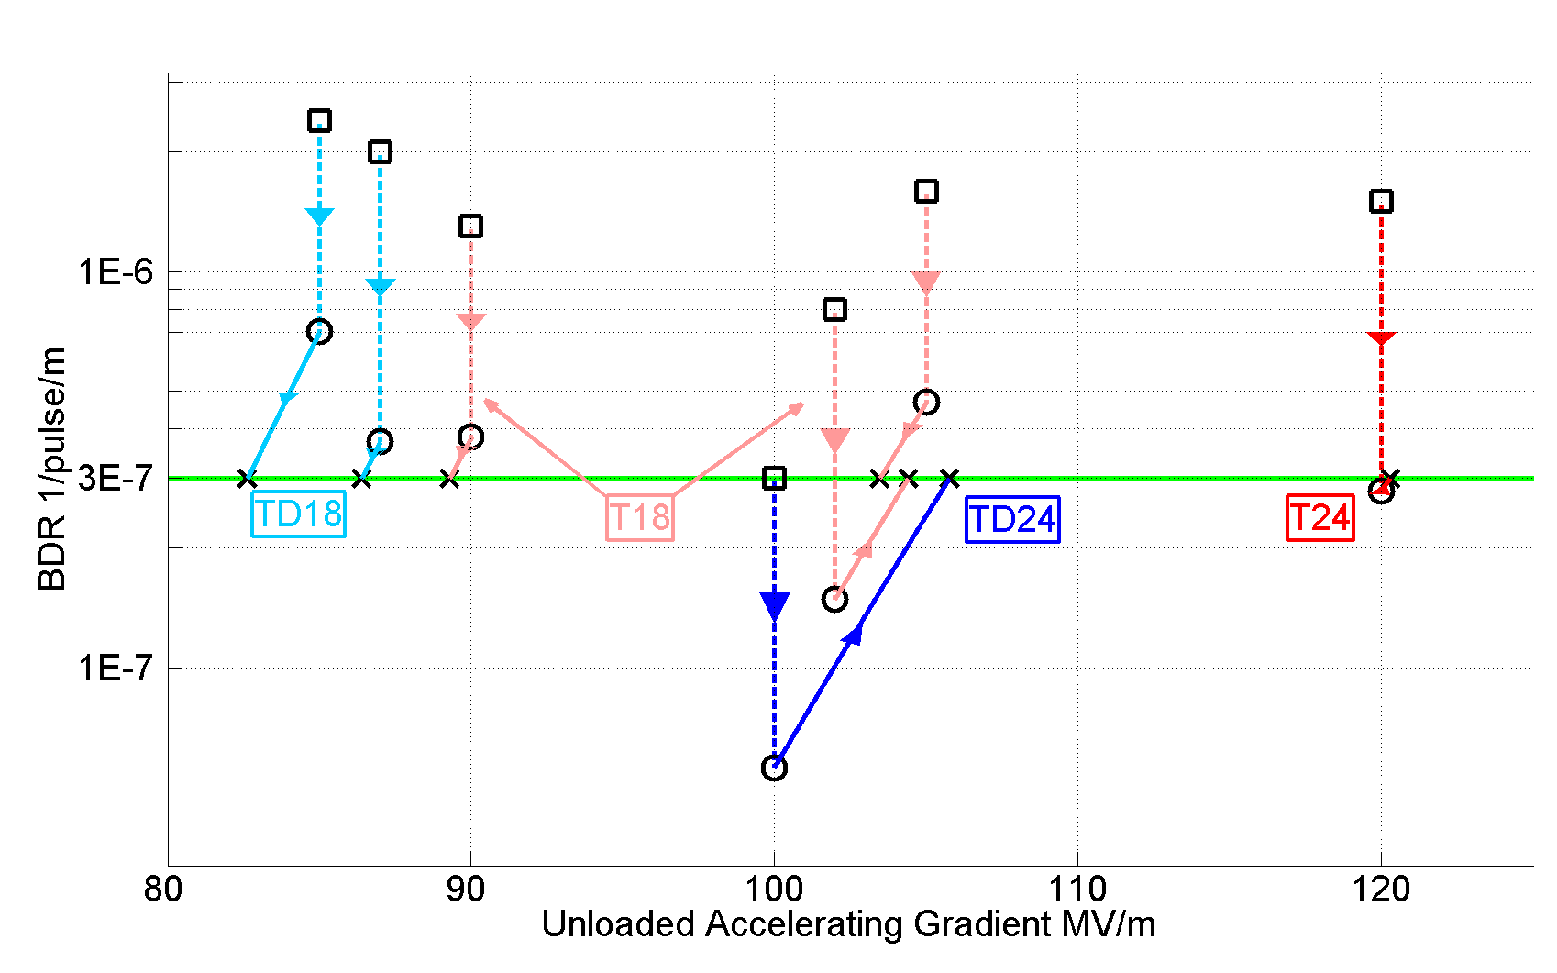
Backup
Accelerating gradients achieved in tests.
Status: 4-9-2012
loaded

Slide 35
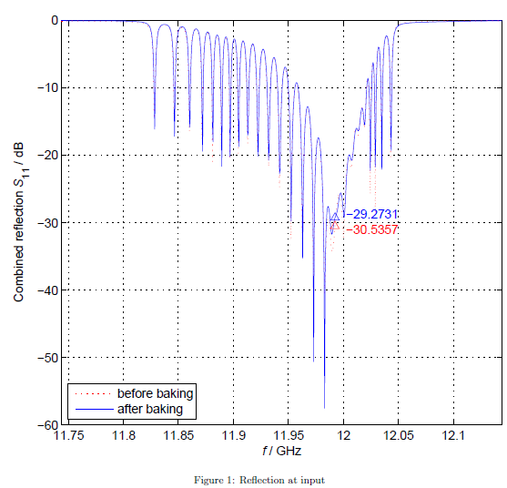
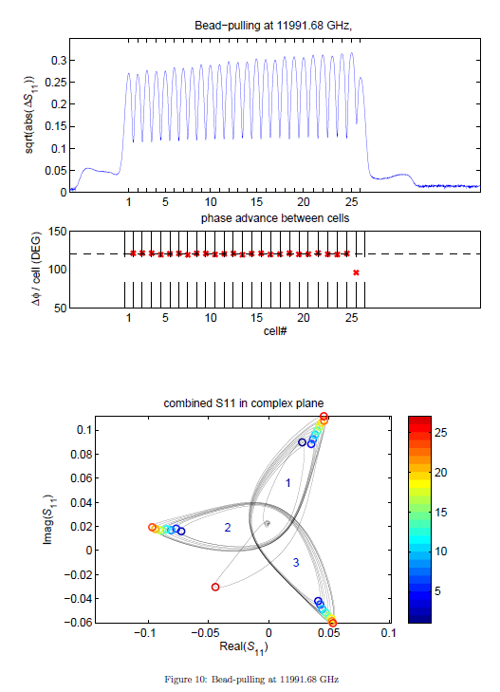

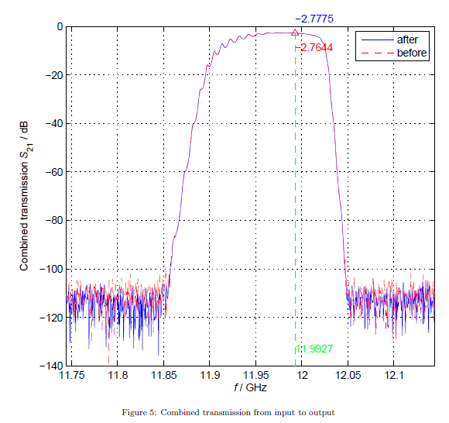
Backup (I. Syrachev. CLIC Workshop 2013)
Structure under test:
CERN’s T24 (12WNDSvg1.8 KEK N1)
No damping

Slide 36
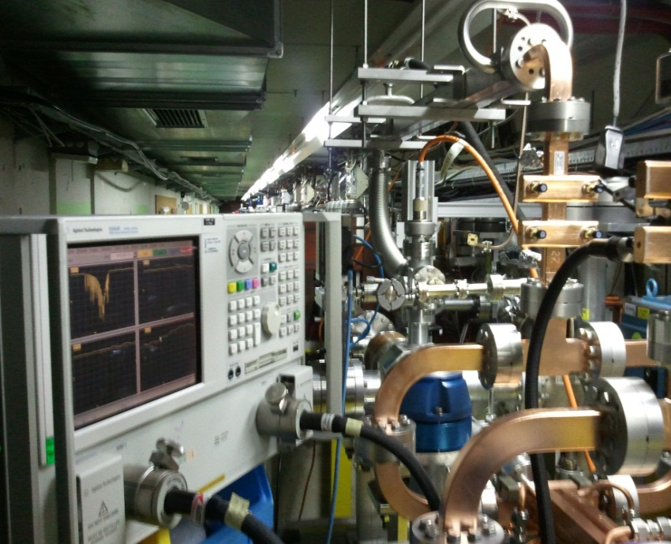
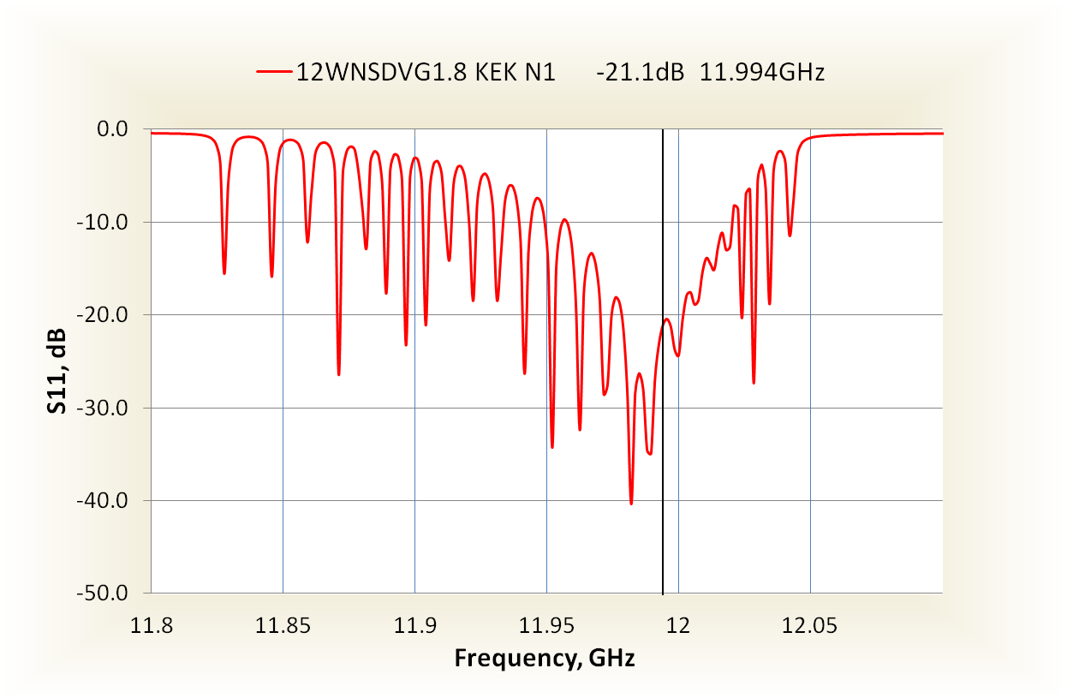
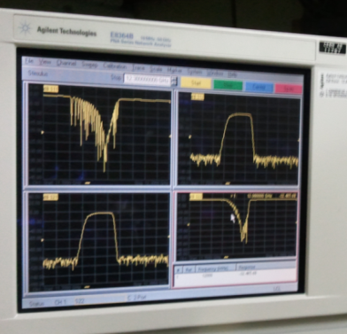
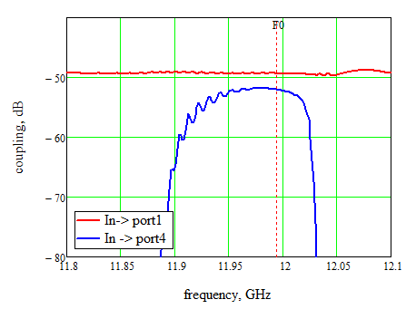
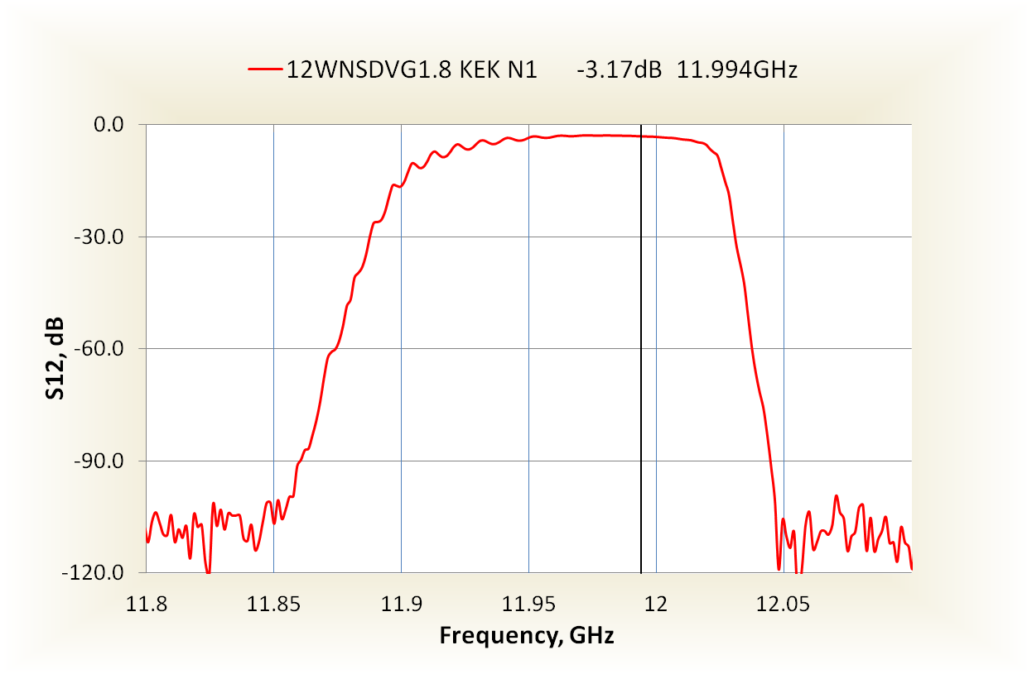
Calibration (I. Syrachev. CLIC Workshop 2013)
-49.32
-52.04
Insertion losses of the input/output waveguide network (splitter and bends) is -0.15 dB (η=0.967)

Slide 37
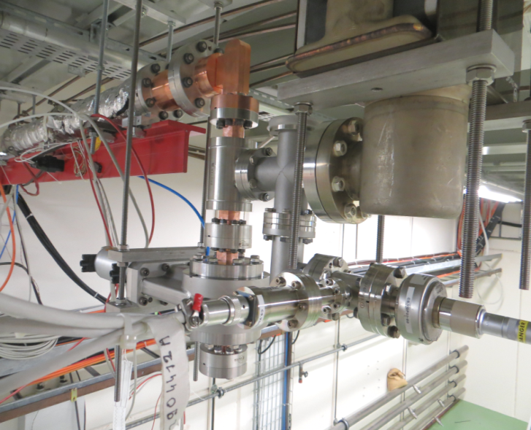
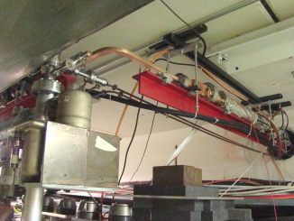
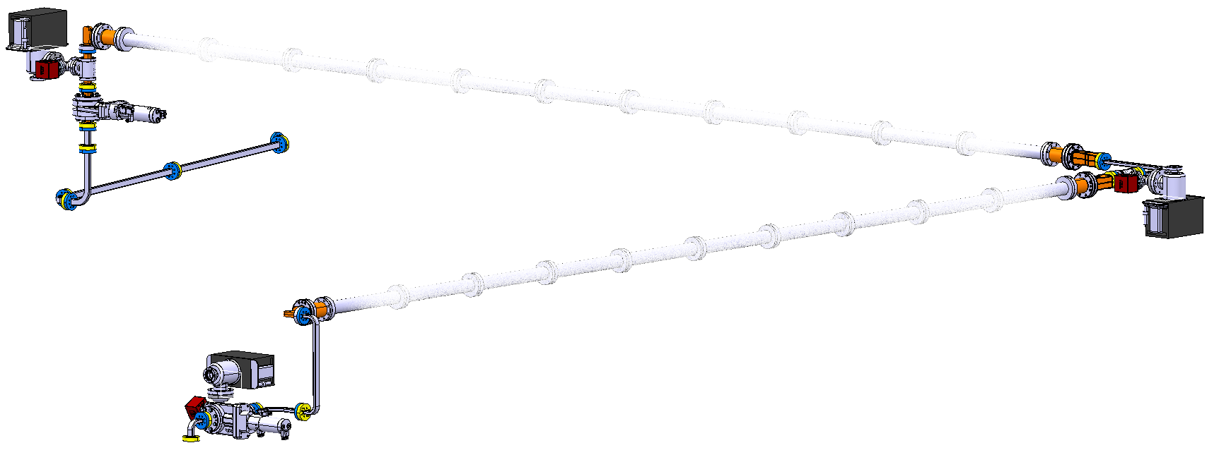
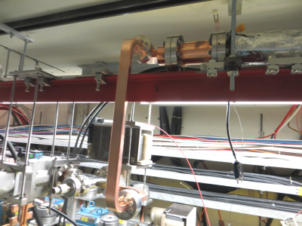
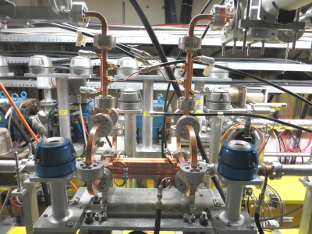
Dog-leg waveguide line installation status.
All the components are installed.
Connected to accelerated structure and closed for vacuum.
Vacuum leaks checked (tight).
Ready to be connected to XBOX1.

Slide 38
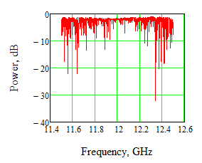
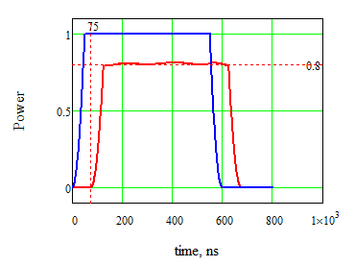
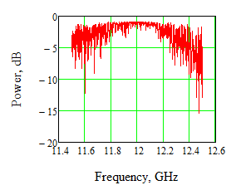
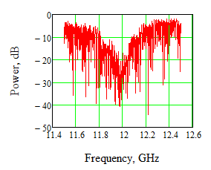
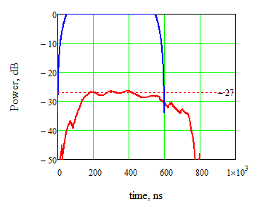
RF power transmission measurements
S11 data
Transmission (simulated)
S21 Reconstructed
(Xiaowei Wu)
Short circuit(+offset)
Reflection
Matched load
The measured RF power transmission efficiency is 80%.
Reflection is below -27dB.
The group delay time is 75 ns (~23.5 m).

Slide 39

Overall power transmission efficiency
0.87
0.8
Xbox1
CTF2
wall
CTF3
The overall measured RF power transmission efficiency is 67%.
The round group delay time is 230 ns (~35 m).
To provide nominal CLIC RF pulse, XBOX1 klystrons needs to deliver 36 MW x 1.5μs

Slide 40

Backup

Slide 41


Backup

Slide 42

Phase I Results: Running of Dec 2013
And from the RF side:
Theoretical model fits within experimental uncertainties
Data from May 2013
P[MW]=2.62 I²
P[MW]=3.17 I²
P[MW]=1.91 I²
Data from Dec 2013
(after DAQ recalibration)

Slide 43
First Results
Breakdown measurements started 23/09/2014.
History plot from 23/09 to 02/10
65 BD
1.9 M pulses
72 BD
5.7 M pulses
102 BD
4.9 M pulses
Very preliminary results!!!!!!

Slide 44
First Results
Very preliminary results!!!!!!
Data from 23/09/2014 to 02/10/2014
Gradient, MV/m
Period 1:
BD rate: 3.4 10⁻⁵ ± 0.4
Period 2:
BD rate: 2.0 10⁻⁵ ± 0.2
Period 3:
BD rate: 1.2 10⁻⁵ ± 0.1
Systematic errors not included!!!
Period 1 and 3
Period 2
Length, m
Preliminary Conclusion: Beam loading does not show an increased breakdown rate at constant input power

