Slide 1
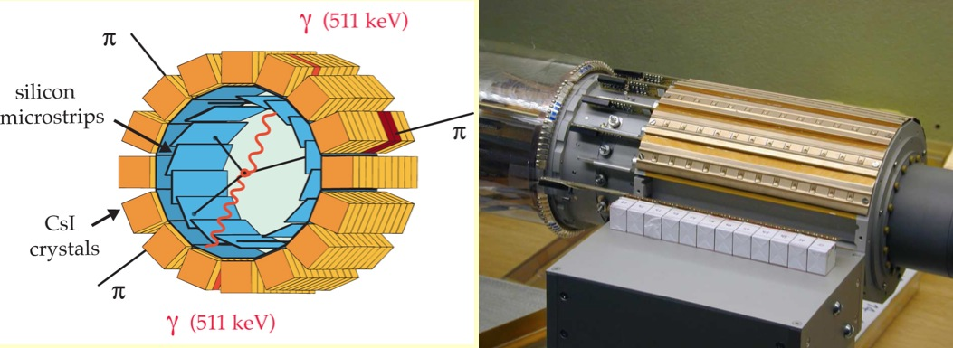
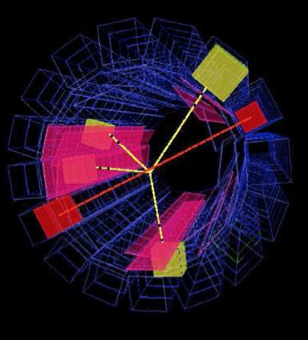
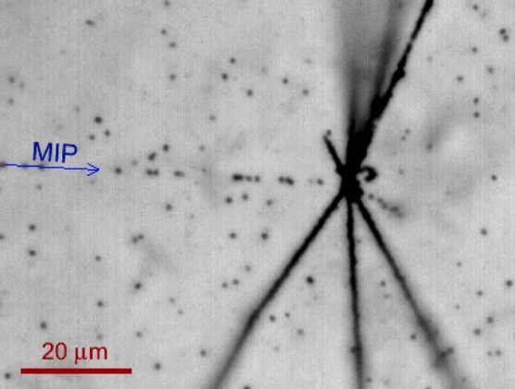
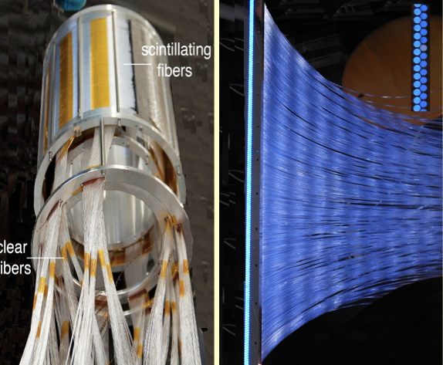
Antihydrogen: ATHENA & AEgIS
Antiproton Decelerator
2002 & since 2008
Antiproton Phiysics at the Antiproton Decelerator
Antihydrogen Production with ATHENA (2002)
M. Amoretti et al, Nature 419 (2002) 456
The ATHENA experiment at the CERN antiproton decelerator produced for the first time cold antihydrogen atoms in large quantities in a nested penning trap by overlapping antiproton and positron clouds. Once formed, antihydrogen is electrically neutral. Not confined anymore, it annihilates on the walls of the trap. The antihydrogen detector measured the annihilation vertex of the pions and detected the two 511 keV from electron-positron annihilation. The angle between the two photons (180 degrees) was measured by using the annihilation vertex.
Sketch of the ATHENA antihydrogen detector (left). Photograph with one row of CsI crystals prior to installation (middle). Electronic reconstruction of an antihydrogen annihilation on the trap wall (right). The yellow lines show the tracks from three charged pions, the red lines the directions of the two 511 keV annihilation photons which are emitted in opposite directions.
Gravitational acceleration of antihydrogen (AEgIS), since 2008
S. Aghion et al., J. of Instrumentation 8 (2013) P08013
J. Storey et al., Nuclear Instruments and Methods in Physics Research A 732 (2013) 437
Nuclear emulsions can measure the annihilation vertex of antihydrogen atoms with a precision of 1 micron. A substantial reduction of the data taking time needed to measure the gravitational sag of an antihydrogen beam can be achieved when combined with a time of flight measurement.
Antiproton annihilation into nuclear fragments and pions (MIP), observed at AEgIS (left). The scintillating fiber detector (right) detects the pions which are emitted when antiprotons annihilate on the surface of the vacuum vessel. The detector is used to measure antihydrogen production (right).

