Slide 1
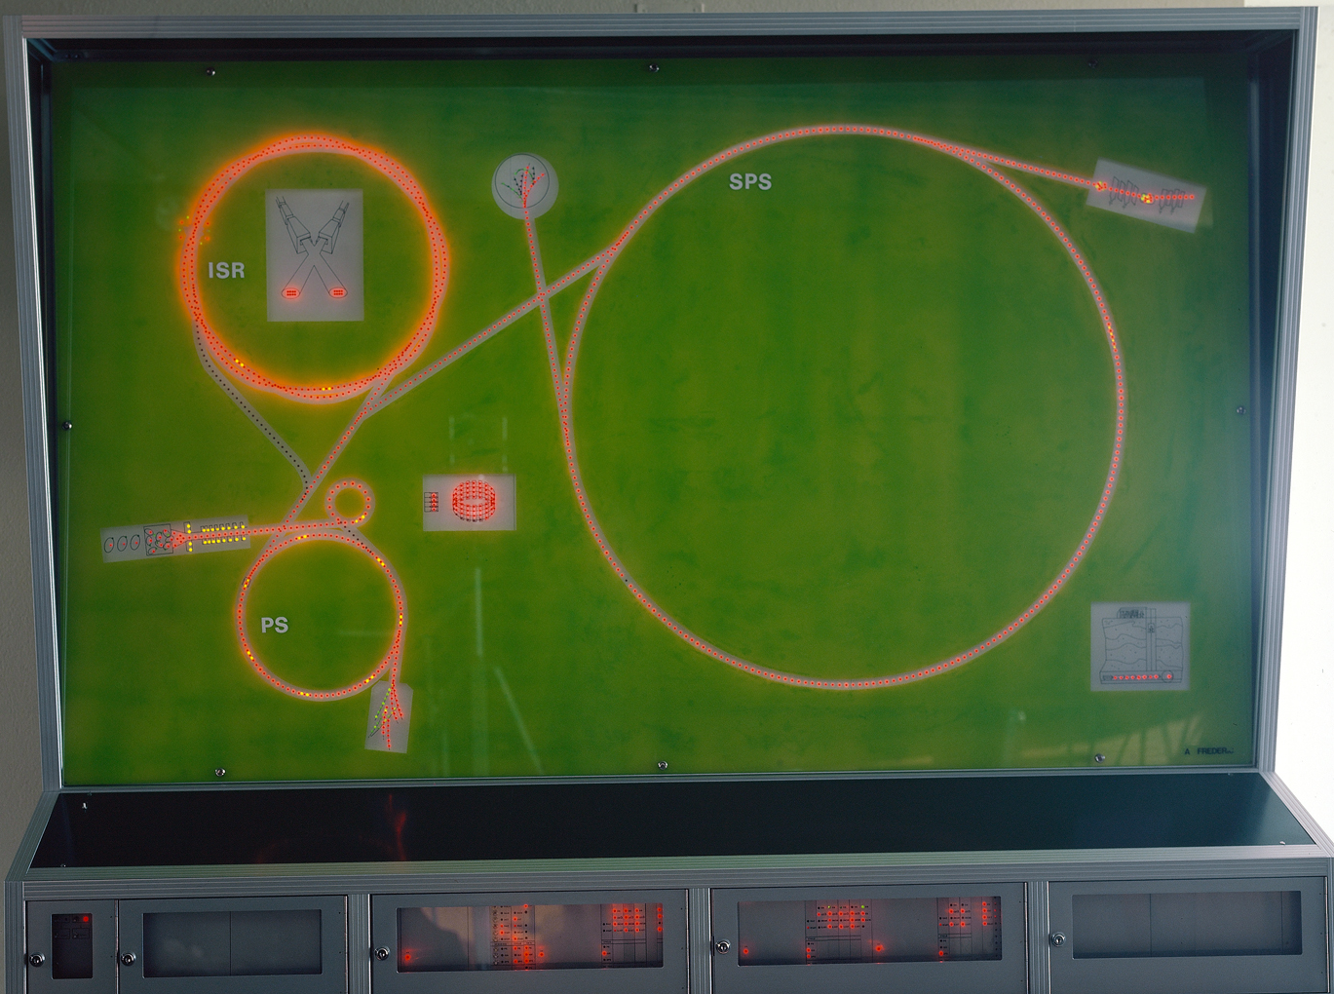
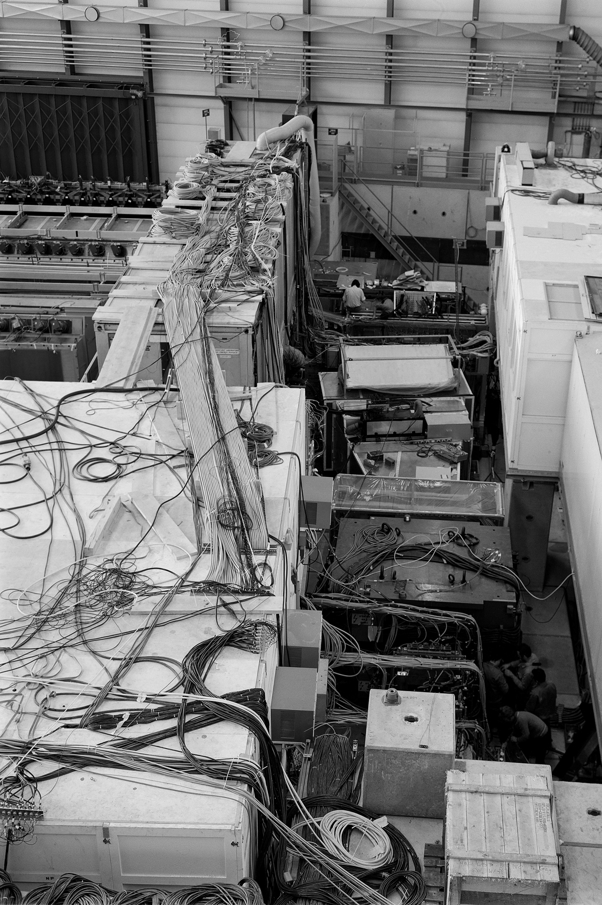
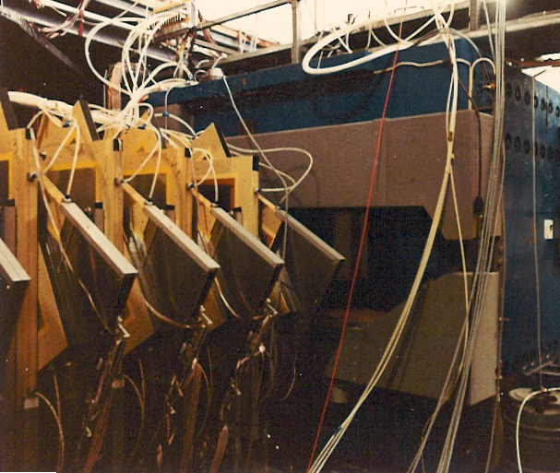
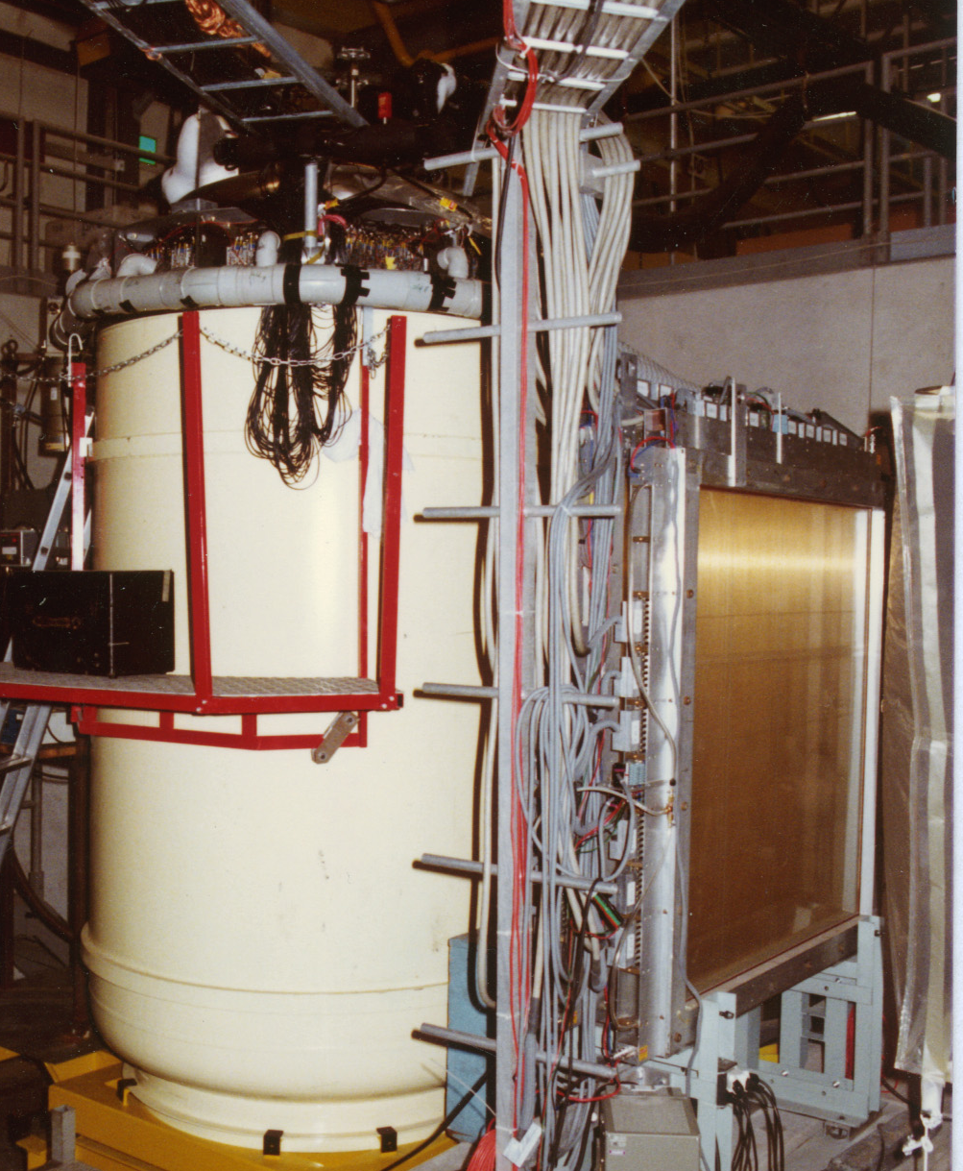
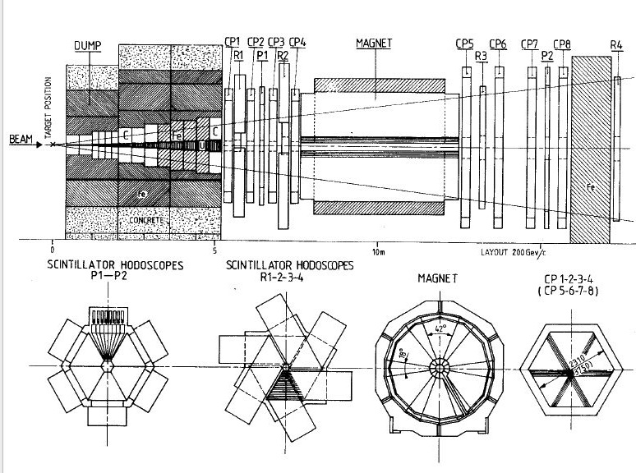
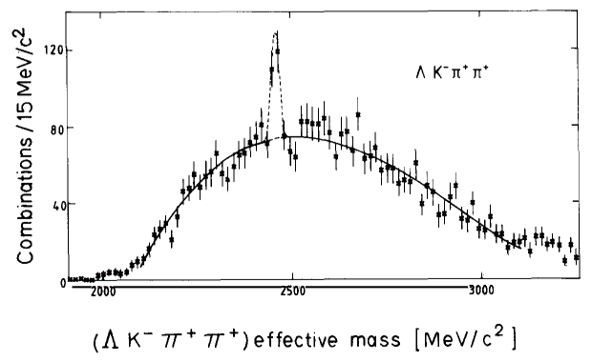
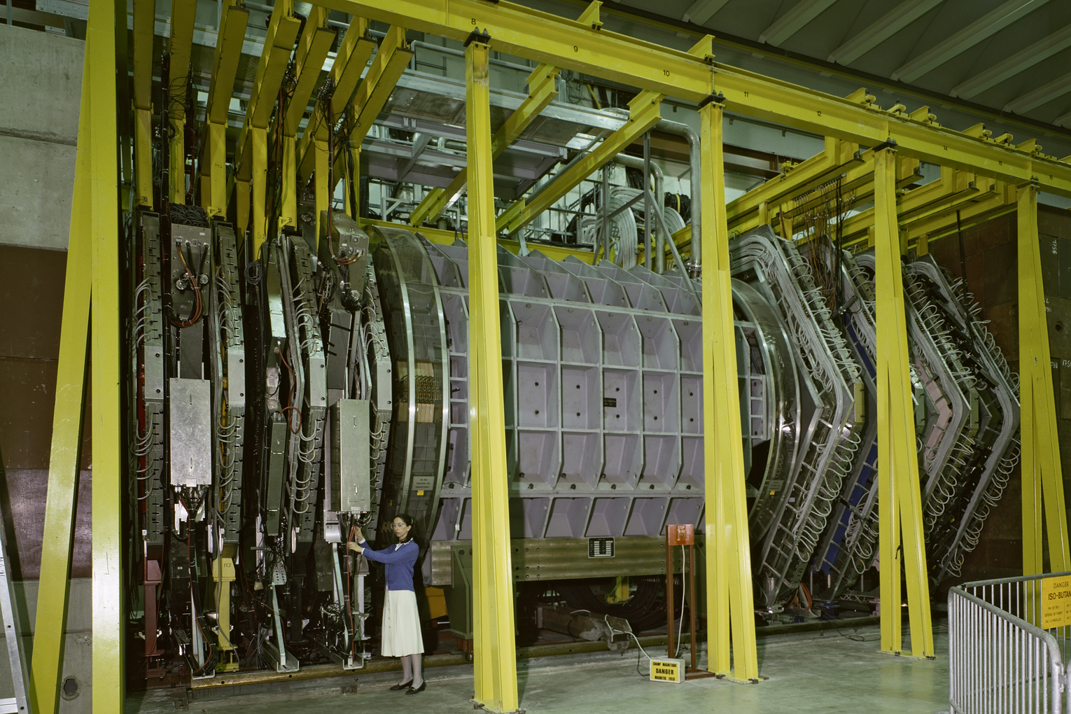


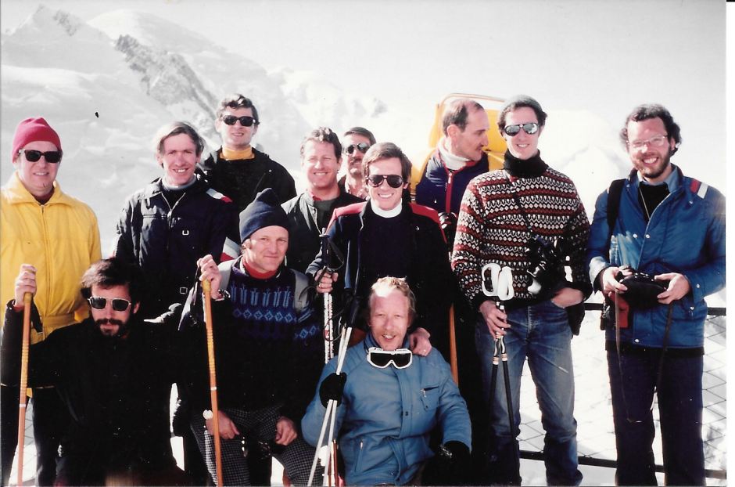
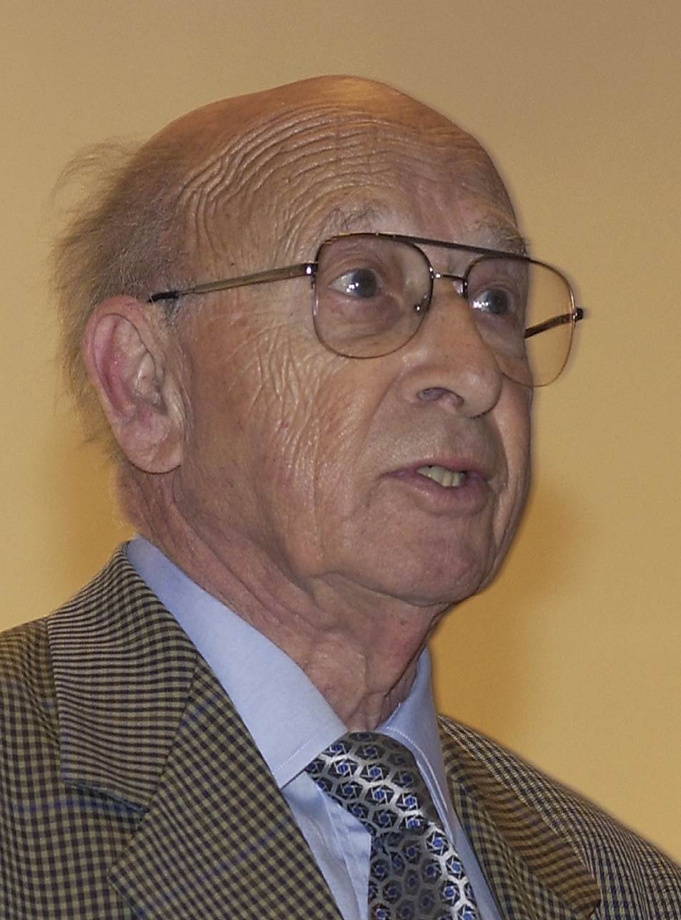
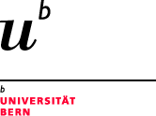

Hyperon experiments
Drell-Yan experiment
Fixed Target Programme @ SPS
1976–1985
SPS – Super proton Synchrotron
The 400 GeV proton beam of the 7km-circumference SPS, commissioned in 1976, was extracted and used to produce secondary beams for fixed-target experiments located in the “West area” (WA) and “North Area” (NA). Swiss groups were involved in several WA experiments operating with charged hyperon beams between 1976 and 1982, as well as NA experiments operating with intense pion beams between 1980 and 1985.
Starting in 1981, the SPS was also operated in proton-antiproton collider mode for experiments in the “Underground Area” (UA), leading to the discovery of the W and Z bosons in 1983 by the UA1 and UA2 experiments. Swiss groups were involved in UA2 and UA6 (see separate poster).
ISR
WA
NA
CERN-PHOTO
7802653X
February 1978
Maquette of the
CERN accelerator
complex displayed
at CERN’s main
entrance
SPS
PS
WA2, WA46
WA42, WA62
NA10 (DRELL-YAN)
Leptonic decays of hyperons
Study of the Ω– properties
Bristol-Genève-Heidelberg-Orsay-Rutherford Lab-Strasbourg
Strong interactions of charged hyperons Search for charmed strange baryons
Bristol-Cambridge-Genève-Heidelberg-Lausanne-Queen Mary College-Rutherford lab
High resolution study of inclusive production of high-mass muon pairs
by intense pion beams
CERN-Naples-Palaiseau-Strasbourg-Zürich
Liquid argon calorimeter
built by Swiss groups
WA2 experiment
CERN-PHOTO-7702209
February 1977
Multi-wire proportional chambers
First observation of a charmed strange baryon, produced in Σ––Be interactions [Phys. Lett. B 122 (1983) 455]
Maurice Bourquin (1941–)
Professor at UniGE since 1983
President of CERN Council (2001–2003)
NA18
Valentine Louis Telegdi (1922–2006)
Professor at ETHZ since 1976
Initiator of the NA10 experiment
Chair of CERN scientific policy committee (1981–1983)
Search for short-lived particles
produced on nuclei
with a heavy liquid mini bubble chamber
Bern-Münich
WA2 team at the Vallée Blanche (~1978)

