Slide 1
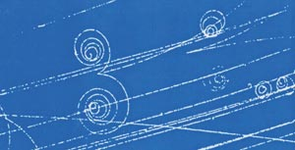
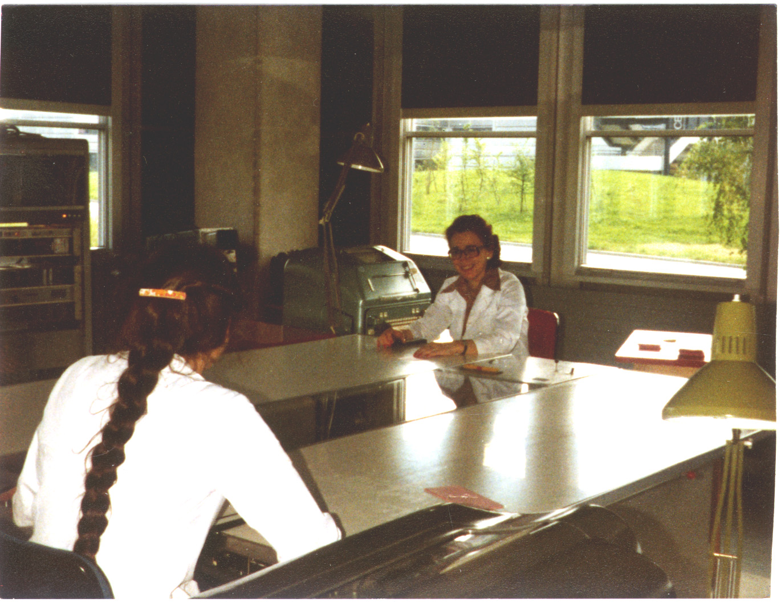
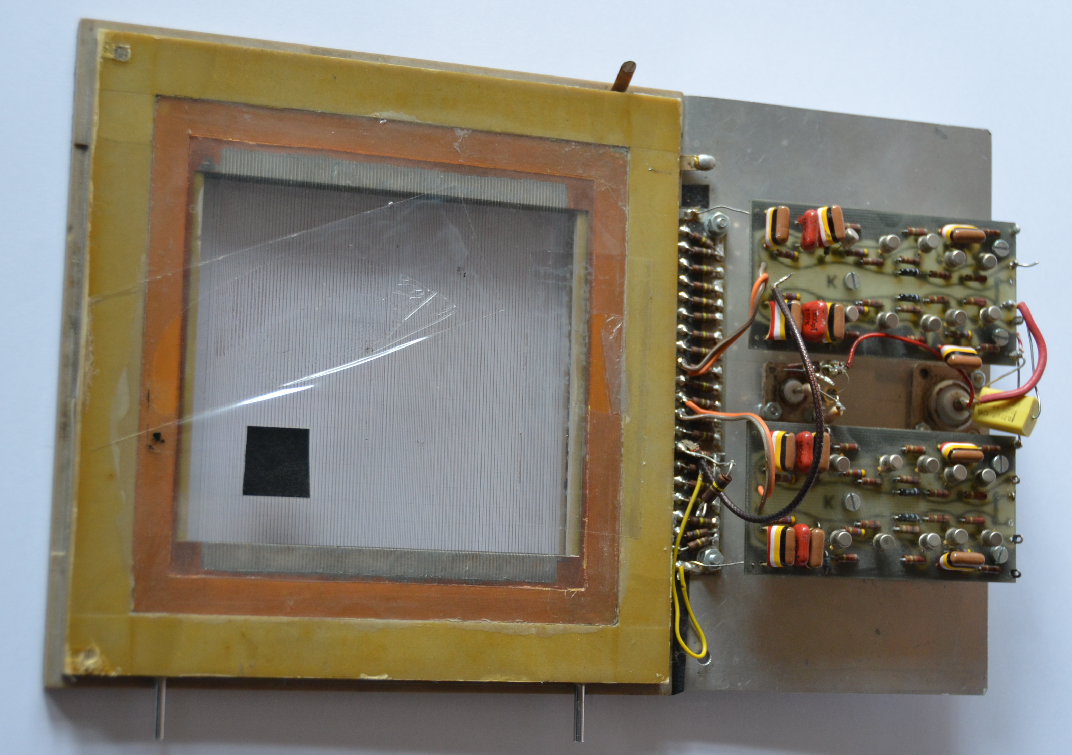
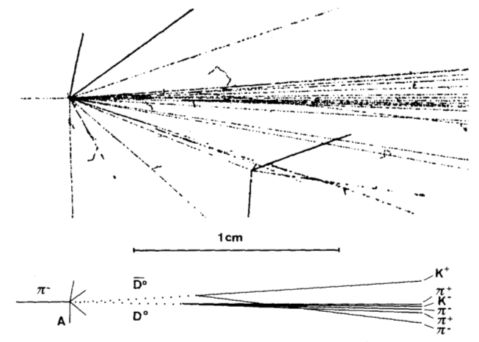
From Bubble Chambers to Wire Chambers
Early Detectors
1960-1980
During the 1950s and 1960s the experimental particle physics made the transition to compact transistorized electronics for detector readout, allowing the increase of speed and number of channels. Today, a LHC experiment acquires the information from millions of channels each 25 ns (the interval between two LHC proton bunch crossings). Billions of events are recorded, instead of O(100k) events for a typical bubble chamber experiment.
Bubble Chambers
MultiWire Proportional Chambers
(invented by D.A. Glaser in 1952, Nobel 1960) give the most esthetic representation of the behavior of particles. The ~100 bubbles per cm left by charged particles are recorded by optical cameras on films.
In 1968 G. Charpak (Nobel 1992) presents his new detector concept: the charged particle (T) ionizes the gas in the region between cathode planes (P). The signal is collected on
tiny anode wires (W) and
sent to amplifiers (A) and
pulse shapers.
Here is a prototype built in Lausanne in 1969 for Charpak. Was tested in the context of the SC19 experiment at CERN (1968-1973 capture π⁻on p: tests of isospin structure of e.m. current, T symmetry in e.m. interaction, charge independence of strong interactions).
Tracks in a bubble chamber showing a particle-antiparticle vertex
The images are projected by precision optics on tables and “digitized” by visual inspection and semi-automatically recorded on data cards or (paper) tape.
In the picture, the two ladies at the Lausanne University are inspecting the images obtained with the 2m CERN bubble chamber: experiments T173 and T210 at PS (1969-1980 measurement of hyperon production in pbar-p and pbar-n collisions at 4-5 GeV).
Specialized versions of bubble chambers have been used for their excellent vertex resolution. Here is an event recorded with the Bern Infinitesimal Bubble Chamber (BIBC) (NA18, 1979-1989, study of charmed particles) showing two D⁰ decays.
The chamber has 20 channels, but only the 4 central wires are read out on this prototype.
In general two MWPC with orthogonal views are used to provide the (X,Y) position.
The signals can be electronically digitized and transferred to recording machines.
The 6.5 cm
BIBC of Bern
University

