Slide 1
ECFA ACTIVITIES
CHIPP Plenary meeting
Fribourg, 30 June – 2 July, 2014
Lenny Rivkin, EPFL & PSI

Slide 2

ECFA 1st High Luminosity
LHC Experiments Workshop
Physics and Technologies
Challenges
2nd workshop planned for 21-23 October, 2014
(again) in Aix-Les-Bain, France

Slide 3
ECFA mandate includes
“Monitoring of the ongoing implementation of the European Strategy for Particle Physics”
Discussion on future (post-LHC) accelerators:
  ILC and CLIC: continuous support through the ECFA LC study
  FCC (Future Circular Collider):
  RECFA strongly supports the proposed design study!
  ECFA represented in steering committee
Goal: Have studies available at the time of the next European Strategy Update in sufficient details on physics case, technological feasibility and with stable cost estimates.

Slide 4
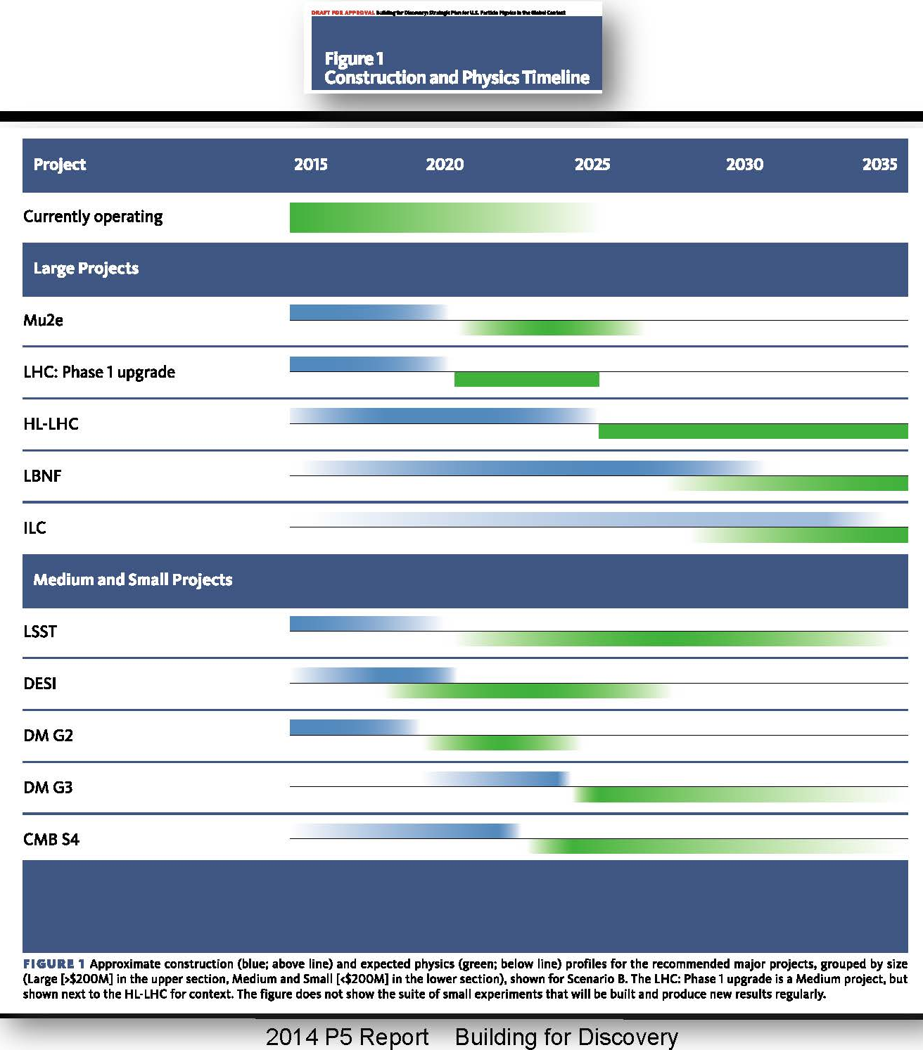
P5 recommendations
LHC
LBNF
ILC in Japan
(beyond scope)

Slide 5

ILC in Japan’s Master Plan of Large Research Projects
(HEP related, all category A)
Exploring Physics beyond Today's Particle Theory with a Super Bfactory (Operation 2013 – 2020)
Revealing the Origin of Matter with an
Upgraded J-PARC (2015 - 2019)
World Research Center for the ILC
International Linear Collider (2025 – 2034)
Nucleon Decay and Neutrino Oscillation Experiments with Large Advanced Detectors (Hyper-Kamiokande, operation 2021- 2035)

Slide 6
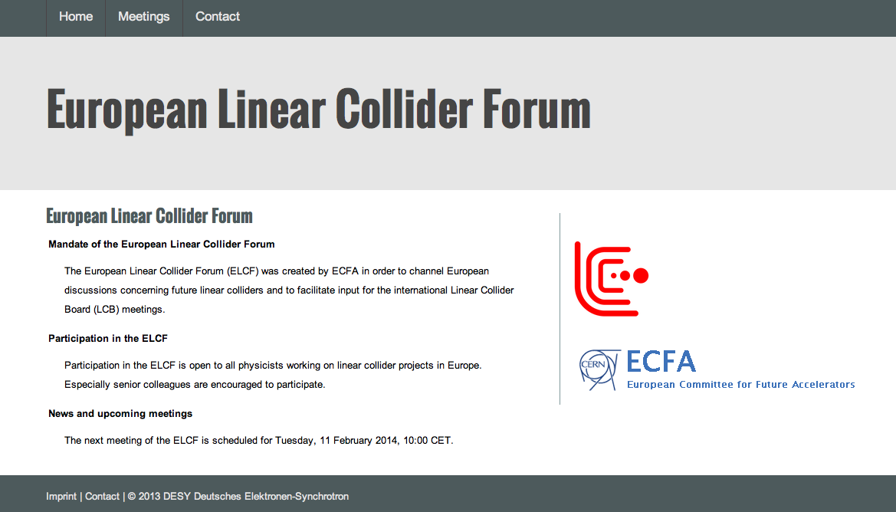
European LC Forum
Launch of a bi-directional information channel between the European members of LCB and the European linear collider community.
Web site (for information and subscription): http://elcf.desy.de
Coordinated by J. Mnich
Technical support by
Thomas Schörner-Sadenius
Next meetings before and
after LCB in Valencia on July 6

Slide 7
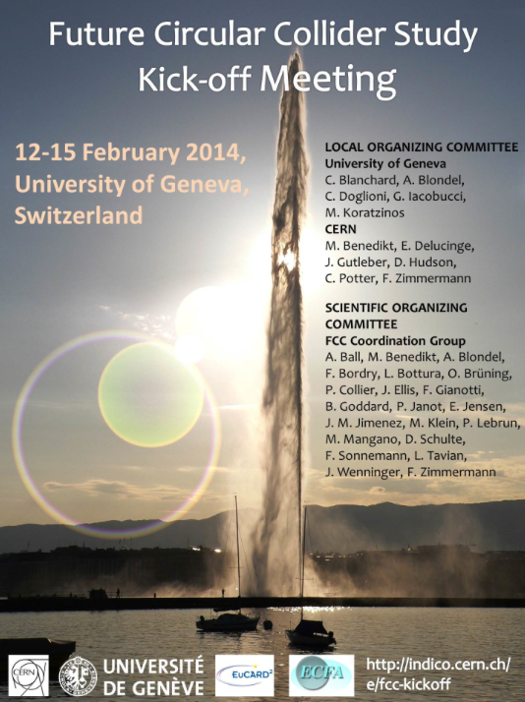

Future Circular Collider Study (FCC)
Launch of a conceptual design study for Future Circular Collider
(under the auspices of ECFA)
Kick-off meeting 12-15 February 2014,
University of Geneva
http://indico.cern.ch/event/282344/
330 registered participants

Slide 8
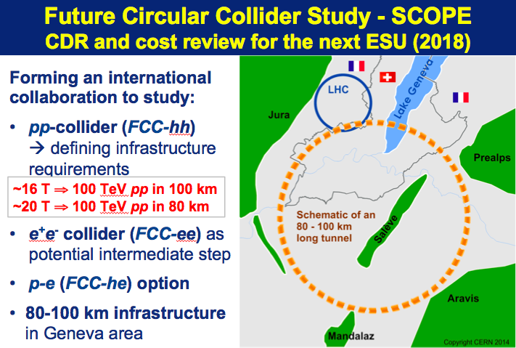
Slides from M. Benedikt (Study coordinator together with F. Zimmermann)

Slide 9
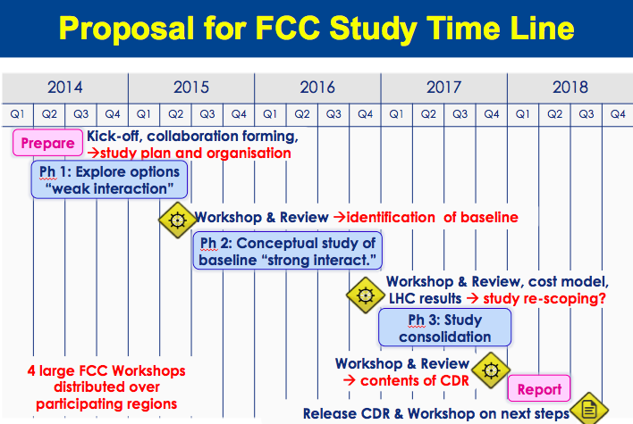
Slides from M. Benedikt

Slide 10
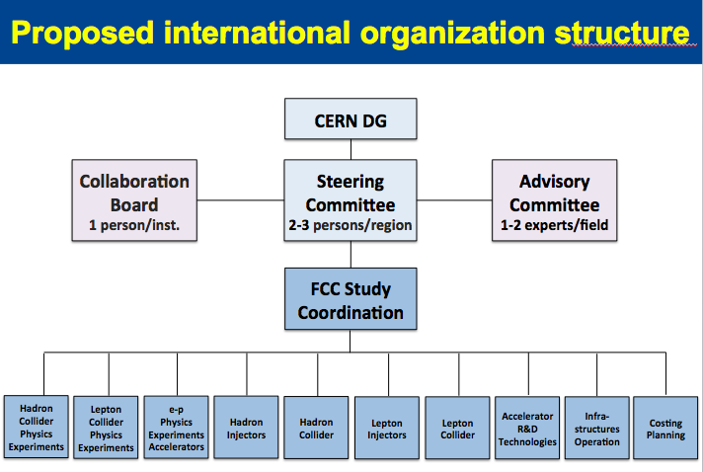
Slides from M. Benedikt
ECFA representative

Slide 11

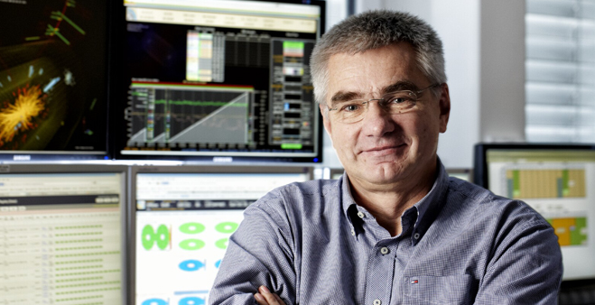
News from ICFA
Organization of the 11th ICFA seminar at IHEP, Beijing, on 27-30 October 2014, http://icfa2014.ihep.ac.cn
Appointment of the next ICFA chair person
(rotation scheme brings the
ICFA chair back to Europe):
Joachim Mnich (DESY)

Slide 12
News from ICFA
ICFA meeting February 21 at DESY (preceded by an Linear Collider Board meeting)
Reports from FALC, ILC, Global HEP Planning, ICFA Panels,…
Following the LCB meeting and the discussion in ICFA, the following statement was issued:
The International Committee for Future Accelerators (ICFA) is pleased to note the great progress of the global community’s efforts to realize a linear collider built in Japan. ICFA, which includes the Directors of the world’s major accelerator laboratories, will evaluate the technical capabilities worldwide to build the ILC.
Global HEP Planning (100 TeV pp collider)
Discussion on the two proposed studies launched by CERN and China (see later)
  ICFA agreed on the following statement:
ICFA supports studies of energy frontier circular colliders and encourages global coordination.

Slide 13
Chinese Plans
Remarkable presentation and comments by Yifang Wang (IHEP, Beijing)
at the FCC Kickoff Meeting and at the ICFA Meeting.
Plans (by the scientific community):
e⁺e⁻ circular collider Higgs-factory followed by a pp collider using the same tunnel
Reconfirm Chinese intention to participate in the ILC in Japan as a major partner

Slide 14
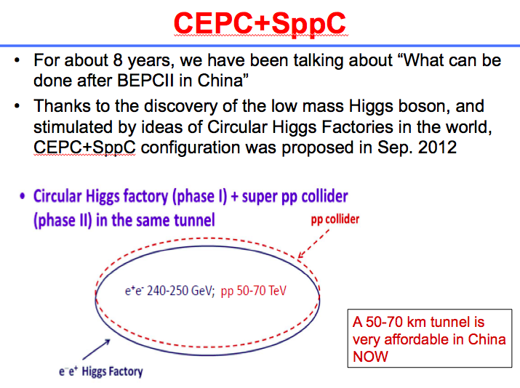
Slides from Yifang Wang (IHEP, Beijing):

Slide 15
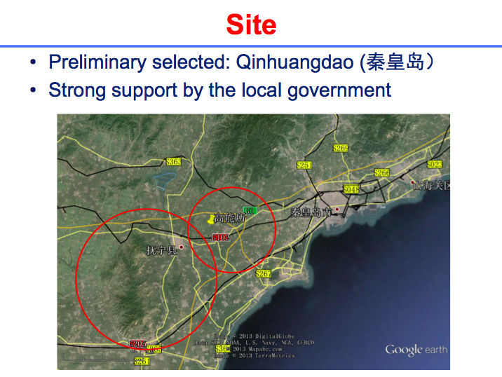
Slides from Yifang Wang (IHEP, Beijing):

Slide 16
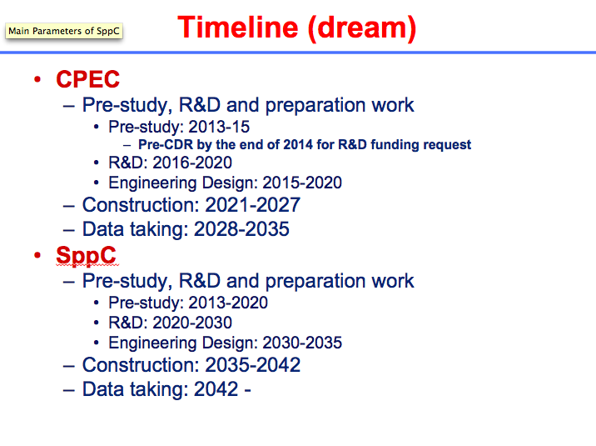
Slides from Yifang Wang (IHEP, Beijing):

Slide 17
EPS-HEPP Board
Statement by the EPS-HEPP Board: Why fund basic science?
http://eps-hepp.web.cern.ch/eps-hepp/Initiatives/
PositionStatementBasicResearch.pdf
EPS-HEPP Board already very busy to prepare EPS2015
(July 22-29, 2015 in Vienna)
Again joint ECFA - EPS-HEPP session will be held
(suggestions for good themes?)

Slide 18

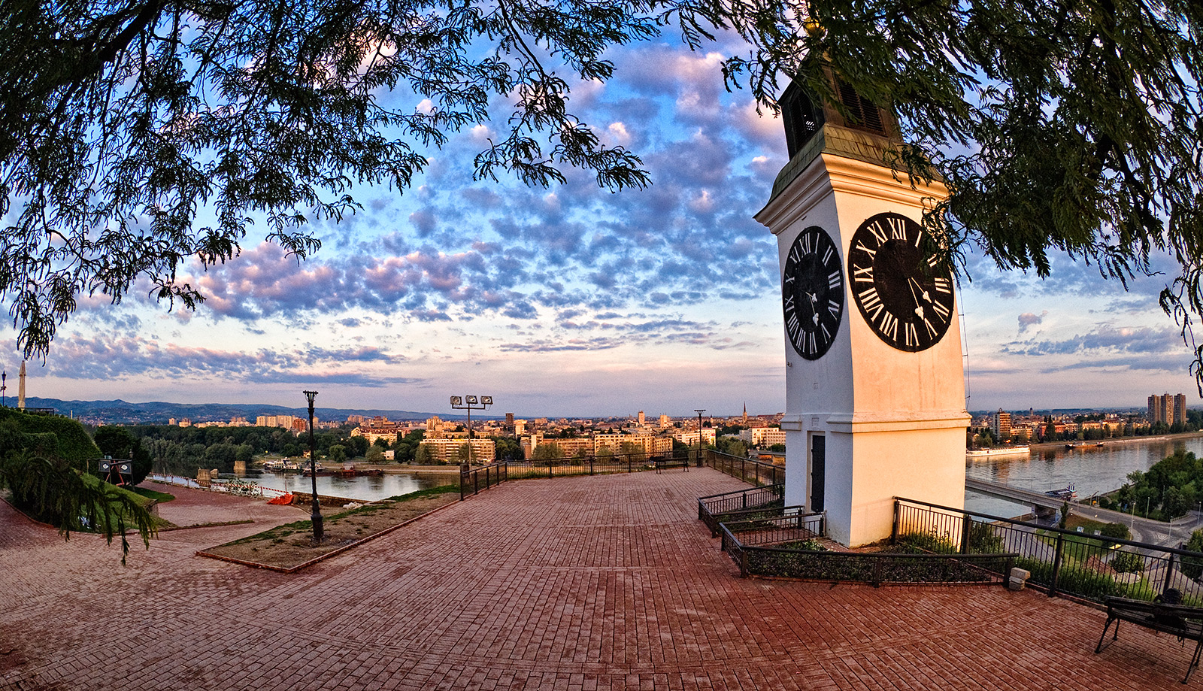
ECFA-ICFA Instrumentation
School in Serbia
September 8-13, 2014
University of Novi Sad http://cern-danube-school.uns.ac.rs/

Slide 19
Restricted ECFA meetings
Stockholm, 20 July 2013
Budapest, 5 October 2013
CERN, 21 November, 2013
Jerusalem, 11 April, 2014 (CERN 21st member)
Bonn, 9 May, 2014
DESY, 24 July, 2014

Slide 20
Plenary ECFA meetings
  Stockholm, 20 July 2013, EPS-HEP
  CERN, 21/22 November 2013
  Member countries midterm reports:
    Switzerland (Olaf Steinkamp)
    Bulgaria and Norway
  DESY, 24/25 July 2014
    Belgium and Finland

