Slide 1



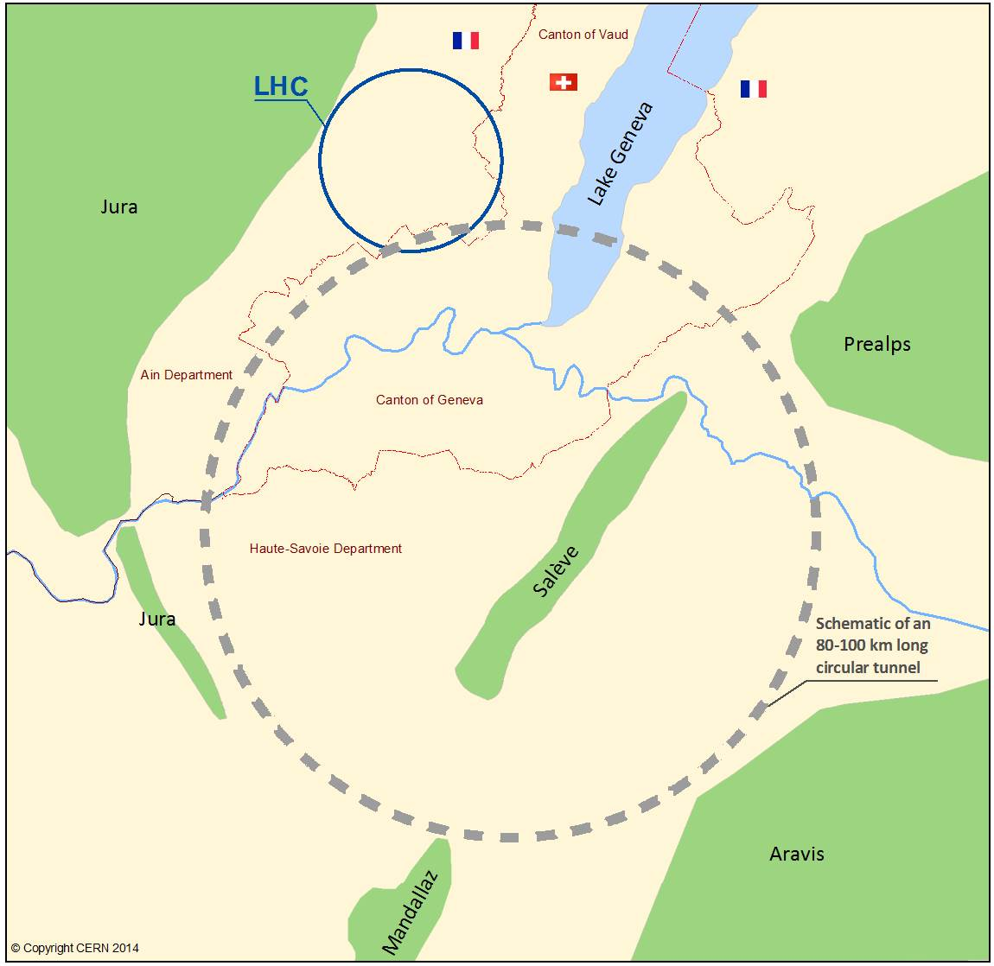
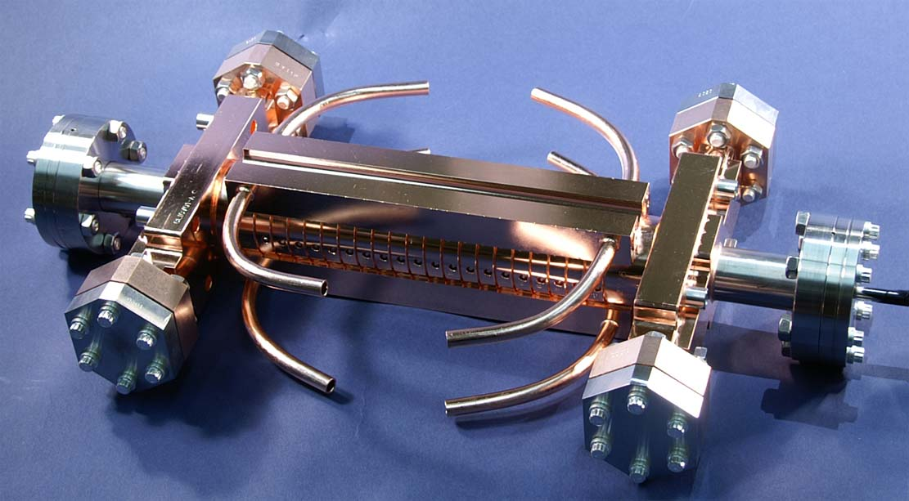
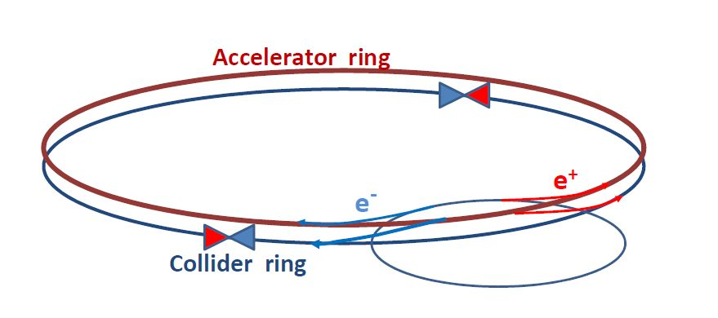
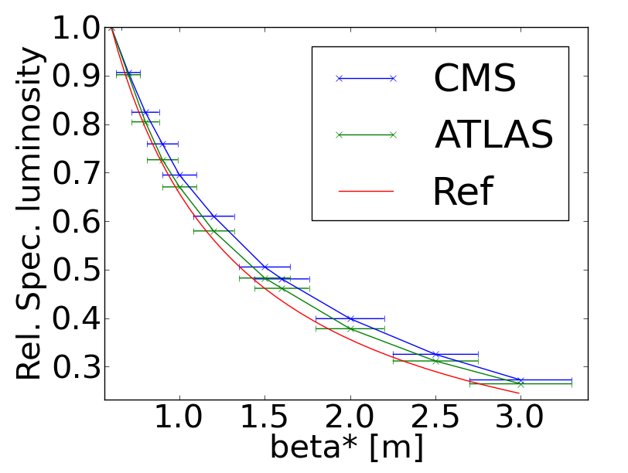
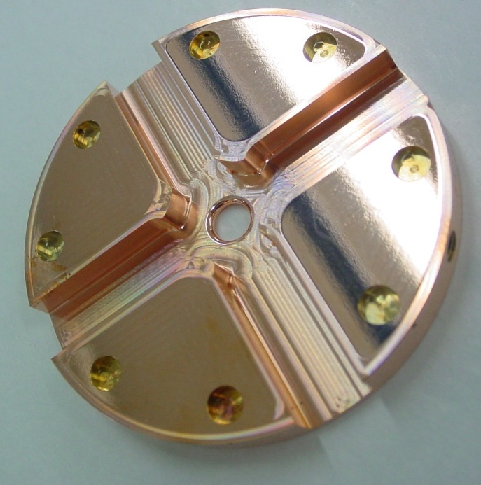
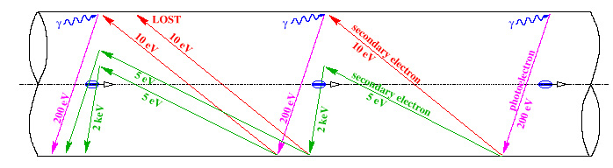
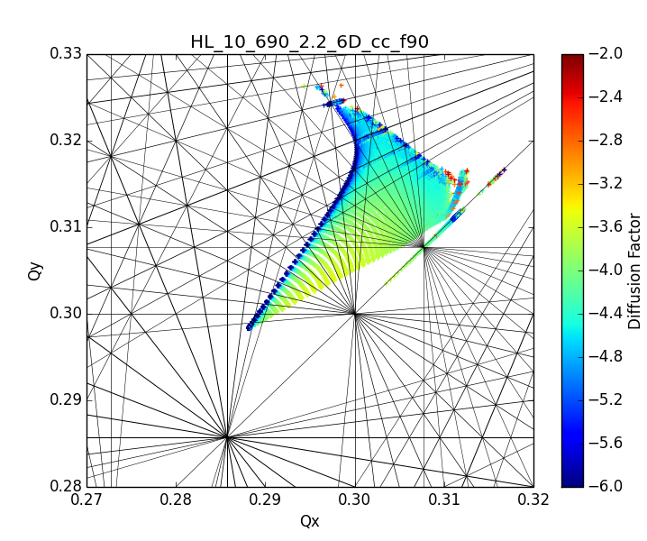

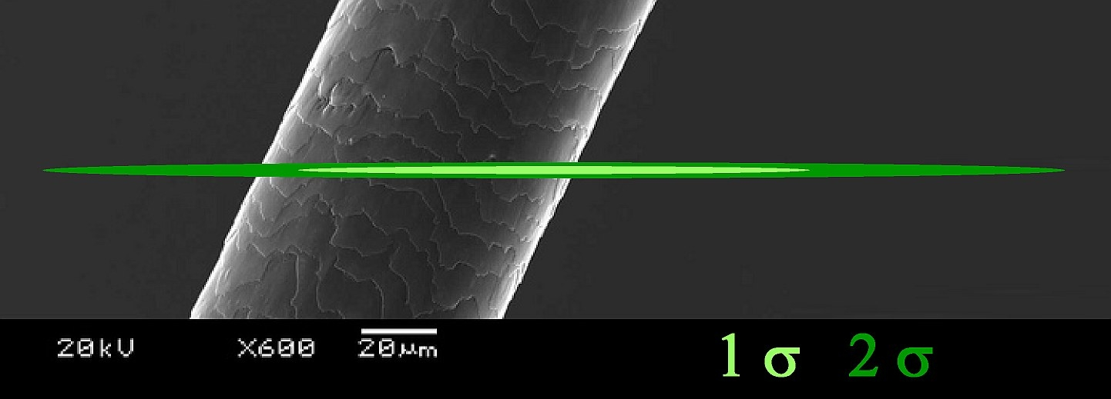



CLIC, HL-LHC and FCC
The Energy Frontier
since 1954
Future Accelerators at CERN
The Swiss accelerator community has been contributing to the development of CERN accelerators. Among these are the LHC complex, the HL-LHC upgrade and the Compact LInear Collider (CLIC) study.
Recently, CERN initiated the FCC study of a 100 km tunnel to host future circular colliders with the ultimate goal of reaching 100 TeV center-of-mass proton-proton collisions, and, as possible intermediate step, a high luminosity Z, W, H, top “factory” e⁺e⁻ collider.
CLIC
LHC & HL-LHC
FCC
CLIC studies have been supported by both the Paul Scherrer Institute and the EPFL. Contributions have been made on the following topics:
The development of high gradient X-band accelerating structures.
Studies of damping materials to reduce detrimental wake-fields in the linac.
High resolution diagnostics for beam position monitoring.
Optics studies to reduce vertical beam emittance to 1 picometer in the damping rings.
20 PhD thesis on LHC and HL-LHC studies have been followed by the LPAP EPFL in collaboration with the Accelerator Physics groups at CERN. The team of EPFL has contributed on the following topics:
Theoretical and numerical studies of beam-beam effects.
Studies of Luminosity leveling
Studies on electron cloud
Collimation studies
Bold vision of pushing the high energy frontier up to 100 TeV in pp collider together with e+e- collider offers a unique combination of precision and potential for discovery.
In 2011, with the discovery of the Higgs Boson of mass 126 GeV, A. Blondel from University of Geneva proposed a circular e+e- collider FCC-ee to study it with high luminosity. It can be used also for high precision studies of the Z, W and top particles and sensitive searches for dark matter particles.
Head-on
Long-range
r
While UNIGE studies the feasibility of polarized beams for FCC-ee, EPFL is engaging in a study of beam-beam and collective effects for the FCC-hh, based on LHC and experimenting with new calculation algorithms and techniques on SUPER COMPUTERS and a volunteer based computing platform LHC@home.
Image of the beam in the Swiss Light Source
superimposed with a human hair

