Slide 1
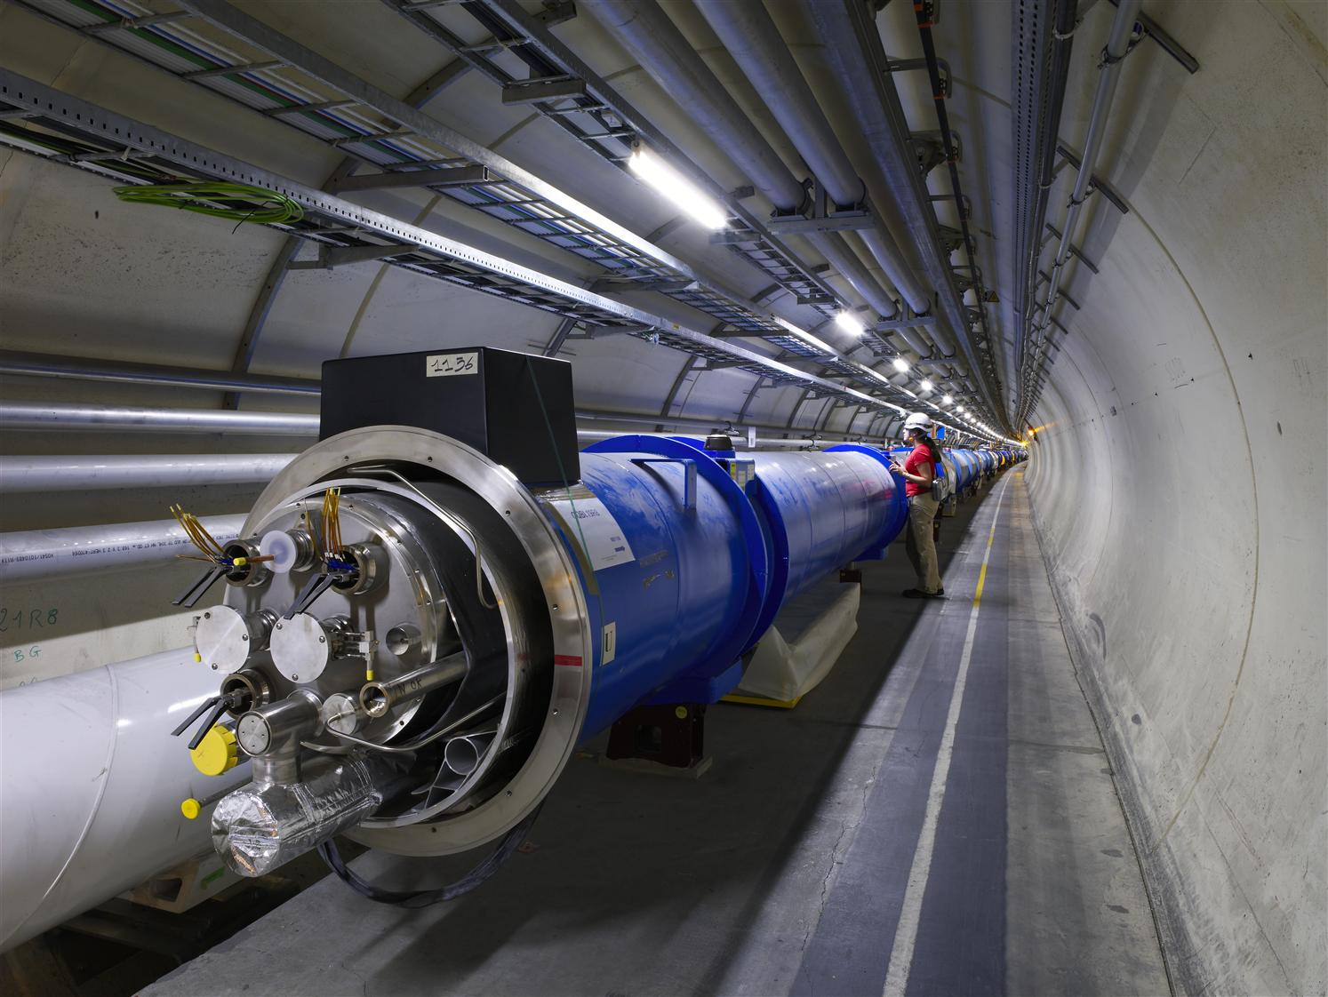

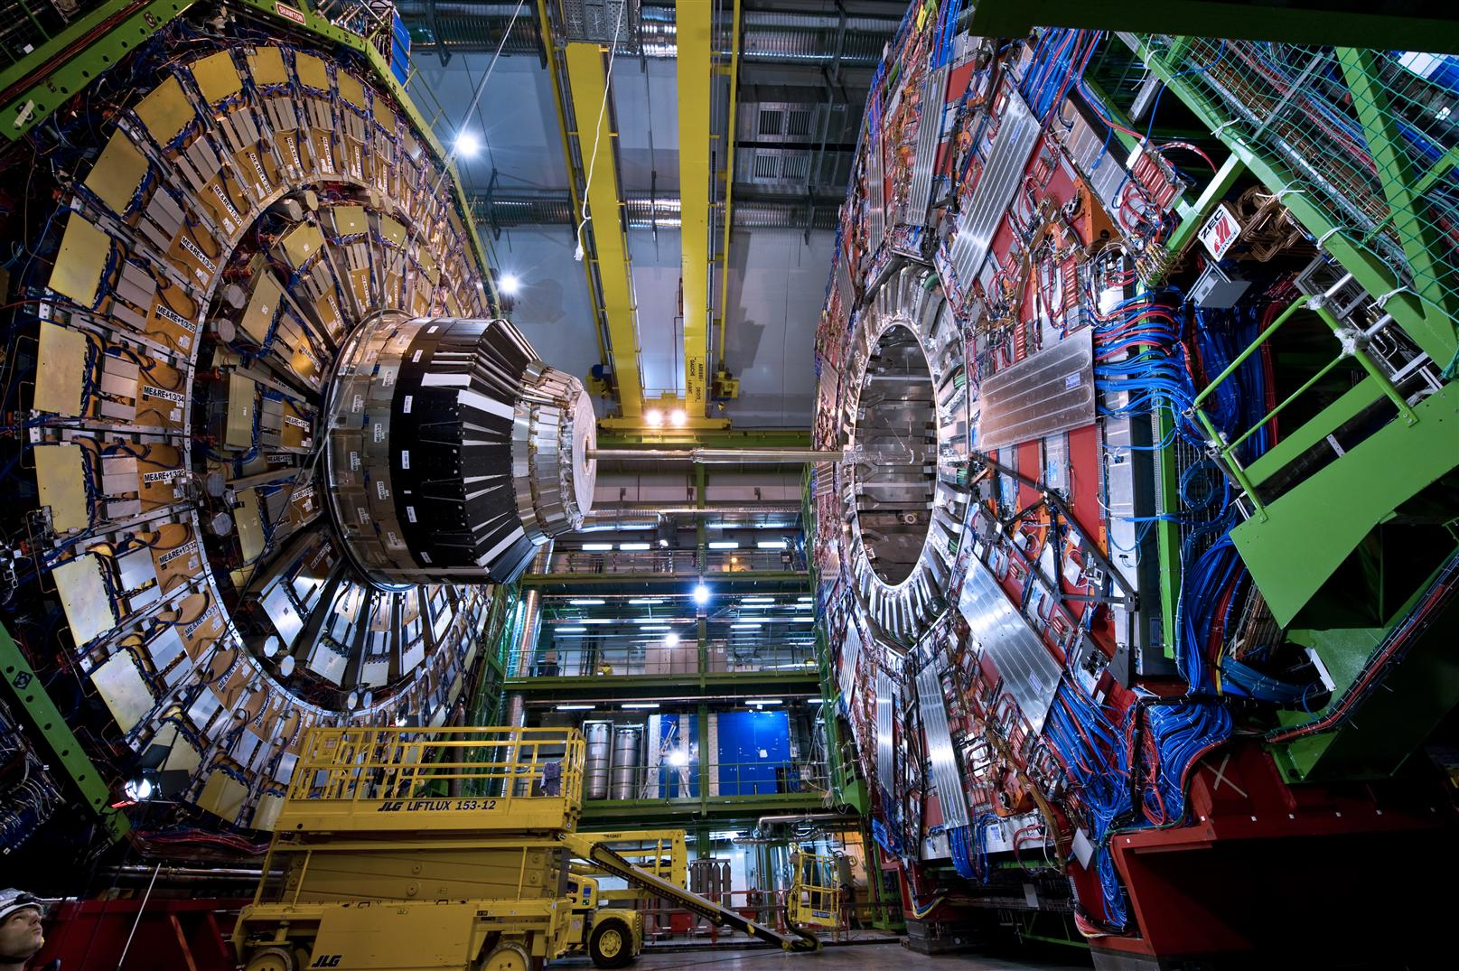



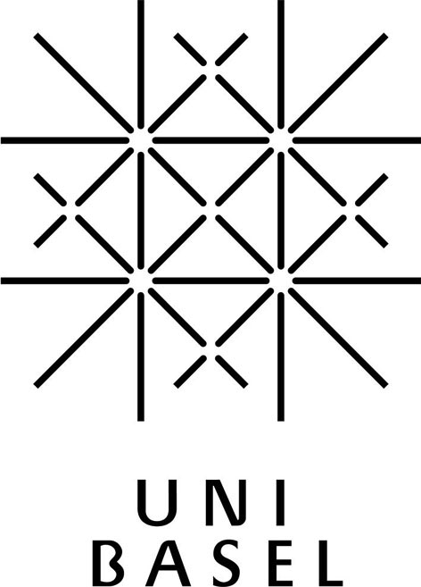



LHC Experiments:
ATLAS, CMS & LHCb
Proton - Proton Collisions @ LHC
since 2009
The Large Hadron Collider (LHC)
CERN's LHC is designed to elucidate the origin of electroweak symmetry breaking, to search for New Physics beyond the Standard Model and to perform precision measurements to test the Standard Model. Swiss groups have contributed to the ATLAS, CMS and LHCb projects since the mid-1990s. In addition, Switzerland operates a Tier-2 computing centre located at the Swiss National Computing Centre (CSCS) in Lugano. ATLAS and CMS jointly discovered the Higgs boson in 2012, which led to the 2013 Nobel Prize in Physics. By October 2013, the overall involvement of students in the LHC projects, including data analysis, lead to the completion of 115 master theses and 109 doctoral theses at the Swiss institutes.
ATLAS
CMS
LHCb
IT
TT
With a diameter of 25 m and a length of 46 m, ATLAS is the largest LHC experiment.
Swiss contributions went to:
Superconducting cables and casings for the barrel toroid coils
Silicon strip tracking detectors
Calorimeter readout electronics
Event transfer, building and high-level triggers
Online data logging system
Tier-3 data analysis facilities
The “Insertable Pixel Layer”
With 12’500 tons, CMS is the heaviest LHC experiment.
Swiss contributions went to:
The barrel pixel detector
Silicon strip tracking detectors
The Electromagnetic calorimeter (ECAL):
  Scintillating crystals
  Photo-sensors
  Read-out electronics
  Detector control system
Superconductors for the
4 Tesla solenoid
The magnet procurement
LHCb is designed to probe New Physics at much higher energy scales than by direct production, through virtual processes in the decay of particles containing heavy quarks.
Swiss contributions went to:
Silicon strip tracking detectors:
  Tracker Turicensis (TT)
  Inner Tracker (IT)
Off-detector electronics: TELL1 common readout boards
Vertex Locator: powering, analogue readout lines
On-line filter farm

