Slide 1


Validation Repository Status Report and Plans
Hans Wenzel
May 19th 2014

Slide 2
Outline
Introduction
Status/ongoing development
  Status of porting/improving legacy (JSP) application to new framework (JSF/primefaces)
  Status of implementing overlays
  Implementing tests for IF.
  Status of upload applications.
Conclusions/Plan

Slide 3
Introduction
Often get questions from users like:
  Where can I look at tests to validate G4.
  What are the energy ranges covered?
  ……
Often misconceptions: I heard that Geant 4 is not very good at that energy range (different from the one that LHC experiments are interested in)
There is lot of great data out there giving lots of confidence in the quality of the simulation, but it is scattered around, sometimes can be found only in Geant 4 internal meetings → difficult to find. Misses big part of the audience (the user).
Vision: Validation repository morphs into a complete collection that we can point users to with all the questions→ Needs to be complete (include all aspects of geant 4: em, hadronic, optical, medical…), easily searchable, use case driven, user friendly……

Slide 4
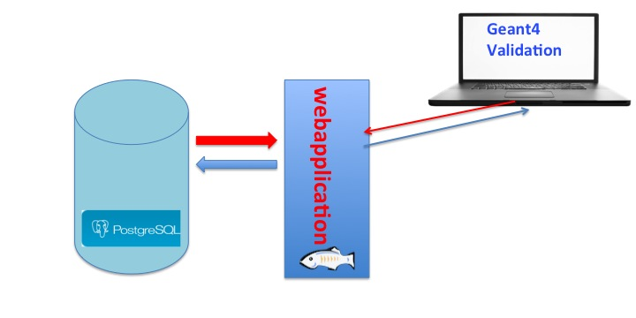
The tool
Fermilab db group
VM on Fermi Cloud
Central repository (Database) of tests, where a test is a comparison of experimental data with simulation.
Test and experimental data are stored as plots, data arrays or histograms with metadata (tags, testdes, publications…) in the data base. The web application allows to View the tests. We distinguish what can be seen by the public and by collaborators.
Currently: Providing/uploading the test results is responsibility of the model developers (up to the developer what tags to attach to the data)

Slide 5
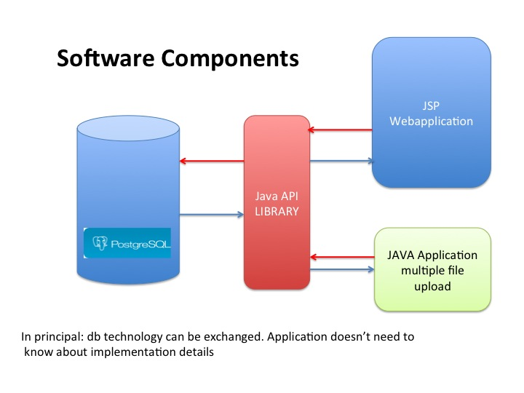
JSF JavaEE6
xxxxxx

Slide 6
Porting legacy web application (jsp) to primefaces/jsf
At least the same functionality but improving
- menus → very selective.
improved search functionality by keywords like
(beam, beam energy, target, experiment, author,
outgoing particles etc.) ( allow to click on found results directly to display.)
- display/select keywords as/from tagCloud
- requires clean up existing tags (only for public data)
- requires turning some of the java classes into managed Beans
- extended schema for test and histogram
- define JSF template for G4 web application to define look and feel

Slide 7
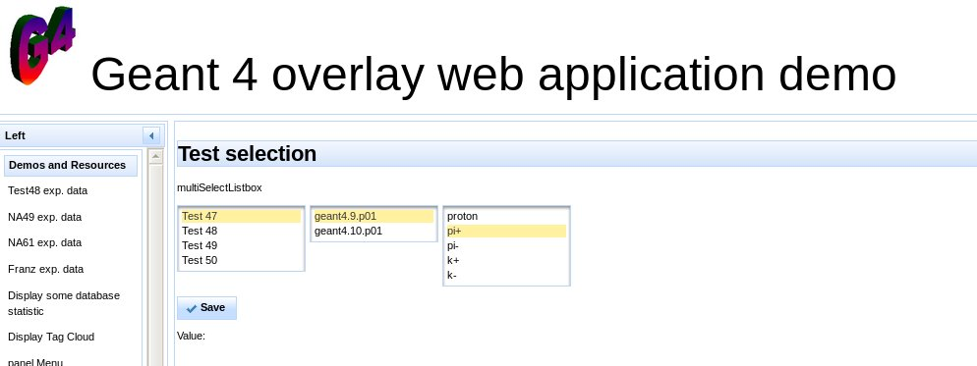
Selective menus
Menus dynamically/lazily created from data base.

Slide 8
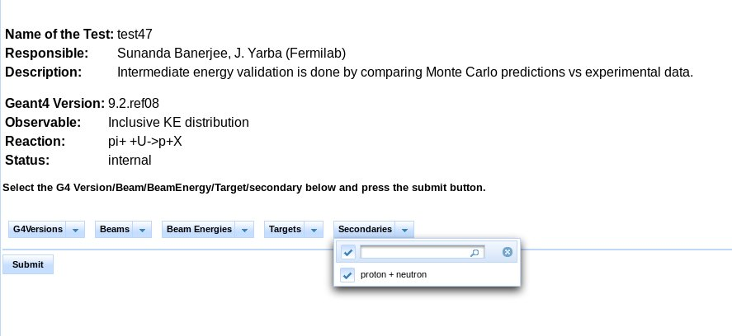
Selective menus
Selection will result in a small list → click on result directly to display

Slide 9
Overlay of data
Data is stored as data table in the data base → plots are created and overlayed on the fly
allows to select and overlay experimental data and simulation
import and display all data sets we are using for validation.
currently we have :
  experimental data for test 48: (Madey et al.)
  test 19: (NA49) proton (158GeV) induced particle production
  NA61: proton induced particle production
  Franz et al: neutron (312-542 MeV) induced particle production
Currently we have 70 test 48 histograms in the db.
provide script to extract data from root histograms and store result in db.

Slide 10
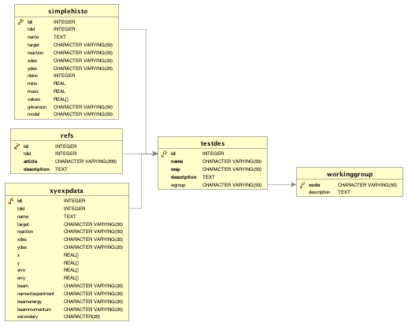
Data base schema for tests exp. Data and histos
Data set

Slide 11
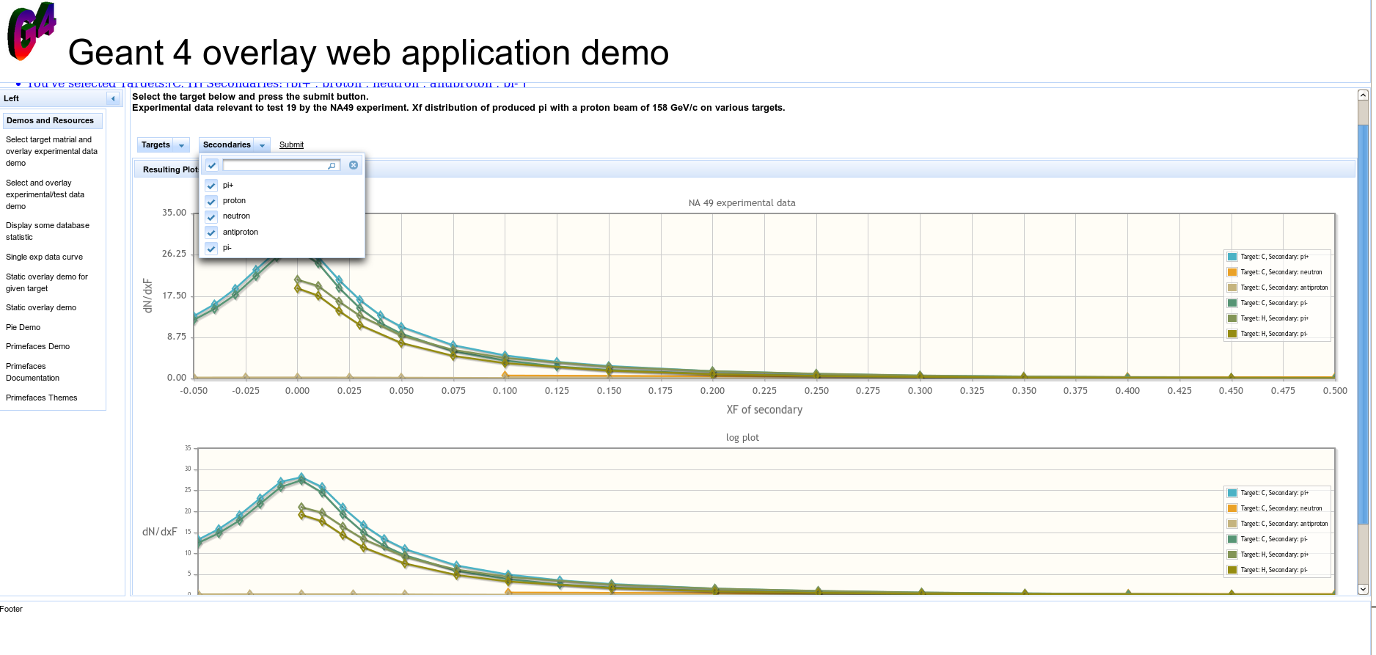
NA49: xF of secondaries
Menus allow to narrow down selection by experiment
Target, secondary…..plots done by primefaces/jqplot

Slide 12
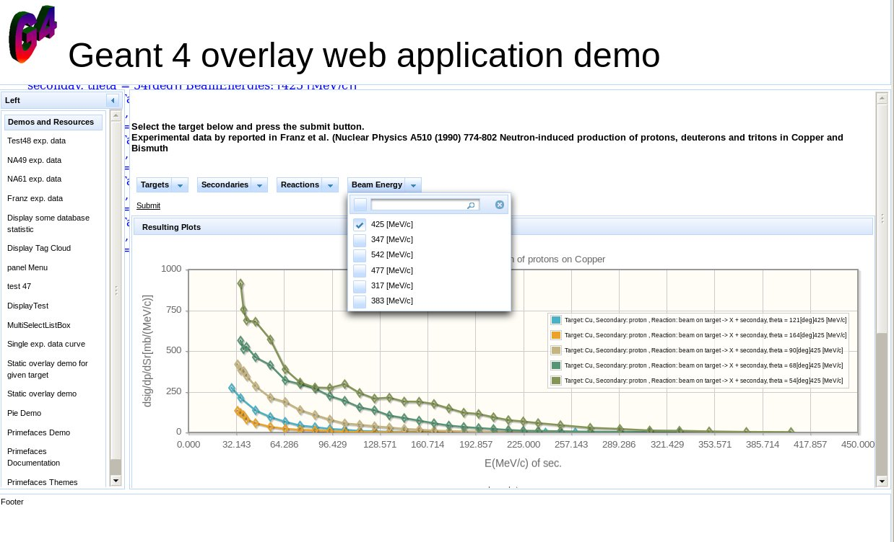
Neutron induced particle production

Slide 13
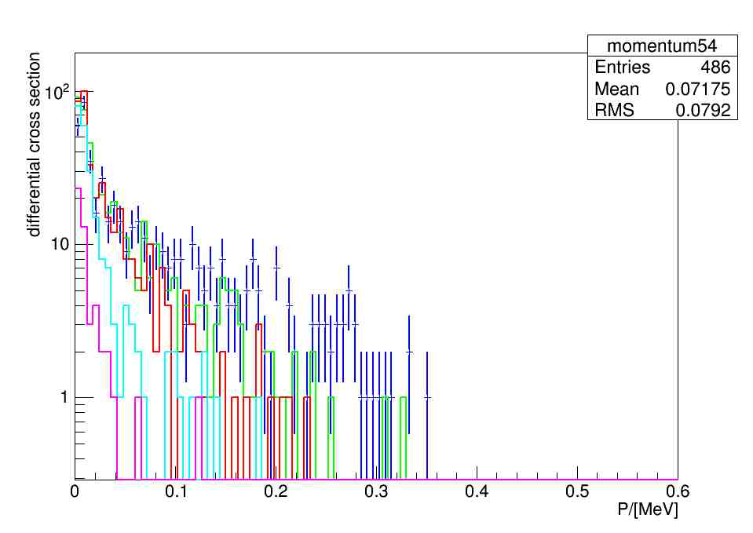
Implement test relevant for IF
Implement tests in artg4tk – currently we have neutron induced particle
production (exp. data by Franz et al.)

Slide 14
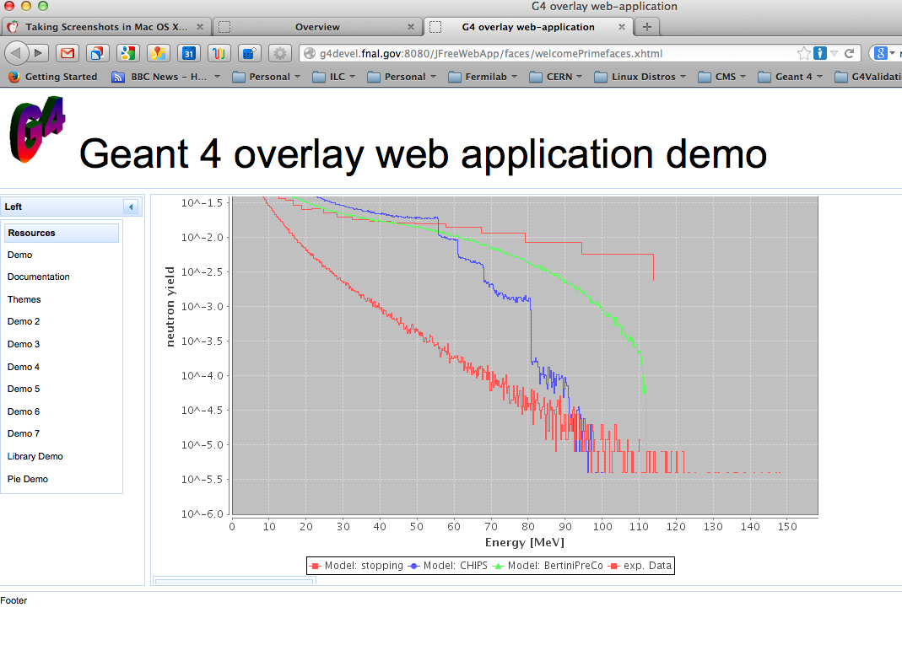
Test 48
Status:
Schema in place,
API library extended,
Wep application demo
that allows to make
Selections and create
plots on the fly

Slide 15
Upload application
single test:
provide templates for a given test, provide webapplication that allows to change only items that changed (usually most keywords stay the same only g4 version and name of the file to upload changes)
multiple tests:
provide template for all the tests, provide webapplication that allows to change only items that changed (usually most keywords stay the same only g4 version and name of the file to upload changes)
automation:
allow script/application (e.g. triggered by end of job) to run and populate the database automatically requires authentication (could be encrypted password/ certificate based) → collaborate with CERN/Andrea.

Slide 16
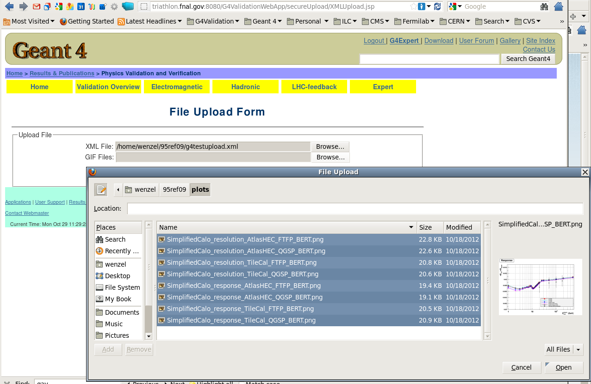
Example: Uploading multiple tests (cont.)
Select the xml file describing the tests
Select all the images that need to be uploaded

Slide 17
Conclusions/Plan
We have demo that creates plots on the fly and allows
overlaying selected items.
Need more complete list of tests (in form of data tables)
in database.
(Working on it, fermilab specifically interested in
data specific for intensity frontier, neutrino community)
Continue adding more experimental data.
Started replacing/improving the current pages with
primefaces.
Work with CERN/Andrea on automated upload
We will have a summerstudent working on this project
starting May 19 (today).

Slide 18
Backup Slides

Slide 19
Ongoing development: Primefaces /Graphs on the fly prototype
Choice of technology was motivated by the fact that it seemed to be the fastest way to provide the required features.
  No new framework to learn
  We keep existing Java based API, database etc.
  The selected components are well integrated in the IDE of our choice (netbeans)
Data base schema extended to store raw experimental and raw simulation data (histograms) in the data base. (data arrays with metadata). Extended the java API to deal with it.
Select → plot and overlay (comparable) data, using the jfreechart/jqplot graphics packages
Uses PrimeFaces to create modern looking web pages
and easy to navigate menus allowing to narrow the selection.
Experimental data test48/NA49/NA61 data provided by Julia.

Slide 20
Why fixed schema?
We think tests, experimental data etc. can be expressed with a fixed schema
and a separate schema for each test is not necessary.
We looked into frameworks (e.g. hibernate) that automatically mapped objects
to java-classes and managed beans and also created the necessary JSF pages.
But:
We found that the created classes still required tweaking e.g. to deal with
db extensions like blobs or arrays, use of connection pools…
Don’t see that the schema will change that often so changes to the API
can be done by hand.

Slide 21
Use Cases
An experimenter wants to know if there is any test data which compares
to a specific experiment (say MIPP,HARP or NA49). All he wants to do is
to search for the experiment and get a list of available tests in the data base.
(e.g. pi+ production in p+C reactions at a given energy)
The choice should be possible by selecting from multiple choice fields in the
web application.
Related Geant 4 developer wants to find some Validation plots to show
at a conference. The choice should be possible by selecting from multiple
choice fields in the web application.
an experimenter wants guidance what physics-list to use for the specific
physics he/she is interested in. Given that a physics list is composed
of models, he/she wants to select the reaction and observable he/she is
interested in and then display the result for various models/physics lists, in order to
determine what models does better, if it's properly included in a standard
physics list, or it'll make sense to create a custom physics list.
an experimenter wants to know if it makes sense to upgrade the geant 4
version of his experiment. So he wants to compare the results of various
geant 4 versions for a given observable and reaction. (timing information?)

Slide 22
Backup Slides

Slide 23









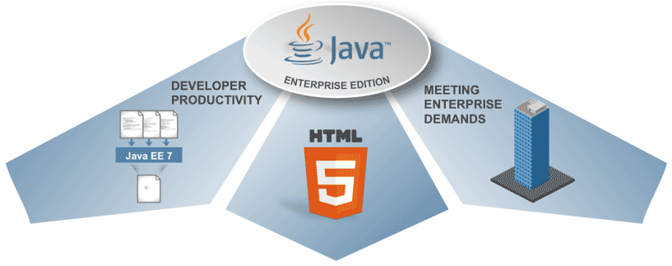

Technologies now/future
JFREECHART
GlassFish
JSTL

Slide 24
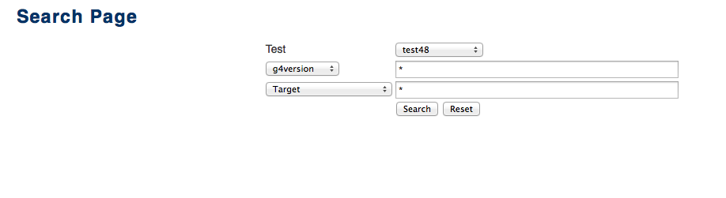
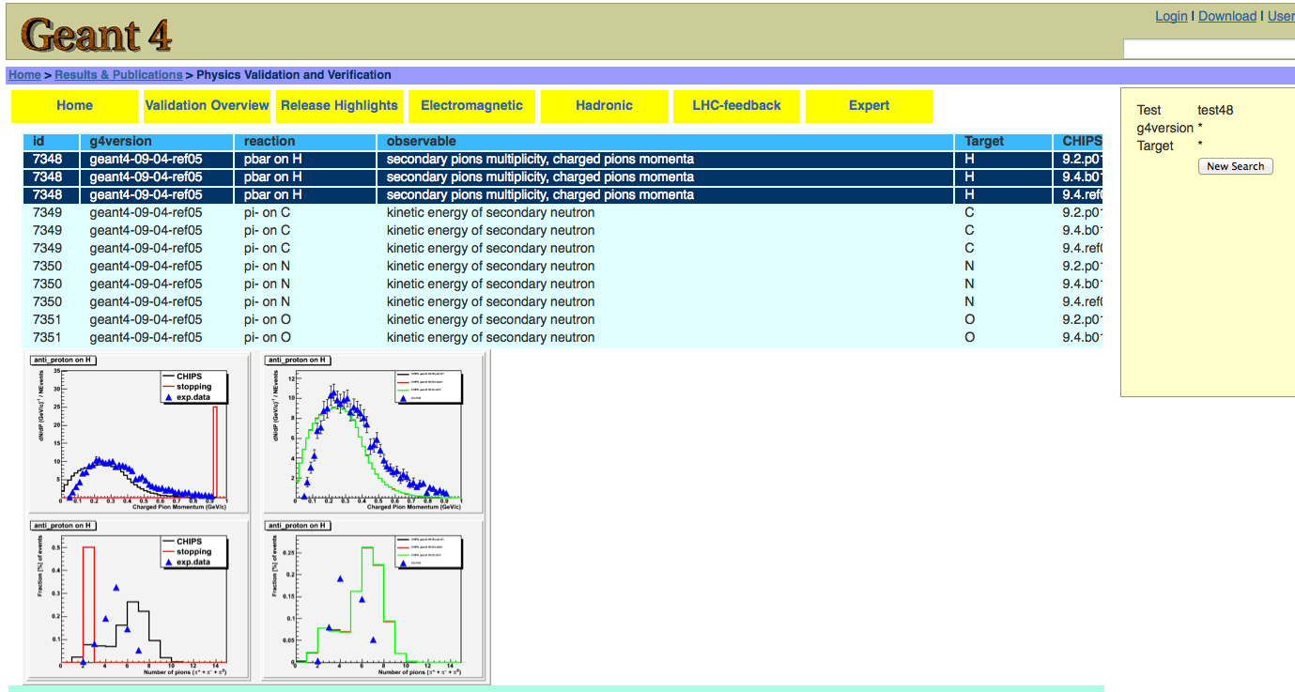
Searching

Slide 25
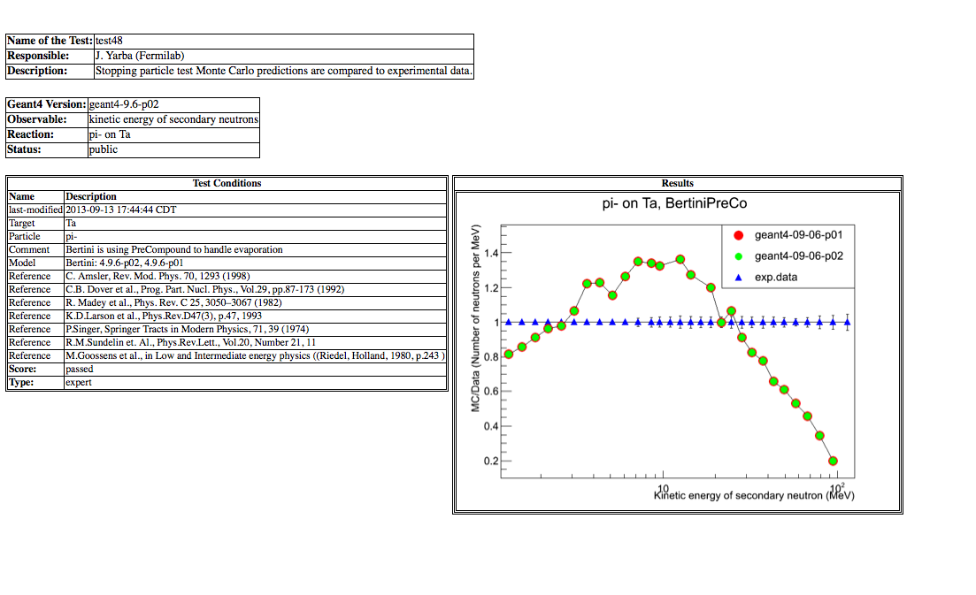
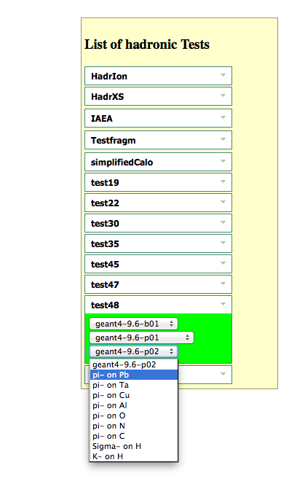

Slide 26
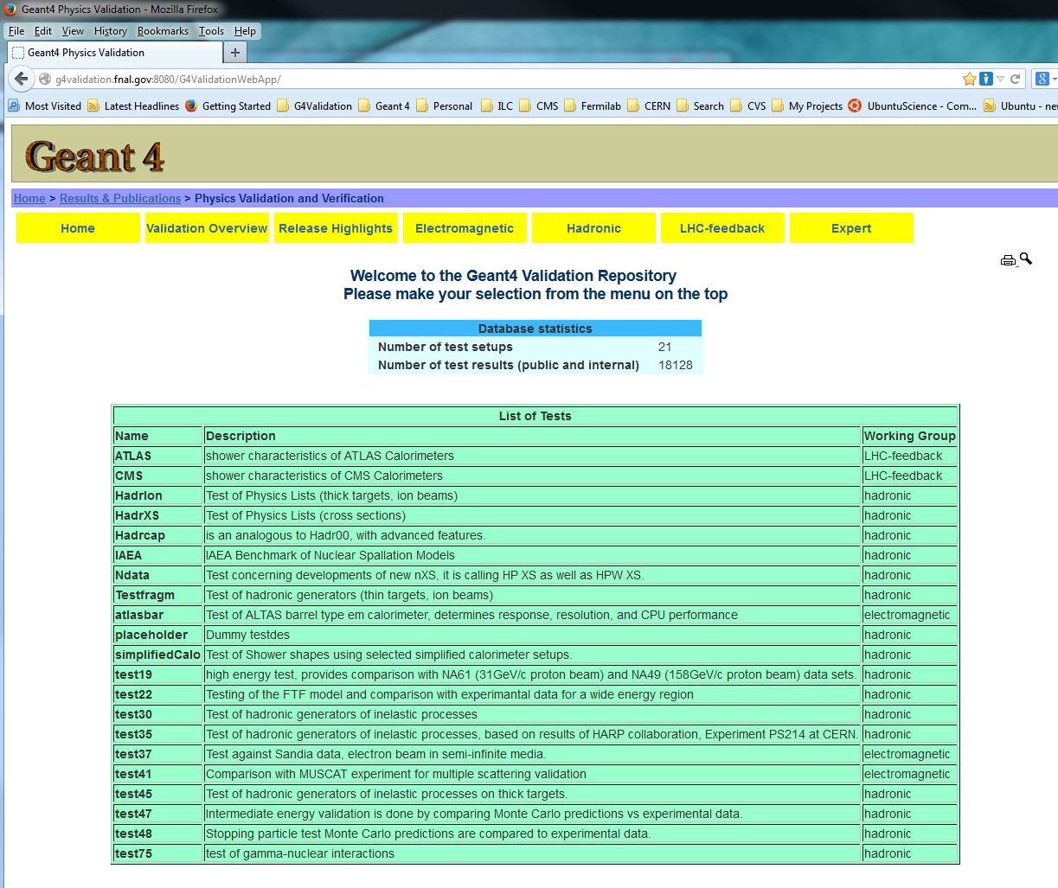
Search Button

Slide 27

But that needs active participation of the developers
We will provide templates and assistance,
Make searches easy,
provide common notation etc.

Slide 28
Features available to the geant 4 expert

Slide 29
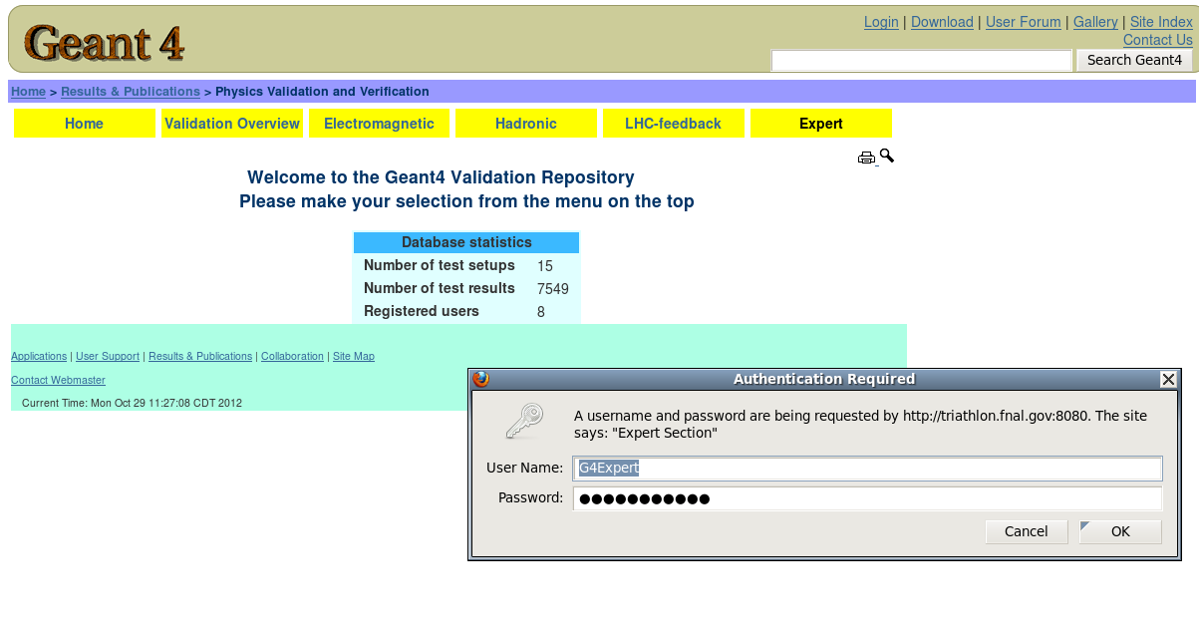
Expert pages
First login to expert page: Currently only one user (G4Expert)
contact me for password → temporary solution
Many of the pages provided by Andreas Schaelicke

Slide 30
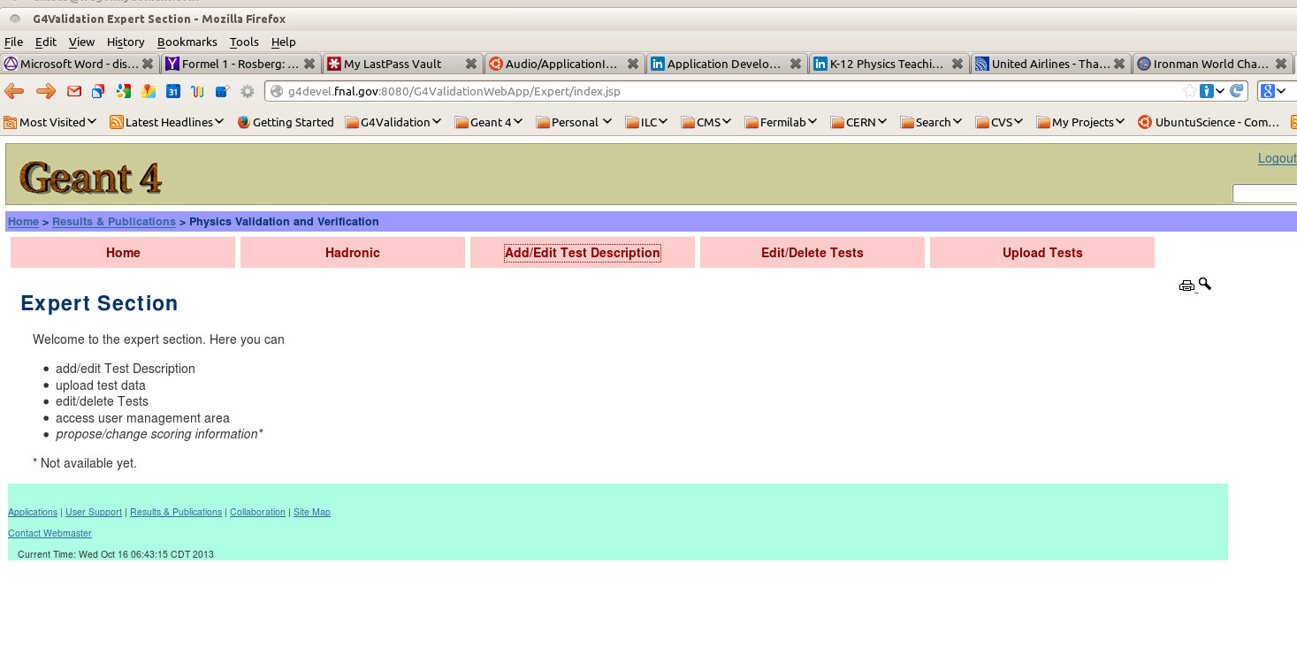
Edit modify a test description

Slide 31
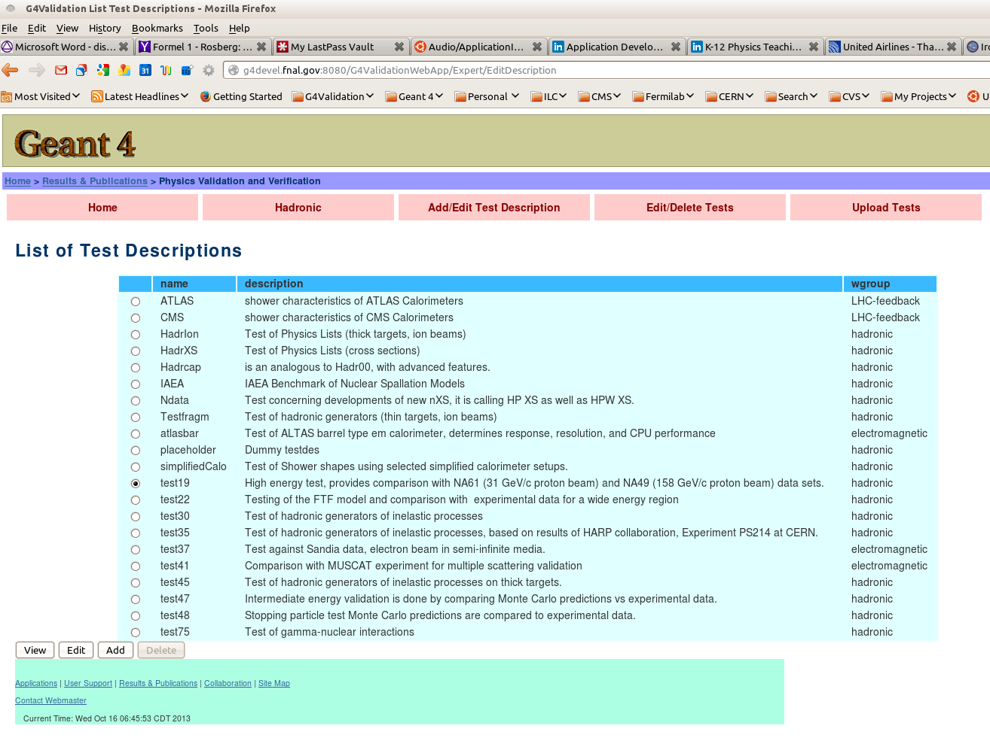
First select a test
Then press edit

Slide 32
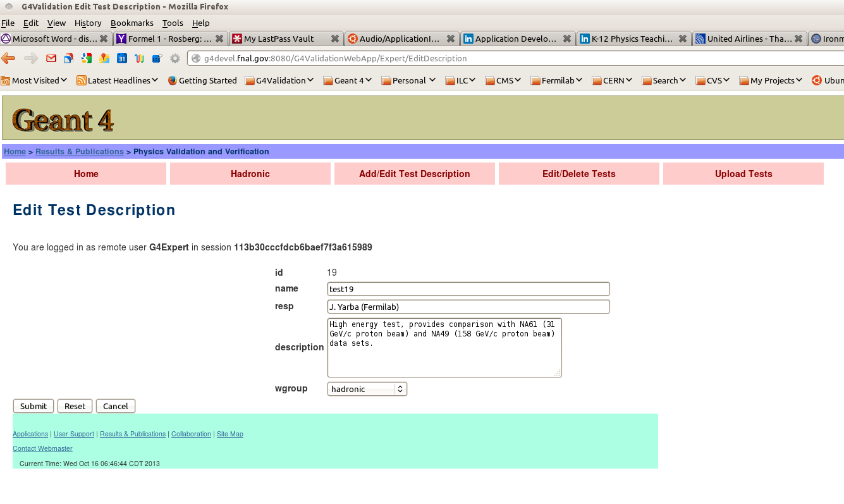
Brings up menu you can use to modify your test description

Slide 33
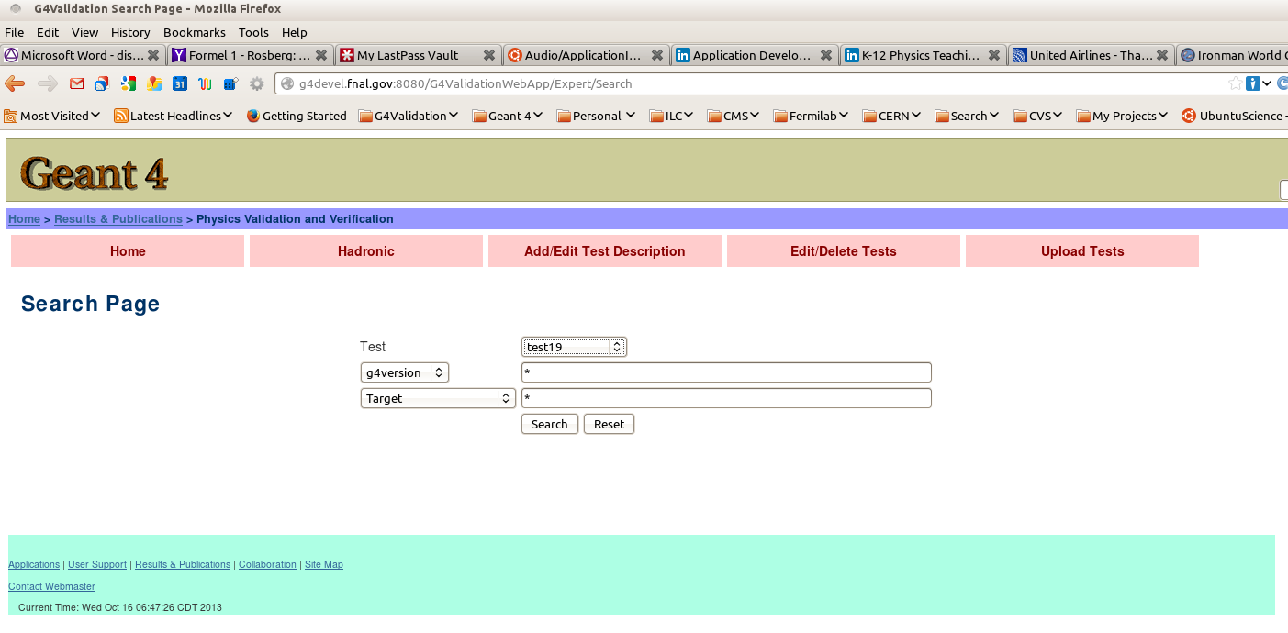
Edit a test already in the database
Select Edit test
Select test

Slide 34
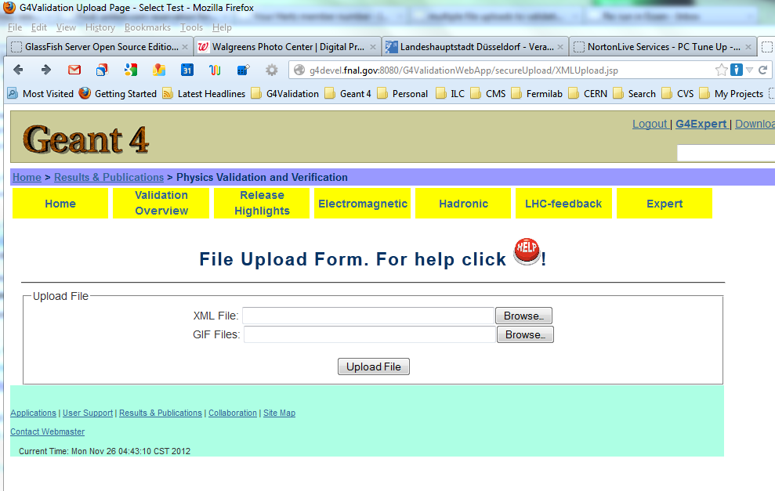
Example: Uploading multiple tests (cont.)
Press Help button for:
detailed instructions
Example xml file describing the multiple file upload the

Slide 35
Project info
Web page:
http://g4validation.fnal.gov:8080/G4ValidationWebApp/
Code in SVN https://svnweb.cern.ch/cern/wsvn/g4validation/trunk/G4ValidationWebApp/
Validation Taskforce TWIKI/Task list: https://twiki.cern.ch/twiki/bin/view/Geant4/PhysicsValidationTaskForce
https://twiki.cern.ch/twiki/bin/view/Geant4/ValidationTasks
https://svnweb.cern.ch/trac/g4validation/

Slide 36
Again

Slide 37
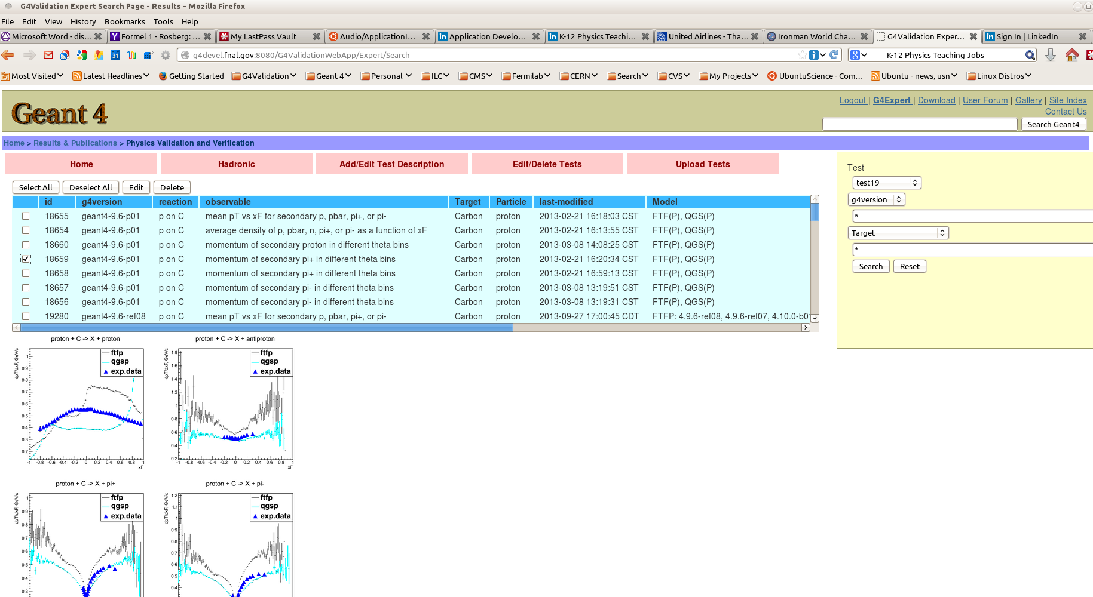
Select test

Slide 38
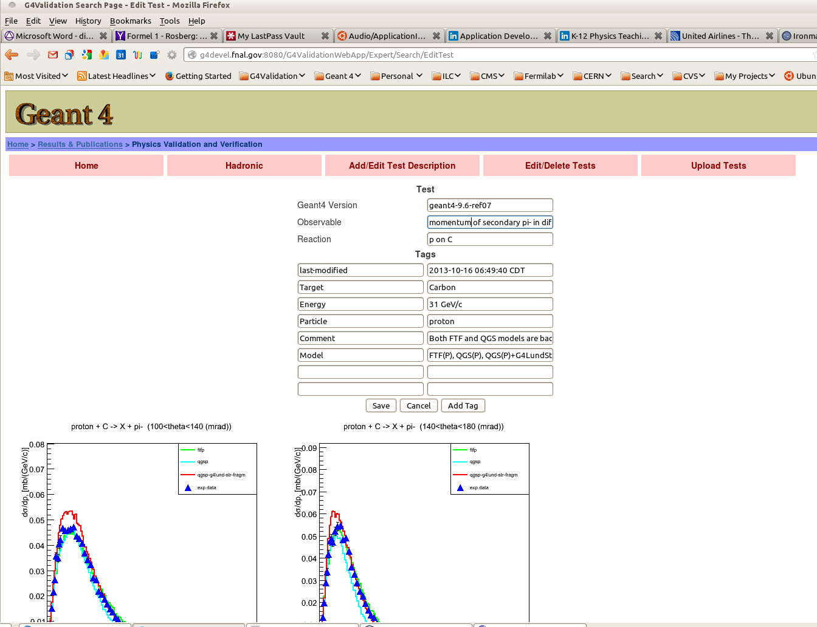
Allows to edit the test metadata (e,g. in this case momentum was mispelled)

Slide 39
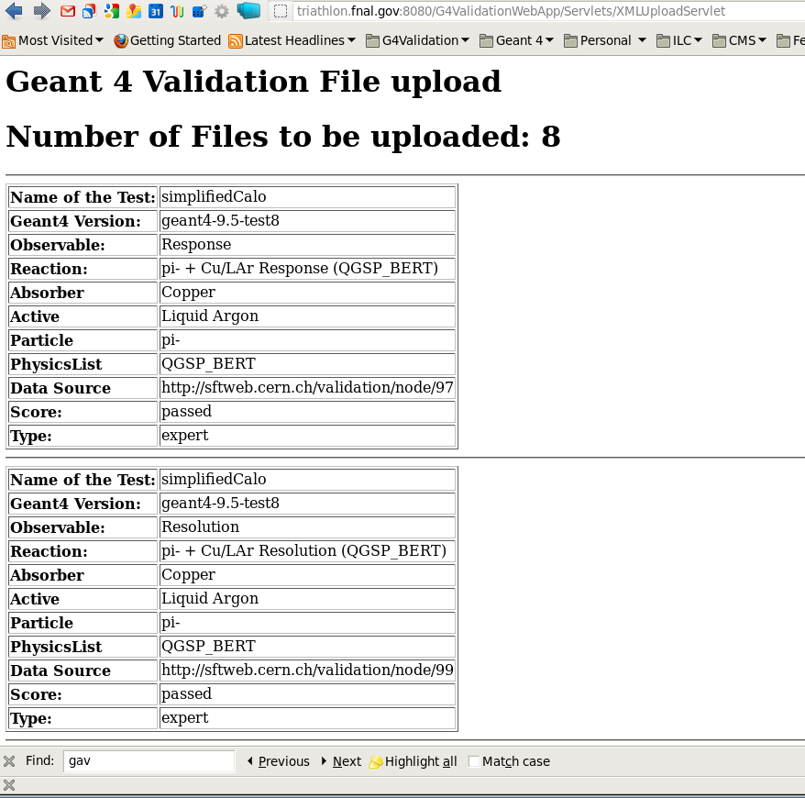
Example: Uploading multiple tests (cont.)
This is what a successful upload should look like.
Problems usually arise from malformed xml files which can be avoided by:
Use of xml enabled editor
Templates for different tests (usually only geant 4 version changes for a given test)

Slide 40
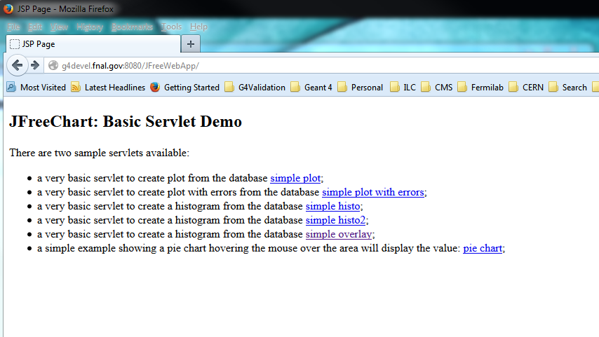
Development/Test environment
Development web Application server on Fermi Cloud/ development data base, used to test features/configurations then will be rolled over to production server . http://g4devel.fnal.gov:8080/G4ValidationWebApp/
Also hosts prototype ‘plots on the fly’ web application:http://g4devel.fnal.gov:8080/JFreeWebApp

Slide 41
What's next
Work and extend the existing task list.
Develop prototype web application that allows to select experimental and simulation data and then overlays the data in a plot.
Import all the experimental data files used by various tests.
Evaluate web frameworks like PrimeFaces to provide scalability and modern look and feel.
Actually it is a fun project for e.g. computer science students to learn about web application frameworks, javaEE etc.

Slide 42
Production environment
web Application server on VM on Fermi Cloud, postgresql database operated by fermilab database group.
http://g4validation.fnal.gov:8080/G4ValidationWebApp/
Up to date: latest java/java libraries, glassfish web application server, database schema identical to development environment.
New features include:
  Multiple (single) File Upload web application. Help available to guide you through the process.
  Release highlights for upcoming Geant4 release (Julia)
  Only tests explicitly declared public can be viewed without authentication.
  Expert login to view, edit, delete tests. (Makes use of functionality provided by glassfish web application server).

