Slide 1
LumiDAQ - BHM
Stella Orfanelli

Slide 2
Outline
BHM Electronics
Comparison to HF case
Ongoing work
Monitoring for BHM

Slide 3
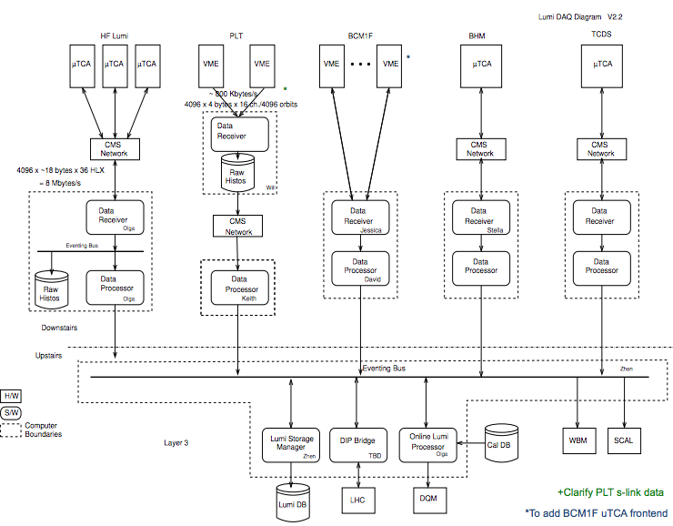
stella

Slide 4
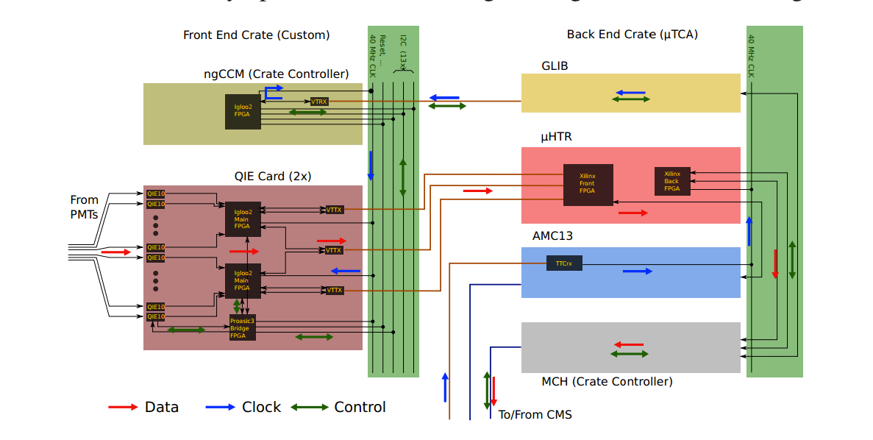
BHM electronics overview similar to HF

Slide 5
PMTs -> QIEs
20 PMTs
20 PMTs
Each QIE Card consists of 24 QIE chips. The output data of the QIE chip is 16 bits @40MHz.
20
40MHz
20
40MHz
24*QIE10
Chip
Digitization and Rising edge TDC
24*QIE10
Chip
24
640Mbps
24
640Mbps
Data formatting
Serialization
Falling edge TDC
2*Igloo2
2*Igloo2
20 PMTs/
end
3*VTTX
Dual transmitters
3*VTTX
6
4.8 Gbps
8b10b
4.8 Gbps
8b10b
6
uHTR

Slide 6
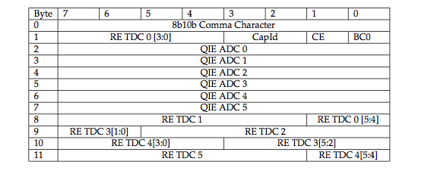
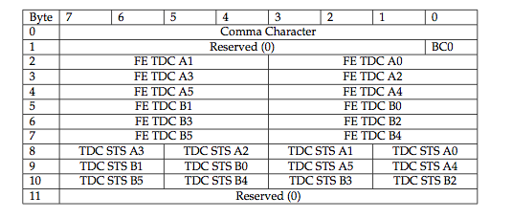
QIEs -> uHTRs
4 packets of 12 bytes for 24 QIE channels for ADC and RE TDC
Optical link @4.8Gbps
TCDS/ clk
TCDS
2 packets of 12 bytes for 24 QIE channels for FE TDC
IP bus*
*https://cactus.hepforge.org/attachments/rob_frazier_ipbus_tipp_2011.pdf
lumiDAQ

Slide 7
Differences from the HF case
Hardware
  BHM will use 1 crate with 1 UHTR
    WE COULD USE TWO if we see we need it.
  HF will use 3 crates with 12 uHTRs.
Software
  BHM will have 40 occupancy histograms with 4*3564 timing bins (40 in total). Additional 20 amplitude (1D) and 20 for calibration (1D).
  HF will have 6 histograms with 3564 timing bins.
  Multi-threading technique to read out fast enough uHTRs in the same crate.
  Different firmware to send multiple histograms every time they are asked to avoid latenices.

Slide 8
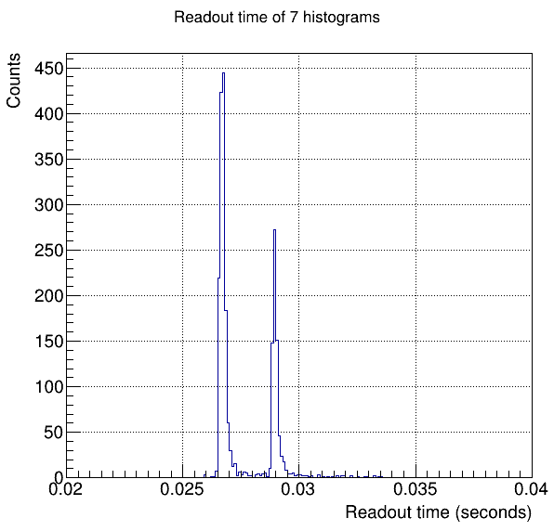
Comparison with HF data rates
Histogram integration time (hardware)
Is set to 0.37sec (2¹² orbits).
At least 40 occupancy histograms per uHTR
instead of 6 for HF.
If we assume that time will scale up,
0.03sec * 7 times more histos = 0. 21 sec!
Size difference should not affect the readout
Time BUT THIS NEEDS TO BE CONFIRMED.
THE FIRMWARE WOULD HAVE TO BE
ADAPTED SO THAT THE READOUT OF THE
HISTOGRAMS IS NOT DONE INDIVIDUALLY
BUT IN BLOCKS TO AVOID ANY LATENCY
INCREASE.
TEST NEEDS TO BE REPEATED FOR BHM
FIRMWARE AND NEEDS.

Slide 9
uHTR ->Data Receiver
Histograms for leaving the uHTR:
  Occupancy for each channel (2D)
    32 bit integ.*3564 BX * 4bins/BX ~ 440kb/histo =>
      40*440kb = 17.6Mbps ~20Mbps
  Amplitude for each channel (1D)
    Size decided by the number of significant bits we want to keep from the QIE
  Calibration histogram for each channel (1D)
    Amplitude normalized over the amplitude of the photodiode
    Rate : 20Mbit *11kHz/ 2¹²orbits ~= 110Mbps ~13MBps

Slide 10
Current Status
Have tested lumiproto released earlier this year
Mainly have focused on 904 tests of uHTRs
Amplitude functionality has been tested in uHTRs (TDC to be tested)

Slide 11
Monitoring for BHM
Calibration system
PVSS for HV monitoring
No histogram / Zero histogram.
  PMT?
    Check HV & PVSS
    Check calibration histogram
  QIE? uHTR? Hardware failure? Crate on? Processes?
  Computer? DAQ problem?
Would an azimuthal picture of the BHM detectors be helpful?

Slide 12
Work to do
Test hcal software with xdaq12 next week
  Installation of xdaq12 in bril pc in 904 (Arkady)
  Chris West has provided us with all the libraries needed to readout the uHTR for xdaq
Combine readout application written for uHTR of HCAL and DataReceiver of lumiDAQ.
Complete test: uHTR + TCDS + xdaq12
Decide on the monitoring aspects for BHM.
Repeat Olga’s test for BHM firmware (larger size histograms).

Slide 13
backup

Slide 14
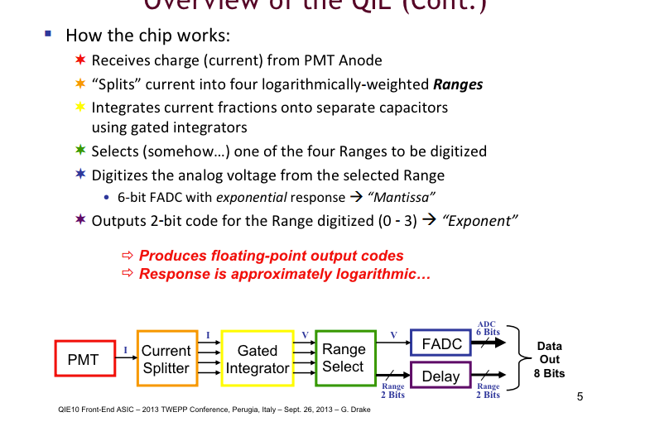

Slide 15
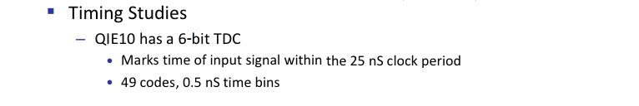
Special Codes:
60: When rising edge set for last pulse gives invalid code.
61: Delay lock loop unlocked. This is bad; it means the TDC won't function correctly.
62: Input current stayed above threshold for the whole integration window.
63: Input current stayed below threshold for the whole integration window.

