Slide 1
CLIC MODULE TRANSPORT AND INSTALLATION
Keith Kershaw
CES, 8 October 2008

Slide 2
AIMS
REVIEW REQUIREMENTS AND PROPOSE CONCEPTUAL SOLUTION FOR LOWERING AND UNDERGROUND TRANSPORT / INSTALLATION OF CLIC MODULES.
THIS CONCEPTUAL DESIGN WILL BE AN INPUT INTO THE TUNNEL INTEGRATION STUDIES

Slide 3
APPROACH
NEED TO CONSIDER :
TRANSPORT ALONG TUNNEL
TRANSFER AND INSTALLATION ON SUPPORTS
LOWERING FROM SURFACE AND ENTRY INTO TUNNEL
20,000 MODULES SO NEED TO BE FAST.
ALLOW INDIVIDUAL MODULE EXCHANGE
Previous presentations reviewed transport and installation solutions used elsewhere

Slide 4
Transport questions + answers
MODULE CONDITIONING FOR TRANSPORT
What is the unit of transport? -one module –see later slides
Dimensions in transport configuration - see later slide
Weights in transport configurations -1500kg
Potential lifting points (e.g. for transfer) –consider lifting points above module – allow space for spreader beam
Potential support points – support under girders during transport
TRANSFER TRAJECTORY RESTRICTIONS
What supports etc will already be installed on the floor? – see later slides
How much clearance space between adjacent modules during transfer/installation- 30mm allowed for interconnections – space available during installation to be defined
POSSIBLE SIMULTANEOUS TRANSPORT/INSTALLATION OF SEVERAL INTERCONNECTED MODULES
What are the possibilities/implications if several modules are interconnected on the surface and transported/ installed at same time? –support and survey concepts based on module installation one at a time
VIBRATIONS
Is it reasonable at this stage to assume that the levels of precaution taken for cryodipole tunnel transport will be sufficient? - 1g used as basis (i.e. normal handling techniques) note: need to avoid overloading supports during installation.

Slide 5
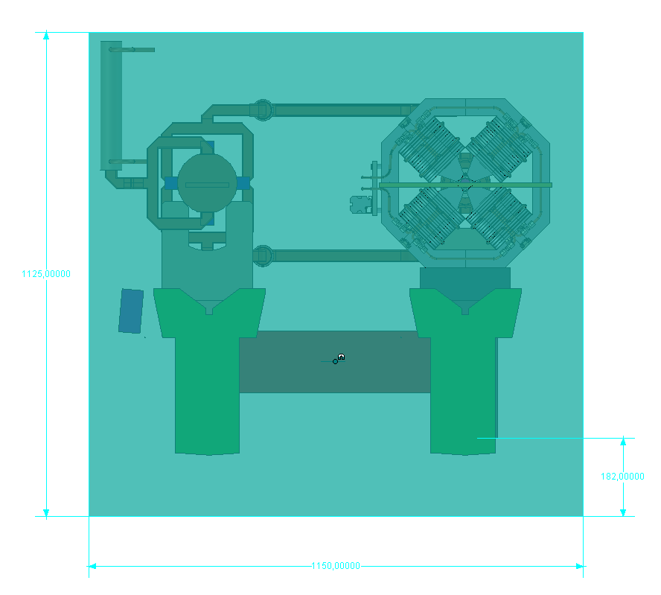
Transport envelope in cyan – 1125 x 1150 x 2100
Lifting points according to the worst case, i.e. on top of the transport envelope.
Intergirder support acceptable assumption for the moment.
R. Nousiainen 04092008

Slide 6
Assembly, Transport and Installation
Continuation of the meeting held on 28th of August 2008
K. Kershaw, H. Mainaud Durand, R. Nousiainen, G. Riddone, T. Touze
(R. Nousiainen slides)

Slide 7
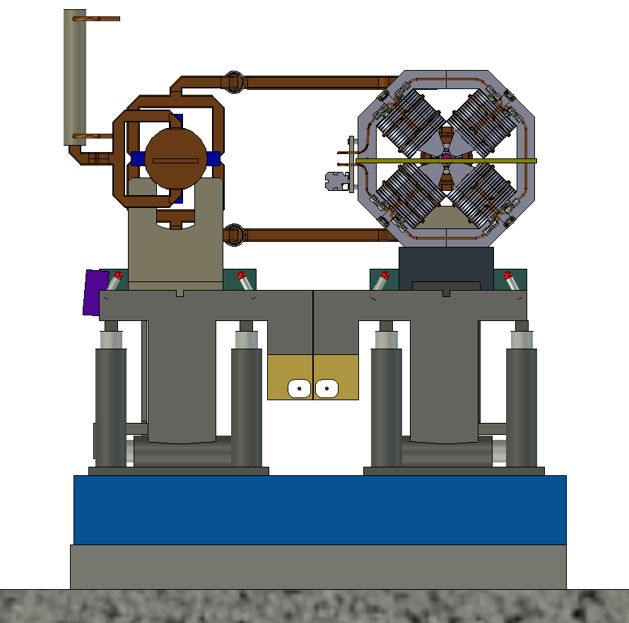
Step 1
Assembly at surface
Use the same configuration
as in the tunnel
- MB-DB interconnections installed
- Fiducialisation done

Slide 8
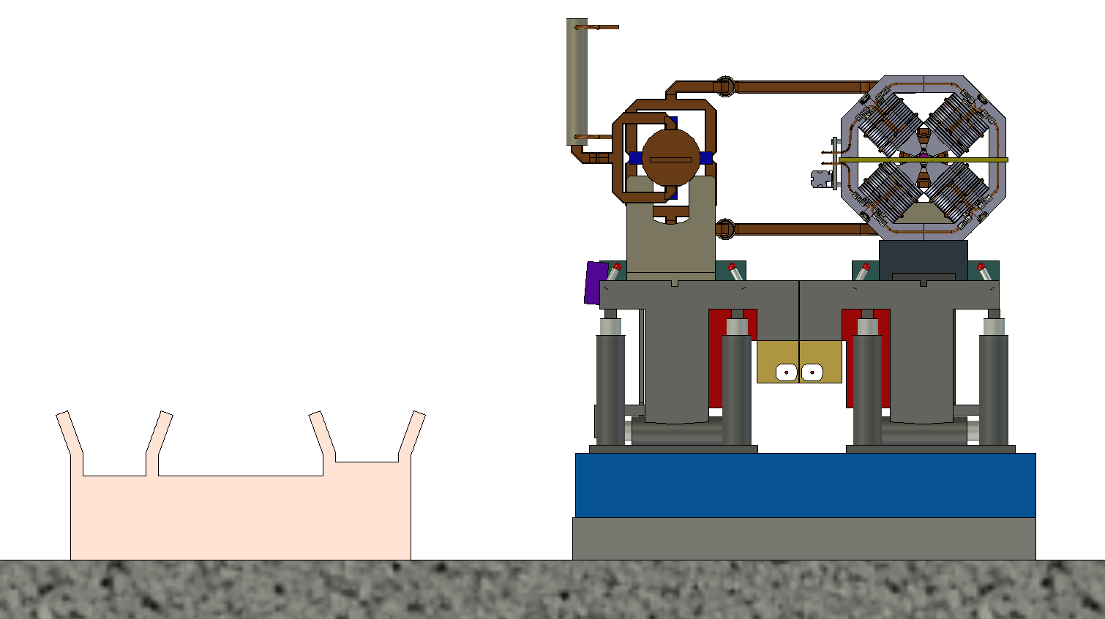
Step 2
Add installation and transportation supports

Slide 9
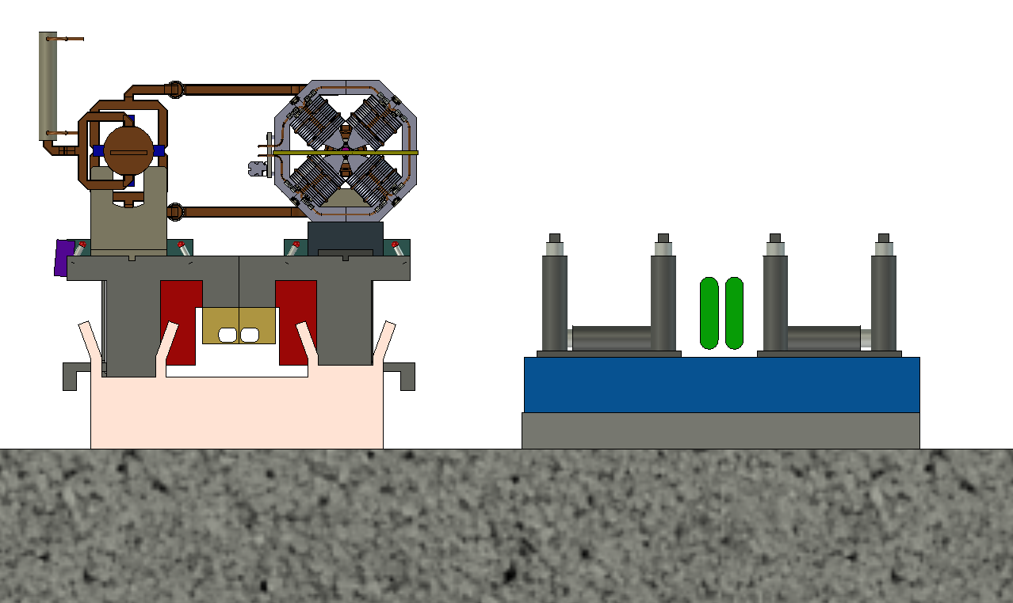
Step 3
Move module to a transportation support

Slide 10
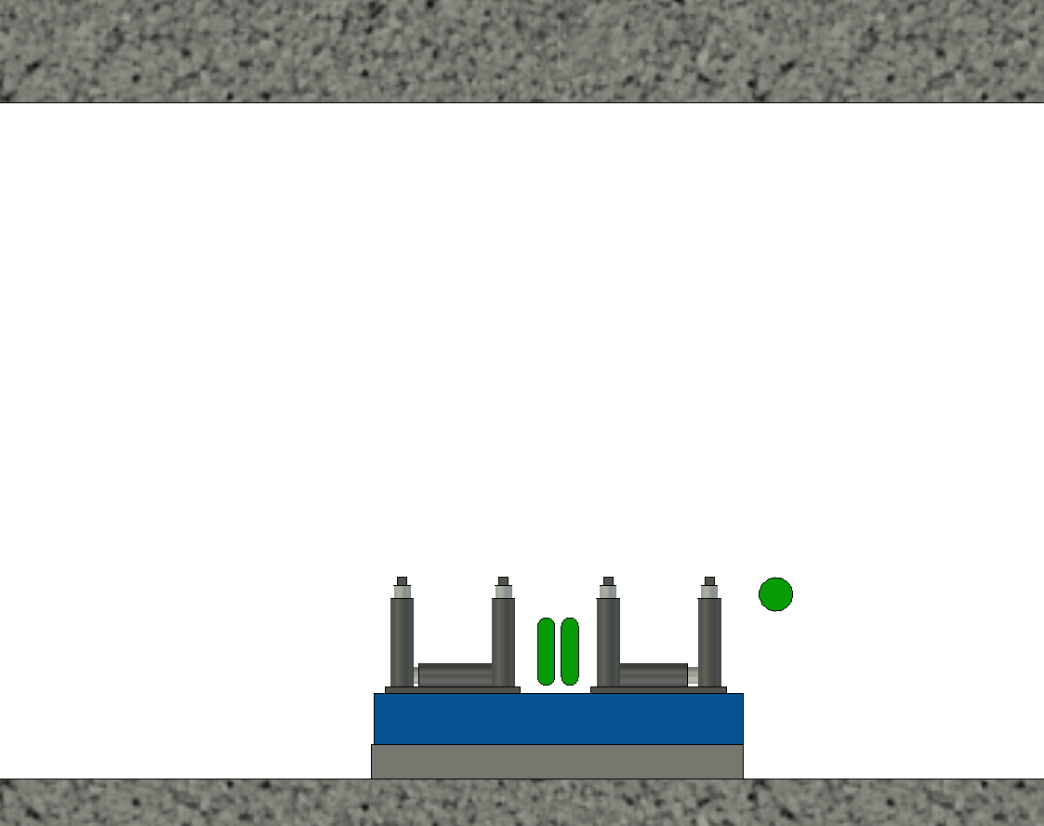
Step 4
Tunnel before module installation
- Prepare propagation network reference and pre-align supports

Slide 11
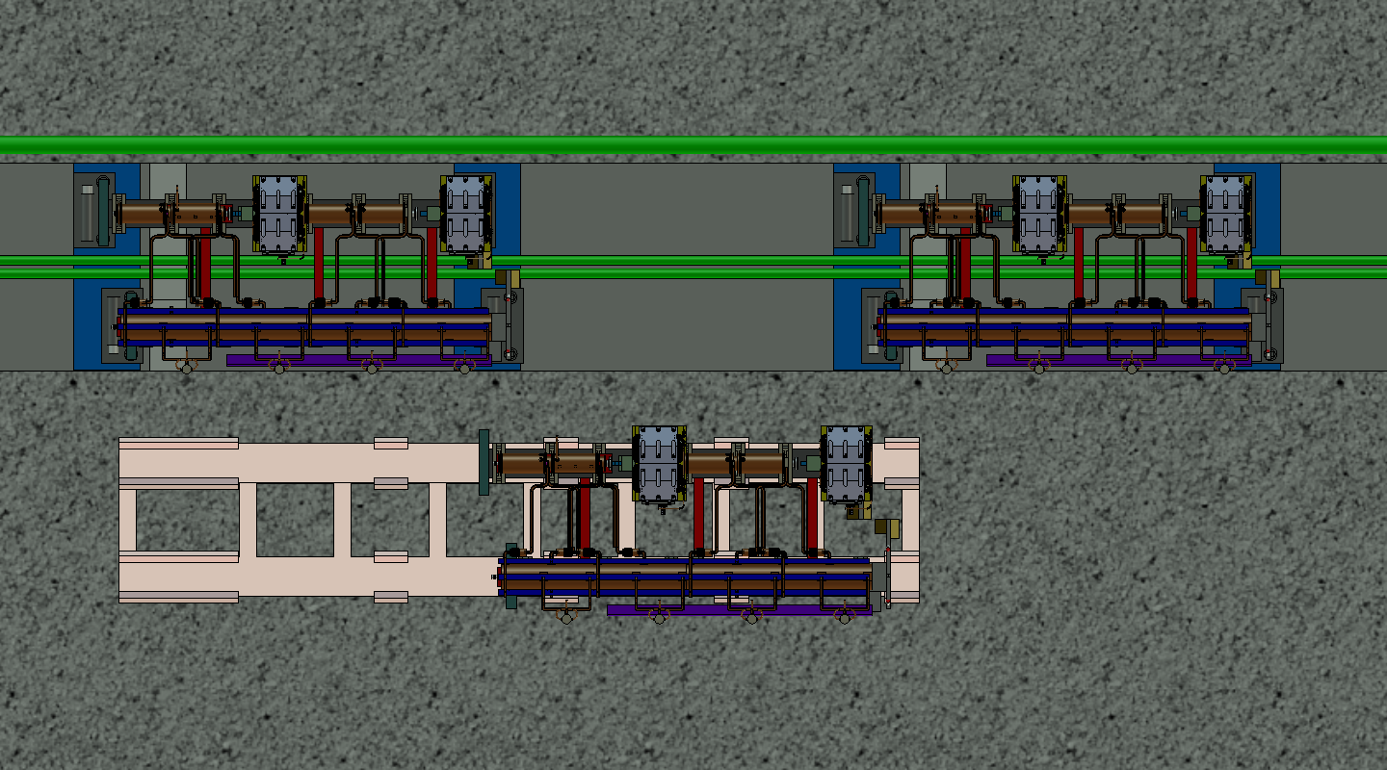
Step 5
Module at the installation point.
- Use temporary supports for installation.

Slide 12
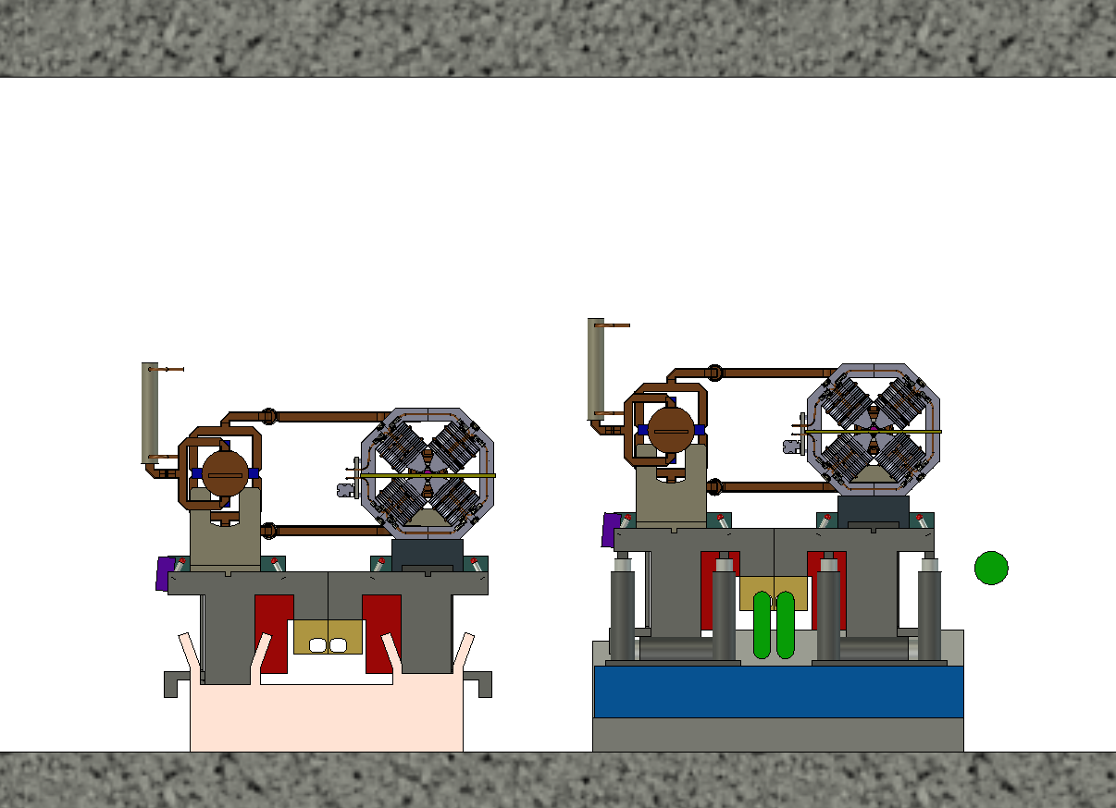
Step 5b
Module at the installation point.
- Use temporary supports for installation.

Slide 13
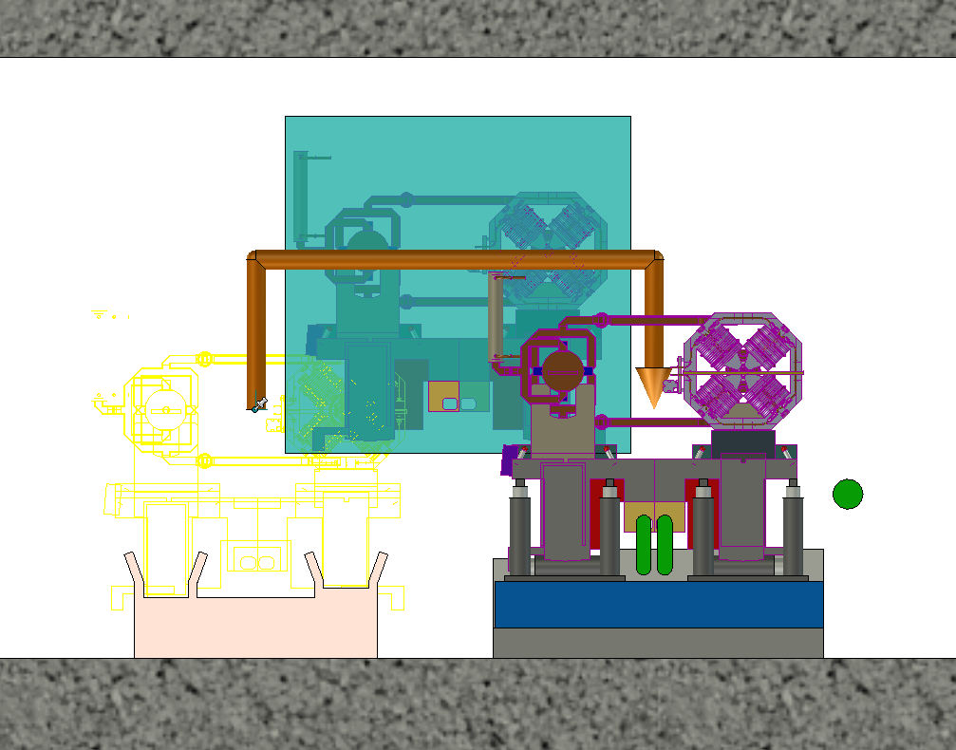
Step 6
Module installation trajectory
500

Slide 14
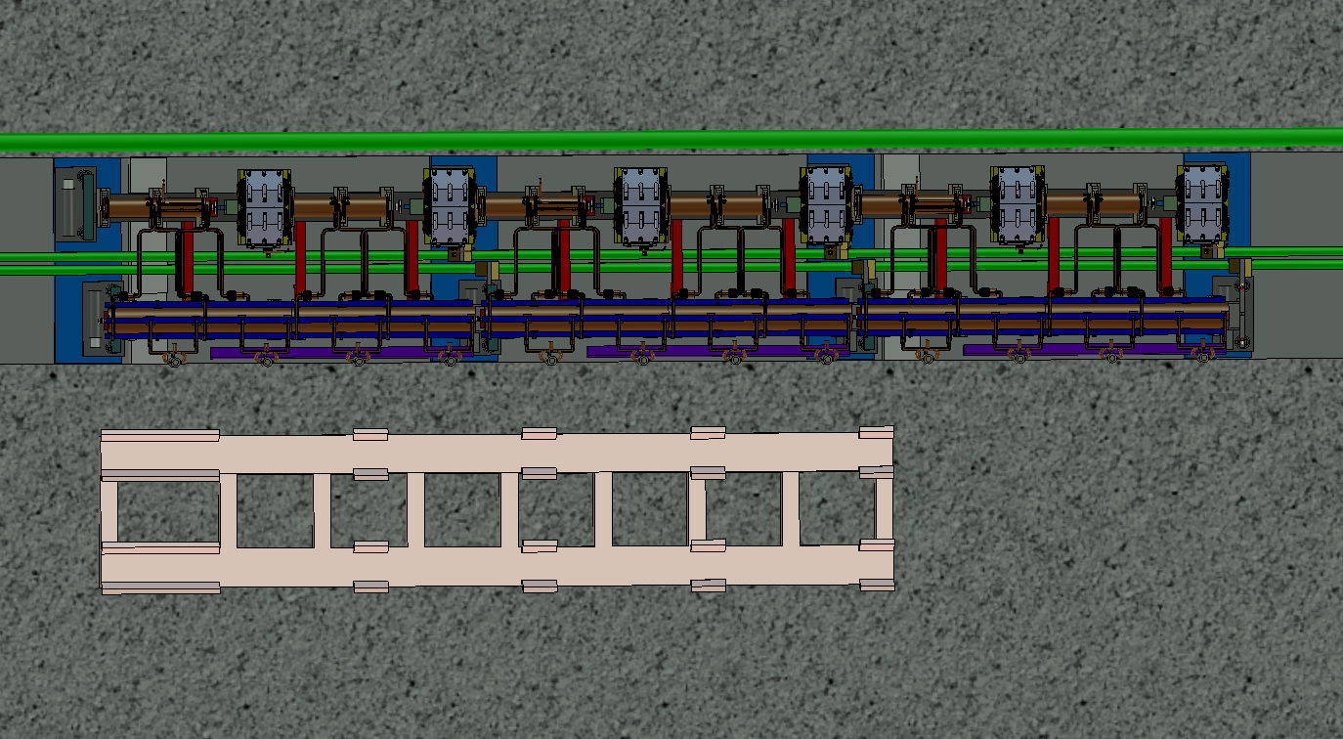
Step 7
Installed module with temporary supports

Slide 15
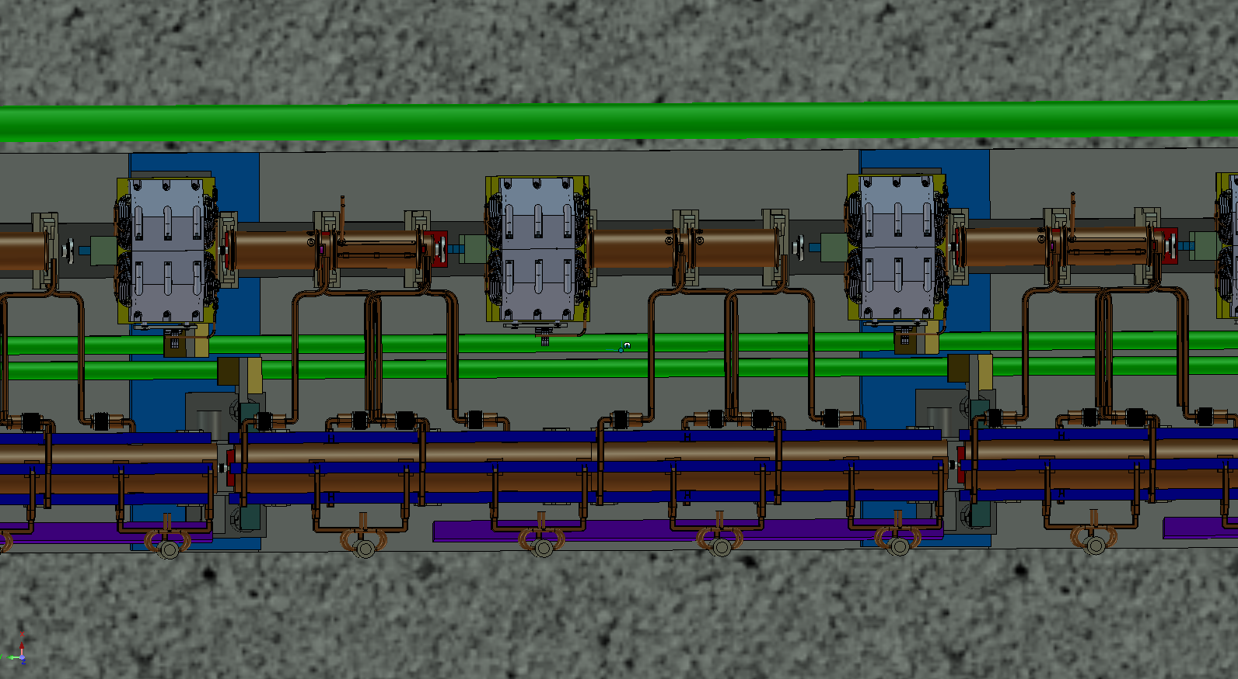
Step 7b
Installed module
- Temporary supports removed

Slide 16
CLIC
3-D Studies for module Transport
and Installation
INSTALLATION MODULES
Keith Kershaw / John Osborne / A.Kosmicki
2008 Sept. 25th

Slide 17
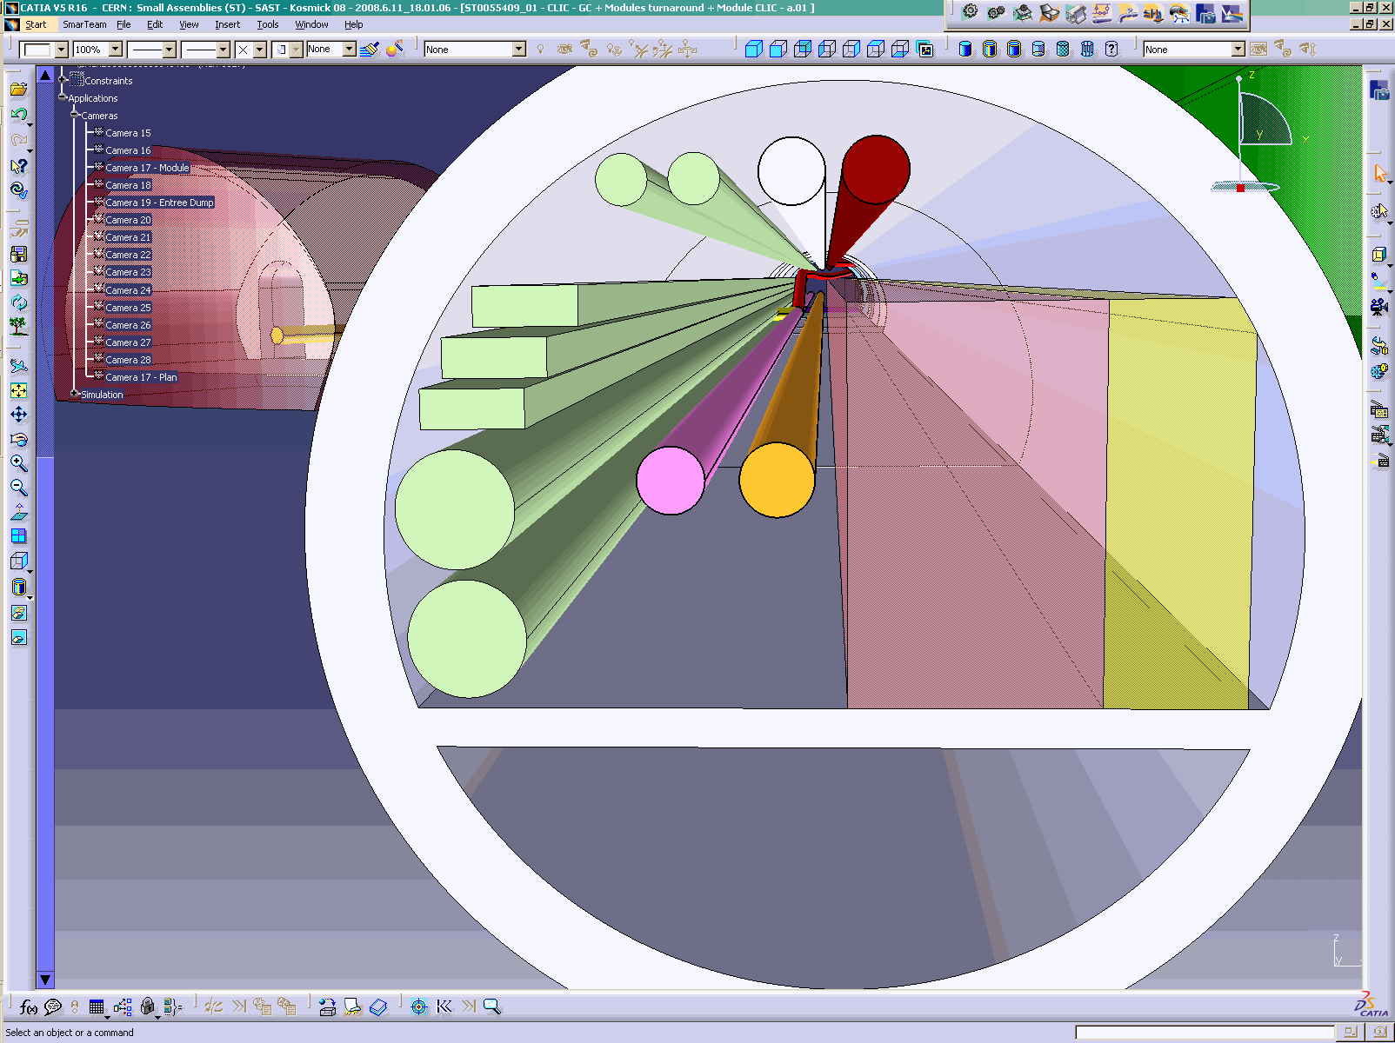
RIGHT VIEW
TYPICAL CROSS SECTION CLIC TUNNEL

Slide 18
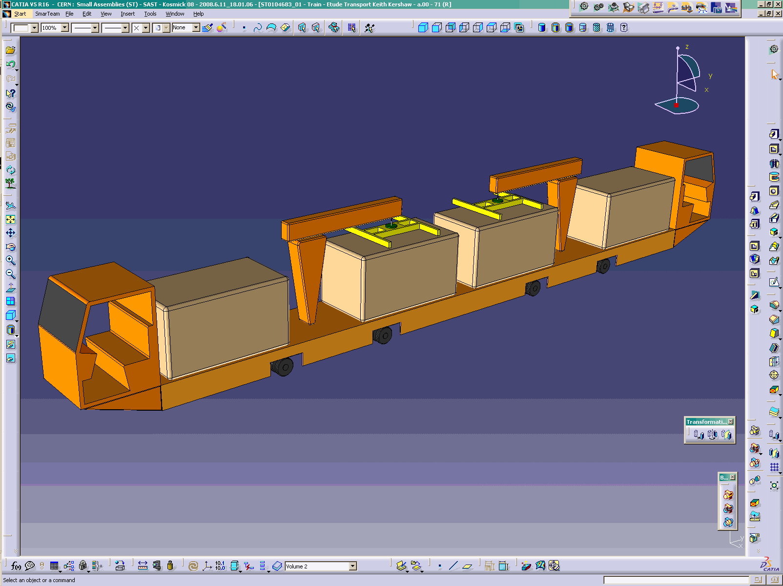

Slide 19
Vehicle conceptual design
Floor – running vehicles with on-board (un)loading cranes.
Transport several modules at a time
Avoid requirement for reserved space below beams / girders
Modular: vehicle base with separate operator cabins and interchangeable lifting equipment modules
Monorail for power (+ buffer batteries)
1200 wide x 2270 high x 12m long (+ 2.5m for cabs)
Allows reservation of space in tunnel for transport and transfer of modules (however module beam offset issues may change transfer height)

Slide 20
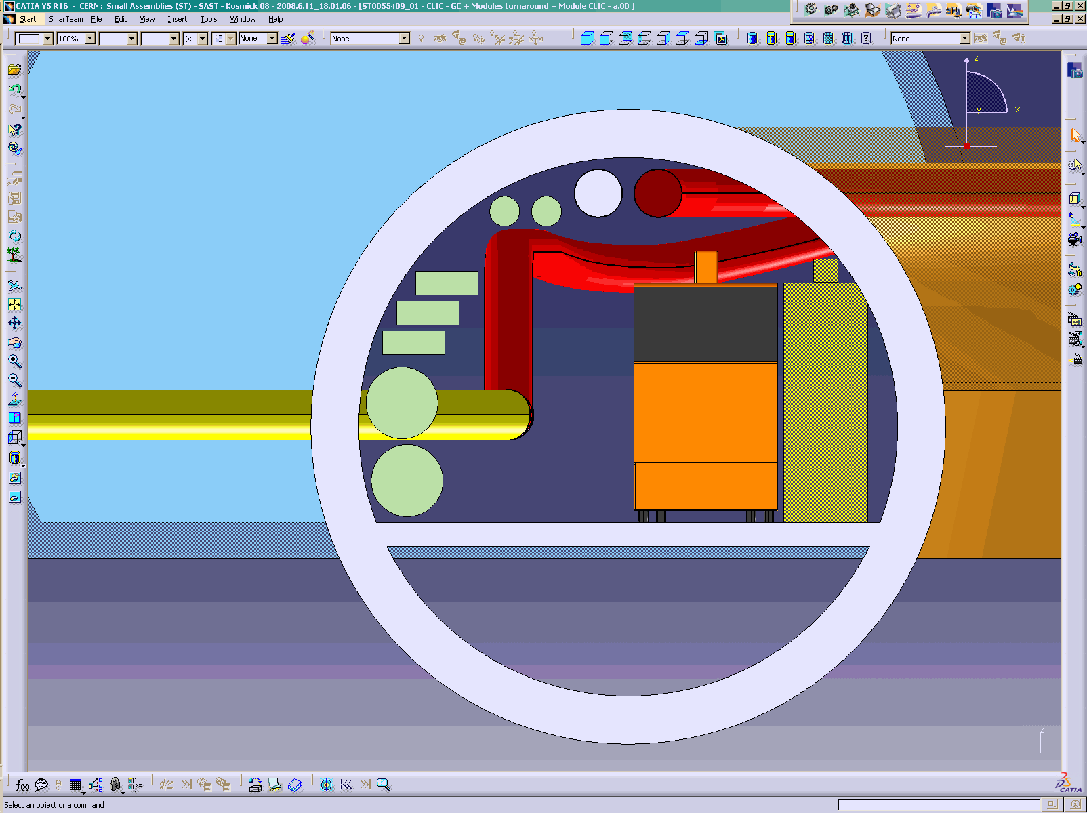
Main beam
Drive beam
2 CV pipes 250mm
Turnaround loop
Monorail
3 cable trays 520mm
2 CV pipes 600mm
Safe passage
Drive beam
Transport train
RIGHT VIEW
TYPICAL CROSS SECTION CLIC TUNNEL
Main beam

Slide 21
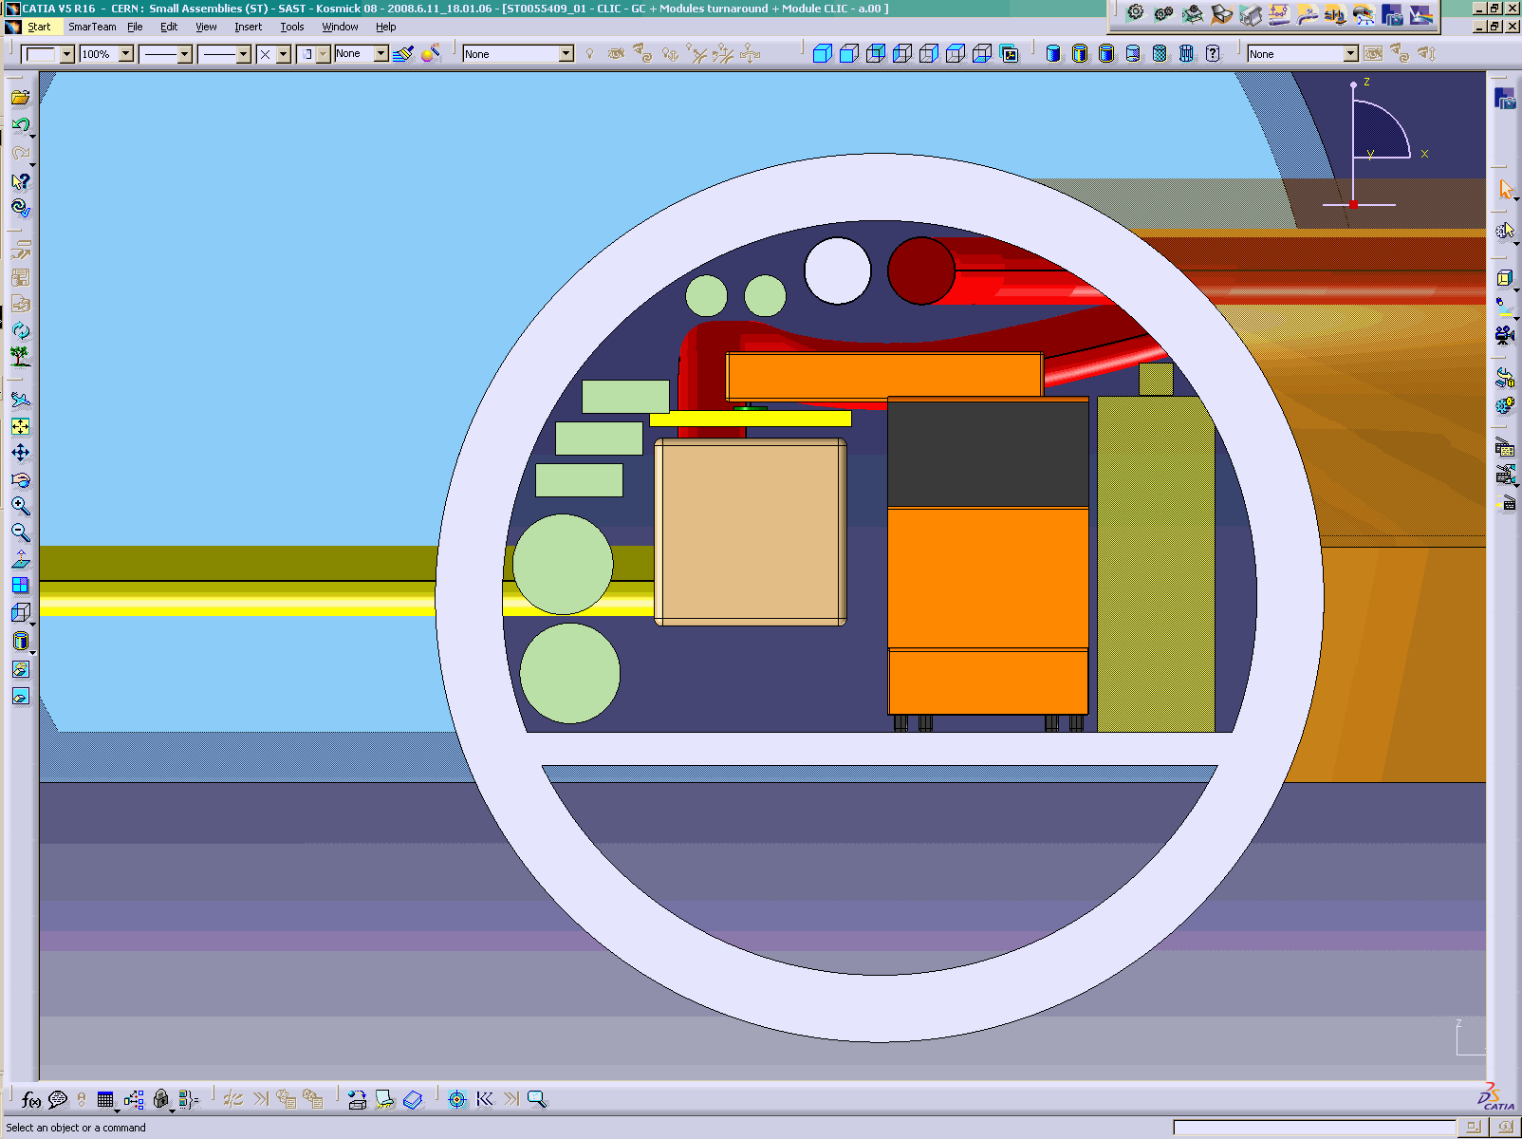
Main beam
Drive beam
2 CV pipes 250mm
Turnaround loop
Monorail
3 cable trays 520mm
2 CV pipes 600mm
Safe passage
Drive beam
Transport train
RIGHT VIEW
TYPICAL CROSS SECTION CLIC TUNNEL
Main beam

Slide 22
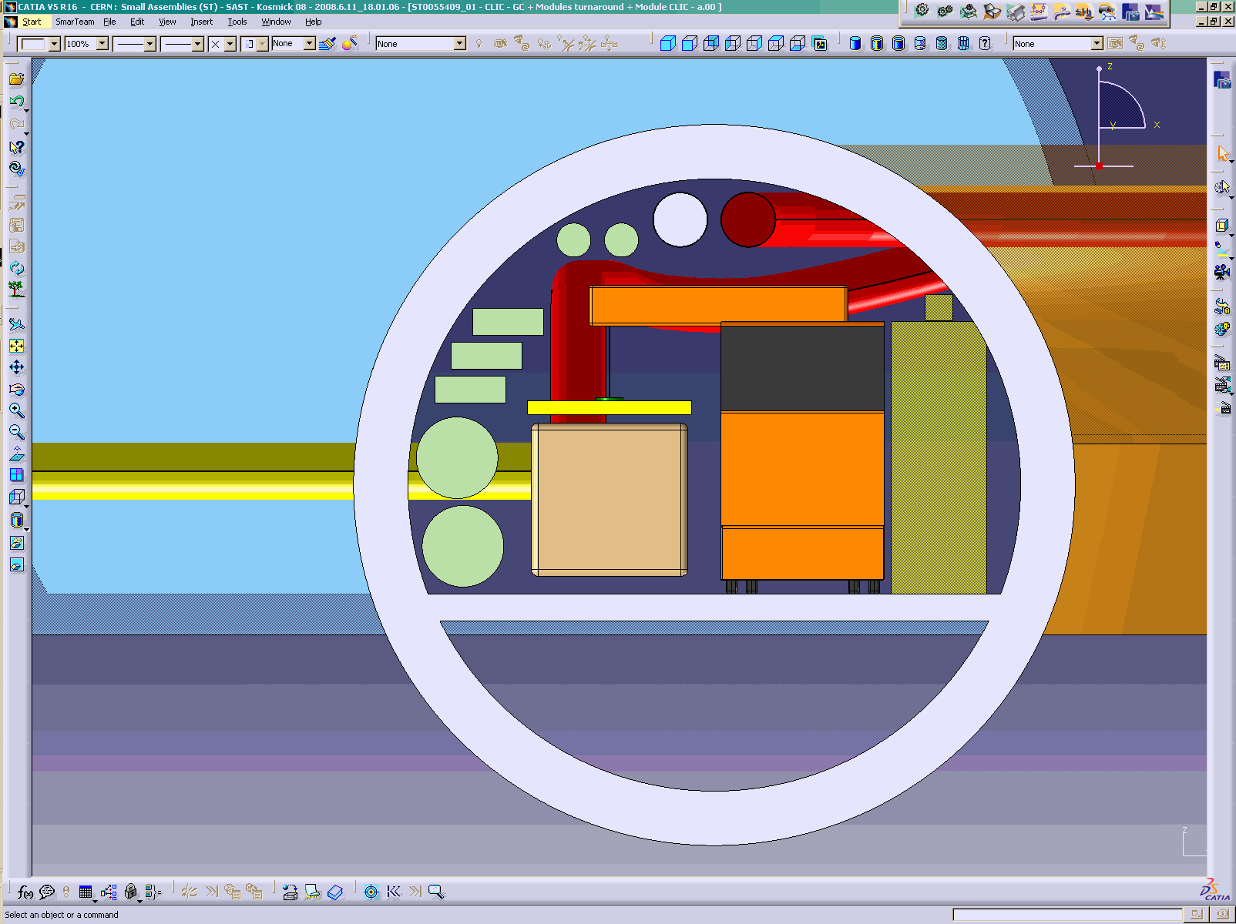
Main beam
Drive beam
2 CV pipes 250mm
Turnaround loop
Monorail
3 cable trays 520mm
2 CV pipes 600mm
Safe passage
Drive beam
Transport train
RIGHT VIEW
TYPICAL CROSS SECTION CLIC TUNNEL
Main beam

Slide 23

Main beam
Drive beam
2 CV pipes 250mm
Turnaround loop
Monorail
3 cable trays 520mm
2 CV pipes 600mm
Safe passage
Drive beam
Transport train
RIGHT VIEW
TYPICAL CROSS SECTION CLIC TUNNEL
Main beam

Slide 24
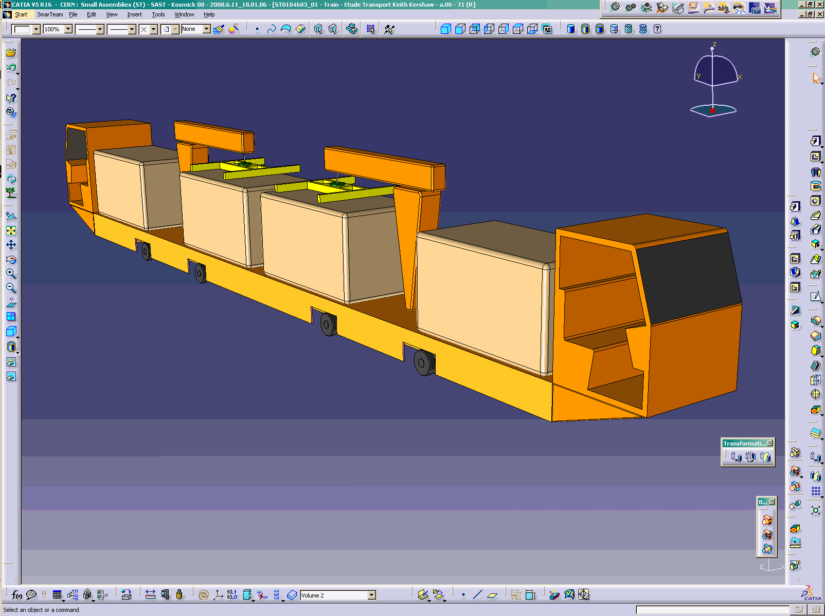

Slide 25
Lowering of modules etc
Use lifts for fast lowering of modules
Method of fast loading of modules onto vehicles
Space to allow loaded vehicles to queue before driving along tunnel (-e.g. grouped passage through interconnection work sites)
Space for maintenance /repair
Passing places to allow sorting of vehicles/modules

Slide 26
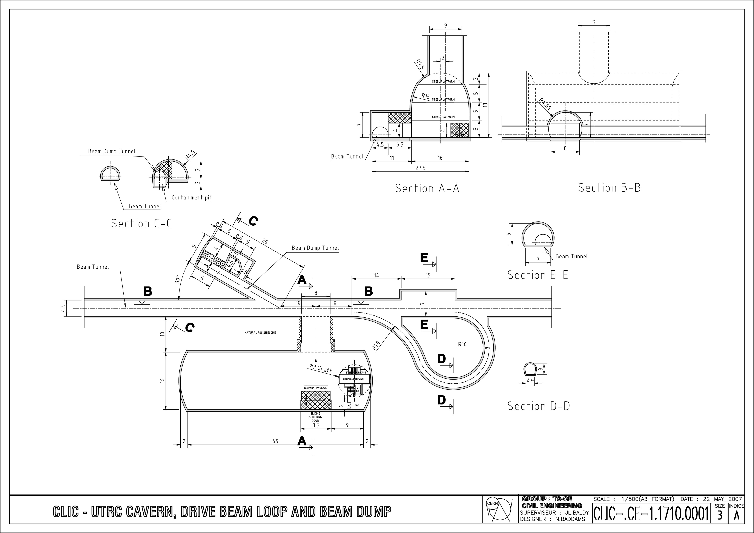
3D models are based
on Civil Engineering drawings prepared in 2007
Jonction chamber
with shielding
Shaft
Loading area
Maintenance area
10t Crane
Services area

Slide 27
Logistics – indicative figures
20,549 modules to install (assume supports already in place)
Access shafts 5km apart
Consider 1 vehicle with 4 modules
Driving speed 4km/h
Consider mid-sector (2.5km driving each way )
Ignore loading time (queuing)
Driving time = 2 x 2.5/4 =1.25hrs
Unloading / installation time = say ½ hr x4 = 2hrs
1 shift → 8 modules with one vehicle
20549 modules in 2 years (single shift, weekdays) → ~41/day → need min 6 operational vehicles for modules

Slide 28
Next steps
Agree concept as basis for further work –feedback from other groups
Continuous review and refinement as more details of modules and supports and other items and services become available
Consider transport and installation of:
Overhead magnets
Turnarounds
Beam dumps
Services

