Slide 1
New resistivity control method for carbon sputtering for fast production
Atsuhiko Ochi¹, Yasuhiro Homma¹, Tsuyoshi Takemoto¹, Fumiya Yamane¹, Satoru Yamauchi¹, Tatsuo Kawamoto², Yousuke Kataoka², Tatsuya Masubuchi², Tomoyuki Saito², Shingo Terao², Masahiro Yamatani², Tomohiro Yamazaki²
Kobe University¹, Univ. Tokyo ICEPP²
19/06/2014 RD51 mini week@ CERN

Slide 2
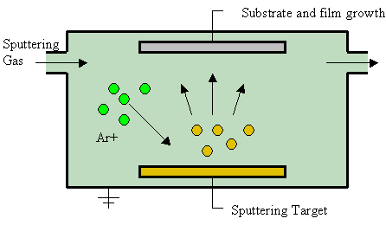
Liftoff process using sputtering
Photo resist
(reverse pattern of
surface strips)
Very fine structure (a few tens micro meter) can be formed using photo resist. (same as PCB)
Surface resistivity can be controlled by sputtering material and their thickness
@PCB company
(Laytech inc.)
Substrate (polyimide)
Metal/Carbon sputtering
@Sputtering
company
(Be-Sputter inc.)
Substrate (polyimide)
Developing the resists
@PCB company
(Laytech inc.)
Substrate (polyimide)

Slide 3
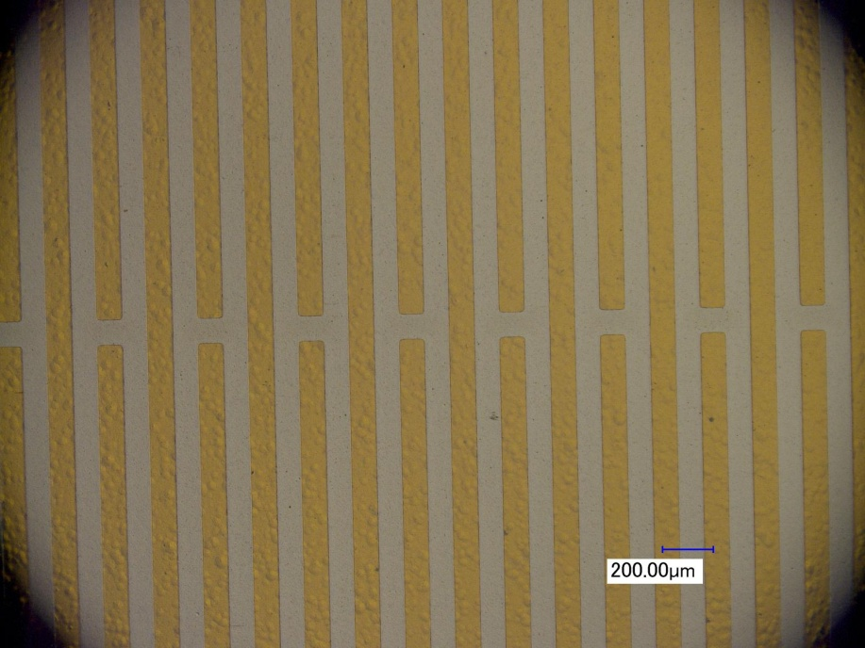
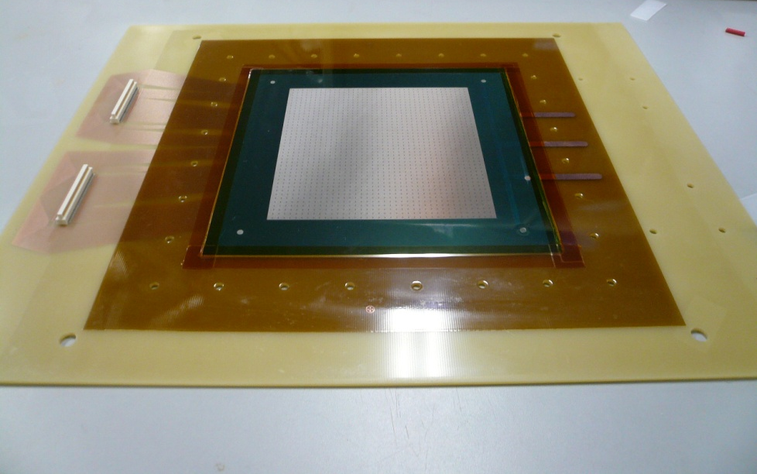
Prototype of small MicroMEGAS
June, 2013 – bulk MM
  Surface resistivity: 10MΩ/sq.
    With 300Ǻ carbon + 50Ǻ W
November, 2013 – floating mesh
  Surface resistivity: 500kΩ/sq.
    With 3600Ǻ carbon
The readout board consists of
    Readout strips (Rigid PCB).
    Resistive strip foil (Polyimide film).
  Fine strip pitch of 200 μm is formed on 25μm polyimide foil.
  Substrate thickness : 60 μm.
Carbon (300-600Å)
Tungsten (10-50Å)
Substrate (polyimide)
Mesh
Resistive strips (sputtered)
Pillar
25μm
Flexible foil (polyimide)
35μm
Bonding film
Readout strips
Rigid PCB (epoxy)

Slide 4
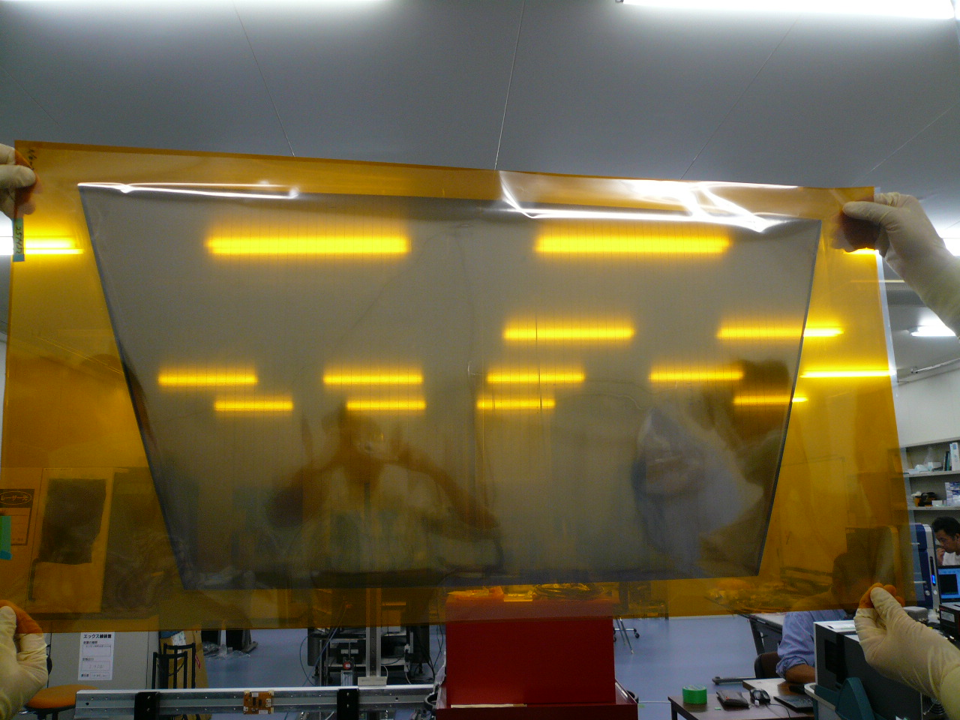
Large resistive strip foil for MSW
866.4mm
425.3mm

Slide 5

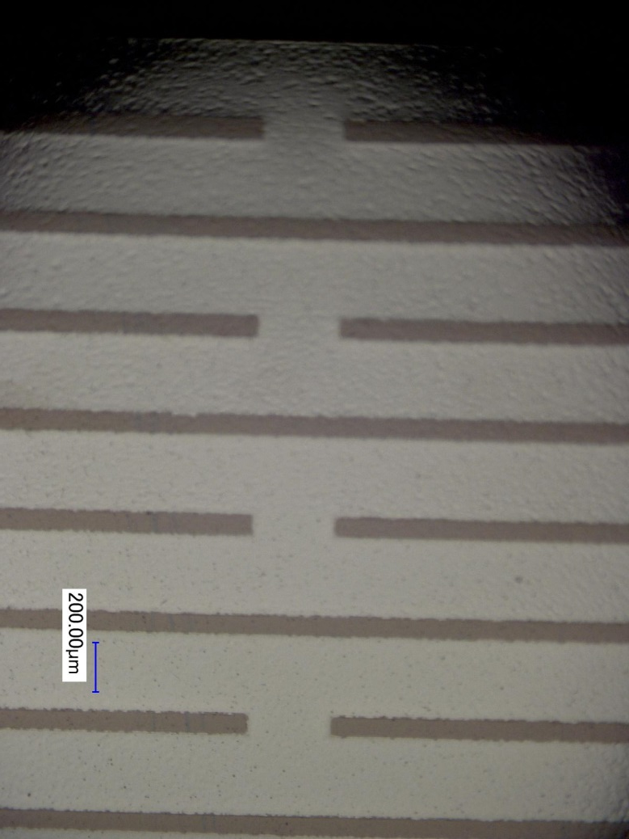
Enlarged picture of resistive strip foil
10 mm
0.3 mm
1 mm

Slide 6
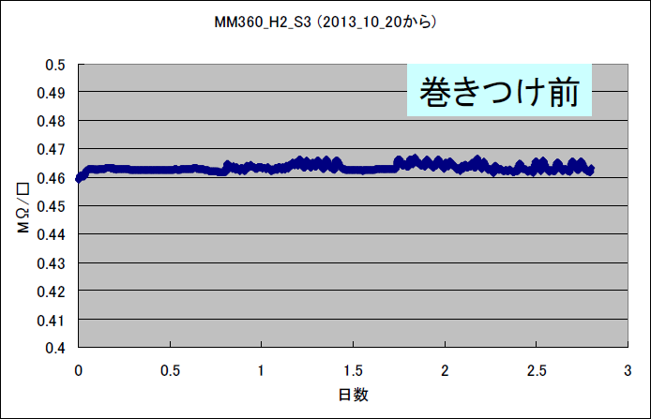
Resistivity and it’s stability
Resistivity dependence on carbon thickness
  300Ǻ → 2GΩ/sq.
  3600Ǻ → 500kΩ/sq.
  Conductivity is not proportional to the thickness (t < 1000Ǻ)
  At t > 1000Ǻ, good reproducibility found
No time variation founds after several days from sputtering
However, deposition rate is very slow.
  500-600Ǻ / hours are maximum rate in industrial chamber.
  For ATLAS MM, 3600Ǻ = 6hours are needed!!
  The MSW foils were made by this longtime sputtering.
  But we need faster way for mass production.
Carbon (3600Å)
Substrate (polyimide)
Preliminary
Surface Resistivity [MΩ/sq.]
No time variation founds
ATLAS MM requirement
Cupper thickness [Ǻ]
day

Slide 7
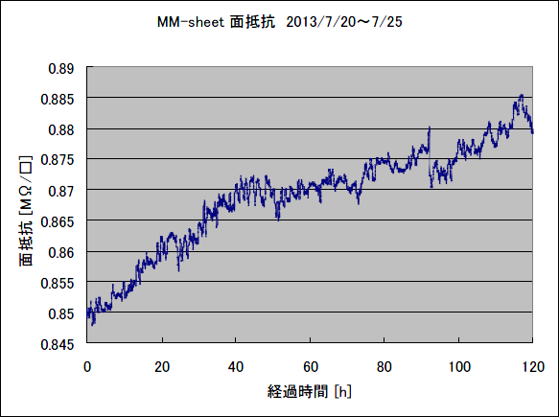
First trial … Carbon with metal
Sample
Vacuum chamber
(with Ar gas)
The sputtering chamber (in Be-Sputter Co. Ltd,) has two target stations.
  Different target can be equipped,
  e.g. Carbon + Metal
  At the first time, we have tried the Carbon and Tungsten target.
  W 50Ǻ + C 300Ǻ shows low resistivity (<1MΩ/sq.) with short ( ~ 30 min.) sputtering time.
  However, the resistivity is not stable, due to the oxidation of the metal.
It is not good way for using (thin) metal to control the resistivity.
C
Rotating drum
4.5 m round
W
Sputtering
target
Surface resistivity [MΩ/sq.]
after 3 weeks from deposition
0.89
0.88
0.87
0.86
0.85
Carbon (300Å)
Tungsten (50Å)
Substrate (polyimide)
5days

Slide 8
Pure carbon with two stations
Sample
Vacuum chamber
(with Ar gas)
For preparing double carbon target, we can reduce the sputtering time to half.
  For 3600Ǻ carbon foil,
  6 hours → 3hours
  It was great reduction, but we need more …
  Can we reduce it to less than 1 hour ?
C
Rotating drum
4.5 m round
C
Sputtering
target

Slide 9
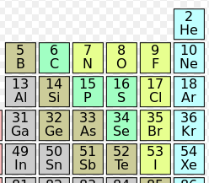
New idea: Nitrogen doping
Vacuum chamber
(with Ar + N₂ gas)
Sample
The structure of the sputtered carbon is amorphous diamond like carbon (a-DLC).
It is thought that the charge carrier is very few in the DLC
So, I got an idea of nitrogen doping as a supplier of carrier electrons.
  This is same story as the n-type semiconductor production.
The nitrogen is easy to introduce into the sputtering chamber with Argon gas.
C
Rotating drum
4.5 m round
C
Sputtering
target
Dope

Slide 10
N₂ doping – first trial (May, 2014)
For the first trial for N2 doping, following two samples were made and tested for 2hour sputtering.
  3.2 % N₂ gas in Argon gas
  50 % N₂ gas in Argon gas
Results are very interesting
Those trial were followed by systematic test for varying the N₂ (a few %) content and thickness
N₂ content | Thickness | Surface resistivity
0% (pure Argon) | 2100 Ǻ | 2.1 MΩ/sq.
3.2% | 2400 Ǻ | 0.055 MΩ/sq.
50% | 3900 Ǻ | 46 MΩ/sq.

Slide 11
Resistivity vs N₂ content (June, 2014)
The resistivity is strongly reduced by nitrogen doping.
Surface resistivity of 1000Ǻ foils:
  Pure carbon → 5MΩ/sq.
  3.2% N₂ in Ar → 400kΩ/sq.
Thickness: 1000Ǻ (60min sputtering with 2 stations)
Surface Resistivity[MΩ/sq.]
ATLAS MM requirement
Nitrogen content in chamber [%]

Slide 12
Resistivity vs thickness (June, 2014)
For 3.2% N₂ content foils
  2400Ǻ → 55kΩ/sq.
  700Ǻ → 700kΩ/sq. (42min. sputter)
Resistivity vs thickness
Surface Resistivity[MΩ/sq.]
N₂ content in Ar is 3.2%
Thickness [Ǻ]

Slide 13
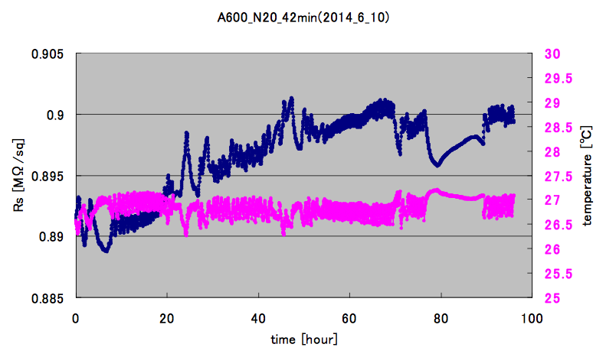
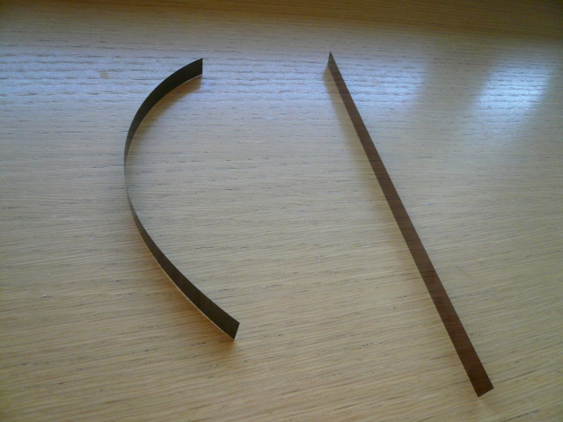
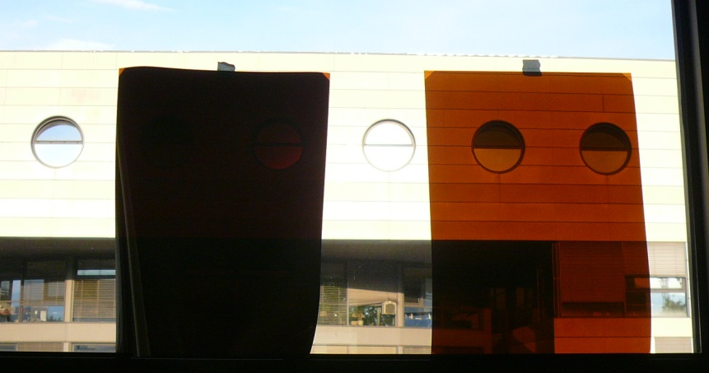
Properties of N-doped carbon foil
3.2% N-doped with 700Ǻ thickness foil was tested.
Stability of the resistivity
  It will be ok
    ~1% changing is observed in 4 days measurements, 4 days after sputtering).
    It seems to be the balanced value.
  We need more measurements
Stress of the foil
  Very small, comparing with the thick carbon foil.
Mechanical and chemical tolerance check should be done
  Same test as applying to thick(3600Ǻ) foil
Surface resistivity
AC off
Temperature
4 days
C(N) :700Ǻ
C:3600Ǻ
C:3600Ǻ
C(N) :700Ǻ

Slide 14
For ATLAS MM mass production
The sputtering process is most time consuming.
  We need [sputtering time] + 1.5 hours (load and eject the materials, vacuuming etc.) for one batch.
  6 foils can be sputtered in one batch.
  For 2048 foils … 350 batch needed
Estimation for production rate
Foil type | Time/batch | Batch/day (day work) | Batch/day (24h work) | Prod. period (day work) | Prod. period (24h work)
Thick carbon | 4.5 hours | 2 | 5 | 8.5 month | 3.5 month
N-doped C | 2.2 hours | 4 | 10 | 4.3 month | 2 month

Slide 15
Future prospects
Test, test and test
  Mechanical tolerance test
    Peeling test
    Bending test
  Chemical tolerance test
    Tolerance test for PCB related liquid
      Tomorrow, at Rui’s workshop
  Stability test
    Resistivity
    Migration
Fine pattern making with Liftoff process
This technique will be used in Module-0 for ATLAS NSW MM
  Also we will make small prototypes for aging test

Slide 16
Summary
The new resistivity control technique for carbon sputtered foil is developed using Nitrogen doping
Very wide range of the surface resistivity is available between 50kΩ/sq. and 4GΩ/sq., in our experience.
The stability and tolerance test should be continued for N-doped carbon foil.
N-doping technique is very promising for mass production process of ATLAS MM resistive foils.

