Slide 1
Two Beam Module
Program News
Organizational changes
Measurements on the Test Module
Status of the CLEX module
Outlook and conclusions

Slide 2
Organizational changes
Germana left the BE-department and the rf-group as of May 1st
All activities have been integrated into BE-RF-MK
(section leader: Olivier Brunner)
Nuria took on the x-band structure fabrication and development
Markus and Steffen are responsible for the two beam module program
Future industrialization studies remain with Philippe, some structure related studies are likely followed up by Nuria

Slide 3
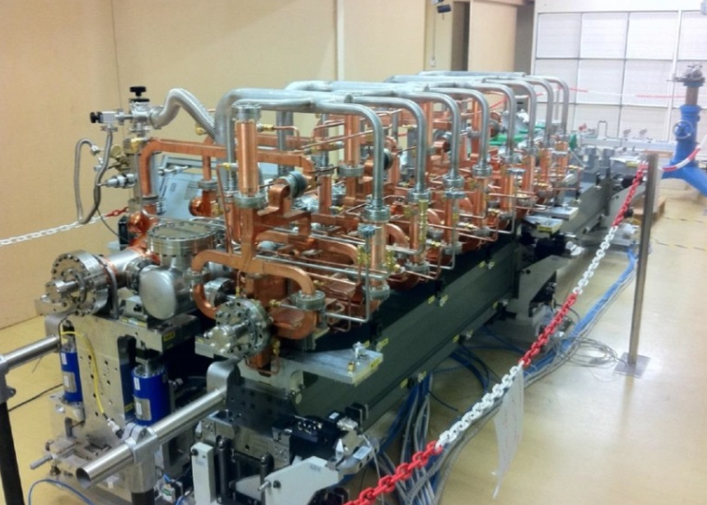
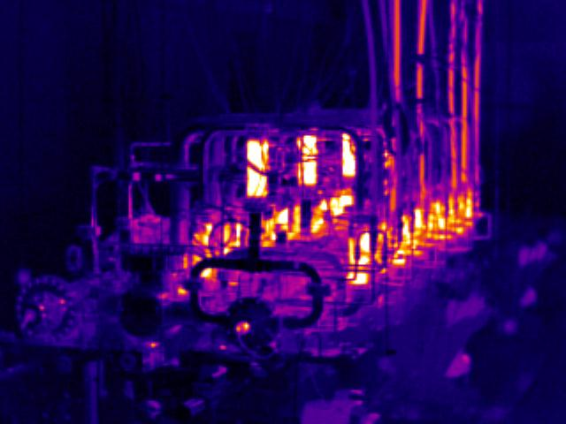
TBM status
infrared camera
Mechanical prototype module successfully constructed
Currently under thermal and alignment testing
Two more modules under assembly for integrated tests
One module under construction for beam testing in CTF3.
Installation will start end of June
Module test program in the lab until 2015, in CLEX until 2016
Future plans: Incorporate lesson learned form the test program into the design of next generation modules and industrialization studies

Slide 4
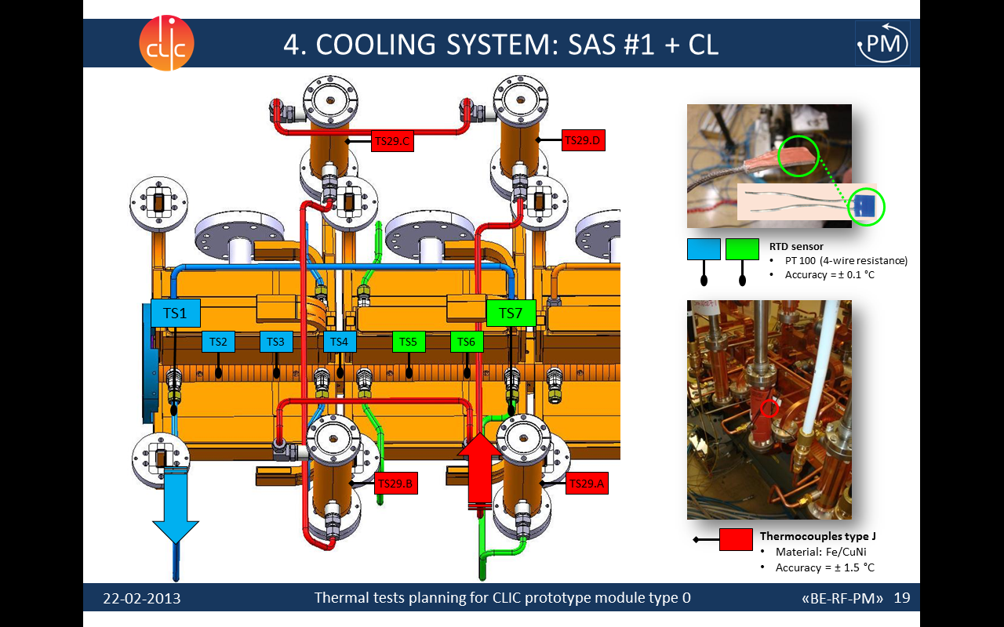
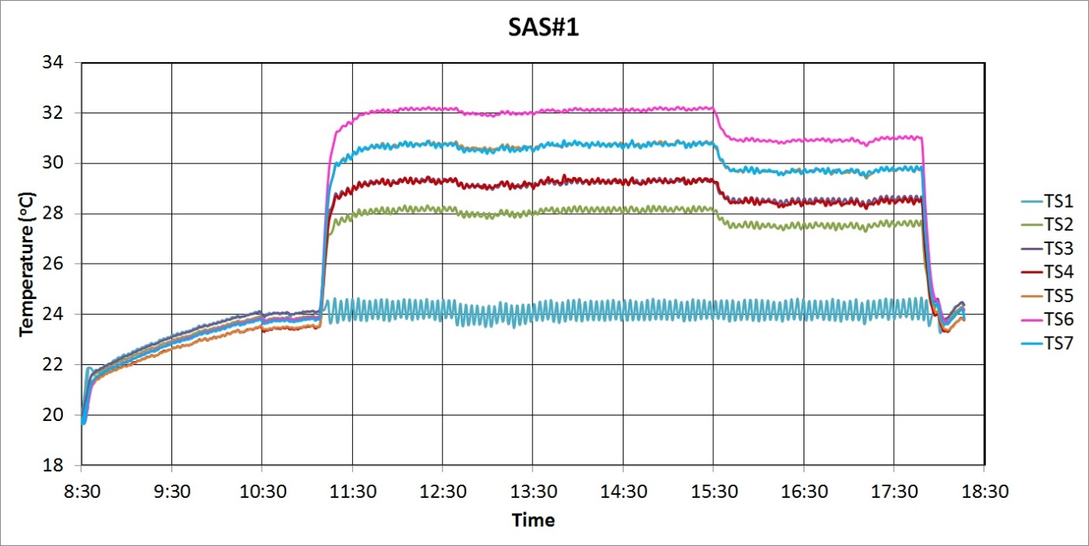
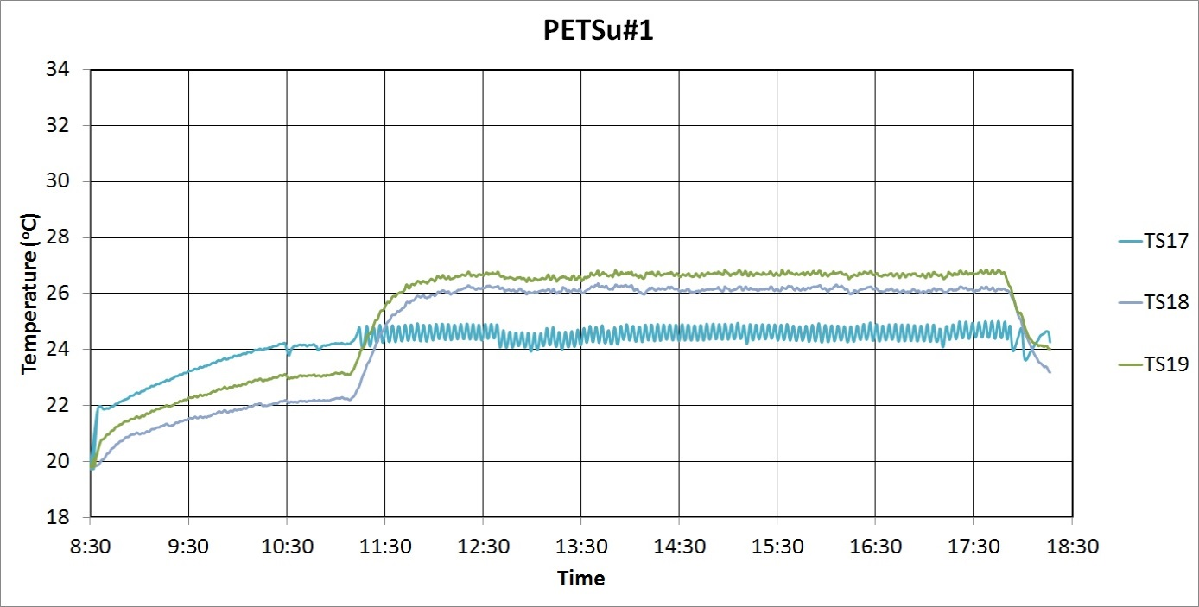
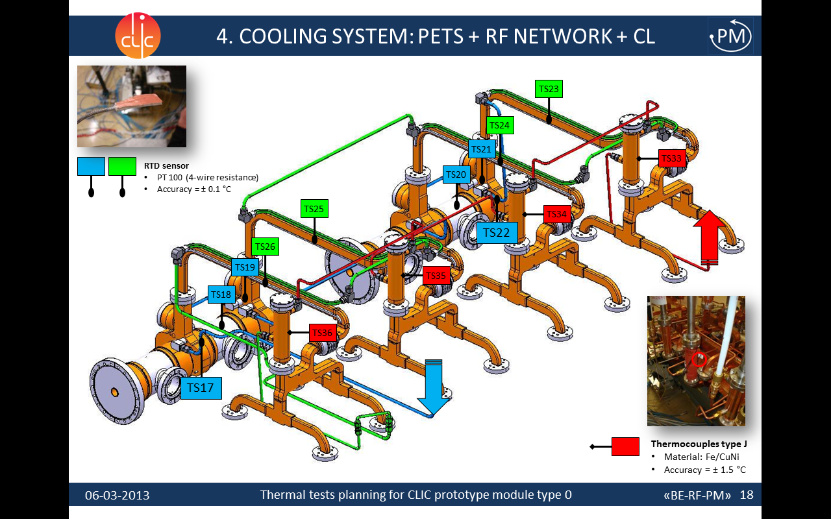
Thermal test data example
Water only
Unloaded
Loaded
Temperature fluctuation: ± 0.2 ºC
Elena Daskalaki, Alex Vamvakas,
Anastasia Xydou
Temperature evolution (Zero - Unloaded - Loaded conditions)

Slide 5
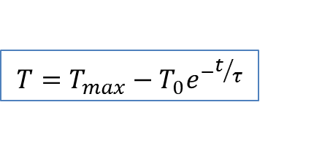
Results
Thermal time constants
Component | Time constant τ (min)
SAS#1 | 5.16
SAS#2 | 5.30
SAS#3 | 5.05
SAS#4 | 5.08
AS Load 1 | 1.86
AS Load 2 | 2.00
AS Load 3 | 1.90
AS Load 4 | 1.80
PETSu#1 | 16.19
PETSu#2 | 18.83
WG | 18.61
RFN Loads | 1.80
$$T=T_{max}−T_{0}e^{−t/τ}$$
62.3% of ΔΤ
ΔΤ
τ
Elena Daskalaki

Slide 6
Results and comparison with
FE-simulations
Components’ temperatures in steady-state (ºC)
 | DBQ only |  |  | Unloaded |  |  | Loaded
 | Experiment | Simulation | Diff. | Experiment | Simulation | Diff. | Experiment | Simulation | Diff.
SAS#1 | 23.7 | 24.5 | 0.8 | 29.5 | 31.9 | -2.4 | 29.0 | 30.7 | -1.7
SAS#2 | 24.3 | 24.5 | 0.2 | 32.2 | 29.7 | 2.5 | 31.5 | 29.3 | 2.2
SAS#3 | 24.4 | 24.5 | 0.1 | 32.2 | 31.8 | 0.4 | 31.5 | 31.2 | 0.3
SAS#4 | 24.2 | 24.4 | 0.2 | 32.2 | 29.2 | 3.0 | 31.5 | 29.0 | 2.5
PETSu#1 | 22.7 | 23.2 | 0.5 | 25.9 | 29.8 | -3.9 | 26.4 | 27.6 | -1.2
PETSu#2 | 23.2 | 23.2 | 0.0 | 29.4 | 32.4 | -3.0 | 30.1 | 29.3 | 0.8
DBQ#1 | 37.6 | 39.3 | 1.7 | 34.4 | 32.2 | 2.2 | 33.2 | 31.8 | 1.4
DBQ#2 | 36.1 | 38.4 | 2.3 | 33.6 | 33.9 | -0.3 | 31.8 | 33.6 | -1.8
Elena Daskalaki, Alex Vamvakas, Anastasia Xydou

Slide 7
Further analysis
T_{amb}
Q_{air}
Q
Q_{water}
T_{water, in}
T_{water, out}
ΔT_{water}
Elena Daskalaki, Alex Vamvakas, Anastasia Xydou

Slide 8
Further analysis
 | T_{water,in} (ºC) | T_{water,out} (ºC) | ΔT (ºC) | Q_{water} (W) | T_{amb} (ºC) | T_{comp} (ºC) | Q_{air} (W) | Q_{tot} (W) | F (m3/h) | F_{measured} (m3/h)
SAS1 | 24.12 | 30.02 | 5.90 | 744 | 20.00 | 29.16 | 73 | 817 | 0.108
SAS2 | 24.44 | 32.12 | 7.69 | 720 | 20.00 | 32.18 | 97 | 817 | 0.081
SAS3 | 25.05 | 35.01 | 9.96 | 701 | 20.00 | 34.53 | 116 | 817 | 0.061
SAS4 | 25.12 | 33.34 | 8.22 | 714 | 20.00 | 32.94 | 103 | 817 | 0.075
SAS total |  |  |  |  |  |  |  |  | 0.324
PETS | 24.63 | 29.37 | 4.74 | 267 | 20.00 | 27.79 | 153 | 420 | 0.048
Total |  |  |  |  |  |  |  |  | 0.373 | 0.311
One flow meter measures the total flow
Flow at each cooling channel (4 SAS and PETS) is not known
Flow meter accuracy: ± 2% measured value
Elena Daskalaki, Alex Vamvakas, Anastasia Xydou

Slide 9
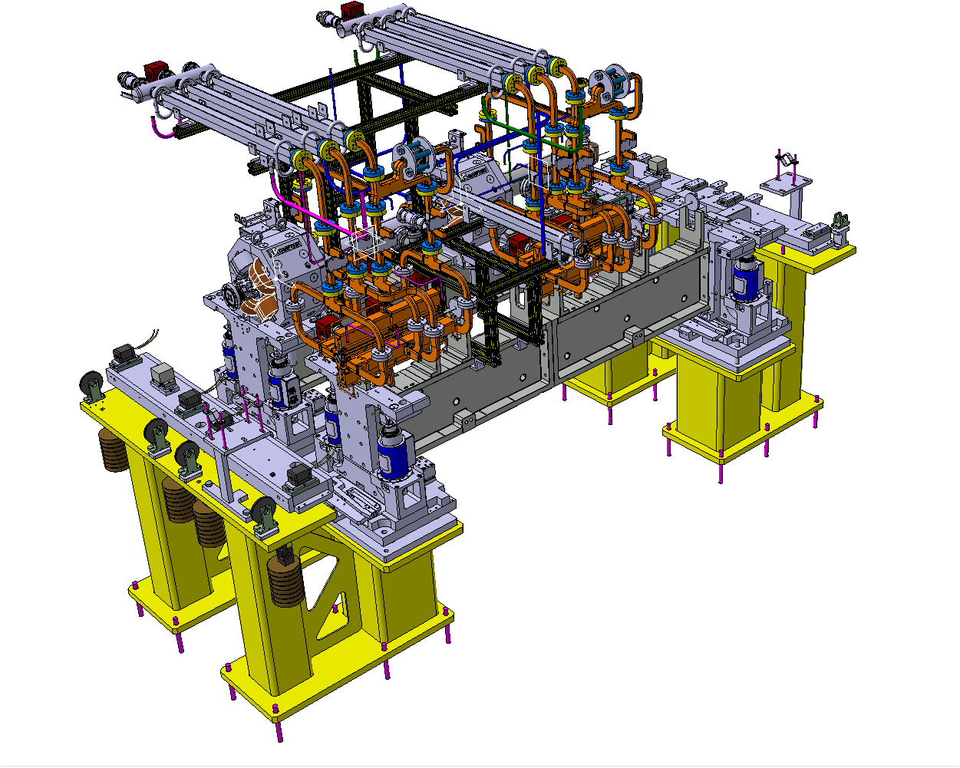
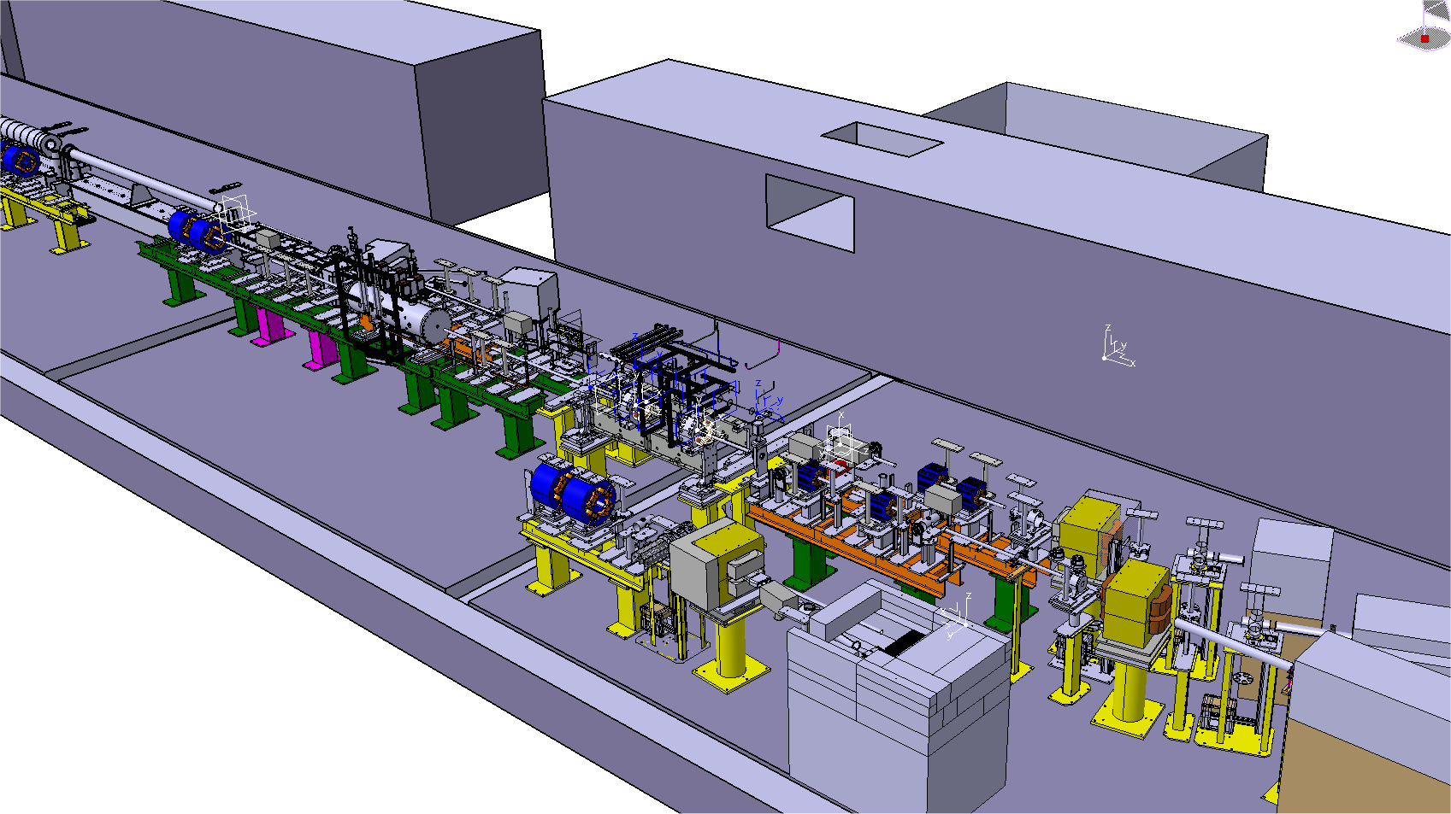
CLEX module installation
Dmitry Gudkov

Slide 10
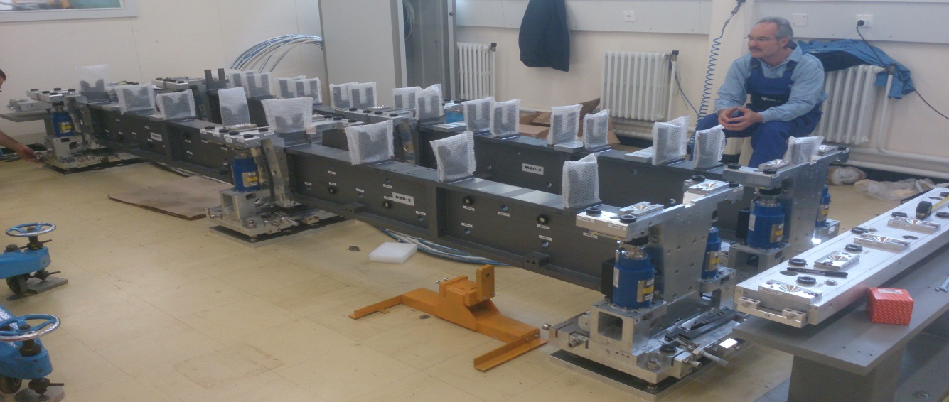
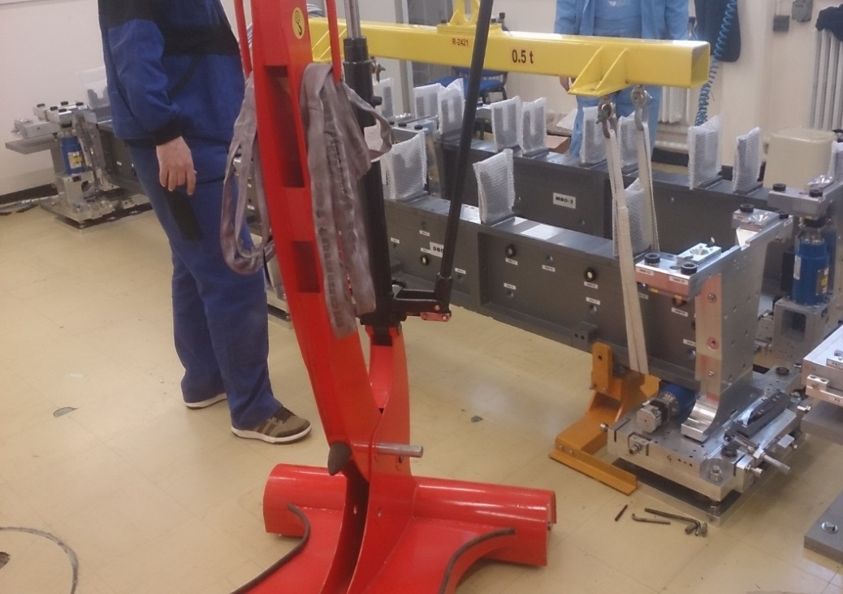
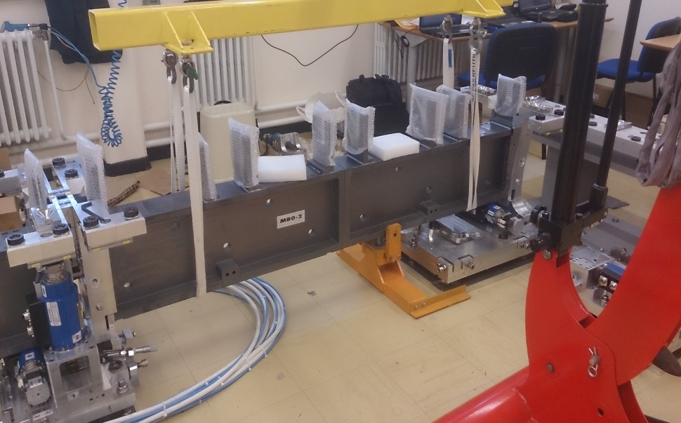
CLEX module supporting system received and tested

Slide 11
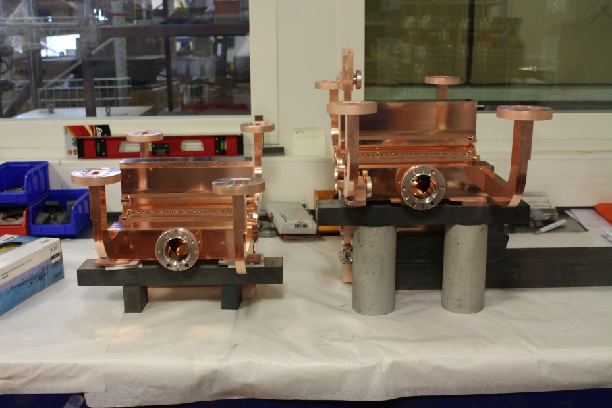
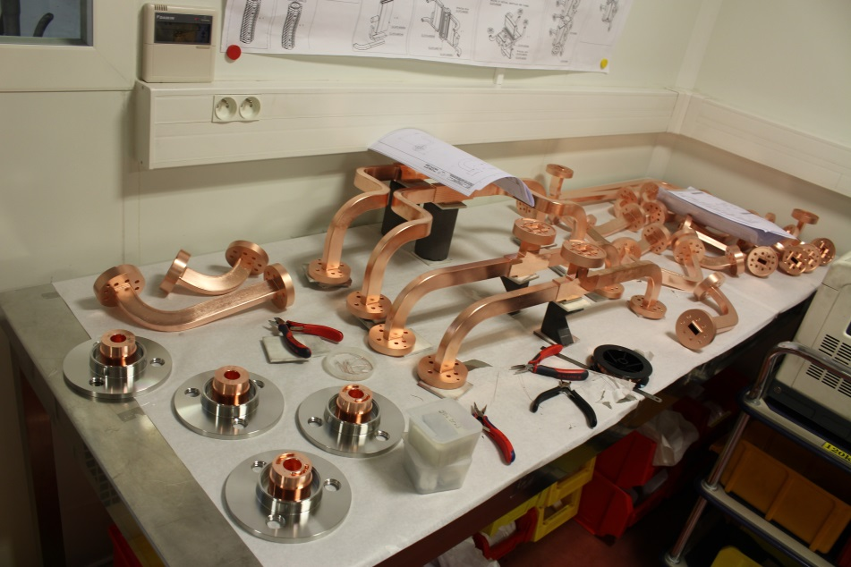
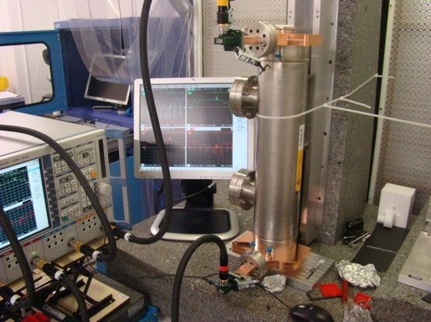
Status of main components
Pets, DB-Quad and girder available
ACC-structures: final brazing steps
Waveguide system: final brazing steps
BPM: rf test and assembly
Missing: some supports, clamps, transition beam chambers

Slide 12
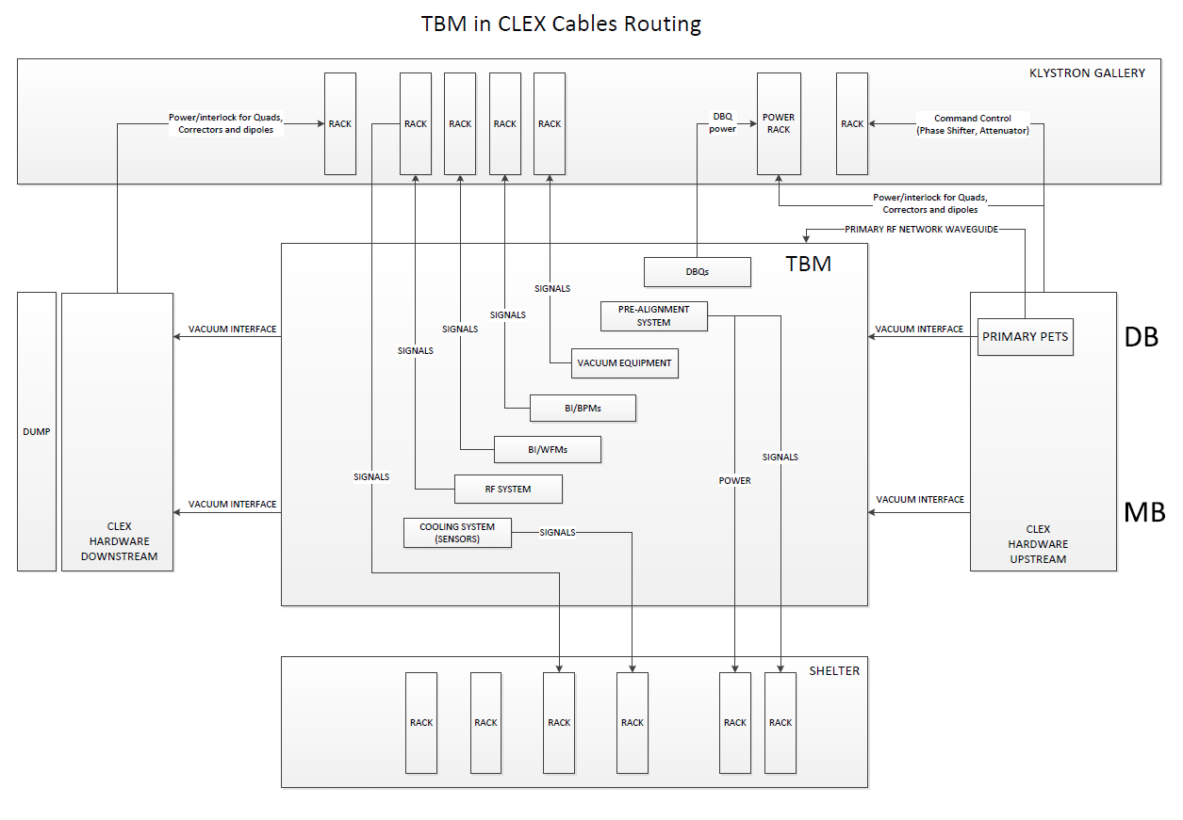
CLEX module installation
Cabling scheme preparations
Dmitry Gudkov, Stephane Curt, Wilfrid Farabolini

Slide 13
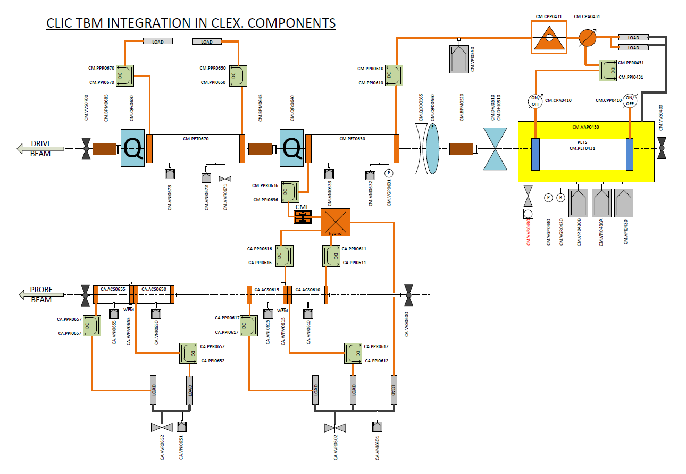
CLEX module installation
Equipment identification and naming for control integration
Dmitry Gudkov, Stephane Curt, Wilfrid Farabolini

Slide 14
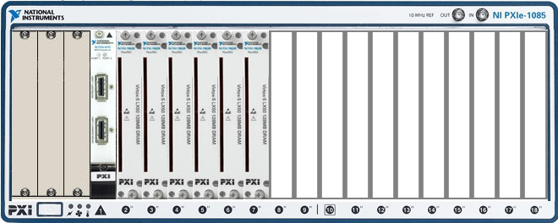
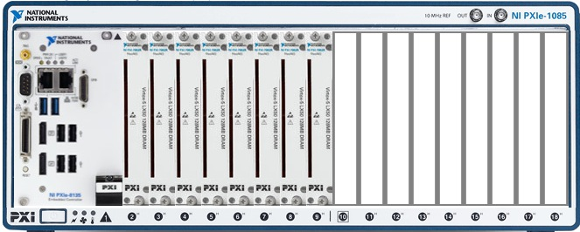
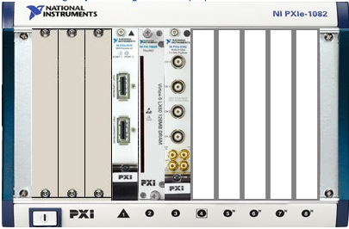
Module electronics for CLIC
Examples base on NI-hardware, a radiation environment test is planned in CTF3 acquiring rf signals from the CLEX module
Adriaan Rijllart

Slide 15
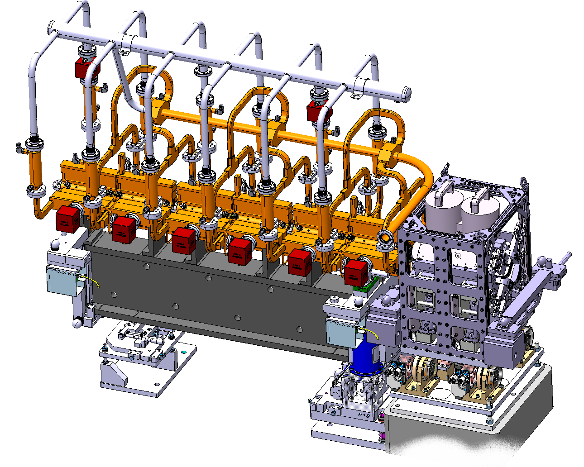
Klystron base module design
Alexandre Samochkine

Slide 16
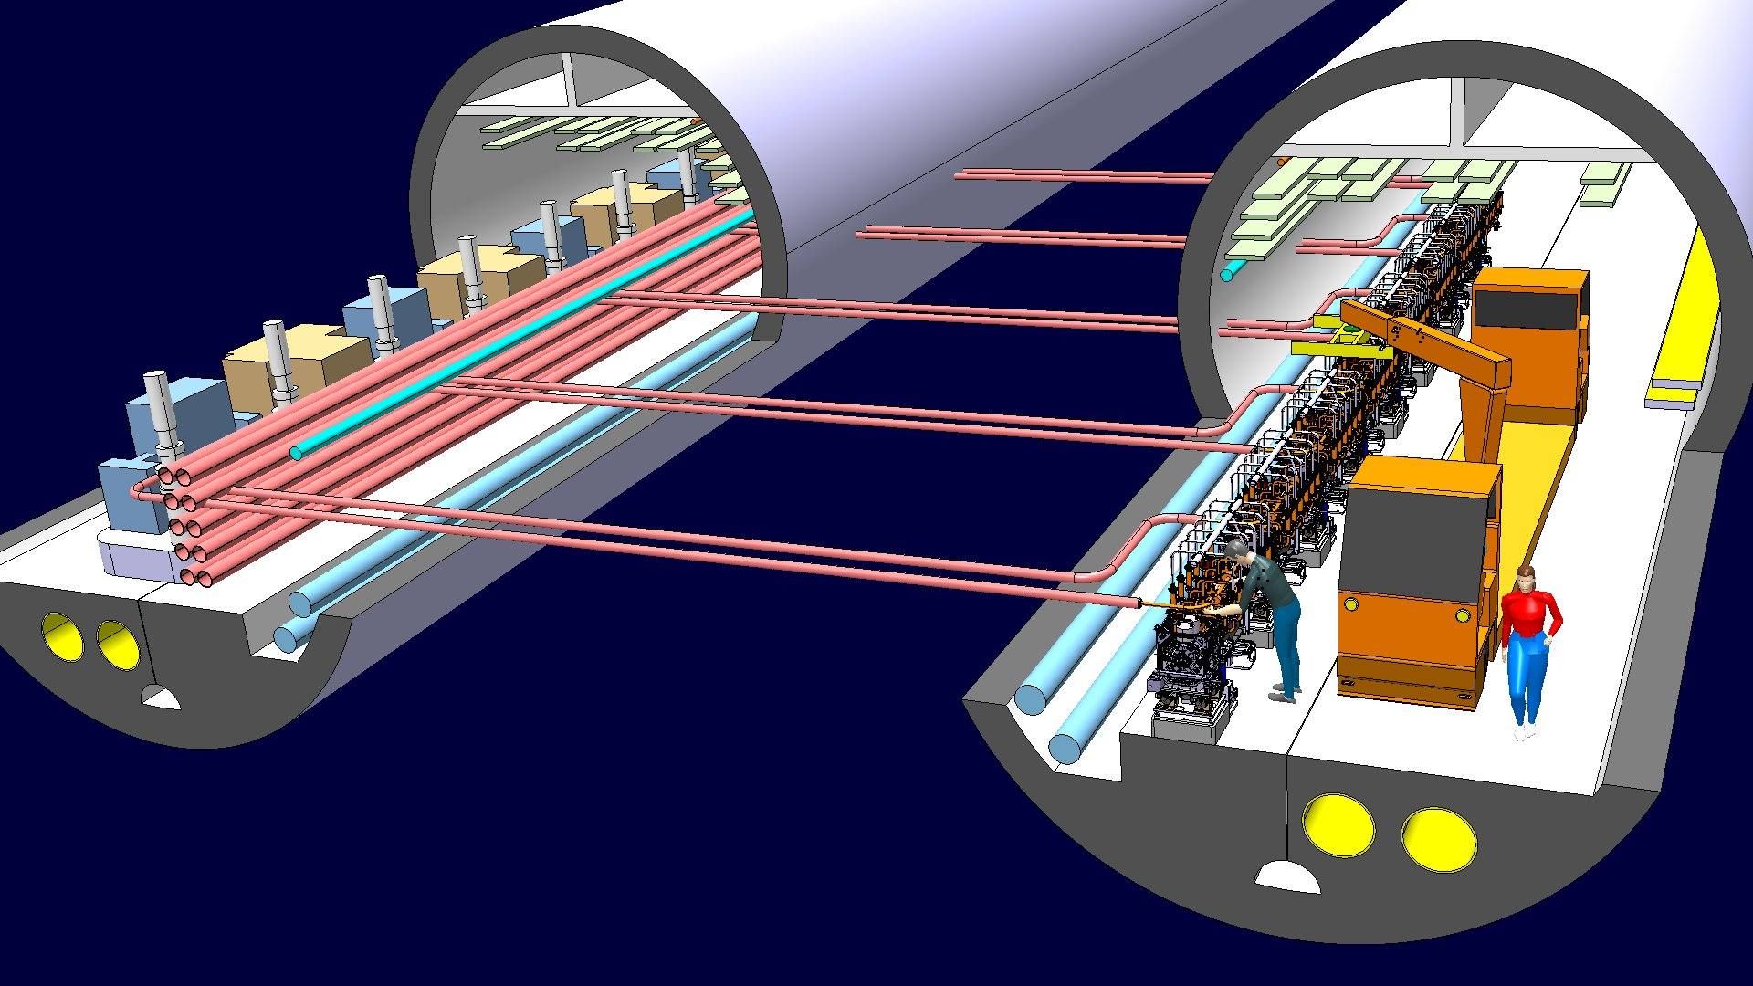
Klystron base module design

Slide 17
Outlook and conclusions
The two beam module program will continue as advised by the module review committee
Good progress in analyzing the data taken on the Lab-module (see as well Helene’s talk), to be continued
Highest priority right now is to get the CLEX module installed and start experiments with it
Will have to review (again) the objectives and configurations of the lab-based module program evolution
Prepare transition to ‘next’ generation modules

Slide 18
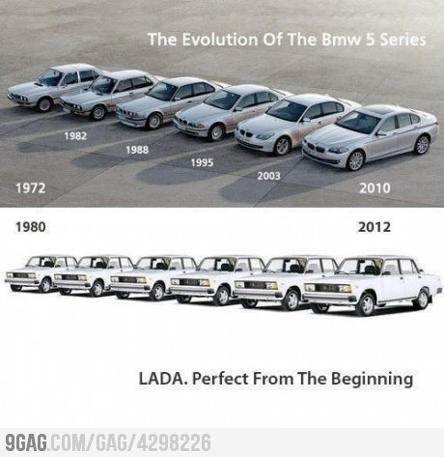
End
Alexandre Samochkine

Slide 19
Phase 2: Duty cycles tests
STEP | # | INPUT
 |  | T_{amb} (°C) | v_{air} (m/s) | Q (W) |  |  |  |  | T_{i,water} (°C) | ΔT_{o,water} (°C)
 |  |  |  | SAS | AS Load | PETS | RFN Load | DBQ |  | SAS | PETS
Nominal operation mode | DBQ only | 20 | 0.7 | 0 | 0 | 0 | 0 | 150 | 25 | 0 | 0
 | Unloaded | 20 | 0.7 | 820 | 178 | 220 | 178 | 150 | 25 | 10 | 6
 | Loaded | 20 | 0.7 | 683 | 137 | 220 | 178 | 150 | 25 | 8.3 | 6
 | DBQ only | 40 | 0.7 | 0 | 0 | 0 | 0 | 150 | 25 | 0 | 0
 | Unloaded | 40 | 0.7 | 820 | 178 | 220 | 178 | 150 | 25 | 10 | 6
 | Loaded | 40 | 0.7 | 683 | 137 | 220 | 178 | 150 | 25 | 8.3 | 6
Failure mode SAS breakdown | Loaded | 20 | 0.7 | 683 | 137 | 220 | 178 | 150 | 25 | 8.3 | 6
 | SAS breakdown | 20 | 0.7 | 0 | 27.4 | 220 | 178 | 150 | 25 | 0 | 6
 | PETS off | 20 | 0.7 | 0 | 27.4 | 55 | 0 | 150 | 25 | 0 | 1.5
 | Loaded | 20 | 0.7 | 683 | 137 | 220 | 178 | 150 | 25 | 8.3 | 6
 | Loaded | 40 | 0.7 | 683 | 137 | 220 | 178 | 150 | 25 | 8.3 | 6
 | SAS breakdown | 40 | 0.7 | 0 | 27.4 | 220 | 178 | 150 | 25 | 0 | 6
 | PETS off | 40 | 0.7 | 0 | 27.4 | 55 | 0 | 150 | 25 | 0 | 1.5
 | Loaded | 40 | 0.7 | 683 | 137 | 220 | 178 | 150 | 25 | 8.3 | 6
Failure mode PETS breakdown | Loaded | 20 | 0.7 | 683 | 137 | 220 | 178 | 150 | 25 | 8.3 | 6
 | PETS breakdown | 20 | 0.7 | 683 | 137 | 55 | 0 | 150 | 25 | 8.3 | 1.5
 | SAS off | 20 | 0.7 | 0 | 27.4 | 55 | 0 | 150 | 25 | 0 | 1.5
 | Loaded | 20 | 0.7 | 683 | 137 | 220 | 178 | 150 | 25 | 8.3 | 6
 | Loaded | 40 | 0.7 | 683 | 137 | 220 | 178 | 150 | 25 | 8.3 | 6
 | PETS breakdown | 40 | 0.7 | 683 | 137 | 55 | 0 | 150 | 25 | 8.3 | 1.5
 | SAS off | 40 | 0.7 | 0 | 27.4 | 55 | 0 | 150 | 25 | 0 | 1.5
 | Loaded | 40 | 0.7 | 683 | 137 | 220 | 178 | 150 | 25 | 8.3 | 6
* EDMS# 1332627
Elena Daskalaki, Alex Vamvakas, Anastasia Xydou

