Slide 1
CERN workshop on “Compact and Low Consumption Magnet Design for Future Linear and Circular Colliders”
Energy management at GSI and FAIR, strategy on energy management,
efficiency, sustainability strategy

Slide 2
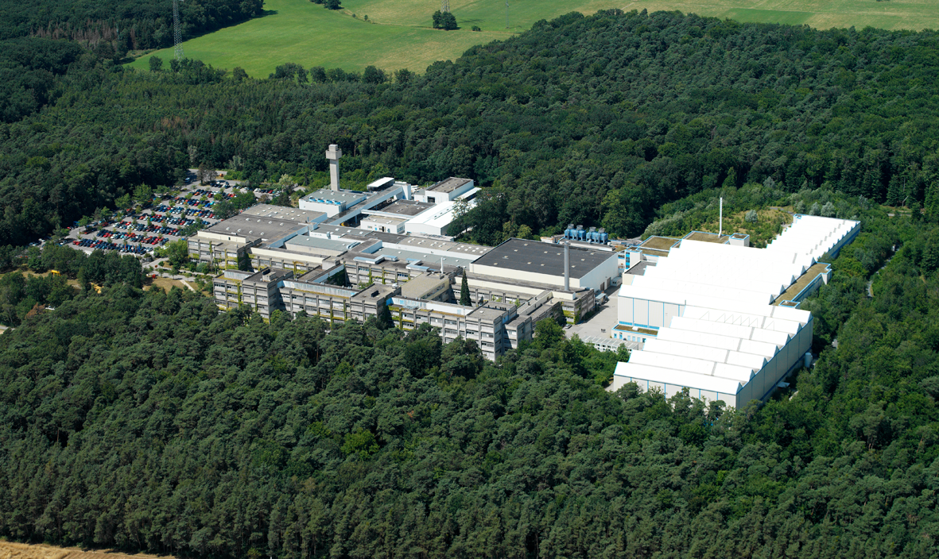
GSI – facts and figures
Foundation | 1969
Associates | Federal Republic of Germany (90%), State of Hesse (8%), State of Rhineland-Palatinate (1%), Free State of Thuringia (1%)
Member | Helmholtz-Gemeinschaft Deutscher Forschungszentren
Mission | Construction and operation of accelerator facilities and research with heavy ions
Budget | €108 million
Staff | 1,075 employees, including 600 scientists and engineers
Visiting scientists | 1,400 scientists from universities and research institutes all over the world, including more than 350 master and doctoral candidates
Apprenticeship | 31 apprentices in technical and commercial professions
Young researchers | approx. 300 doctoral candidates in our graduate school HGS-HIRe for FAIR
Scientific cooperations | Global cooperations with approximately 400 institutes from more than 50 countries
Large facility equipment | Linear Accelerator UNILAC Heavy Ion Synchrotron SIS Experimental Storage Ring ESR Fragment separator FRS Highenergy-/Highperformance Laser PHELIX Several large spectrometer and detector systems Medical irradiation facility for cancer therapy Participation in the ALICE detector of the European Organization for Nuclear Research CERN
Source: GSI

Slide 3
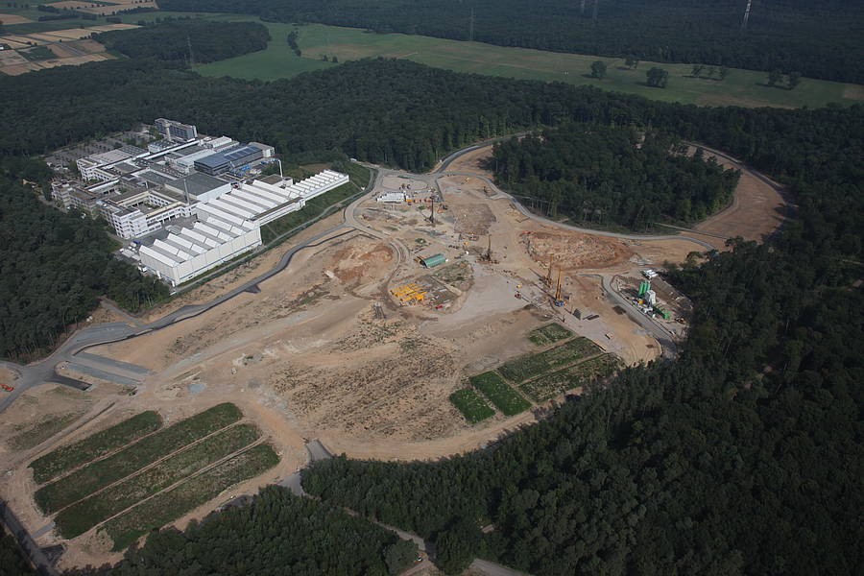
FAIR
FAIR construction site
(July 2013)
Source: GSI

Slide 4
Energy management – yet to be implemented
Typical PDCA cycle in energy management
Energy policy
Objectives and action plans
Energy review
…
Implementation and realization
Operational control
Awareness
…
Plan
Do
Optimization
New strategic goals
Management review
…
Monitoring
Analysis
Corrective action
Preventive Action
Internal Audit
Act
Check
Source: www.wikipedia.de

Slide 5
GSI – Projects and efforts
Energy efficient planning of new buildings
Energy efficient redevelopment of outdated buildings and building services equipment
Green IT – currently highest MFLOPS/W supercomputer located at GSI*
(using watercooling instead of air cooling)
Using backup power generator to minimize peak loads (virtual power plant)
Installation of bus based energy meters at the Low Voltage Main Distribution
Testing of different shutdown modes and the impact on reliebility on e.g. cooling systems
Development of concepts for the FAIR facility
Scientific work e.g. on load based cooling concepts and energy efficiency for magnet systems
Establishing an Energy Efficiency Working Group
Development in monitoring and analysis of energy consumption data
Review of energy consuption in different operational modes and shut down
Reduction of base load
*Source: http://www.green500.org/lists/green201411

Slide 6
GSI - energy consumption in 2012
Common load grid (C1)
Pulse load grid (P1)
Electric energy consumption (GWh)
110 kV
VNB
Common load grid (C1)
20 kV
GSI
Emergency bypass
kW
Load duration curves of P1 and C1 grid in 2012
Summary of load and consumption in 2012
Consumption | Average power 2012 | Energy consumption 2012
Common load grid (C1) | 6,3 MW_{electrical} | 55,5 GW_{helectrical}
Pulse load grid (P1) | 0,8 MW_{electrical} | 7,0 GW_{helectrical}
Natural gas | 2,1 MW_{thermal} | 18,3 GWh_{thermal}
h

Slide 7
GSI - C1 grid load duration curves
kW
C1 grid load duration curves 2009-2012
Beamtime 2012: 5640 h
Baseload 2012
h

Slide 8
FAIR – planned electrical grid connection
Common load grid (C1)
Pulse load grid (P1)
Current electrical energy connection at GSI
two seperate grids due to the high pulse loads (up to 18 MW for 0,5 s) of SIS 18 and ESR
110 kV
31,5 MVA
31,5 MVA
20 kV
GSI
Emergency bypass
Common load grid (C1, C2/3)
Pulse load grid (P2)
Planned electrical energy connection for FAIR
(ready in 5/2017)
110 kV
31,5 MVA
FAIR-South
31,5 MVA
63 MVA
FAIR-North
2 x 63 MVA
20 kV
Emergency bypass

Slide 9
Electrical load at FAIR and GSI
GSI
FAIR
Current structure
Upgrade in progress
FAIR facilities
GSI accelerator and experiments
GSI base load
GSI data center
GSI offices and auxiliary
H=2
Cryring
New southern buildings
Green IT-Cube
Accelerator
Cryo facility
Experiments
Base load
Cooling systems
GSI total electrical energy consumption in 2012:
62.5 GWh
Additionally estimated electrical energy consumption for a typical
operation year:
approximately 360 GWh

Slide 10
Estimated energy consumption distribution for a typical year of operation FAIR

Slide 11
Typical operational scenario of FAIR with modular start version
Beam time fraction
Anti-proton chain from the p-LINAC Filling the pauses caused by beam cooling with ion cycles (PE) Every 15 min the pbar cycle pauses as the accumulation stops and HESR gets into experimental mode
ion cycle including SIS18 and SIS100 slow extraction to SFRS or APPA within slow extraction one more SIS18 cycle
triangular ion cycle for SIS18 and SIS100 beam to CR via SFRS or APPA
SIS18 and SIS100 cycle with slow extraction (4s) to SFRS
ca. 25 MW
ca. 18 MW
ca. 25 MW
ca. 14 MW

Slide 12
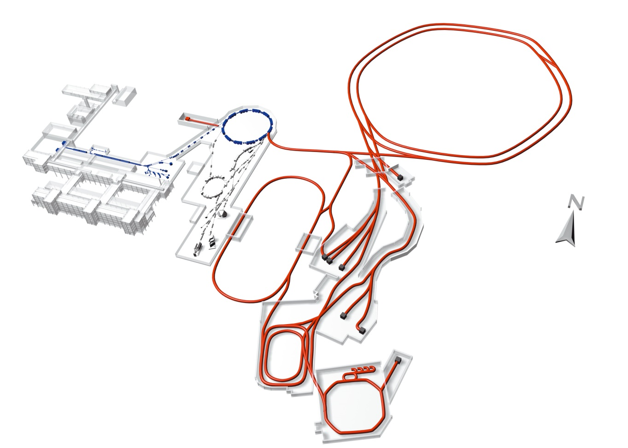
Strategies for energy saving:
Switch off unused part of HEBT
SIS 100/300
HESR
Super
FRS
→
RESR
CR
NESR
Parallel operation of several
experiments require flexible HEBT
Switch off unused part of HEBT
Require control system

Slide 13
Strategies for energy saving:
Pulsing beam lines with low repetition rate
Example: beam line from CR to HESR
DC
pulsed
294 kW
55 kW
Beam line gets beam every 6,5 seconds (fast extraction).
Pulsing the beam line will safe 45 k€ per year.
Power converter upgrade (not build yet) would cost only 13 k€.

Slide 14
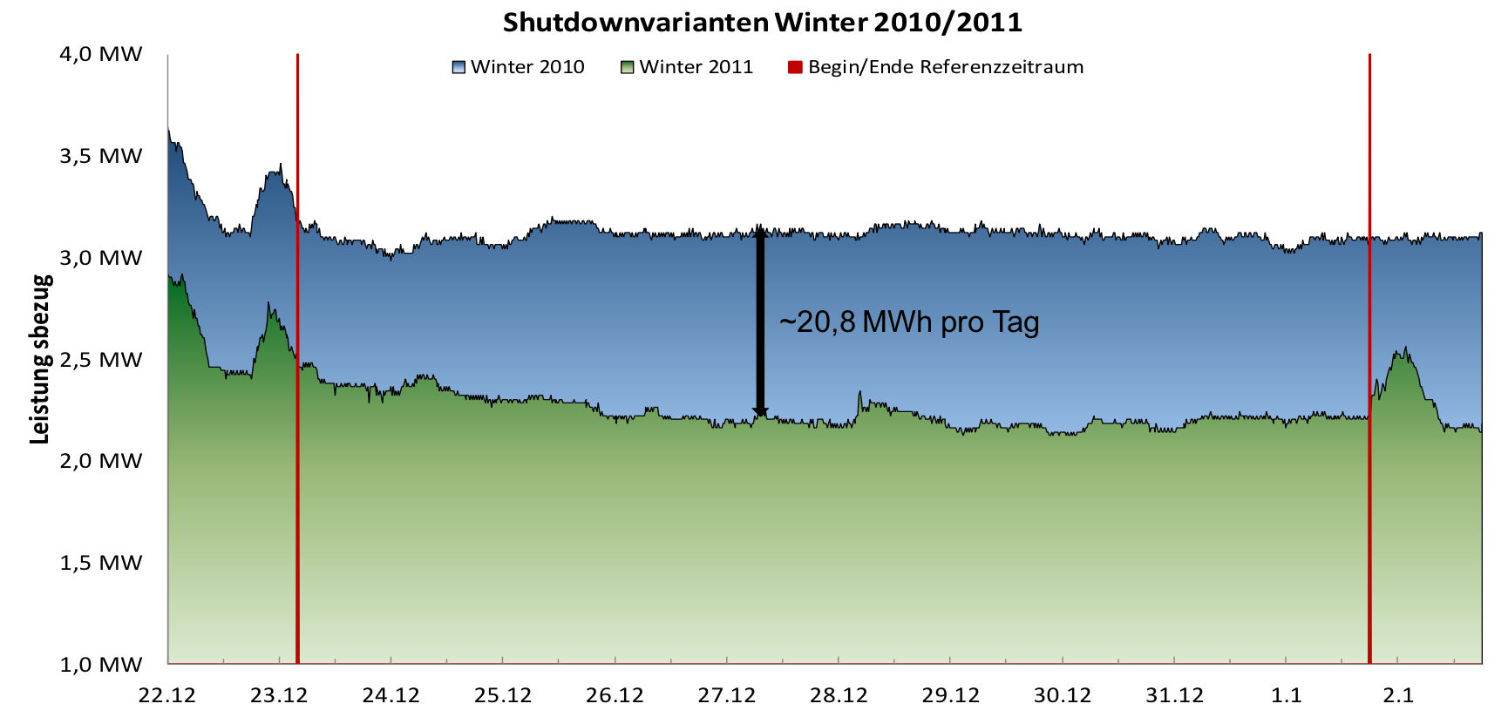
Strategies for energy saving:
Switch off watercooling while Shutdown
(Master Thesis C. Ripp, 2013)
Switch off watercooling while Shutdown → decrease base load by ~20,8 MWh/day

Slide 15
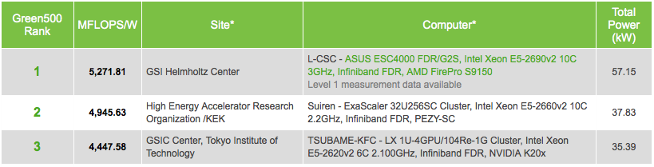
Summary
Realise a Plan-Do-Check-Act cycle for energy management
Examples for energy saving strategies:
  Green IT - currently highest MFLOPS/W supercomputer (H2O instead of air)
  Using emergency power aggregate as virtual power plant
  Switch off unused part of HEBT
  Pulsing beam lines with low repetition rate
  Switch off watercooling while Shutdown

