Slide 1
In-Vacuum Magnet Design and Challenges
Jim Clarke
STFC Daresbury Laboratory and The Cockcroft Institute
Workshop on Special Compact and Low Consumption Magnet Design,
26th November 2014

Slide 2
Overview
Motivation
Additional Challenges
Current Solutions
Practical Experience
Ongoing Improvements
Future Potential

Slide 3
Disclaimer
The topic of this talk is undulators for generating synchrotron radiation
I appreciate that there are other specialised magnets which are also mounted in-vacuum (e.g. kickers and septa) but they will not be covered here

Slide 4
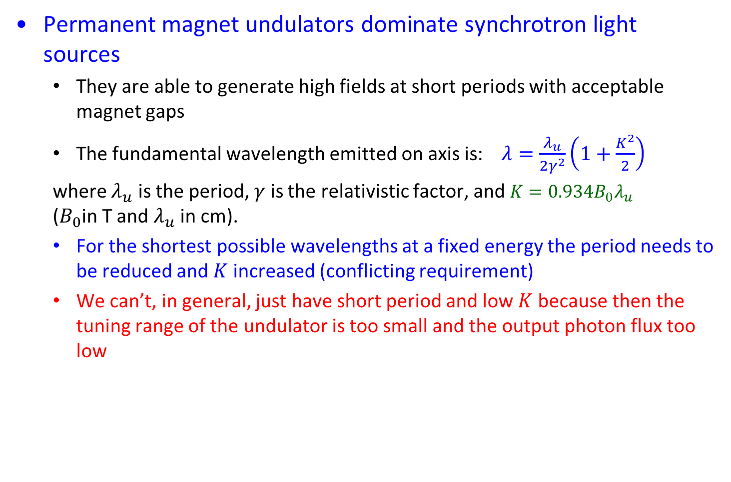
Motivation
Permanent magnet undulators dominate synchrotron light sources
  They are able to generate high fields at short periods with acceptable magnet gaps
  The fundamental wavelength emitted on axis is:$λ=\frac{λ_{u}}{2γ^{2}}\left(1+\frac{K^{2}}{2}\right)$
  where $λ_{u}$ is the period, $γ$ is the relativistic factor, and $K=0.934B_{0}λ_{u}$
  ($B_{0}$in T and $λ_{u}$ in cm).
  For the shortest possible wavelengths at a fixed energy the period needs to be reduced and $K$increased (conflicting requirement)
  We can’t, in general, just have short period and low $K$because then the tuning range of the undulator is too small and the output photon flux too low

Slide 5
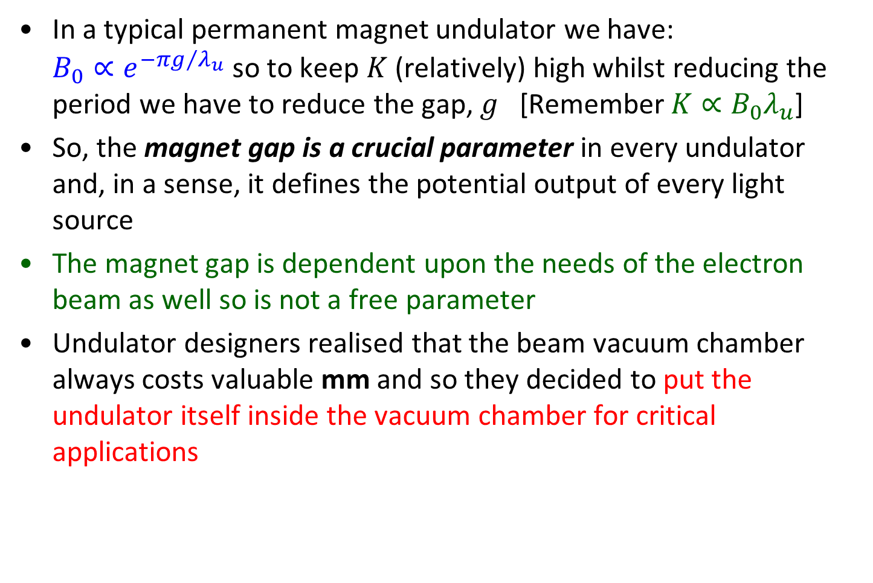
Motivation
In a typical permanent magnet undulator we have:
$B_{0}∝e^{−πg/{λ_{u}}}$ so to keep $K$(relatively) high whilst reducing the period we have to reduce the gap, $g$ [Remember$K∝B_{0}λ_{u}$]
So, the magnet gap is a crucial parameter in every undulator and, in a sense, it defines the potential output of every light source
The magnet gap is dependent upon the needs of the electron beam as well so is not a free parameter
Undulator designers realised that the beam vacuum chamber always costs valuable mm and so they decided to put the undulator itself inside the vacuum chamber for critical applications

Slide 6
Example
For normal out of vacuum undulators, if an electron beam requires 5mm full vertical gap, say, then typically the vacuum chamber might be 1 to 2mm thick and so with allowance for tolerances the magnet gap could be 8 to 10 mm.
If the undulator can be put in vacuum the magnet gap will typically be 5.2mm,
  At 3 GeV, a typical out of vacuum PM undulator with 20 mm period will generate 2.6 to 4.2 keV photons in the first harmonic with an 8 mm gap
  With a 5.2 mm gap, the same undulator in vacuum will generate 1.6 to 4.2keV.
  Alternatively, the period could be reduced to 17.2mm and then the photon range would be 2.6 to 4.9 keV and the flux would be increased by approx 30% compared with the 8mm gap device as well.

Slide 7
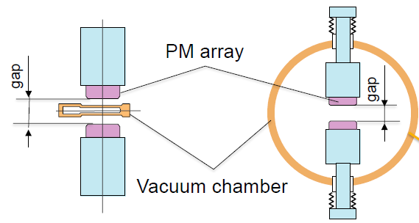


Slide 8
The Challenges of In Vacuum Undulators
Maintaining a suitable vacuum for the electron beam
Coping with wakefield issues
Not being able to make magnet measurements or shimming of the final device
[Approx double cost of standard undulator]

Slide 9
The Beam Vacuum
Storage ring vacuum is very important for beam lifetime and permanent magnets are porous so there was a lot of concern that they could not be used in vacuum in large numbers (a 100 period undulator typically uses ~800 individual PM blocks).
Each PM block is individually coated (~5 μm of Titanium nitride often used but nickel or aluminium also possible)
The undulator design of stacking blocks next to each other and holding them in individual holders against a backing beam naturally creates trapped volumes of gas
UHV engineering practices implemented, trapped volumes minimised as far as possible
Installed pumping of ~7000 l/sec used (ion pump & NEG)

Slide 10
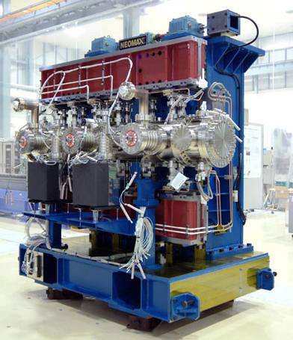
ALS in vacuum undulator – plenty of pumps and vacuum instrumentation

Slide 11
The Beam Vacuum
To attain UHV, baking to several hundred °C is common practice – this is not compatible with PM blocks as causes unwanted and poorly controlled demagnetisation
Bake to ~125 °C still possible with NdFeB (grade dependent – some limitations) and beneficial to vacuum. SmCo can go to higher temperatures but magnetisation strength lower so no overall benefit in terms of peak field.
Need to allow for thermal expansion of arrays during bake.
PM blocks are pre-baked prior to use to make sure even low temperature bake has no effect (stabilising effect).

Slide 12
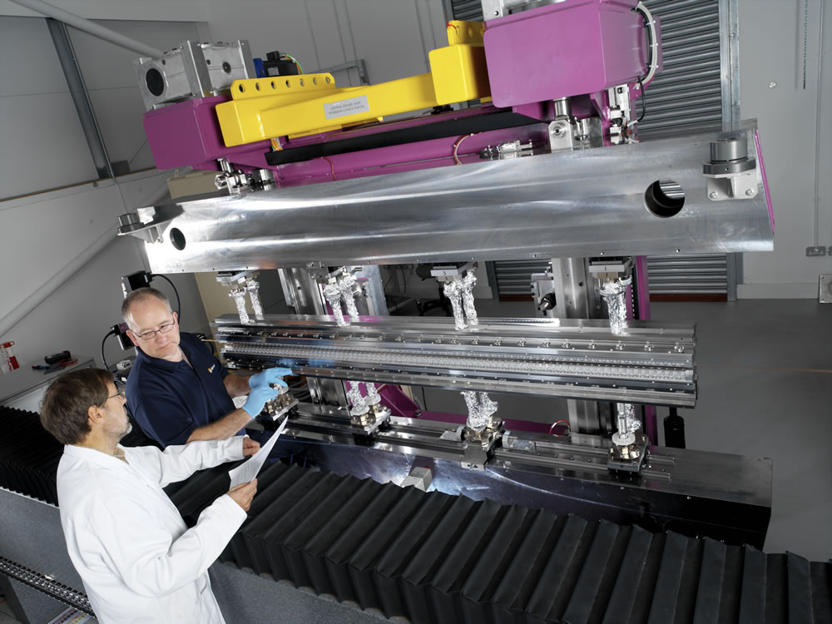
Diamond in vacuum undulator
Out of vacuum part
In vacuum part
Rails allow for thermal expansion

Slide 13
Wakefield Issues
PM Blocks present high resistance surface adjacent to electron beam – resitive wall wakefield very significant, leading to overheating of PM blocks and damage to undulator
Therefore must have continuous conducting surface on top of blocks so electron beam does not see high resistance
Furthermore, must have continuous conducting surface connecting adjacent fixed gap vessels to (moving) magnet arrays of undulator
Lay thin copper foil (50 μm) coated with nickel (50 μm) so held in place over surface of all blocks so beam sees high conductivity surface and wakefields then manageable – early in-vacuum undulator did suffer from damage due to heating effect
Use flexible RF transitions which provide good conducting path from adjacent vessel to moving arrays

Slide 14
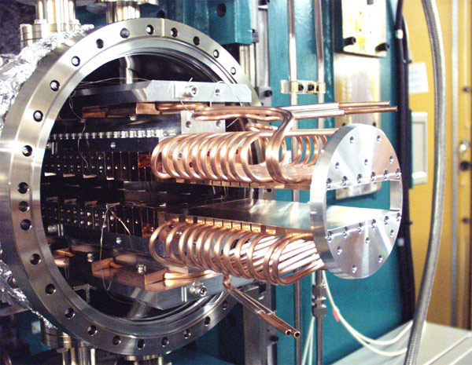
In vacuum examples
Diamond in vacuum undulator
Cooling water for any wakefield heating or synchrotron radiation absorption
Fixed aperture for adjacent vacuum vessel
Flexible transition

Slide 15
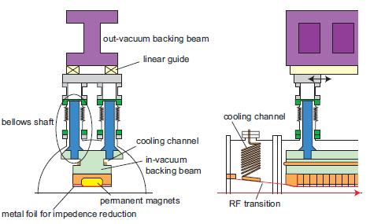
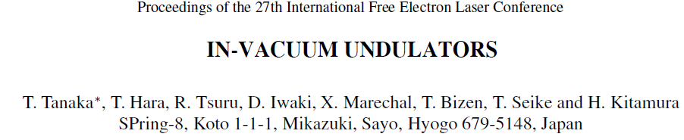

Slide 16
Magnet Measurements
Undulator magnet measurement systems move Hall probe around volume of interest by accessing from the side – far easier than accessing from the end due to aspect ratio – short probe arms!
Can’t measure undulator with this system when outer vacuum vessel in place
Can’t apply shims to undulator when outer vacuum vessel in place
Measure and shim before outer vessel is in place – extra complication – have to make sure demounting the arrays and reinstalling them is very reproducible
Alternative of changing the measurement system so enters lengthways has been developed later when essential for specific applications – results good but certainly more complex

Slide 17
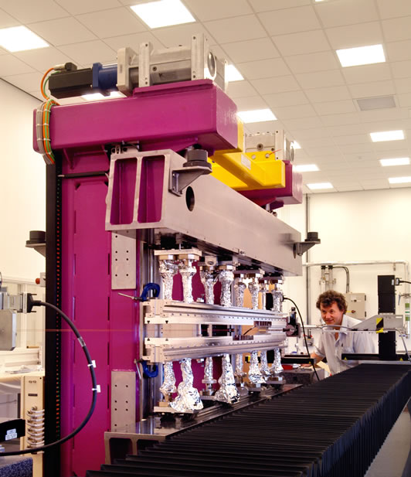
Diamond in vacuum undulator
Out of vacuum part
In vacuum part
Hall probe arm
Rotating coil system
Measurement bench

Slide 18
Experience
The Spring-8 facility in Japan played a major role in making in-vacuum undulators part of the mainstream (~mid 1990s)
Worldwide they are implemented in most modern storage ring light sources and some FELs
They are available from industry and are very reliable
Very good vacuum levels are achieved (10⁻⁹ mbar) and beam lifetime has not suffered from their introduction
A typical minimum magnet gap would be ~4 to ~5mm for a 2m long magnet
Many storage rings ‘top-up’ continuously 24 hrs/day with these magnets in use at minimum gap – electron beam very well controlled
Operating costs low – a few more vacuum pumps but no extra water cooling needed

Slide 19
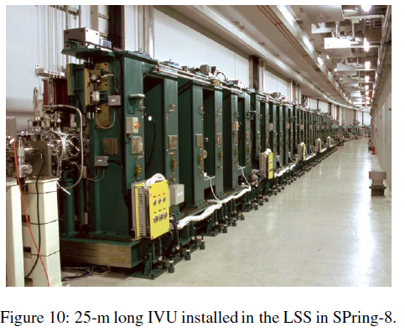

Slide 20
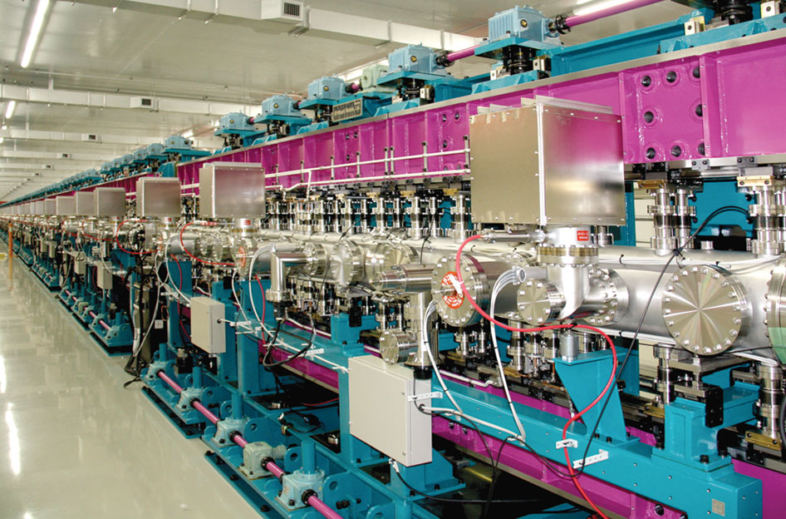
SACLA X-Ray FEL in Japan
18 x 5m undulators
18 mm period
3.7 mm gap
SwissFEL will also rely on in-vac undulators

Slide 21
Improvements
In-vacuum undulators have successfulluy transitioned from R&D in the 1990s to mainstream off the shelf systems today
There have been incremental improvements but fundamentally the same principles are still used
The most significant enhancement has taken advantage of the in-vacuum technology to cool down the PM blocks to increase the magnetisation of the material and so enhance the magnetic fields – so-called cryogenic PM undulators (CPMUs)

Slide 22
Cryogenic PM undulators
Magnetisation increases as temperature decreases, coercivity increases even more – selection of stronger grades possible
Better performance, better vacuum because cold, better radiation damage resistance – lots of advantages
PrFeB better than NdFeB because good at 77K which is easy temperature to generate stably (LN2)
CPMUs have been implemented successfully unbaked
Operating costs increased because of LN2 cooling loop (~250 litres/day)
Operational experience good

Slide 23
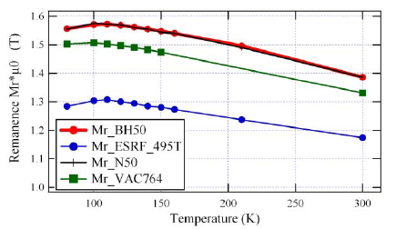
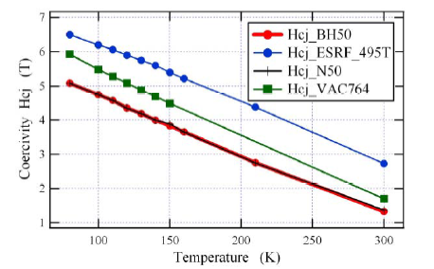
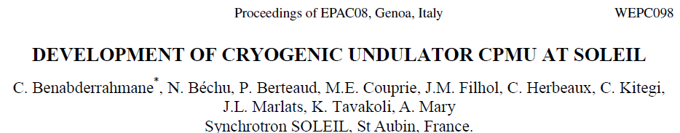
PM Materials
Different NdFeB grades
Spin reorientation at ~100K, don’t want to work at 77K

Slide 24
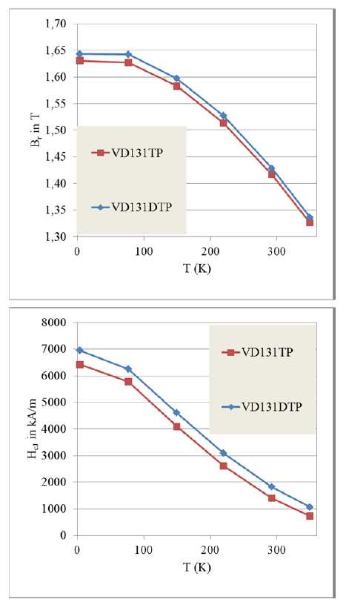
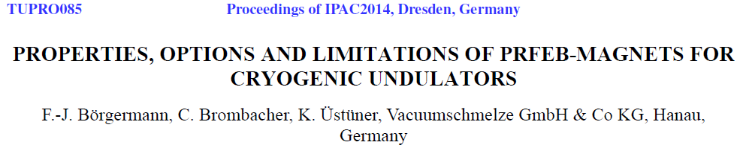
PM Materials
PrFeB or mixed (PrNd)FeB alloys
No spin reorientation
Stable performance, good at 77K

Slide 25
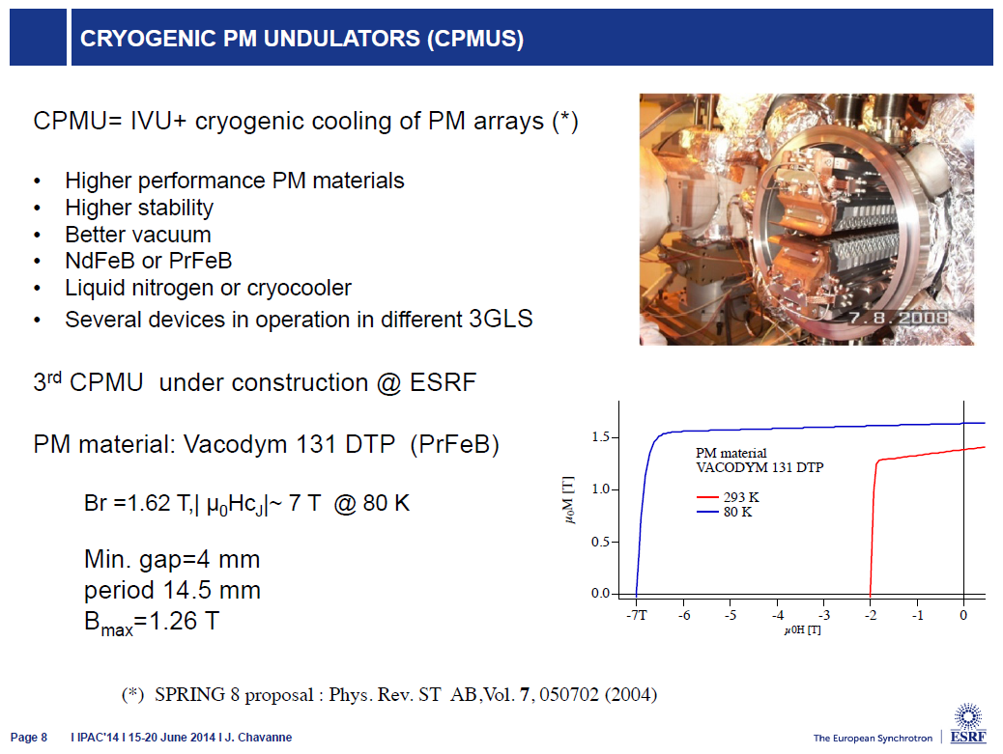

Slide 26
Summary
There is a significant driver to minimise the magnet gap of undulators as far as possible
This has been achieved by putting the magnets inside the beam vacuum
The challenges of maintaining UHV, coping with wakefields, and having to measure and shim before the vacuum vessel is fitted have all been successfully met
Smaller magnet gaps mean lower electron energies (less GeV!) needed for the same wavelength – big energy savings in light sources already generated with this shift to in-vacuum undulators – good news story!
In-vacuum magnets are now considered routine and are available from industry
Putting the arrays in-vacuum has enabled them to be cooled down to take advantage of enhanced PM properties – another beam energy reduction now possible
Remaining Issue: There are many more complex undulator systems (e.g. variably polarising) which could also benefit from smaller gaps but because of the extra degrees of freedom required these are still out of vacuum only (except for one or two prototypes)

Slide 27
Acknowledgements
Thanks to everyone who helped with providing material for this talk, especially Joel Chavanne, ESRF, for his detailed comments on his experiences with IVU & CPMUs

