Slide 1
UPV contribution to medical imaging on the EGEE grid
I. Blanquer (1), L. Martí (2), V. Hernandez (1)
(1) Universidad Politécnica de Valencia – ITACA
(2) Dr. Peset University Hospital

Slide 2

Contents
Objective of UPV’s Activities in Medical Imaging for EGEE.
The TRENCADIS Middleware and its Connection to EGEE.
DICOM Structured Reporting.
Work in Progress.

Slide 3
Objective of UPV’s Activities in Medical Imaging for EGEE
UPV’s Participates in the Biomed Cluster (TNA4.2.2) in the LS3 (Support for Selected Services) and LS4 (Life Science Application Porting Support) Activities.
The Focus of the UPV in Those Activities is on the Support of Structured Radiology Reports and Fostering the Use of AMGA
  Use of Semantic Structuring of Radiology Reports will Also Increase the Exploitation of Knowledge.
  A Key Issue is the Representation of the Metadata From Image Diagnosis Structured Reports.
  It will Complement DICOM MDM and TRENCADIS, Focused on the Images.

Slide 4
TRENCADIS Middleware: Concept
Towards a Grid Environment for Processing and Sharing DICOM Objects
  TRENCADIS Aims at the Development of a Middleware to Create Virtual Repositories of DICOM Images and Reports.
  It Uses a Semantic Model for Organising the Data.
  Data is Encrypted and Decrypted to Ensure Privacy Protection.
  High-Performance Services are Included with the System.
  Architecture Totally Based on WSRF.
Objective: Creation of Virtual Shared Repositories of Medical Images.
  Complementary to PACS.
  Intended Mainly for Research and Training.
  Multicentric and Multiuser.
  Data to be Shared is Explicitly Selected.
  Data is Pseudoanonimised Before Entering in the System.

Slide 5
TRENCADIS Middleware: Data Model
Semantic Organisation
  Users Organise Themselves on Virtual Communities.
  From the Studies Available,
  Only Those Matching the Selection Criteria of the Virtual Community Profile are Accessible.
  From the Images Available to a Virtual Community, a User Can Create an Experiment with the Studies Matching a Set of Restrictions.
  From this Experiment, More Detailed Views can be Obtained.
  The Criteria for the Selection of the Relevant Information Relies on the DICOM Tags of the Image and the Structured Report.
View: (e.g. Patients Between 1 and 2 Years with hetrogeneous Supratentorial Findings)
Experiment:
(e.g Neuroblastoma)
User Comunity
(e.g. Paediatric Neuroimaging)
Global Database: All the Images and Reports Shared

Slide 6
TRENCADIS Middleware: Data Model
Seven Templates Have Been Generated By the Experts
  Report for the Staging of Malignant Liver Neoplasia, Small and Non-Small Cell Lung Cancer and Intraaxial Tumours of Central Nervous System.
  Follow-up Reports for Liver Metastasis, Lung Carcinoma and Intraaxial Tumours of Central Nervous System.
The Reports are Structured and Coded Using the Rules of DICOM-SR.
Standard Coding (Mainly DICOM) Has Been Used When Possible, Following the DICOM-SR Rules To Introduce New Coding Schemas.
The Reports Generate Automatically the TNM Staging Code (From the Radiological Information) in the Cases of Liver and Lung.

Slide 7
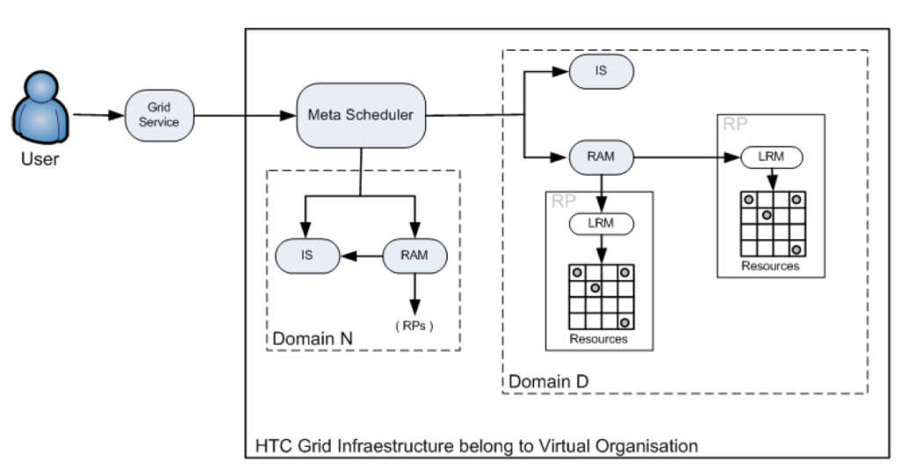
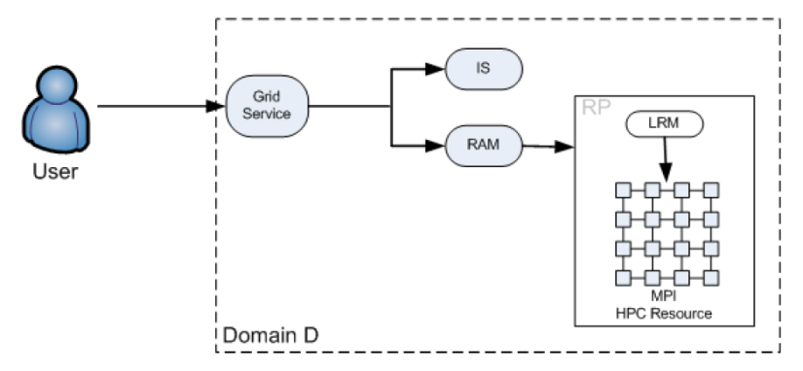
TRENCADIS Middleware: Connection to EGEE
TRENCADIS Uses Different Services Common to gLite and EGEE
  VOMS Authorisation Mechanism.
  gLite HTC and HPC Gateways for the Massive Submission of Jobs.
TRENCADIS Uses its Own Indexing, IS and Storage Systems

Slide 8
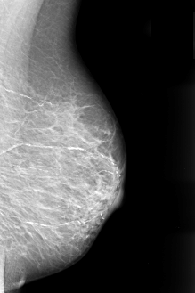
Conventional Report vs. Structured Report
Observation of an Irregular Espiculated Mass of 7mm. of Maximum Diameter,
Located on the inter-quadrant inferior line of the left breast.
The Lesion Comprises Heterogeneous, Linear, grained and branched Microcalcifications
Apparently a Malignant Lesion
Maglinancy
  Based on:
    Mass
      Size: 7mm.
      Shape: Irregular
      Margins: Espiculated
    Associated
      Calcification
        Tipus: Heterogeneous
        Tipus: Branched
    Distribution: Grouped.
Free Text. There is no Structure Defined and Agreed and not Associated to Images.
Structure and Lexicon Defined And Agreed. Associated to Images.

Slide 9
Structured Report
Digital Report:
  Properly Stored and Coded.
  Fields Agreed by the Community.
  Standard Lexicon and Semnatics.
  Links to Images, Audio, Measures and Postprocessing Results.
  Universal Medical Usage.
  Based on Evidence.
  Able to Reflect Experimental Results.

Slide 10
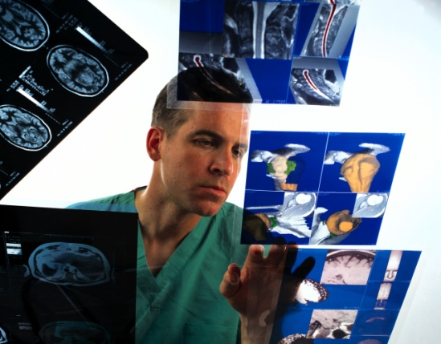
DICOM Structured Reporting: Concept
DICOM Structured Reporting Defines a DICOM-Compatible Format to Specify Structured Electronic Reports.
DICOM-SR Defines, Through DICOM Information Object Definition (IOD) Data Sets and Information Entity (IE) Data Element Objects, the Way to Specify Concepts and Coding Schemas.
DICOM-SR Defines Three IODs
  Basic Text, Enhanced SR, Comprehensive SR.
  IEs are Structured in a Tree-Shape
Each IE a Name / Value Pair, in Which the Name Comprises Three Items: Code Value, Code Schema and Code Meaning.

Slide 11
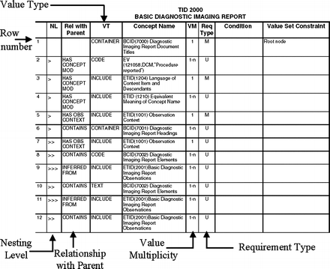
DICOM Structured Reporting: Templates
DICOM-SR Does not Define Which Fields Should be Included.
Templates are Being Provided and Agreed at DICOM
  A Template is a Tree Structure with a Fixed set of IEs.
  Defined in the “DICOM Content Mapping Resource" (DCMR) Supplement.
  DICOM Working Group 15 Provides the Computer-Aided detection Templates for mammography (sup. 50), the chest CAD (sup. 65), patient history (sup. 75), and breast report (sup. 79).
  Other Templates for catheterization, ventriculography, intravascular US, US obstetrics and gynecology, vascular US, echocardiography, and fetal and pediatric echocardiography.

Slide 12
Work in Progress: Support for AMGA Databases
A DICOM Study is then a Pair DICOM-SR + DICOM Images.
  DICOM Images Could be Huge and Comprise from one to Thousands of Files.
    SEs are Good Storage Means (Either TRENCADIS DICOM Interaction Components or MDM SRM DICOM).
  DICOM-SR Require a Relational or Documental Database.
    AMGA is a Good Candidate to Standardise the Interface.
Finding = Malignant Mass
Finding= Mass
Shape= Round
Malignancy
Location= Central
Size= 1,5cm.
Margins= Irregular
DICOM SR Tree
AMGA Schema
Has Properties
Has Properties

Slide 13
Work in Progress: Support for AMGA Databases
Develop three Tools
  Translate a DICOM-SR Template into an AMGA Schema.
  Insert a DICOM-SR File in an AMGA Database.
  Retrieve a DICOM-SR File From an AMGA Database.
Benefit from the AMGA Features
  Security and Authorisation.
  Replication and Reliability.
  Efficiency and Performance.
  Standardisation and Availability of Services.

